Slide 1








Rhetoric and Propaganda
in China
—— Chen Shumin, Qin Shiya
2022.11.18

Slide 2
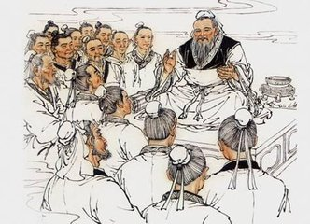
壹
You will be given several pictures
Please recognize:
What the pictures are about?

Slide 3

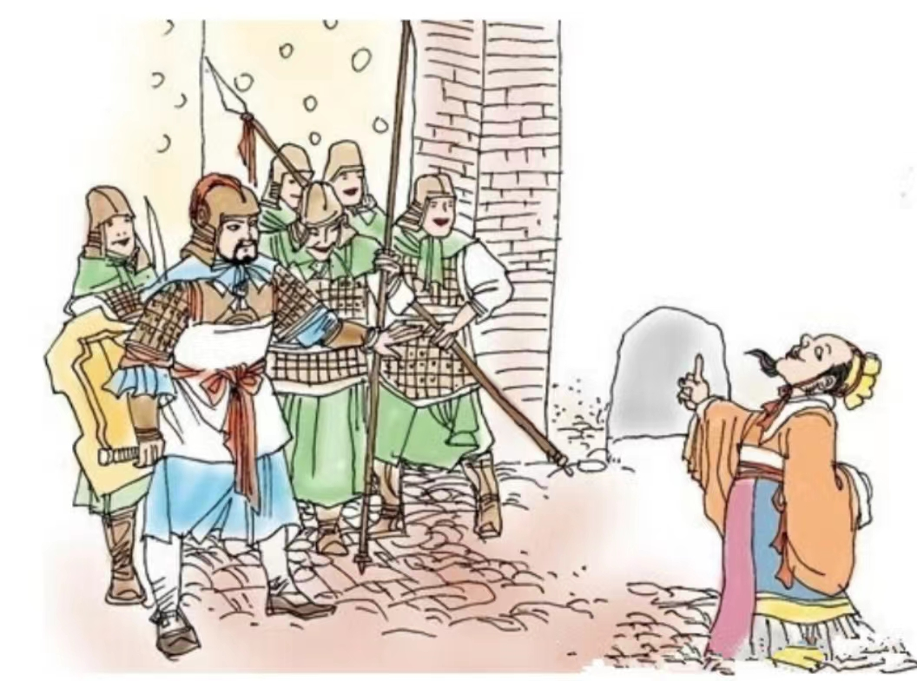
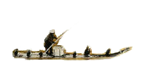
a dog door
晏子使楚（Yan Zi Shi Chu/ Yan Zi’s mission to Chu state)

Slide 4
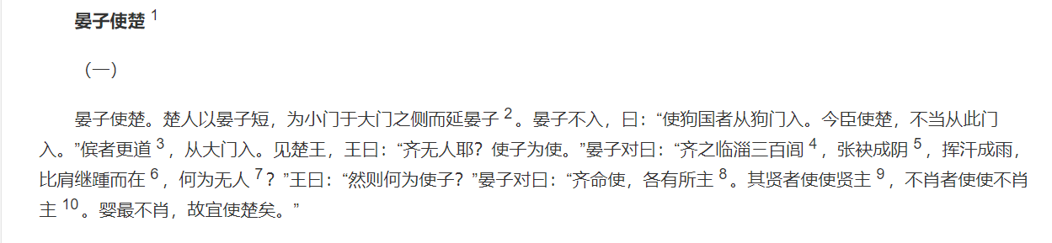
what did Yan Zi use to convince the king of Chu?
remarkable eloquence and subtle language
Yan Zi was ordered to go to Chu state as an official in Qi. The king of Chu prepared to play tricks on Yan Zi to humiliate his small stature. When Yan Zi got to the gate of Chu state, a soldier only opened a small door and said,
“ Welcome to our state, I think it’s high enough for you to go into.”
Yan Zi said very calmly, “ Okay, since I visited the kingdom of dogs, it’s reasonable to get in from the dog door.”
The king of Chu had to ask the soldier to open the gate for him.

Slide 5
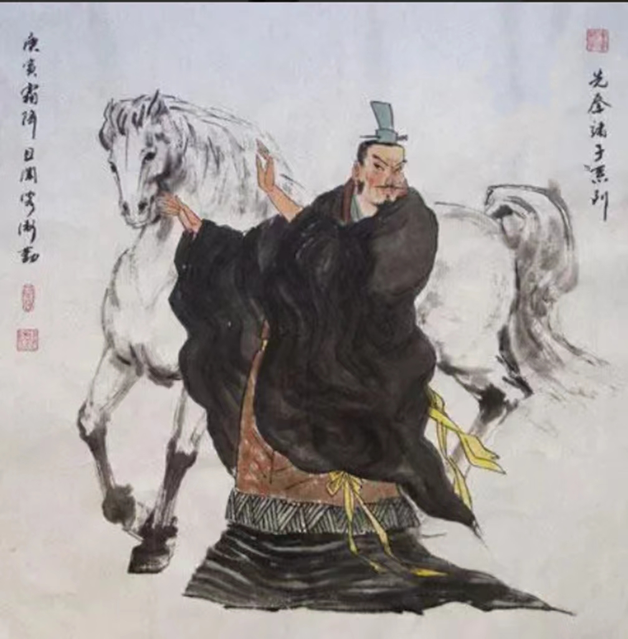
No! It’s not a horse!
公孙龙Gong-sun Long
白马非马（White horse isn’t horse)

Slide 6
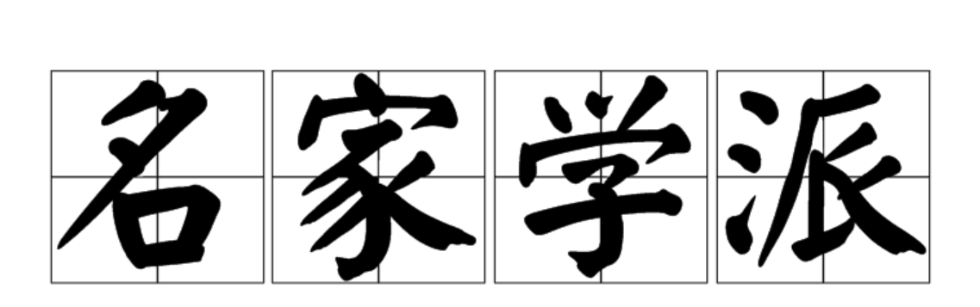
the School of Logicians
辩士（bian shi/ debaters)
many debaters were born in this school to advertise their ideology, like the identify between “名ming” and “实shi”.

Slide 7
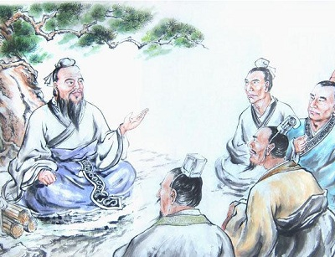
壹
Rhetoric and Propaganda
Both are very old discipines, they have established a set of tools to reach the goal to persuade people.

Slide 8

贰
1. Rhetoric
1.1 Definition
1.2 Comparison Between China and Greek
2.Propoganda
1.1 Definition
1.2 Comparison Between China and the Western
3.Conclusion
Content

Slide 9
Rhetoric
--Definition
In ancient Greece, a rhétōr was a ‘public speaker’, or an ‘orator’. So, rhetoric means the technique and rules for using language effectively (especially in public speaking).
We often use it to change others' thoughts or ideas, so as to persuade others.

Slide 10
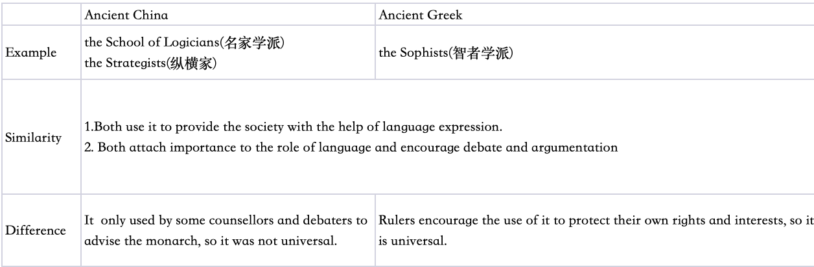
Rhetoric
--Comparison

Slide 11

Propoganda
--Definition
The spreading of ideas, information, or concepts for the purpose of advertising for an institution, a cause, or a person.
We often use it to carry forward a certain idea, especially society systems,research methods or political ideas.

Slide 12
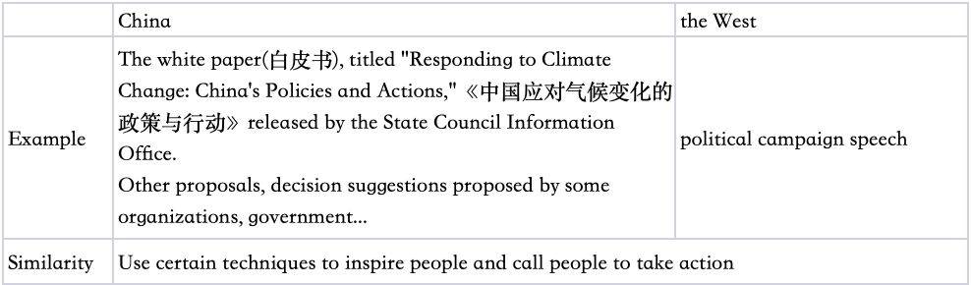
Propoganda
--Comparison

Slide 13
Conclusion
As can be seen from the above examples, no matter the status or appearance, as long as a good eloquence and the use of speech skills, no matter in ancient or modern times, in China or the West, will attract people's attention. And if we want to persuade certain people to do something, we can use Rhetoric and Propoganda to achieve our objectives.

Slide 14
Reference
Edward. M.C.& John. E.S. Aristotle Rhetoric. Cambridge Press, 2010.
Xing. L.&Xing.L.J. Rhetoric in Ancient China, Fifth to Third Centuty B.C.E.: A Comparision with Classical Greek Rhetoric. University of South Carolina Press.1998.
Xia.P. 夏帕. 2014年. 普罗泰戈拉与逻各斯：希腊哲学与修辞研究. 吉林出版集团有限公司.

Slide 15
感
谢
观
看
Thanks for watching

