Slide 1
Academic Titan:
Qian Zhongshu

Slide 2
Table of
Contents
A Brief Introducion of Qian Zhongshu
Literary works of Qian
Anecdotes of Qian

Slide 3
1. A Brief Introducion of Qian Zhongshu

Slide 4
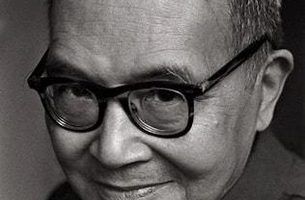
Ch’ien Chung-shu (1910-1998), styled Mocun(to keep a low profile and speak less), is a well-known scholar, writer, translator and literary researcher in contemporary China. He was born in an education family in Wuxi, Jiangsu Province.

Slide 5
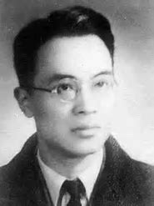
In the autumn of 1929 (the 18th year of the Republic of China): Qian Zhongshu was admitted to the Department of Foreign Languages at Tsinghua University.
In the spring of 1932 (the 21st year of the Republic of China):Yang Jiang, who would later become Qian’s wife, was admitted to Tsinghua University from the Department of Politics at Soochow University, and the two met for the first time.

Slide 6
In the summer of 1935 (the 24th year of the Republic of China): Qian was selected as a recipient of the third session of the British Boxer Indemnity Scholarships by the Ministry of Education. He then returned to his hometown of Wuxi to marry Yang Jiang and departed for the United Kingdom with her to pursue further studies.

Slide 7
In 1937 (the 26th year of the Republic of China): Qian graduated from the Oxford University and declined the university’s offer to stay on as a lecturer. Instead, he and Yang Jiang went to the University of Paris to study French literature.
In 1938 (the 27th year of the Republic of China): Qian, together with his wife and their daughter Qian Yuan, returned to China by ship from France.

Slide 8
2. Literary works of Qian

Slide 9
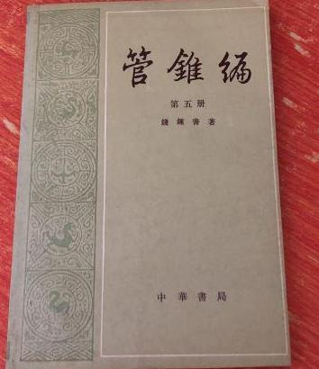

Limited Views: Essays on Ideas and Letters

Slide 10
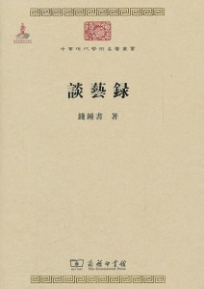
Patchwork: Essays on Art and Literature

Slide 11
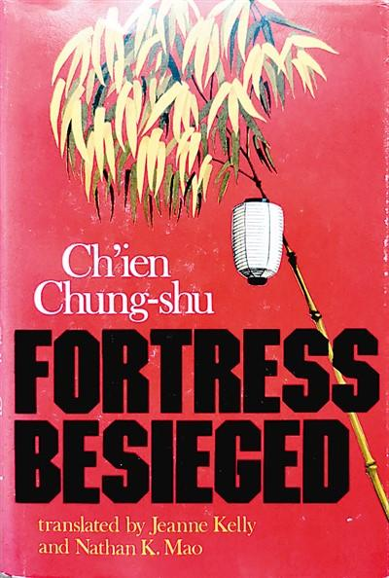
Fortress Besieged

Slide 12
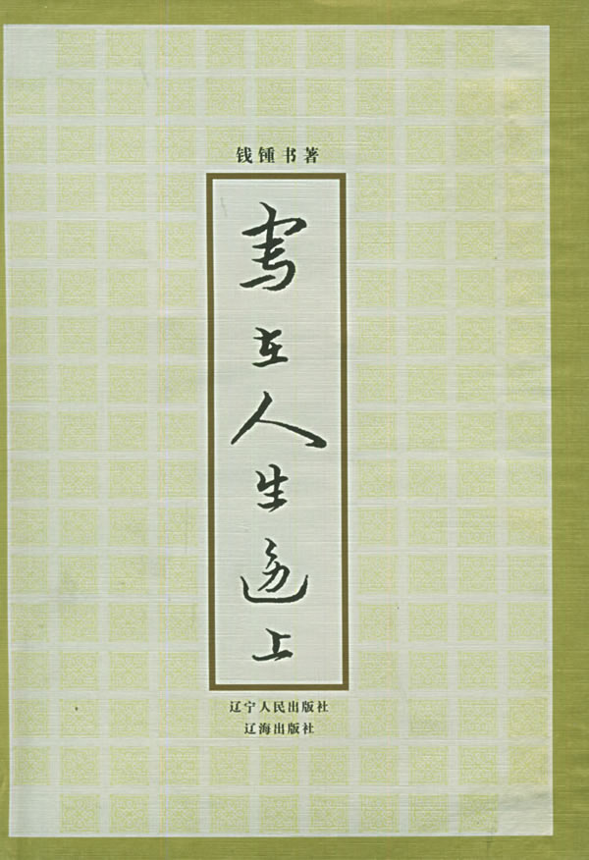
Written in the Margins of Life

Slide 13
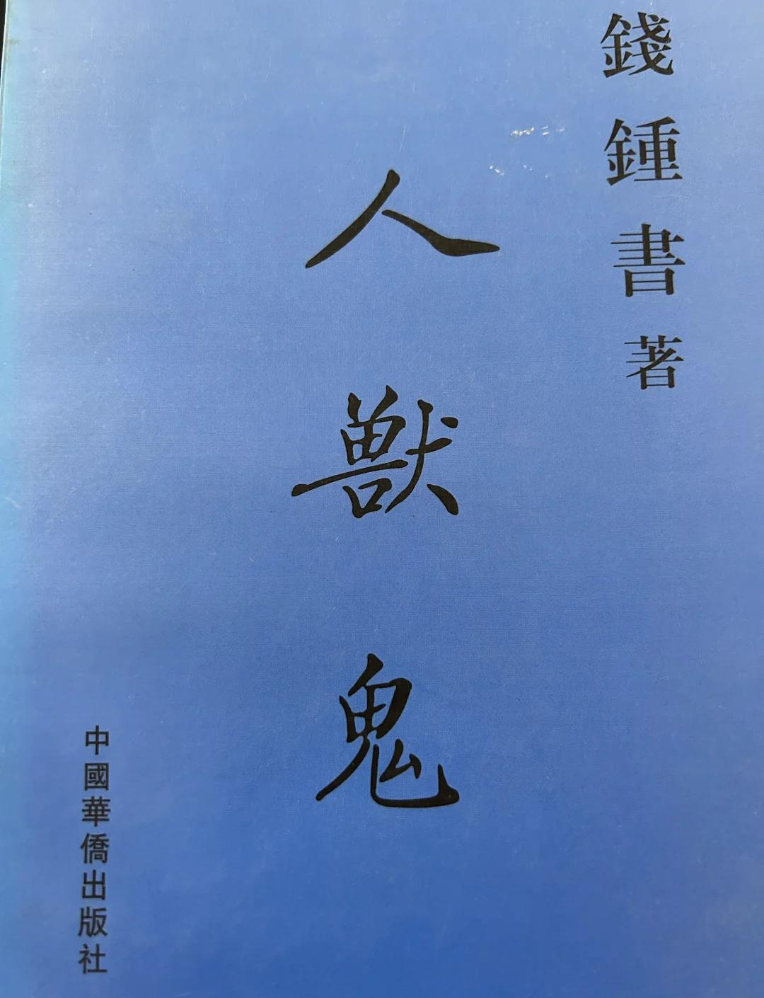
Humans·Beasts·Ghosts

Slide 14
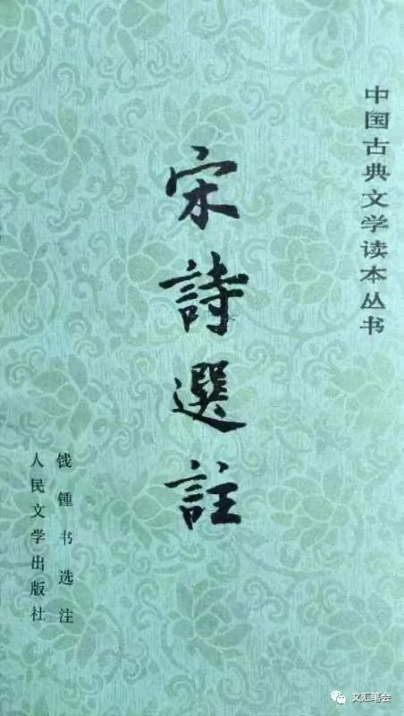
Selected Poems of the Song Dynasty

Slide 15
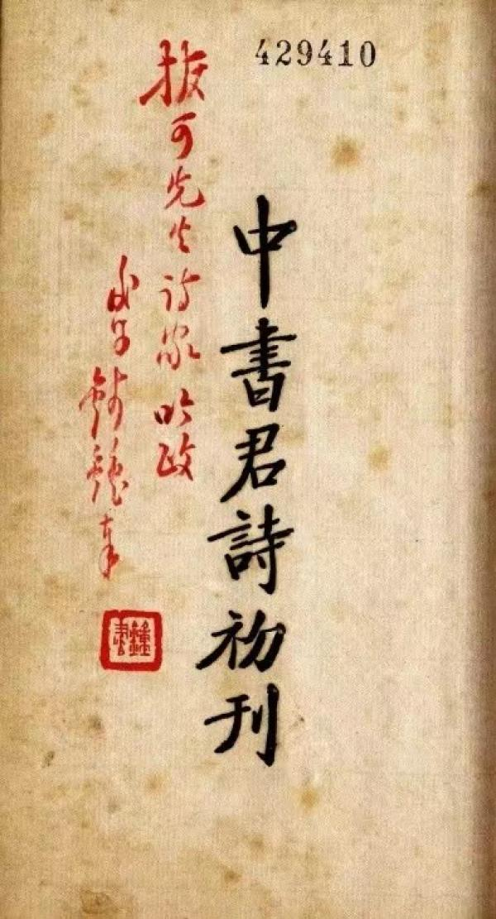
The First Edition of Poems by Zhongshu Jun

Slide 16
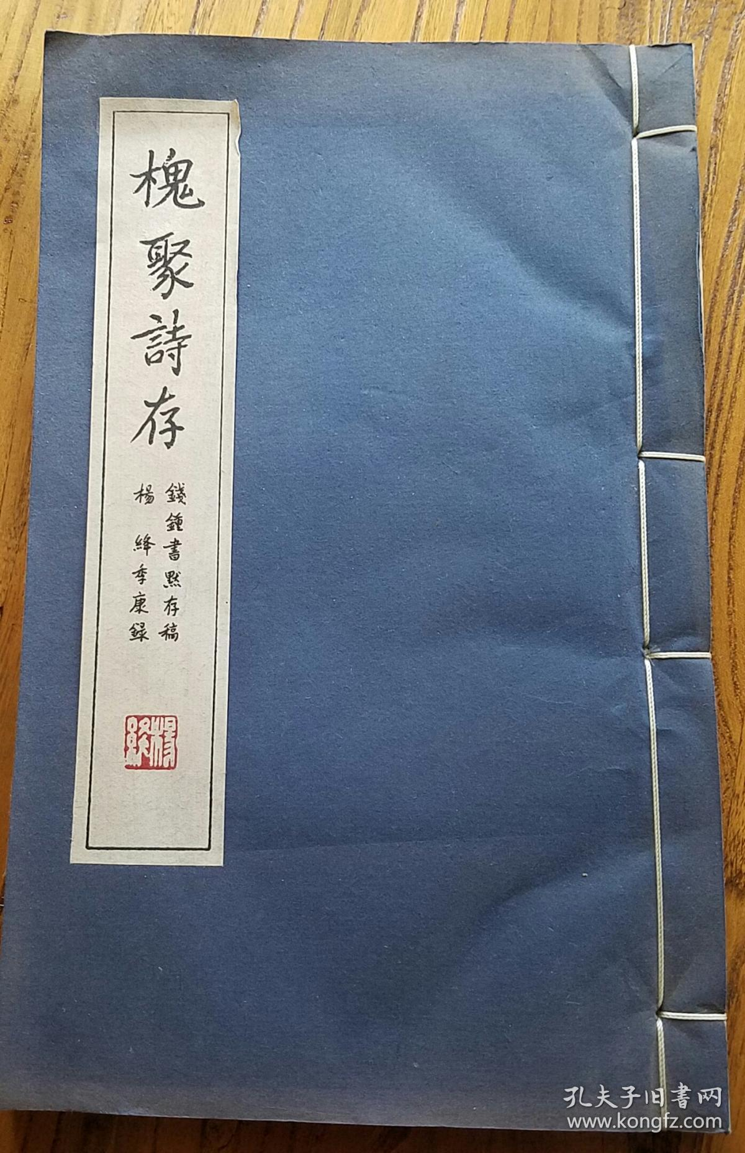
Huai Ju Shi Cun

Slide 17
3. Anecdotes of Qian

Slide 18
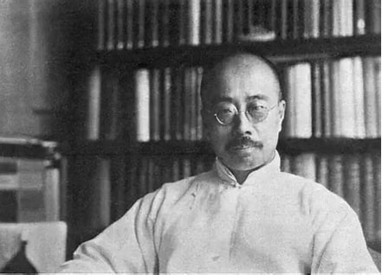
Qian Zhongshu and Zhou Zuoren
In his novel “The Cat,” Qian Zhongshu satirized the integrity of Zhou Zuoren through the figure of Lu Bailing. Lu Bailing is described as an old man with a small tuft of Japanese-style mustache, who is extremely pro-Japanese. And like Zhou Zuoren, he also advocates “humor” in writing.
Qian Zhongshu wrote: “Apart from sunflowers, there is probably no one or thing in the world more pro-Japanese than Lu Bailing.” This portrayal is believed to criticize Zhou Zuoren’s collaboration with the Japanese during the war.

Slide 19
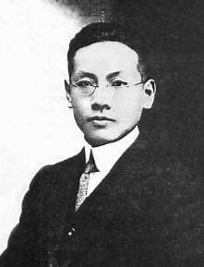
Qian Zhongshu and Wumi
Wu Mi was Qian Zhongshu’s teacher at Tsinghua University and once praised him as a “dragon among ordinary men.” However, during his study abroad, Qian Zhongshu published a book review titled “Mr. Wu Mi and His Poetry,” in which he heaped some sharp criticisms upon Wu Mi’s poetry and personal character. This review deeply hurt Wu Mi and led to a period of tension between the two.
Years later, when Qian Zhongshu was asked to write a preface for Wu Mi’s Diary, he reflected on his youthful arrogance and disrespect towards his teacher. He expressed deep remorse for his past actions and condemned his own immaturity. This act of self-reflection and apology helped to mend their relationship.

Slide 20
Thanks for your times and attention!

