Slide 1
Seal-cutting
篆刻
Zhao Xi 赵茜
Zhang Yu 张瑜

Slide 2
Contents
Part 1 Development of Seal-cutting
Part 2 Masters of Seal-cutting
Part 3 Translation Methods

Slide 3
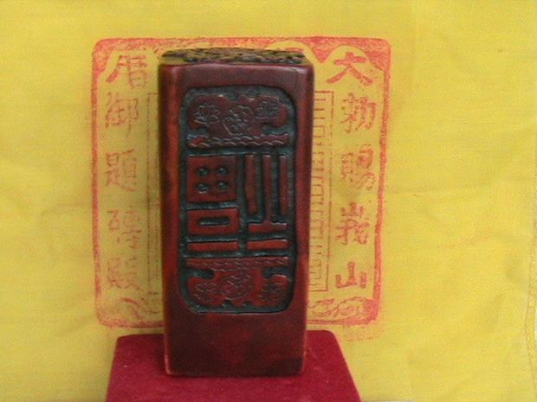
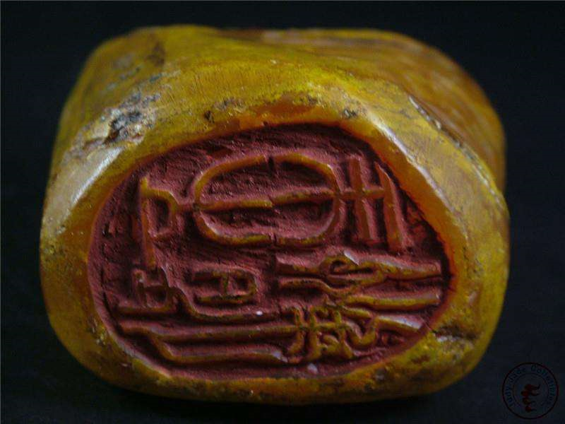
Wooden Chinese Seal

Slide 4
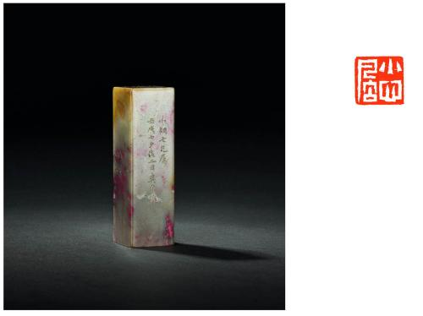
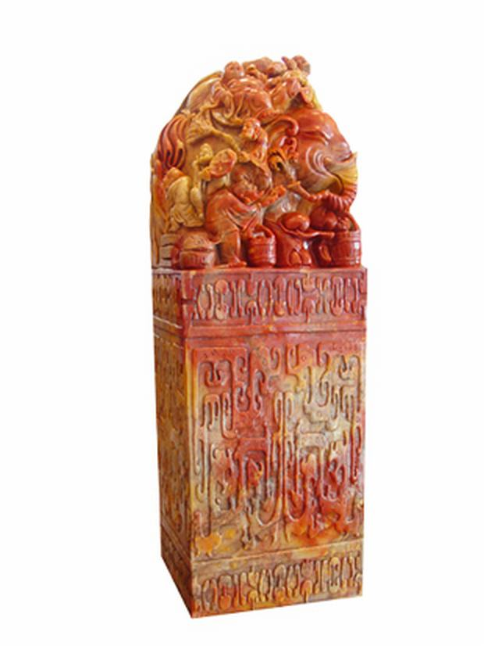
Stone Chinese Seal
Bloodstone-made Chinese Seal

Slide 5
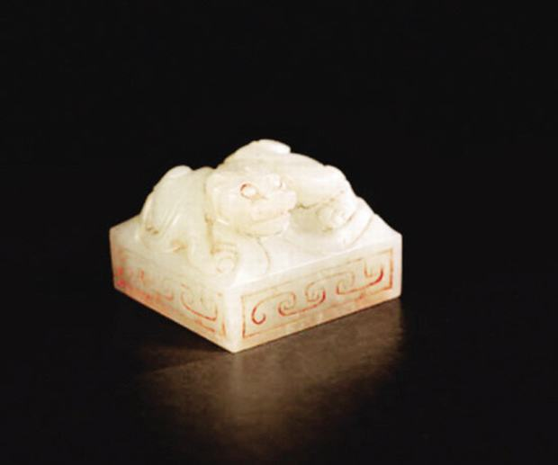
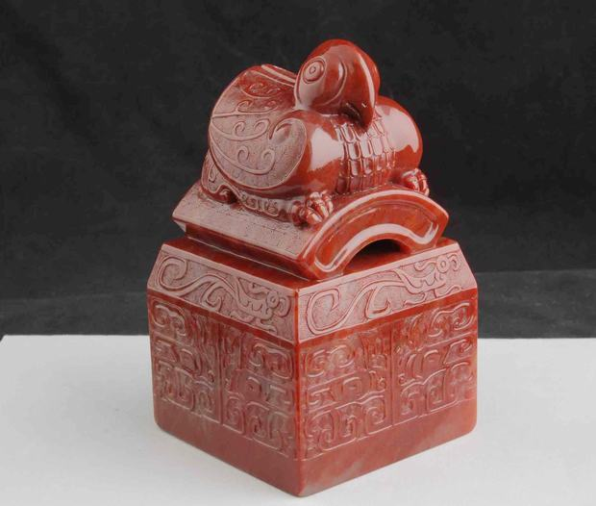
Jade Chinese Seal
Red Jade Chinese Seal

Slide 6
Development of Seal-cutting

Slide 7
Development of Seal-cutting
Shang Dynasty
Qin and Han Dynasties
Wei and Jin Dynasties
Emergence
Flourishing period
Decline period

Slide 8
Sui, Tang and Song Dynasties
Yuan and mid-Ming Dynasties
Late Ming and Qing Dynasties
Incubation period
Turning point
Prosperous period

Slide 9
Masters of Seal-cutting
Wen Peng
Wu Changshuo

Slide 10
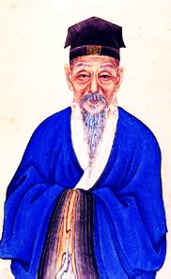
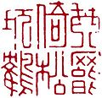

Wen Peng 文彭
The son of painter Wen Zhengming
The founder of modern seal-cutting
Founded the Wumen School of seal engraving
琴罢倚松玩鹤 江风山月

Slide 11
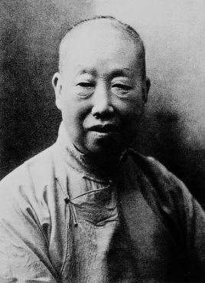
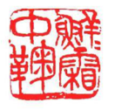
Wu Changshuo 吴昌硕
A Chinese seal carver, painter, and calligrapher
Learned seal carving from the Zhe and Anhui schools
Influenced by the stone carving of the Qin and Han dynasties
鲜鲜霜中菊

Slide 12
Translation Methods

Slide 13
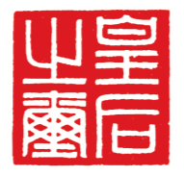

Transliteration
仁和魏锡曾稼孙之印
Ren He Wei Xi Zeng Jia Sun Zhi Yin
皇后之玺
Huang Hou Zhi Xi
司马玺
Si Ma Xi

Slide 14
Transliteration + Literal Translation
将军印 Jiang Jun Yin, General’s seal
急就章 Ji Jiu Zhang, haste seal
《苏氏印略》Su Shi Yin Lüe,
Impressions of Sushi's Seal Engraving
《小瑯 环 室 藏 印》Xiaolanghuanshi Cangyin,
Impressions of Seals Collected in Xiaolanghuanshi

Slide 15
Thanks for listening!

