Slide 1
Empresses of China
Lü of Han
Wu Zetian of Tang
Cixi of Qing
By: Mallory Wilsted

Slide 2
How did empresses gain power?
Many empresses gained power after the death of their husband
They were then given the title “Dowager Empress”
Most of the time, Empresses would act as regent for child emperors or emperors who were incapable of ruling

Slide 3
Concubines
Many empresses started as concubines
Chinese term for concubine is qie
  A woman who lives with a man and his legal wife
Concubines were ranked between paid servants and the legal wife
Were able to raise their rank if they bore sons
After gaining power in the household, some concubines could gain political power if they were the concubines of the emperor

Slide 4
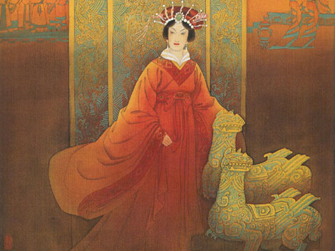
Lü of Han
I was the wife of Kao-ti, who was the founder of the Han dynasty
  He was also known as Liu Bang
My son, Hui-ti, became the second Emperor, but he died in 188 B.C.

Slide 5
Lü of Han
A son of his consort was made emperor, Shao-ti Kung
After 3 years, he was replaced by Shao-ti Hung. Another child
I was given the title “Grand Empress Dowager”
I never claimed title as Empress of my own

Slide 6
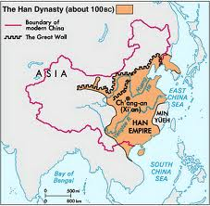
Lü of Han
I ignored an oath signed by Kao-ti and his followers
  I nominated 4 of my family members as kings
  I elevated 6 others to marquis
  I posted other family members as generals
By appointing family members, I was able to command forces that were encamped in Ch’ang-an,

Slide 7
Lü of Han
I died in 180 B.C.
Before I died, I had appointed family members as Chancellor of State and General of the Army
  The 2 most senior posts
My family wanted to eliminate the imperial house of Liu, but the 3 descendants of Kao-ti still had kingdoms
  Ch’u, Huai-nan, and Tai
They eliminated my family

Slide 8
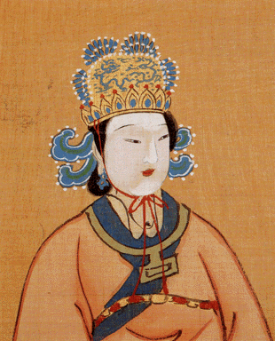
Wu Zetian of Tang
627-705
I was Gaozong’s concubine
Influenced him so much I replaced his previous empress
When Gaozong suffered from a stroke in 660, I took control of the Empire

Slide 9
Wu Zetian of Tang
I had 2 sons and many people thought they should rule while their father was ill
    Unfortunately both died, one from suicide
Gaozong died in 683
His heir, Zhongzong, wanted to put his father-in-law in power.
  I stepped in to prevent this from happening
  I exiled Zhongzong and made Ruizong, another son of Gaozong emperor

Slide 10
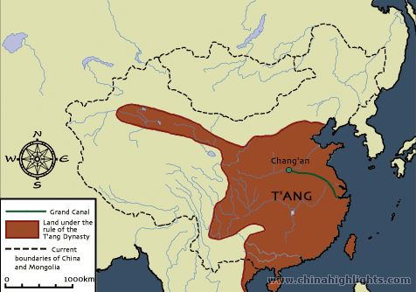
Tang Dynasty

Slide 11
Wu Zetian of Zhou
I idealized the early Zhou Dynasty
In 688 a stone was found with a prophecy
  "A Sage Mother shall come to rule mankind; her rule shall bring eternal prosperity“
In 690, I assumed full imperial power and started a new dynasty
  I named it Zhou
During this time there was a rise in Buddhism, and traditional ruling was entangled with Buddhist prophecies

Slide 12
Wu Zetian of Zhou
One of these prophecies of a bodhisattva called Maitreya-
  "who would come to save the cosmos and its people from apocalyptic disaster.“
My lover Xue Huaiyi had a commentary on a text, the Great Cloud, and said Maitreya would come as a female
  He argued I was Maitreya
I added Maitreya to my title in 694

Slide 13
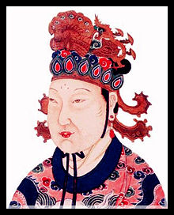
Wu Zetian of Zhou
In 695, after some uprising and the death of Zue, I gave up that title
I brought Zhongzong out of exile
In 705 I was forced to abdicate and by the end of the year I was dead

Slide 14
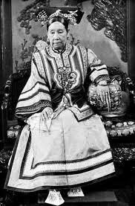
Cixi of Qing
1835-1908
I was a concubine of Xianfeng
  I had his only son
Xianfeng died in 1861
My 5 year old son was made emperor
  Tongzhi

Slide 15
Cixi of Qing
I staged a coup d'état with the help of Prince Gong and was coregent with the Empress Ci’an
My son died in 1875, and my three year old nephew was made Emperor
In 1898, Guangxu was mature enough to rule on his own.
  I moved to the summer palace, but I was kept informed

Slide 16
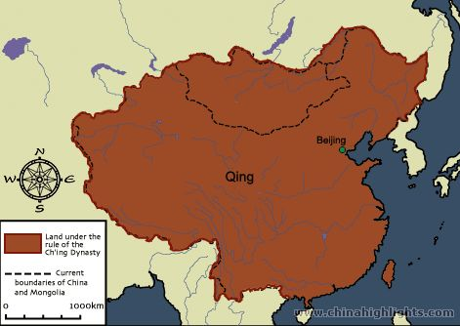
Qing Dynasty

Slide 17
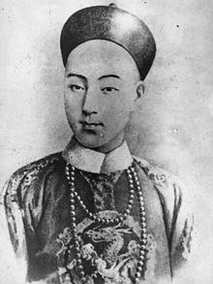
Cixi on Reform
There was a push for reform
Guangxu called on Kang Youwei to help with reform
  Kang was a leader of a group urging for modernizing and presented Confucius as an “institutional innovator and proponent of change.”
Guangxu

Slide 18
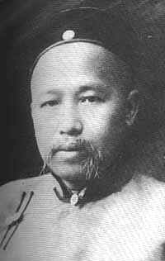
Cixi on reform
With Kang’s help, Guangxu passed many edicts for reform in education, government, and commerce
After 3 months, I locked up Guangxu and executed all of the reformers I could find
  Kang managed to escape to Japan
Kang Youwei

Slide 19
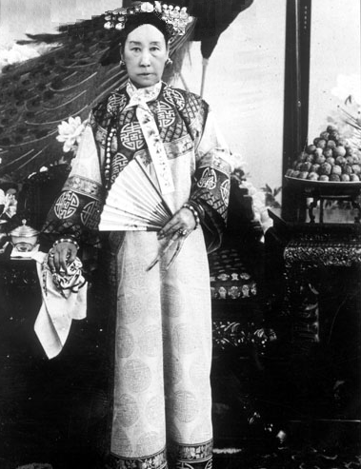
Cixi of Qing
After the Boxer Rebellion, I implemented a few reforms
  It wasn’t enough to stop the 1911 Revolution
My nephew died on November 14, 1908
  I named Puyi emperor
I died on November 15, 1908

Slide 20
References
Ebrey, Patricia Buckley. Cambridge Illustrated History of China. New York: Cambridge University Press, 2010. 2nd ed.
The Cambridge History of China, vol. 1. New York: Cambridge University Press,1986
The Oxford Encyclopedia of Women in World History. Oxford University Press, Online Version, 2012.

