Slide 1

Emergence of Translation Study in China
中国翻译学的起源

Slide 2



CONTENTS
·目 录·
CONTENTS
壹
Translation and Translation Study
贰
Milestones
叁
肆
Андрей В. Фёдоров
Dong Qiusi

Slide 3

壹
Translation and Translation Study

Slide 4


What is translation？
Translation can be defined as a rendering from one language into another. Also it can be seen as the product of such a rendering.
Translation, essentially is the faithful representation in one language, of what is written or said in another language.(钟述孔）
Translation is the act of replacing text material in the source language by an equivalent text material in the target language.(J.C.Catford)
Translation is the act of replacing text material in the source language by an equivalent text material in the target language.(J.C.Catford)

Slide 5
What is translation study？
Translation Study, interdisciplinary in nature, is a science to study translation. It is about general laws of translation, studies of translation with special reference to Chinese and English, and methods to apply theories to practice.It addresses the description of the phenomenon of translation by focusing on such questions as the definition of translation, the nature of translation, types of translation, criteria of translation, procedures of translation, and disciplines related to translation and translation studies.

Slide 6
贰
Milestones

Slide 7
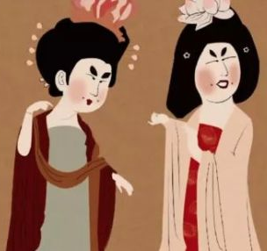

Milestones
From Han Dynasty to Northern and Southen Dynasties (206 BC–589)
Zhi Qian, a monk coming to China in late Eastern Han Dynasty, was the first in China to probe into translation theory and techniques.His translation principle is being expressive and elegance and being acceptable to the readers.
Dao An knew little about Sanskrit, but through the comparison of different translated versions he explored the law of translation such as complicated and con-cise, literal and liberal techniques, and proposed his theory "Five Adaptations and Three Difficulties." The five adaptations are 1) adapting in the light of the order of Chinese, 2) doing some polishing because of the plain Sanskrit and flowery Chinese,3) not deleting the repetitions of the same thing in the original, 4) deleting the unnec-essary repetition in the end of sutra, and 5) deleting the re-expressions of the things expressed previously before coming to other parts. The three difficulties are 1) it is hard to properly translate the ancient Sanskrit by using the Chinese rhythmical prose(characterized by parallelism and ornateness), 2) it is hard for the later generation to master the delicate philosophy of the ancients, and 3) it is hard for people at present to achieve accuracy in translating materials of the old days.

Slide 8
Milestones
From Han Dynasty to Northern and Southen Dynasties (206 BC–589)
Kumarajiva (350-409),based on Dao An's theory, founded the school of liberal translation, the first in China.Different from Zhi Qian's liberal translation of somewhat faithfulness to the original,he thought translation should be faithful to the original, but that didn't mean to copy the form of the original.

Slide 9
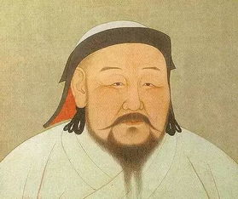
Milestones
From Sui Dynasty to Yuan Dynasties (581-1368)
Great monk Yan Zong (557-610) in Sui Dynasty proposed "Eight Requirements for Translators": 1) Love Buddhist sutra and make nothing of hardships, 2) be faithful and trustworthy, 3) master the theme and leave no doubt, 4) be knowledgeable, 5) be magnanimous and not arbitrary, 6) be indifferent to personal fame and wealth, 7) be good at Sanskrit and master its argumentation, and 8) be good at Chinese and be accurate in translation.
Great monk Xuan Zang (about 600-662) was against Kumarajiva's liberal trans-lation, he blended the literal and liberal techniques. To him, faithfulness is the main concern. His criterion was being faithfulness and expressiveness. B esides, he put forward in his translation of B uddhist sutra the so-called "Five Non-translatable Categories": 1) mysterious ones, 2) polysemic ones, 3) non-existent in China, 4) fol-lowing the customary saying, and 5) non-translatable ones. Actually he referred to transliteration.

Slide 10
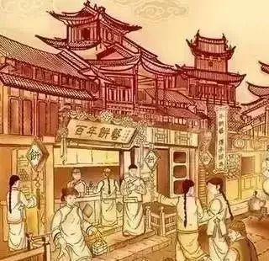
Milestones
Ming Dynasty (1368-1644) and Qing Dynasty (1644-1911)
The science translation in late Qing Dynasty is the second science translation climax in China . The government and some people of insight thougt it necessary to train translators ,so they set up some translation orgnizations and translation centres .
Yi Xue (translation studies) appeared first in the rules of Si Yin Guan ( Translation School) established in 1644.
Ma Jianzhong thought that only by understanding tacitly every link of the translation process can target readers have the same resonance as these of the original .

Slide 11
Milestones
Ming Dynasty (1368-1644) and Qing Dynasty (1644-1911)
Liang Qichao laid stress on liberal translation and thought that, taking consideration of the circumstances, science translation needs some kind of creation .
Yan Fu, by studying the successful experience in translating Buddhist sutra from Sanskrit into Chinese and summarizing his own translation practice, put forward the three-word criterion , i.e. faithfulness , expressiveness and elegance ,which was widely accepted in Chinese translation circles ,and now which still has the practical significance.

Slide 12
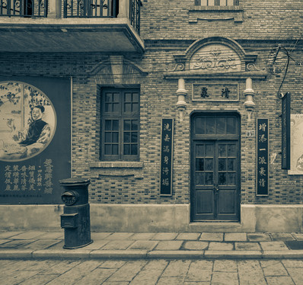
Milestones
Republic of China (1912-1949)
Chen Xiying (1896-1970) in 1927proposed the necessity of distinguishing non-literary translation from literary trans-lation, and he thought the criterion for science translation or non-literary transla-tion is faithful and expressive.
Ai Wei (1890-1955) in the same year studied translation approaches by investigation, and compared literal and liberal translation by experiment. He is the first in China to do translation studies by a quantitative approach. There were a great many discussions on faithfulness and smoothness. As for science translation, Lu Xun(1881-1936), Qu Qiubai(1899-1935), Mao Dun(1896-1981), Ai Siqi(1901-1966) and Chen Kang(1902-1992) thought faithfulness is primary and smoothness secondary.

Slide 13
Milestones
Republic of China (1912-1949)
Zhu Ziqing (1898-1948) in 1919 examined translated names (terms) from as-pects such as distinguishing transliteration from liberal translation, blending of transliteration and liberal translation, coining new words, transliteration and liberal translation. The discussions by Yang Duanliu (1885-1966), Fu Sinian (1896-1950),Guo moruo (1892-1978) and Lu Xun's (1881-1936) were centred on which is most important for science translators, science accomplishment, understanding of the source text, or the expression of the target text. They all believed science accomplish-ment is the most important. Fu Sinian proposed doing selective translation of the less important science works.

Slide 14
Milestones
Republic of China (1912-1949)
He Lin (1902-1992) in 1940 explored translation philosophically, discussed the translatable, the untranslatable, unnecessary translation and the worthless of transla-tion, as well as the translated being equal to or even surpassing the original.
With the quantity increase of science translation and the increase of science terms and foreign names, it became necessary to standardize the terms and names. The government set up the Terms Standardizing Committee. Non-governmental organi-zations actively participated in the work. One of the achievements that resulted from term standardization was the compiling of a great many bilingual science dictionaries.

Slide 15

Milestones
The People’s Republic of China (1949- )
The initiation of science translation studies began with the period of China's opening to the outside world. The practice of science translation in the fifties and sixties laid a solid foundation for translation studies from the eighties on.
The quantity of science translation work since the seventies has increased rap-idly, becoming the largest, and people recognize the great part played by science translation. However, compared with its practice, science translation studies is much more backward.1984-2004 saw eleven National Sci-T ech Translation symposiums, each demon-strating the trends of China's science translation studies. The National Chinese-Foreign Languages Translation Symposium has been held every year since 2000 by the Central Compilation and Translation Bureau, the Chinese Translators Association and other organizations. Apart from the above two symposiums, various translation conferences are held here and there, which, more or less, tackle science translation studies.All these meetings promote the development of science translation studies.

Slide 16
Milestones
The People’s Republic of China (1949- )
More than 50 years 'development in science translation and its studies moved gradually from practice to theory, from written translation to oral interpretation and to machine translation, from general theory to science translatology. The basic line of science translation in China is as follows: from basic approaches to basic theories,from morphology and syntax to discourse and style, from into Chinese to from Chinese, from linguistics to thought science, from general theory to discipline study, and from basic discipline to applied discipline.
The question of whether or not science translation is a branch of learning sparks heated discussions. Zhou Yiping& Li Yashu in 1996 explored the system of science translation theory that contains the basic theory, approaches and skills, and multi-disciplinary study. The basic theory consists of its basic principles, its criterion, its comment, and its history that are all the special contents of science translation except the basic theory. The approaches and skills incorporate its process, its methods of handling science vocabulary, syntax, discourse, rhetoric and non-linguistic symbols,which are all the special objects of the study of science stylistics. The multi-disciplinary study examines the relations between science translatology and other relevant disci-plines.

Slide 17
Milestones
The People’s Republic of China (1949- )
The year 2003 witnessed Huang Zhonglian& Li Yashu's Science Translatology that shapes its basic system (its nature, its category, its inner law, its basic principles,its criterion, its process mechanism, its basic unit, etc.) and its applied theory (its teaching, machine translation, edited translating science dictionary, its criticism, etc.)by studying the basic strategies and history, and by combining the general system of a discipline. The book exactly defines science translatology, devises the train of thought of establishing science translatology, thus shaping science translatology.

Slide 18
叁
Dong Qiusi

Slide 19
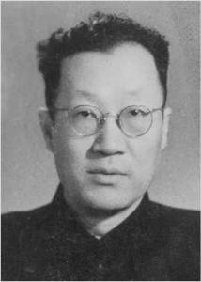
Dong Qiusi
Dong Qiusi is a famous figure in modem translation history of China. He achieved magnificent accomplishments in both translation theory and translation practice. His views on the construction of translation theory promoted the development of Chinese translation theory.

Slide 20
肆
Андрей В. Фёдоров

Slide 21
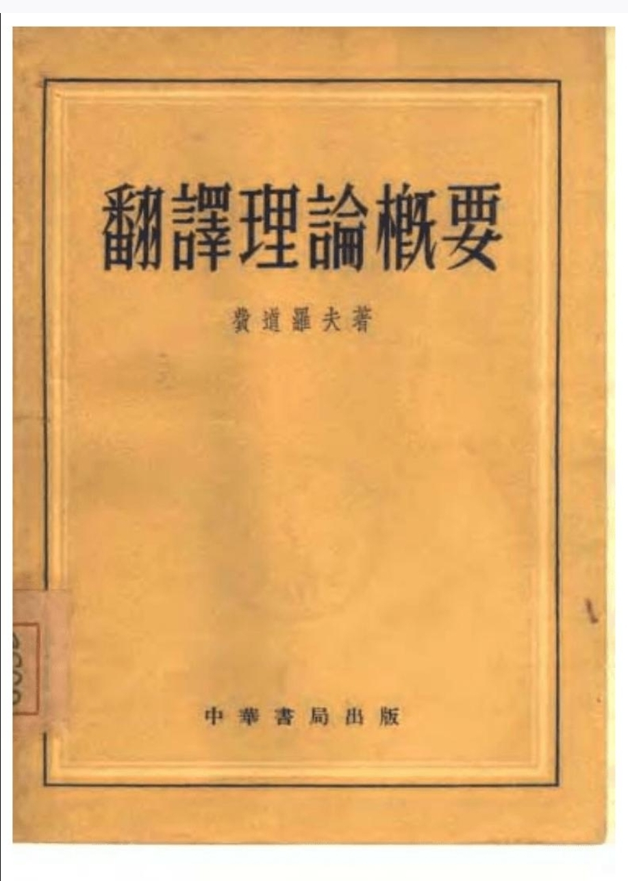
Андрей В. Фёдоров
《Введение в теорию перевода》
In this book, he believed that the translation theory is one branch of translation study，and the problems of translation can only be solved in the field of translation, because any translations need to be done through comparing two languages,

Slide 22
References:
[1] 董秋斯. 翻译批评的标准和重点[J]. 翻译通报，1950b（4）：2-4.
[2] 董秋斯. 论翻译理论的建设[J]. 翻译通报，1951（4）：3-6.
[3] 汪庆华，张春柏. 翻译学的先驱: 董秋斯翻译学思想探析[J]. 上海翻译，2017(01)：67-72+95.
[4] 蔡毅，段京华（编著）. 苏联翻译理论[M]. 武汉：湖北教育出版社，2000.
[5] 何妍. 译学研究的语言学探索:对奈达、威尔斯、卡特福德和费道罗夫译学构想的解读与思考[J]. 贵阳学院学报（社会科学版），2009，4(01)：106-108.
[6]许钧 穆雷. 翻译学概论[M]. 译林出版社, 2009.
[7]https://wk.baidu.com/view/4184c60dba1aa8114431d956?pcf=2&bfetype=new

