Slide 1

Chinese Contemporary Literature
2023英语口译 陈广子
2023English Interpreting Class
Alan Chen

Slide 2

1
Me and Chinese Contemporary Literature

Slide 3

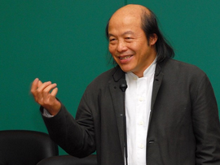
a renowned Taiwanese essayist, novelist, and poet, celebrated for his profound philosophical reflections and poetic prose
Themes: Zen Buddhism, Taoism, and traditional Chinese philosophies, which he skillfully intertwined with everyday life, offering readers deep insights into existence, self-awareness, and inner peace.
Notable works:The Wisdom of Zen, The Lotus in the Fire, A Tree in the Distance
Writing style:gentle, introspective tone, vivid imagery, encourage mindfulness, simplicity, and spiritual awakening.
林清玄Lin Qingxuan

Slide 4
“俗话说‘人生不如意事十常八九’，但扣除八九成的不如意，至少还有一二成是如意的、快乐的、欣慰的事情，我们如果要过快乐人生，就要常想那一二成好事，这样就会感到庆幸、懂得珍惜，不致被八九成的不如意所打倒了。”
“Life means frustration eight or nine times out of ten". Deducting the eighty or ninety per cent of frustration, you still have ten or twenty percent of success, happiness or gratification. If you want to enjoy life, you should focus on the one or two times you are happy, be thankful and cherish them. Then you’ll never be overwhelmed by the eight or nine times when you are unhappy.”
------《常想一二》Dwell on One or Two

Slide 5
种树人语重心长地说：“如果我每天都来浇水，每天定时浇一定量的水，树苗就会养成依赖的心，根就会浮在地表上，无法深入地下，一旦我停止浇水，树苗会枯萎得更多。幸而存活的树苗，遇到狂风暴雨，也会一吹就倒了。”
What he said was thought-provoking. He went on to explain, “If I came every day to give them a definite amount of water, the saplings would get used to it and rely on it. Their roots would remain skin-deep in the surface; there is no need for them to strike deep into the earth. If I happen to stop watering, the saplings would wither badly. Even those that survived accidentally would be easily broken in the storms.”
植树者言，使我非常感动，想到不只是树，人也是一样。在不确定中，我们会养成独立自主的心，不会依赖，我们会把很少的养分转化为巨大的能量，努力生长。
I was moved by his remarks. I think the same is true for us human beings. When we encounter uncertainties, we would have to rely on ourselves and act on our own. In that way, we would be like the mahogany trees, turning the little amount of nutrient we have absorbed into powerful energy to help us grow.
------《桃花心木》Mahogany

Slide 6
2
Definition

Slide 7
Definition
Literature from the founding of New China in 1949 to the present day is referred to as contemporary literature.
从 1949 年新中国成立到现在的文学被称为当代文学。
Chinese literature from the Opium War of 1840 to the founding of the People’s Republic of China in 1949 is known as modern Chinese literature.
从1840年鸦片战争到1949年中华人民共和国成立的中国文学被称为中国现代文学。

Slide 8
3
Key Phases

Slide 9
Key Phases
1. Early Years (1949-1976):
Socialist realism, collective narratives, model heroes
2. Post-Cultural Revolution Era (1976-1989):
This period marked a literary renaissance, as writers began to express their experiences and observations of society.
Scar Literature伤痕文学 :focus on trauma and the scars left by the Cultural Revolution.
3. 1990s: Literature of the 1980s and 1990s:
Root-seeking Literature寻根文学:reconnect with Chinese cultural traditions and explore the complexities of identity.

Slide 10
Key Phases
4. 2000s: Globalization and Literary Diversity:
Engage with international themes and styles, reflecting the complexities of life in a rapidly changing society.
The emergence of various literary genres, including urban fiction, science fiction, and experimental literature.
5. 2010s and Beyond: Digital Literature and New Voices:
Web novels and fan fiction.
Exploring themes of technology, environmental issues, and globalization.

Slide 11
4
Representative Writers

Slide 12
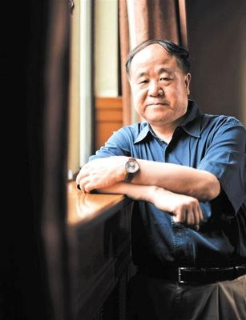
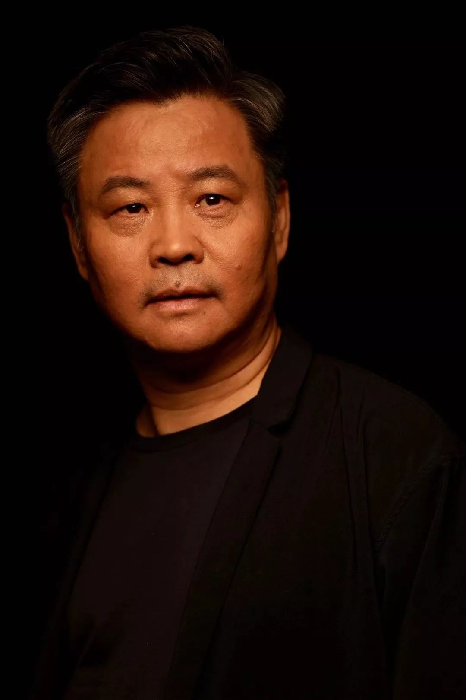
Representative Writers
莫言Mo Yan
余华Yu Hua

Slide 13


Representative Writers
韩寒Han Han
陈楸帆Chen Qiufan

Slide 14
5
Characteristics

Slide 15
Diverse Themes
Blending of Genres
Engagement with Social Issues
Emphasis on Individual Voices

Slide 16
Thanks for Watching

