Slide 1
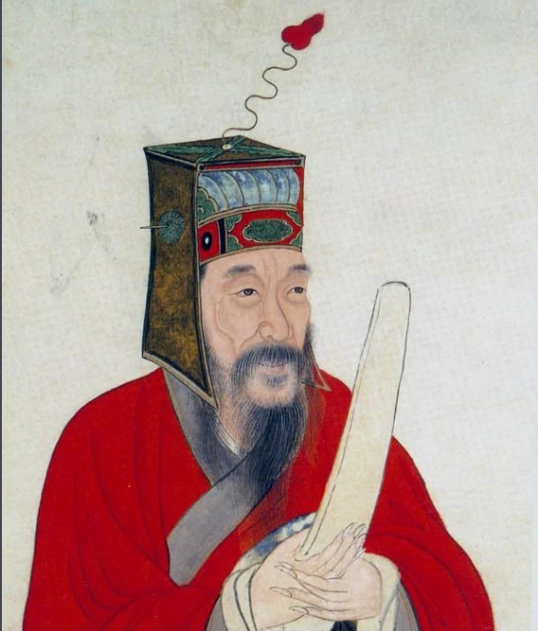
Wang Shouren: The Sage of Mind and Chinese Neo-Confucianism
Presenter:Lv Jiahao

Slide 2
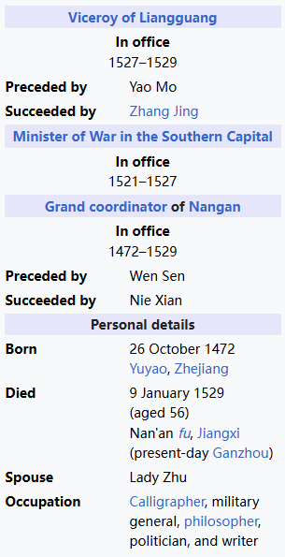
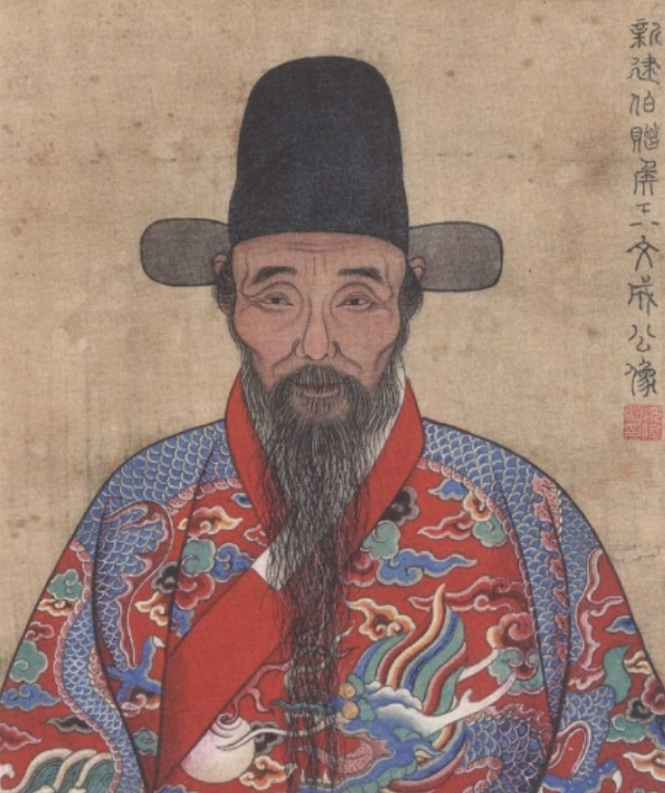
Intoduction to Wang Shouren
Wang Shouren (Chinese: 王守仁, 26 October 1472 – 9 January 1529)
Courtesy name Bo‘an (Chinese: 伯安)
Art name Yangmingzi (traditional Chinese: 陽明子
Usually referred to as Wang Yangming (traditional Chinese: 王陽明

Slide 3
Core Philosophy
Mind as Ultimate Principle (心即理）
Unity of Knowledge and Action(知行合一）
Extension of Innate Knowledge（致良知）

Slide 4

Historical Impact
Revolutionized Confucianism:
- Shifted focus from rigid rituals to introspection and ethical practice.
- Influence beyond China: - Inspired Japanese "Ōyōmei-gaku" () and Korean Confucianism.

Slide 5
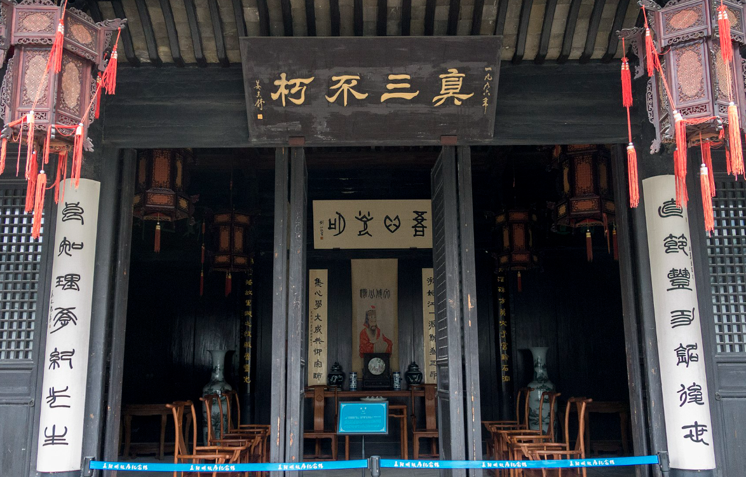
Summary

