Slide 1


Brief History of Western Translation Theory
周诗卿、纪甜甜
Zhou Shiqing, Ji Tiantian
Wednesday, October 21, 2020

Slide 2






2
Contents
Ⅰ
Ancient Translation
Ⅱ
Translation in the Middle Ages
Ⅲ
Translation in the Renaissance Period
Ⅳ
Modern Translation

Slide 3


Ancient Translation
3
characterisitcs:
Translation of Greek drama works into Latin, or adaptation of Greek drama in Latin language, so that ancient Greek literature can be spread and inherited.
Representatives: Cicero, Jerome

Slide 4
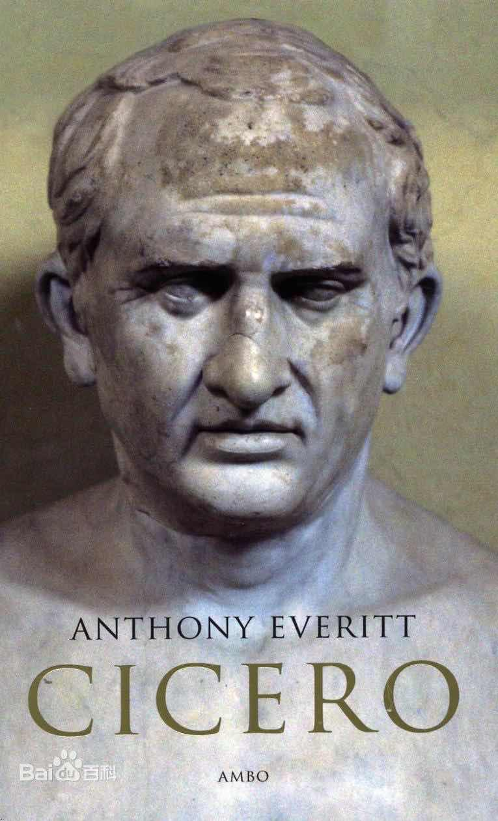
4
Cicero was one of the most prolific Roman writers, and the number of his speeches, letters and treatises that have survived into the modern era is a testament to his admiration by successive generations. For Cicero, philosophical understanding was an orator’s paramount virtue.
----..And I did not translate them as an interpreter, but as an orator, keeping the same ideas and forms….

Slide 5
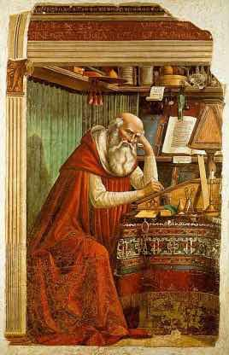
5
In the early translation of the Bible, Jerome was the representative. He expounded his principle of translation, that is, he should adopt flexible principle of free translation instead of word pairing. His flexible translation principles, which are based on correct understanding, have a positive guiding significance for current translation theories and practices.
Jerome

Slide 6
6
Translation in Middle Ages
characterisitc:
Closely related to the Christianity;
Translation of the Hebrew and Greek Bible into Latin.
From Arabic to Latin. Spain became the center of academic activities in Europe.
Representative: The Toledo School

Slide 7

7
The Toledo School
How was it developed?
...As the original works of many Greek classics were lost, and Arabic versions flooded into Europe, western translators could only take the Arabic versions as the original works. To some extent, the rise of Arab academic studies in the Middle Ages should be attributed to Greek culture. However, the importance of Arab translation went far beyond time and space, and its influence later spread to Europe. By the middle of 11C, Arabic works were flooding into Spain and being translated into Latin. Toledo replaced Baghdad as the European Academy of Translation. It was not until 13C that the Original Greek was introduced into Toledo, and the original Greek was directly translated and no longer translated.

Slide 8
8
The Toledo School
Three characteristics of The Toledo School of Translation:
1) The translation activities are always subject to the independence of the Church
2) Translated works are mainly Arabic translations of Greek works, followed by Arabic and Greek original works
3) Toledo was a center of education and Muslim scholarship in Spain at the time.

Slide 9
9
Translation in the Renaissance Period
Translation thought in this period mainly has the following characteristics:
Advocate the respect for the original, pay attention to the combination of content and form, free translation and literal translation
Pay attention to the innovation and the style of translation on the basis of respecting the original.
Lay emphasis on the practical spirit
Representative: Jacques Amyot, Etienne Dolet, Georga Chapman, Martin Luther

Slide 10
10
Various Translation Thoughts
Jacques Amyot, French bishop and classical scholar famous for his translation of Plutarch’s Lives (Les Vies des hommes illustres Grecs et Romains, 1559), which became a major influence in shaping the Renaissance concept of the tragic hero.
He believed that the translator must have a thorough grasp of the original. When Amyot translated ancient Greek and Roman classics, he put forward the idea of "trying to be on a level with the original".

