Slide 1

Premodern Literature - Tang-Song
Speaker：Li Shujing
Date：2024.03.29

Slide 2

行业PPT模板http://www.1ppt.com/hangye/
The Eight Tang-Song Prose Masters
1
CONTENTS
2
Ancient Prose Movement
3
Conclusion

Slide 3
01
The Eight Tang-Song Prose Masters
（唐宋八大家）
This title was first appeared in the Banknotes of Eight Masters of Tang and Song Dynasties（《唐宋八大家文钞》）.

Slide 4
Brief Introduction of The Eight Tang-Song Prose Masters
The Eight Tang-Song Prose Masters are Han Yu, Liu Zongyuan in Tang Dynasty and Ouyang Xiu, Su Xun, Su Shi, Su Zhe, Wang Anshi, Zeng Gong in Song Dynasty.
Among them, Han Yu and Liu Zongyuan are the leaders of the Ancient Prose Movement in the Tang Dynasty, while Ouyang Xiu and "Three Su"(Su Xun, Su shi, Su Zhe) are the core figures of the Ancient Prose Movement in the Song Dynasty. Wang Anshi and Zeng Gong are the representative figures of Linchuan Literature（临川文学）.

Slide 5
Han Yu (韩愈)
Master works:
Han Changli Collection（《韩昌黎集》）
External collection（《外集》）
The Teacher's Theory（《师说》）
Han Yu was a litterateur, philosopher, and thinker of Tang Dynasty. He was honored as "The Decline of Eight Generations" （文起八代之衰）by Su Shi in Song Dynasty, as well as the head of Eight Masters of Prose in Tang and Song Dynasties.

Slide 6
Liu Zongyuan (柳宗元)
Master works:
Liu He Dong Colloection（《柳河东集》）
Liu Zongyuan was a litterateur, philosopher, proser and thinker of the Tang Dynasty. He was known as "Liu Hedong", " Mr. Hedong ", as well as "Liu Liuzhou" because of his official end of feudal provincial of Liuzhou.
He was a deep-thinking philosopher and great litterateur, who attached importance to the content of the article and advocated that writings should be practical.

Slide 7
Ouyang xiu (欧阳修)
Master works:
The Anthology of Ouyang Wenzhong Gong
（《欧阳文忠公文集》）
Ouyang Xiu was a statesman, litterateur, historian and poet in the Northern Song Dynasty. He was called the "Liu Yi scholar"(六一居士), which means that he had ten thousand volumes of collections, a thousand volumes of collections of inscriptions（金石遗文一千卷） of Xia, Shang, Zhou Dynasties（三代）, a piano, a chess, a pot of wine and a drunk man alone.

Slide 8
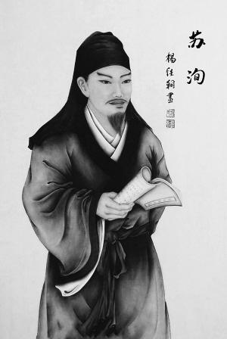
Su Xun (苏洵)
Master works:
Heng Lun（《衡论》）
The Book to the Emperor（《上皇帝书》）
Owing to his great understanding of social reality, he was good at summing up experience and lessons from past history. Therefore, putting aside certain pedantic and biased views in his political discourse, many of them were still right on the spot.

Slide 9
Su Shi (苏轼)
Su Shi, with a fame as "Dongpo Jushi"（东坡居士）, was a famous litterateur, calligrapher, essayist, Ci writer, poet and the representative of the Unconstrained Ci School（豪放派） in Northern Song Dynasty.
Su Shi was called "the first all-round talent in ancient China"（中国古代第一全才）. He was regarded as one of the most outstanding men in literary and artistic attainments in thousands of years of Chinese history.

Slide 10
Su Zhe (苏辙)
Master works:
the Book to Han Tai Wei in Privy Council
（《上枢密韩太尉书》）
The New Theory（《新论》）
On the Six Kingdoms（《六国论》）
Ode to Ink bamboo（《墨竹赋》）
Su Zhe's prose showed the deep and mellow spirit. He had his own views on ancient writing. From these works, we can draw lessons from the past and criticize the current problems.

Slide 11
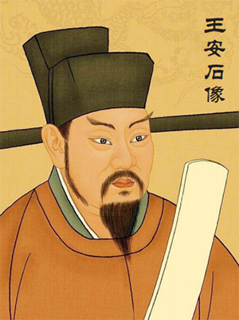
Wang Anshi (王安石)
Wang Anshi was not only an outstanding politician and thinker, but also a brilliant litterateur. In order to realize his political ideal, he closely linked literary creation with political activities, emphasizing that literature should aim to serve the society first.
That means, he emphasized the realistic function and social effect of articles, and advocated the unity of literature and Taoism. His prose largely carried out his literary opinions of enlightenment of political decrees for world use.

Slide 12
Zeng Gong (曾巩)
Master works:
Book to Ouyang She Ren（《上欧阳舍人书》）
Book to Bachelor CAI（《上蔡学士书》）
He was also one of the "Seven Zengs of Nanfeng"（南丰七曾）, including Zeng Gong, Zeng Zhao, Zeng Bu, Zeng Yu, Zeng Hong, Zeng Xie and Zeng Dun（曾巩、曾肇、曾布、曾纡、曾纮、曾协、曾敦）.
Zeng Gong was a supporter and participant of Ouyang Xiu's ancient prose movement. He advocated the doctrine before the text（先道后文）.

Slide 13
To sum up, they all advocated prose and opposed parallel prose, which has exerted profound influence on the literary world at that time and later generations. Their successive waves of innovation of ancient prose has changed the obsolete appearence of poetry and prose.

Slide 14
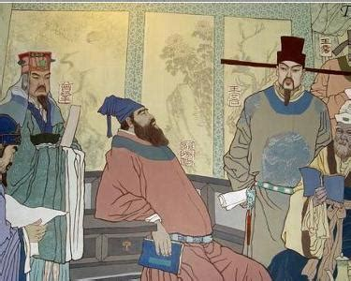
02
Ancient Prose Movement
（古文运动）
The ancient prose movement in Tang and Song dynasties
The ancient prose movement in Tang and Song dynasties refers to the movement of style reform in the middle of Tang Dynasty and Song Dynasty, which is characterized by advocating ancient prose and opposing parallel prose(骈文).

Slide 15
Development
The first promoters of the Ancient Prose Movement were Han Yu and Liu Zongyuan who were not only writers but also theorists, forming the basis of the movement. Both were enthusiastic to promote the movement and were keen to teach young people so that the movement could achieve further development and then revive the Confucianism.
After that, Ouyang Xiu once again advocated the ancient prose in the Song Dynasty. As many people were dissatisfied with the florid piantiwen(骈体文) style, the Ancient Prose Movement reached a nother peak during that period.
However, after the death of Han Yu and Liu Zongyuan, the movement fell into a decline, their students writing with such ancient characters as to hinder understanding or neglecting the importance of writing good essays. Furthermore, the government only allowed people to use pianwen for official use, so those who want to be officials had to learn that style.
In Tang dynasty
In Song dynasty

Slide 16
Influence
The Classical Prose Movement of the late Tang Dynasty and the Song Dynasty is a milestone during the development of Chinese ancient prose, it has a profound influence on the later schools of literature like Tang-Song School in the Ming Dynasty and Tong Cheng school in the Qing Dynasty. Besides that, it also helped to lay a solid foundation of prose in China and acted as a fine example for later scholars.

Slide 17
Comparison between the Ancient Prose Movement and Renaissance
Comparison in writing style
Comparison in literary form
Comparison in ideology

Slide 18
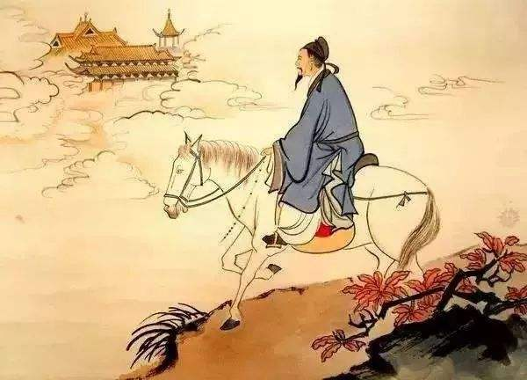
03
Conclusion
Premodern Literature, particularly during the Tang and Song dynasties in China, is characterized by its rich diversity and cultural significance.

Slide 19
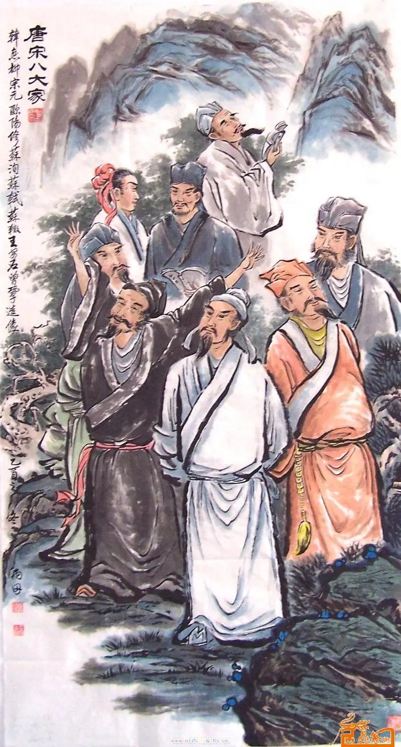
Conclusion
Overall, Tang-Song premodern literature holds a revered status in Chinese literary history, showcasing the creativity, sophistication, and depth of Chinese cultural expression. It continues to be studied and appreciated by scholars and enthusiasts worldwide for its enduring literary value.

Slide 20
Thank you for listening
Speaker:Li Shujing
Date:2024.03.29

