Slide 1



Chinese Calligraphy
中国书法
Speaker: Tang Yan（唐彦）

Slide 2

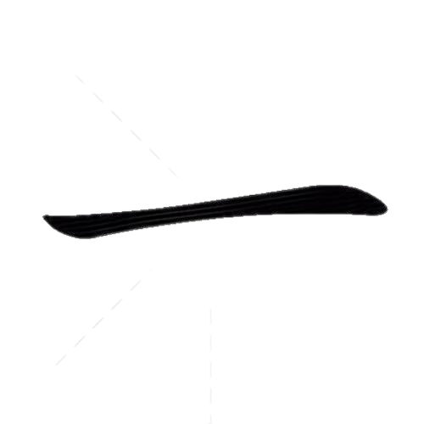



Lead-in
Lead - in
Make a guess: How many strokes are there in the following Chinese character?
biáng
Answer: 56
Answer: 1

Slide 3
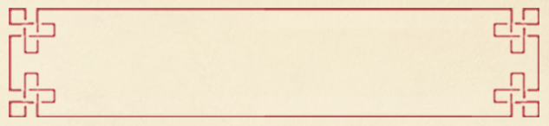

Summary
8 Basic Strokes
Destination
Resources

Slide 4
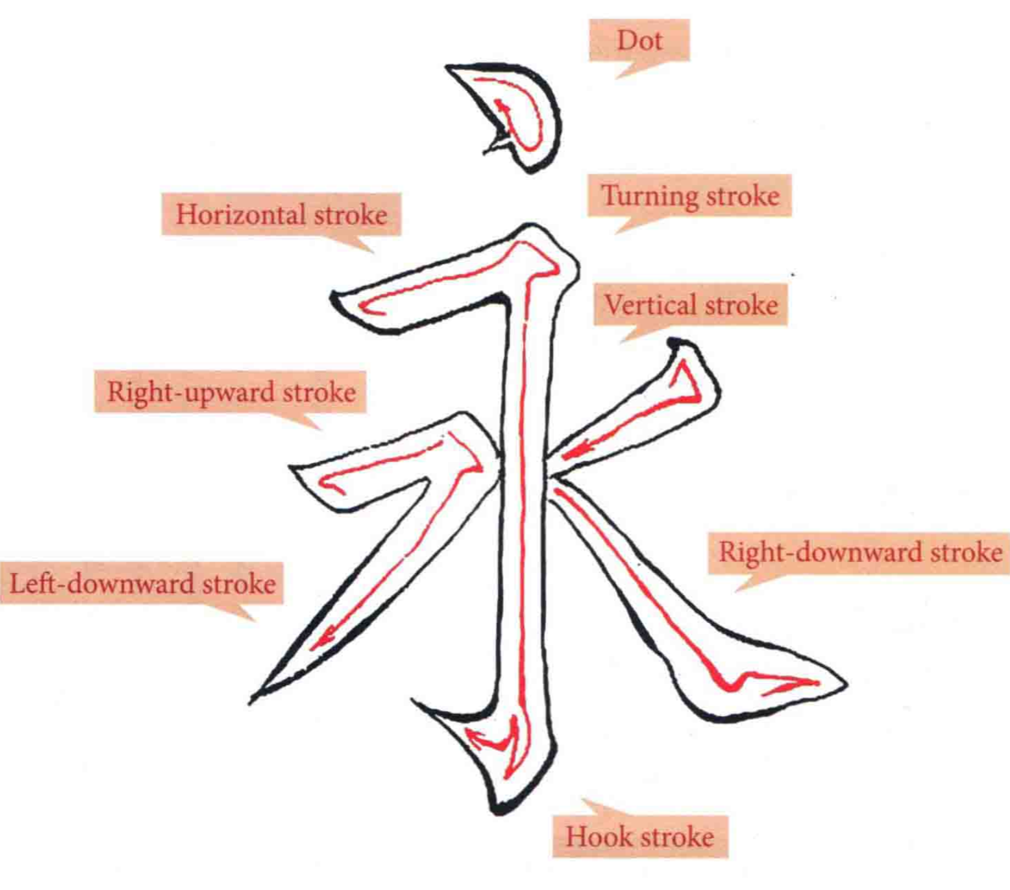

点
横
折
竖
提
捺
撇
preparing
钩
Resources

Slide 5
Summary
5 Major Script Styles
Destination
Resources

Slide 6

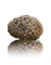
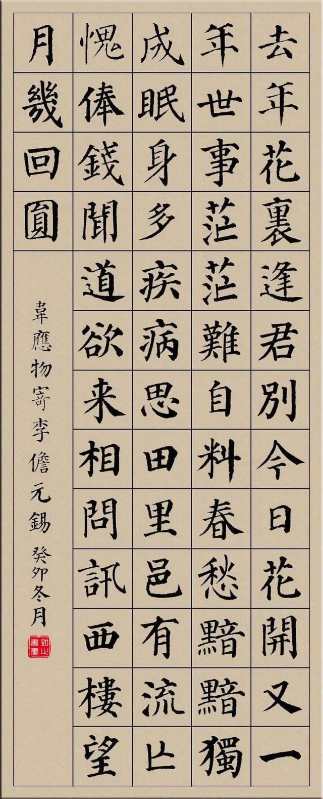
Summary
Formal / regular script
a. Featuring standard strokes, rigorous rules and a slow speed of writing
Summary
楷书
b. Easy to recognize
Resources

Slide 7
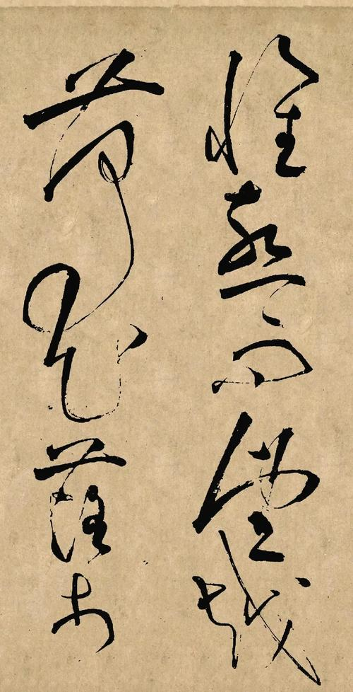
Summary
Cursive script
a. With improved writing speed and infrequent pen lifting
Summary
b. With irregular forms, some strokes join together, or parts of strokes or some whole strokes are omitted
草书
c. Difficult to write and recognize
Resources

Slide 8
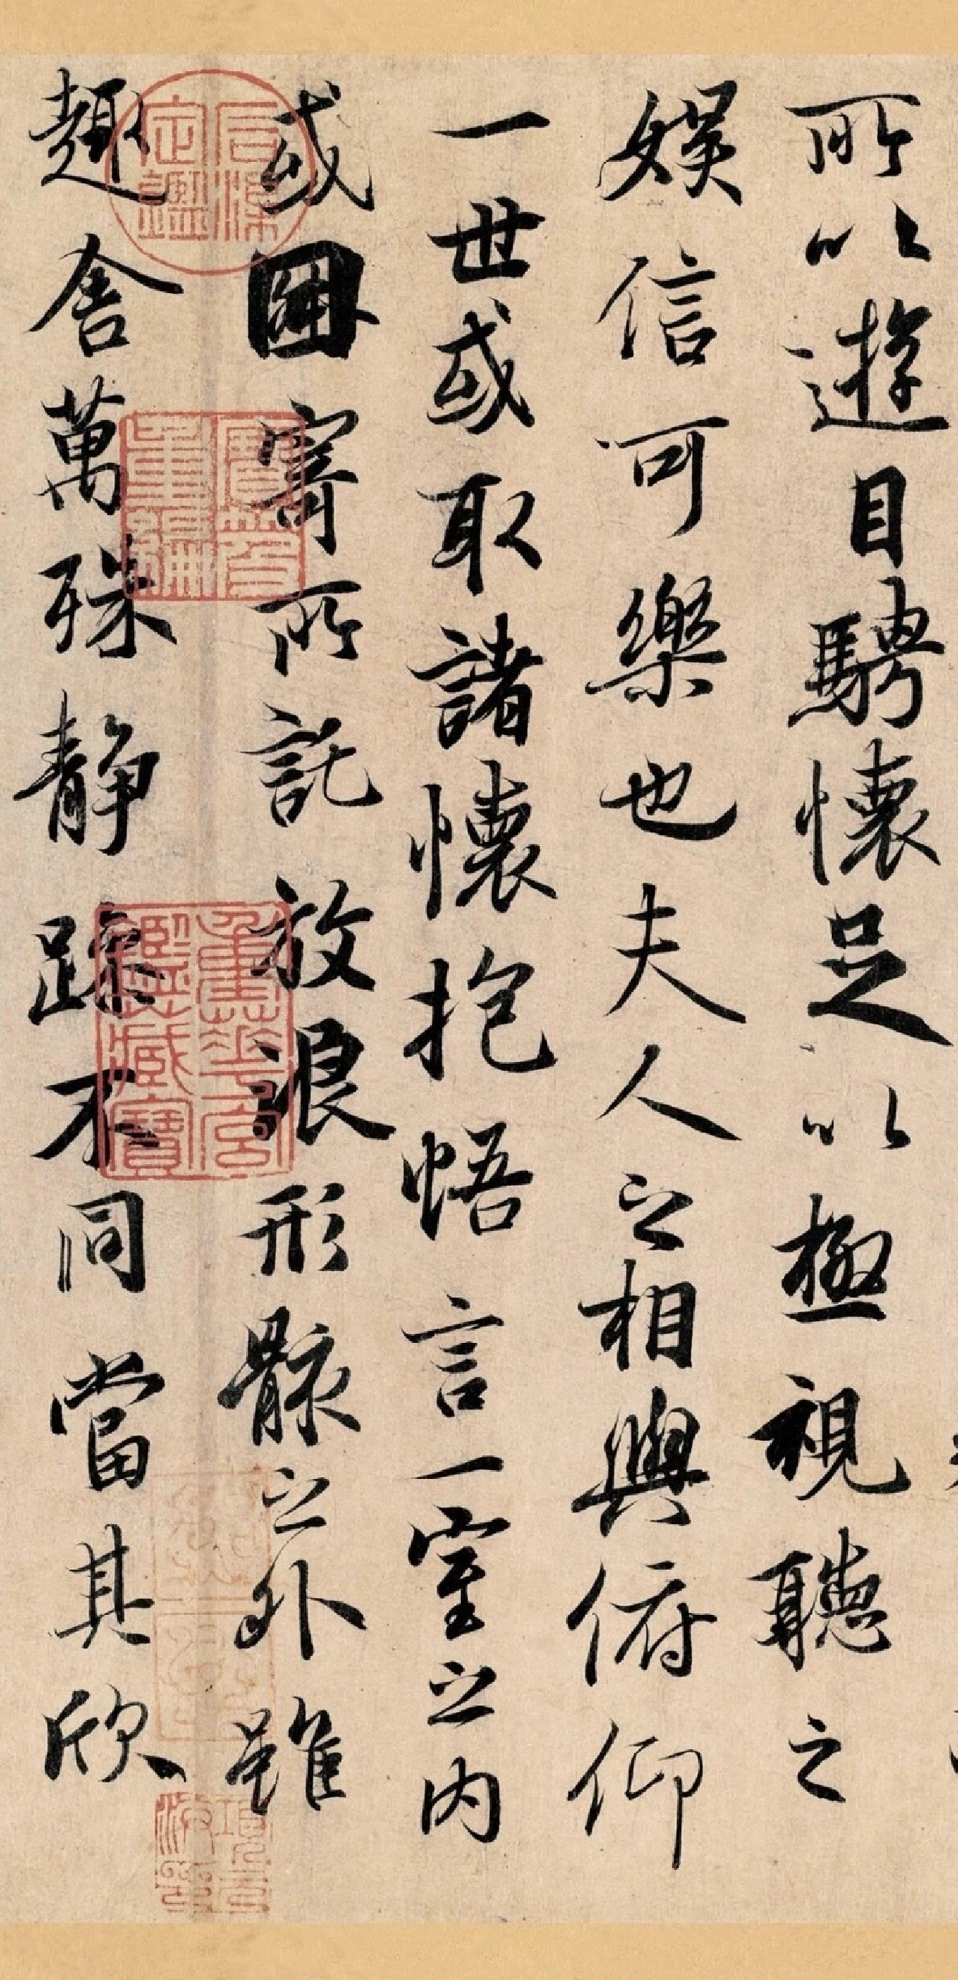
Summary
Running script
a. A style halfway between formal script and cursive script.
b. Looser than the formal script, with more links between strokes
行书
c. Featuring slanting-shape strokes
d. Simple,smooth and light moving of the strokes

Slide 9
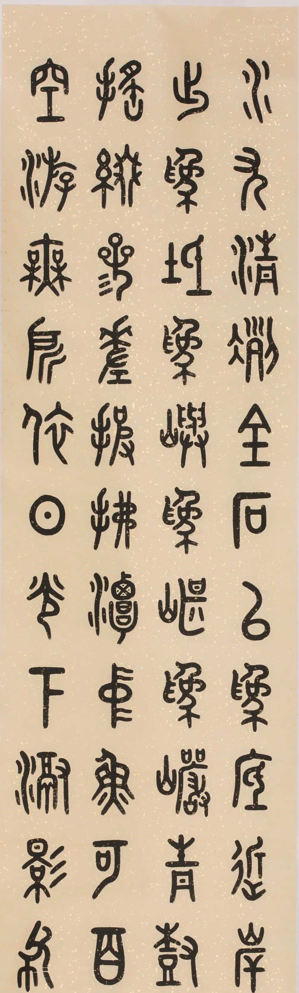
Summary
Seal Script
a. The most ancient calligraphic style, discovered in inscriptions carved on oracle bones
Summary
b. Containing few strokes and no dots, hooks or turning strokes
篆书
c. Seeking a unanimous thickness of lines, symmetry and balanced distribution of strokes
Resources

Slide 10
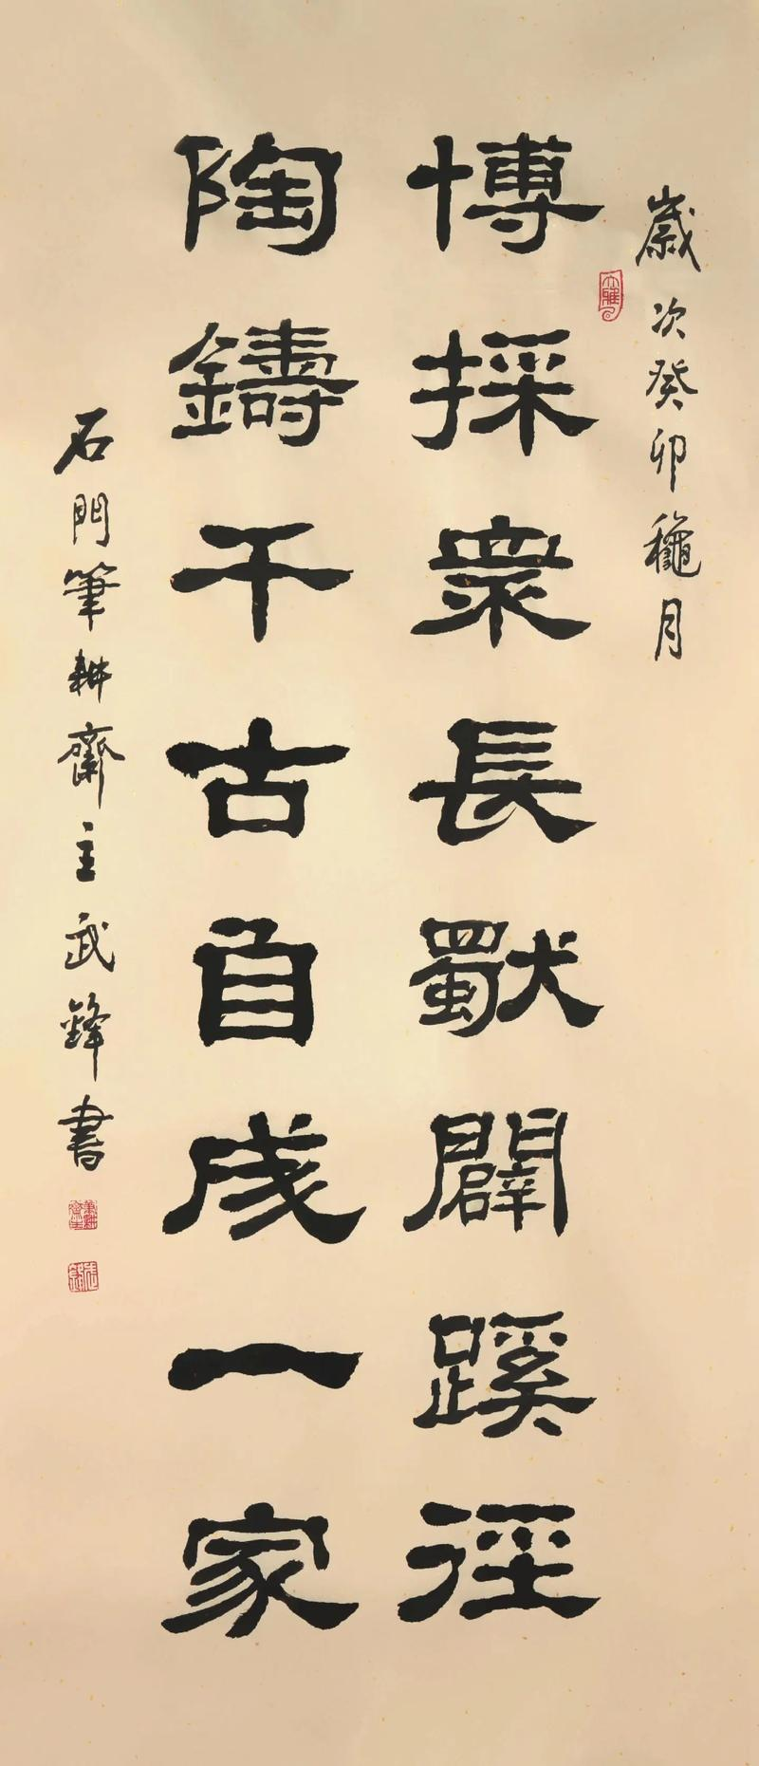
Summary
Official / clerical script
a. Mainly used during the Han Dynasty
Summary
b. Squat-shaped and antique
隶书
c. Changing the rule of unanimous thickness of strokes in the seal script and abolishing the pictographic features of the seal script
Resources

Slide 11

Thank you!

