Slide 1
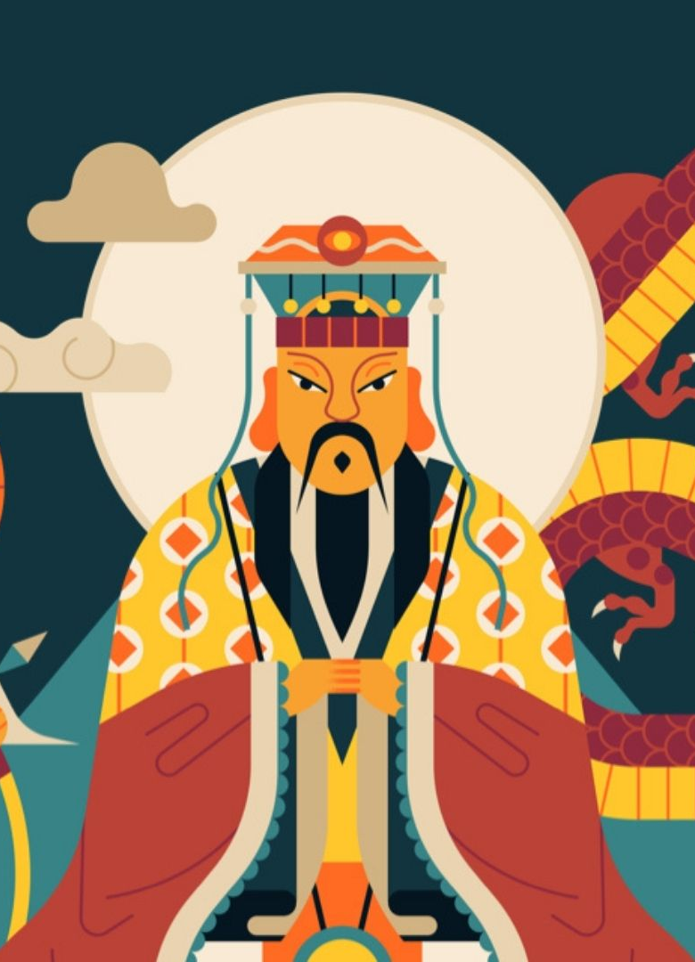
Mythology:
Chinese Gods and Immortals
Presented by Ling

Slide 2
CONTENTS
Chinese mythology system
神 shén, 帝 dì and 仙 xiān
Eight immortals

Slide 3
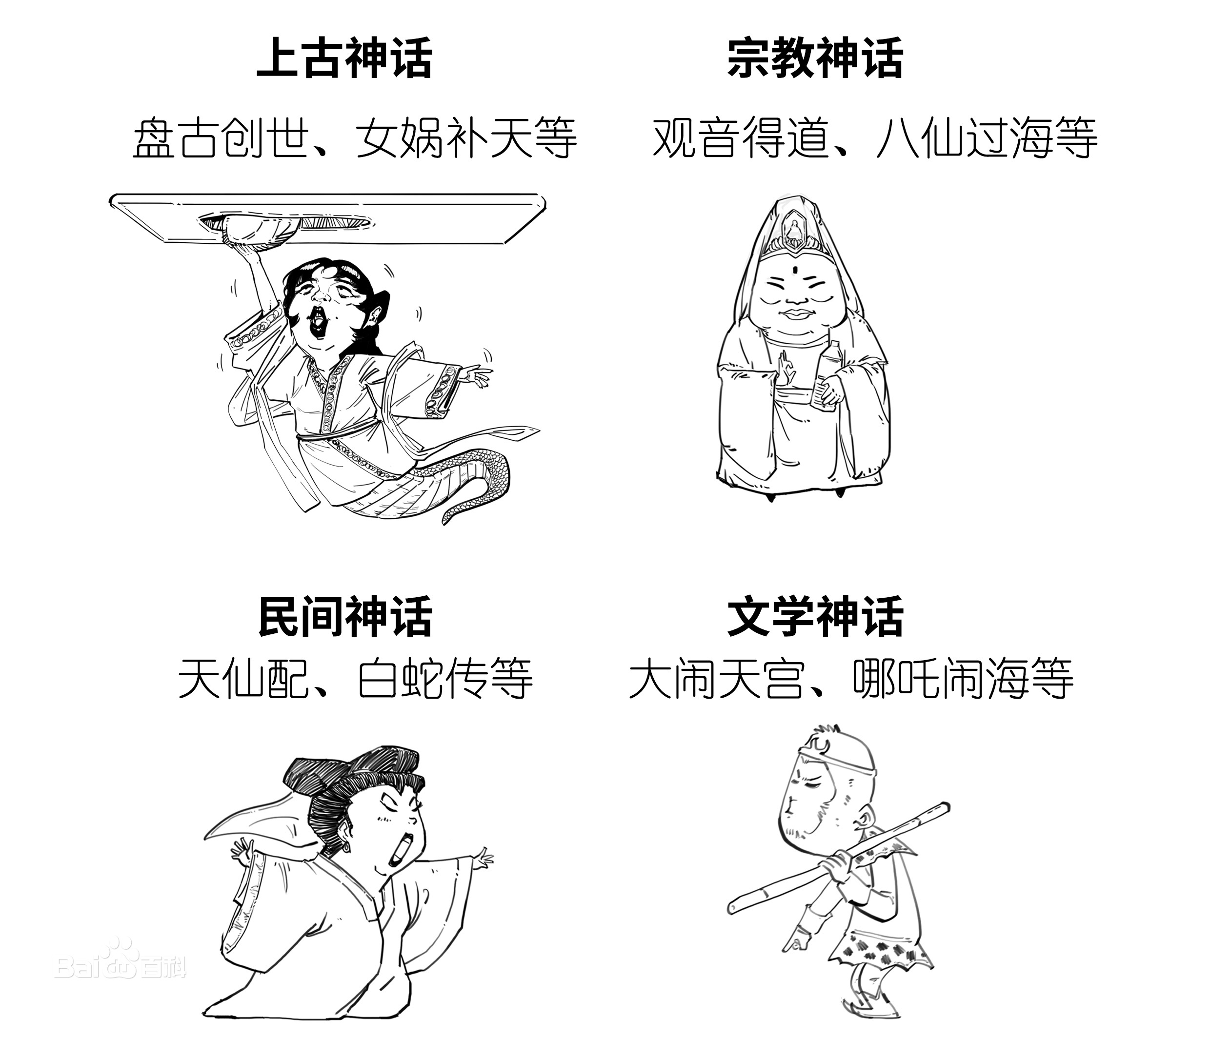
Ancient Myth
Chinese mythology system
Religious Myth
Folklore
Literary Myth

Slide 4
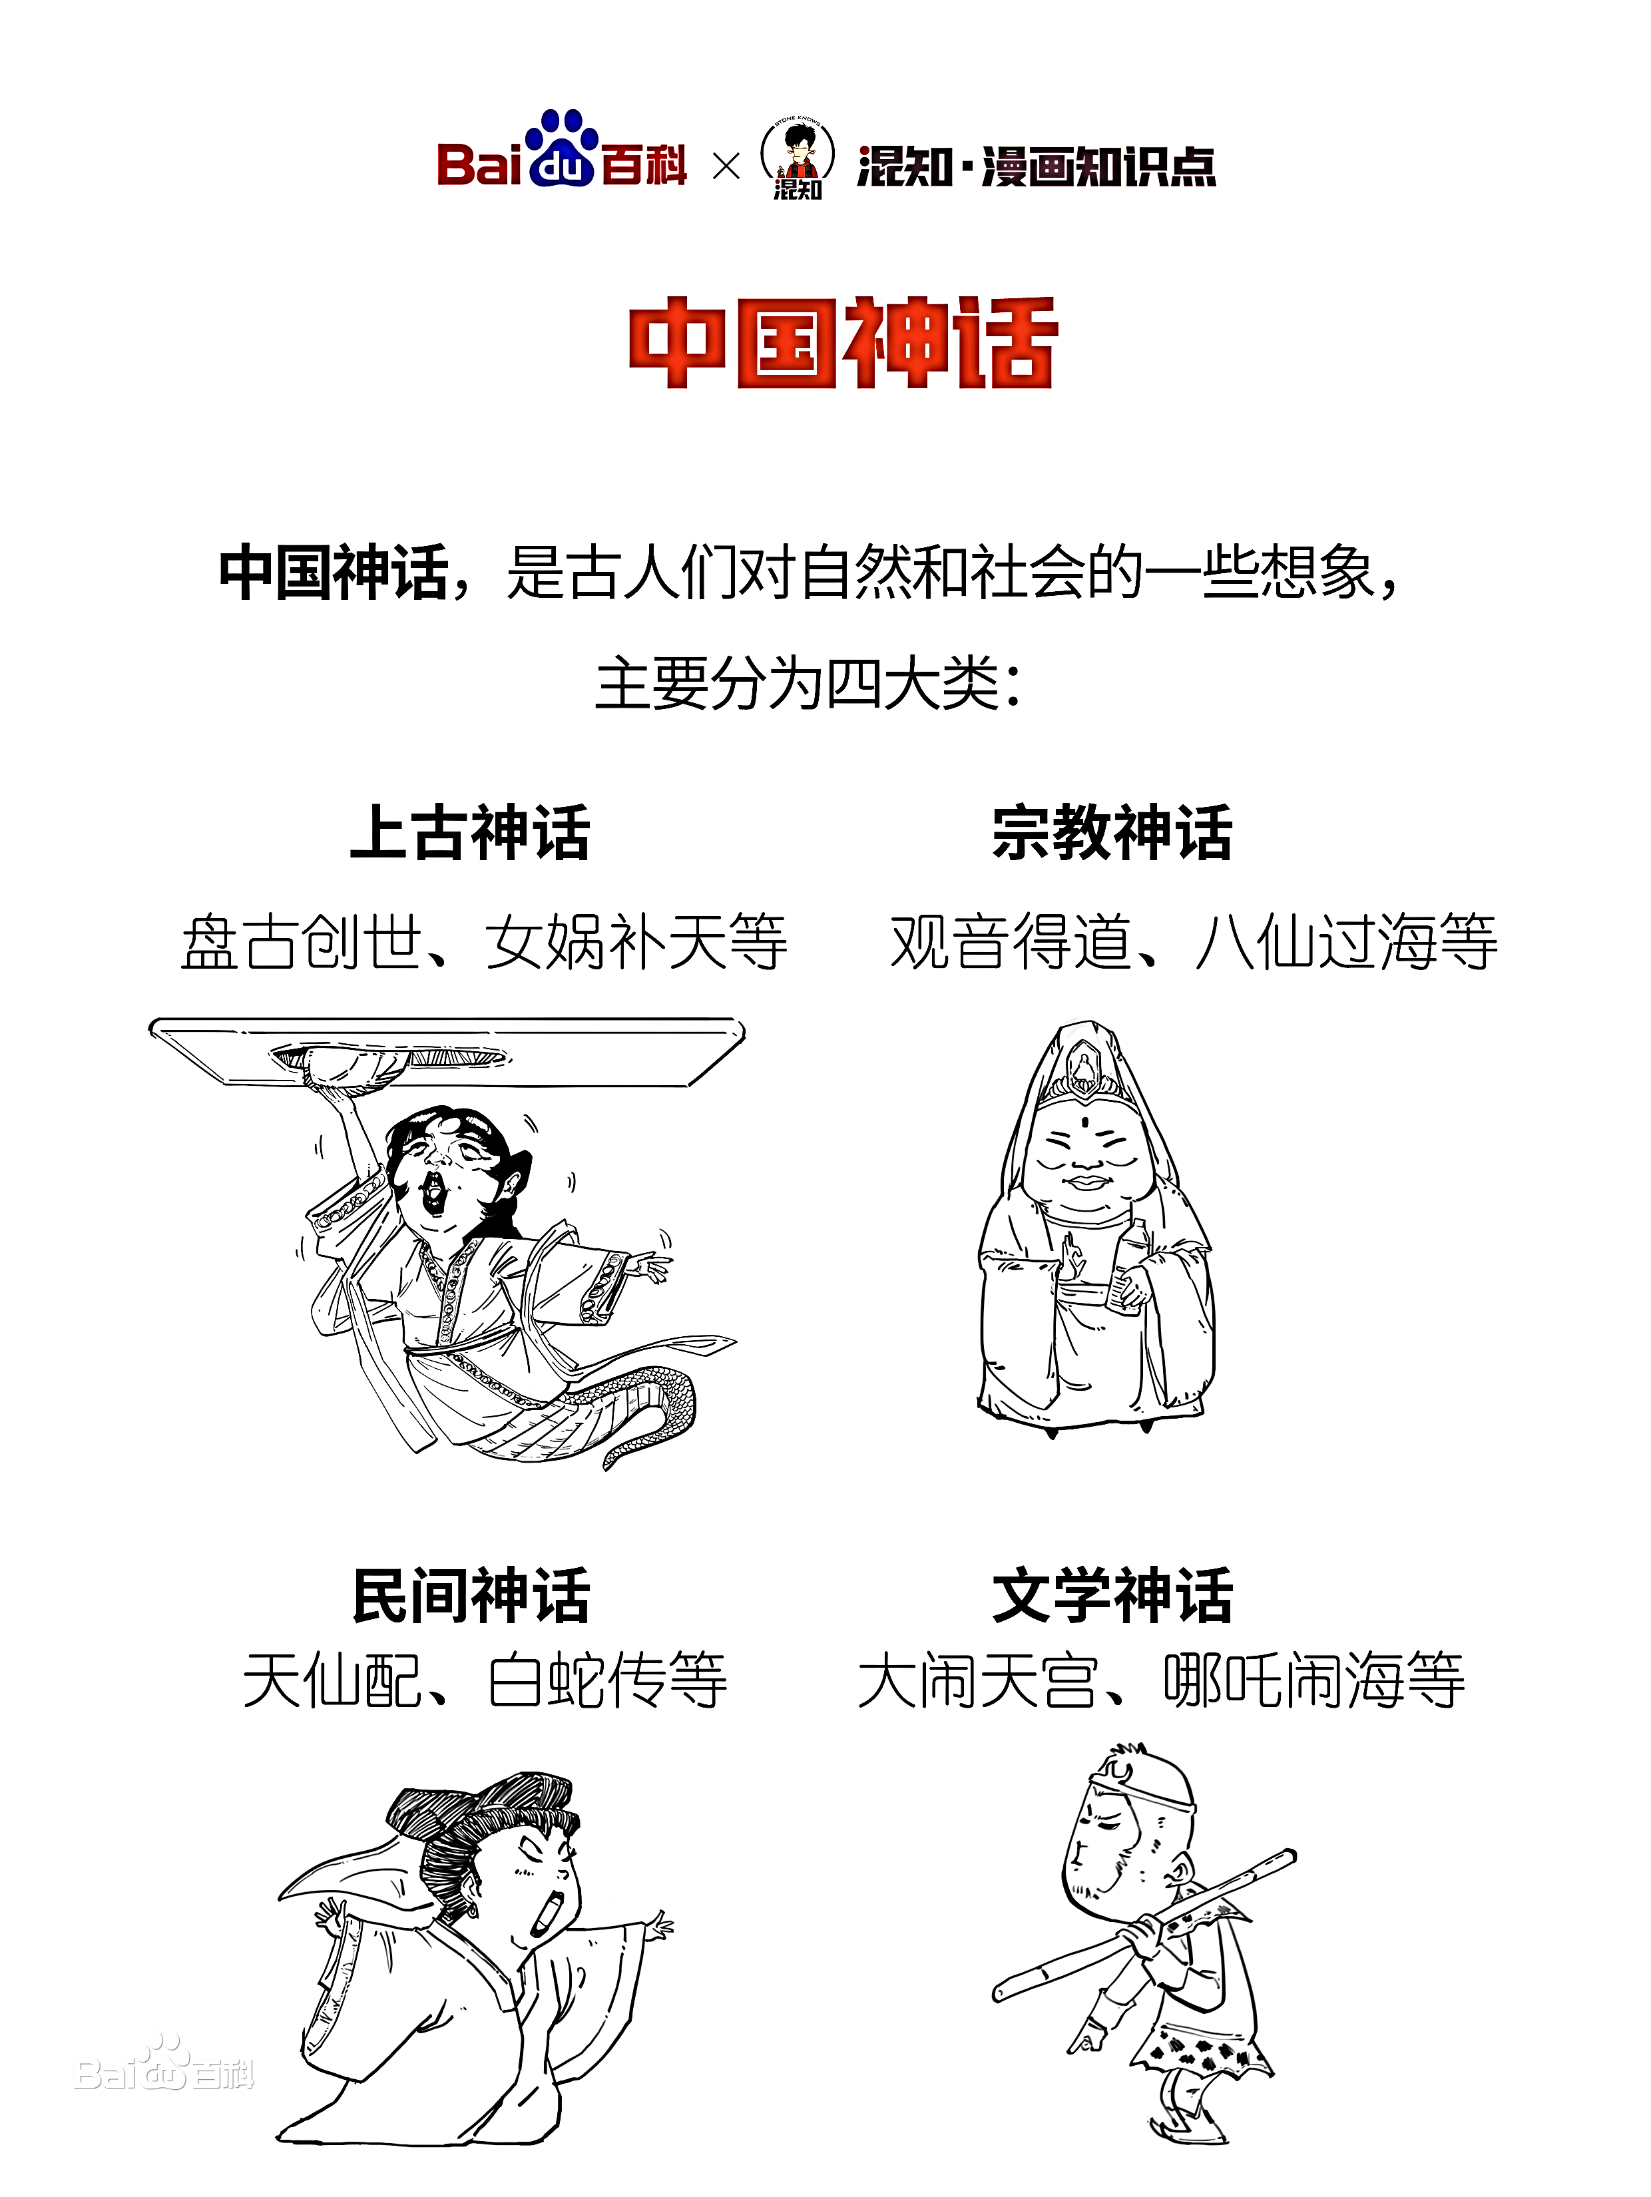
Ancient Myth
Chinese mythology system
Religious Myth

Slide 5
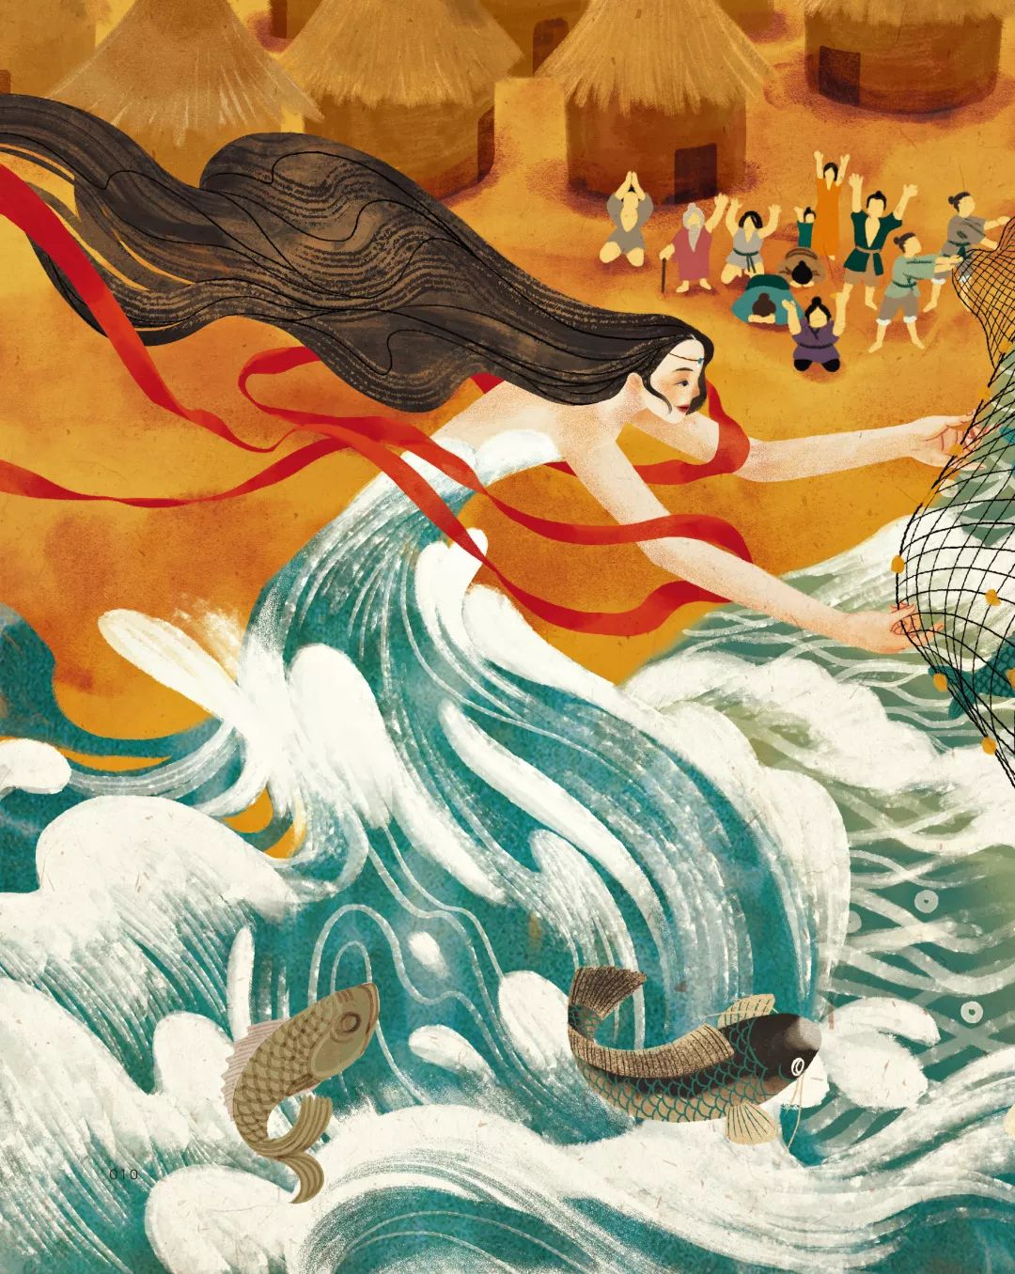
Ancient
mythology system
Chinese mythology system
Fragmented and scattered
Rich in content

Slide 6
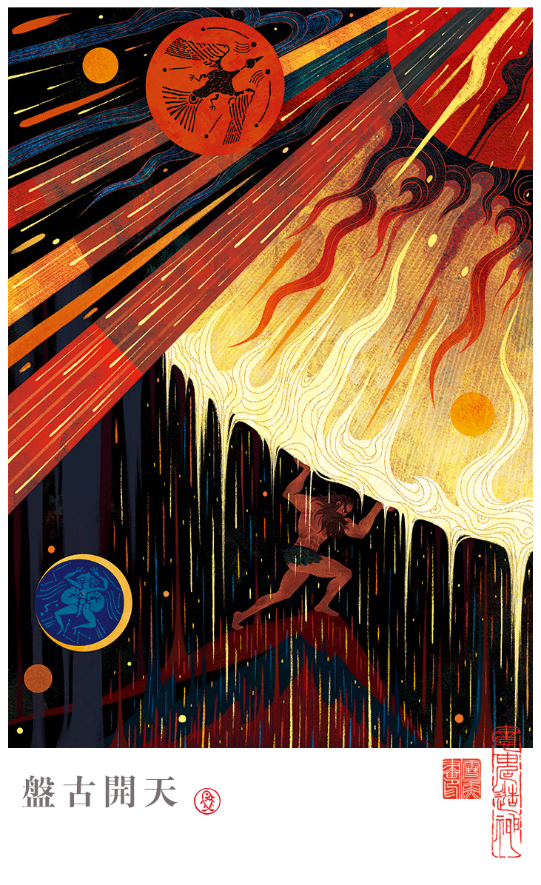
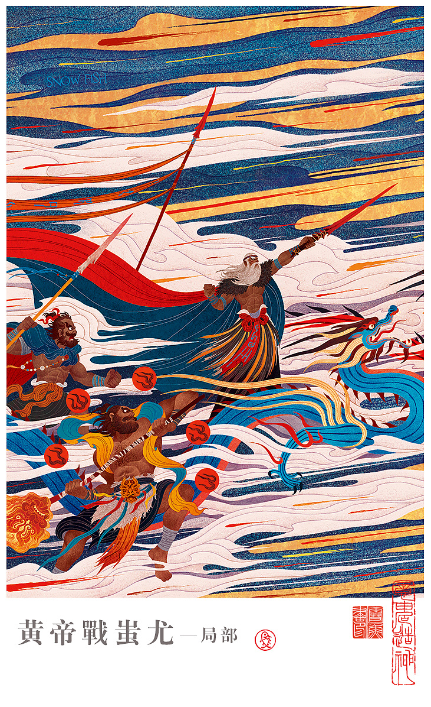
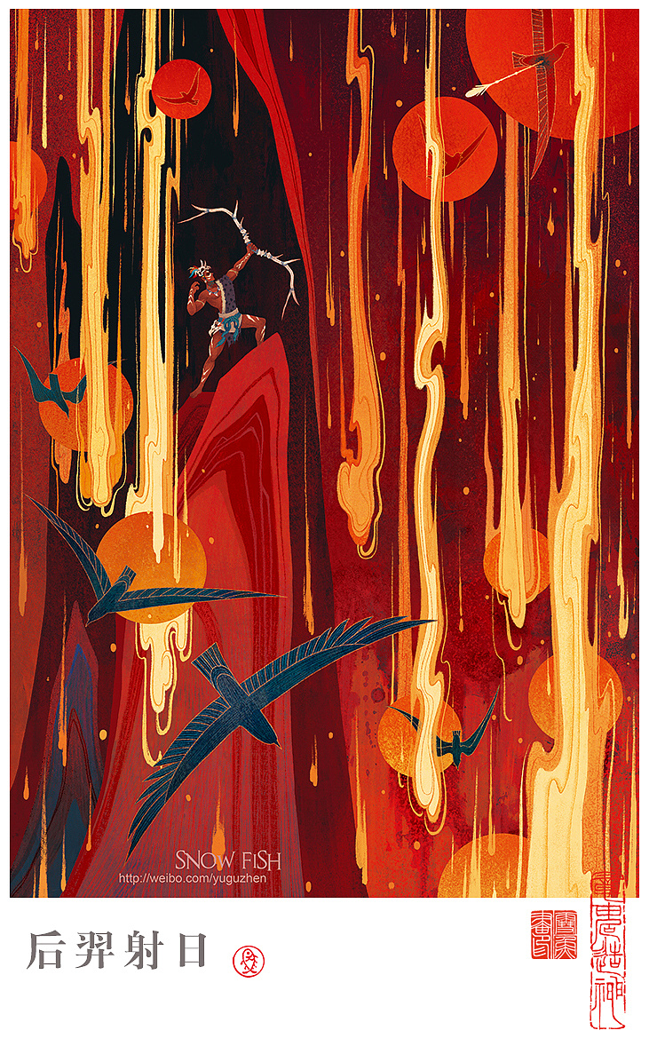
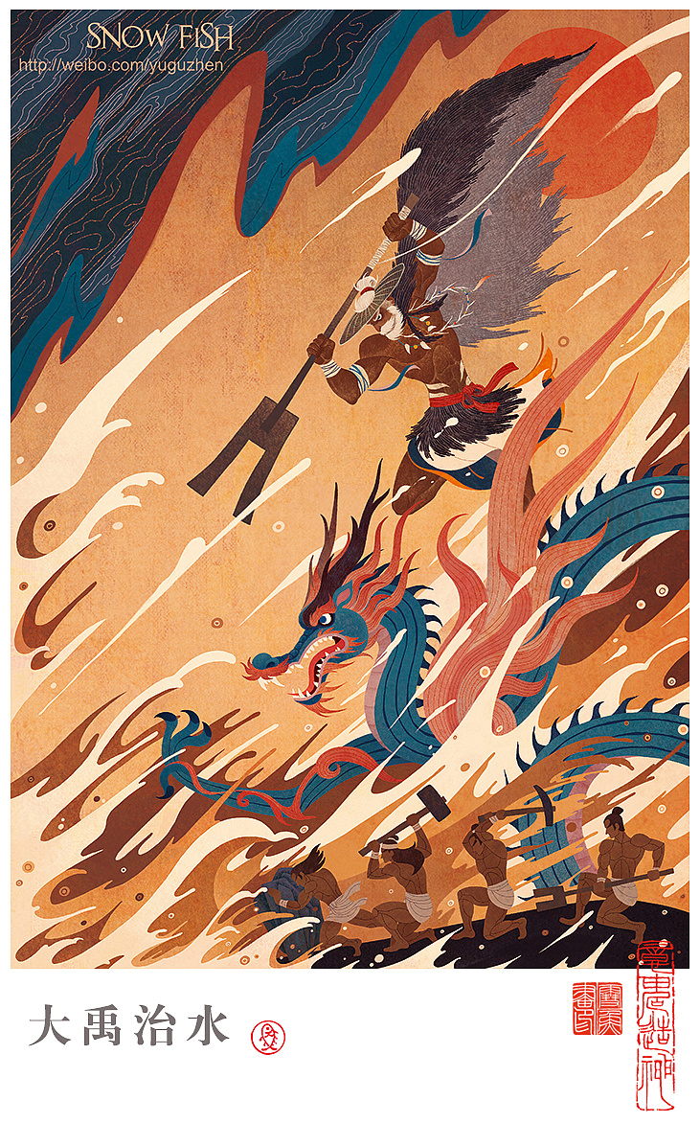
Chinese mythology system
Creation Myth
Tribal War
Heroic Myth
Human & Nature

Slide 7
Ancient Myth
Chinese mythology system
Religious Myth

Slide 8
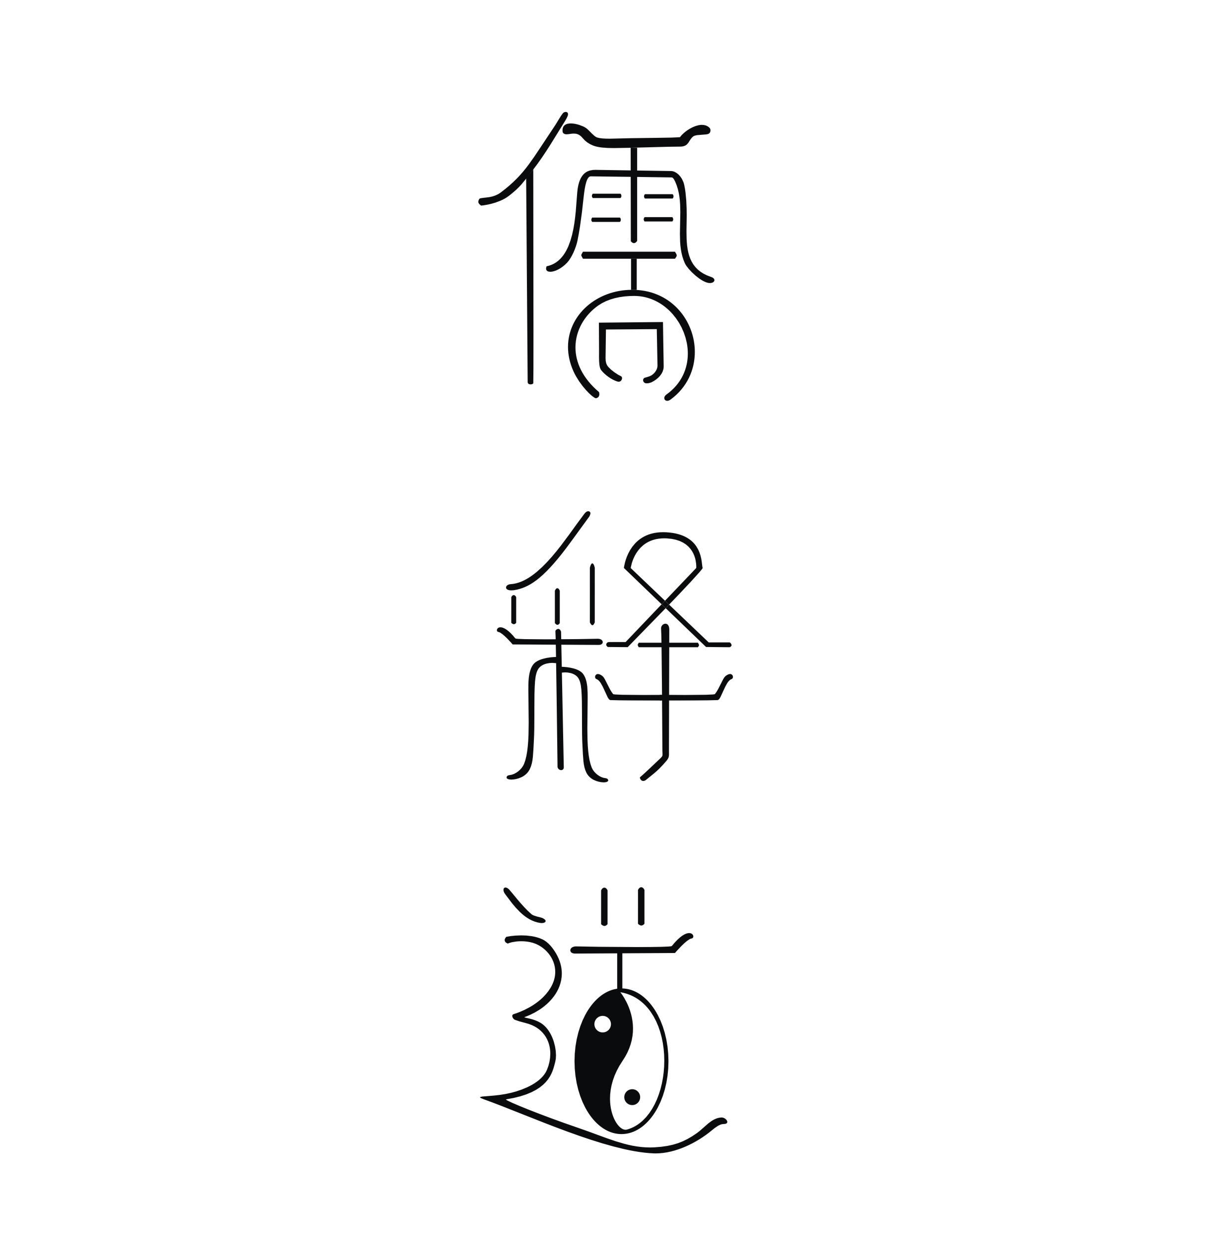
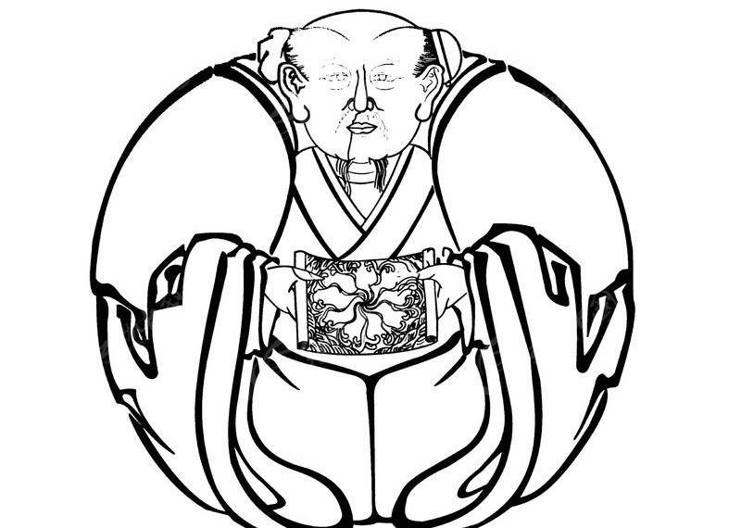
Chinese mythology system
Religious Myth
Confucianism
Buddhism
Taoism

Slide 9
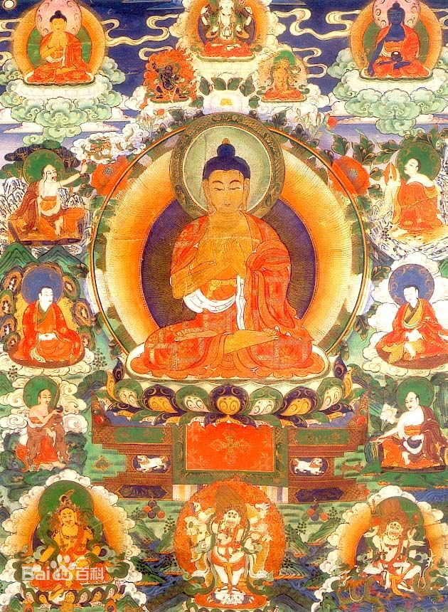
Buddhism
mythology system
Chinese mythology system
Mature
Impeccable
Educative

Slide 10
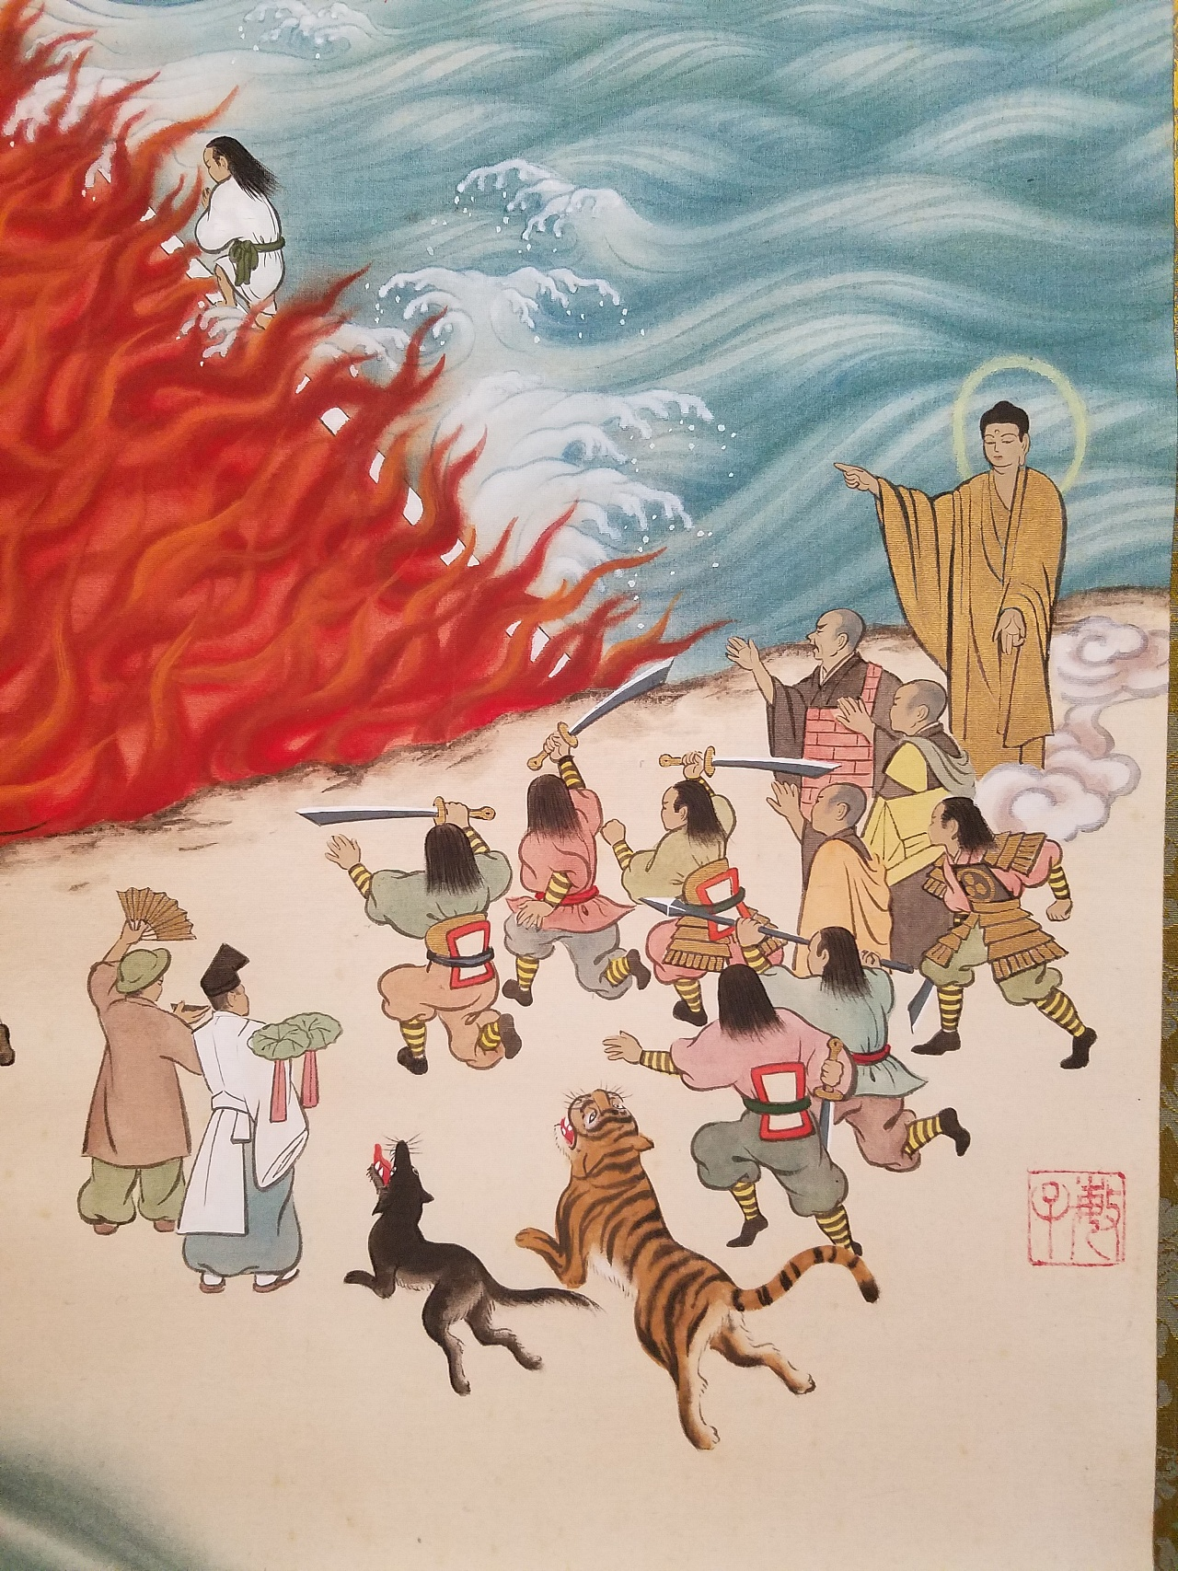
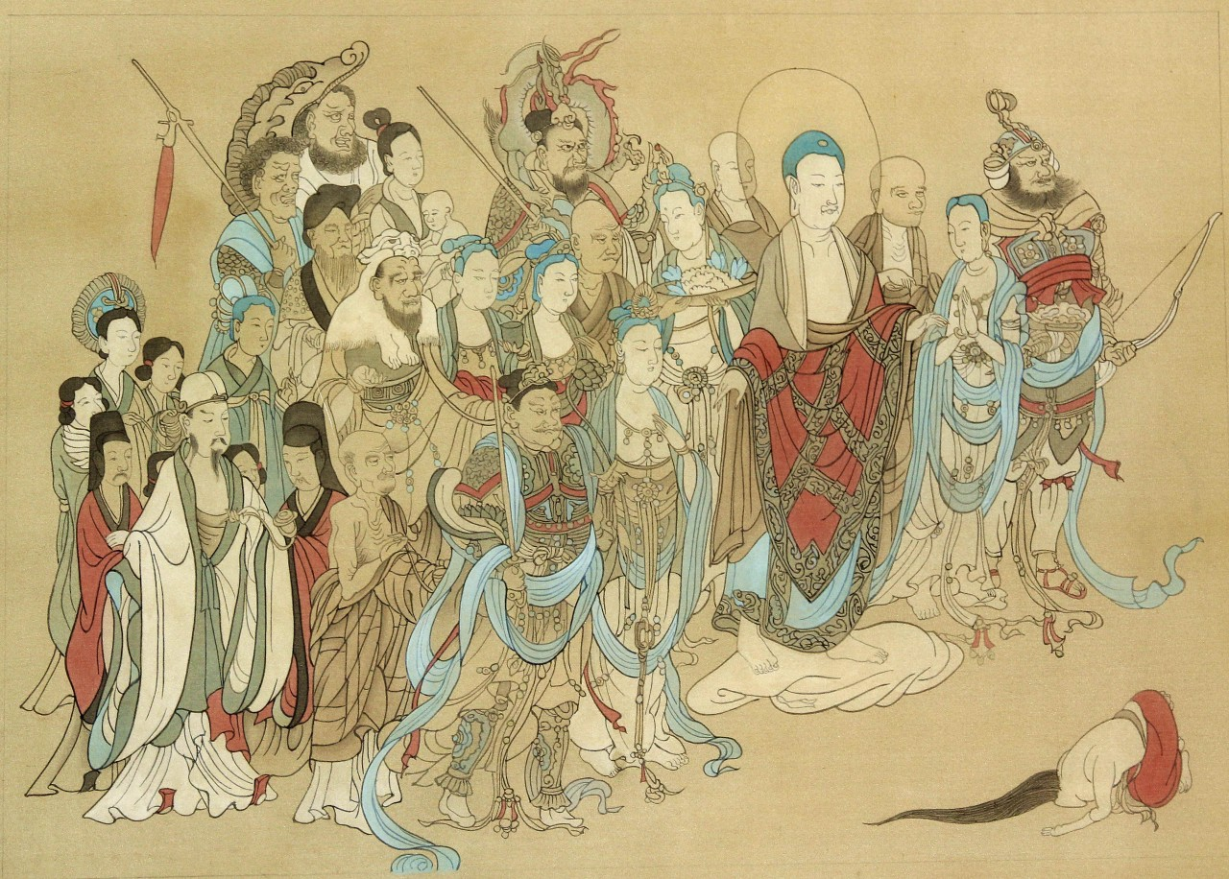
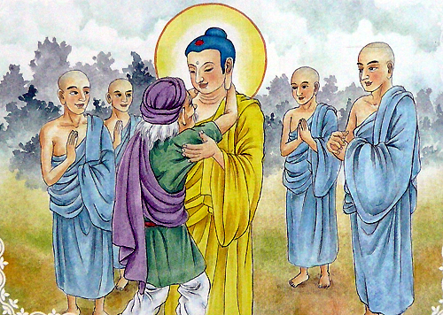
Chinese mythology system
Shakyamuni

Slide 11
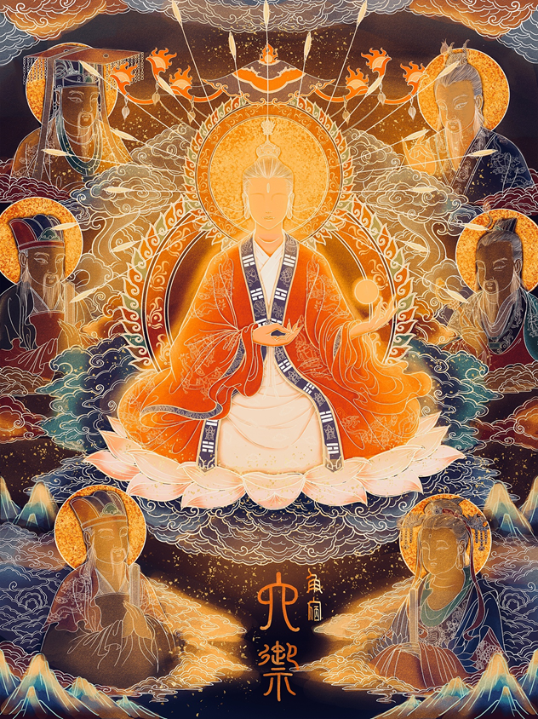
Taoism
mythology system
Chinese mythology system
Combination
Hierarchy

Slide 12
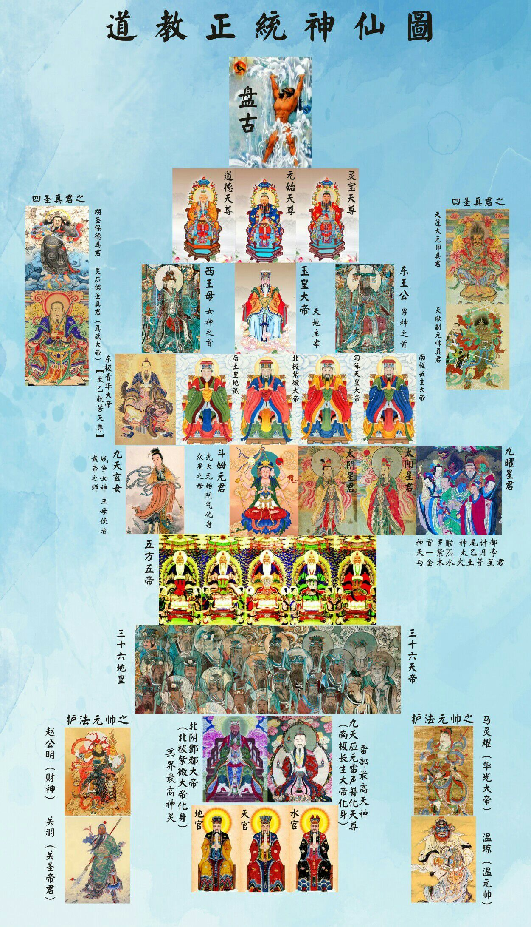
Chinese mythology system

Slide 13
Chinese mythology system

Slide 14
神 shén, 帝 dì and 仙 xiān
帝 dì
神 shén

Slide 15
神 帝 仙 shén, dì and xiān

Slide 16
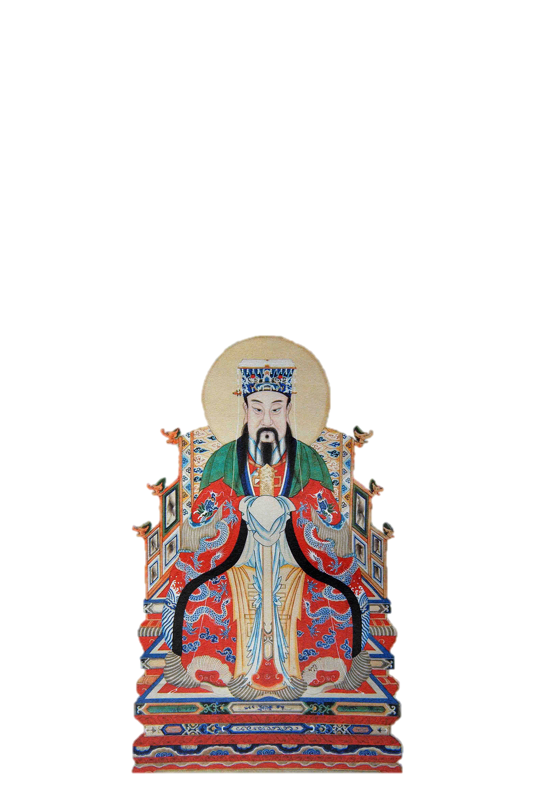
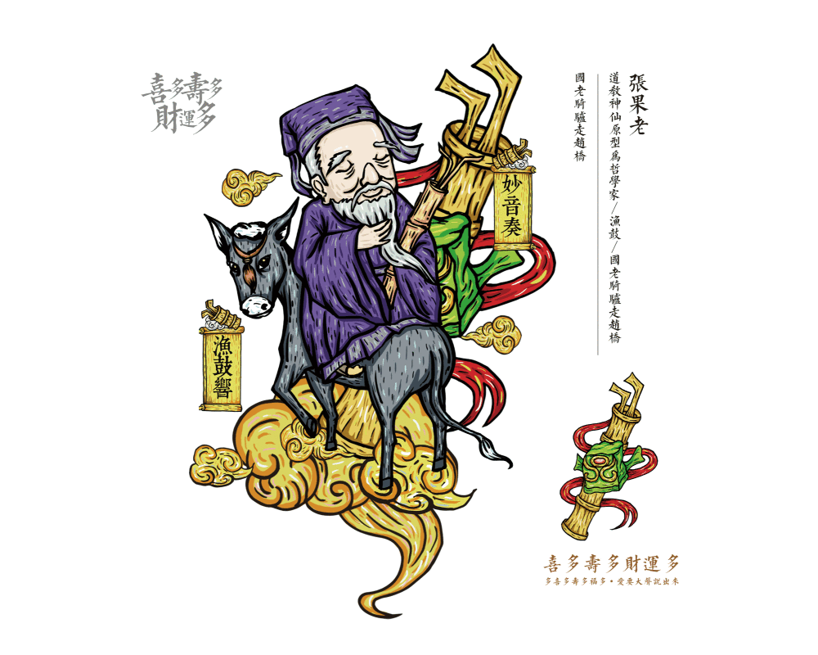
神 shén, 帝 dì and 仙 xiān

Slide 17
Eight immortals

Slide 18
Eight immortals
各显神通
八仙过海

Slide 19
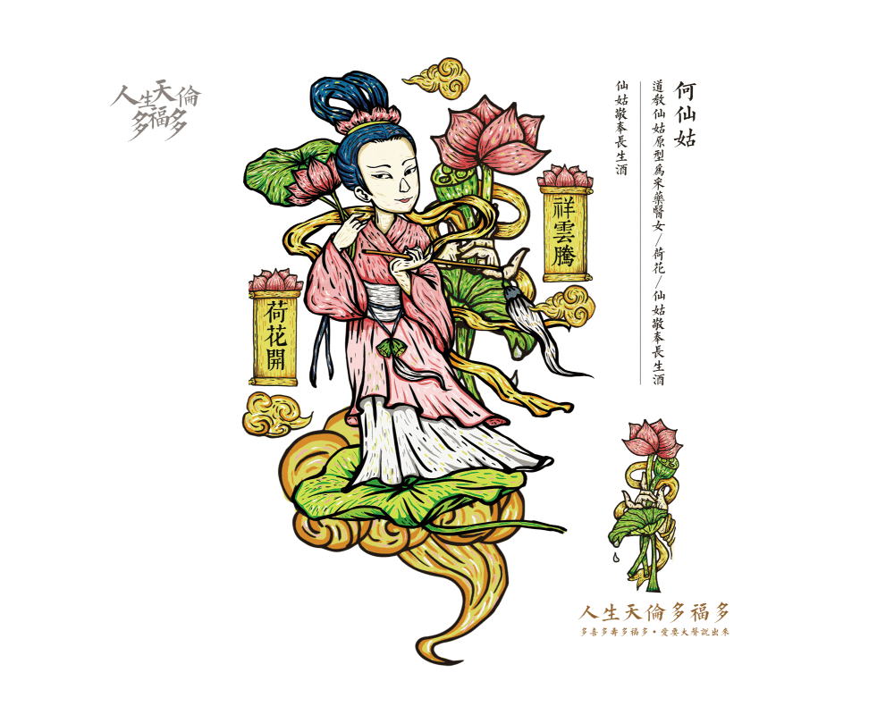
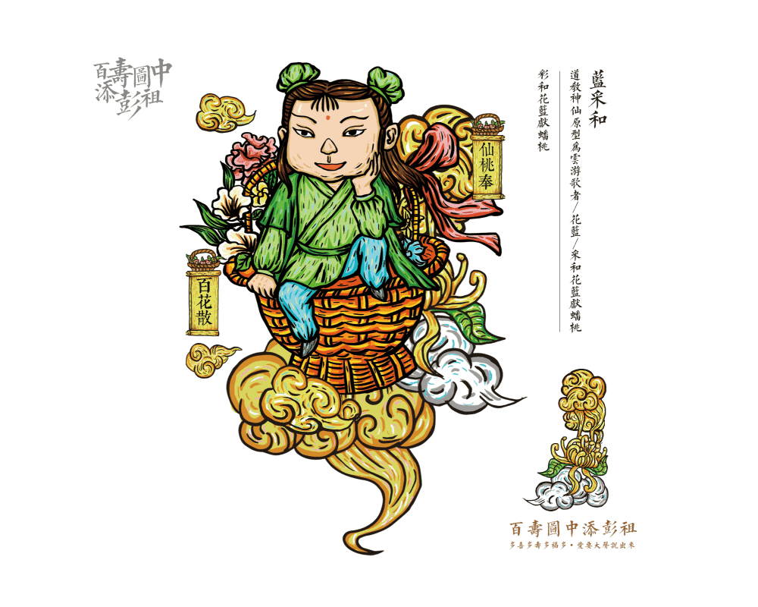
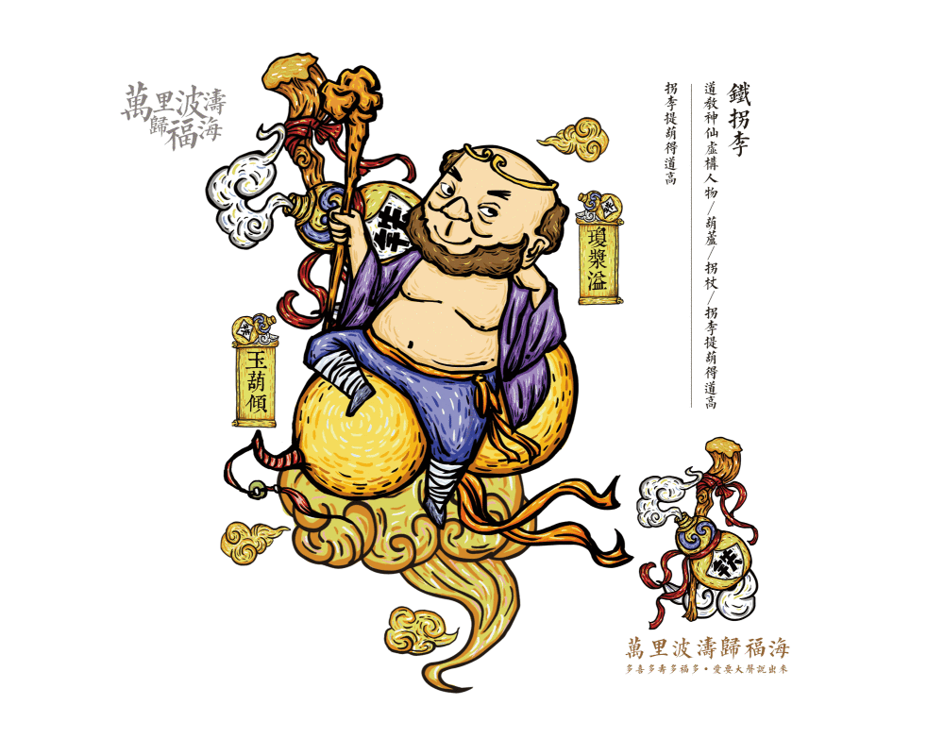
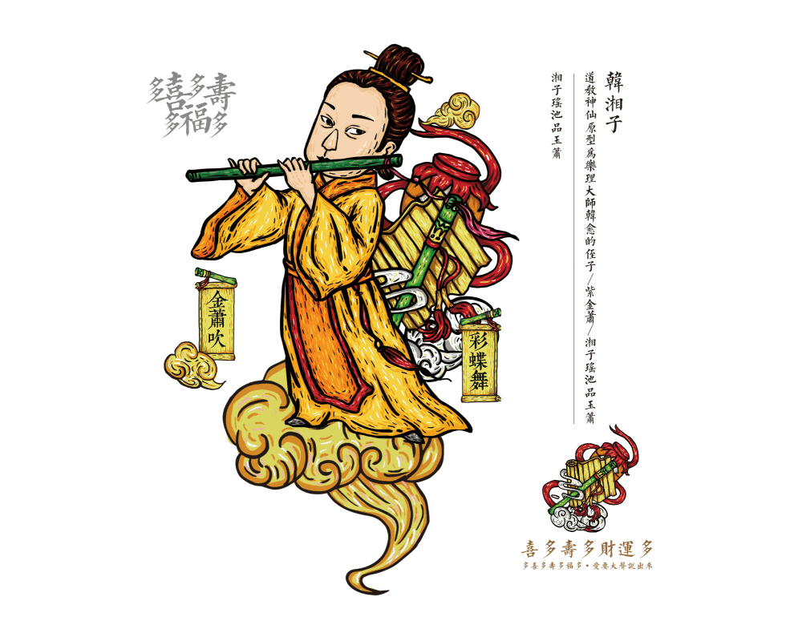
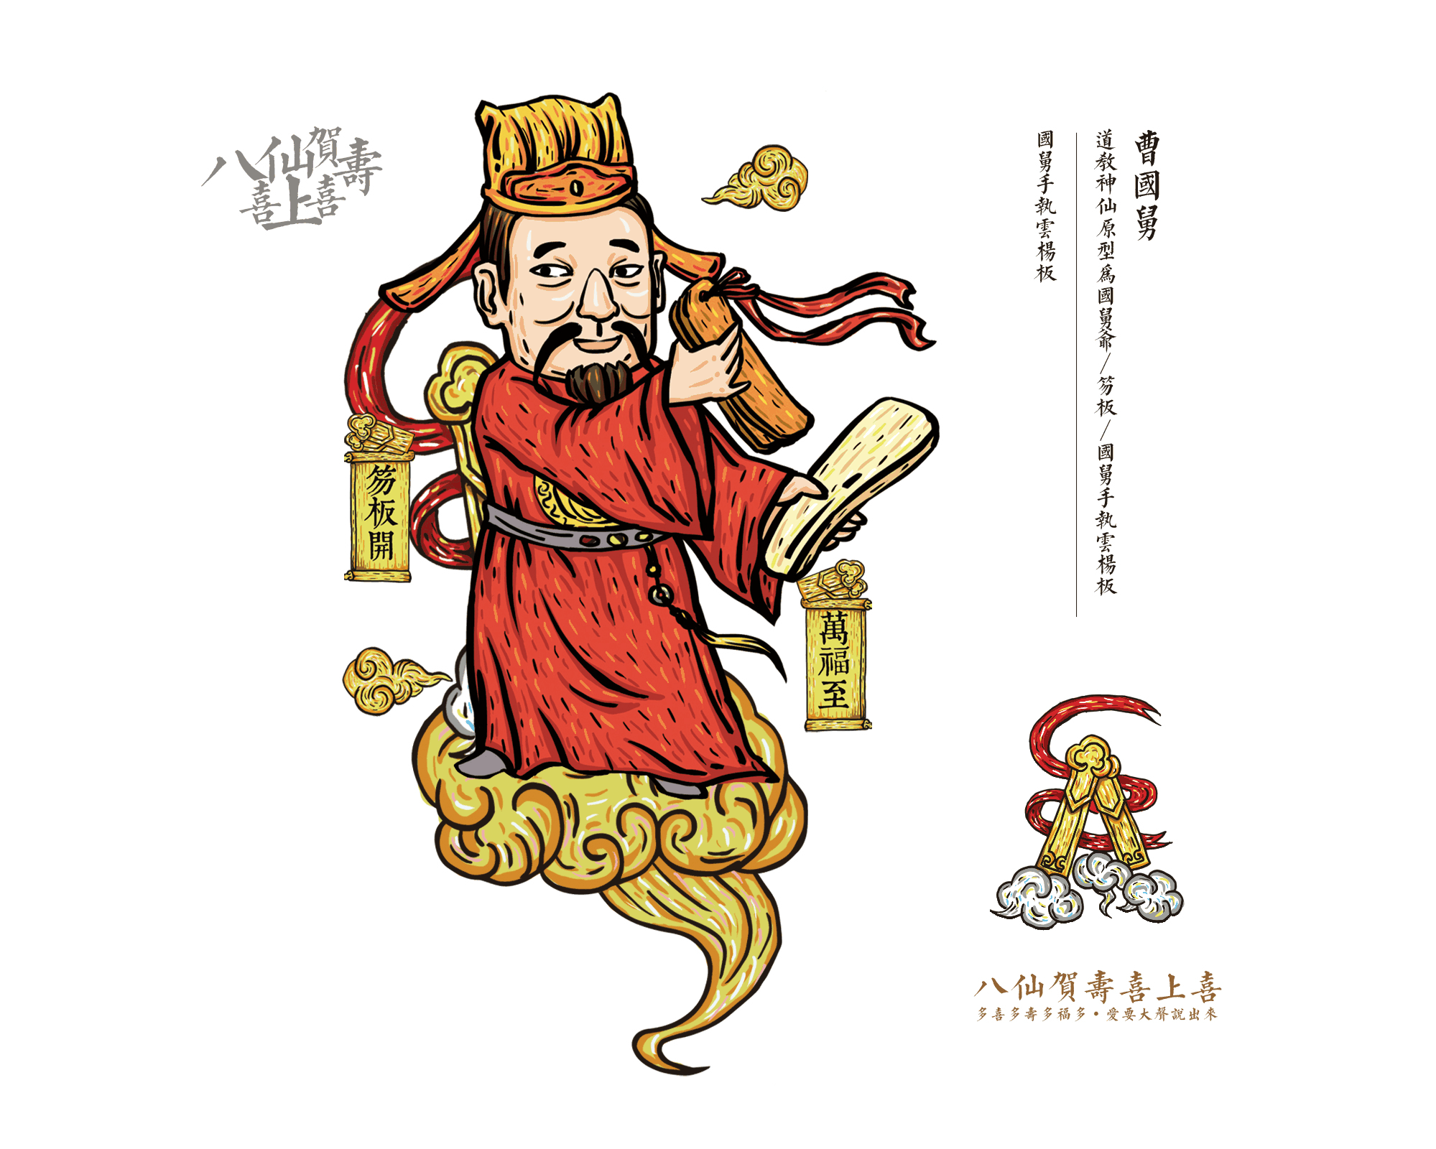
Eight immortals

Slide 20
Mythology:
Chinese Gods and Immortals
THANK YOU

