Slide 1

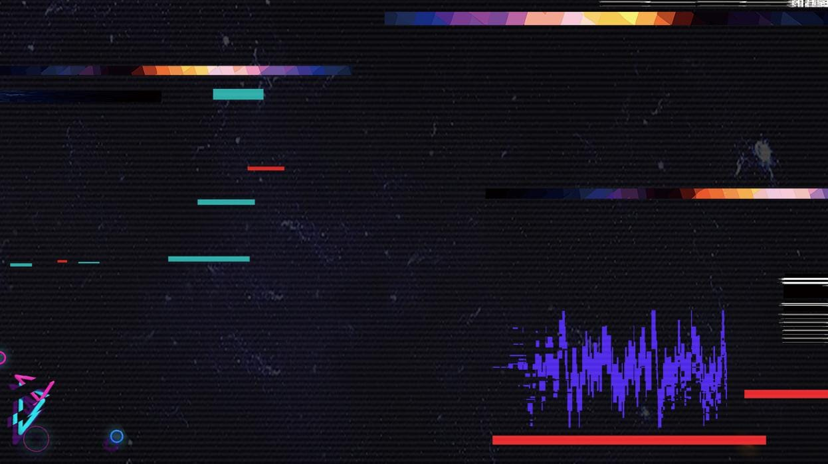


Science and Technology: TikTok (Douyin)
舒思靖
Rosie

Slide 2




目录 / CONTENTS
Overview of Douyin and Tik Tok
Popularity and Effects
Comparison Between Tik Tok and Instagram

Slide 3
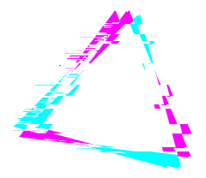
1
Overview of Douyin and Tik Tok

Slide 4

Overview of Douyin
Overview of Douyin
A short video media app developed by China’s young tech giant Bytedance.（北京字节跳动科技有限公司）
Interact with the camera and sing at the same time.
Show off dance skills and comedy routines.
It allows users to create and share short videos as well as livestreams.
A powerful recommendation algorithm（算法）.
Dances, comedies, babies, food, pets, pranks, and stunts.
One of the few applications that has enjoyed wild popularity inside and outside China.

Slide 5
Overview of Douyin
Overview of Tik Tok
In September 2017, the international version of Douyin, Tik Tok, was launched.
Only have access to one version of the app.
By the same parent company
but
not one and the same.
The two apps host completely different content, and the content is not shared between them.

Slide 6
2
Popularity and Effects

Slide 7
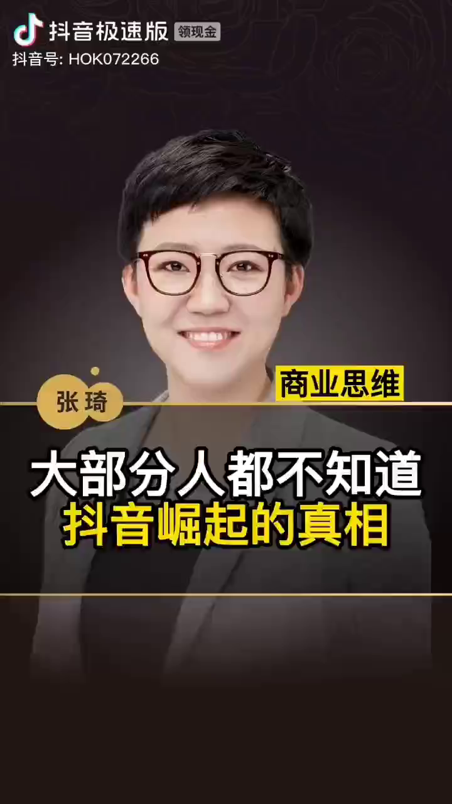
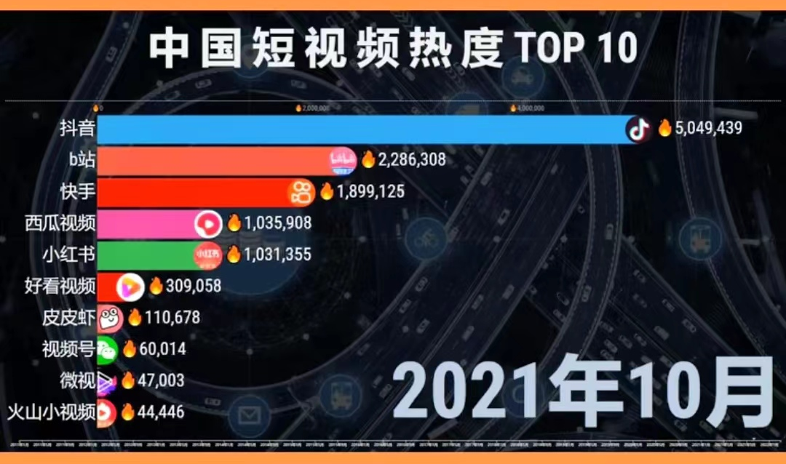
Popularity

Slide 8

Popularity
Localized content
Douyin sends personalised recommendations to each of its users. This ensures that Douyin users are always updated on the latest trending videos and are never out of ideas for video creation.
Easy content creation, sharing, and viewing
Due to the short format, neither the video-creation nor the watching process takes much time or effort. Also, the short-form video content plays as soon as a user opens the app.

Slide 9
Effects:Benefits
There are some people that make videos with great opportunities and life tips that can help many people. Also, there are other people like doctors or teachers on Tik Tok utilizing the platform to teach new things every day.
Ⅰ.Moral Entertainment
Ⅲ. Learning New Things
The major advantage of Tik Tok is that it serves as a great source of entertainment. Overall, it is a great app to help stay entertained, especially during the stress of the pandemic.
Ⅱ.Publicity
With Tik Tok, anyone can create short videos doing anything they choose to do that’s appropriate and legal to ensnare the public interest and become viral in society.
As an engaging
platform, Tik Tok connects determined youths together to volunteer for
nonprofits like Chinese Red Cross Foundation or intern for companies.
Ⅳ.Providing New Opportunities

Slide 10
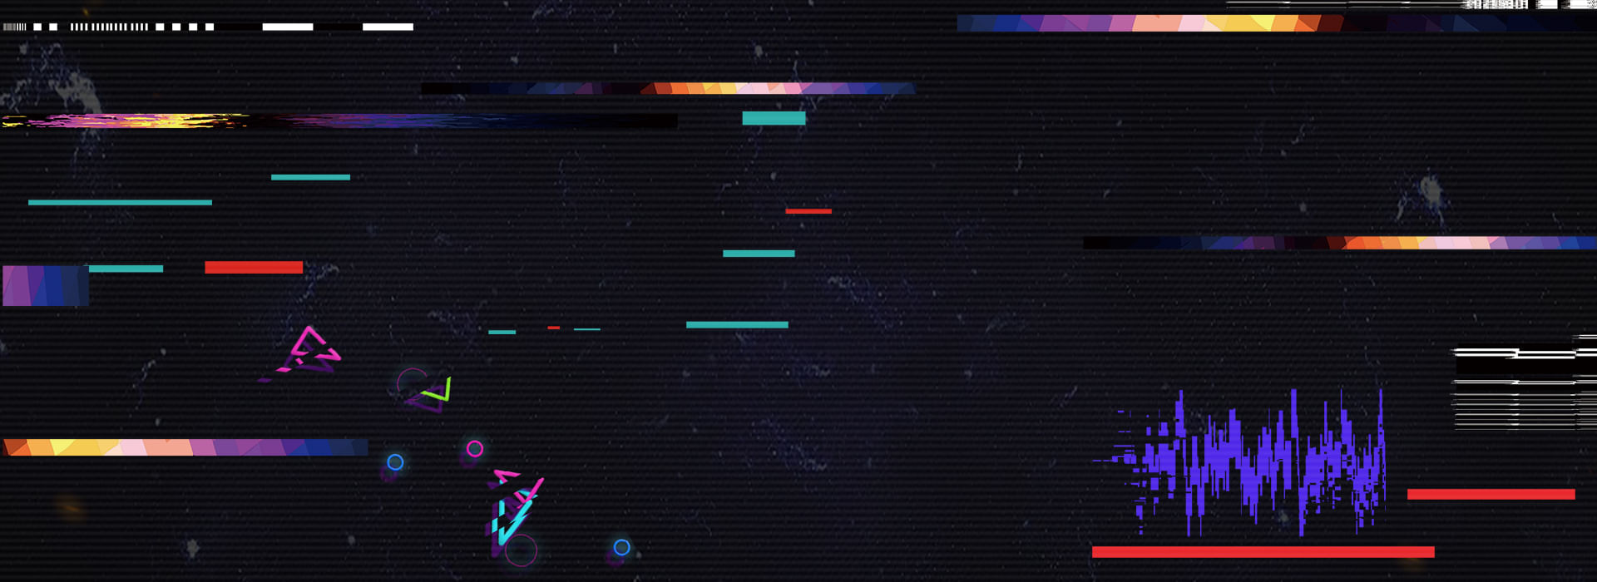
Effects:Negative Effects
Addiction
The app is designed to be addictive, with an unlimited stream of videos at around 30 seconds each, making users hard to get bored.
01
02
Bullying/Mental Health
It can also be used as a platform for bullying. Some people criticize other people’s videos, while others create videos for deriding someone.
Unsafe
On TikTok, there are no restrictions as to who can join the app, so strangers can easily message children and create harmful situations.
03

Slide 11
3
Comparison Between Tik Tok and Instagram

Slide 12
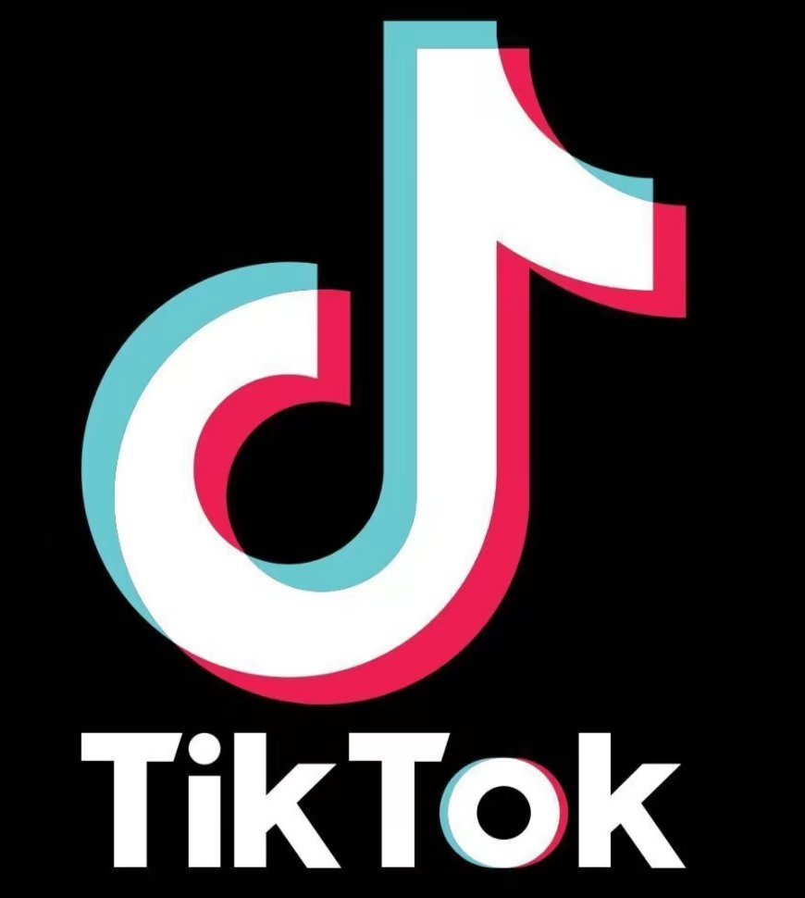
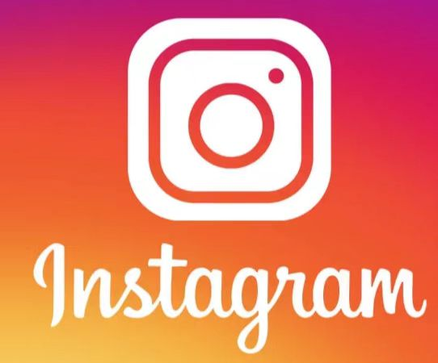
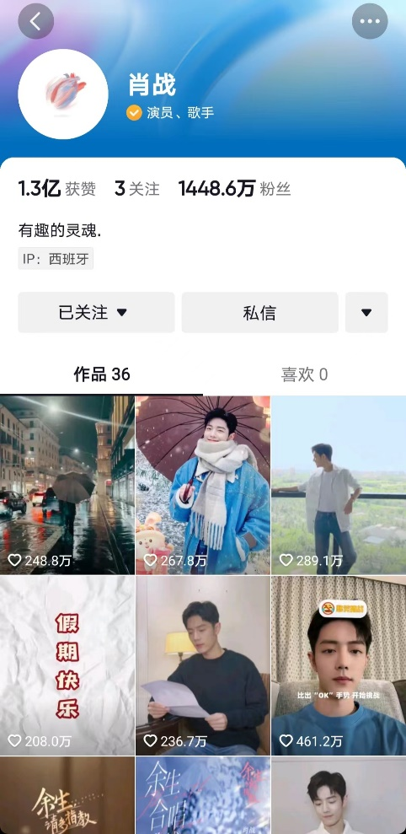
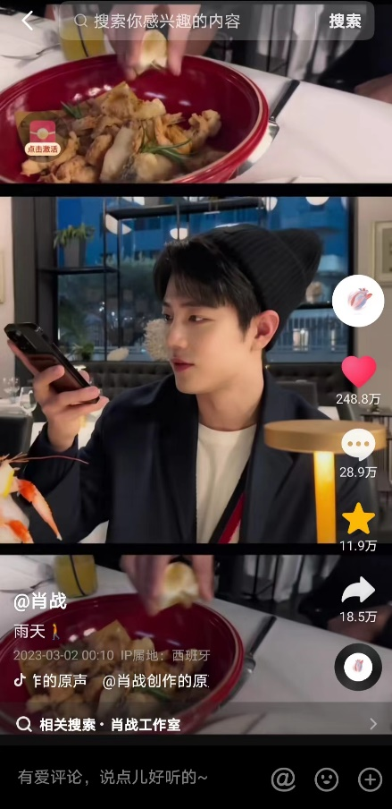
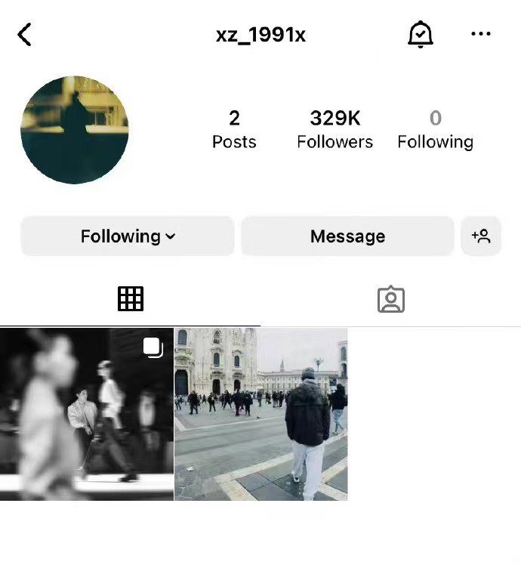

VS
Text here
30%
25%
35%
45%
Text here

Slide 13
VS
Time limit:
Tik Tok currently does not support a long-form video. While IGTV, Instagram’s long-form video feature, allows a video length of up to one hour.
Users:
Most Tik Tok users are younger than that of Instagram. According to Carissa Brones, Most Tik Tok users belong to generation Z and most Instagram users belong to generation Y.
Community:
Compared to Instagram, the Tik Tok community is distinctly palpable. It allows users to easily connect, build friendships, and collab with each other. Besides, something new and trendy is pushed to the users every week, so as to further increase its attention.
Text here
30%
25%
35%
45%
Text here

Slide 14
Thanks

