Slide 1




Bamboo Weaving

Slide 2

CONTENT
Introduction to Bamboo Weaving
02
Cultural Significance
01
03
Materials and Tools
04
Techniques
Regional Styles and Masterpieces
06
Conclusion: Preserving the Craft
05

Slide 3
Introduction to Bamboo Weaving
01

Slide 4
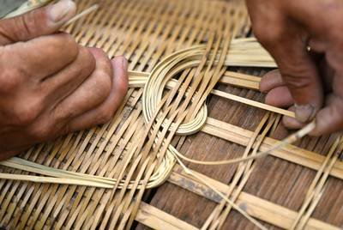
Definition
Traditional Craft
Bamboo weaving is a traditional Chinese craft using bamboo strips to create various objects. It dates back thousands of years and is still practiced today.
This craft combines artistry and functionality, making it unique among traditional crafts.

Slide 5
Cultural Significance
02

Slide 6
Cultural Symbols
Bamboo as a Symbol of Virtue
Bamboo is known as the “gentleman’s plant” in Chinese culture, symbolizing resilience and humility. Its qualities are admired and emulated.

Slide 7
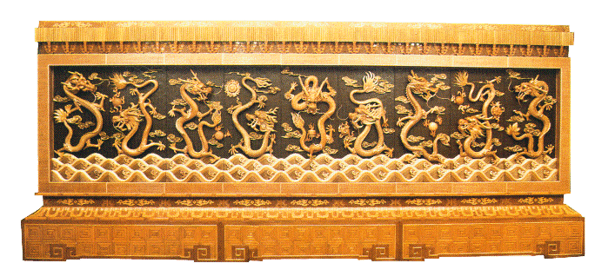
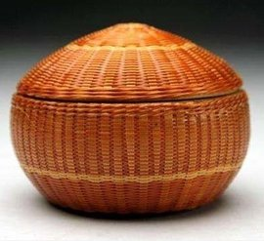
UNESCO Status
Recognized Intangible Cultural Heritage
Dongyang Bamboo Weaving
from Zhejiang
Qingshen Bamboo Art
from Sichuan

Slide 8
Materials
and Tools
03

Slide 9
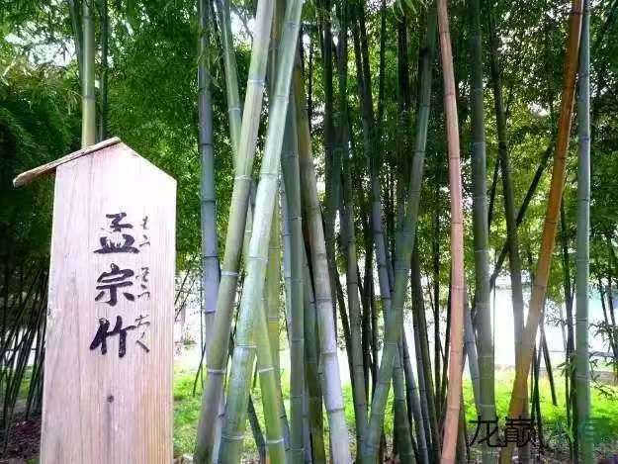
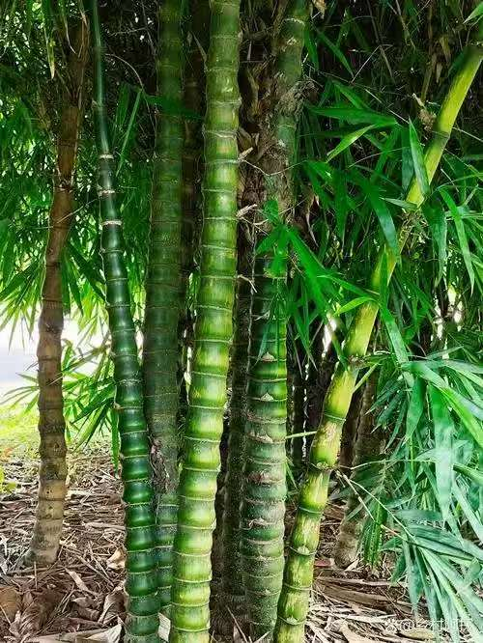
Bamboo Selection
Preferred Species
The selection of bamboo is crucial as it affects the quality and durability of the final product.
Moso bamboo and Bambusa ventricosa are the preferred species for bamboo weaving. They are chosen for their strength and flexibility.
Moso bamboo
孟宗竹
Bambusa ventricosa
佛肚竹

Slide 10
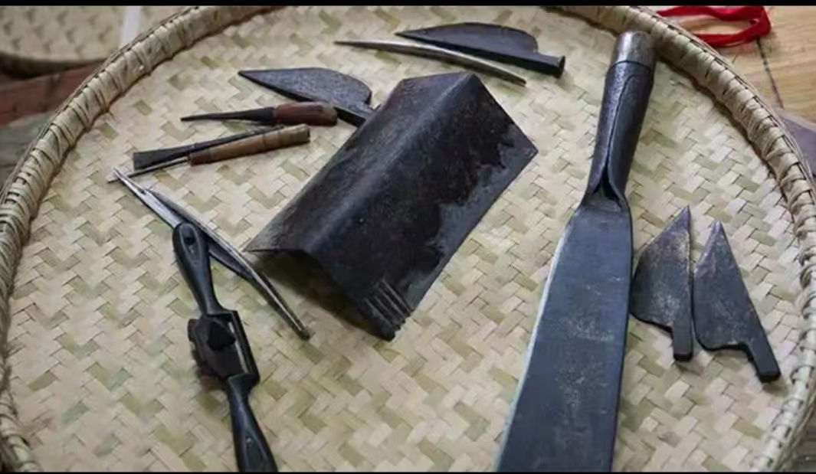
Toolkit
The toolkit includes knives, shavers, awls, and weaving frames. Each tool has a specific function in the weaving process.

Slide 11
04
Techniques

Slide 12
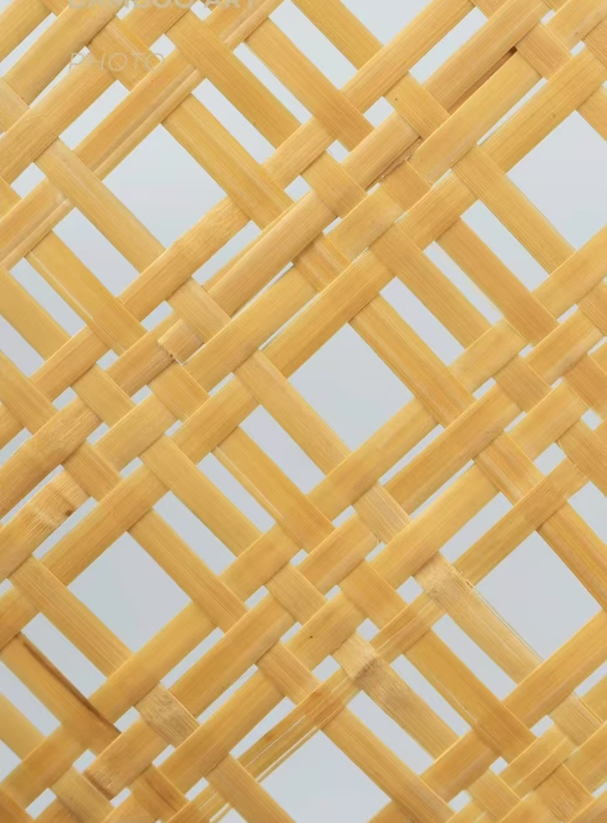
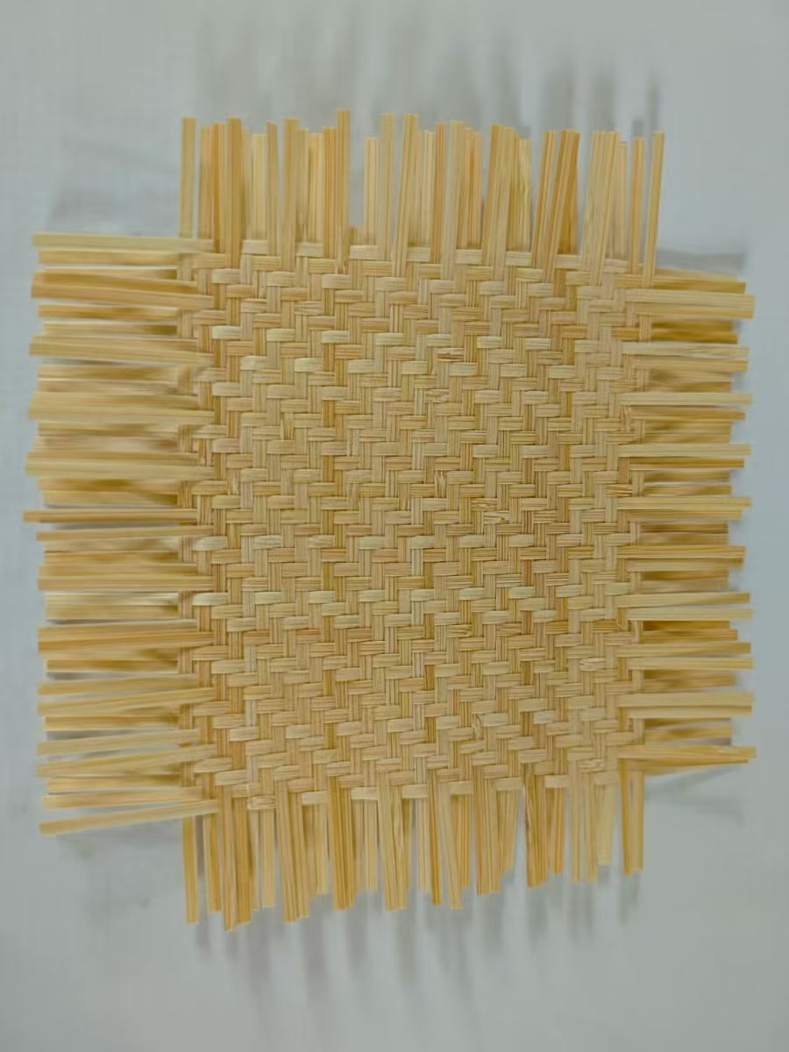
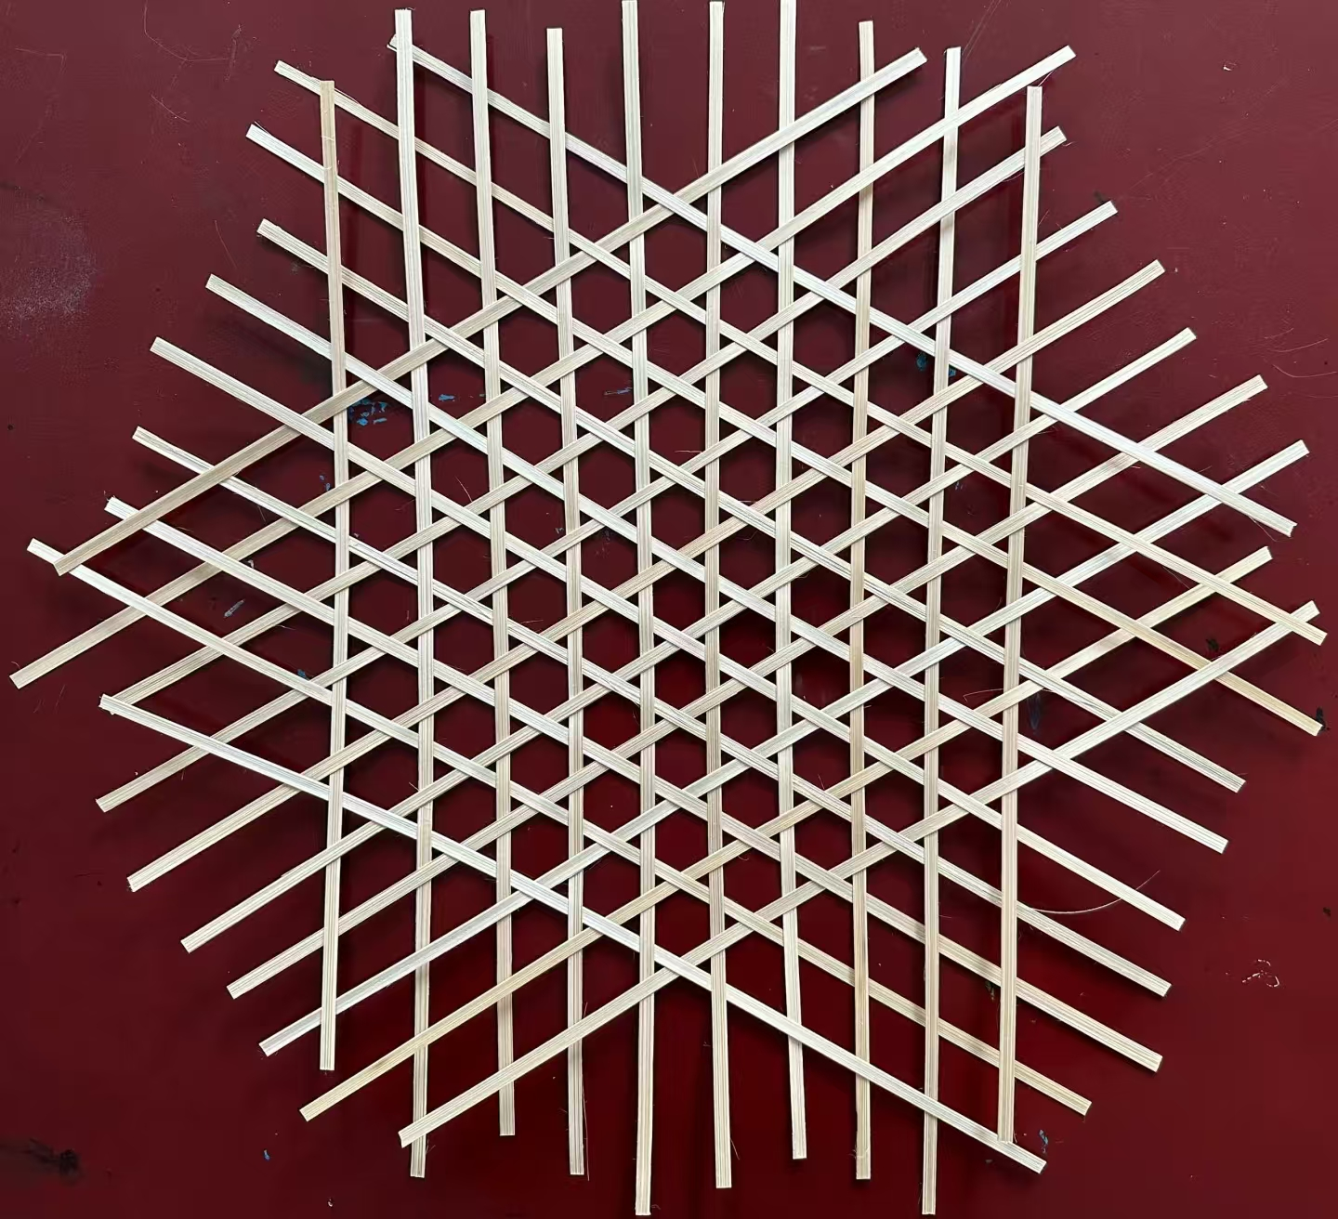
Basic Weaving Methods
Checker Weave
方格编织
Hexagonal Weave
六角孔编织
Twill Weave
斜纹编织

Slide 13
Regional Styles and Masterpieces
05

Slide 14
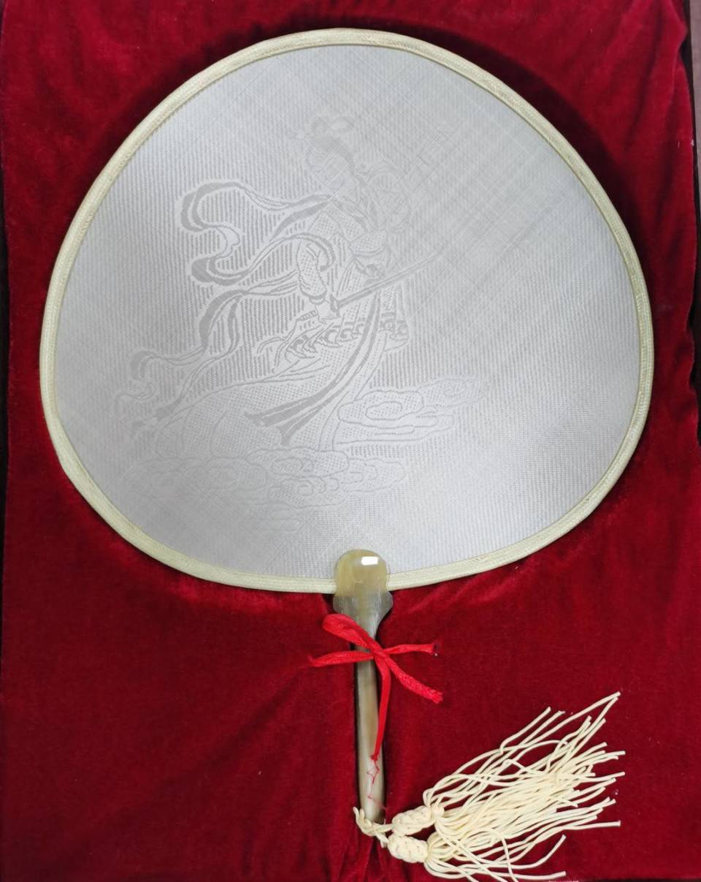
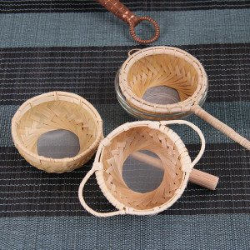
Regional Variations
Sichuan——Gong Fan
“silk- like” fans
Fujian——Anxi Bamboo- Tea Ware

Slide 15
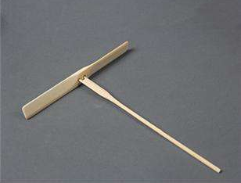
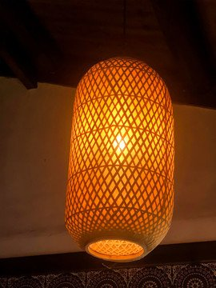
Iconic Artworks
“Bamboo Dragonfly” toys
Bamboo Lanterns

Slide 16
Conclusion Preserving the Craft
06

Slide 17
Challenges
One of the main challenges facing bamboo weaving is the declining number of artisans. This is due to the difficulty of the craft and the competition from factory- made products. Preserving the craft requires addressing these challenges.
Declining Artisans

Slide 18
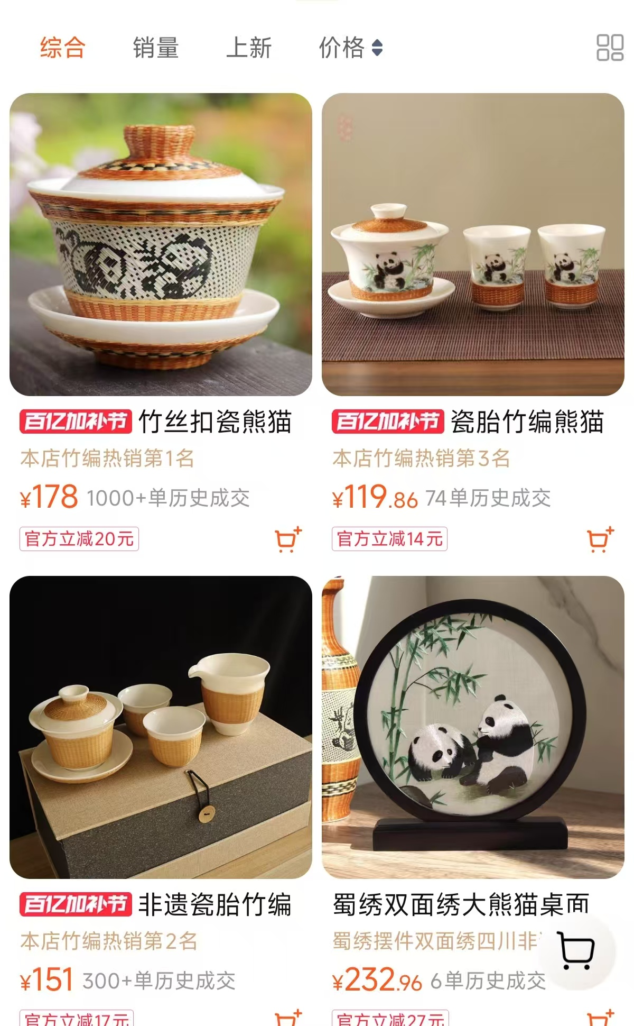
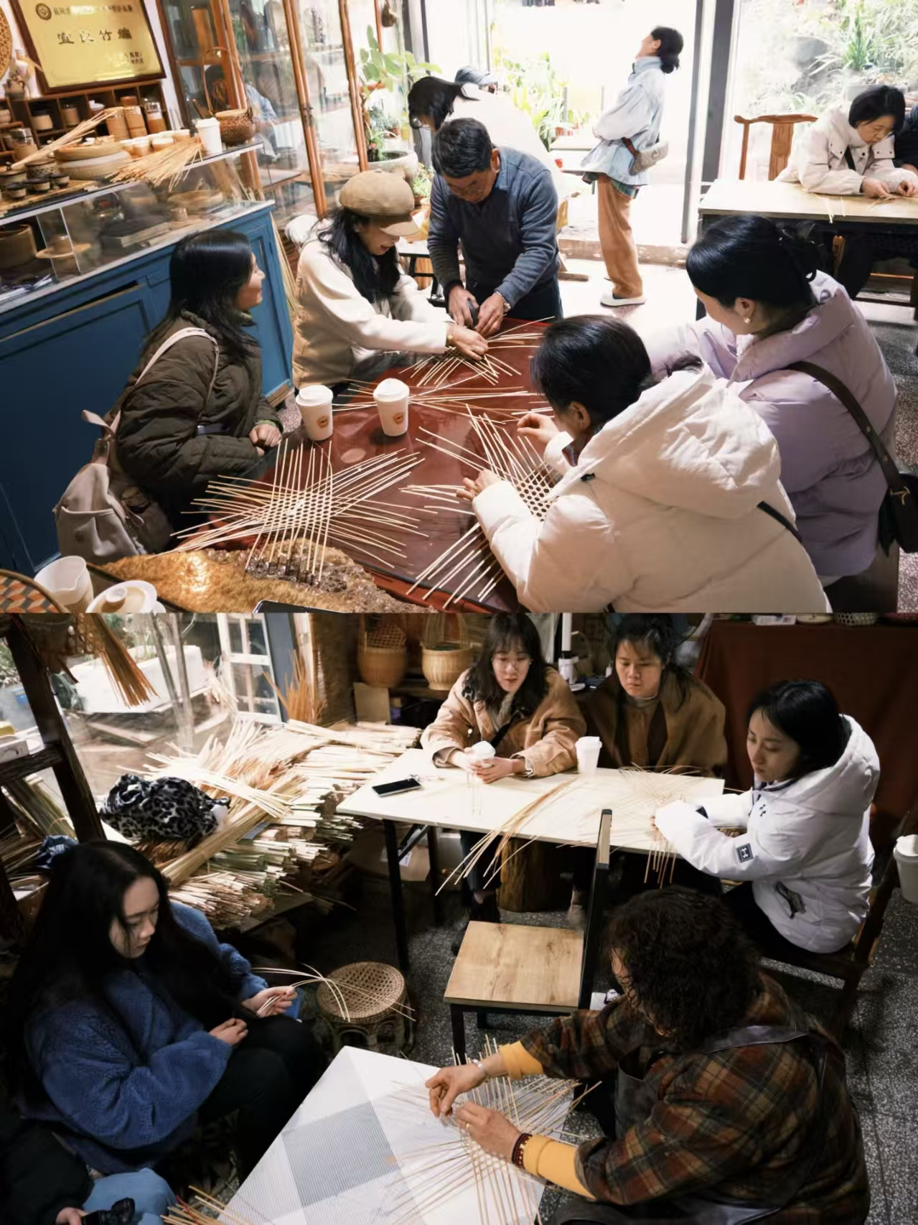
Preservation Efforts
Youth workshops, and e-commerce platforms like Taobao’s intangible cultural heritage shops are helping to preserve the craft.

Slide 19
Thank you

