Slide 1
Contemporary Literature
Yang Yue 杨悦 Yi Zichu 义子楚
November, 16, 2020

Slide 2
1
Introduction to Contemporary Literature
Content
2
The Development of Contemporary Literature
3
The Main Representatives and Works

Slide 3
Introduction to Contemporary Literature
Literature from the founding of New China in 1949 to the present day is referred to as contemporary literature. It firstly refers to Chinese literature since 1949; secondly, it refers to literature that occurred in a specific historical context of socialism, which is limited to the scope of "Chinese Mainland".
The First National Literary Congress held in July 1947 marked the starting point from which China's new literature entered the stage of contemporary literature.

Slide 4
The Development of Contemporary Literature
Early Stage of Socialism
New Period
Ⅰ
Ⅱ
Ⅲ
stage
1949
1978
1989
(1990s)
present
Great Cultural Revolution
(1966-1976)

Slide 5
The First Stage: Early Stage of Socialism (1949-1978)

Slide 6
The First Stage: Early Stage of Socialism (1949-1978)
The First National Congress of Literature and Art
(1949)
The Second National Congress of Literature and Art
(1953)
The Literary Movement in the 1950s and 1960s
the 10-years Great Cultural Revolution
(1966-1976)
Double Hundred Guideline
(1956)

Slide 7
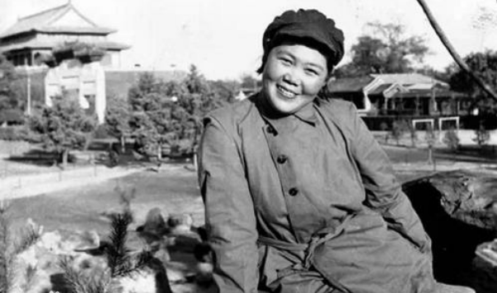
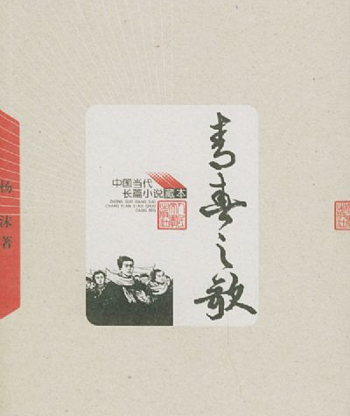
Yang Mo
The Song of Youth

Slide 8
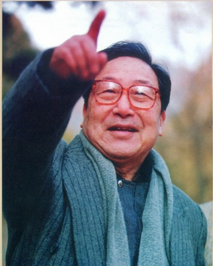
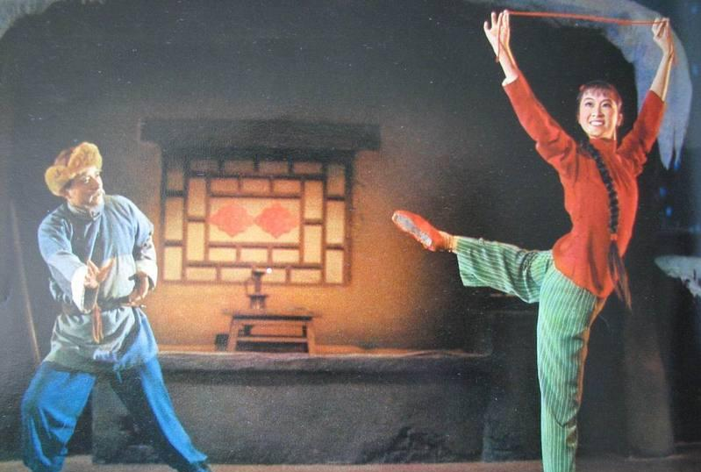
He Jingzhi
The White-haired Girl

Slide 9
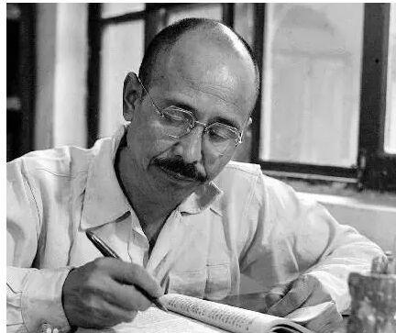
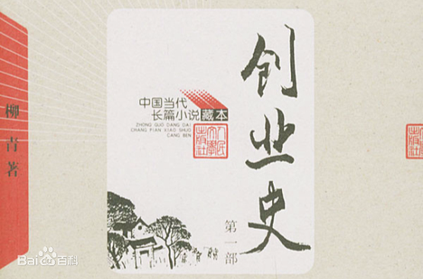
Liu Qing
Builders of a New Life

Slide 10
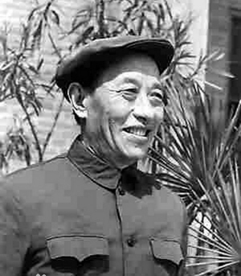
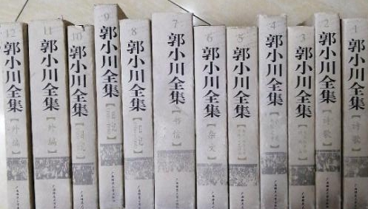
Autumn in Tuanbowa
The Old Man in the Plain
Into the Fiery Struggle
To Young Citizens
Guo Xiaochuan

Slide 11
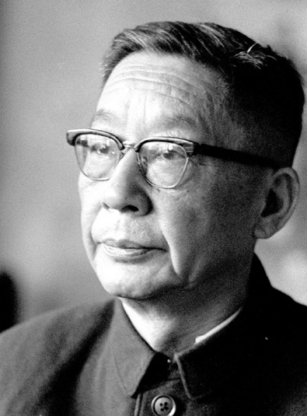
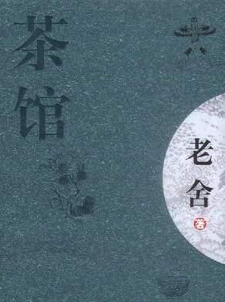
Lao She
Teahouse

Slide 12
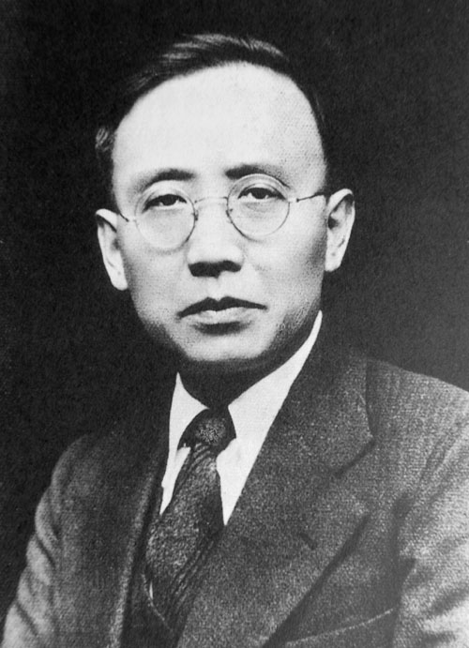
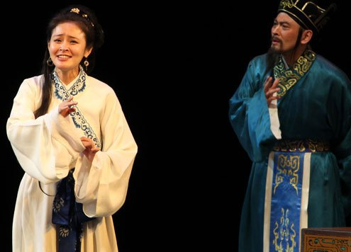
Guo Moruo
Cai Wenji

Slide 13
The Second Stage (1978-1989)

Slide 14
The Second Stage: The new period (1978-1989)
Wound Literature
(1978)
the Third Plenary Session of the Eleventh Central Committee
(1978)
The Fourth National Congress of Literature and Art
(1979)
Regained Vitality
(1980s)
The General Policy of Literature and Art
(1980)

Slide 15
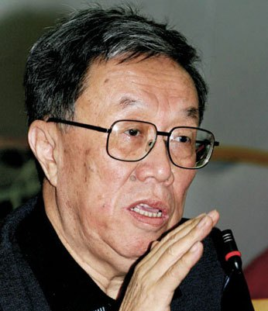
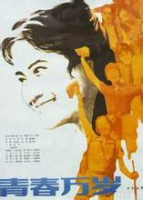
Wang Meng
Youth Forever

Slide 16
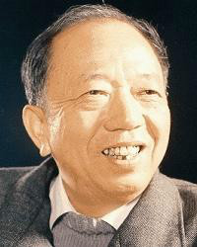
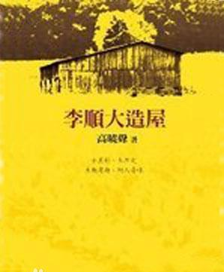
Gao Xiaosheng
Lishunda Builds a House

Slide 17
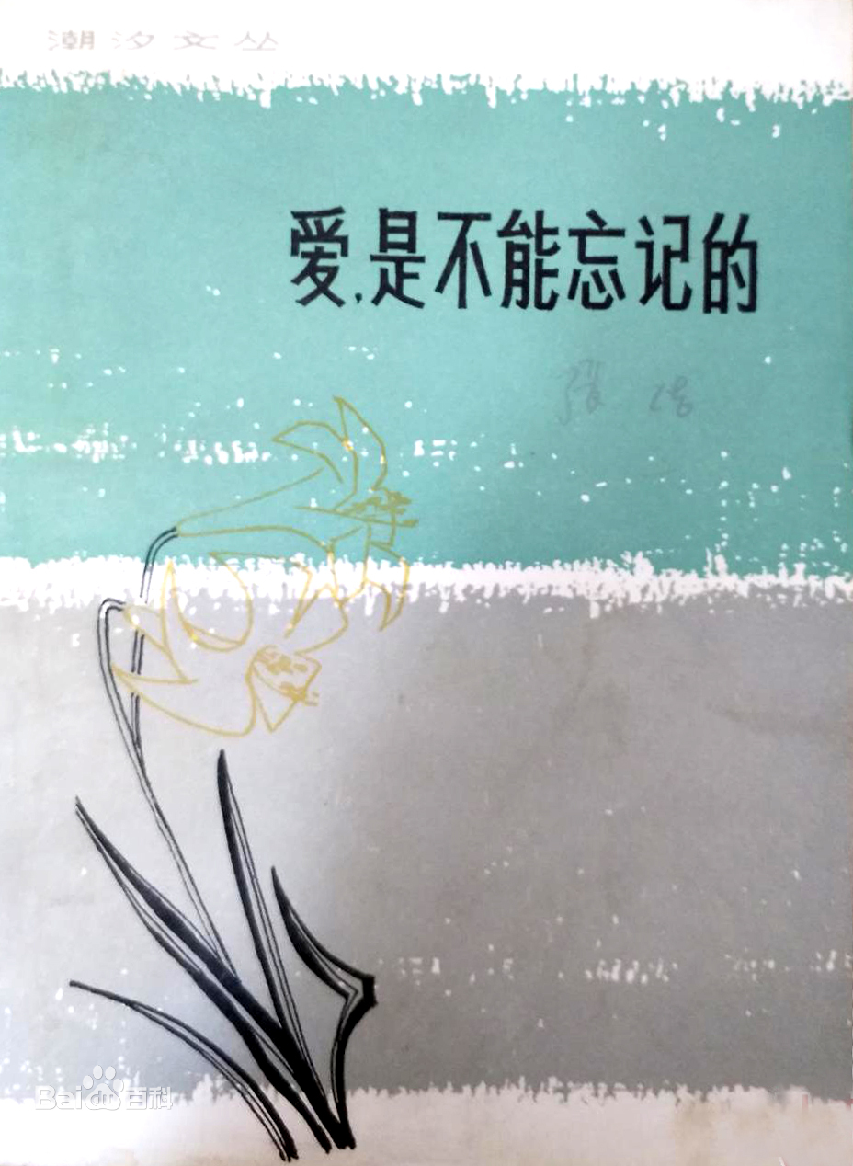
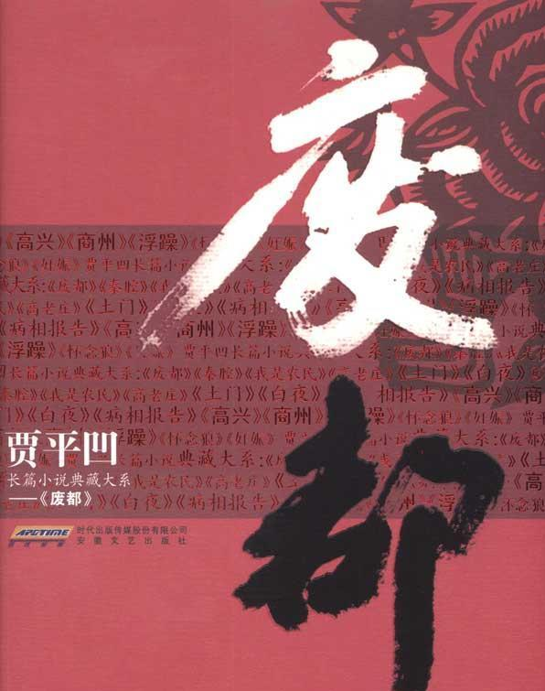
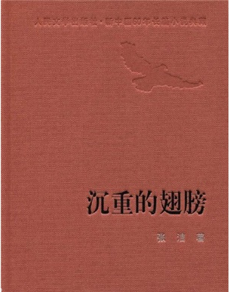
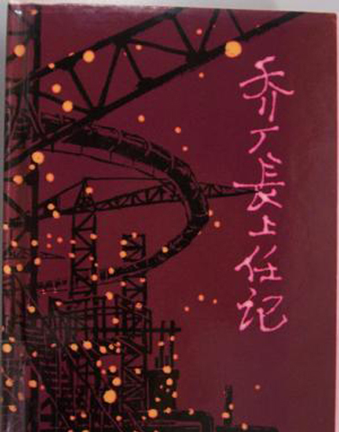
Other Representatives and Works
Jiang Zilong: Manager Qiao Assumes Office
Zhang Jie: Leaden Wings
Love Must Not Be Forgotten
Jia Pingwa: The Abandoned Capital
Ru Zhijuan: A Story out of Sequence
Li Guowen: Lunar Eclipse
Lu Yanzhou: A Tale of Mt. Tianyuan
Chen Rong: At our Middle Age
Zhang Xian: A Corner Forsaken by Love

Slide 18
The Third Stage (1990s- Present)

Slide 19
The Third Stage: The New Period (1990s-Present)
The multicultural pattern gradually formed unconsciously. The tradition of new literature showed new vitality in the 1990s.
The literary narrative of the personal standpoint has turned to the personal writing style which is closer to life itself, so a group of young and female writers called "new generation" came into being.
It is particularly noteworthy that since the beginning of this century, some new concepts have emerged, which have elevated contemporary Chinese literature to a new and unprecedented height. A real self-return to literature is emerging.

Slide 20
1
Chinese Avant-garde Literature
2
Chinese Free Literature
3
Popular Literature

Slide 21
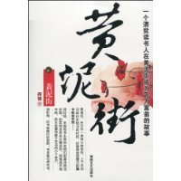
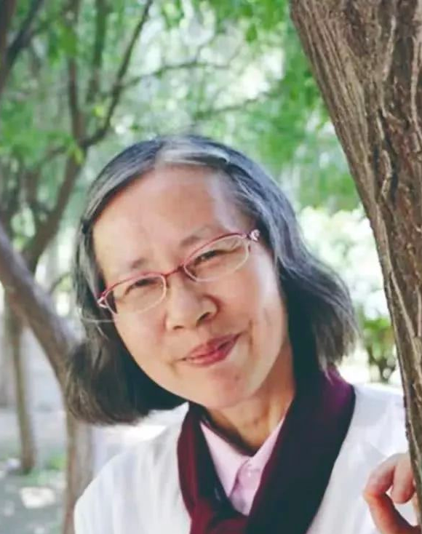
1
Chinese Avant-garde Literature
Huangni Street
Can Xue
Shack on the Mountain
Liu Suola： You Have No Choice
Wang Shuo：Playing with Heartbeat Looks Beautiful
Ma Yuan：The Temptation of Gangdise

Slide 22
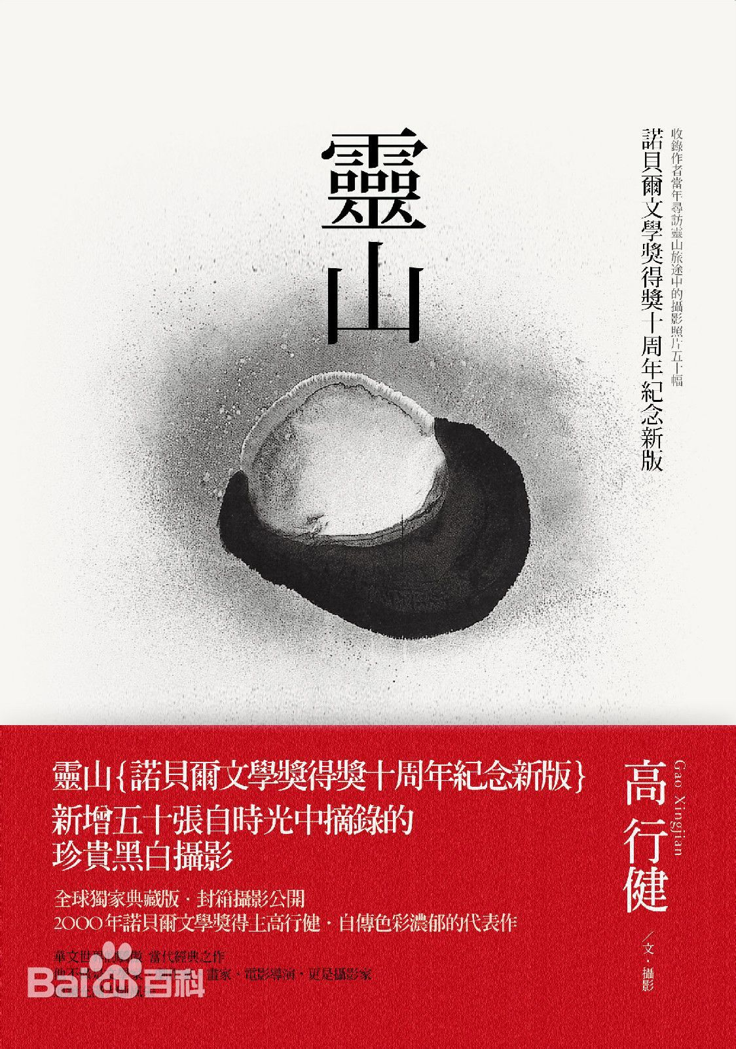
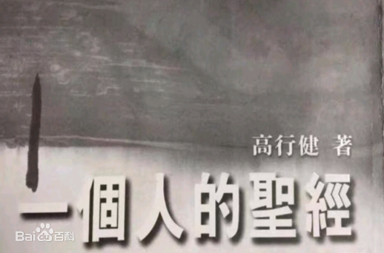
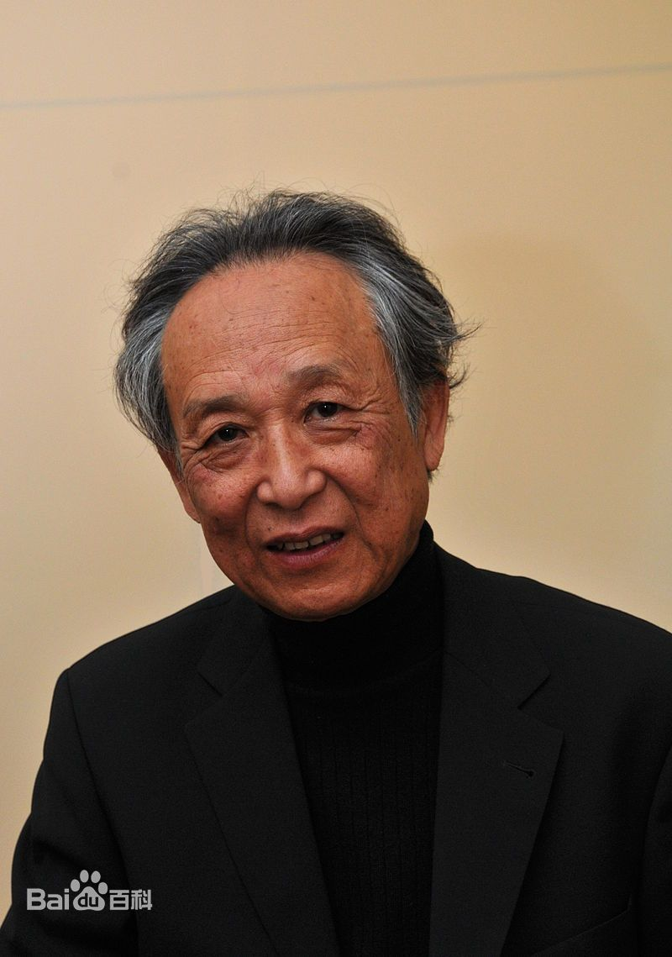
2
Chinese Free Literature
Lingshan
A Man's Bible
Liu Binyan: Between Shemales On the Bridge Site
Ye Wenfu: Raise a Forest-like Hand to Stop I Am a Moth
Wang Tu: River of Joy Detention for 15 Days
Yu Hua: Brothers To Live Xu Sanguan Selling Blood
Gao Xingjian
Station Absolute Signal

Slide 23
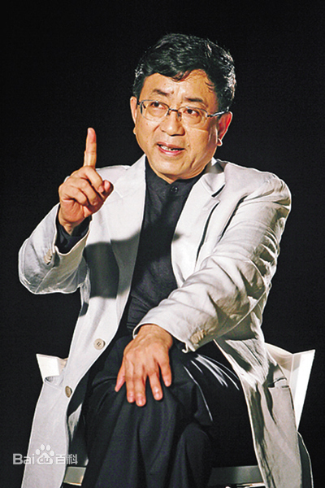
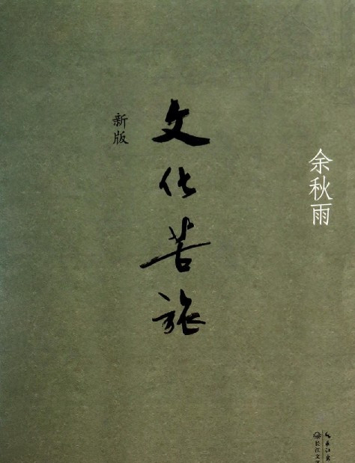
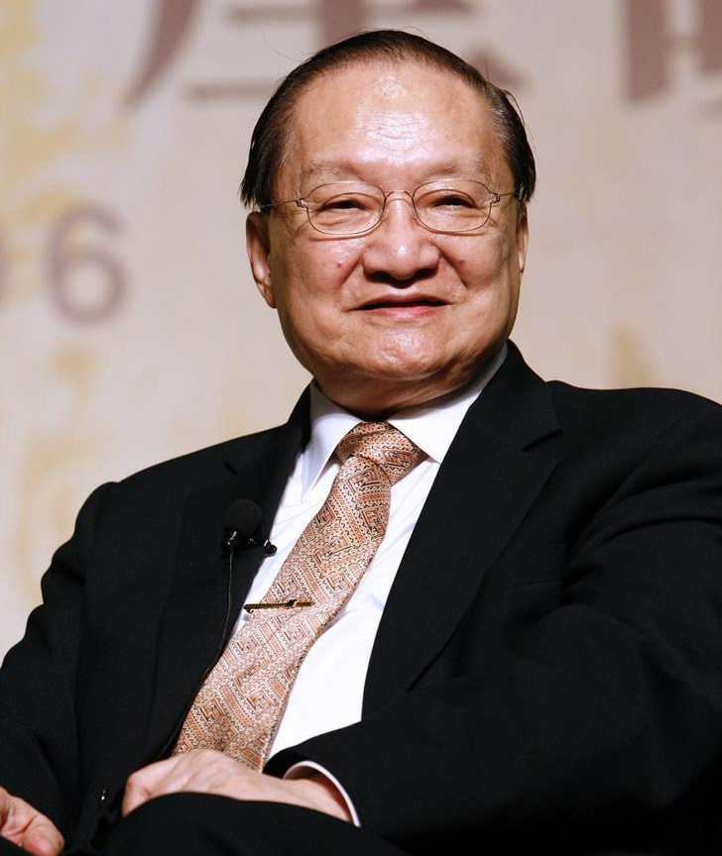
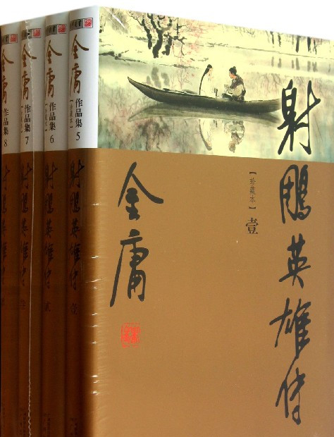
3
Popular Literature
Yu Qiuyu
Cultural Bitter Journey
Jin Yong
The Legend of the Condor Heroes
Han Han: Triple Doors Just Floating Around

Slide 24
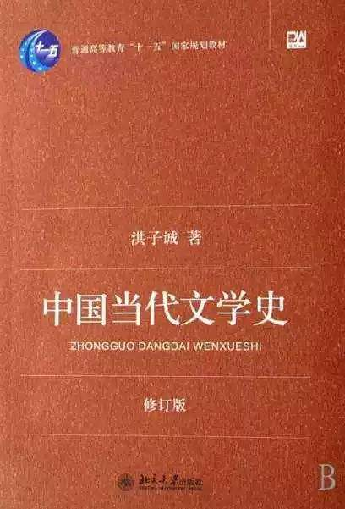
References
[1]洪子诚. 《中国当代文学史》（修订版). 北京：北京大学出版社，2007-6-1 [2] 黄万华. 《中国现当代文学》. 高等教育出版社，2010.2 [3] 刘纳;期待文革文学研究的新突破[J];涪陵师范学院学报;2004年01期 [4] 温儒敏等著. 中国现当代文学专题研究. 北京:北京大学出版社, 2002.1 [5]https://baike.baidu.com/reference/8079406/f2ca3B4PTgOkrMs85lg3- S3QvVs6XqX951TXOu4henRUsDCkPyyckcLOZRSQHKbUAaxywW4eZZ0MF8V62tQVymRER_gw9TIuc5qH

Slide 25
Thank you for listening!

