Slide 1
Translation: Oral Interpreting from and into Chinese
Li Lifei, Fang Chuhan, Hu Wenwen

Slide 2
1. History
Fang Chuhan

Slide 3

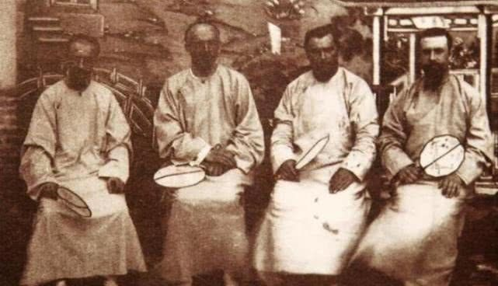
1.1 Wars
Kangxi Emperor
(Xuanye; 4 May 1654 – 20 December 1722)
the third Emperor of the Qing dynasty
Western Jesuits in the Qing dynasty
Notes:
In the early Qing Dynasty, some Western Jesuits were retained by the Qing Emperor. Some continued to help compile calendars and revise calendars in the Imperial Academy of heaven, and some became close attendants of Emperor Kangxi, teaching him all kinds of western scientific knowledge and compiling scientific books every day. At that time, the Russian Czar's army invaded Northeast China. In the negotiation with the Russian military representatives, Emperor Kangxi used the Jesuits to translate Latin during the negotiation.
However, since there are no domestic translators, foreign translators have to be employed in foreign negotiations. Driven by self-interest, foreign translators may betray China's interests at any time, and Chinese negotiators were not aware of it.

Slide 4
1.1 Wars
the late Qing Dynasty (1840 — 1912):
the Opium War (4 September 1839 – 29 August 1842) a series of wars of aggression against China by the British, French and Eight Allied forces
the Republic of China (1912 — 1949):
Northern Expedition army and the Red Army in the Soviet area
War of Resistance against Japanese Aggression & the trial
Civil war. In the armistice negotiation between the Kuomintang and the Communist Party, which was "mediated" by Marshall of the United States, many translators from both the Kuomintang and the Communist Party participated in the negotiation.
Notes:
In the Opium War in the late Qing Dynasty and a series of wars of aggression against China by the British, French and Eight Allied forces, the Qing government had to rely on the Protestant missionaries employed by the other side for translation in many post-war negotiations because of the lack of their own translators.
Throughout the period of the Republic of China, there were constant wars. There were foreign military advisers in the Northern Expedition army and the Red Army in the Soviet area who worked as interpreters for them.
During the War of Resistance against Japanese Aggression, translators participated in the joint operations of the US air force to assist China or the Chinese army with the British and American allies in India and Myanmar. Our army carried out propaganda and disintegration work for the Japanese army. Therefore, some people who understand Japanese acted as translators in the propaganda work. In addition, there are a few translators in China who have served as translators in the trial of Japanese war criminals by the Far East International Military Tribunal.
After the victory of the war of resistance against Japan, the Kuomintang provoked a civil war. In the armistice negotiation between the Kuomintang and the Communist Party, which was "mediated" by Marshall of the United States, many translators from both the Kuomintang and the Communist Party participated in the negotiation.

Slide 5

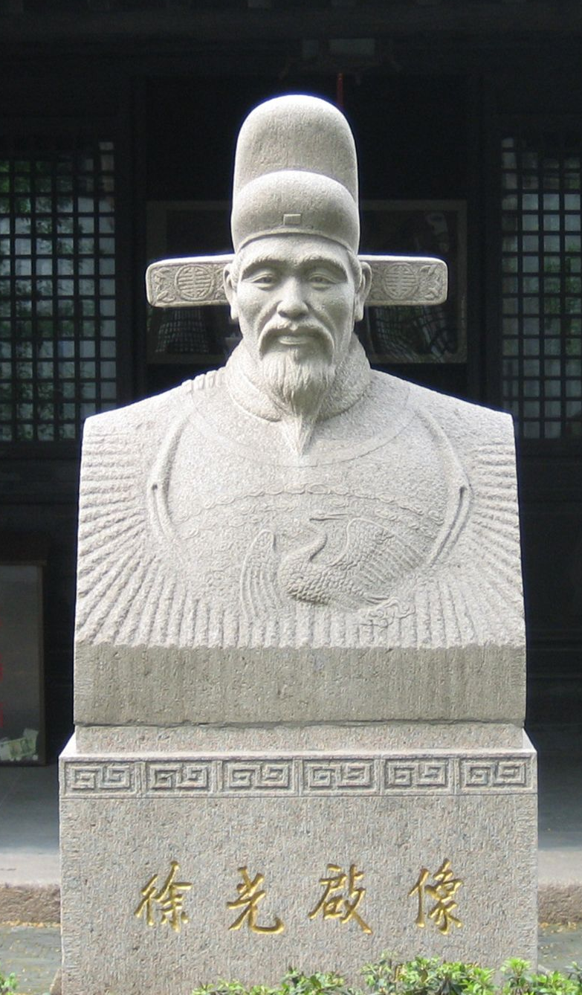
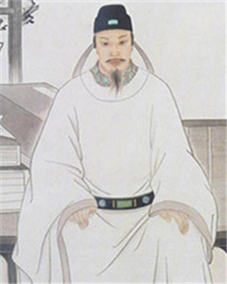
1.2 Interpretation in Translating Science Works
In the late Ming and early Qing Dynasties, missionary Matteo Ricci and Chinese scientists Xu Guangqi and Li Zhizao set off the climax of China's first scientific translation.
Notes:
In the late Ming and early Qing Dynasties, missionary Matteo Ricci and Chinese scientists Xu Guangqi and Li Zhizao set off the climax of China's first scientific translation.

Slide 6
1.2 Interpretation in Translating Science Works
During the more than 100 years from the missionaries of Wanli Dynasty in the Ming Dynasty to the prohibition of religion in Yongzheng Dynasty in the Qing Dynasty, foreign missionaries and Chinese people who are enthusiastic about western science jointly translated and published more than 170 kinds of science books. At that time, none of the Chinese knew a foreign language.
Although missionaries usually learned Chinese before and after coming to China, they were still reluctant to deal with general daily dialogue.
Therefore, many versions, especially the widely circulated famous works, were usually translated by cooperation. That is, it was interpreted by foreign missionaries and written by Chinese scholar bureaucrats, and then proofread and polished repeatedly by foreign missionaries and Chinese scholar bureaucrats.
Notes:
It can be said that in the process of translating science books in the late Ming and early Qing Dynasties, interpreting was an essential link.

Slide 7
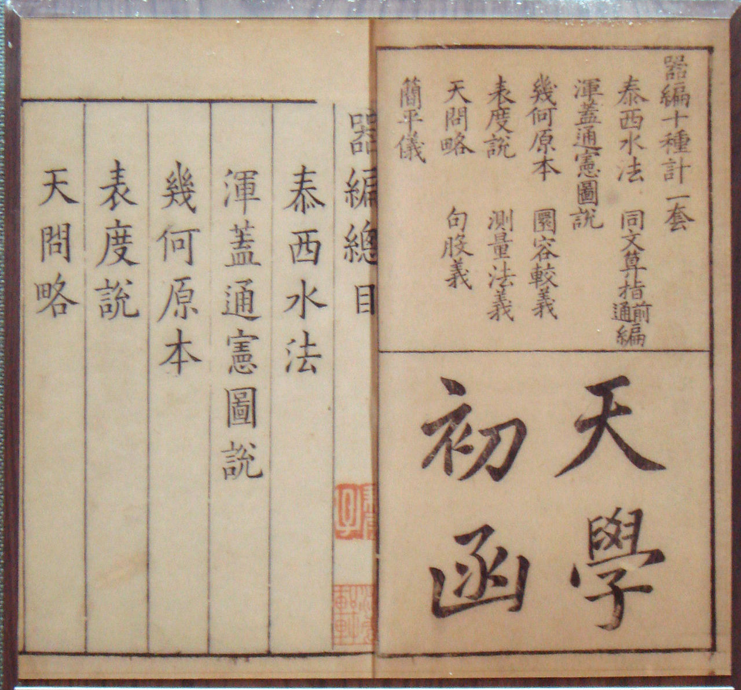
Introduction to Astronomy, translated by Xu Guangqi

Slide 8
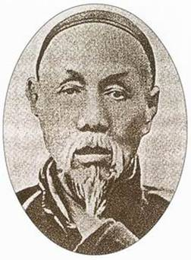
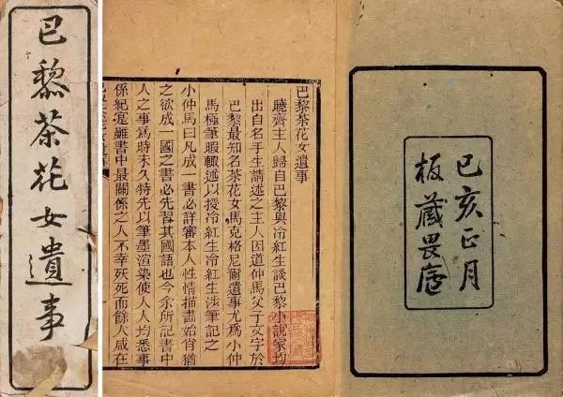
1.3 Interpretating in Translating Literary Works
A large number of translation and introduction of foreign literature began at the turn of the 19th and 20th centuries.
In 1899, Lin Shu translated the remains of the Camellia in Paris by French little Dumas, which can be regarded as the first work passed on to China by the translator of European literary classics.
Notes:
For more than 20 years from 1898 to 1924, Lin Shu, who did not understand foreign languages, even translated more than 180 kinds of foreign literary works by cooperating with interpreters. With regard to "Lin Yu's Novels", due to the long history, in addition to some important and good books, many translated books have disappeared from the society.
What we mentioned above are all interpretation activities when foreign literature is translated into Chinese. In the translation of Chinese literature into foreign languages, because some foreign translators do not have a high level of Chinese, there is also a situation in which the Chinese population translates foreigners' writings.
At the end of the Qing Dynasty, Wang Tao, an early bourgeois reformist thinker in China, began to assist foreign missionaries in translating books in the mohai library run by the Shanghai British church at the request of the English missionary madus in 1849. Later, the Taiping army was wanted by the Qing government because of the letter and fled to Hong Kong in 1863. When James Legge, a British missionary, was translating Chinese classics into English, Wang Tao helped his assistant translate them.

Slide 9
1.3 Interpretating in Translating Literary Works
For more than 20 years from 1898 to 1924, Lin Shu, who did not understand foreign languages, even translated more than 180 kinds of foreign literary works by cooperating with interpreters.
Notes:
What we mentioned above are all interpretation activities when foreign literature is translated into Chinese. In the translation of Chinese literature into foreign languages, because some foreign translators do not have a high level of Chinese, there is also a situation in which the Chinese population translates foreigners' writings.
At the end of the Qing Dynasty, Wang Tao, an early bourgeois reformist thinker in China, began to assist foreign missionaries in translating books in the mohai library run by the Shanghai British church at the request of the English missionary madus in 1849. Later, the Taiping army was wanted by the Qing government because of the letter and fled to Hong Kong in 1863. When James Legge, a British missionary, was translating Chinese classics into English, Wang Tao helped his assistant translate them.

Slide 10
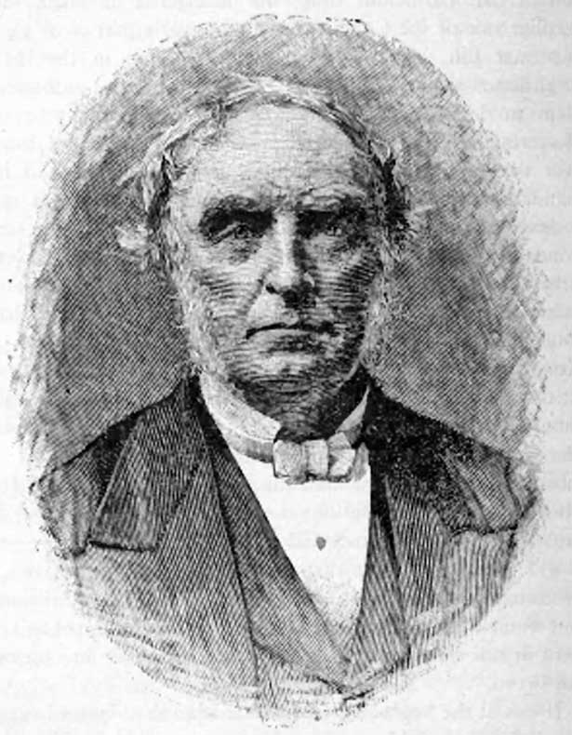
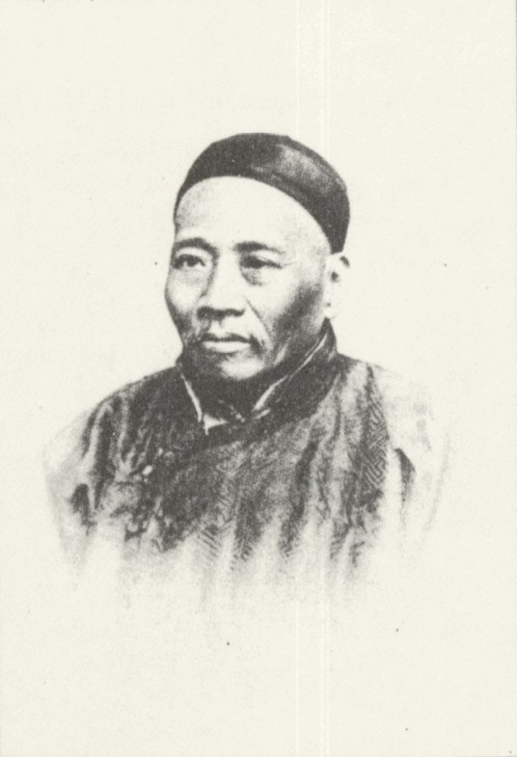
1.3 Interpretating in Translating Literary Works
James Legge
Wang Tao
At the end of the Qing Dynasty, Wang Tao, an early bourgeois reformist thinker in China, began to assist foreign missionaries in translating books in the Mohai Library run by the Shanghai British in 1849.
When James Legge, a British missionary, was translating Chinese classics into English, Wang Tao helped his assistant translate them.
In the spring of 1870, they completed the translation of The Book of Songs, The Book of Changes, The Book of Rites and other Chinese classics.
Notes:
What we mentioned above are all interpretation activities when foreign literature is translated into Chinese. In the translation of Chinese literature into foreign languages, because some foreign translators do not have a high level of Chinese, there is also a situation in which the Chinese population translates foreigners' writings.
At the end of the Qing Dynasty, Wang Tao, an early bourgeois reformist thinker in China, began to assist foreign missionaries in translating books in the mohai library run by the Shanghai British church at the request of the English missionary madus in 1849. Later, the Taiping army was wanted by the Qing government because of the letter and fled to Hong Kong in 1863. When James Legge, a British missionary, was translating Chinese classics into English, Wang Tao helped his assistant translate them.

Slide 11
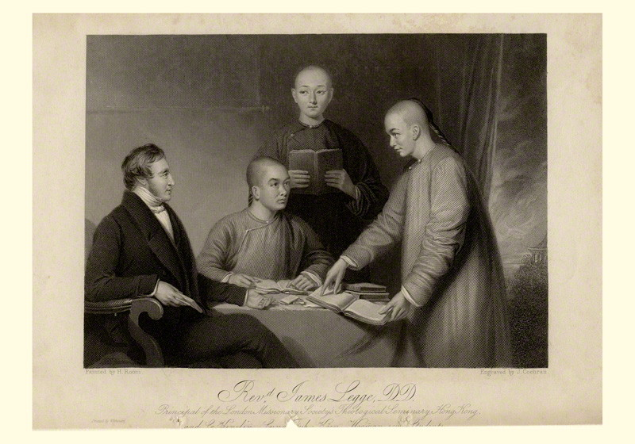
James Legge & his Chinese assistants
Notes:
In the spring of 1870, Jacob Li and Wang Tao completed the translation of The Book of Songs, the Book of Changes, the Book of Rites and other Chinese classics.

Slide 12
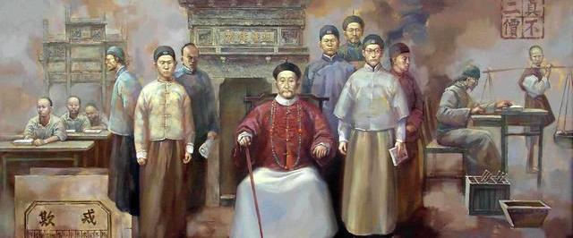
1.4 Interpretating in Teaching
During the Opium War (4 September 1839 – 29 August 1842) , Zuo Zongtang believed that in order to prepare for the naval war, the Navy had to be revitalized, so it was also necessary to supervise shipbuilding ".
Marie Giguel and Paul Alexandre Neveue, French officers, were employed as the principal and Deputy supervisors of Fujian Shipping Bureau respectively.
At the same time, there are interpreters for classroom teaching. In less than four years, more than 140 apprentices in the bureau have learned English and French. These artists are young workers who study while working with foreign craftsmen.
In addition, the factory also has a slightly different situation of art children and hospital students to learn art with foreigners.

Slide 13
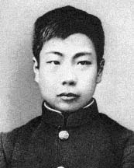
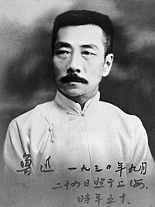
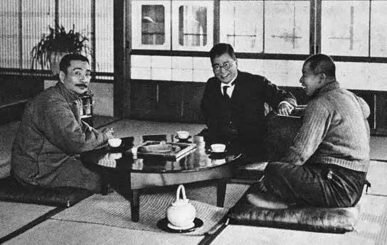
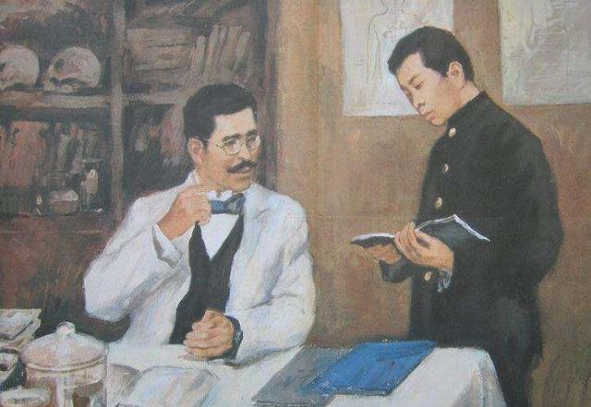
1.4 Interpretating in Teaching
Zhou Shuren (25 September 1881 – 19 October 1936), better known by his pen name Lu Xun.
He started studying in Japan since 1902.
He worked as an interpreter in the botany class taught by foreign teachers.

Slide 14
1.5 Interpreting in Diplomatic Relations
After the Opium War in 1840, especially after the Qing government was forced to establish formal diplomatic relations with some countries.
Foreign delegations sent by the government are usually accompanied by translation officials who are specialized] or even have formal foreign language education or employ foreigners in China as temporary translators.
Individuals sent by the government to visit, even if they cannot be equipped with interpreters, will try to equip them with a person who knows a foreign language as a temporary interpreter. Of course, the level of interpretation of such personnel is relatively limited.
As for those who go abroad for purely private visits for various reasons, most of them have no money to hire interpreters, but they will always have all kinds of acquaintances and friends to assist in interpretation during the visit.

Slide 15
2. Modes
Fang Chuhan

Slide 16
Modes of Interpreting
Consecutive Interpreting (CI)
Simultaneous Interpreting (SI)
The Shift from CI to SI
After World War II, simultaneous interpretation came into use at the Nuremberg trial, and began to be more accepted..
In 1951, when the United Nations expanded its number of working languages to five (English, French, Russian, Chinese and Spanish), consecutive interpretation became impractical in most cases, and simultaneous interpretation became the most common process for the organization's large meetings. Consecutive interpretating, which provides a more fluent result without the need for specialized equipment, continued to be used for smaller discussions.

Slide 17


*SimConsec – Simultaneous Consecutive Interpreting
SimConsec - A hybrid type of interpreting
First Trial: 1999, Michele Ferrari, EU staff interpreter (SCIC)
Digital voice recorder: audio playback
Smart Pen/App (Notability): synchronized audio and note-taking playback
The interpreter:
records the speech while also taking notes
plays back the recording of the original speech into earphones
renders the original speech into the target language while listening to the recording (in simultaneous mode).
Confidentiality
Enhanced interpreting performance (?)

Slide 18
3. Types (Setting-based)
Hu Wenwen

Slide 19








4 Main Types
Conference interpreting
Judicial interpreting
Interpreting
Escort interpreting
Medical interpreting

Slide 20





3.1 Conference interpreting
1. interpretation at a conference or large meeting, either simultaneously or consecutively.
2. two main markets: institutional institutions (EU, UN, EPO, et cetera) and Local private markets.
multilingual meetings
bilingual meetings
International institutions
favor interpreting several foreign languages into the interpreters' mother tongues.
Local private markets
the interpreters work both into and out of their mother tongues.
Notes:
These markets are not mutually exclusive.

Slide 21












3.2 Judiciail Interpreting
3
consecutive interpretation/
simultaneous interpretation
2
administrative tribunals,
Judiciail Interpreting
wherever a legal proceeding is hel
4
witnesses' testimony
/entire proceedings
1
courts of justice
5
One person, or all of the people attending.
Notes:
Judicial, legal, or court interpreting occurs in courts of justice, administrative tribunals, and wherever a legal proceeding is held (i.e., a police station for an interrogation, a conference room for a deposition, or the locale for taking a sworn statement).
Legal interpreting can be the consecutive interpretation of witnesses' testimony, for example, or the simultaneous interpretation of entire proceedings, by electronic means, for one person, or all of the people attending.

Slide 22

3.2 Judiciail Interpreting
a fundamental rule of justice:
The right to a competent interpreter for anyone who does not understand the language of the court (especially for the accused in a criminal trial)
Requirements for interpreters:
Incompetent interpretation, or simply failure to swear in the interpreter, can lead to a mistrial.
Requirements
1
practical mastery of the source and target languages,
2
thorough knowledge of law and legal and court procedures
Notes:
In addition to practical mastery of the source and target languages, thorough knowledge of law and legal and court procedures is required of court interpreters. Incompetent interpretation, or simply failure to swear in the interpreter, can lead to a mistrial.

Slide 23




3.3 Escort Interpreting
Requirements for escort interpreter:
needs to be equipped with some business and financial knowledge in order to best understand and convey messages back and forth.
a business meeting
presentation
investor meetings
a tour, on a visit,or interview.
Notes:
In escort interpreting, an interpreter accompanies a person or a delegation on a tour, on a visit, or to a business meeting or interview. It is often needed in business contexts, during presentations, investor meetings, and business negotiations.

Slide 24

3.4 Medical Interpreting
Medical interpreting is a subset of public service interpreting, consisting of communication among healthcare personnel and the patient and their family or among Healthcare personnel speaking different languages, facilitated by an interpreter.
Notes:
facilitated by an interpreter, usually formally educated and qualified to provide such interpretation services.

Slide 25




3.4 Medical Interpreting
IN CHINA
No mandatory certificate for medical interpreters as of 2012. Most interpretation is done by doctors, who are proficient in both Chinese and English (mostly) in his/her specialty.
In the United States
language access is a socioeconomic disparity, and to federally-funded health services is required by law. .
Requirements for escort MEDICAL interpreters:
Some knowledge of medical terminology, common procedures, the patient interview and exam process.

Slide 26
4. Key Factors
Hu Wenwen

Slide 27





Key Factors
Listening Listening comprehension in interpretation is different from that in traditional foreign language learning.
Memory Another important interpreting step followed by interpreting listening comprehension..
Note-taking an important part of interpretation memory
Listening
Memory
Note-taking

Slide 28
4.1 Listening
Listening comprehension in the process of interpretation is different from that in traditional foreign language learning. The main manifestations are:
1) do not demand pronunciation, take "understanding" as the first goal, and can hear and distinguish with relatively high efficiency and complete the task of transmitting source language information;
2) complete phonetic listening comprehension, word meaning comprehension, sentence level meaning comprehension and even paragraph or text meaning comprehension at the same time,
3) often forgets most words and focuses on the context, discourse logic and discourse content and meaning.
Notes:
Listening comprehension in the process of interpretation is different from that in traditional foreign language learning. The main manifestations are:
1) Foreign language learning generally pays attention to hearing and distinguishing "standard sound", and is not used to noise interference and partial distortion of speech. However, translators do not demand pronunciation, take "understanding" as the first goal, and can hear and distinguish with relatively high efficiency and complete the task of transmitting source language information;
2) In foreign language learning, listening comprehension is not necessarily completed at the same time, while the interpreter must complete phonetic listening comprehension, word meaning comprehension, sentence level meaning comprehension and even paragraph or text meaning comprehension at the same time, otherwise he cannot complete the interpretation work;
3) In foreign language learning, the listener is good at grasping words and often pays attention to the language form, while the interpreter often forgets most words and focuses on the context, discourse logic and discourse content and meaning.

Slide 29
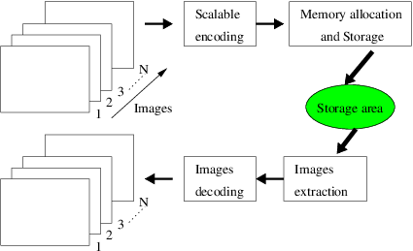
4.2 Memory
According to the relevant research of psychology, memory includes two stages: storage and extraction. These two links are indispensable.
Good memory may be innate, but the acquired scientific and systematic training can also greatly improve a person's memory.
Notes:
we should improve the organization of storage and grasp the clues extracted.

Slide 30





4.2 Memory
Memory
3 kinds
3 means
Hub 2
sound memory
visual memory
meaning memory
sensory storage
short-term memory
1ong-term memory
Hub 4
Notes:
Psychology divides memory into three kinds: sensory storage, short-term memory and long-term memory.
The duration of short-term memory is 20-30 seconds, and the memory capacity is 7 ± 2 unrelated information units, which is always active and does not need to be activated; The duration of long-term memory can be as long as days, months or even years. The memory capacity is almost unlimited, but it needs to be activated.
According to the relevant principles of psychology, the basic means of memory are: sound memory, visual memory and meaning memory.
. The basic memory method used by experienced translators is "visualization", that is, imagine the meaning framework of the source text as an image, or restore the scene described in the source text into a visual image in thinking. Another common method is to connect the information points extracted from listening comprehension with a familiar sequence, such as a sequence of numbers, a row of buildings, etc. At the scene of interpretation, we can observe that some interpreters "break their fingers" while listening, while others mark numbers such as 1, 2, 3 and 4 on the left side of the notebook page, using this memory method.

Slide 31

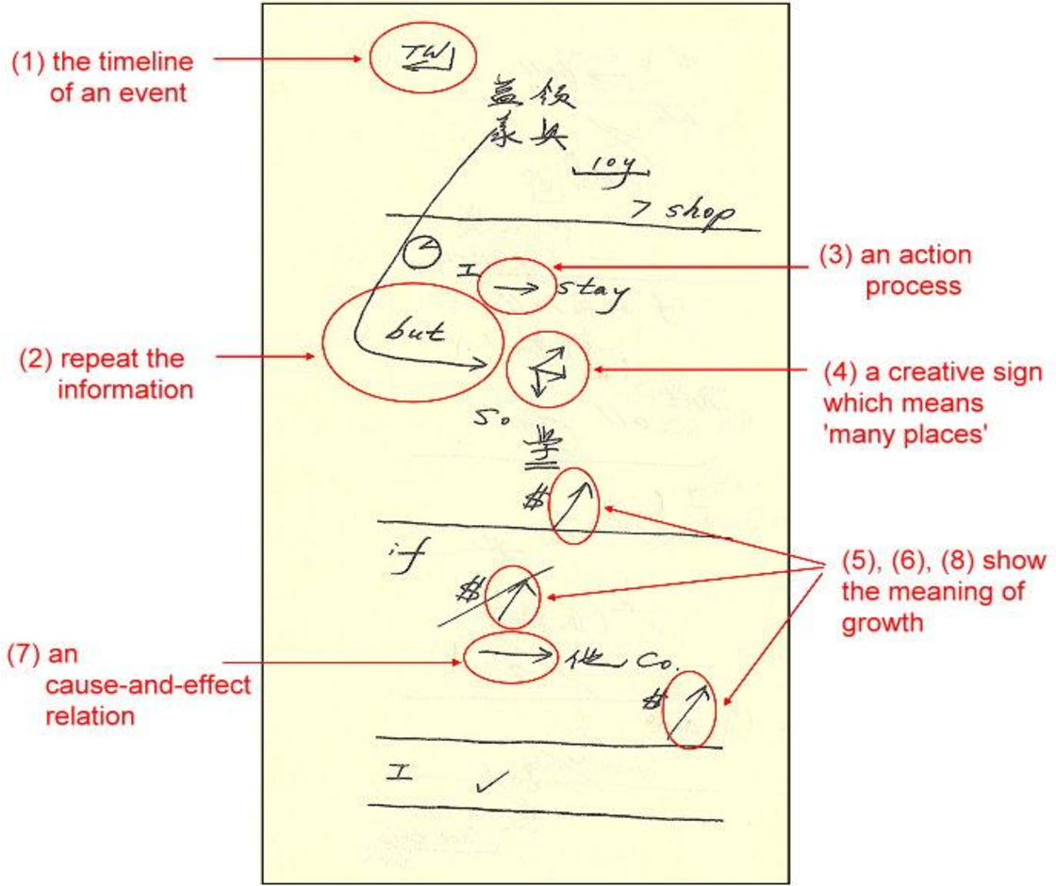
4.3 Note-taking

Slide 32
4.3 Note-taking
why should we take notes in interpretation?
1. The capacity of short-term memory is limited. It's difficult to write down such a long paragraph without some memory aids.
2.The duration of short-term memory is also very short. If you remember by brain alone, you may forget it soon.
3A lot of information in the source language that we need to transcode accurately in interpretation( numbers, proper nouns, listed items, etc. ), brain memorization alone may not be able to ensure the accuracy.

Slide 33
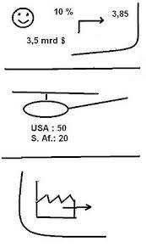
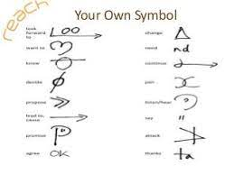
4.3 Note-taking
what role does interpretation notes play?
An aid to supplement memory;
A cue role in brain memory retrieval;
Visualize the structure of SL speech;
Organize TL reproduction.

Slide 34
4.3 Note-taking
Is the interpretation notes as complete as possible relative to the source language?
No. It is unnecessary and impossible to take complete notes.
They only play the role of memory assistance and prompt at the time of interpretation
Notes:
It is unnecessary and impossible to take complete notes. Interpretation notes are different from classroom notes. They only play the role of memory assistance and prompt at the time of interpretation, and there is no need to pursue integrity.

Slide 35
THANKS FOR YOUR ATTENTION!

