Slide 1

Scientific Style
Luo Yuqing & Lou Cancan

Slide 2
1
|
The Classification of Scientific Style
2
|
CONTENTS
The Characteristics of Scientific Style
3
|
The Key Points of Chinese Translation of Scientific Style
4
|
Translation Skills

Slide 3
1
1
|
The Classification of Scientific Style

Slide 4
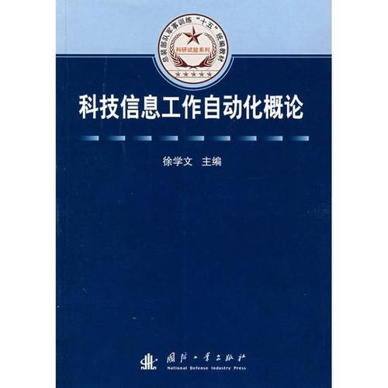
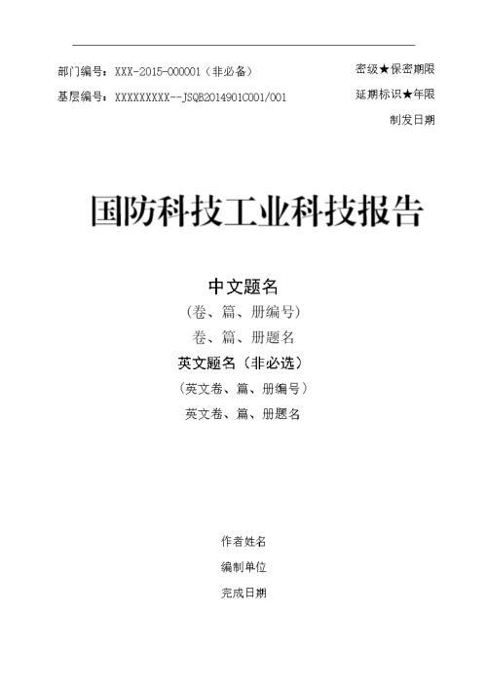
The Classification of Scientific Style

1. Works, texts and reports on science and technology, test reports, and programs for the development of science and technology.
2. Scientific and technical information and written materials.

Slide 5


The Classification of Scientific Style

3. Descriptions of structure and rules of operation in operative manuals (of meters, instruments, machines, tools, etc.).
4. The language of talks, meetings and conversations on scientific or technical problems.
5. Commentaries in such audio materials as films, videos, etc.
Source: English Varieties and Translation by Liu Miqing

Slide 6
2
2
|
The Characteristics of Scientific Style

Slide 7
The Characteristics of Scientific Style
1
Lexical Characteristics
PART ONE
2
Grammatical Characteristics
PART TWO
3
PART THREE
Discoursal Characteristics

Slide 8
The Characteristics of Scientific Style
1. Lexical Characteristics
On the lexical level, there are a large number of technical terms in EST (English for Science and Technology). Technical terms are the words that express different meanings in a particular field rather than what they do in ordinary English.
"processor" in "multi-core processor"
"processor" means“加工者”，while in scientific and technological texts, it means“处理器”,
therefore, "multi-core processor" means“多核处理器”.

Slide 9
The Characteristics of Scientific Style
1. Lexical Characteristics
Lots of abbreviations are employed in scientific English texts, abbreviations are specific in meaning and concise in language.
“WC”
It may stand for “ Water Carrier ” , “ Water Column ”, “ Water Cooled ”, “ Water Cooler ”,
“ Wireless Communication ” and “ Water Closet ”.
An English word is not only used by one major, but also used by many majors to express their professional concepts.
“ transmission ”
Radiao Engineering “发射”、“播送” Mechanology “传动”、“变速”
Physics “透射” Medicine “遗传”

Slide 10
The Characteristics of Scientific Style
2. Grammatical Characteristics
The frequent use of compound nouns and nominalization
The highly occurence of Passive voice
The wide use of simple present tense
The frequent use of long sentences and parallel structures

Slide 11
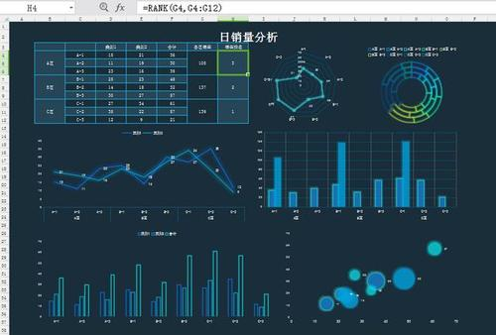
The Characteristics of Scientific Style
3. Discoursal Characteristics
coherence
clearness
fluency
strict logic
objective description

Slide 12
3
3
|
The Key Points of Chinese Translation of Scientific Style

Slide 13
The Key Points of Chinese Translation of Scientific Style
To translate scientific and technological words accurately
1
To be familiar with commonly used structures
Key Points
To analyze structures thoroughly
To work hard at scientific and technological knowledge
To maintain a rigorous and responsible working attitude
单击此处添加文本具体内容

Slide 14
The Key Points of Chinese Translation of Scientific Style
1.To translate scientific and technological words accurately
① Paying attention to the special meanings of words in specific fields
light show 轻音乐 × 光显示 √
② Learning English word-building
Compounding（合成法） moon+walk moonwalk 月面行走
Blending （混成法） medical+care medicare 医疗保健
Affixation （词缀法） micro- +economics microeconomics 微观经济学
2.To be familiar with commonly used structures
It is believed that （人们认为） Seeing that （由于、鉴于）
It has been proved that （已经证明） Supposing that （假设）

Slide 15
The Key Points of Chinese Translation of Scientific Style
3.To analyze structures thoroughly
① Mastering the meanings of words, grammatical relations and thematic relations；
② Identifing two types of English words: Form words (including nouns, verbs, adjectives, adverbs)
and Structure words；
③ Recognizing the basic structures of English sentences；
④ Finding out the grammatical and thematic relations of each modifier in order to determine its
position in the structure.

Slide 16
4
4
|
Translation Skills

Slide 17
Translation Skills
1. Translate the passive voice into the active voice.
His pride must be pinched. 他这股傲气应该打下去。
2. Use a general subject, such as “有人”“人们”“大家” or translate the sentence into active voice without subject.
Power would be gotten if there were money to get it with. 有了钱，就会以钱谋权。

Slide 18
Translation Skills
3. Use“……为……所……”
In his late thirties he was almost knocked down in his despondency of the unsuccessful career.
近四十岁时，由于事业上的挫折，他几乎为失意所毁。
4. Use the verbs “受”“遭受”“遭到”“受到”
Two super go players from Japan were defeated one after another.
日本两位围棋高手接连受挫。
5. Use “被”when translating English sentences of passive voice into Chinese and we can also use “ 叫 ”、“ 让 ” 、 “挨” and “ 给 ” instead of “被”.
The boy was criticized yesterday.
这孩子昨天挨了一顿批评。

Slide 19
References
References
[1]边鸿倩. 基于目的论视角下科技文本翻译实践报告[D].西安理工大学,2020.
[2]李金灿. 科技英语否定句汉译策略的研究[D].湖北工业大学,2018.
[3]刘宓庆. 文体与翻译[M].北京：中译出版社,2019.
[4]马晶. 生态翻译学“三维转换”视角下的科技文本翻译策略探究[D].北京交通大学,2018.
[5]刘疾橹. 科技英语文体风格在英汉翻译中的体现[D].哈尔滨工业大学,2009.
[6]张伟. 文体分析在科技英语汉译中的应用[D].华中师范大学,2000.

Slide 20
THANKS
Chancellor George Osborne said on Monday: "I am determined that we go on making the decisions to reform the British economy and tackle our debts.

