Slide 1

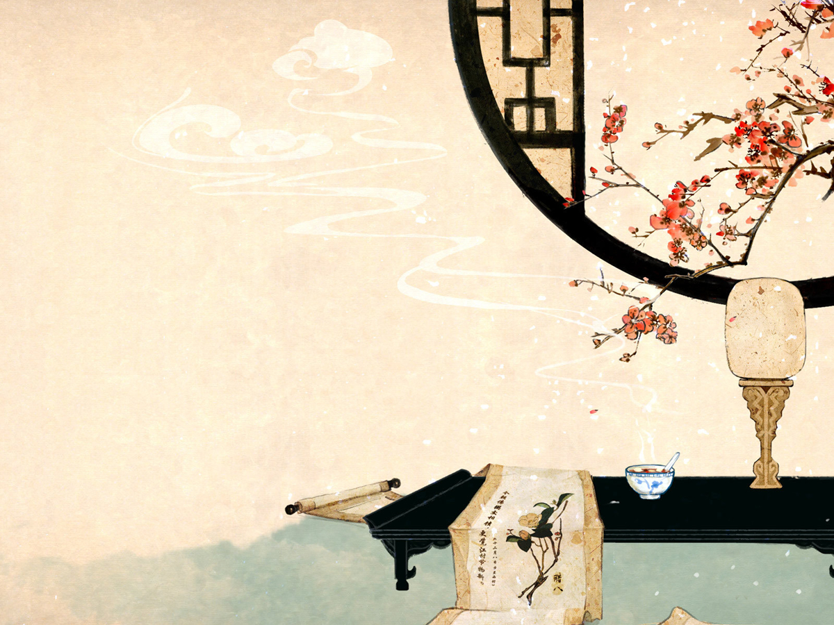

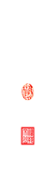
Chinese Traditional Clothing
——舒琳

Slide 2

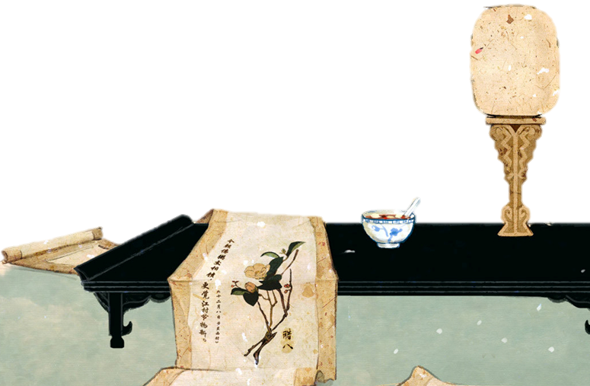

Contents
Characteristics
01
Some Examples
02
The Translation
03
My Reflection
04

Slide 3
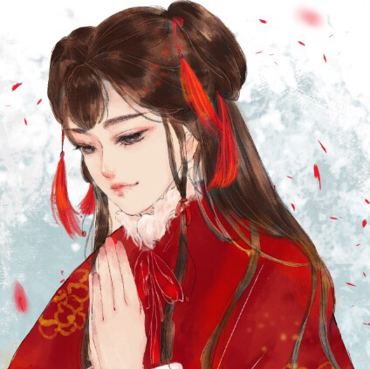
01
Characteristics
Characteristics

Slide 4
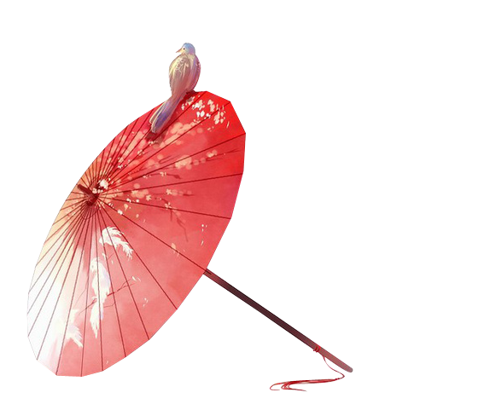
01
Characteristics
Chinese style
comfortable fabric
bright colors
rich designs
exquisite craft elements

Slide 5
01
Characteristics
Elements: Chinese architecture, costumes, traditional Chinese painting and folk art…
Colors: Green, white, yellow, red, black

Slide 6
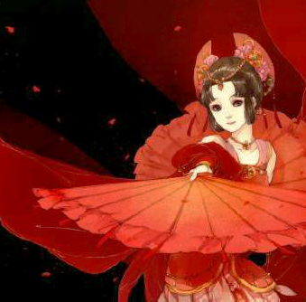
02
Some Examples
Examples

Slide 7
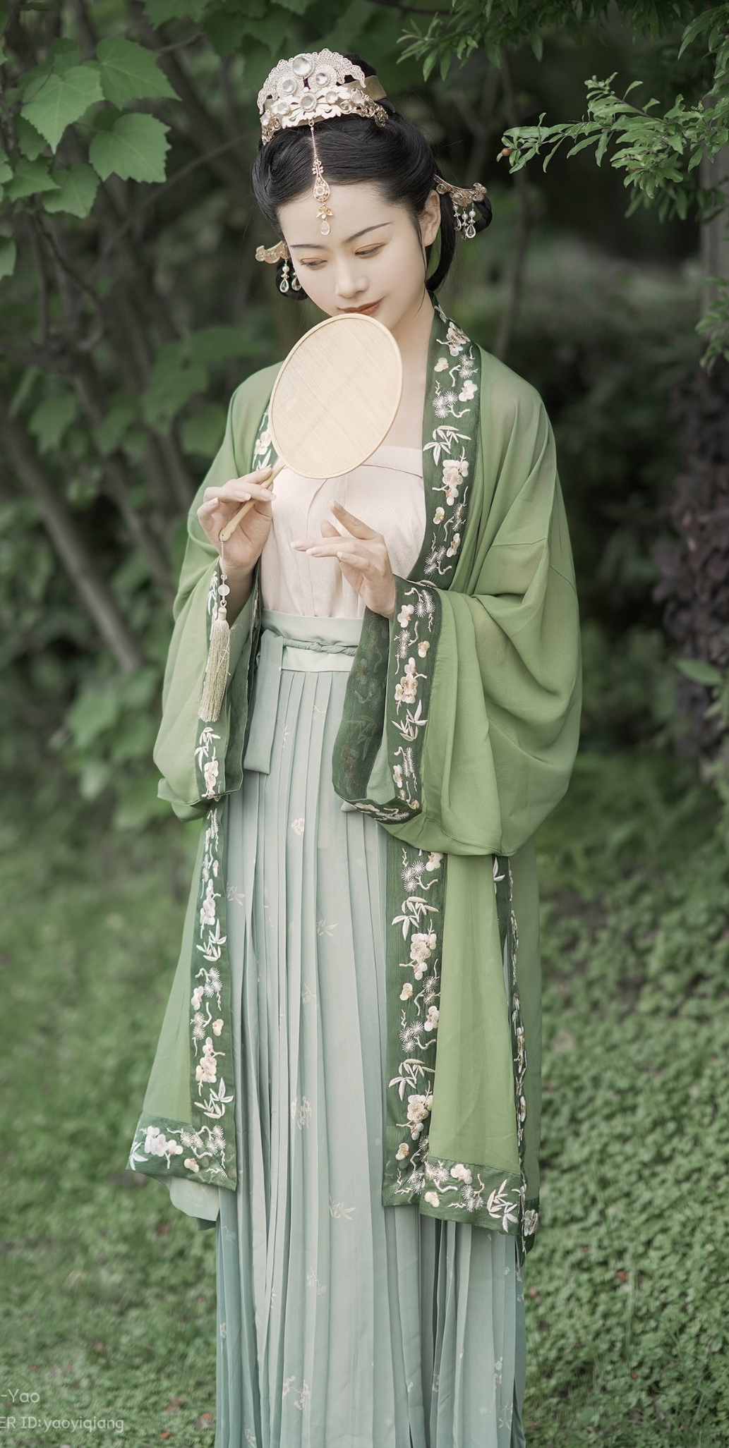
02
Traditional Han Chinese Clothing (Han Fu)
improved and popularized during the Han Dynasty
long gown, cross collar（交叉领）, wrapping the right lapel over the left
loose wide sleeves
no buttons but a sash（腰带）

Slide 8
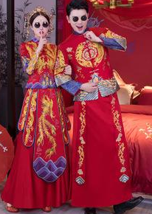
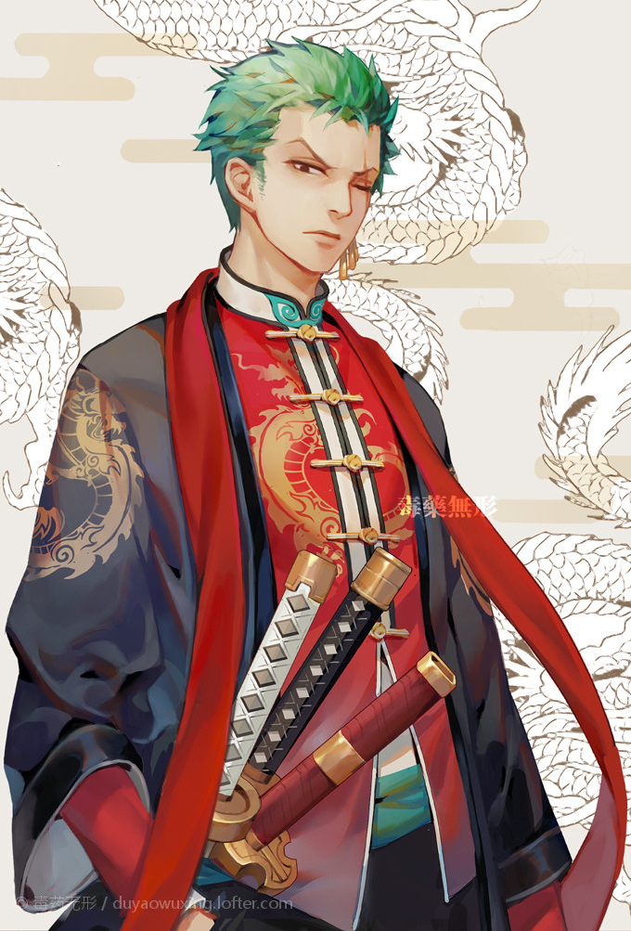
02
Chinese Suit(Tang Zhuang)
a combination of the Manchu male jacket of the Qing Dynasty and the western style suit
straight collared, with coiled buttons down the front
Chinese-style color and design but western tailoring

Slide 9
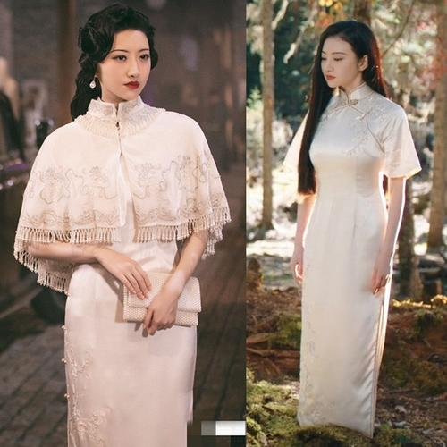
02
Cheongsam(Qi Pao)
/ˈtʃɑːŋsæm/
Originated from the Manchu female clothes
evolved by merging with western patterns
straight collar, strain on the waist, coiled buttons and slits on both sides of the dress（裙子两边开衩）
silk, cotton and linen

Slide 10
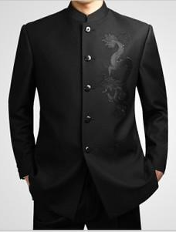
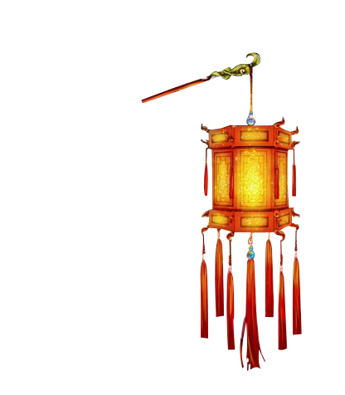
02
Chinese Tunic Suit(Zhongshan Zhuang)
designed by Dr.Sun Yat-sen（孙中山） by combining the western-style suit and Chinese attire
a turn-down collar and four pockets with flaps

Slide 11
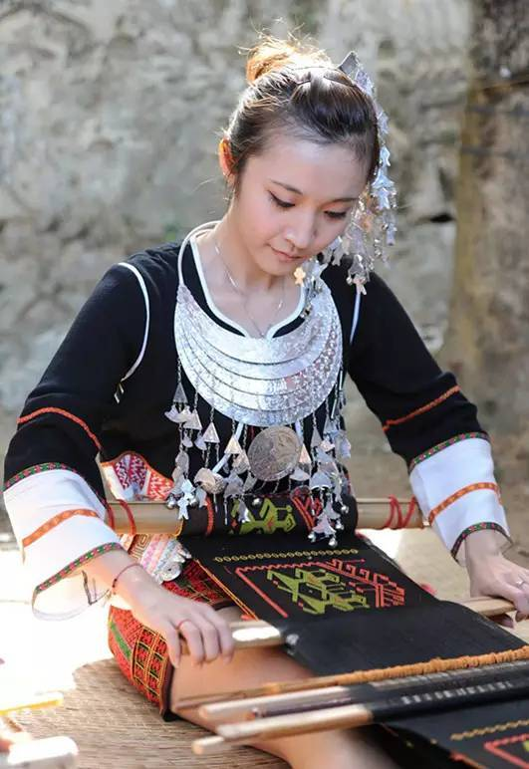
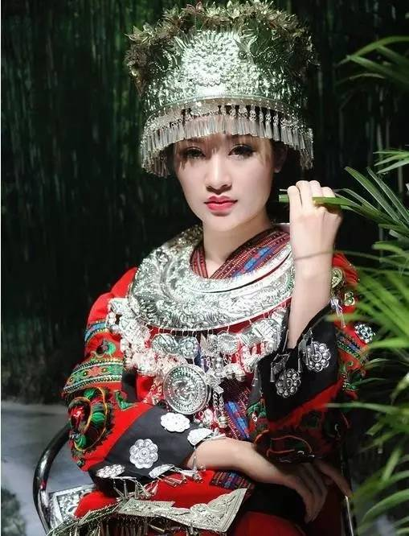
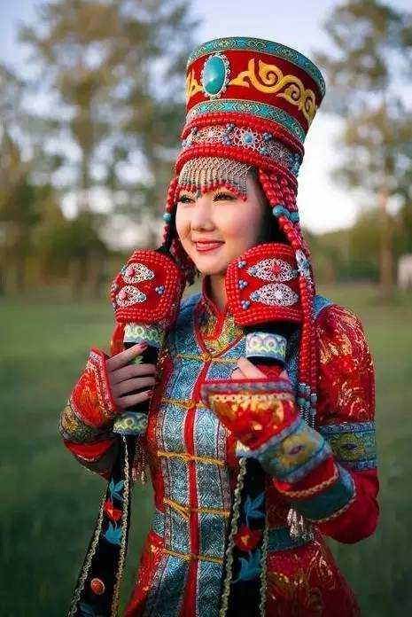
02

Slide 12
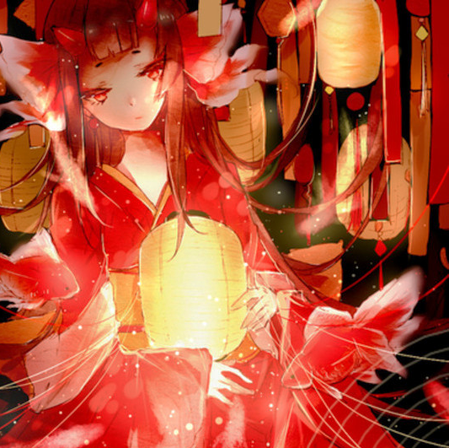
03
The Translation
Translation

Slide 13
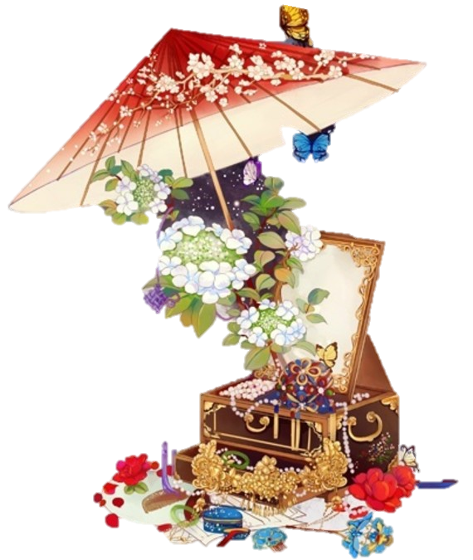
03
The Translation
旗袍 — Cheongsam, Qi Pao
中山装 — Chinese Tunic Suit, Zhongshan Zhuang
汉服 — Traditional Han Chinese Clothing , Han Fu, Han Dynasty Clothing
唐装 — Chinese Suit, Tang Zhuang, Tang Costume
Free translation VS Transliteration

Slide 14
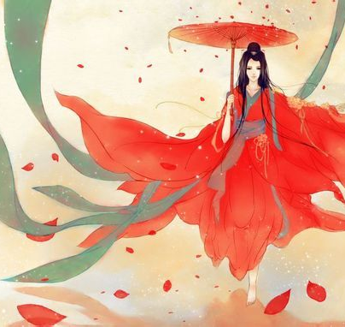
04
My Reflection
Reflection

Slide 15
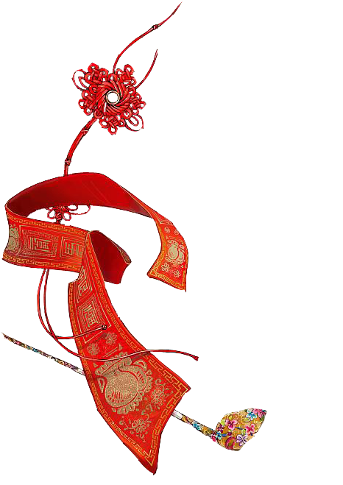
04
My Reflection
Chinese clothing has gone through a process from conservative to open, from unitary to diverse, reflecting the openness of people‘s minds and the inclusiveness and diversity of Chinese culture.

Slide 16
Thanks!

