Slide 1
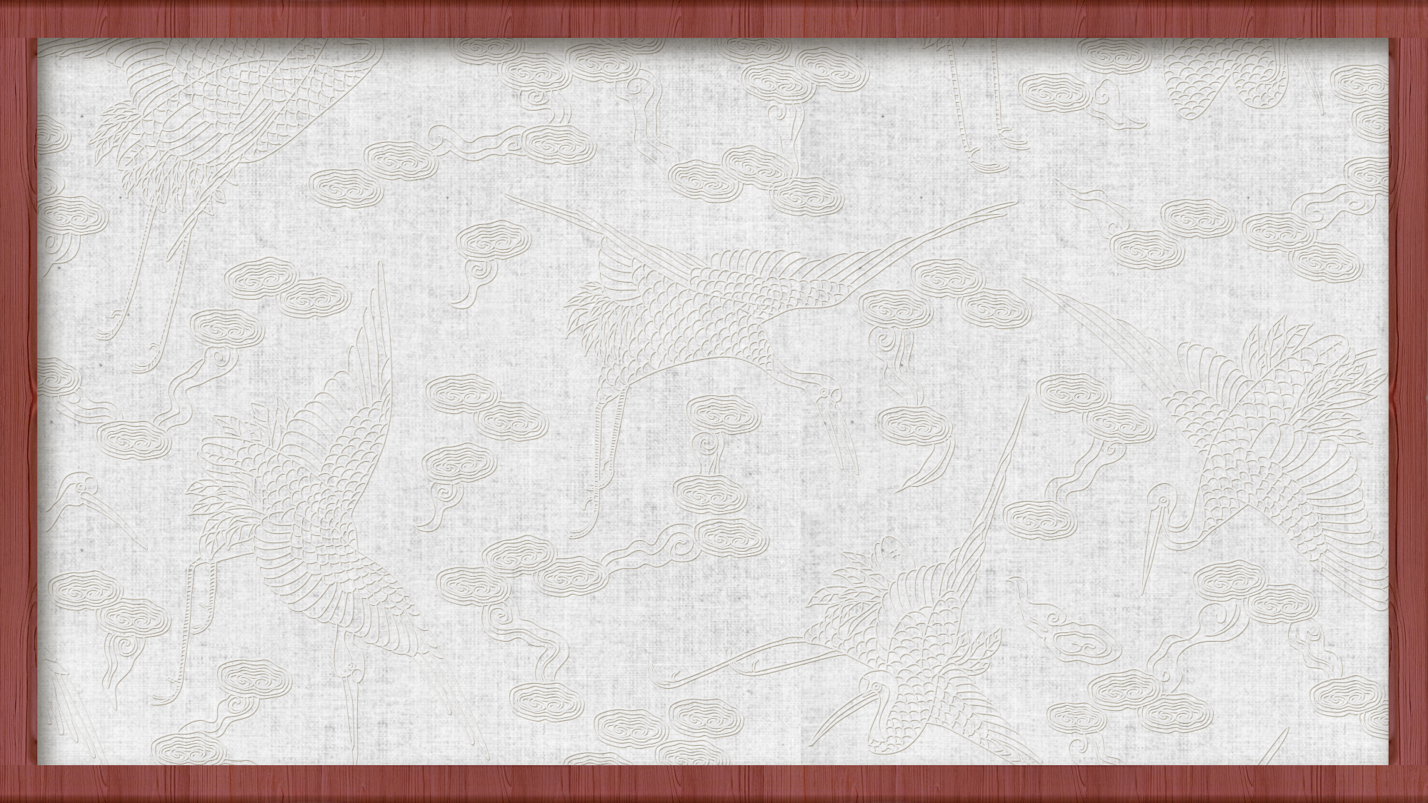
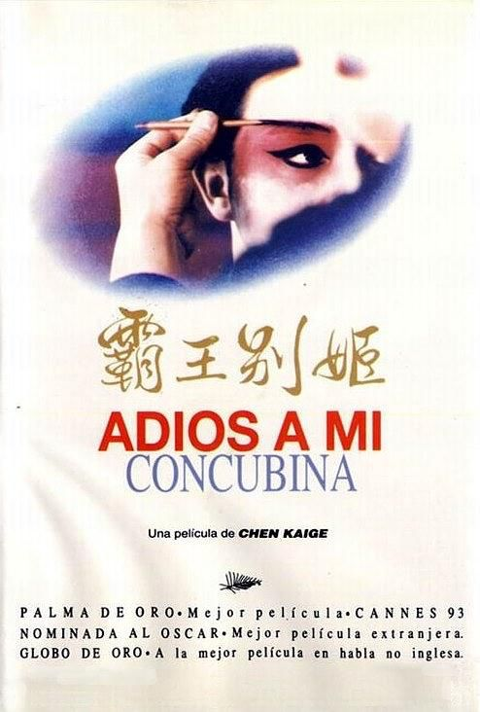
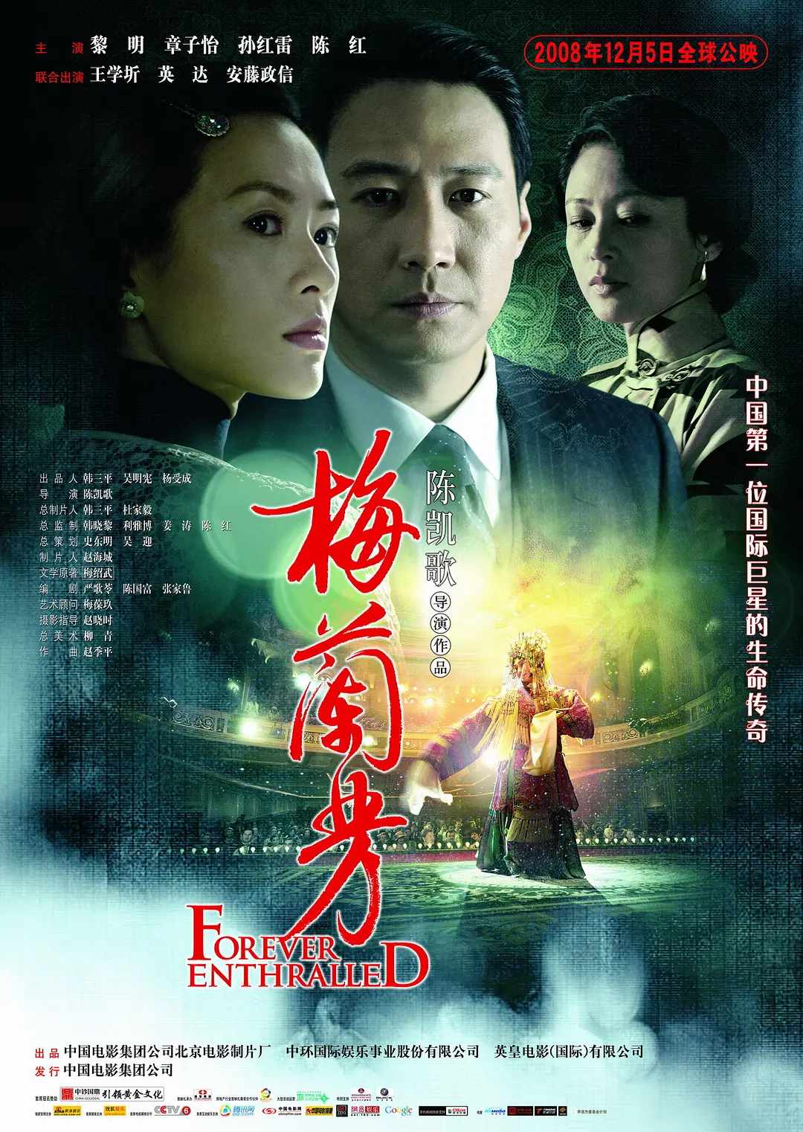

Slide 2
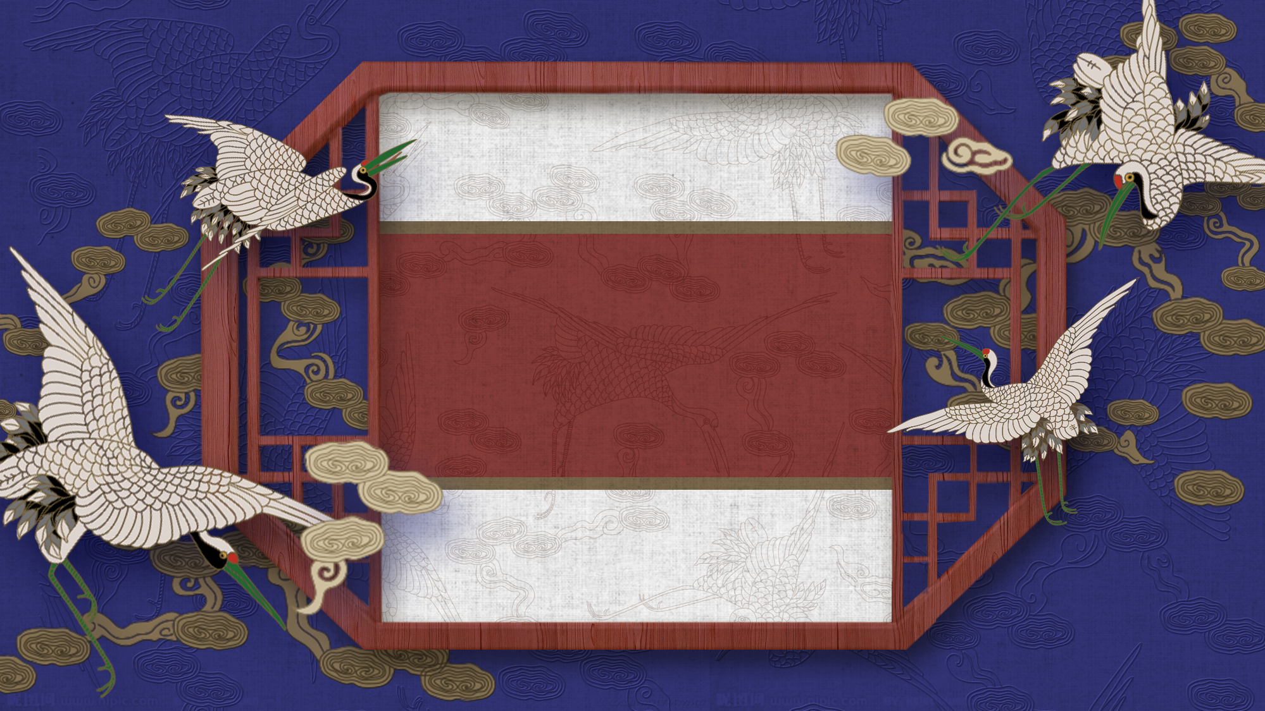
Mei Lanfang
梅兰芳
曾 良 Zeng Liang
陈永相 Cheng Yongxiang

Slide 3
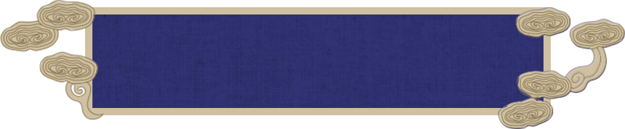

Contents
Brief Introduction
Innovation to Beijing Opera
Translation Methods
Conclusion

Slide 4
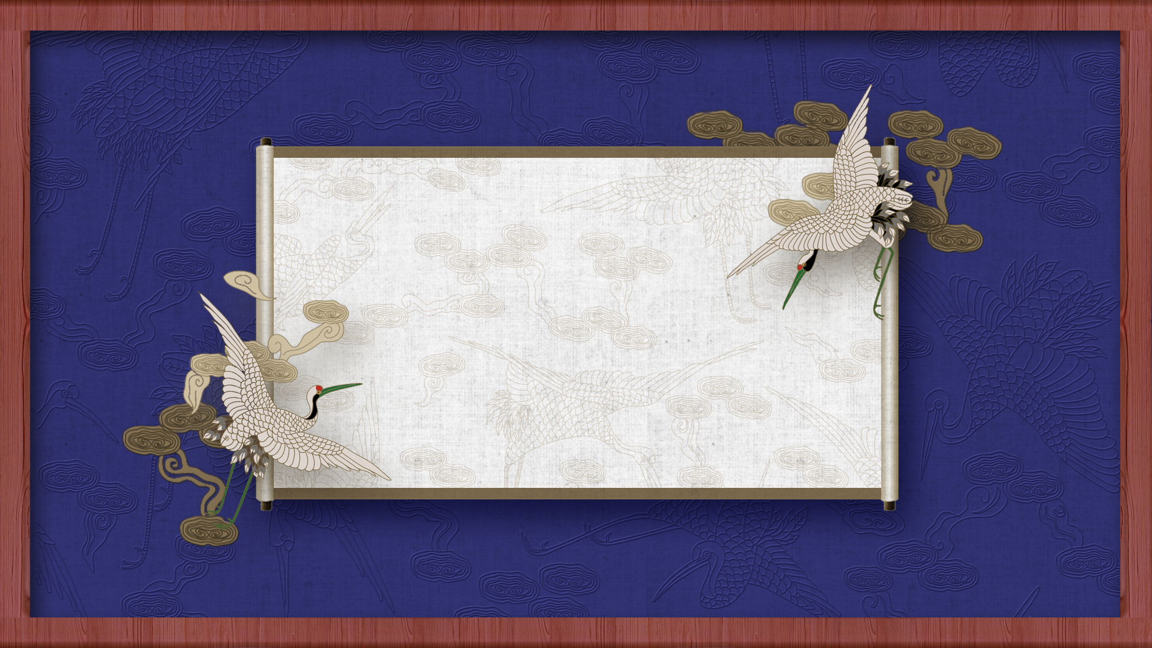
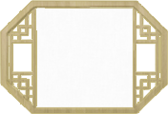
01
Brief Introduction

Slide 5
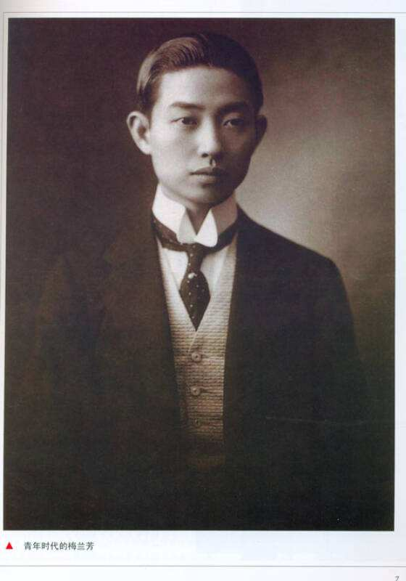
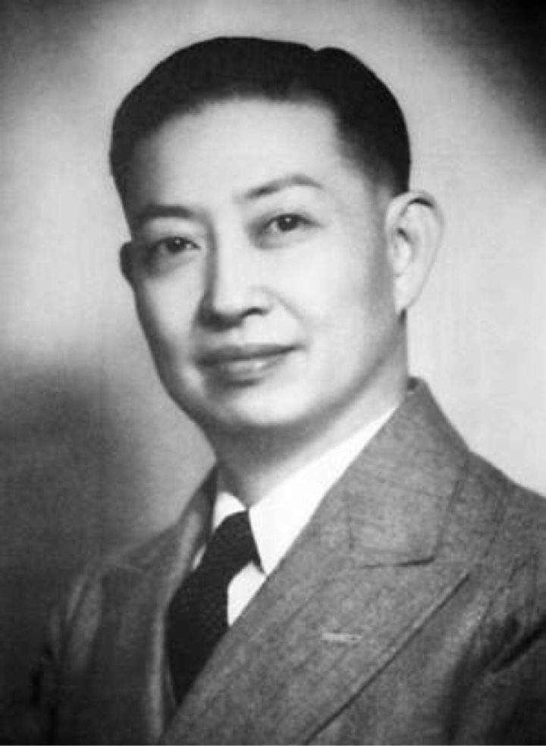
1.Brief Introduction
born into a family of Beijing Opera performers
made his debut at 11 and became well-known before 20
master of Beijing Opera
Mei Lanfang (1894-1961)

Slide 6
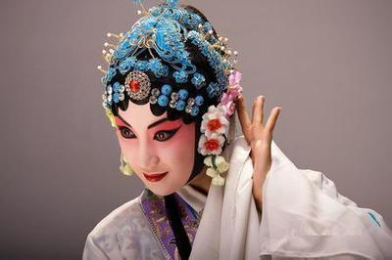
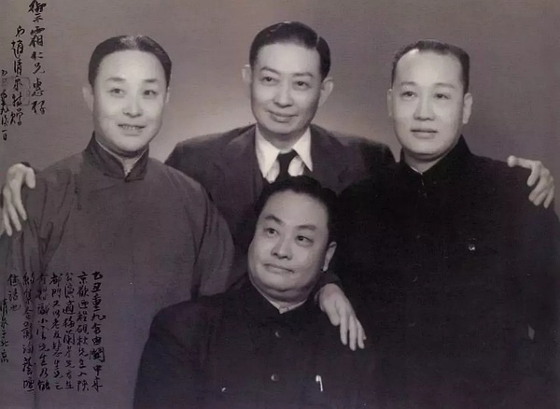
1.Brief Introduction
good at playing the role of women in Beijing Opera “Dan”（旦）
Four greatest artists of Beijing Opera:
Mei Lanfang（梅兰芳）
Cheng Yanqiu（程砚秋）
Shang Xiaoyun（尚小云）
Xun Huisheng（荀慧生）

Slide 7
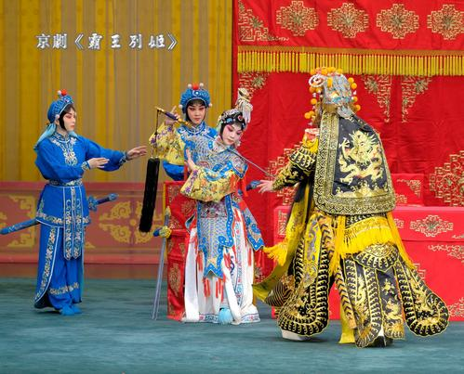
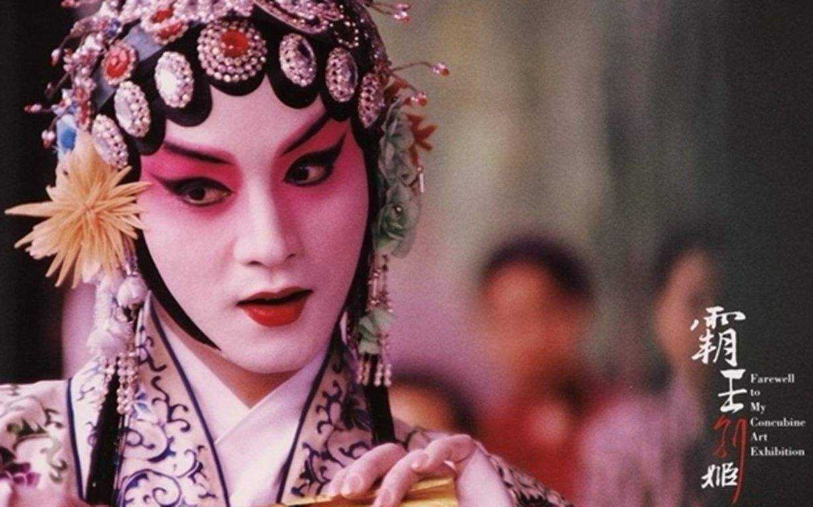
Conqueror Xiangyu Parts with his Concubine （霸王别姬）

Slide 8
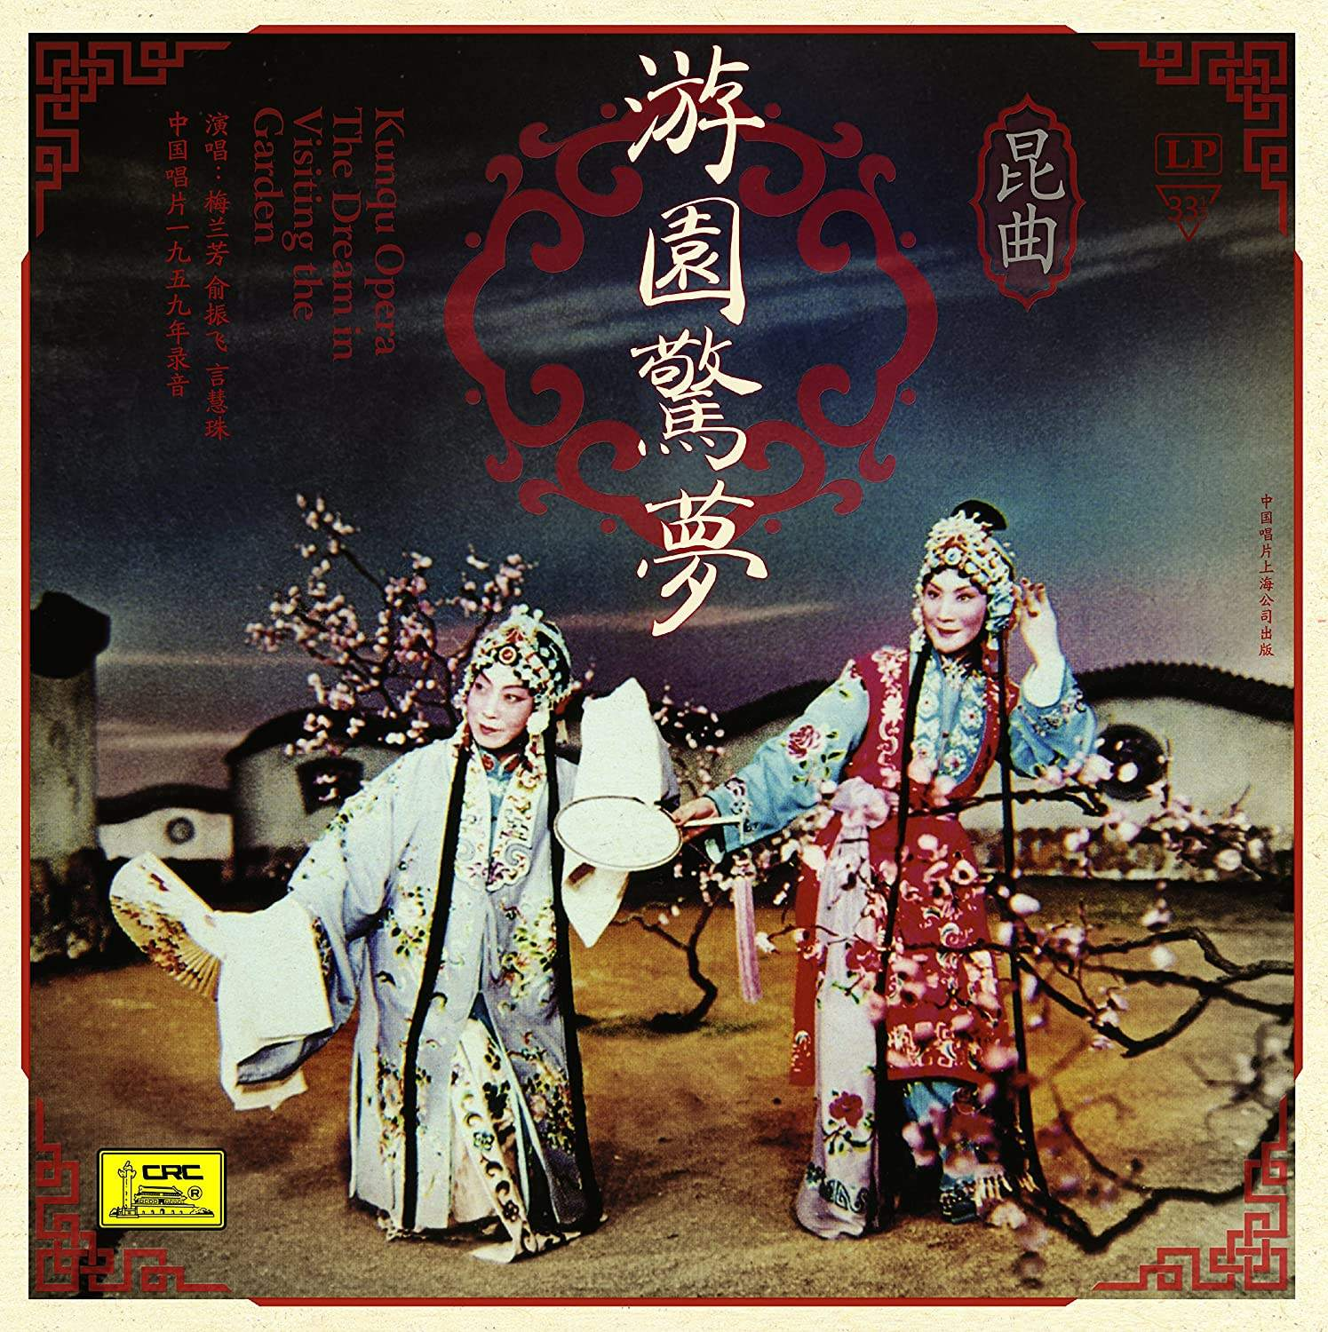
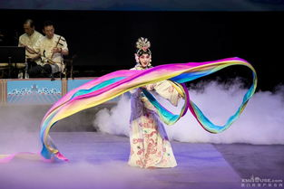
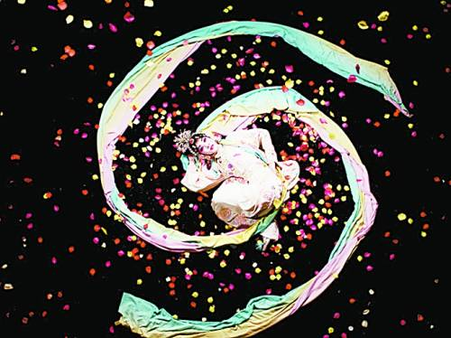
The Fairy Scattering Flowers (天女散花）

Slide 9
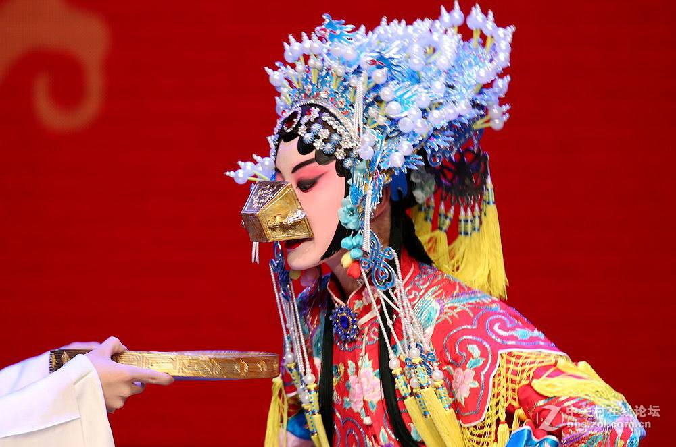
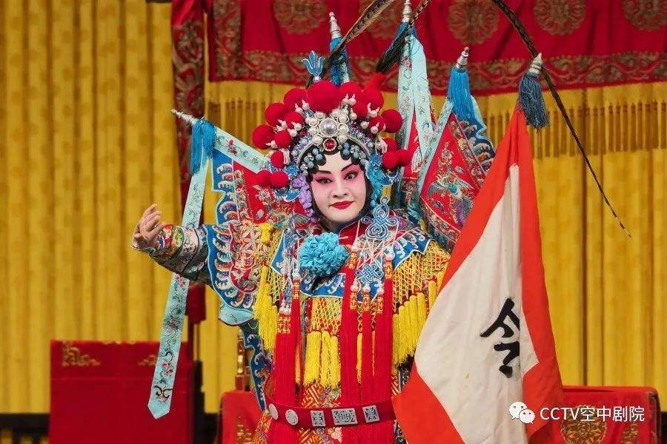
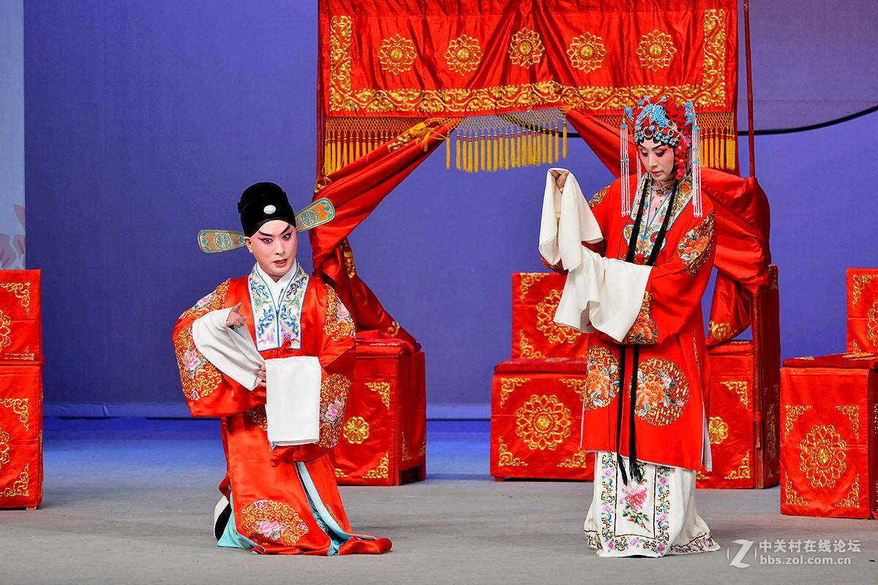

Slide 10
02
Innovation to Beijing Opera

Slide 11
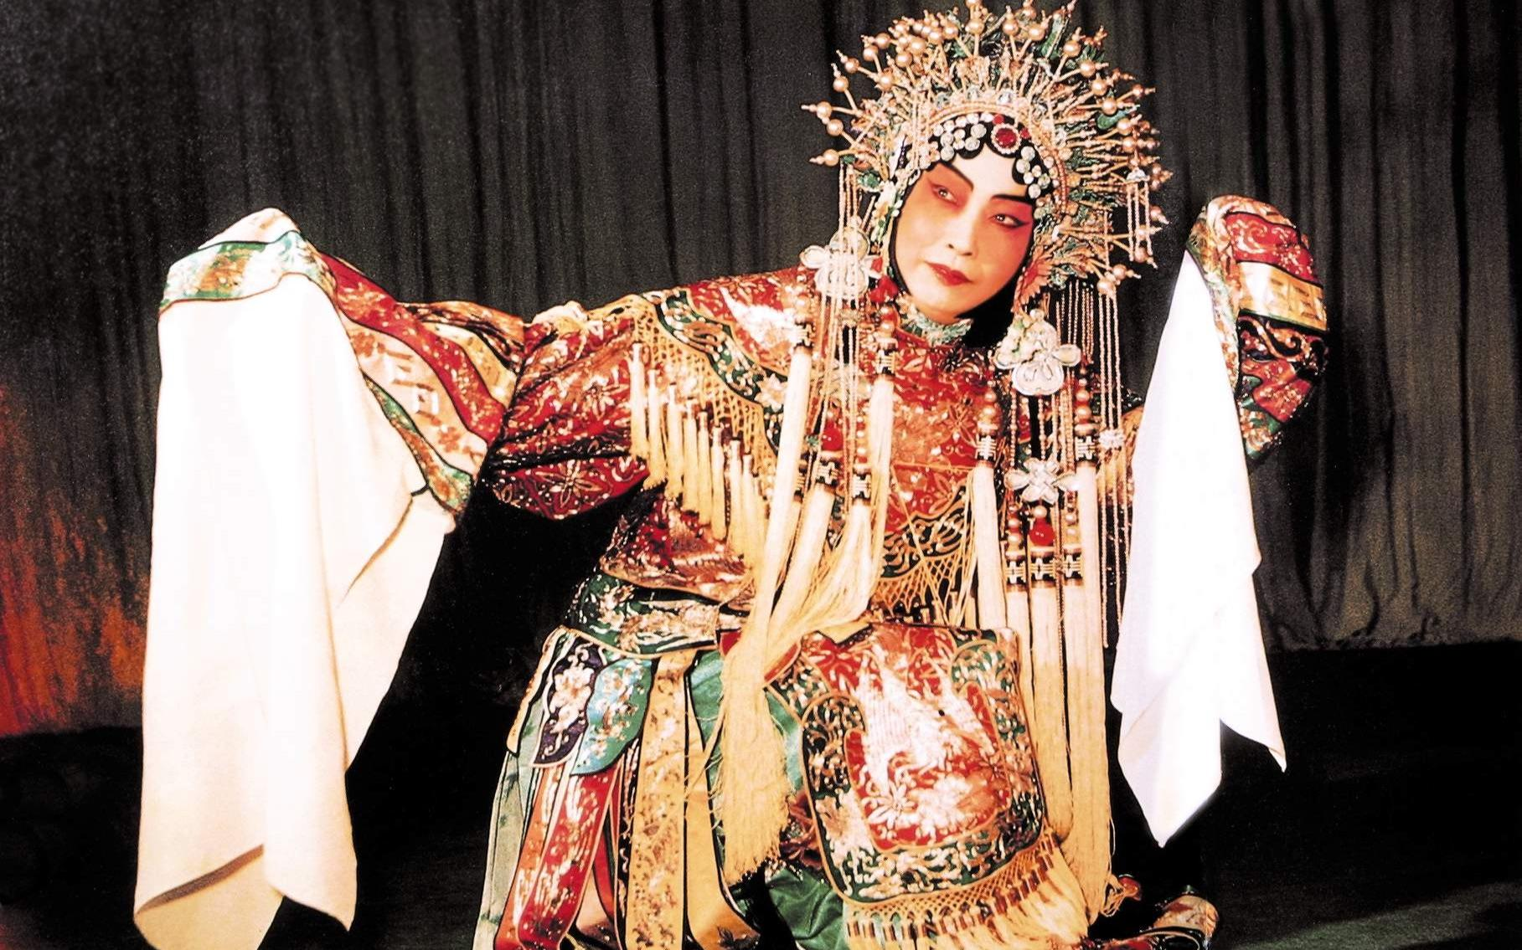
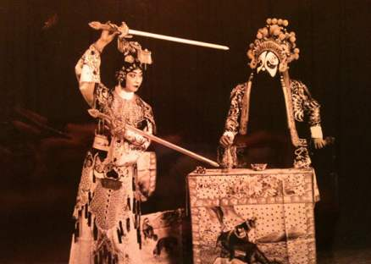
A combination of
singing,
dancing,
expression,
and martial arts.

Slide 12
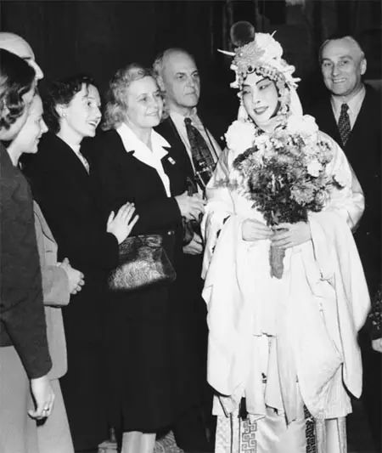
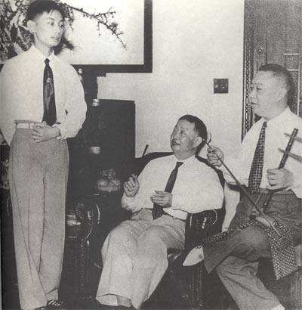
the first one to introduce erhu into the Beijing Opera orchestra
the first person to introduce
Beijing Opera to foreign countries

Slide 13
03
Translation Methods

Slide 14
1. Omission（省略）
Source Text: 对菱花打扮得花枝模样。
Target Text: I fixed up and adorned, just like a flower.

Slide 15
2.Substitution（替换）
Source Text: 自幼生来胆气刚，练就拳棒与刀枪。
Target Text: From my birth I have been brave, trained in fast, sward, knife
and starve.

Slide 16
3.Liberal Translation（意译）
Source Text: 两家成婚配，夫唱要妇随；
洞房花烛夜，才知谁是谁。
Target Text: Two houses join in one, the husband’s will be done.
Tonight in the bridal room, they will finally konw who is whom.

Slide 17
04
Conclusion

Slide 18
Thanks!

