Slide 1
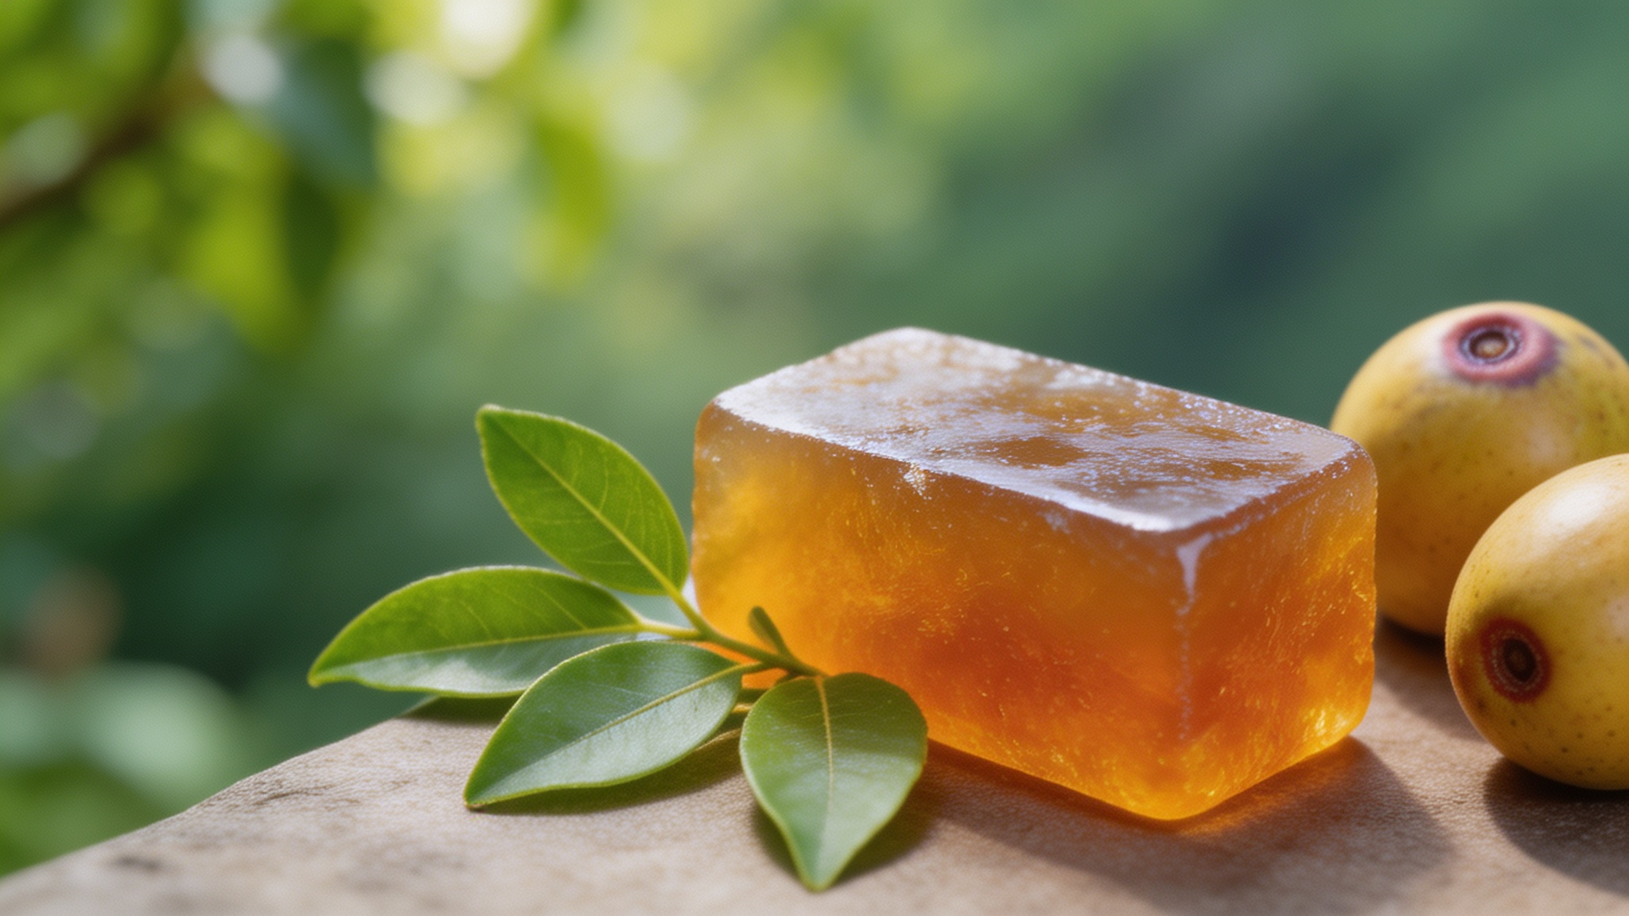
A Journey into the World of Suanzao Gao
China's Amber Delight
琥珀 · 酸枣糕| A Traditional Chinese Confectionery
Notes:
Hello everyone, and welcome. Today, we're embarking on a fascinating journey to discover a unique and delicious treasure from the heart of China. This is a story of nature, tradition, and a flavor that has delighted generations. Let's begin our exploration of Suanzao Gao, China's Amber Delight.

Slide 2

Interactive Opening: The Taste of a Legend
What Does Suanzao Gao Taste Like?
Let's start with a fun interactive question. Before we dive into the details, what flavors do you think this beautiful amber-colored treat holds?
A
Sour
酸 (Suān)
B
Sweet
甜 (Tián)
C
Spicy
辣 (Là)
D
Bitter
苦 (Kǔ)
E
Salty
咸 (Xián)
Allow the audience a moment to guess or discuss...
Notes:
Let's start with a fun interactive question. Before we dive into the details, I'd like you to take a guess. Looking at this beautiful amber-colored treat, what flavors do you think it holds? Is it sour, sweet, spicy, bitter, or salty? Take a moment to discuss with your neighbor or just think about it.

Slide 3
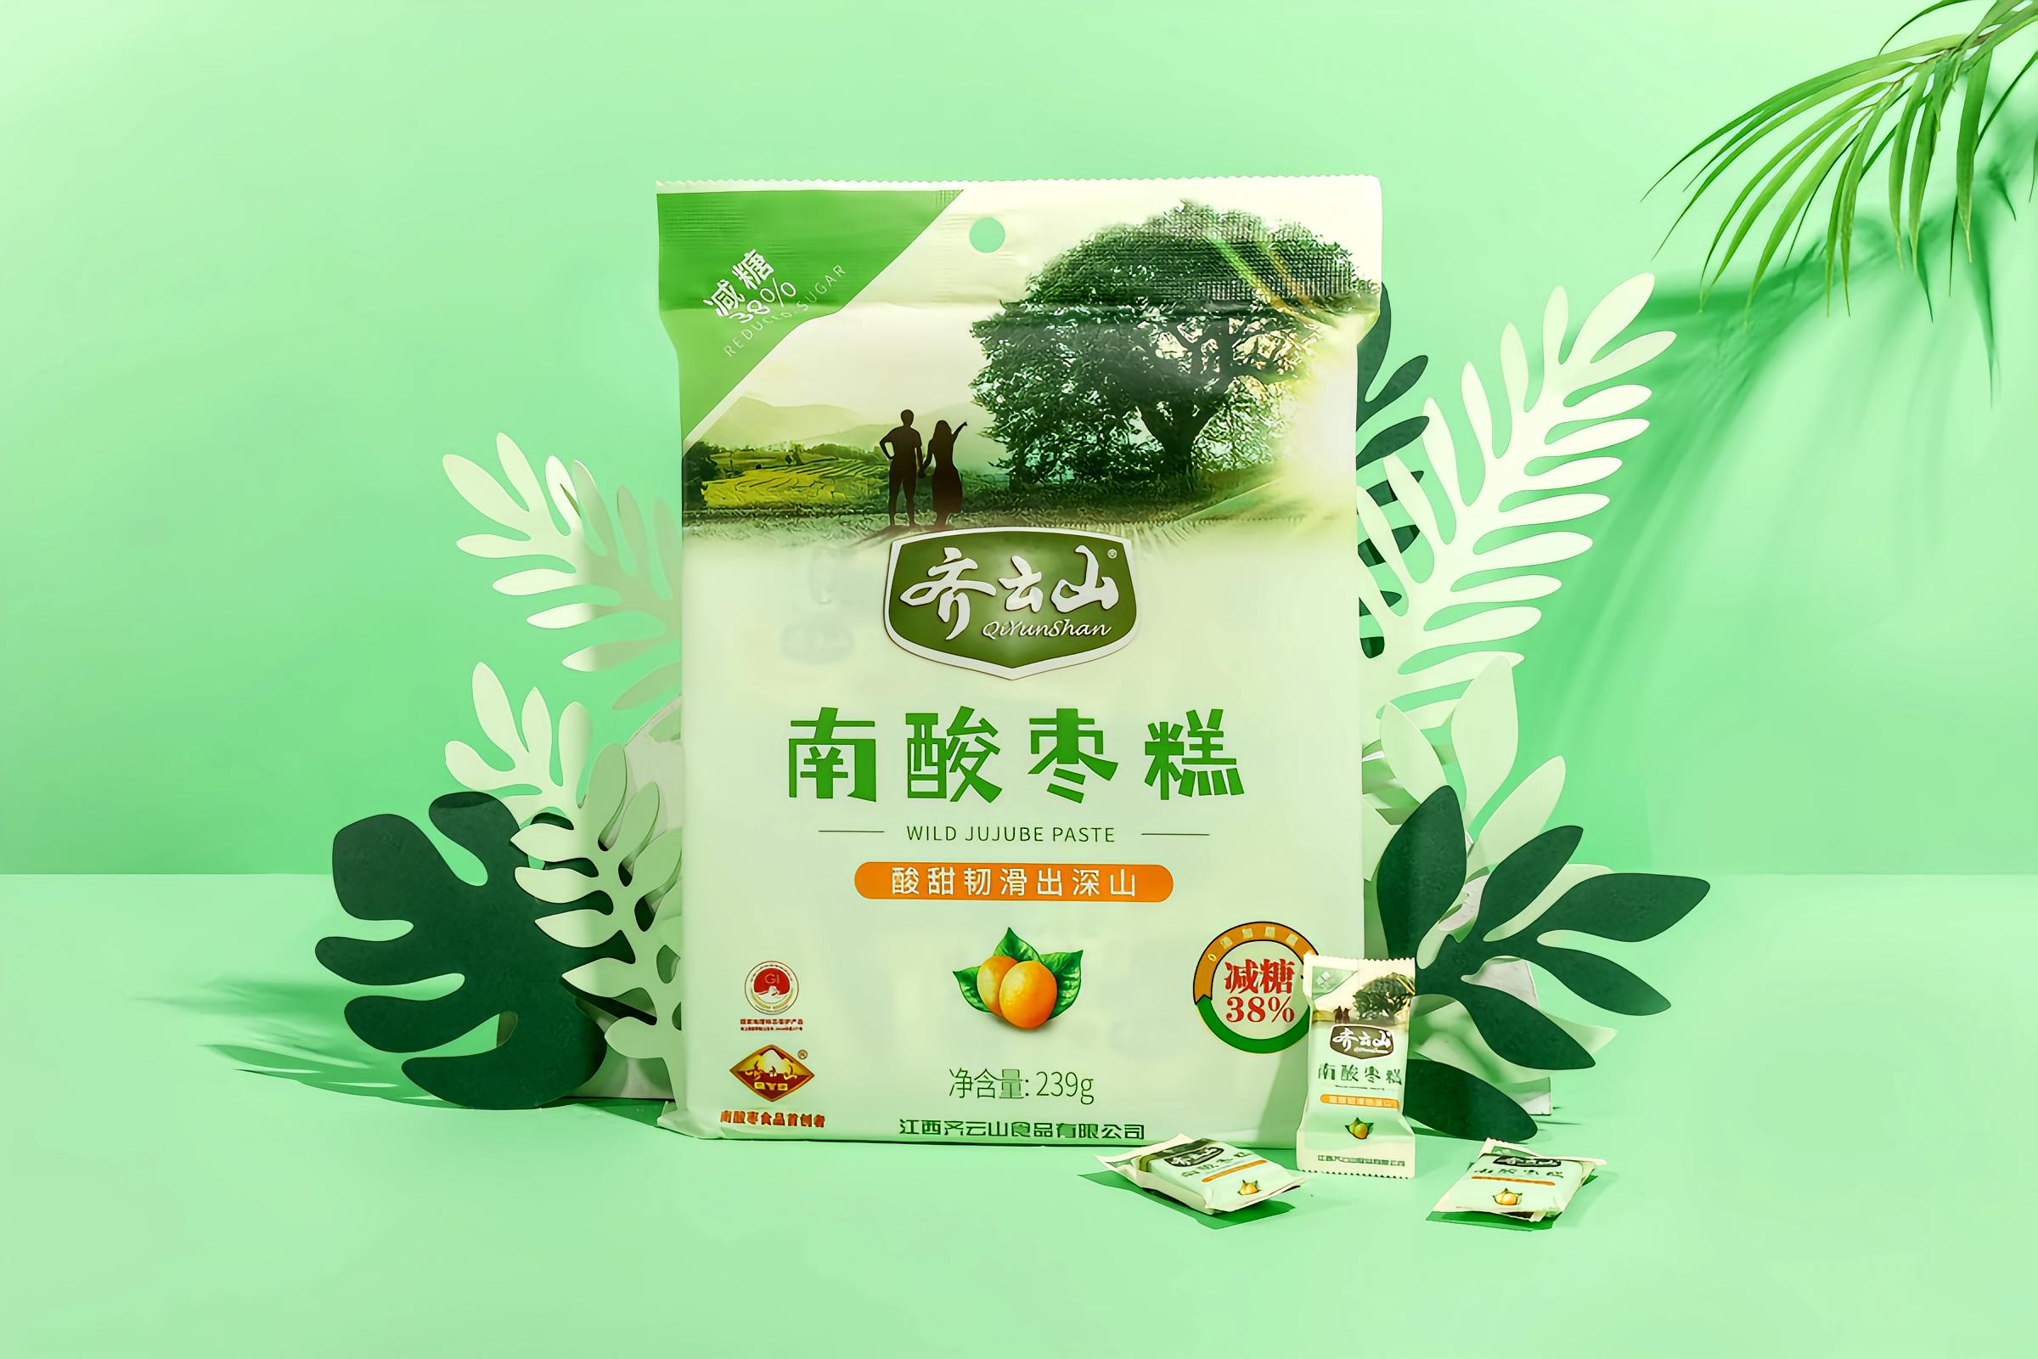
Answer Reveal
THE PRIMARY FLAVORS
A) Sour & B) Sweet
It's a delightful, balanced harmony of natural fruit acidity and gentle sweetness, creating a unique and addictive taste that is loved by many.
Notes:
So, what's the answer? The primary flavors are indeed sour and sweet. It's a perfect balance of the wild fruit's natural tartness and a gentle sweetness, creating a truly unique and addictive taste. If you were lucky enough to try one, you'll know exactly what I mean.

Slide 4
Contents
01
02
03
A Taste Steeped in History
From Fruit to Delicacy
More Than a Snack
Popular Regions and Historical Origins
Raw Materials and Production Process
Cultural Value and Significance
Notes:
Now that we've tasted the mystery, let's uncover its story. Today, we'll explore three main parts: first, we'll travel back in time to discover its historical origins and where it's most beloved. Then, we'll get a close-up look at how this delicious treat is made, from the fruit to the final product. Finally, we'll discuss why Suanzao Gao is much more than just a snack, but a cultural icon.

Slide 5

PART 01
A Taste Steeped in History
壹 · 溯源
Notes:
Let's begin our journey with the first chapter: A Taste Steeped in History. We'll explore where this tradition was born and how it has evolved over centuries.

Slide 6
Where is Suanzao Gao From?
Suanzao Gao is a beloved traditional snack deeply rooted in the mountainous regions of Southern China. Its popularity is most prominent in two key provinces:
Jiangxi Province (江西省)
Specifically,Chongyi County (崇义县)in Ganzhou City is hailed as the "Hometown of Chinese Wild Jujube". The brandQiyunshan (齐云山)from this region is a leading producer.
Fujian Province (福建省)
The county ofPucheng (浦城县)in Nanping City is renowned for its ancient craftsmanship, recognized as anIntangible Cultural Heritage.
Southern China's mountainous landscape —
The birthplace of wild jujubes
Notes:
So, where does this delicious snack come from? Suanzao Gao is deeply rooted in the mountainous regions of Southern China. Two provinces stand out: Jiangxi, and in particular Chongyi County, known as the 'Hometown of Chinese Wild Jujube', home to the famous brand Qiyunshan. And Fujian, where Pucheng County is celebrated for its ancient, intangible cultural heritage craft of making Suanzao Gao.

Slide 7
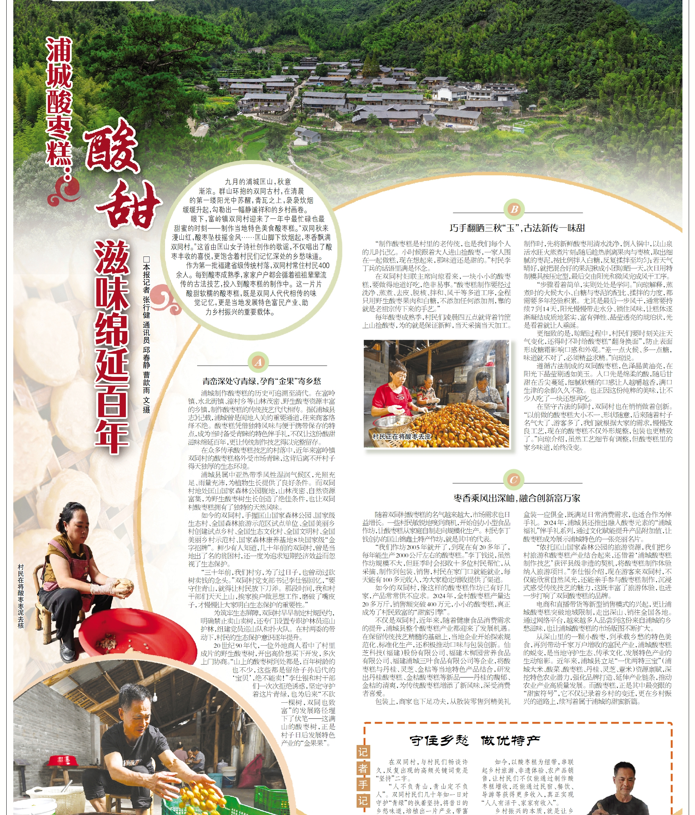
A Taste Steeped in History
Ancient Roots
Historical records trace its consumption back to at least theQing Dynasty (清朝, 1636-1912). It was a way for mountain villagers to preserve the abundant wild jujube harvest.
Anecdotal Origin Story
Legend has it a clever village woman experimented by boiling the sour fruit with sugar and sun-drying it, creating a chewy cake that could be stored for months.
From Local Delicacy to National Treasure
It was a homemade treat for centuries. In 2018, "Chongyi Suanzao Gao" was registered as aNational Geographical Indication Product, recognizing its unique origin and quality.
Historical Records & Local Chronicles
Notes:
The history of Suanzao Gao is a story of rural ingenuity. While its exact origin is unclear, records trace it back to the Qing Dynasty. It's believed to have been invented by villagers looking to preserve the wild jujube harvest. This simple act of preservation became a cherished tradition. From a local homemade treat, it has grown into a national treasure, officially recognized for its unique origin and quality.

Slide 8
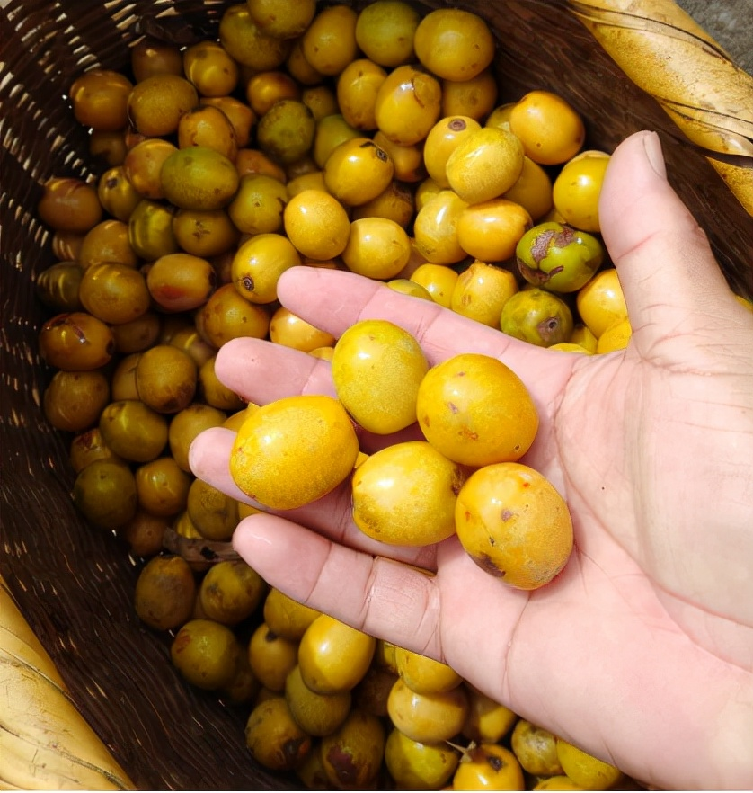
Part 2
From Fruit to Delicacy
果物 · 匠心
Notes:
Now, let's move to the second part of our journey: From Fruit to Delicacy. We'll explore the star ingredient and the meticulous process that transforms it into the treat we know and love.

Slide 9




The Star Ingredient: The Wild Jujube (南酸枣)
The magic starts with the fruit of theChoerospondias axillaristree, known asSuanzao (酸枣)or "Five-Eyed Fruit" (五眼果).
Natural Habitat| Thrives in the pristine subtropical mountain forests of Southern China.
Natural Pectin (天然果胶)
Acts as a natural gelling agent for texture.
Vitamin C
Exceptionally rich content, comparable to kiwi.
Plant Flavonoids (植物黄酮)
Powerful antioxidants for health benefits.
Organic Acids
Source of the fruit's characteristic bright sourness.
Notes:
The magic of Suanzao Gao starts with its star ingredient: the wild jujube, or 'Suanzao'. This fruit, also known as the 'Five-Eyed Fruit', grows in the pristine mountain forests of Southern China. It's packed with nutrients: natural pectin which acts as a gelling agent, high levels of Vitamin C, beneficial plant flavonoids, and the organic acids that give it its signature sour taste.

Slide 10
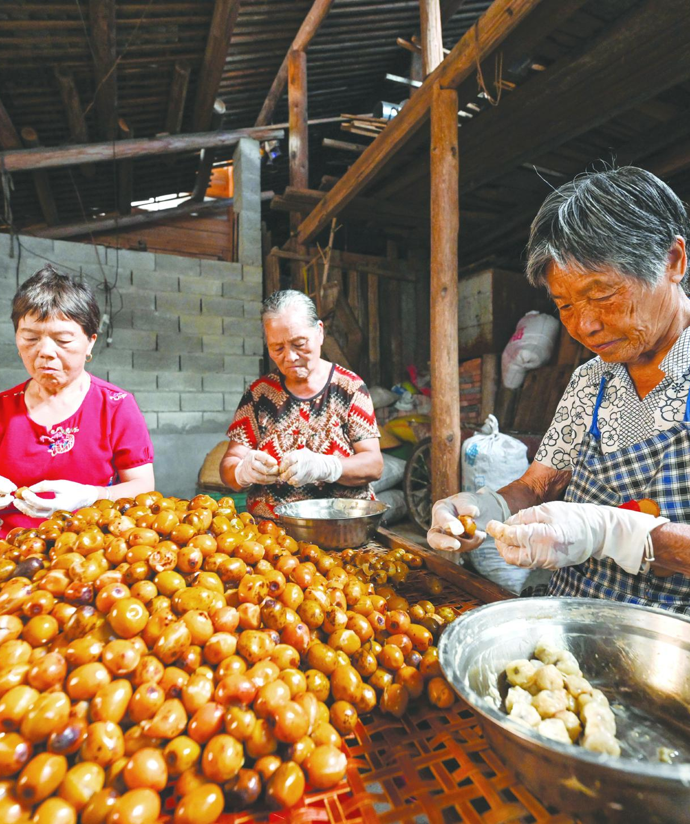
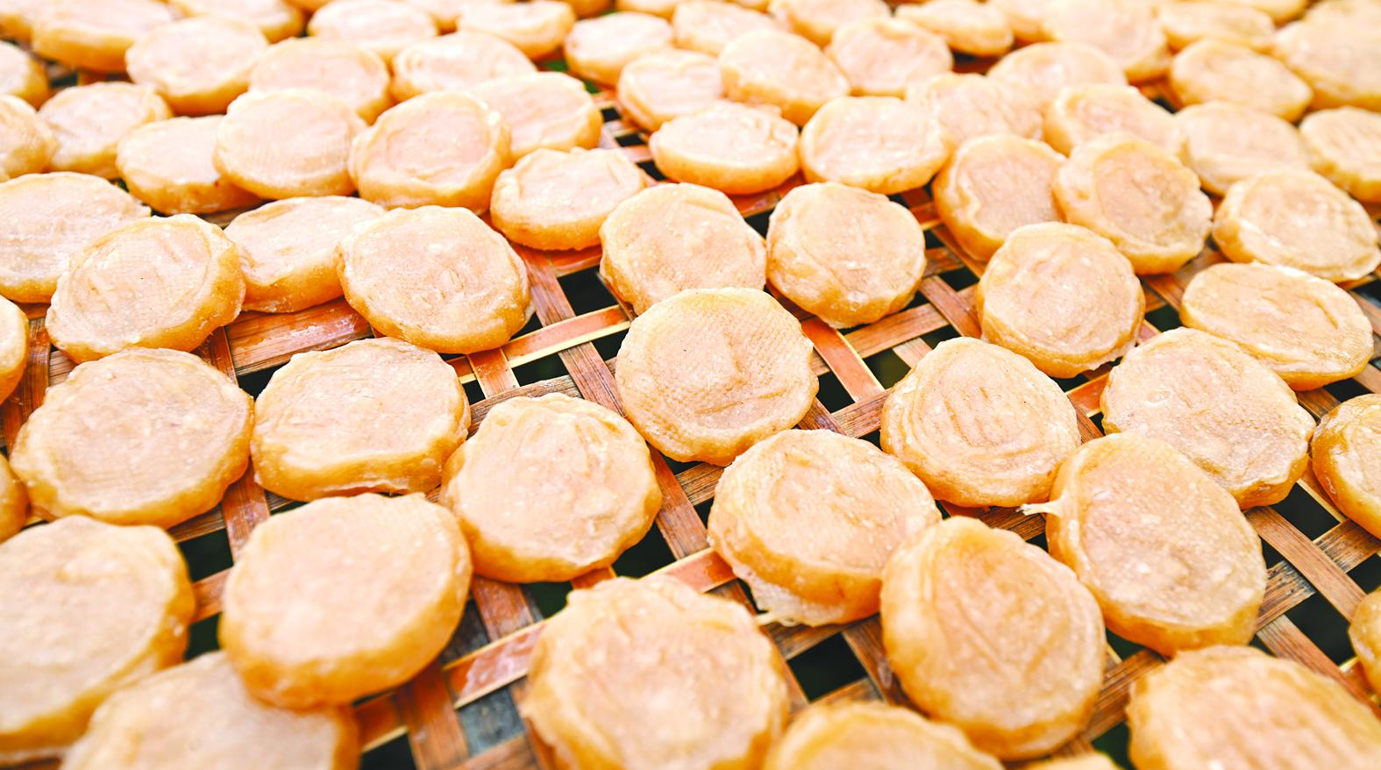
The Traditional Artisanal Process(古法工艺)
The traditional method is a labor-intensive process that honors the fruit's natural essence.
01.Harvesting(采摘)
Handpicking ripe jujubes at the peak of sweetness.
02.Cleaning(清洗)
Gentle washing with pure mountain spring water.
03.Steaming(蒸煮)– Softening fruit over an open fire.
04.Peeling & Pitting(去皮去核)– A delicate, fast step done by hand.
05.Mashing & Kneading(揉捏): Forming a smooth paste.
06.Sweetening(拌糖): Adding pure cane sugar.
07.Sun-Drying(晾晒): Drying 7-14 days to concentrate flavors.
Notes:
The traditional artisanal process is a true labor of love. It begins with handpicking the ripe fruit, washing it, and steaming it. The most delicate step is peeling and pitting the fruit while it's still hot. The pulp is then mashed, sweetened with pure cane sugar, and finally sun-dried for up to two weeks. This slow process allows the natural flavors to concentrate and the pectin to work its magic.

Slide 11

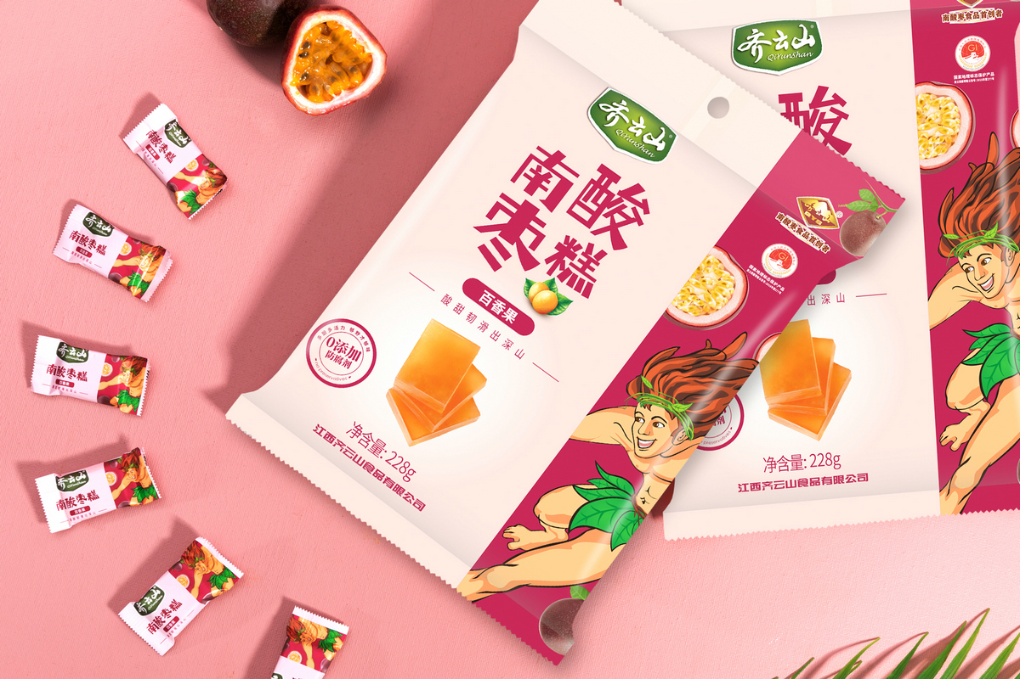

The Modern Industrial Process (现代工艺)
Modern producers combine traditional principles with advanced technology to ensure consistency and safety.
01Selection & Washing
Mechanized sorting ensures quality.
02Blanching / Freezing
Loosens the skin for easy removal.
03Automated Peeling & Pitting
Efficient separation of skin and pit.
04Cooking
Controlled cooking to create a homogeneous paste.
05Controlled Drying
Temperature and humidity-controlled rooms replace sun-drying for uniformity.
06Inspection & Packaging
Ensures safety and quality before sealing.
Innovation:Modern technology has led to new flavors like yogurt, combining tradition with new tastes.
Notes:
While the traditional method is still cherished, modern producers like Qiyunshan have adapted the process for consistency and safety. They use mechanized sorting, automated peeling, and temperature-controlled drying rooms. This allows them to produce large quantities while preserving the authentic taste. Modern technology has also brought innovation, like new flavors such as yogurt, blending the old with the new.

Slide 12
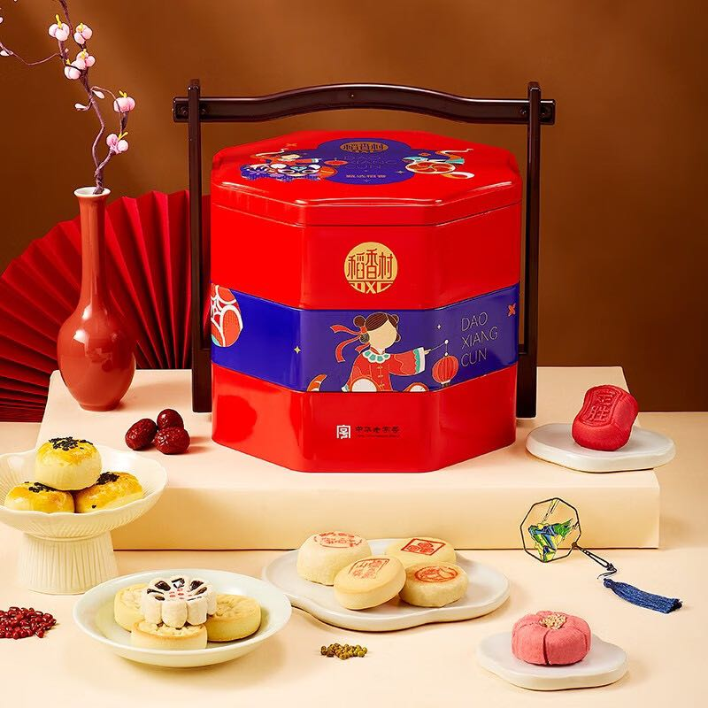
Part 3
More Than a Snack
不止于味 · 更是心意
Notes:
Finally, let's explore the third and final part of our journey. We'll discover why Suanzao Gao is much more than just a delicious snack; it's a cultural icon with deep significance.

Slide 13



Cultural Value and Significance
A Taste of Nostalgia(乡愁的味道)
Regional Identity(地域名片)
For many, it evokes memories of childhood and home, a tangible link to one's roots and the warmth of family.
As a protected Geographical Indication product and Intangible Cultural Heritage, it is a proud symbol of its birthplace.
A Healthful Tradition(健康理念)
Rural Prosperity(富民产业)
Aligns with modern demands for healthy, additive-free snacks, perfectly combining traditional Chinese medicine properties with contemporary health consciousness.
The industry drives rural economies, providing employment and encouraging sustainable development. In Chongyi alone, the annual output value exceeds2.4 billion RMB.
Notes:
Suanzao Gao holds immense cultural value. For many, it's a taste of nostalgia, a reminder of home. It's a symbol of regional identity, a source of local pride as a protected geographical indication. It also represents a healthful tradition, aligning with modern healthy eating trends. Most importantly, it has become a driver of rural prosperity, supporting local economies and creating a sustainable industry.

Slide 14



Conclusion
Suanzao Gao is a perfect blend of:
Nature
From the wild fruits of Southern China's mountains.
Tradition
A craft passed down through generations.
Culture
A symbol of heritage and regional pride.
Health
A natural, nutritious snack.
Qiyunshan Suanzao Gao
A Taste of Southern China
It is truly a unique treasure that encapsulates the essence of Chinese culinary heritage.
Notes:
In conclusion, Suanzao Gao is more than just a sweet and sour treat. It is a perfect blend of nature, tradition, culture, and health. It tells a story of a region, its people, and their ingenuity. It is truly a unique treasure that encapsulates the very essence of Chinese culinary heritage.

Slide 15
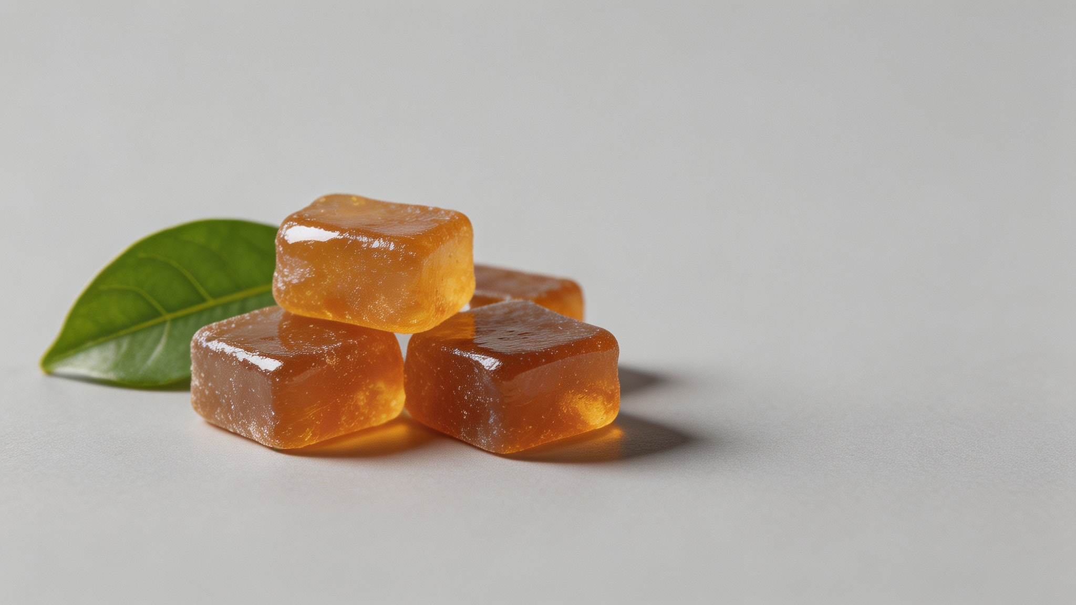

Thank You
感谢观看
期待与您再次相遇
Notes:
Thank you for joining me on this journey into the world of Suanzao Gao. I hope you've gained a new appreciation for this wonderful Chinese delight.

