Slide 1


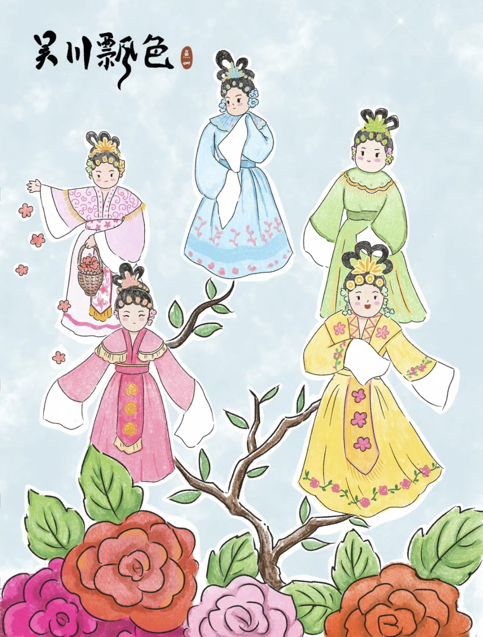

Piao Se
飘色
主讲人:朝鲜语笔译黄梦燕
时间:2024.12.12

Slide 2
目录
CONTENTS
01
02
Meaning of the name
Piao Se history
03
04
The development of Piao Se
Achievements

Slide 3
01
Meaning of the name

Slide 4
Video
http://xhslink.com/a/iBScqoKD4kv1

Slide 5
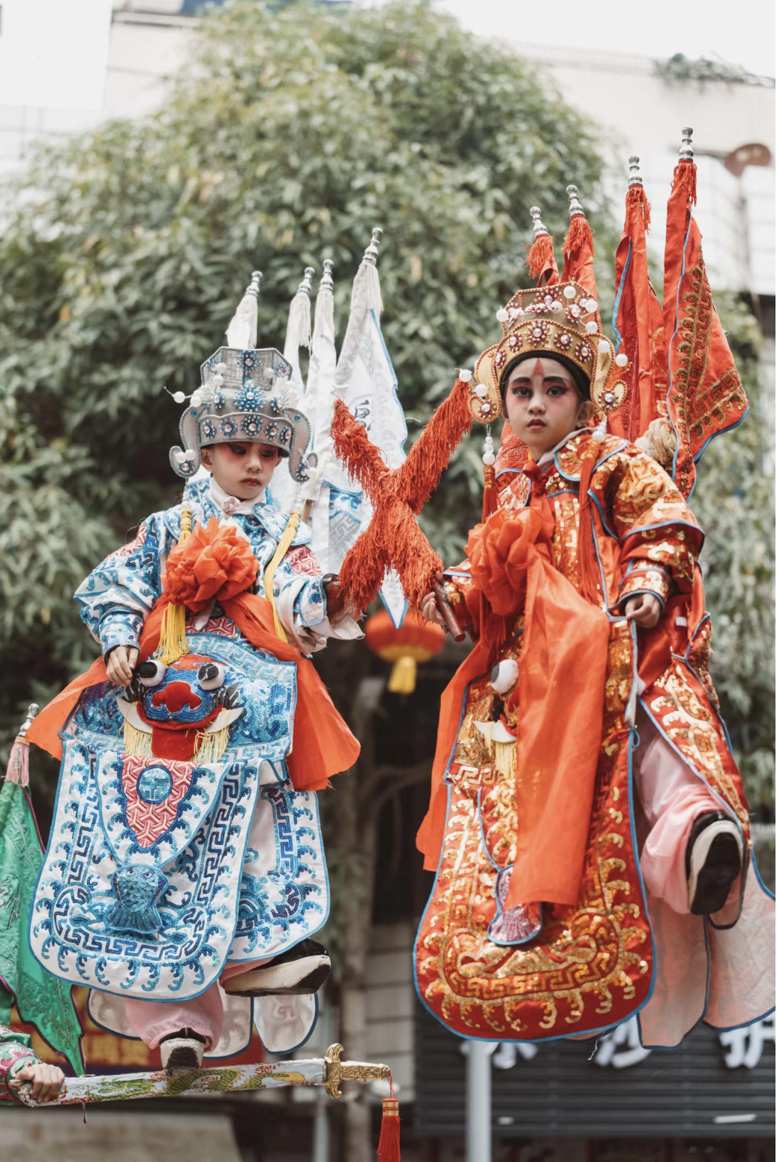
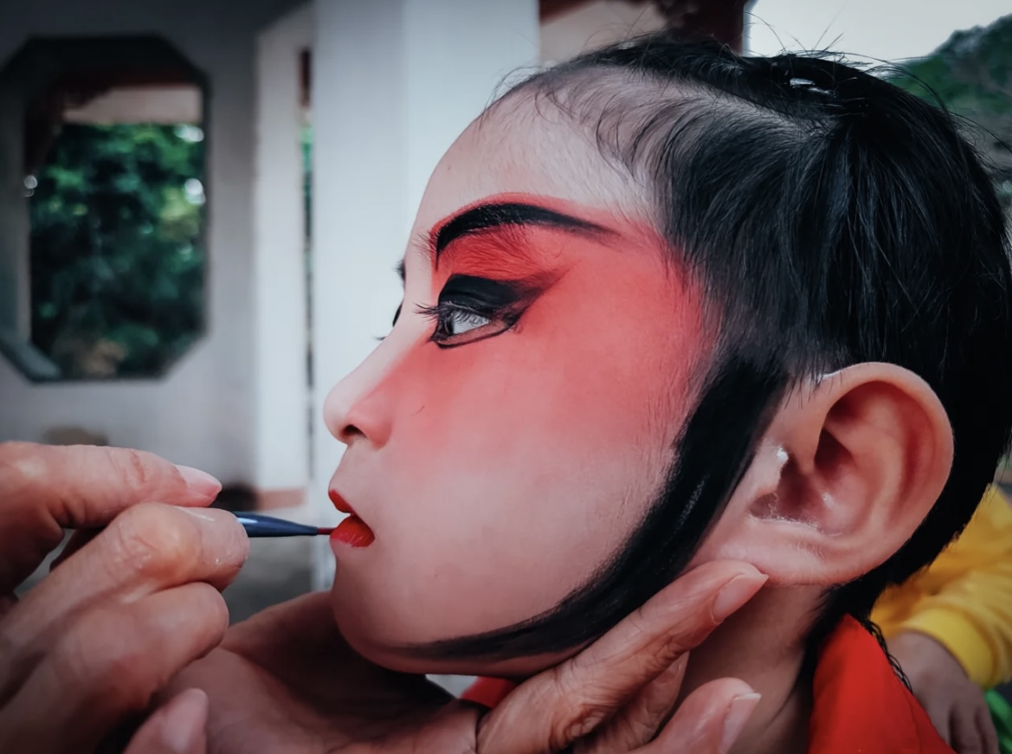
Question
1:What are the meanings of "piao" and "se" respectively?

Slide 6
The Meaning of "Piao"
In Piao Se performances, through ingenious design and support, child actors appear to float in the air.
The Meaning of "Se"
"Se" refers to the actors' attire, costumes, and makeup in Piao Se.

Slide 7
02
Piao Se history

Slide 8
Origin
The Qing government banned the performance of cantonese opera.
Possibly because the leaders of the Taiping Heavenly Kingdom mainly came from Guangdong and Guangxi, and had used Cantonese opera as a means of propaganda and agitation.
● Some cantonese opera artists devised a way to transform the opera into a cart-style Piao Se, which was paraded during the Lantern Festival as a celebration.
● This is considered the crystallization of the Han people's "indirect resistance" to the cultural suppression by the Manchu Qing government.

Slide 9
03
The Development of Piao Se

Slide 10
Zhuan Se 转色
A rectangular platform is equipped with a rotating stool, on which several costumed children sit in the middle. Every year during the parade, four people carry the platform in a procession, occasionally stopping to play music and sing. During the performance, the stool is spun around once, which is called "Zhuan Se".

Slide 11
Ban Se 板色
In Ban Se, se tai（色台） is made from wooden boards, approximately 50 centimeters high, 2 meters long, and 1.5 meters wide, adorned with paper-made flowers, trees... The term "Se" refers to a performer seated on the platform, holding a pipa or huqin.

Slide 12
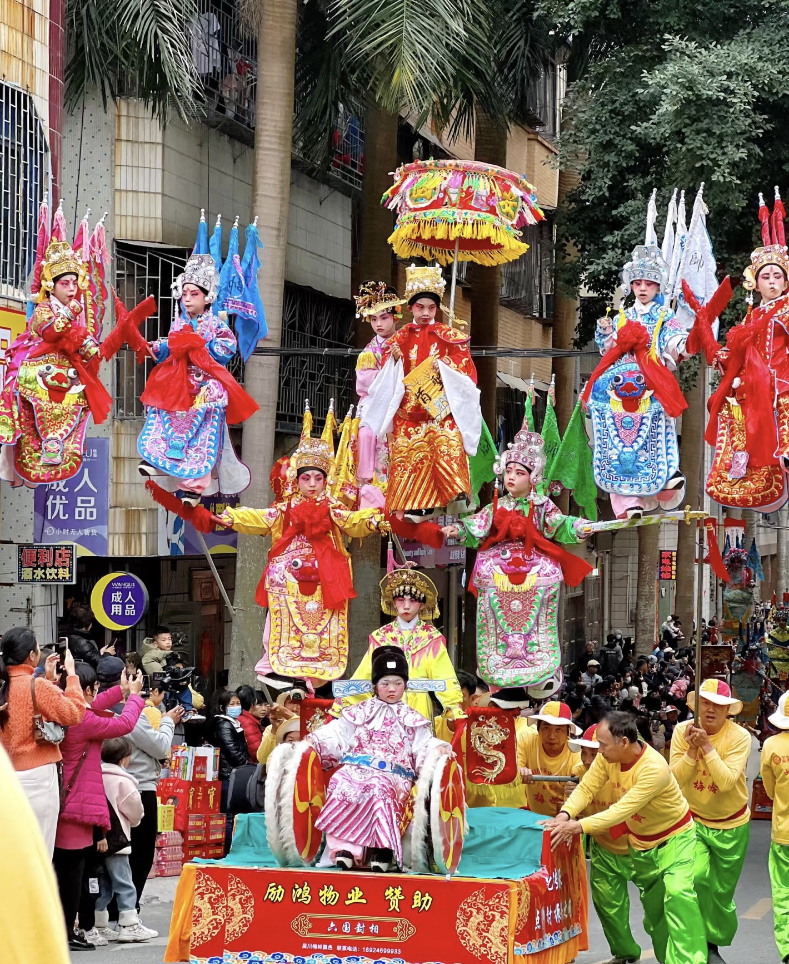
Piao Se 飘色
Performance Time
The Lantern Festival.
Content
The content of Piao Se often includes dramatic stories, mythological legends, historical tales, and so on.
《六国封相》

Slide 13
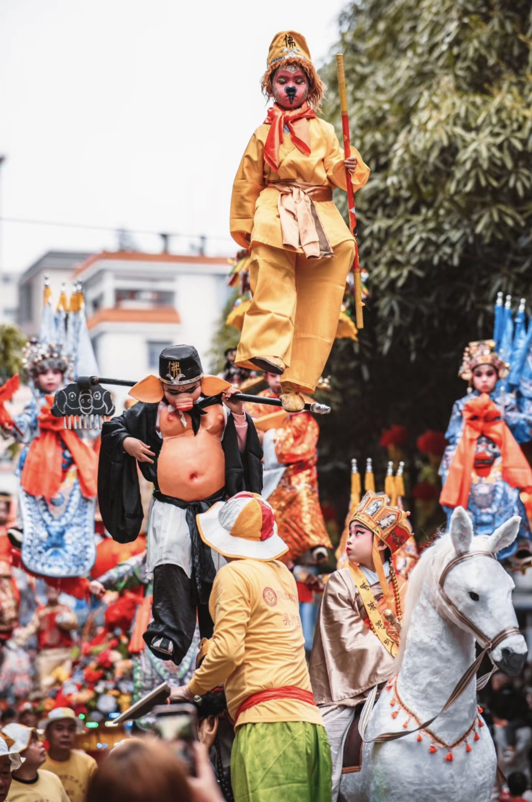
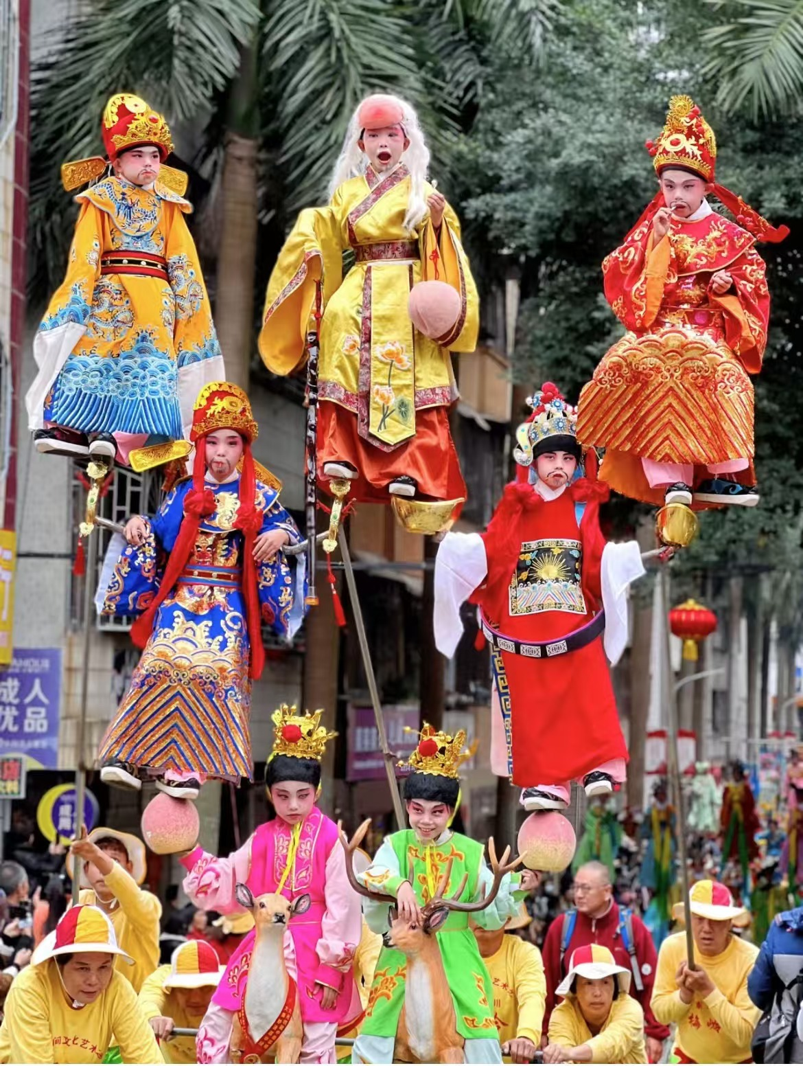
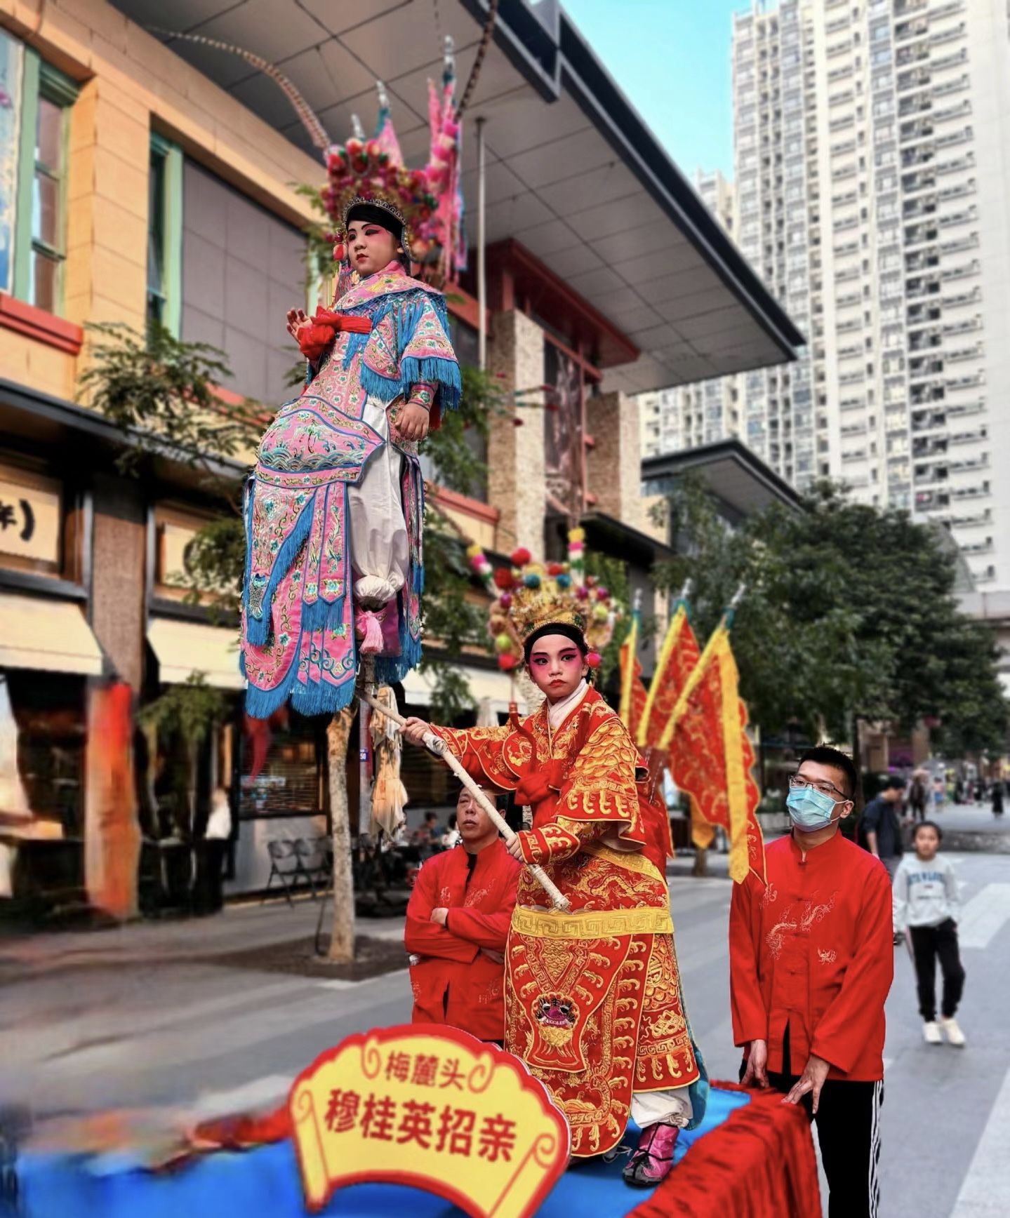
Piao Se 飘色
《西游记》
《五福临门》
《穆桂英招亲》

Slide 14
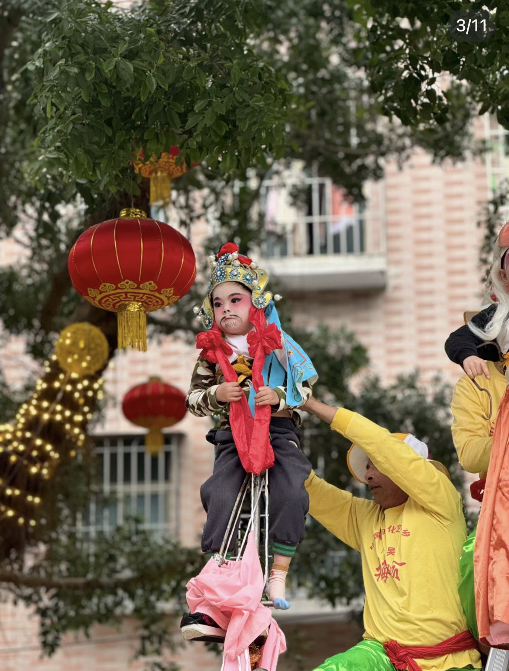
Components
Se Gui色柜:The Se Gui is the performance platform in Piao Se. It is typically a wooden cart measuring about 150 cm in length, 80 cm in width, and 65 cm in height, with drawers on both sides for storing makeup and various props.
Se Geng色梗:The Se Geng is the central spine of Piao Se. It supports all the children both above and below, allowing them to be securely and stably fixed on the Se Gui.
Se Xin色芯:The Se Xin refers to the performers in the Piao Se. When selecting performers for the characters in Piao Se, there are very strict requirements: they should not be too tall or too short; not too fat or too thin; and ideally between the ages of 6 and 12. In Wuchuan, there is a folk legend that the children who are selected are blessed with good fortune.

Slide 15
04
Achievements

Slide 16
Achievements
In 1992, 1997, and 2017, Wu Chuan Piao Se was invited to perform in the CCTV Spring Festival Gala in Beijing.
01
02
In 2008, Wu Chuan Piao Se was selected into the second batch of the national intangible cultural heritage list.
03
From 2006 to 2012, the Mei Ling Piao Se Art Troupe was invited to perform in Hong Kong six times in succession.
04
In 2014, the Mei Ling Piao Se Art Troupe participated in the Singapore Chingay Parade.

Slide 17
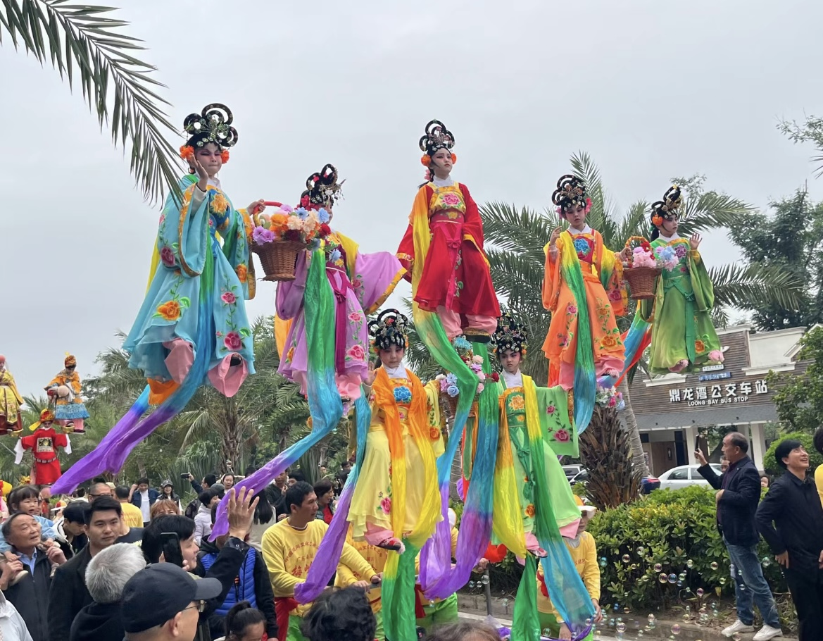
Question
2:What are the three components of Piao Se?

Slide 18
谢谢大家

