Slide 1

Chinese Economy
Rich Businessmen
powerpoint design ---------------------------------------------------------------------
汇报人：
Sihui Fu
时间：
2025. 3.14

Slide 2
目录
CATALOGUE
1.
Introduction to Chinese Economy
2.
Profiles of Chinese Rich Businessmen

Slide 3
01
Part
Introduction to Chinese Economy
powerpoint design ---------------------------------------------------------------------

Slide 4
Overview of the Chinese Economy
Rapid Economic Growth
Transition from Planned to Market Economy
Role of the Government in the Economy
China has experienced rapid economic growth over the past decades, becoming the world’s second- largest economy. Its GDP has been expanding at a remarkable rate, driven by manufacturing, exports, and domestic consumption.
China’s economic reform in 1978 marked a shift from a centrally planned economy to a market- oriented one. This transition has led to increased economic efficiency and innovation, attracting significant foreign investment.
The Chinese government plays an active role in guiding economic development through policies and regulations. It focuses on strategic industries and infrastructure development to support long- term economic growth.

Slide 5
02
Part
Profiles of Chinese Rich Businessmen
powerpoint design ---------------------------------------------------------------------

Slide 6
Hongyan Li
75%
52%
81%
Founding and Growth of Baidu
Diversification and Technological Innovation
Impact on the Internet Industry
Robin Li founded Baidu in 2000, inspired by the search engine technology he saw in the US. Baidu quickly became China’s leading search engine, capturing over 70% of the domestic market.
Baidu has expanded into AI, autonomous driving, and cloud computing. Its Apollo project is a leading platform for self- driving car development in China.
Baidu’s search engine has transformed information access in China. Its AI initiatives are driving technological advancements and shaping the future of smart cities.
01
02
03

Slide 7
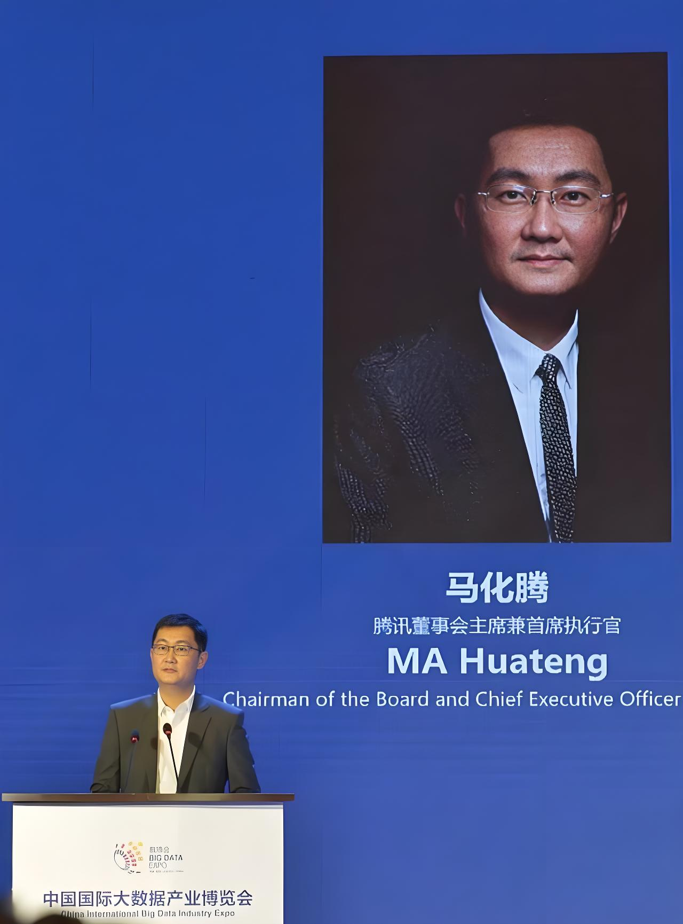

Huateng Ma
Founding and Growth of Tencent
Pony Ma founded Tencent in 1998, starting with the instant messaging service QQ. Tencent has expanded into various fields including social media, gaming, and digital payments.
WeChat and Digital Services
WeChat has become China’s largest mobile instant messaging service with over 1.3 billion users. It integrates social networking, mobile payments, and a wide range of digital services, transforming daily life.
Influence on the Digital Economy
Tencent’s investments and innovations have driven the development of China’s digital economy. It has also promoted the digital transformation of traditional industries through cloud computing and big data.

Slide 8
Yun Ma
Founding and Growth of Alibaba
Innovations in Fintech and Digital Payments
Influence on Global Business and Philanthropy
Jack Ma founded Alibaba in 1999, starting with an online marketplace for businesses. Alibaba has expanded into e- commerce, retail, digital media, and financial services.
Ant Group, a subsidiary of Alibaba, has revolutionized digital payments in China with Alipay. It has also developed innovative fintech products and services, promoting financial inclusion.
Jack Ma’s vision and leadership have made Alibaba a global business icon. He is also known for his philanthropic efforts, contributing to education, poverty alleviation, and environmental protection.

Slide 9
Qiangdong Liu
Founding and Growth of JD.com
Logistics and Supply Chain Innovation
Impact on E-commerce and Rural Development
Richard Liu founded JD.com in 1998, starting with a small computer parts store. JD.com has grown into one of China’s largest e- commerce platforms, focusing on direct sales and logistics.
JD.com has built a robust logistics network, enabling same- day delivery in many cities. Its supply chain management has set new standards for efficiency and reliability in the industry.
JD.com’s focus on rural markets has helped bridge the urban- rural divide. Its initiatives have improved access to quality goods and services in rural areas, boosting local economies.

Slide 10
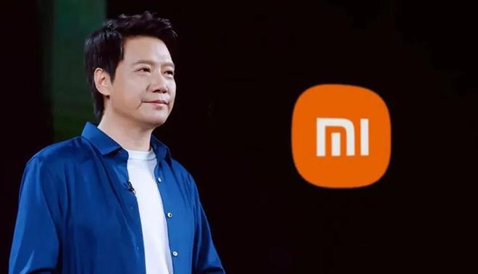
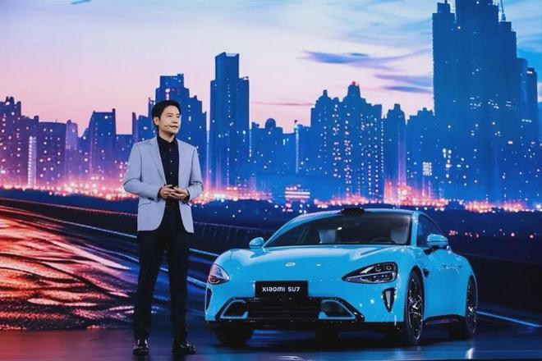
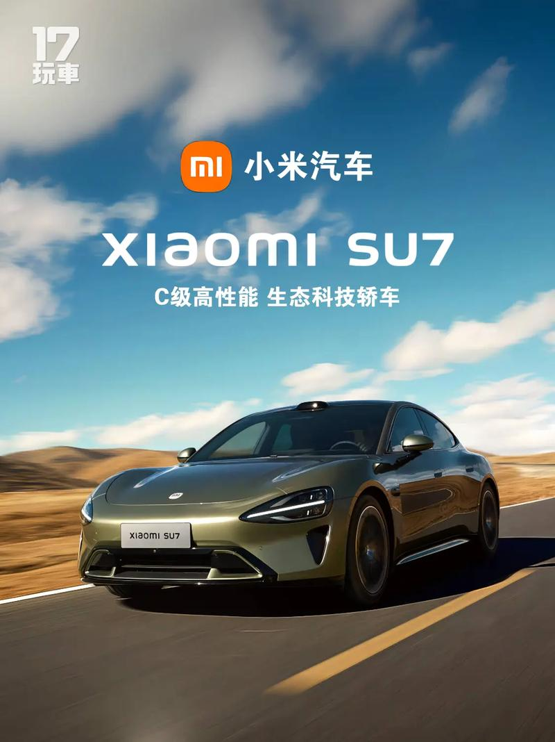



Lei Jun
Founding and Growth of Xiaomi
Expansion into Global Markets
Influence on the Tech Industry
Lei Jun founded Xiaomi in 2010, aiming to create high- quality smartphones at affordable prices. Xiaomi quickly gained market share with its innovative business model and products.
Xiaomi has expanded globally, becoming a major player in the smartphone market. It has also diversified into smart home devices and IoT products.
Xiaomi’s products have set new benchmarks for performance and value. Its open- source approach and community engagement have fostered innovation and collaboration in the tech industry.

Slide 11
202X
Thank you for your listening!
powerpoint design ---------------------------------------------------------------------
汇报人：
Sihui Fu
时间：
2025.3.14

