Slide 1
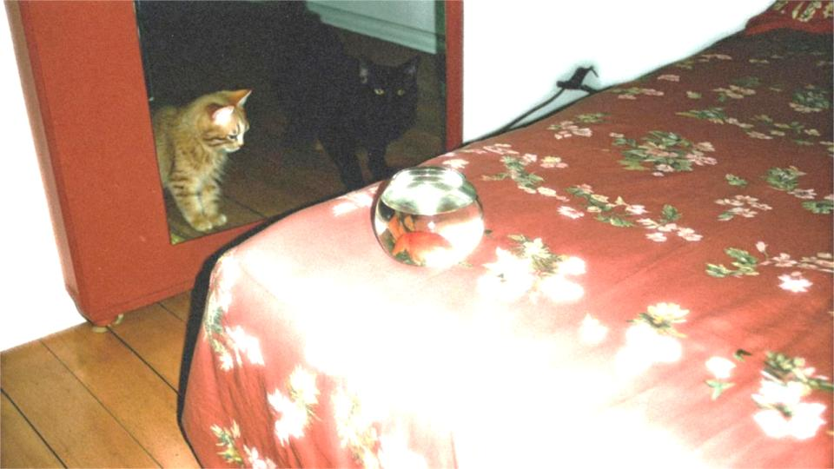
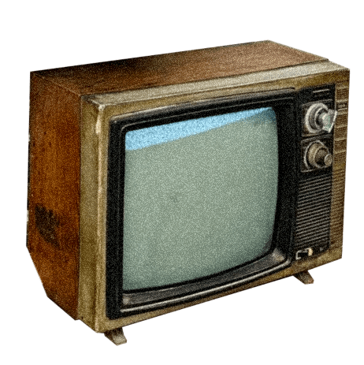
Chinese
Dreamcore
Reporter: Liu Wenziqin

Slide 2
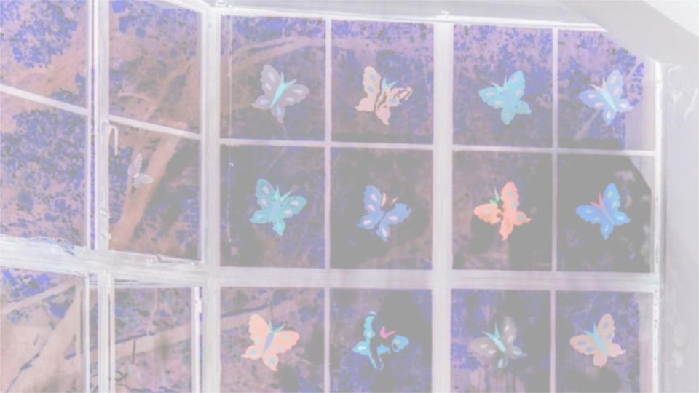
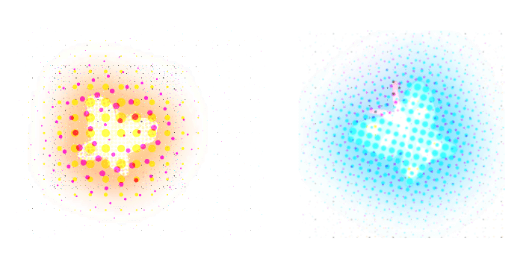

Contents
PART 1
PART 2
PART 3
The Concept of "Chinese Dreamcore"
Why do young people love "Chinese Dreamcore"?
The Characteristics of "Chinese Dreamcore"

Slide 3
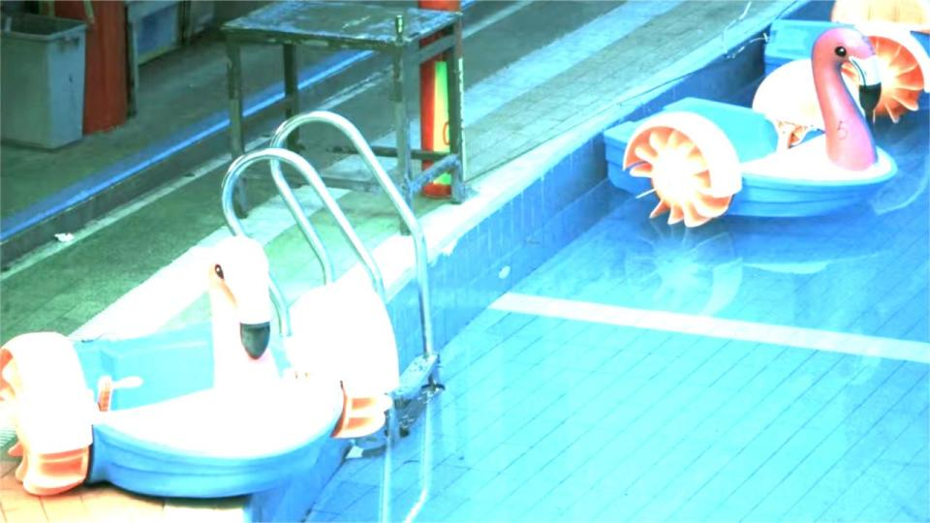
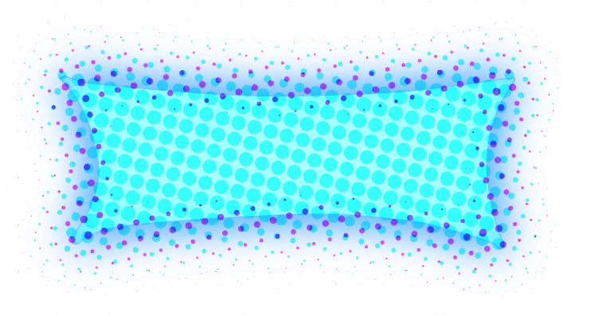
PART 1
The Concept of "Chinese Dreamcore"

Slide 4
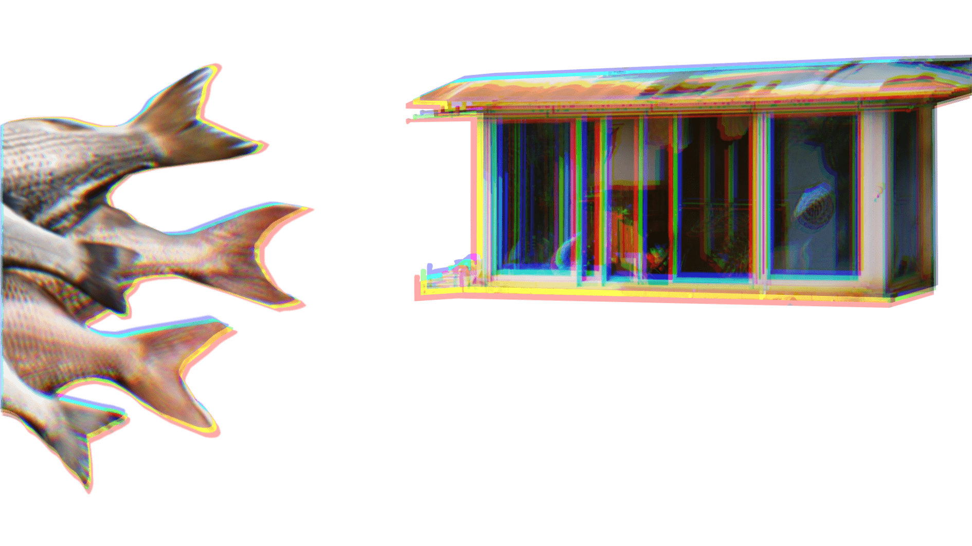
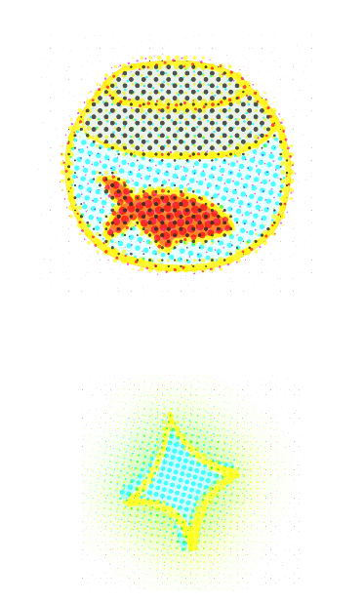
Surrealist Aesthetics
surrealism
fantasy
subconscious
By showcasing imagery reminiscent of childhood memories or dreamscapes, it seeks to evoke emotional resonance in its audience.
visual experimental art
the childhood of the Y2K generation
nostalgia and melancholy

Slide 5
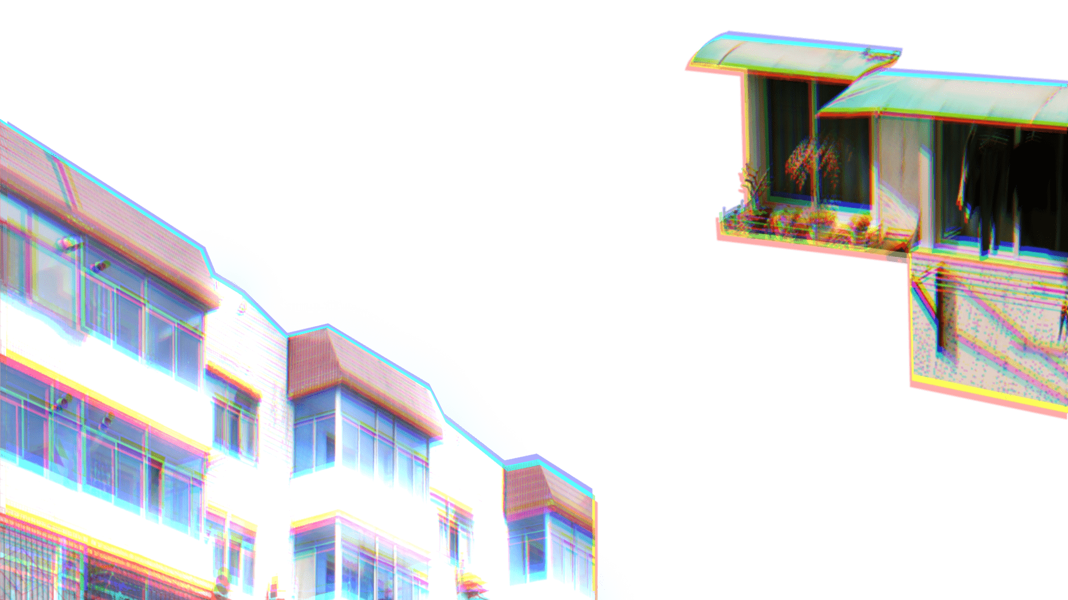

Core Elements: specific architecture and objects
(blue-tinted windows, aluminum alloy window frames, and walls covered in tiles)
Core Audience: The millennial generation
(those born from the late 1980s to the early 2000s)

Slide 6
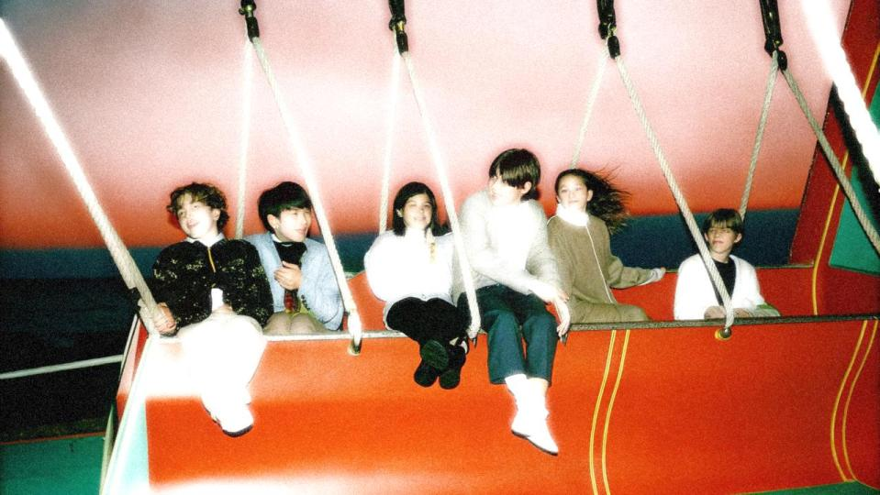
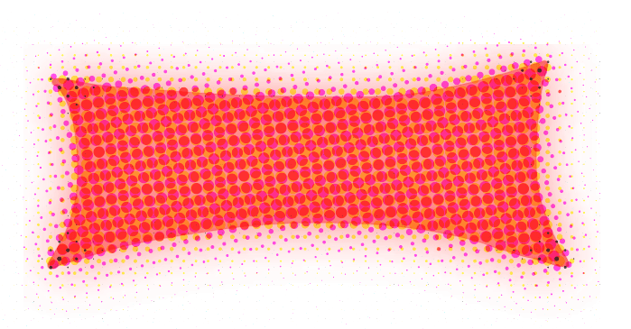
PART 2
Why do young people love "Chinese Dreamcore"?

Slide 7
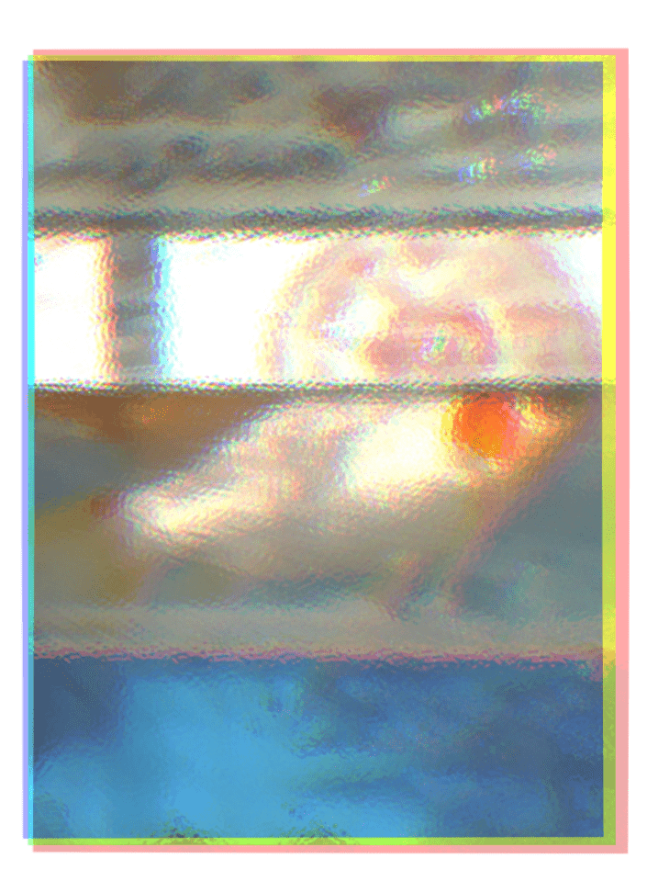

01
Becoming Social Currency:
The Connection of Collective Nostalgia
Shared Emotional Projection
When a group of people projects the same emotions onto these images, a sense of connection is formed.
Emotional Energy Acquisition
The emotional energy encourages people to actively engage in the nostalgic memories and scenarios evoked by "Chinese-style Dream Core."

Slide 8
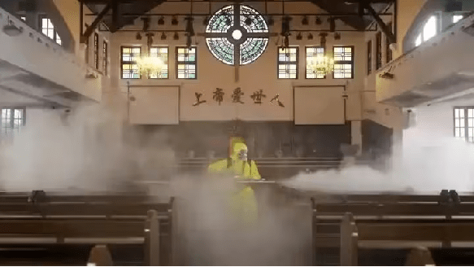
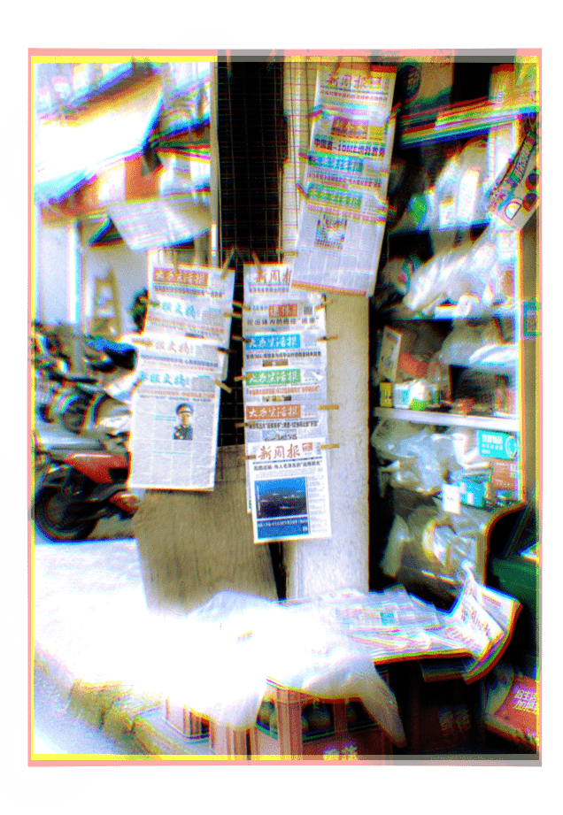
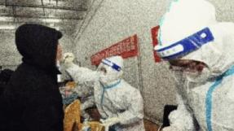
02
Meeting the Need for Escape from Negative Emotions
Negative Emotions
"Chinese-style Dream Core," with its unique aesthetic, offers a virtual world where people can immerse themselves.
This world, filled with nostalgic elements, transports them back to a simpler and more beautiful time, providing a moment of peace and relaxation.

Slide 9
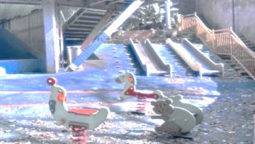
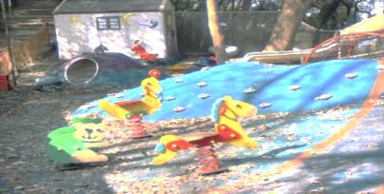
03
The Compensatory Effect of Nostalgia
Emotional Regulation
Fulfilling the Need for Belonging
blurred and distorted visuals
soft, muted colors
carefully chosen music
It fosters a sense of connection with others and with past moments of happiness, helping to ease dissatisfaction with present-day life.
help alleviate feelings of tension and stress

Slide 10
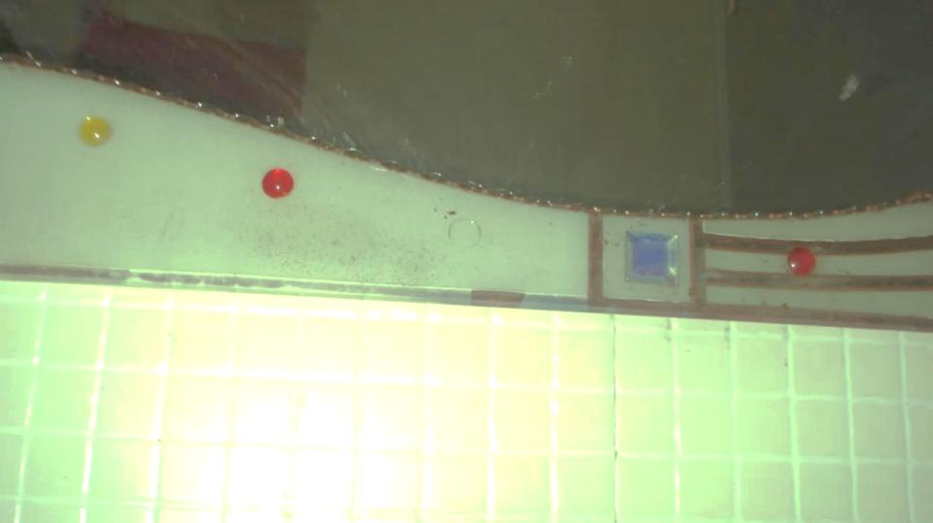

PART 3
The Characteristics of "Chinese Dreamcore"

Slide 11
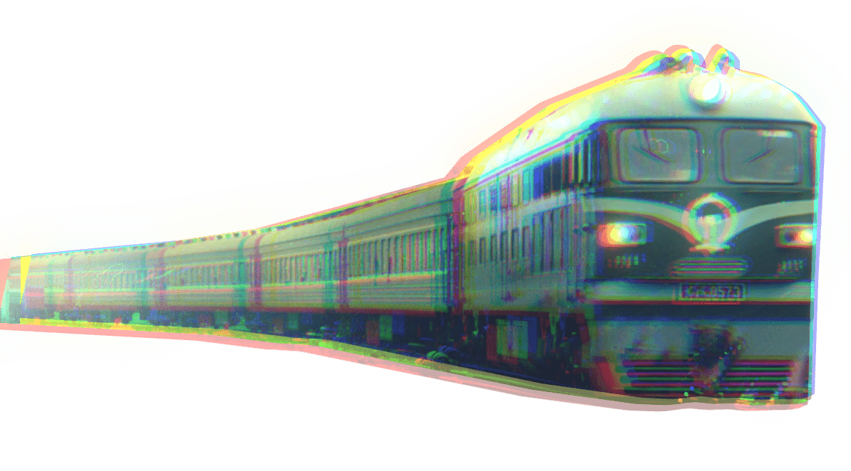
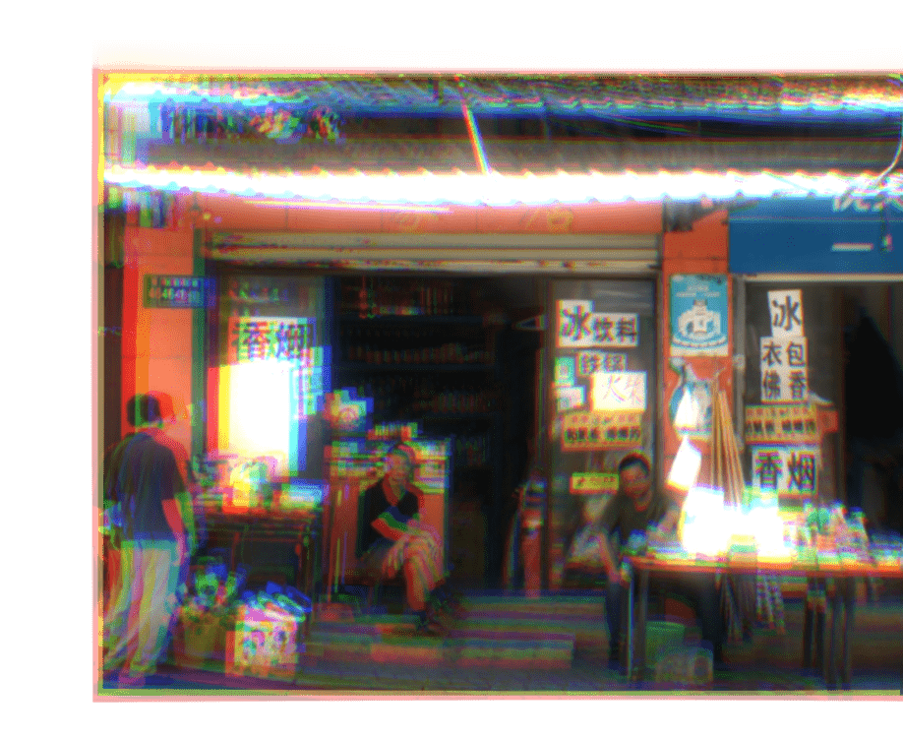
Surreal Chinese-Style Scenes
distinctly nostalgic architectural styles
old residential buildings with blue glass windows
traditional houses with yellow wooden interiors
the essence of everyday Chinese life
small shops near school gates
stationery stores adorned with rows of clocks
commuter buses traveling between villages and towns

Slide 12
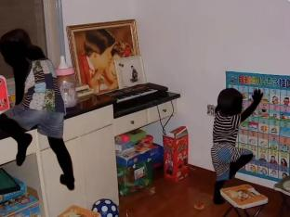
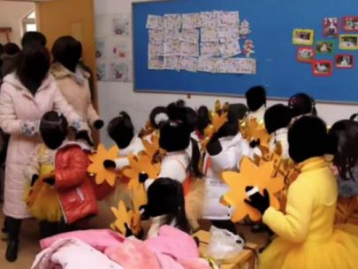
Blurred Human Figures
high saturation, high contrast, and blurred filters
childhood photos of themselves or
images of family members in their youth as the base for their creations.
a sense of absurdity and unease
In these works, the faces, exposed limbs, or even entire figures of the individuals in the photos are obscured with color blocks or smudges

Slide 13
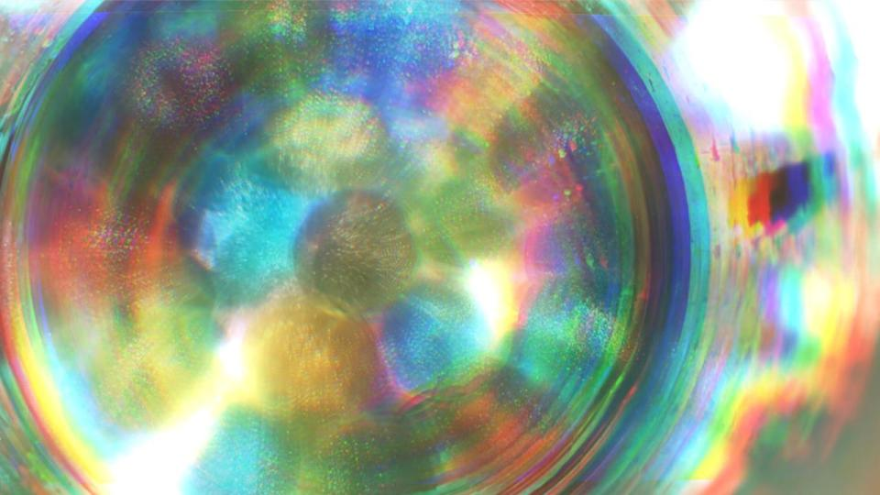
Presenting Dream Core Characteristics
By using high saturation, high contrast, and blurred filters, a dreamlike atmosphere is created.
both inviting and unsettling

Slide 14
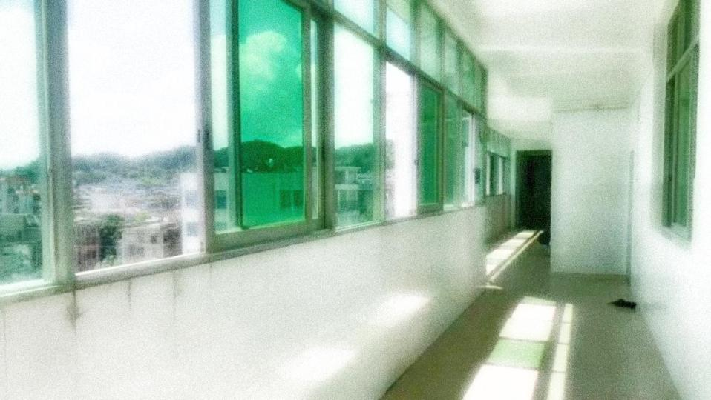
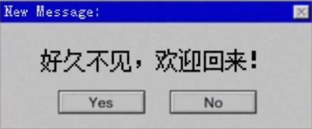


Ambiguous Narratives
in Text
contextless phrases
entire dialogues or monologues
These enigmatic words, intertwined with the visuals, further enhance the mysterious atmosphere of Dream Core.

Slide 15
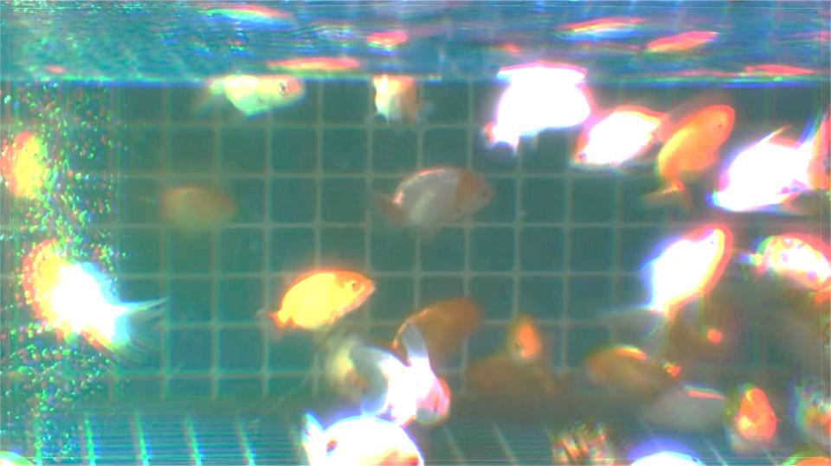
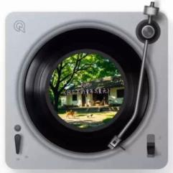

The Essence of Nostalgia in "Chinese Dreamcore"
The background music is predominantly slow-paced, with a calming rhythm that creates a sense of immersion. At the same time, it deepens the overall mood of unease, eeriness, or dreaminess within the work.

Slide 16
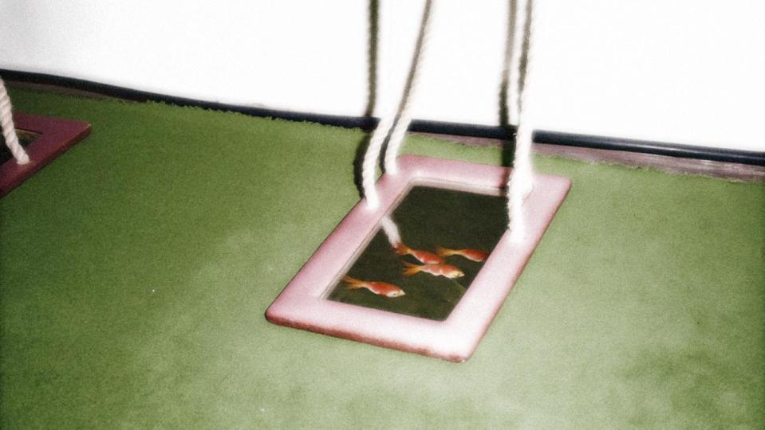
Thank You！
Reporter: Liu Wenziqin

