Slide 1
Translation in Contemporary China
Xie Fan 解帆
Zhang Yuxing 张宇星

Slide 2
Content
Cultural Input
The East Spread of Western Learning
Cultural Output
Transliteration
Masterpiece during the 19th Century
Literal Translation
Creative Translation

Slide 3
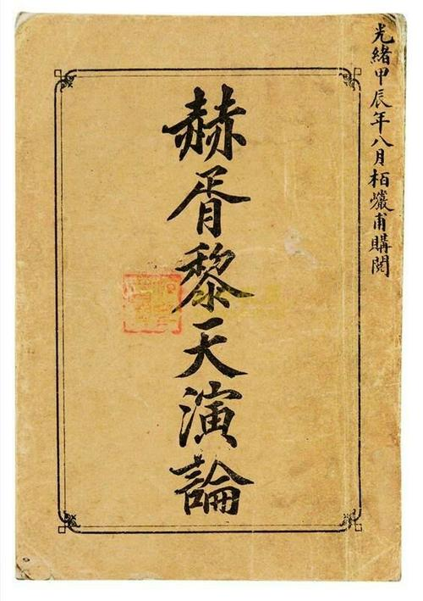
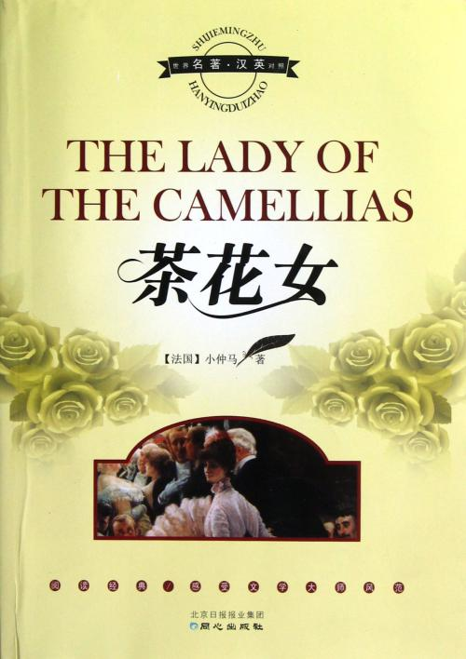
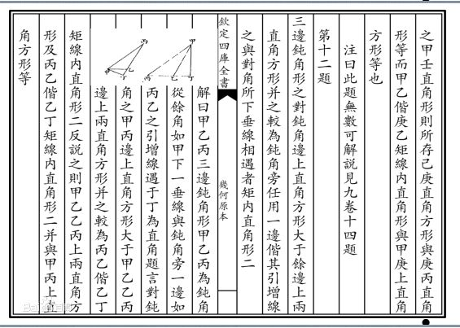
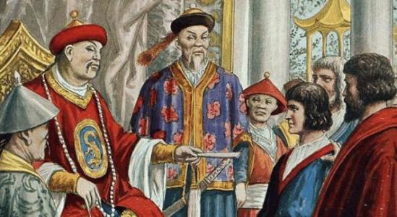
Cultural Input
The Eastern Spread of Western Learning
Figures: Matteo Ricci, Xu Guangqi
Represenntative: Geometrical Originals
Masterpieces during 19th century
Yan Fu---Evolution and Ethics
《天演论》
Lin Shu---The Lady of the Camellias
《巴黎茶花女遗事》

Slide 4

Cultural Output
Transliteration
Literal Translation
Creative Translation
New words are composed of the existing morpheme and vocabulary of English.
Transliteration is the conversion of a text from one script to another, which notes the sounds but not necessarily the spelling.
Literal translation is one of the most labor-saving translation method.

Slide 5
Transliteration
大妈(dama)
风水(fengshui)
胡同 (hutong)
功夫 (kungfu)

Slide 6
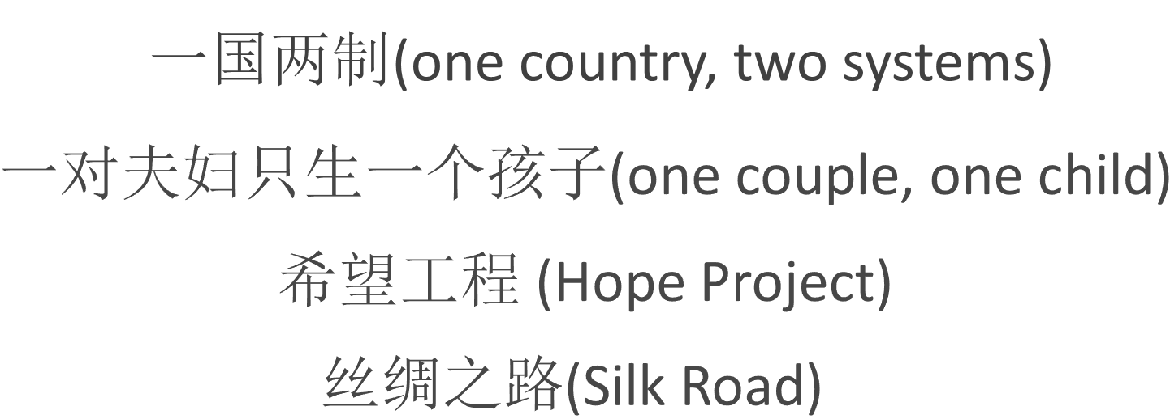
Literal Translation

Slide 7
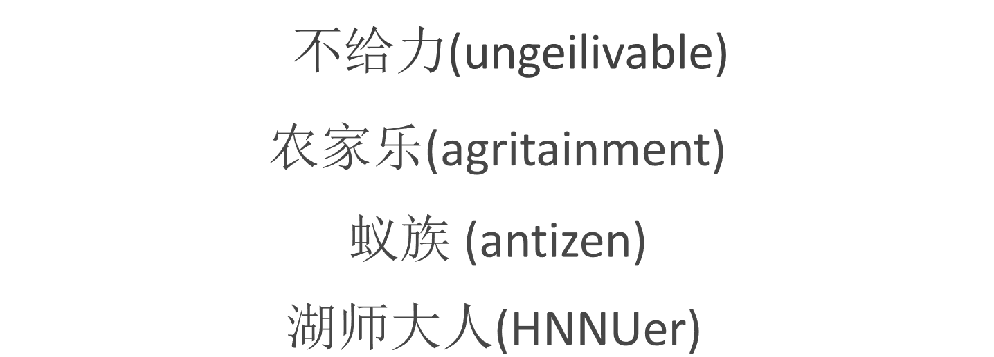
Creative Translation

Slide 8
Thank You!

