Slide 1
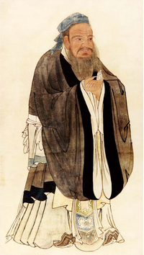

Confucian Teaching Thoughts
By Wu Xiaoli and Wang Shibo, 2022 Japanese translation class, HUNNU
Oct.14th,2022

Slide 2
Confucius
Confucius (/kənˈfjuːʃəs/ kən-FEW-shəs; Chinese: 孔夫子; pinyin: Kǒng Fūzǐ, "Master Kǒng"; or commonly 孔子; Kǒngzǐ; c. 551 – c. 479 BCE) was a Chinese philosopher and politician of the Spring and Autumn period who is traditionally considered the paragon of Chinese sages.
Confucius's teachings and philosophy underpin East Asian culture and society, remaining influential across China and East Asia to this day.
Confucius's principles have commonality with Chinese tradition and belief.

Slide 3
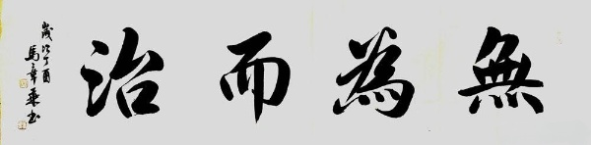
Philosophy of Confucius
“transmitter who invented nothing” (“无为而治”wuweierzhi)

Slide 4
Confucian Teaching Thoughts
The purpose of education : to cultivate loyal and patriotic gentlemen (忠君爱国,zhongjunaiguo)
The goal of education: the full development of the personality of the educated person; attainment of the state of freedom
Teaching principles and methods (requirements for teachers): teaching according to the material, inspiration and guidance, learning and thinking together, gradual and orderly progress
Teaching guidance (requirements for students): Be open-minded, apply what you learn, and persevere

Slide 5
Confucian Teaching Thoughts
“teaching without social discrimination”
“writing and acting faithfully” (“言必信，行必信” ,yanbixin,xingbixin)
“teaching students according to their aptitude” (“因材施教” ,yincaishijiao)
education should be aimed at training “shi” (qualities of a gentleman)(“士”shi)

Slide 6
Thanks for your listening

