Slide 1
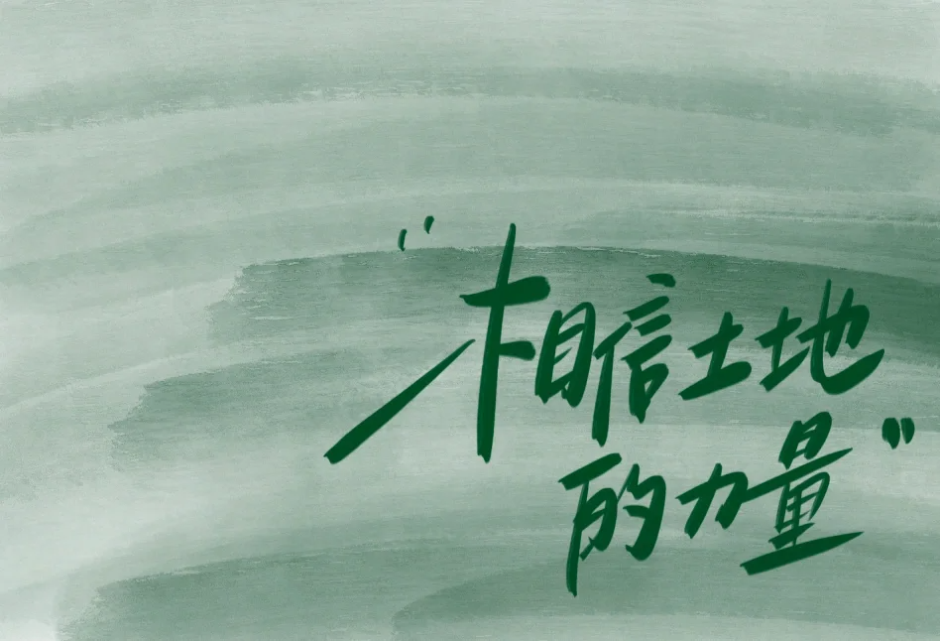
02/Introduction
A true depiction of the villagers' daily life of "working at sunrise and resting at sunset."
It showcases how contemporary Chinese farmers have transitioned from "relying on the weather for their livelihood" to "earning money through technology,"

Slide 2

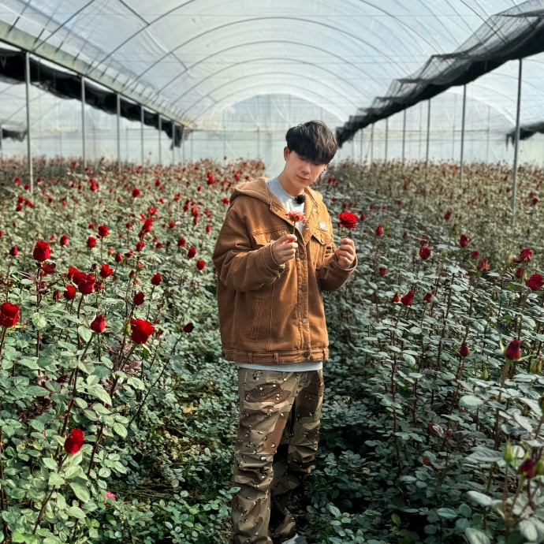
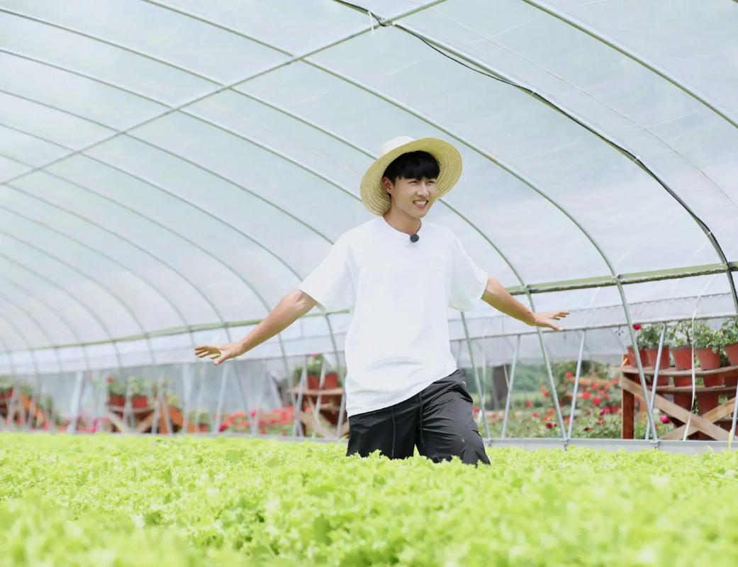
1.Planting Group:
This group is in charge of growing plants like hydroponic lettuce, cherry radishes,chili peppers,as well as roses . The roses aren’t just pretty to look at; they also use them to make rose products. The team has to take care of watering, feeding, and keeping bugs away. They need to check the plants every day to make sure they grow well.

Slide 3
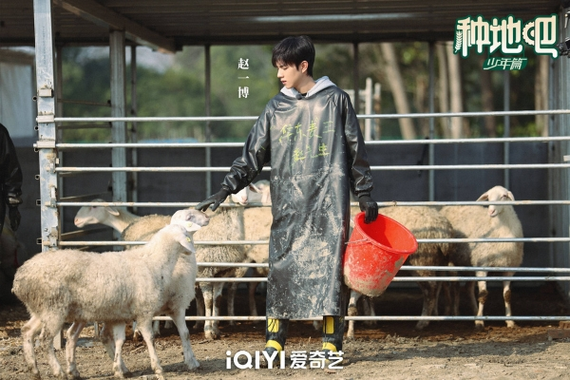
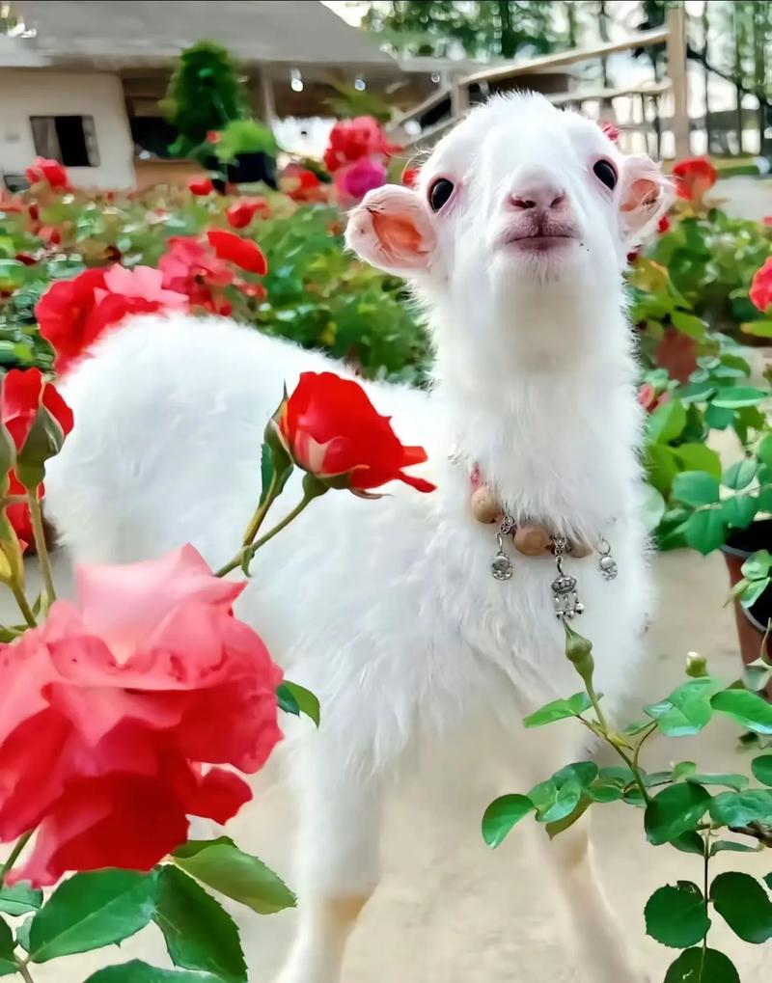
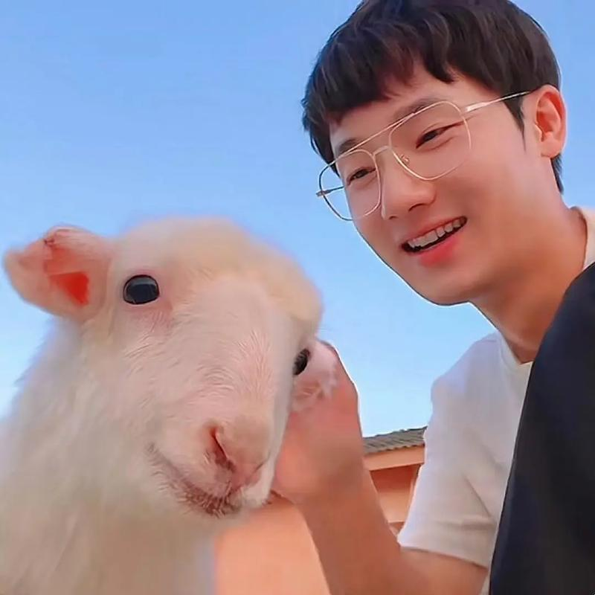
2.Animal Group:
The animal group takes care of the farm animals, like chickens, ducks, and sheep. These animals give the team eggs and meat. The team has to feed them, clean their areas, and make sure they stay healthy and happy.

Slide 4
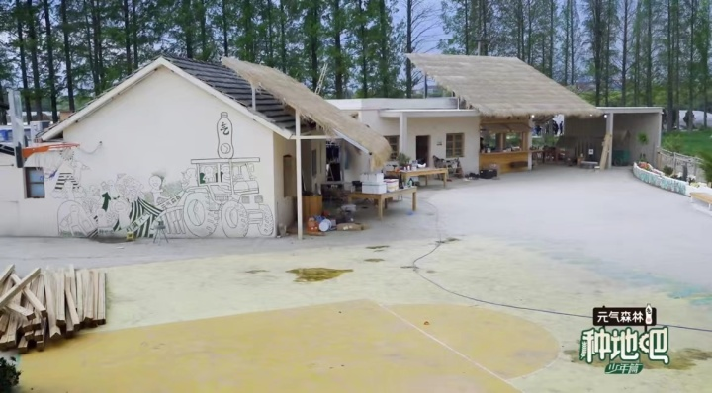
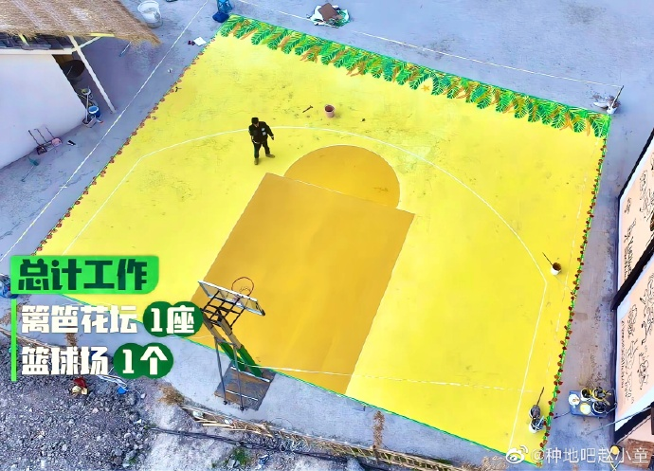
3.Building Group:
This group builds things around the farm, They painted walls, laid floor tiles, built tables, constructed a kitchen, repaired fences, built flower beds, drew a basketball court, and painted murals. In the end, they also gave us a pond with lotus flowers and a swing where we can watch the sunset at Hou Dou Men.

Slide 5
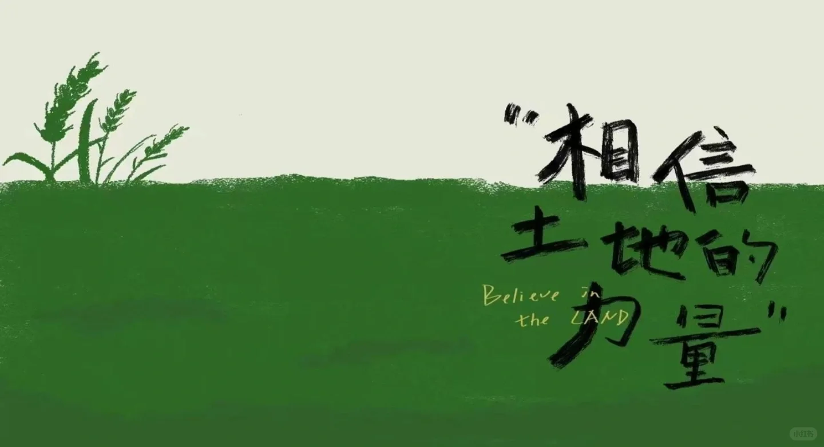

03
The Reason

Slide 6
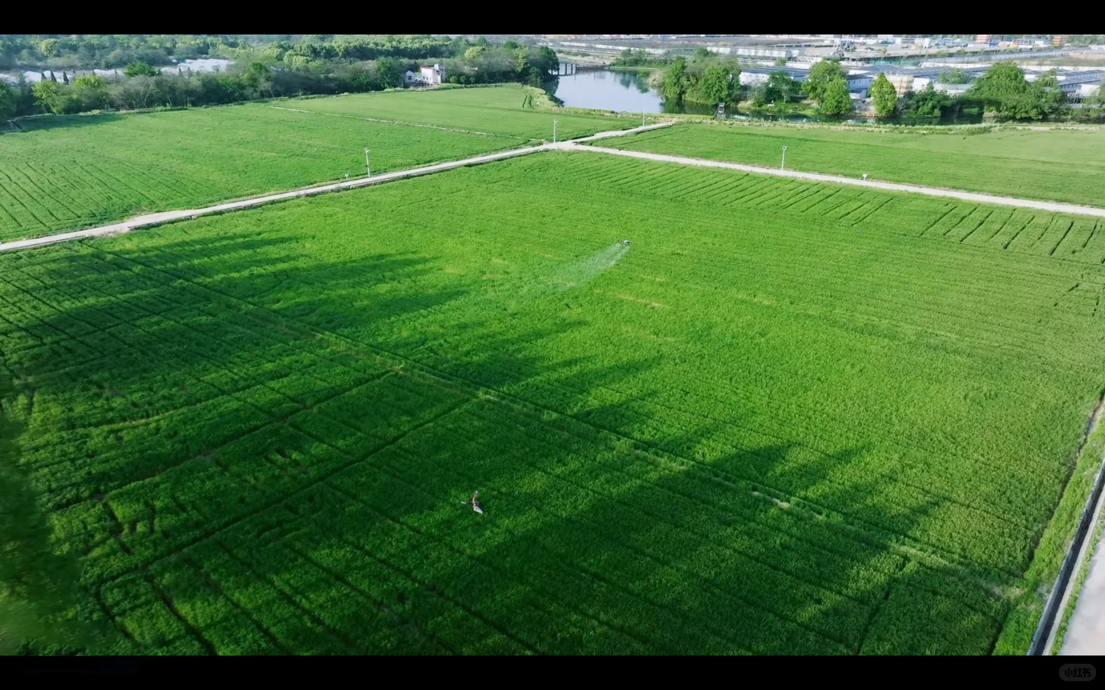
03/The Reason
It focus on hard farm work and meeting actual targets.
Young Chinese viewers appreciate the show’s authenticity and the calmness of the rural scenes that pose a stark contrast with stressful urban life.

Slide 7
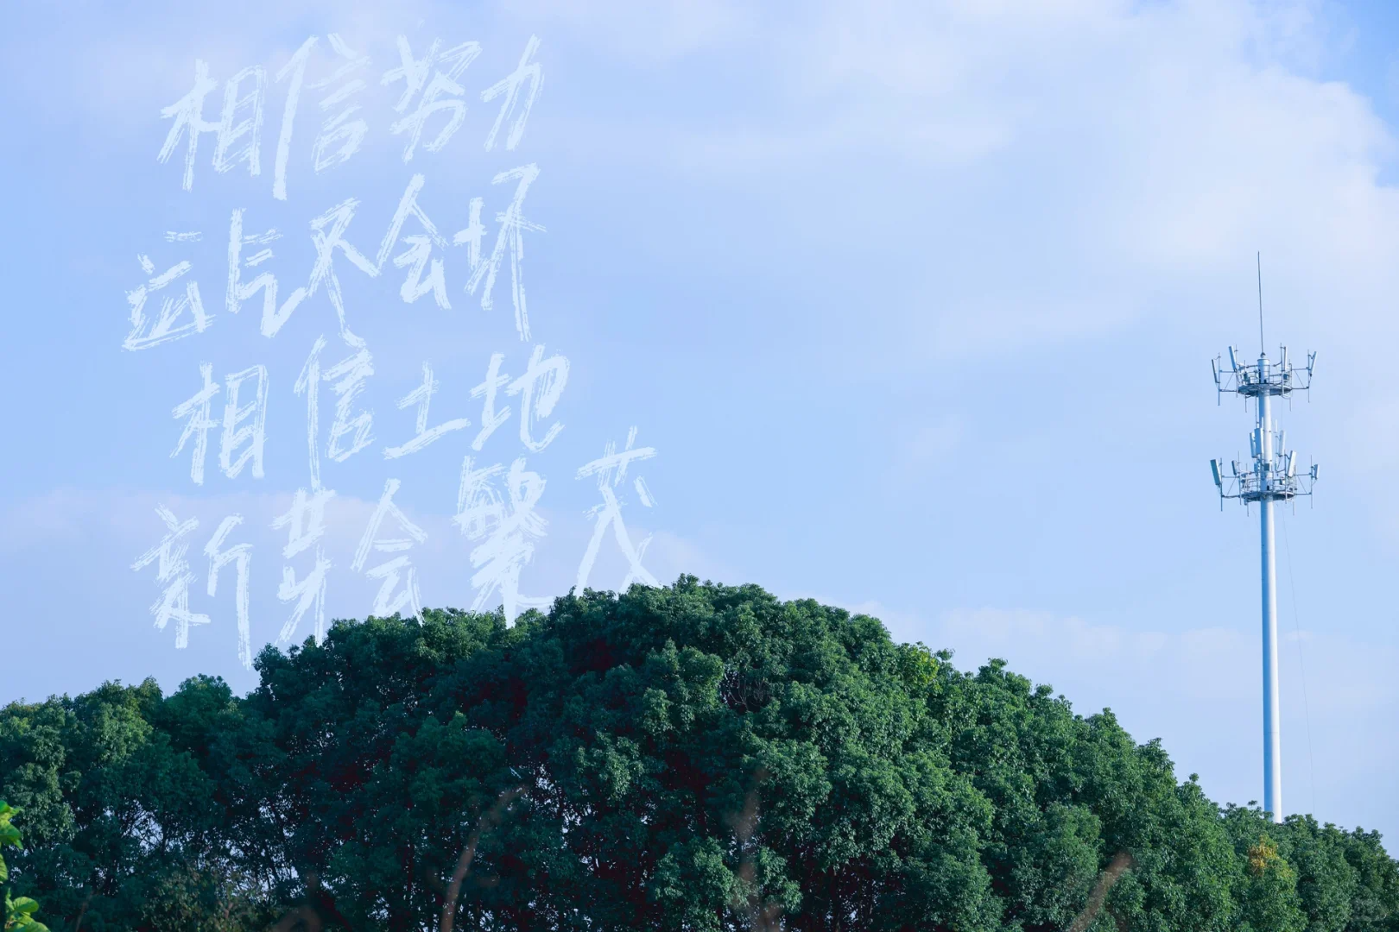
03/The Reason
Factors such as a slower pace of life, lower pressure, and reduced costs were cited as the main reasons why young people find rural areas appealing.

