Slide 1
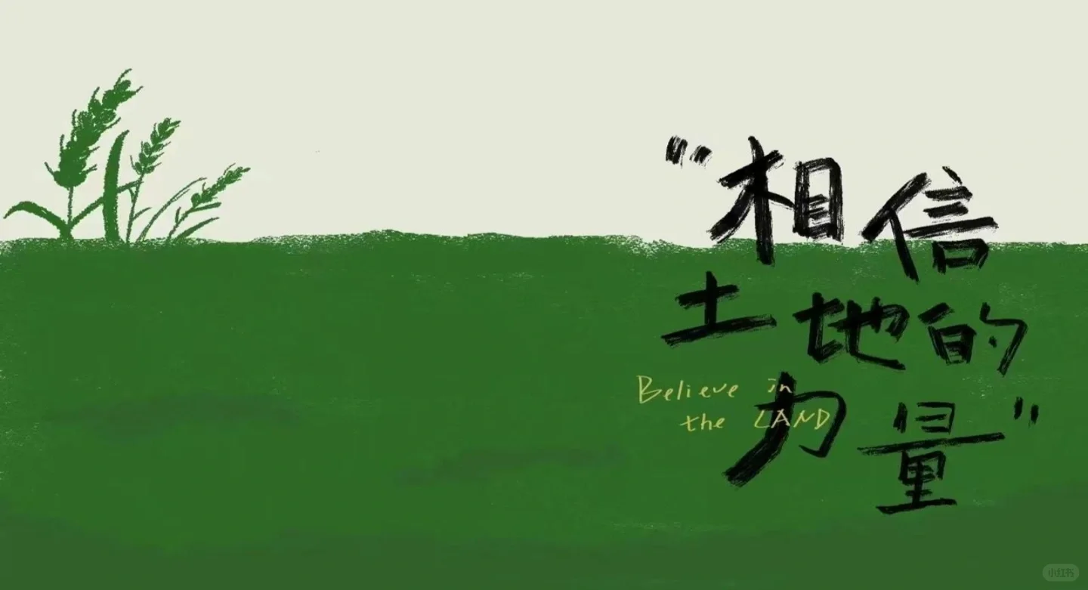


04
My Viewpoint

Slide 2
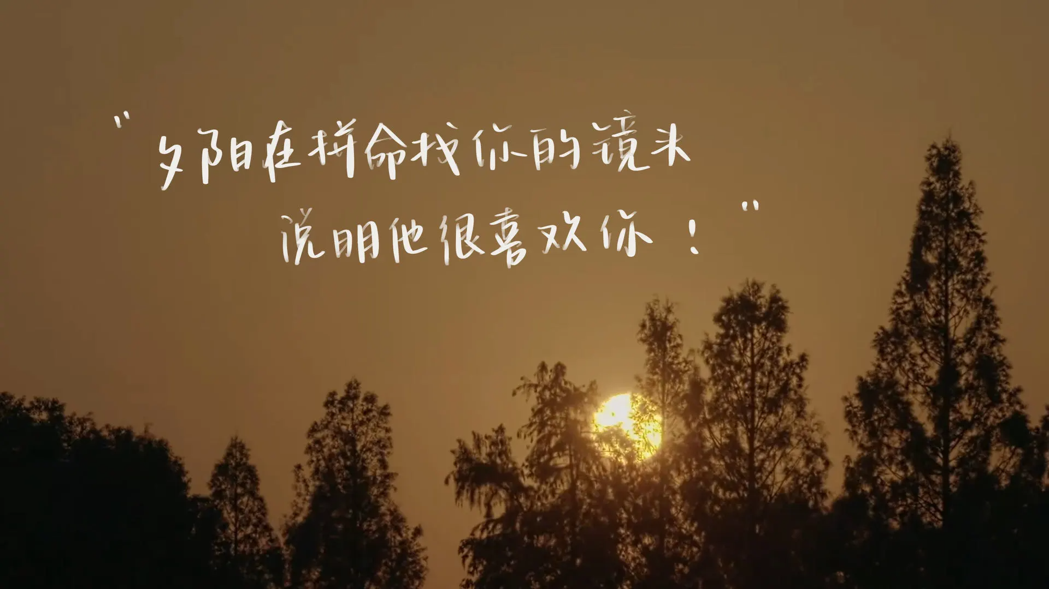
04/My Viewpoint
·the practice of rural revitalization in China
·food security and agricultural development
· important lessons about life skills, teamwork, and self-challenge.

Slide 3

04/My Viewpoint
entertainment and relaxation
persevering spirit
the mutual assistance and teamwork
Their strong and optimistic attitude in the face of failure

Slide 4


Slide 5
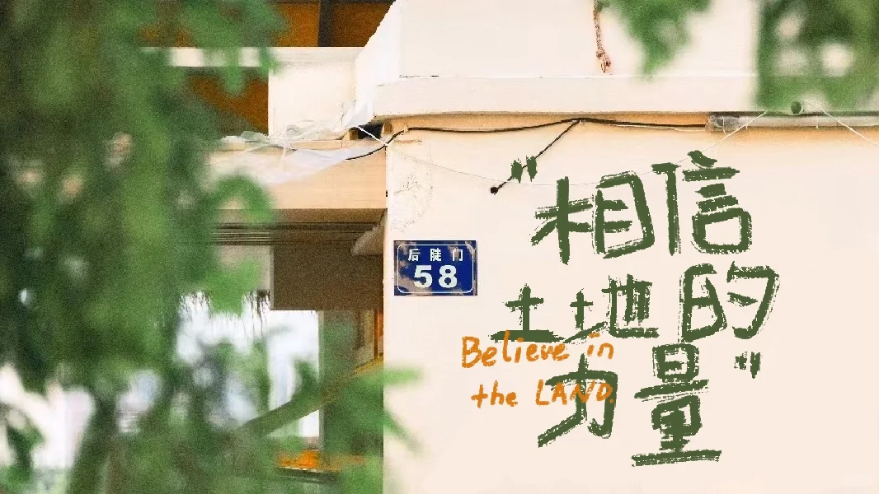
04/My Viewpoint
Finally, I really recommend this program to you. When you feel down or lost, maybe you can find answers in this program.

Slide 6
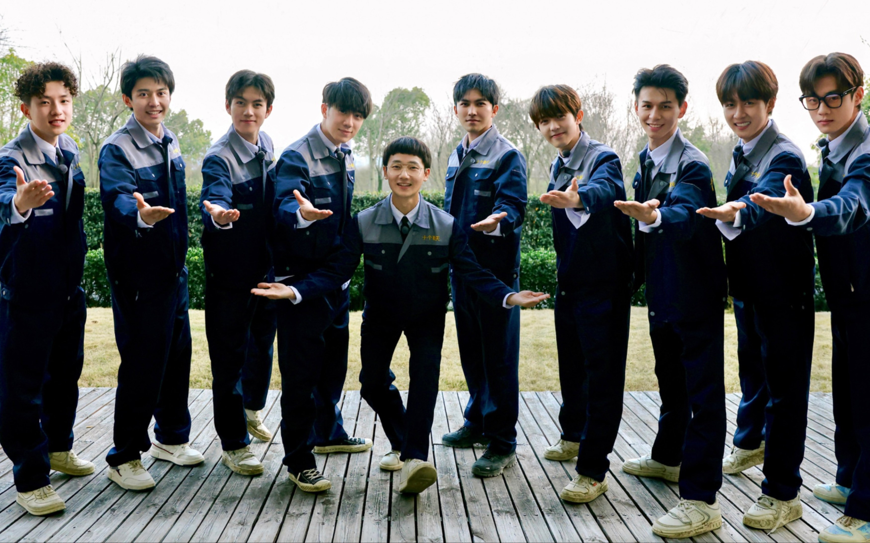
THANKS!

