Slide 1
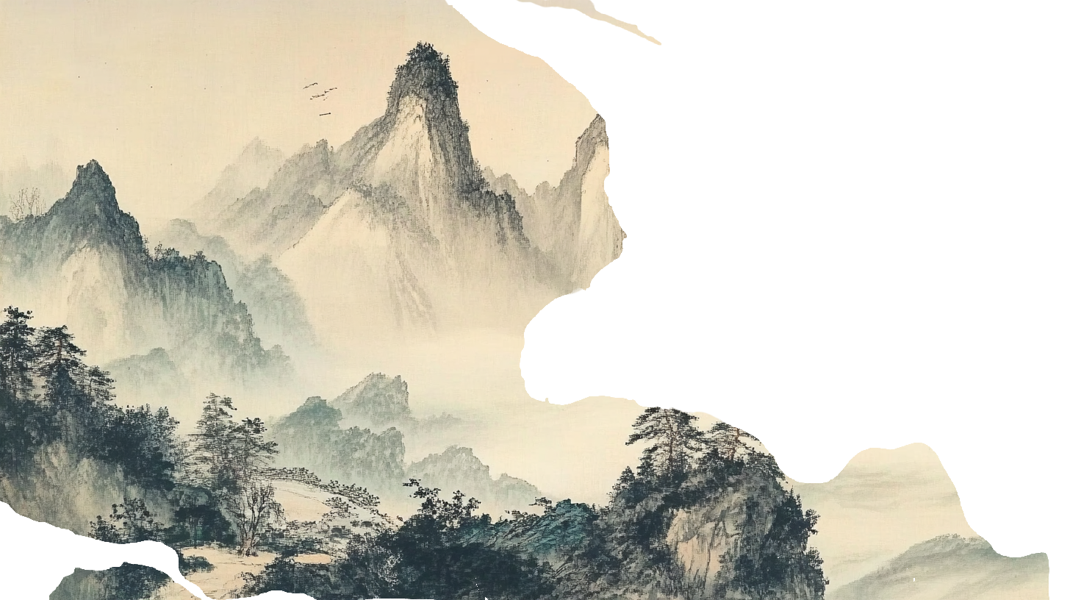
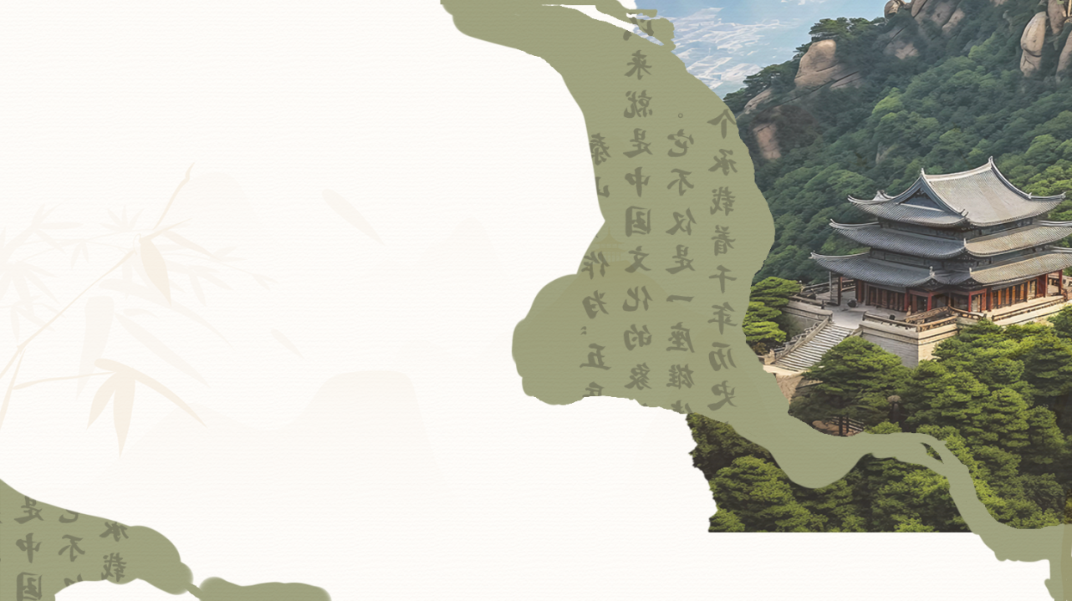
The Culture of Mount Tai
泰山
Name: Qin Yi
Major: MTI-written interlingual translation

Slide 2
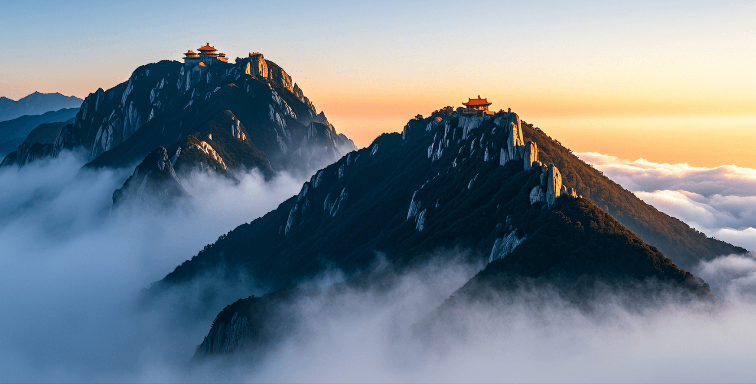
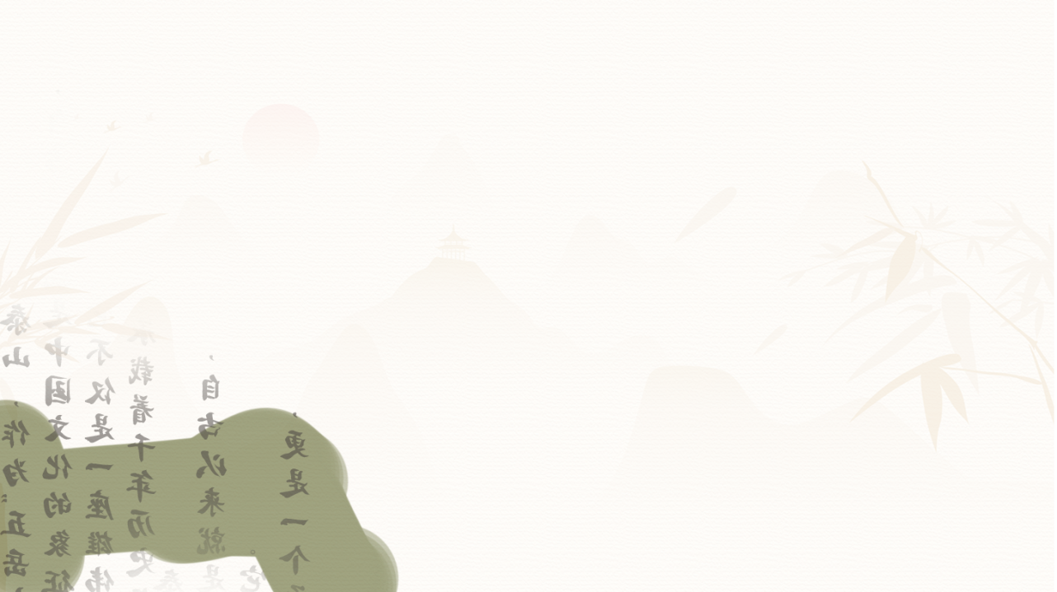
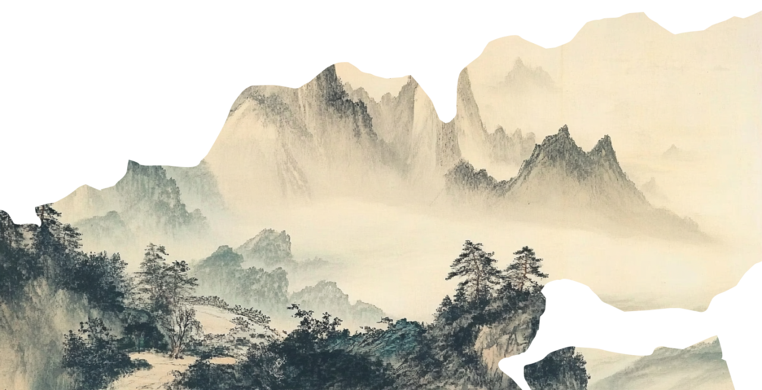

泰山
CONTENTS
01
A brief Introduction of Mount Tai
02
The Culture of Mount Tai
03
The Spiritual Symbolism of Mount Tai
04
The Cultural Significance in Modern Times

Slide 3

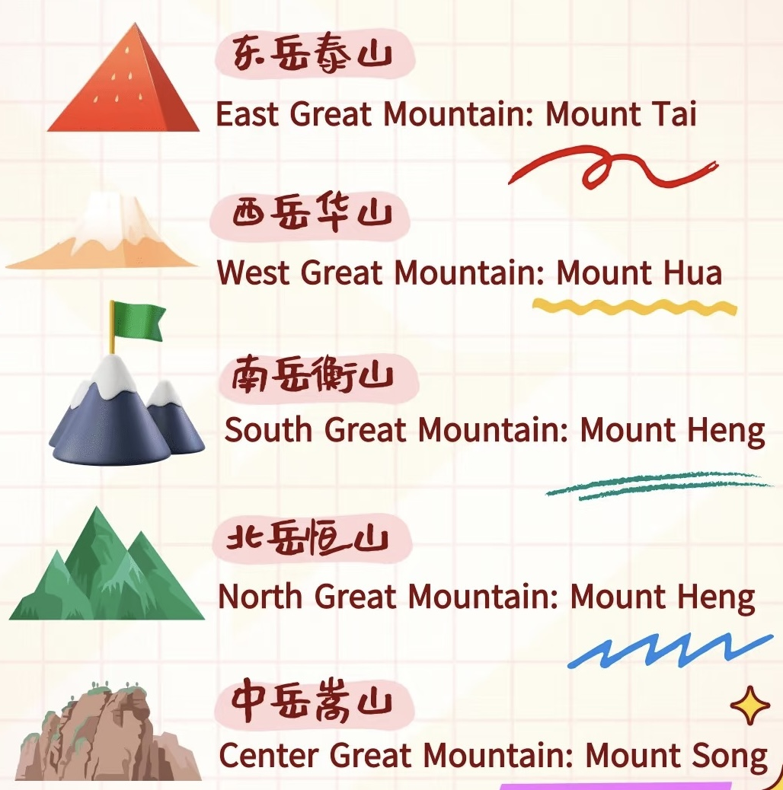
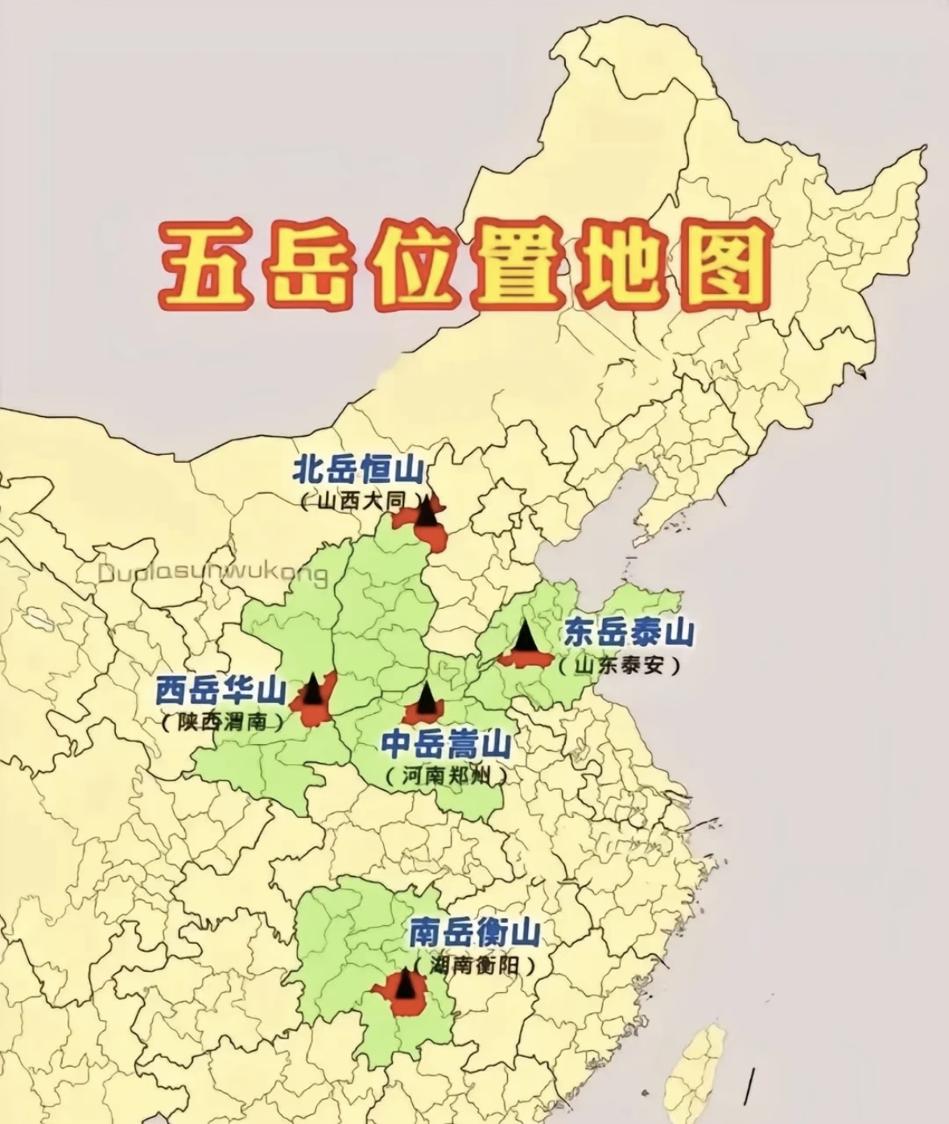
泰山
A brief Introduction of Mount Tai
The Most Revered of the Five Sacred Mountains; Shandong Province

Slide 4
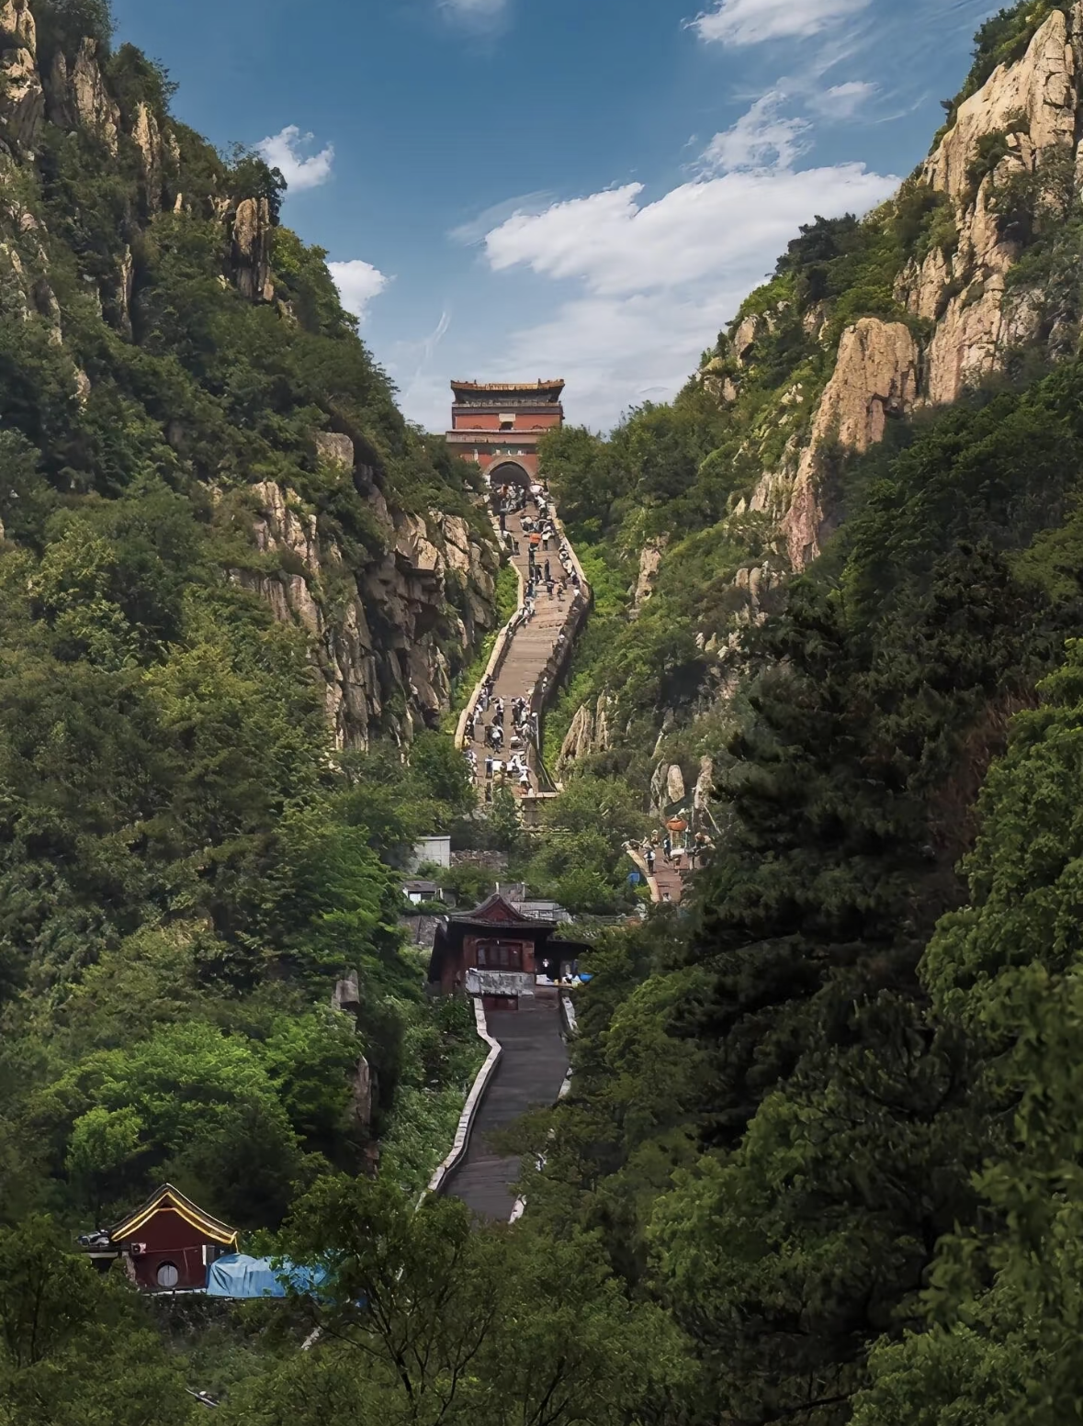
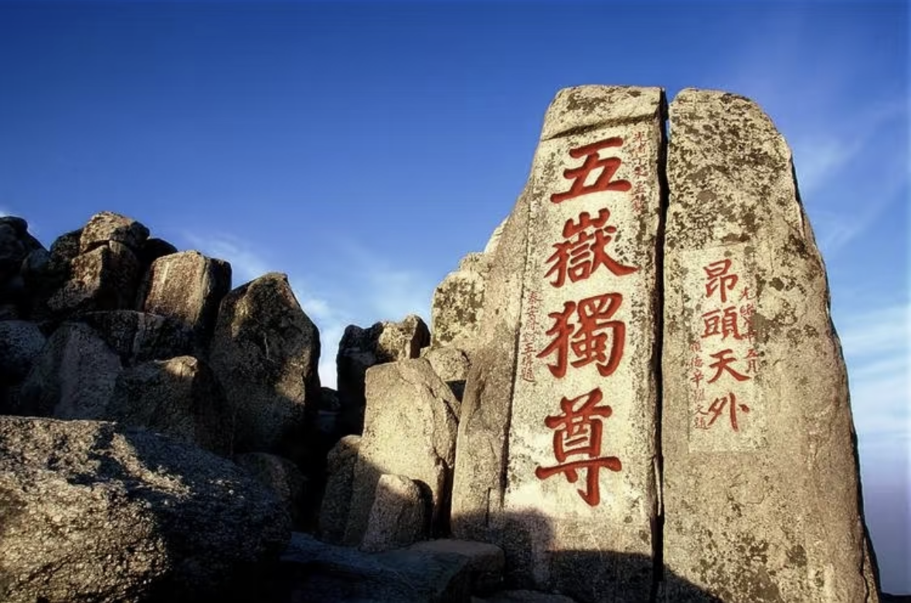
泰山
A brief Introduction of Mount Tai
the stone “Inscription of First of the Five Sacred Mountains”
(“五岳独尊”刻石)
the South Gate to Heaven
(南天门)

Slide 5
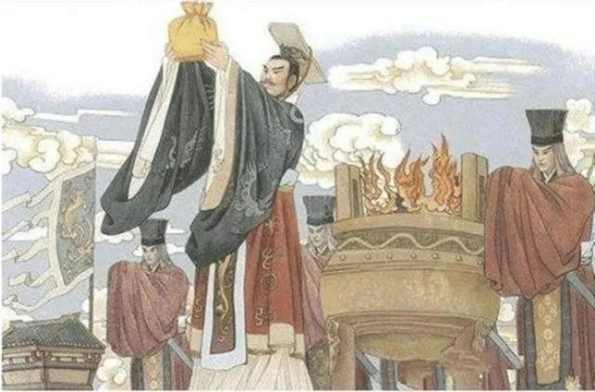
泰山
The Culture of Mount Tai
01
The Culture of Sacrificial Ceremony (Fengshan) 祭祀（封禅）文化
They paid tribute to heaven and earth, announced their achievements, thanked gods, and inscribed their achievements on a huge stone.
Notes:
模板来自于： 第一PPT https://www.1ppt.com/

Slide 6
泰山
The Culture of Mount Tai
02
The Culture of Literati 文人文化
Confucius: The world is smaller on the top of Mount Tai. 登泰山而小天下。
Mencius: The mountain is so high that it could reach the sky and clouds.泰山之高，参天入云。
Dufu: I must ascend the mountain's crest; it dwarfs all peaks under my feet.会当凌绝顶，一览众山小。
Zhang Zhichun: So beautiful the scenery of Mount Tai; so considerate the rain pervades the earth.
岱宗天下秀，霖雨遍人间
Notes:
模板来自于： 第一PPT https://www.1ppt.com/

Slide 7
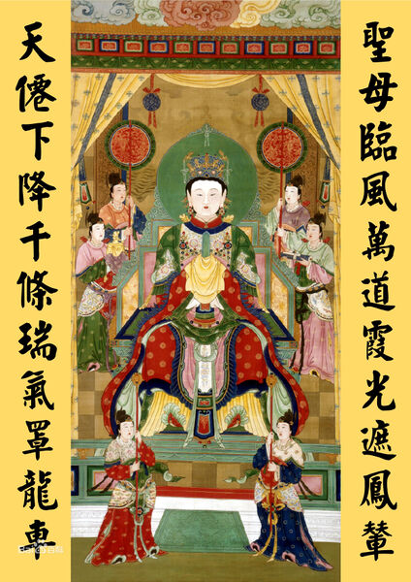
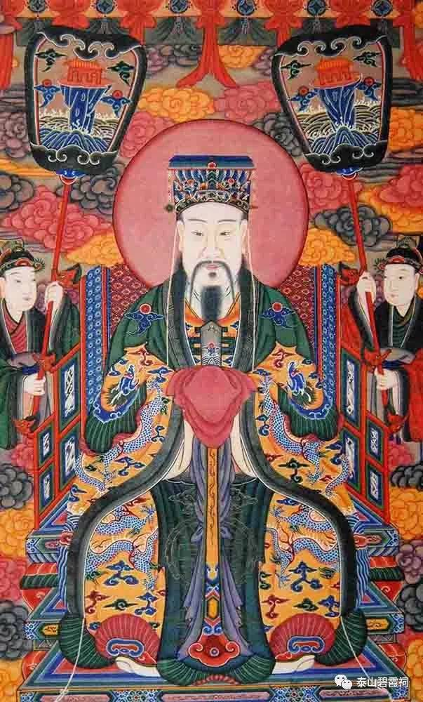
泰山
The Culture of Mount Tai
03
The Culture of Folk Belief 民间信仰文化
Blue Rosy Cloud Fairy (碧霞元君)
The God of Mount Tai (泰山神)
Notes:
模板来自于： 第一PPT https://www.1ppt.com/

Slide 8
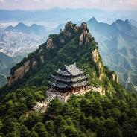
泰山
The Spiritual Symbolism of Mount Tai
Positive and Progressive Spirit
Inclusive Spirit
Righteous Spirit
Noble Personality

Slide 9
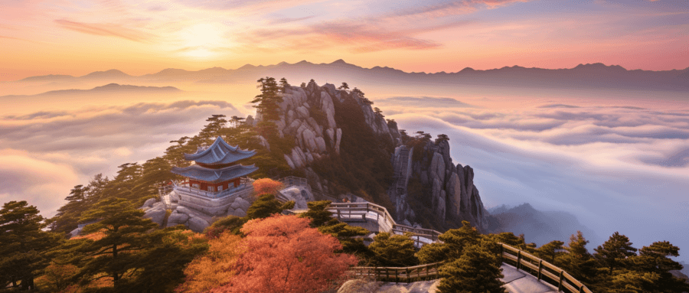
泰山
The Cultural Significance in Modern Times
We should keep an indomitable attitude to struggle, never to be idle in spirit, learning the spirit of those heavers in Mount Tai.

Slide 10
Thanks for your attention
泰山
Name: Qin Yi
Major: MTI-written interlingual translation

