Slide 1
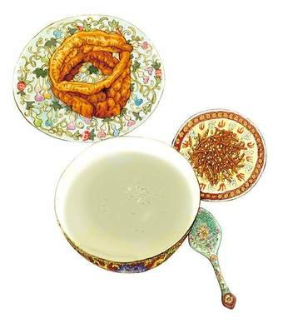
豆汁
Douzhi
Speaker:Li Linyao

Slide 2
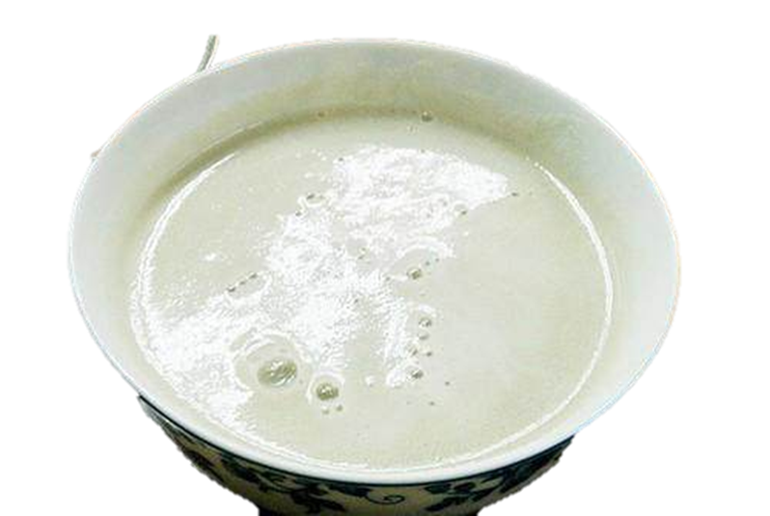
What is Douzhi?

Slide 3
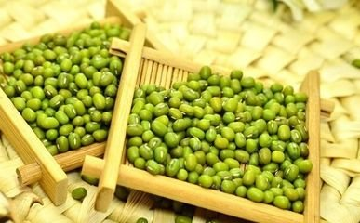
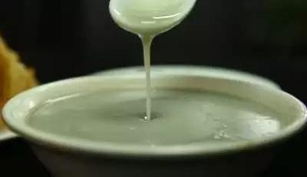


A fermented mung bean drink
Over 300 years of history
Light green color, sour aroma
Rich in vitamin C and fiber
Aids digestion
Clears internal heat
Strengthens the spleen

Slide 4
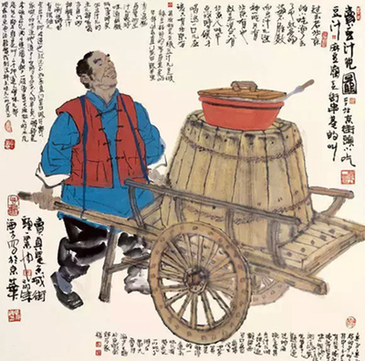
The Origin of Douzhi
The period of Liao and Song :
Tofu maker’s mistake: Used mung beans instead of soybeans → Fermented for days → Unexpected delicacy
Popular among commoners
Qing Dynasty Breakthrough:
Emperor Qianlong recruited Douzhi makers and gathered his ministers to taste it.
Popular in the imperial palace Gained widespread fame

Slide 5
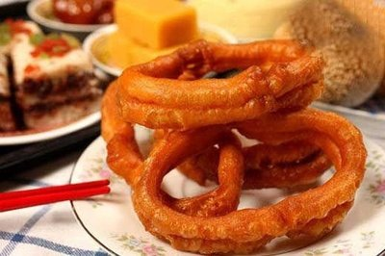
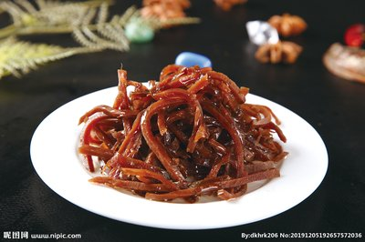
The Production and Taste of Douzhi
Production Process:
Select (plump mung beans)
Soak (10+ hrs to remove skins)
Grind (stone-milled slurry)
Ferment (starch sinks, sour liquid rises)
Simmer (boil at precise heat)
Temperature Rule:
Cold = “Slop” Hot = “Sour-sweet harmony”
Traditional Pairing:
Jiaoquan
pickled vegetables

Slide 6
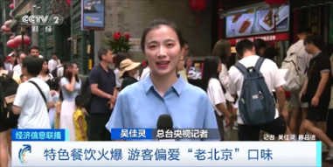

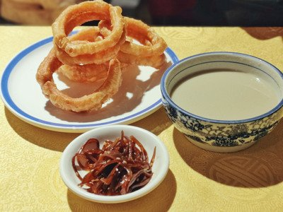
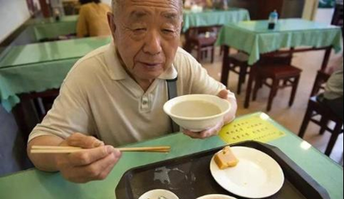
The Cultural Connotation of Douzhi
More than just a drink — it's a symbol of Beijing's culture and way of life.
Douzhi’s distinct flavor draws curious tourists
Enjoyed with pickled vegetables and jiaoquan, it reflects local traditions and identity.

Slide 7
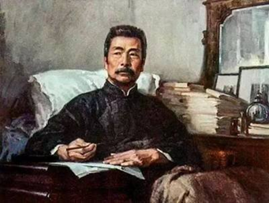
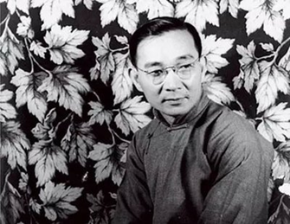
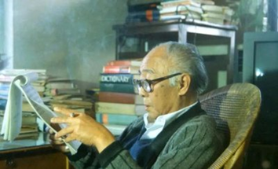
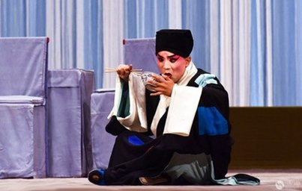
Douzhi in Literature & Arts
A symbol deeply rooted in folk culture
Lu Xun
Chinese Snacks
Lin Yutang
A Record of Beijing Snacks
Wang Zengqi
Douzhir
Peking Opera: The Record of Bean Juice
→ A bowl of Douzhi saves a man’s life

Slide 8
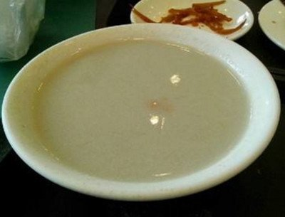
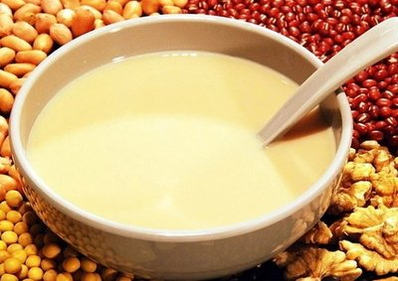
Douzhi vs Soy Milk
 | Douzhi | Soy Milk
Main Ingredient | Fermented mung beans | Soybeans
Color | Pale green | White
Flavor | Sour, pungent, slightly starchy | Mild, smooth, slightly sweet
Smell | Strong, fermented aroma | Light and pleasant
Cultural Context | Traditional Beijing street food | Common breakfast drink across East Asia
Translation Tip | Keep original name “Douzhi” with notes | Translate directly as “soy milk”

Slide 9
Thank you!
Ready to try a sip of Douzhi ?

