Slide 1
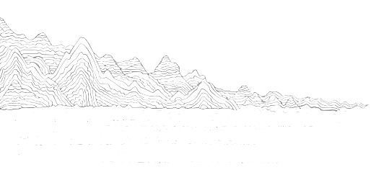
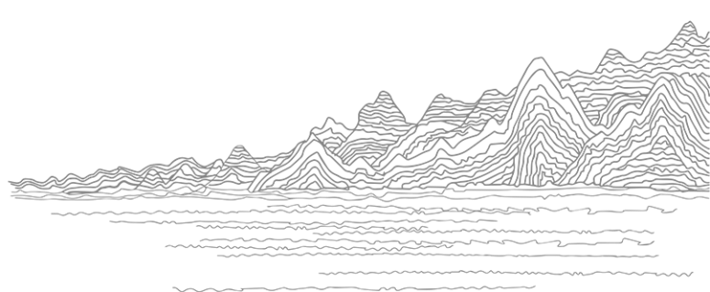
Qingming Riverside Landscape Garden
Wu Xinxin

Slide 2
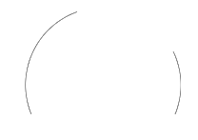

Qingming Riverside Landscape Garden
An Introduction
Contents
Origins
Architectures
1 2
4 3
Performances
Festivals

Slide 3
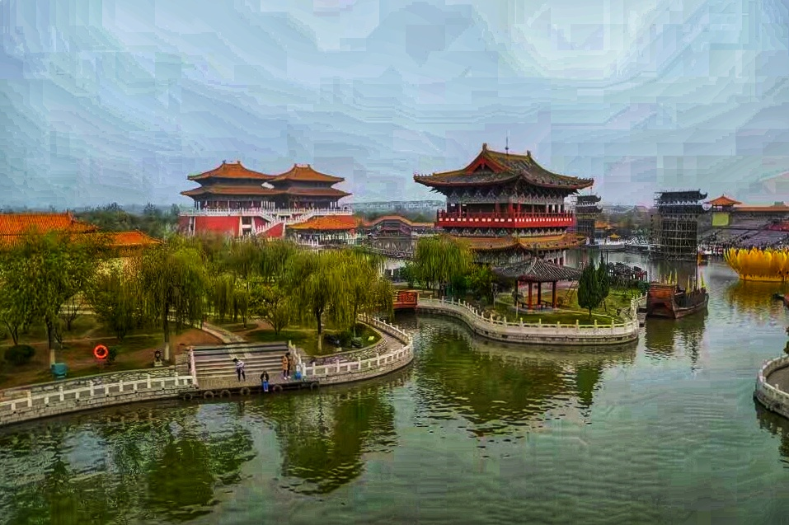
An Introduction
Located on the west bank of Dragon Pavilion in Kaifeng, Henan Province, Qingming Riverside Landscape Garden is a large-scale historical and cultural theme park covering an area of more than 600 mu, showing the prosperous scenery of Song Dynasty. It is based on the painting Riverside Scene at Qingming Festival.
It is interesting that a thousand years ago, Zhang Zeduan moved the life of people in Song Dynasty from reality to a painting, but a thousand years later, Kaifeng people moved it from a painting into reality.

Slide 4
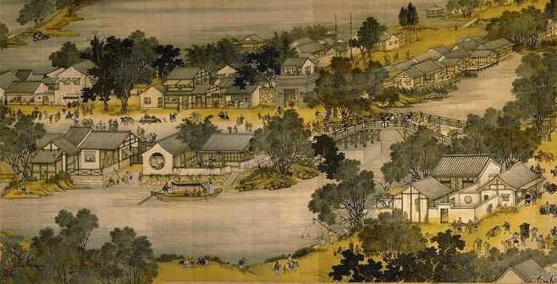

Origins
The painting Riverside Scene at Qingming Festival is a precious scroll of social and folk life in ancient China, reflecting the social life, manners and customs of marketplace, and urban architectural patterns of Kaifeng, the capital of the Northern Song Dynasty in China. Although it is just a minor part of Kaifeng at that time, people can still have a glimpse of the general appearance of other streets and urban areas.

Slide 5
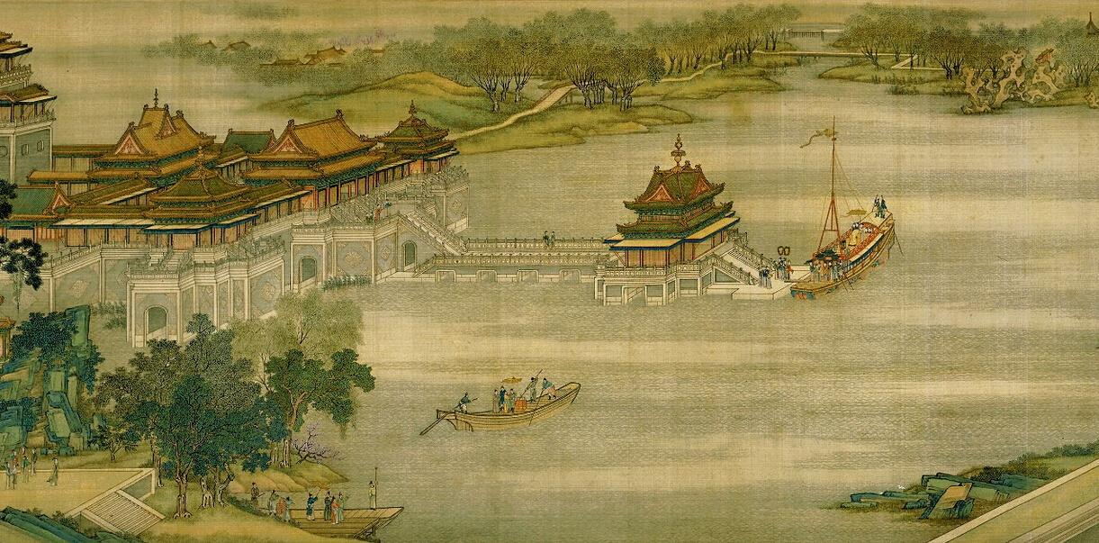

Slide 6
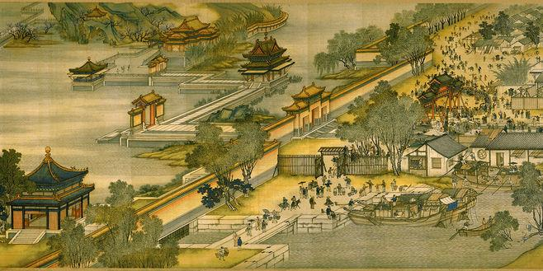

Slide 7
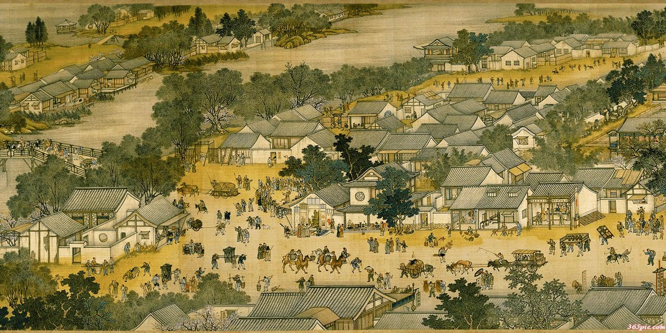

Slide 8
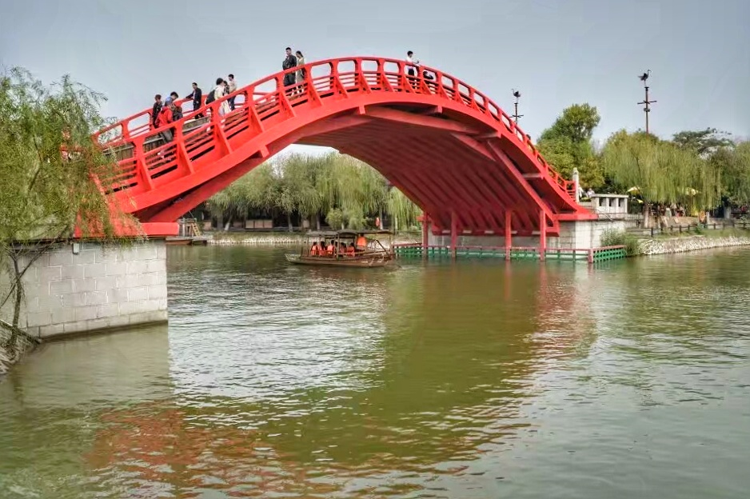
Architectures
The Rainbow Bridge is an important creation in the history of ancient Chinese bridges. It is listed as the top ten famous bridges in China, and a major landscape in the Qingming Riverside Landscape Garden. It is a replica of one of the ten ancient timber bridges.

Slide 9
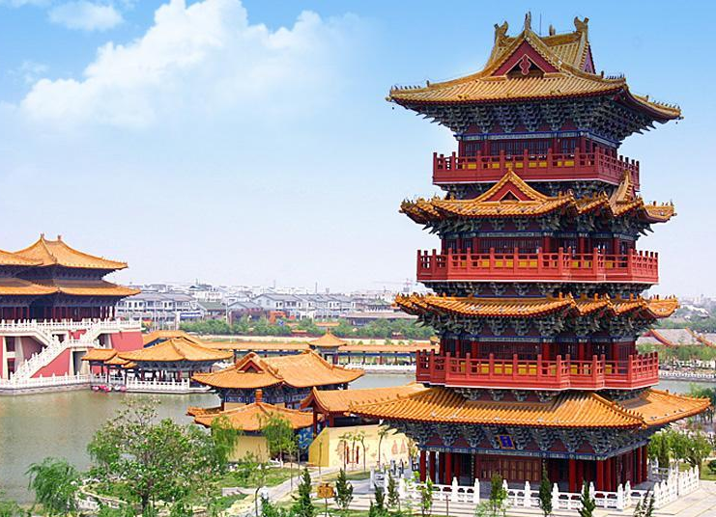
The Fuyun Pavilion, the tallest building in the garden, reaches 31.99 meters high. The name of “Fuyun” has two meanings: one is to touch, which means the pavilion rises into the clouds and touches the white clouds; the other is to clean, which means blowing away the smoke and clouds of history, and returning a real treasure map. From the outside, the pavilion is four floors but there are another three floors hidden inside. It is also the place where important royal documents and traditional Chinese painting and books are stored during the Song Dynasty.

Slide 10
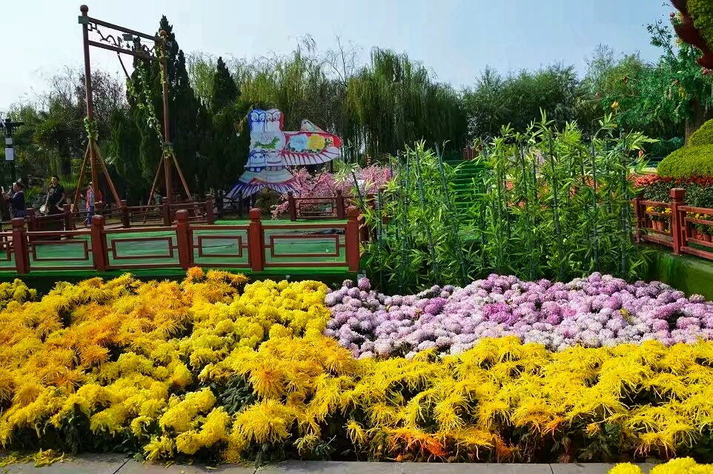

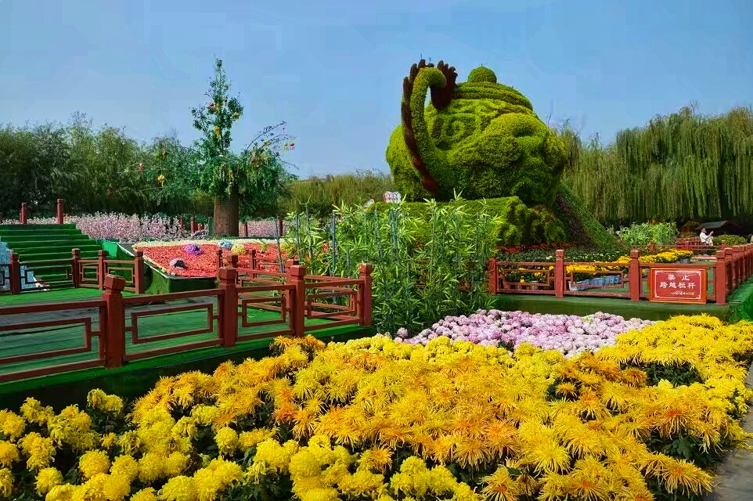
Festivals
Chrysanthemum cultural festival is a grand one in the garden, during which all kinds of chrysanthemums will be presented.
Qingming Riverside Landscape Garden focuses on beautiful chrysanthemum plants, and makes full use of architectures, sculptures, mountains, the surface of the water and association of activity and inertia to highlight the cultivated and creative skills of Kaifeng people.
Chrysanthemums are changed into various shapes, attracting thousands of visitors from all over the world. In the exhibition, visitors can enjoy and appreciate some species of chrysanthemum that are rarely seen in our daily life.

Slide 11
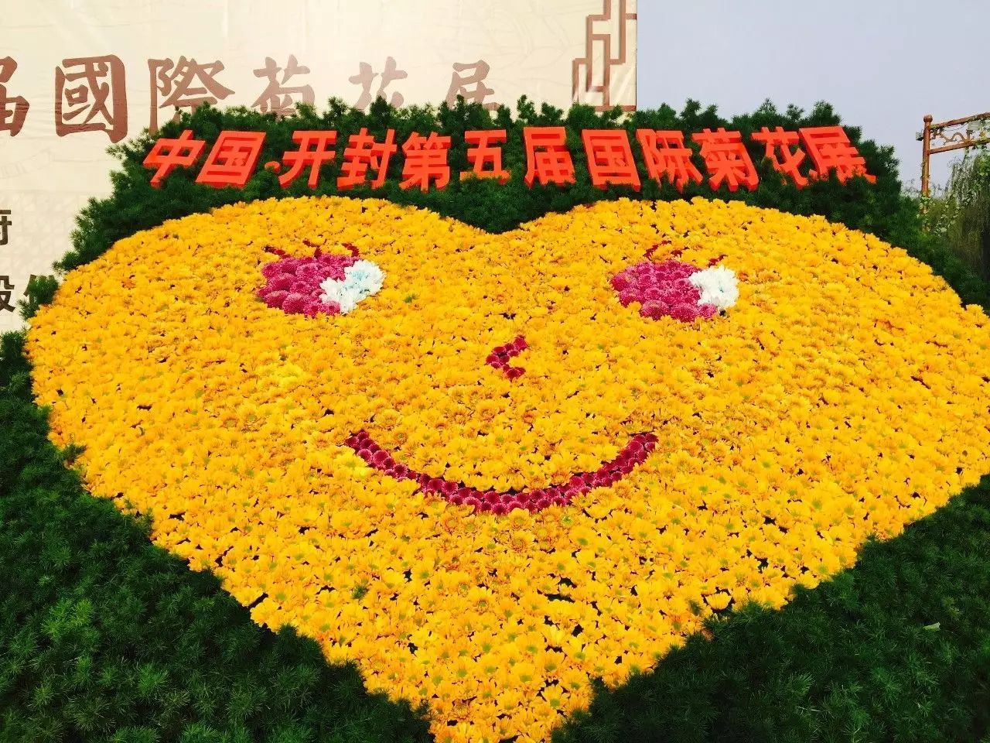
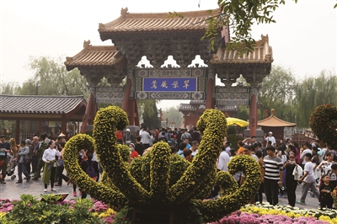
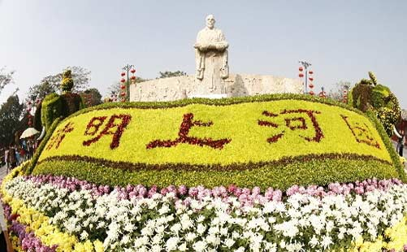

Slide 12
Festivals & Performances
During the Qingming Festival, the garden will hold some Qingming cultural festivals to promote traditional festival culture. At that time, visitors can walk out for a spring outing, plant willow trees, watch folk customs, taste snacks, and enjoy the large-scale water live performances called Luxuriant Dream of the East Capital of the Great Song Dynasty.
"Luxuriant Dream of the East Capital of the Great Song Dynasty" is a representative show of the garden. It is a large-scale live water performance produced by Qingming Riverside Landscape Garden. The performance lasts for 70 minutes and is performed by more than 700 actors.

Slide 13
The Translation
清明上河图
Riverside Scene at Qingming Festival Free Translation
Along the River during the Qingming Festival Literal Translation
清明上河园
Qingming Riverside Landscape Garden
大宋·东京梦华
Luxuriant Dream of the East Capital of the Great Song Dynasty

Slide 14
Thanks!

