Slide 1


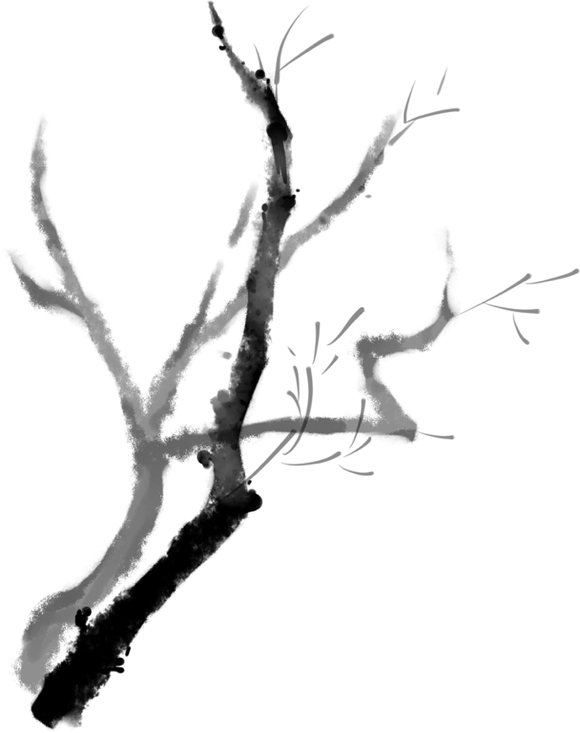
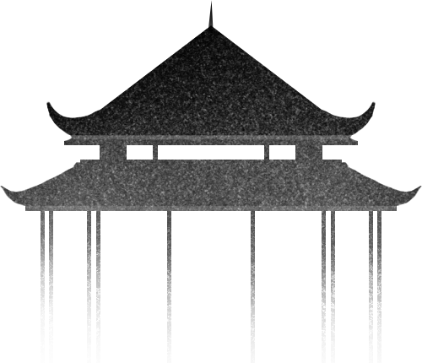
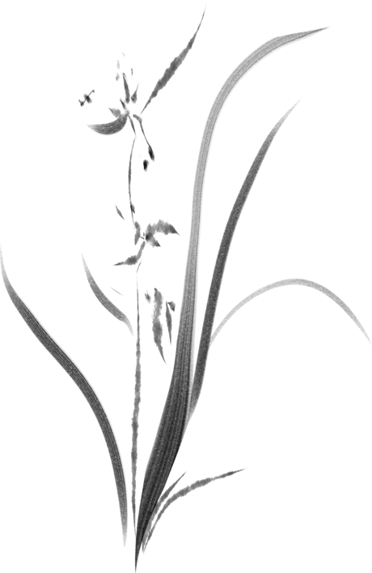
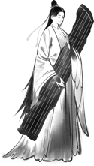

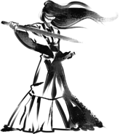

Relegation Literature in Ancient China
——Take Su Shi as an example.
Reportor：Song Chengshuang

Slide 2
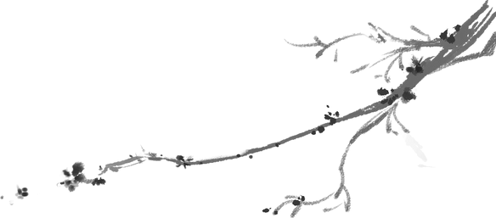


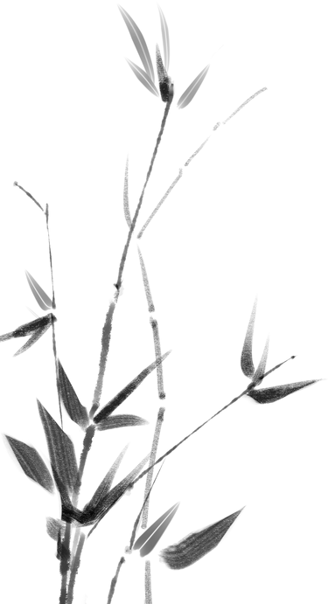
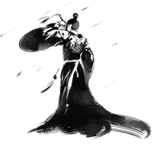

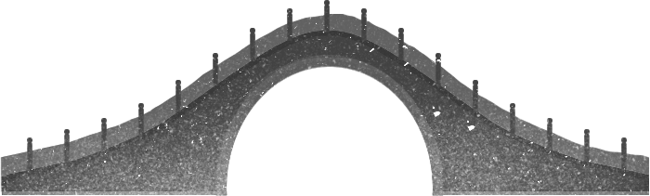

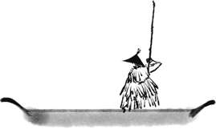

Content
01
02
Introduction
Representatives
03
04
Characters
Thoughts

Slide 3

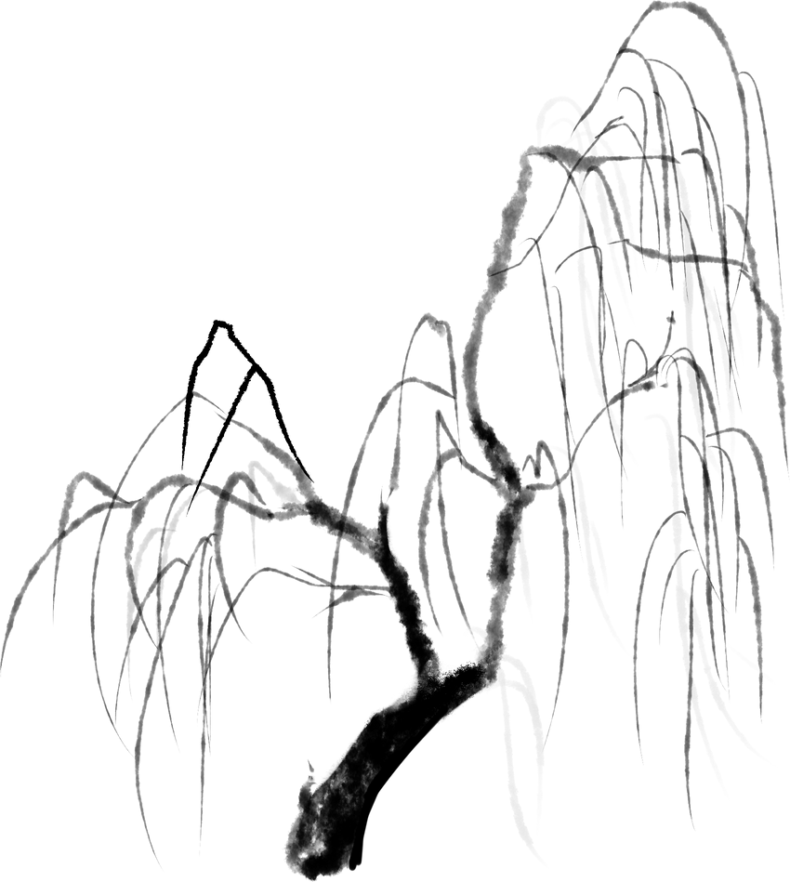
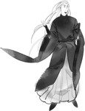




01
Introduction

Slide 4
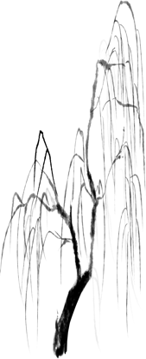
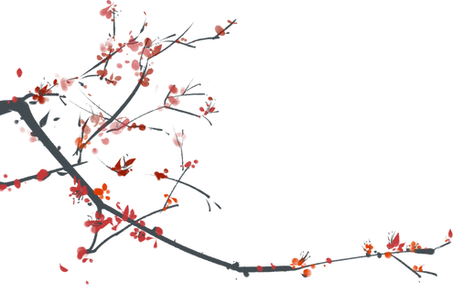

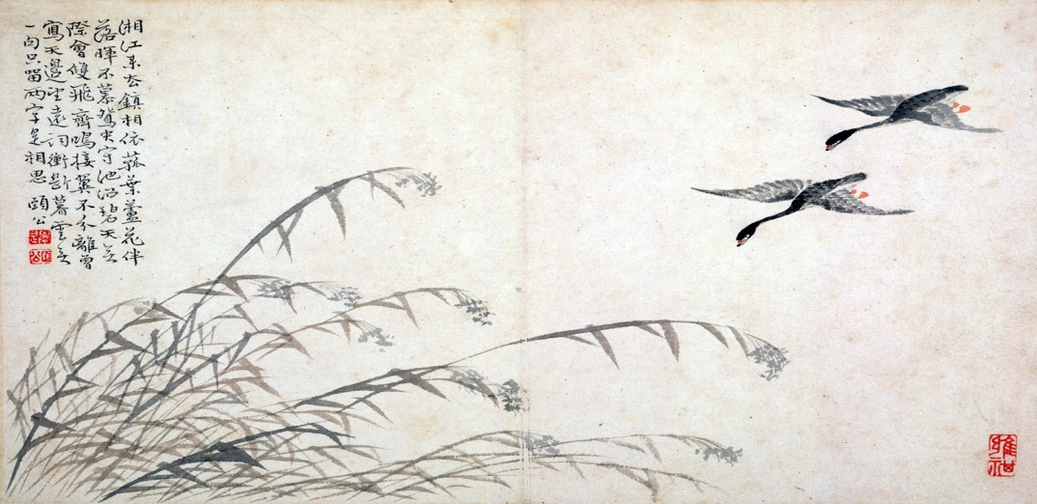
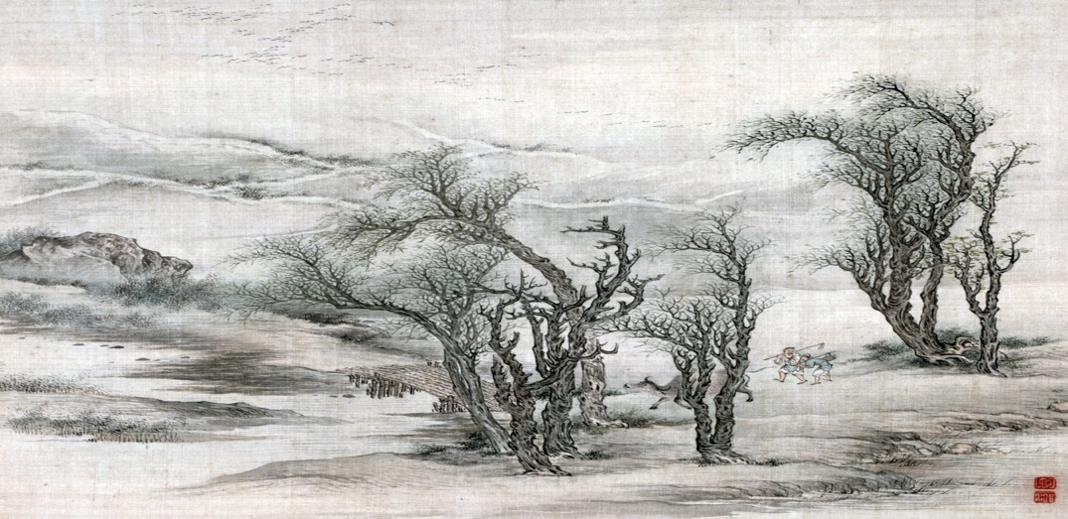


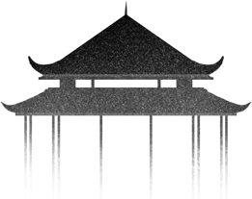
Definition
Relegation is a special cultural phenomenon in ancient China. Many relegated scholars and poets also made great achievements in the relegation literature of ancient China.
The concept of "relegation literature" is a multifaceted one that includes a wide range of intertwined issues such as political systems, political events, literati identities, relegated regions, and relegated groups.

Slide 5


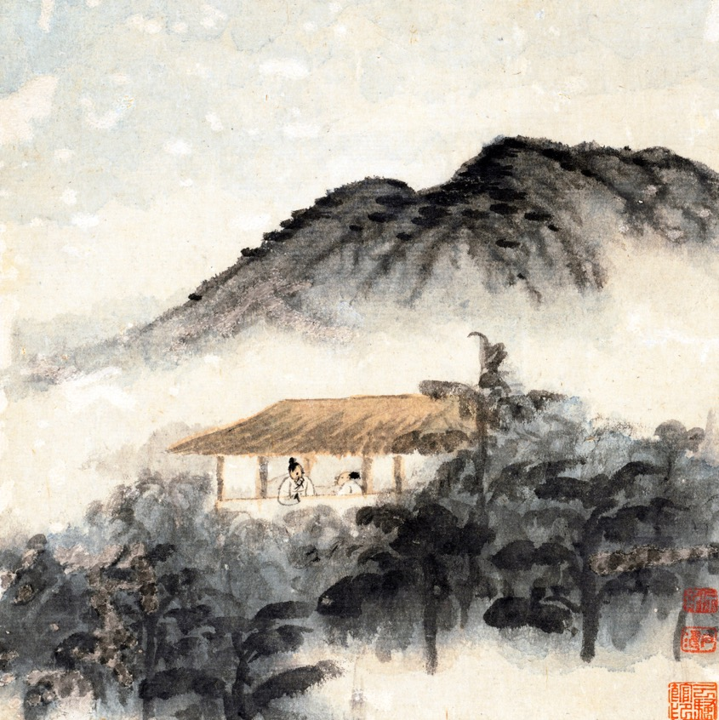


Component
01
the literary works created by the relegated poets during their relegation
the literary works about relegation created by the relegated poets before and after their relegation
02
03
the literary works about relegation created by the non-relegated poets during their farewell and reminiscence

Slide 6
02
Representatives

Slide 7

Question
Who are the representatives of relegation literature ？
01
02
Qu Yuan
Liu Zongyuan
03
04
Han Yu
Su Shi

Slide 8
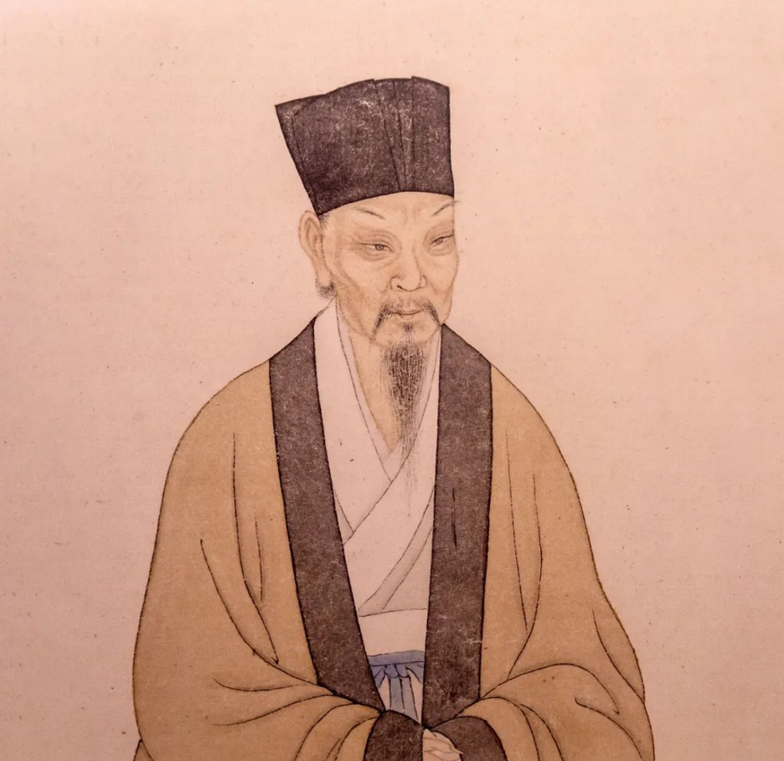


Su Shi (8 January 1037 – 24 August 1101）
courtesy name Zizhan, art name Dongpo, was a Chinese poet, writer, politician, calligrapher, painter, pharmacologist, and gastronome of the Song Dynasty.
one of the most accomplished figures in classical Chinese literature
His poetry has a long history of popularity and influence in China, Japan, and other areas in the near vicinity and is well known in the English-speaking parts of the world through the translations

Slide 9


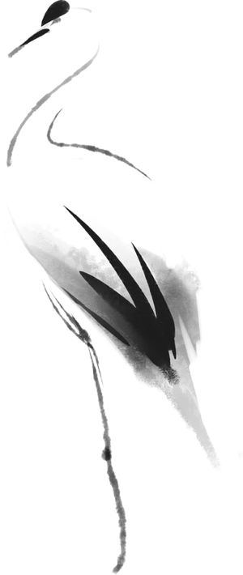


His Relegated Experiences
Relegated to Huizhou
Relegated to Huangzhou
Relegated to Danzhou
1094
1080
1097

Slide 10
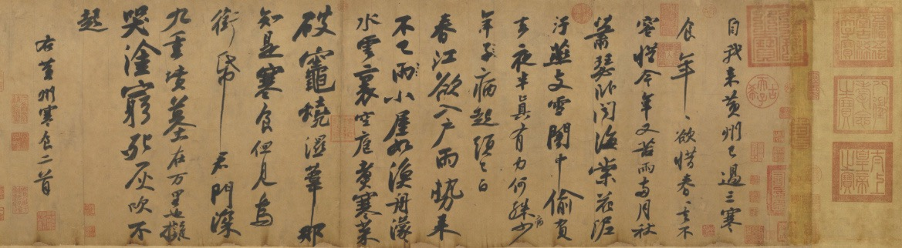
Wutai Poetry Case （乌台诗案）
1
0
7
9
元
丰
二
年
Huzhou Appreciation Recommendation
（湖州谢上表）
foolish and untimely, and could hardly accompany the newcomers
（愚不适时，难以追陪新进）
the old man did not cause any trouble or could shepherd the small people
（老不生事，或能收养小民）

Slide 11


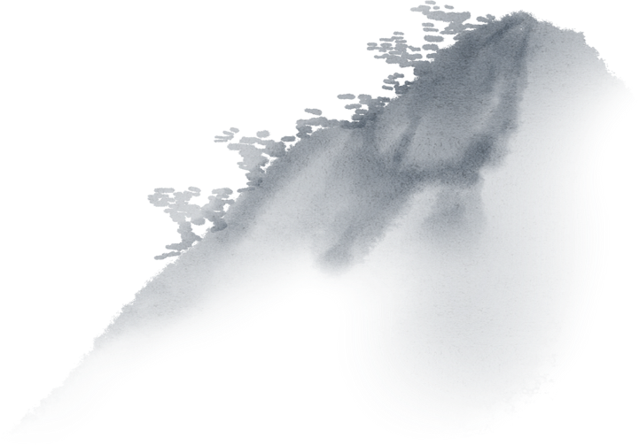
Wutai Poetry Case （乌台诗案）
harboring resentment
and anger
harboring evil intentions
01
02
03
04
fooling the court, presumptuous and arrogant
rebuking the public opinion

Slide 12


Wutai Poetry Case （乌台诗案）
On July 28, Su Shi, who had only been in office for three months, was arrested by the officials of the imperial court and sent to the capital, and dozens of people were implicated. This is the famous "Wutai Poetry Case" of the Northern Song Dynasty .
The New Party was determined to put Su Shi to death.Rescue activities were launched simultaneously in the court and the field.
Finally, with the help of Wang Anshi, Su Shi was spared the death penalty and relegated to Huangzhou.

Slide 13
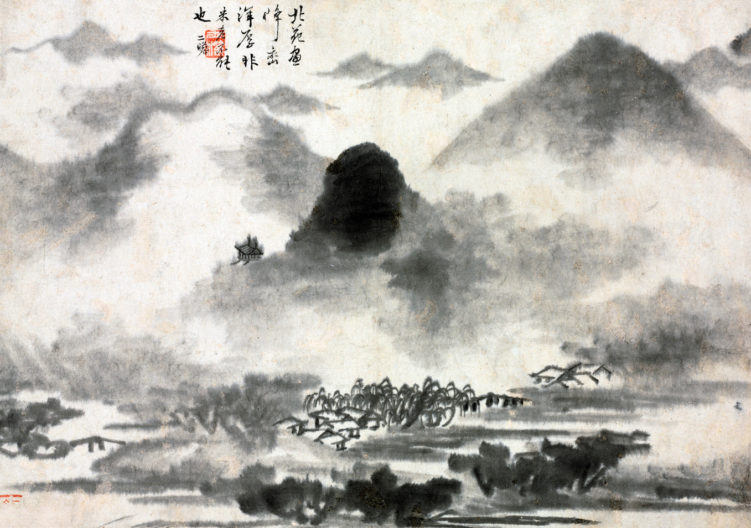
Wutai Poetry Case （乌台诗案）
This huge blow became the turning point of Su Shi's life. Su Shi was imprisoned for 103 days and was nearly killed. Fortunately, Song Taizu Zhao Kuangyin set the state policy of not killing the scholars, he was able to escape a disaster. Therefore, Su Shi's first remote trip of exile (1080–1086) was to Huangzhou, Hubei.

Slide 14

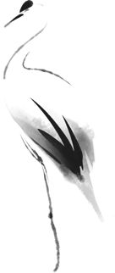
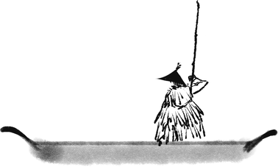
Relegated to Huangzhou
experience
Sushi’s post carried a nominal title,
but no stipend, leaving Su in poverty.
With the help of a friend，Sushi made a living.
In 1086, Su and all other banished statesmen
were recalled to the capital due to the ascension
of a new government.
Works
Han Shi Tie 寒食帖
The First and Second Chibifu (The Red Cliffs) 赤壁赋
Nian Nu Jiao: Chibi Huai Gu 念奴娇：赤壁怀古

Slide 15
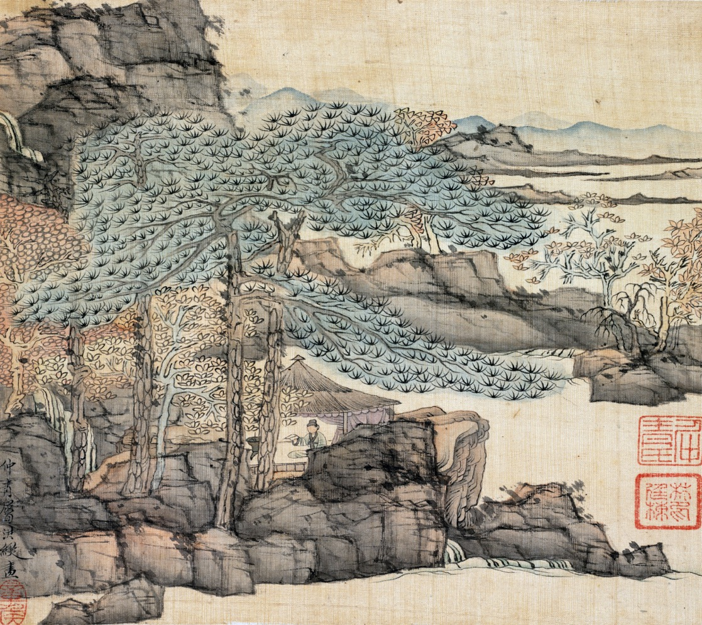


Relegated to Huizhou
experience
In the first year of Shaosheng (1094), Su Shi was again relegated to Huizhou .He only lived in Huizhou for two years and seven months. Although the time is short, he is concerned about the sufferings of Huizhou people and local construction everywhere, and has done a lot of practical things for the people of Huizhou.
Works
One Poem of Huizhou 惠州一绝
Butterfly Lovers - Spring Scene 蝶恋花·春景

Slide 16
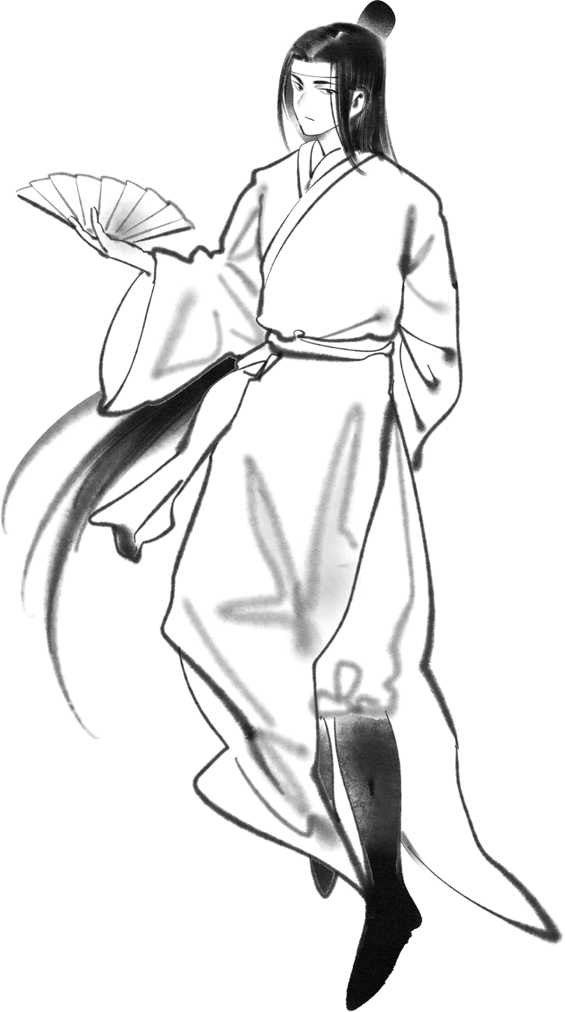
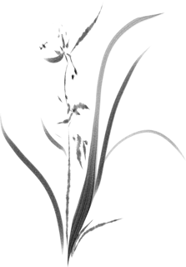

Relegated to Huizhou
the scenery of Huizhou
the temporary residence
I eat 300 lychees a day, and I do not resign to be a long Southerners.
日啖荔枝三百颗，不辞长作岭南人
The sea and mountains are lush and beautiful, and the two rivers merge and the vermilion building opens.
海山葱矓气佳哉，二江合处朱楼开
spring
winter
After the burning of the tea gun, the wheat waves are empty in front of the water.
茶枪烧后有，麦浪水前空
Luofu is moving in spring, and the clouds and sun have a clear light.
罗浮春欲动，云日有清光

Slide 17
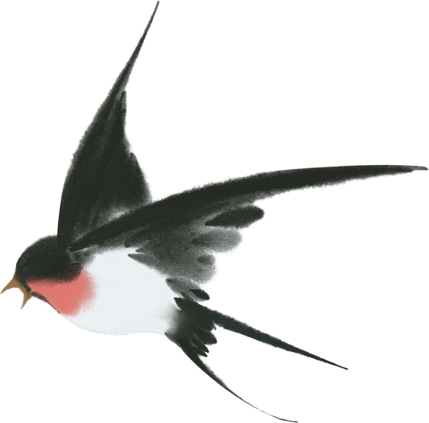
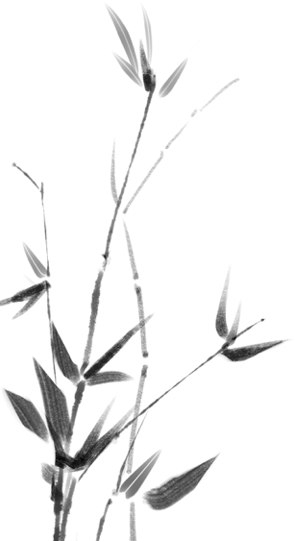
Relegated to Danzhou
experience
In the fourth year of Shaosheng (1097), Su Shi, who was already sixty-two years old, was sent by a lone boat to Danzhou,a desolate place on the island of Hainan.He ran a school here, mediating the learning style, so that many people traveled thousands of miles to follow to Danzhou, from Su Shi learning.People have always regarded Su Shi as the pioneer and sower of Danzhou culture and have deep reverence for him.
I am originally from Dan'er clan and was born in West Shuzhou
我本儋耳人，寄生西蜀周
The sea has never broken the earth's pulse, the pearl cliff from now on break the sky.
沧海何曾断地脉，白袍端和破天荒
If someone asks what my life achievement is, I will answer that I served in Huangzhou, Huizhou, Danzhou
问汝平生功绩，黄州惠州儋州
Rainy Night Staying at Jokhang Temple 雨夜宿镜行院
Entering the Temple 入寺
Works

Slide 18
03
Characters

Slide 19
Characters
01
02
03
common
universal and multi-level
Uncertain
The phenomenon of relegation in China has continued throughout ancient history, but most frequently in the Tang and Song Dynasties. During relegation, lots of works are created because of the special feeling of poet.
Since ancient China entered the era of power and rule, the phenomenon of relegation and exile had been following，ranging from the royal family and its relatives, princes and sons, to officials and bureaucrats at all levels. The number of people who suffered from relegation is innumerable in Tang Dynasty.That’s why relegation literature is universal and multi-level.
From the perspective of the causes of the phenomenon of relegation in ancient times, there are many people whose reasons for relegation are not sufficient and are with great arbitrariness. So the reasons for the emergence of relegation literature are diverse and uncertain

Slide 20

Uncertainty of the reasons for relegation.
01
Jia Yi
02
Wang Changling
03
Ouyang Xiu
desires to trespass on power and disorderly affairs
did not pay attention to surrounding details in his later years
not repairing the curtain
04
Huang Tingjian
05
Lu You
falsely destroying the previous emperor" for his book "The True Records of Emperor Shen.
mocking the wind and moon

Slide 21
肆
Thougts

Slide 22


Summary
The relegation literature shows the character of the ancient literati, and let us see the persistence and perseverance of the ancient literati in the difficult times.
Relegation literature enriches the expression form and content of ancient literature.
01
02
03
04
Relegation literature reflects the style of society and people's life at that time.
Relegation literature has high historical value and humanistic concern.

Slide 23

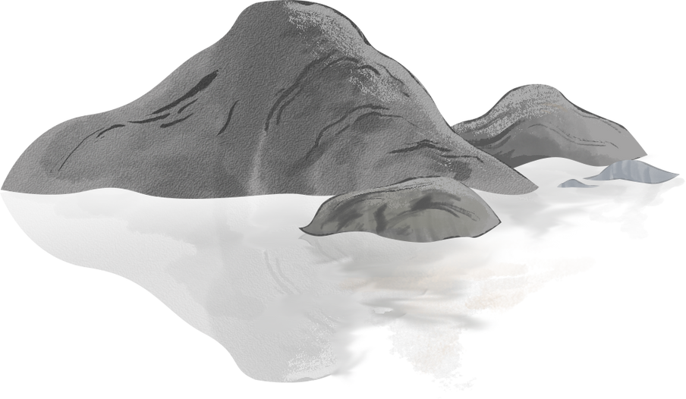
Reflection
Relegation literature is like a clear stream in adversity, which not only reflects the sad fate of the ancient literati, but also leaves many valuable cultural heritages for the later generations. Relegation literature is not only an important part of Chinese culture, but also provides us with an endless source of inspiration for inheriting civilization and innovating culture. In today's society, we should inherit and carry forward the essence of relegation literature, and make a contribution to social development and cultural promotion with our talents and works.

Slide 24
Question
During Su Shi's first exile,what representative works did he create?
01
Han Shi Tie
The First and Second Chibifu (The Red Cliffs)
Nian Nu Jiao: Chibi Huai Gu
02
When did the phenomenon of relegation happened most frequently？
Tang and Song Dynasties

Slide 25



Thank you for listening

