Slide 1
The Development of Bible Translation
By Han Haiyang & Peng Yuzhi

Slide 2



The Bible
from Koine Greek , “the books”
The Bible consists of the Old Testament and the New Testament. The former, completed in around 1300 B.C., is originally in Hebrew while the latter, completed in around 45 A.D., is in Greek.

Slide 3
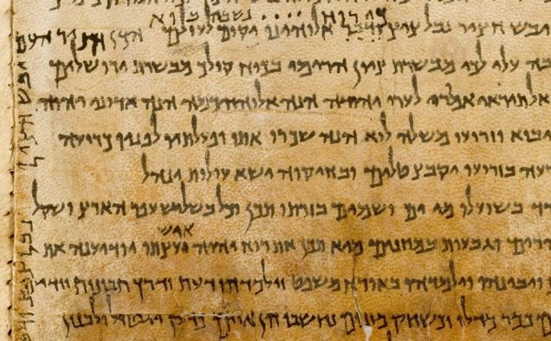
Septuagint
Following conquest by Alexander the Great, the Hebrew Bible was translated into Greek in the 3rd century B.C. ,known as Septuagint which refers to the 70 (or more accurately, 72) Jewish scholars who supposedly worked on the translation.

Slide 4
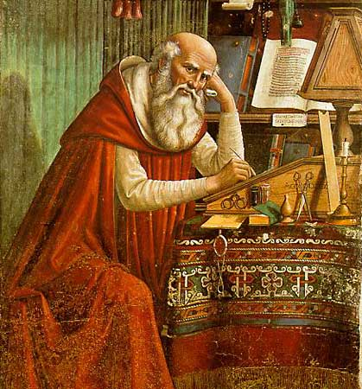
Saint Jerome
Translated the New Testament from original Greek into Latin from 382 A.D. to 384 A.D.
Translated the Hebrew Bible into Latin from 390A.D. to 405A.D.
Translated sense for sense rather than word for word

Slide 5
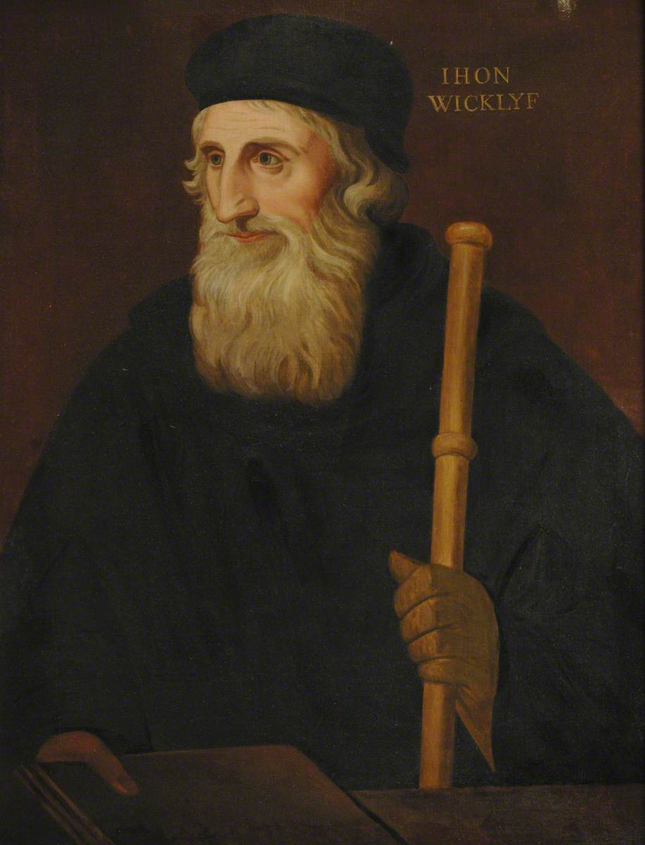
John Wycliffe
Translated the Latin Bible to English in the 14th century
Believed each man should be granted access to the crucial text in a language that he could understand
Translated as clear as possible the ‘sentence’ (meaning)
Church officials dig up his bones, burn them, and scatter the ashes on Swift River.

Slide 6
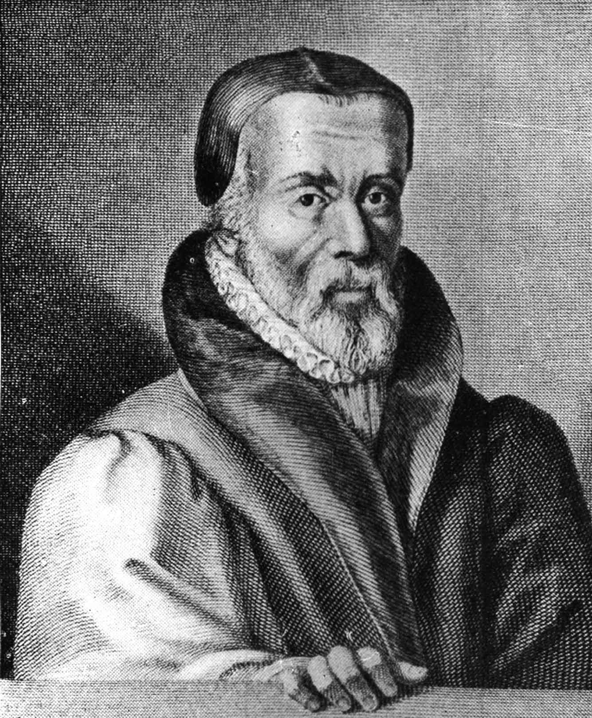
William Tyndale
Printed the first translation of the New Testament from Greek into English, nearly at the same time when Martin Luther translated the New Testament from Greek to German
Intention in translating : to offer as clear a version as possible to the layman
Burned at the stake in the same year when Luther translated The Old Testament from Latin to German

Slide 7

King James Bible 1611
The most important and influential English translation of Bible
A literal translation was adapted , harder to read than some earlier versions
Avoided contemporary idioms, tending towards archaic forms, like verily
King James Version Bible first edition title page 1611

Slide 8
Some modern versions sections from Genesis 1
The 21century King James version
Amplified Bible, Classic Edition
1 In the beginning God created the heaven and the earth.
2 And the earth was without form and void, and darkness was upon the face of the deep. And the Spirit of God moved upon the face of the waters.
1 In the beginning God (prepared, formed, fashioned, and) created the heavens and the earth.
2 The earth was without form and an empty waste, and darkness was upon the face of the very great deep. The Spirit of God was moving (hovering, brooding) over the face of the waters.

Slide 9
THANK YOU FOR WATCHING

