Slide 1


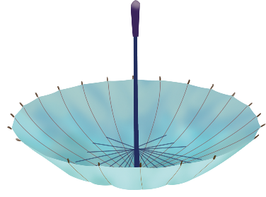
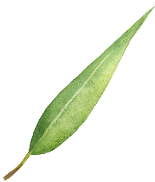


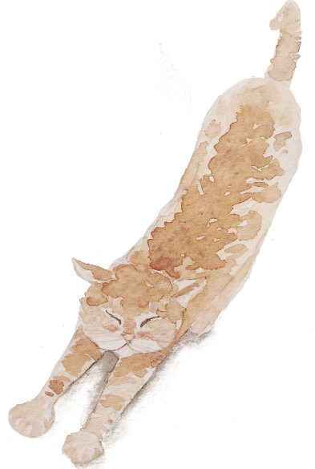
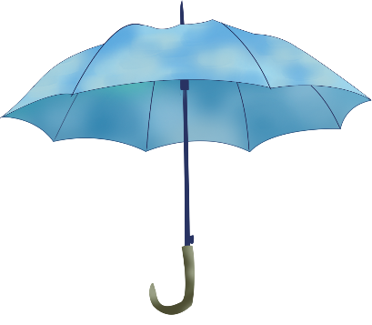

Hypotactic & Paratactic
presented by Liu Wei

Slide 2

General Introduction
content
Hypotaxis, Parataxis and Translation
Conclusion

Slide 3
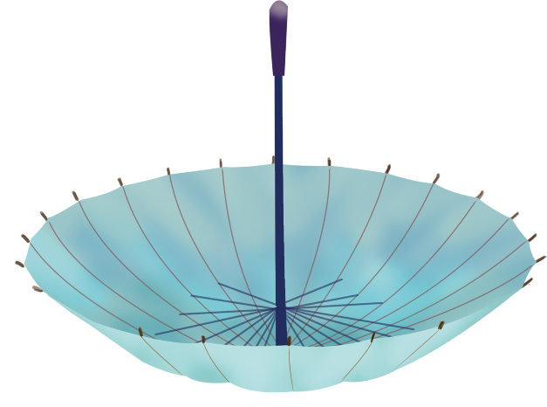

Part.01
General Introduction

Slide 4
English and Chinese
English :the Indo-European Family
Chinese :the Sino-Tibetan Family
Differences:word formation、syntax、their own features 、pronunciation regulations …
西文句中名物字，多随举随释，如中文之旁支，后乃遥接前文，足意成句。故西文句法，少者二三字，多者数十百言。假令仿此为译，则恐必不可通，…此在译者将全文神理，融会于心，则下笔抒词，自善互备。
——严复

Slide 5
Definitions of Hypotaxis and Parataxis
Hypotaxis
Hypotaxis refers to the realization of the connection of the words or phrases, with the help of language forms .
the hypotaxis means “the dependent or subordinate construction or relationship of clauses with connectives, for example, I shall despair if you don't come.”
——American Heritage Dictionary

Slide 6

Parataxis
Parataxis refers to the realization of the connection of them without the help of the language form but the logical meaning of the words or phrases.
The Parataxis means “the arranging of clauses one after the other without connectives showing the relation between them.
——The World Book Dictionary

Slide 7
Part.02
Hypotaxis, Parataxis and Translation

Slide 8
Hypotaxis in English
English is typically a system of grammatical language.
Many methods are used in English sentences to connect words and clauses, which focus much on explicit cohesion.

Slide 9
1 Using relatives and conjunctions
relatives
01
02
conjunctions
include relative pronouns, relative adverbs, conjunctional pronouns and conjunctional adverbs .
such as: who, whom, whose, that, which, what, when, where, why, how etc.
include coordinate conjunction and subordinate conjunction.
such as: and, or, but, yet, so, however, (n)either…(n)or, when, as, since, until, unless etc.

Slide 10

instance
It had been a fine, golden autumn, a lovely farewell to those who would lose their youth, and some of them their lives, before the leaves turned again in a peaceful fall.
译文：那是个天气晴朗，金黄可爱的秋天，美好的秋色为那些青年送别。待到战后和平时期，黄叶纷飞的秋天再度来临时，昔日的青年已经失去了青春，有的丧失了生命。

Slide 11
2 Using Prepositions
instance
simple prepositions
combined prepositions
idiom prepositions
He had a disconcerting habit of expressing contradictory ideas in rapid succession.
译文：他有一种令人疑虑不安的习惯：一会儿一个看法，自相矛盾，变化无常。

Slide 12
3 Other Connective Methods
instance
inflections (changing affix, number, person, etc)
using “it” or “there”
Thereis nothing more disappointing to hostess who has gone to a lot of trouble or expense than to have her guest so interested in talking politics or business with her husband that he fails to notice the flavor of the coffee, the lightness of the cake, or the attractiveness of the house, which may be her chief interest and pride.
译文：最令女主人失望的是，她花了许多心神和费用来招待客人，可是这位客人只顾津津有味地与她的丈夫谈政治、谈生意，却没注意到香喷喷的咖啡，松软的糕点，或房子里吸引人的东西，而这些却可能是她感到兴趣并引以自豪的主要所在。

Slide 13
Parataxis in Chinese
Chinese is typically a system of semantical language.
Few methods are used in Chinese sentences to connect words and clauses, which focus much on implicit coherence.

Slide 14
1 The changing of word order
instance
Few conjunctions because the meaning is highly connected with the word order.
人（若）不犯我，我（则）不犯人。
译文：We will not attack unless we are attacked.

Slide 15
2 Using figures of speech
instance
such as repetition, parallelism, antithesis and balanced sentences.
种瓜得瓜，种豆得豆。
译文： as a man sows, so he shall reap.

Slide 16
3 Using compressed sentences
instances
狼披羊皮还是狼。
译文：A wolf remains a wolf even though it is in sheep's clothing.
不到黄河心不死。
译文： Until all is over ambition never dies.

Slide 17
4 Using four-character structures
instances
欲盖弥彰
译文： one tries to hide, the more one is exposed.
不进则退
译文：Move forward, or you'll fall behind.

Slide 18
Part.03
Conclusion

Slide 19
Chinese is not absolute parataxis and English is not absolute hypotaxis. the key to translation is to be flexible according to the original text.
Qnly a thorough understanding of the differences between Chinese and Western cultures, can we better grasp the laws in translation.

Slide 20
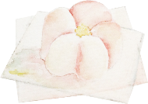
Thank you for watching !

