Slide 1
Mysterious culture: Facial Physiognomy
相面术
周小乔

Slide 2
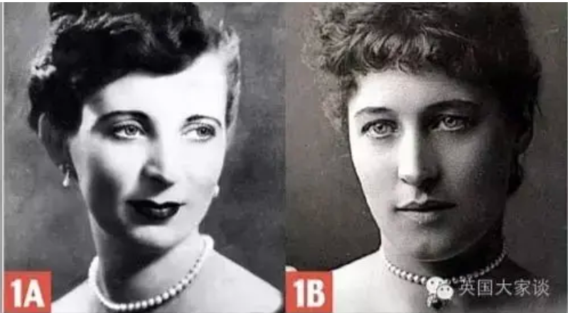
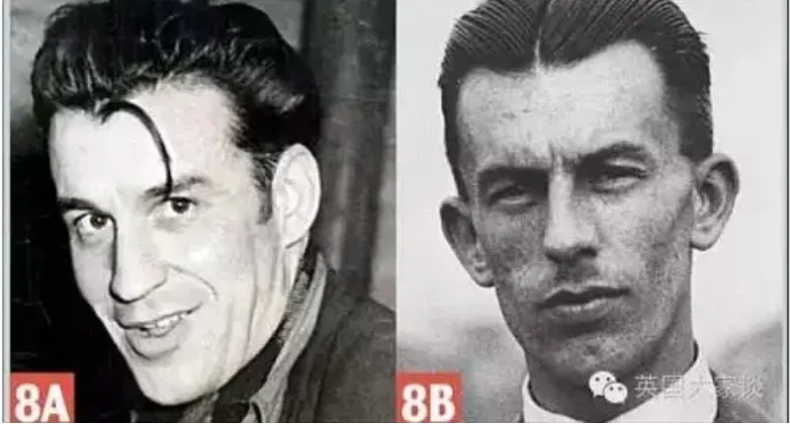
One is a young lady of note, and another is a nightclub waitress who was hanged for killing her lover
One is a serial killer, and another is a genius engineer

Slide 3
The Origin of Physiognomy
相面术起源

Slide 4
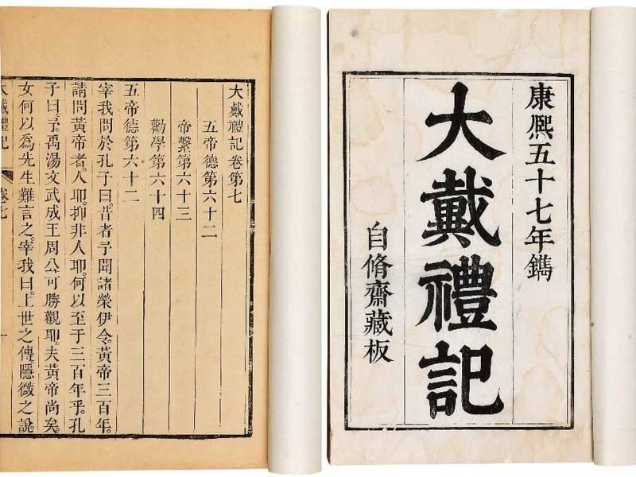
The Origin of Physiognomy
Facial physiognomy is a branch discipline derived from Zhouyi. According to the "Da Dai Li Ji", "Yao admitted people by appearance; Shun admitted people by expression; Yu selected people by behavior; Tang selected people by voice; and King Wen chose people by talent." It can be regarded as the origin of facial physiognomy in ancient times.
尧取人以状，舜取人以色，禹取人以言，汤取人以声，文王取人以度

Slide 5
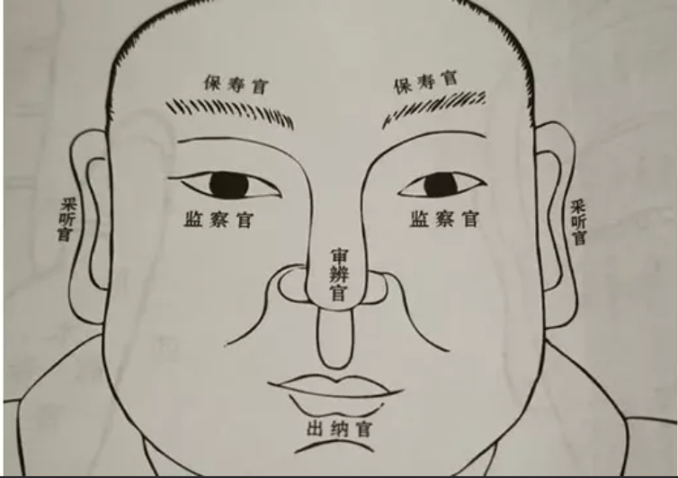
The Origin of Physiognomy
The Spring and Autumn period and the Warring States period is an important stage for Chinese facial physiognomy to mature from the bud. Through the observation and analysis of a large number of people, the physiognomists summed up some basic principles and methods of facial physiognomy, for example, by observing the complexion and facial features to predict fate. Meanwhile, they also absorbed Confucianism, Taoism and other thoughts of the period, so that the theory of physiognomy is more philosophical.

Slide 6
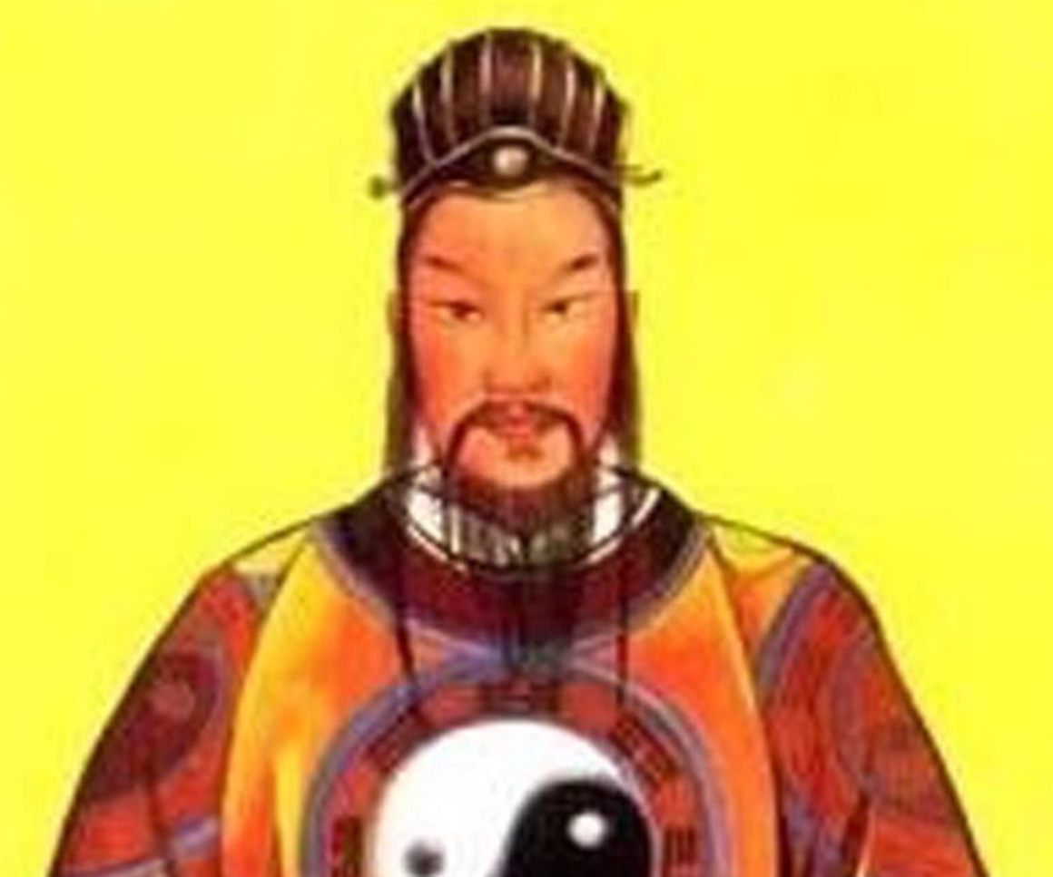
The Origin of Physiognomy
During the Three Kingdoms period, physiognomy developed further. During this period, facial physiognomy was not only better in theory, but also more widely used in practice. For example, the History of the Three Kingdoms records many stories of physiognomists, who used
physiognomy to predict people's destinies. Among them, Zhu Jianping was very famous. He was good at judging people's fate and character by observing their looks and voices.

Slide 7
San Ting
三停

Slide 8
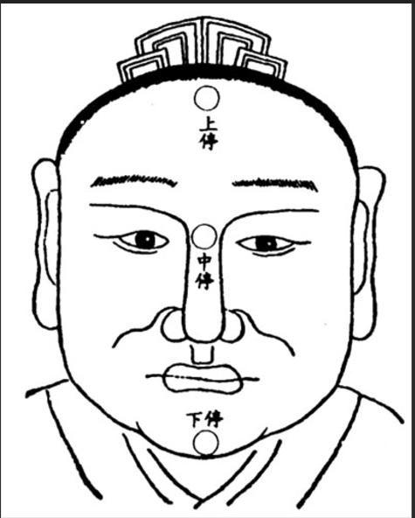
San Ting
Shang Ting: from the forehead hairline to the eyebrow, in charge of the youth's fate and the fortune between the ages before 25.
Zhong Ting: from the eyebrow to the nose is called "Zhong Ting",which is in charge of middle age and the fortune between the ages of 25-50.
Xia Ting: from the nose to the chin part is called "Xia Ting",which is in charge of the life of the old age and the fortune after 50 years old.

Slide 9
Si Du
四渎

Slide 10
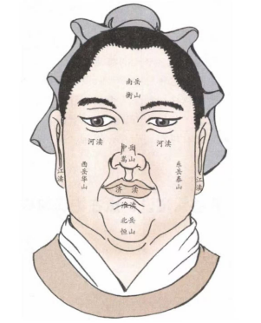
Si Du
Si Du refers to the ears, eyes, mouth and nose. From the looks of these four parts. You can know whether a person is rich all his life.
耳为江，目为河，口为淮，鼻为济

Slide 11
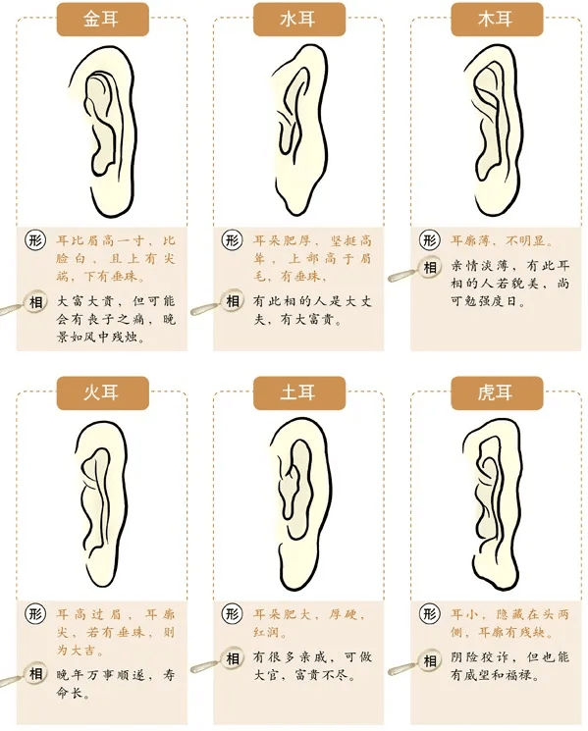

Slide 12
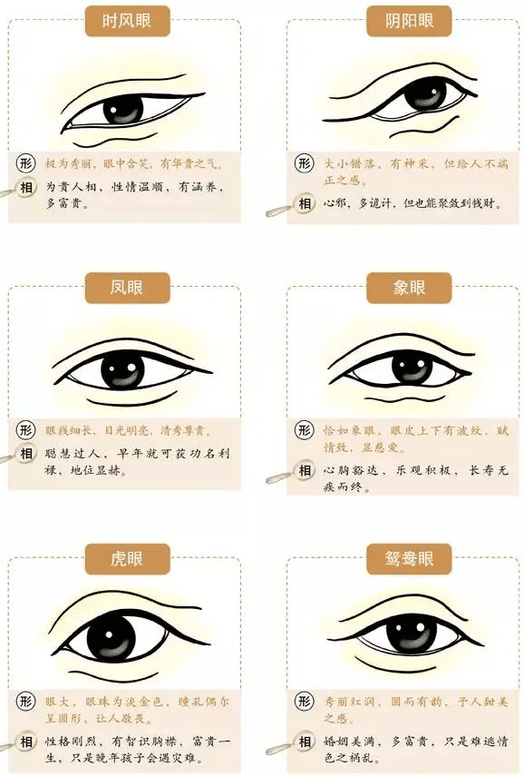

Slide 13
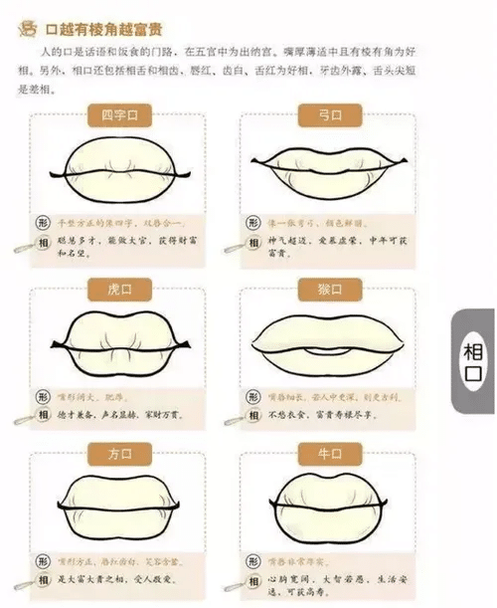

Slide 14
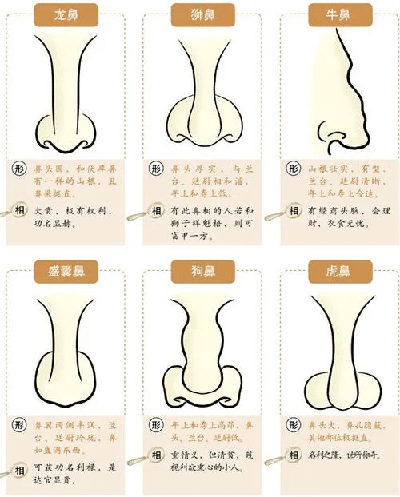

Slide 15
Zodiac signs
十二宫

Slide 16
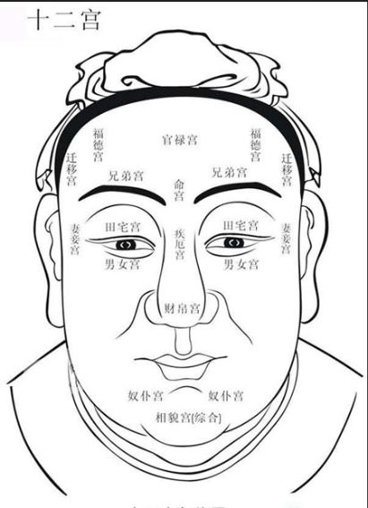
Zodiac signs
(1) Ming Zodiac: located between the two eyebrows, affecting a person's basic fortune.
(2) Caibo Zodiac: located at the head of the nose, in charge of people's financial resources.
(3) Xiongdi Zodiac: The eyebrows are Xiongdi Gong, representing the number of brothers and sisters, but also symbolizing the closeness of the relationship.
(4)Fuqi Zodiac: located at the tail of the eyes, related to the relationship between husband and wife.

Slide 17
Zodiac signs
(5)Zinv Zodiac: located in the raised part of the lower eyelid, representing all aspects of the children; the left one represents the fate of sons and the right one represents daughters’, cooperating with each other.
(6) Ji’e Zodiac: located in the mountain root between the eyes, representing the state of health.
(7) Qianyi Zodiac: located at both ends of the upper forehead, related to the good and bad luck of migration and going out.

Slide 18
Zodiac signs
(8) Nupu Zodiac: located at the lower part of the cheek, in charge of the person's old age fortune and interpersonal relations.
(9) Guanlu Zodiac: located in the middle of the forehead, related to the success or failure of the career and the good and bad luck of the life of official.
(10) Tianzhai Zodiac: located in the eyelid between the eyebrows and the eyes, related to the number of assets in the family and family status.

Slide 19
Zodiac signs
(11) Fude Zodiac: located in the outer position above the eyebrow,
related to people's good fortune and virtue.
(12) Fumu Zodiac: The “father zodiac” is located in the middle of the left forehead and the “mother zodiac” is located in the middle of the right forehead, representing the parents' health.

Slide 20
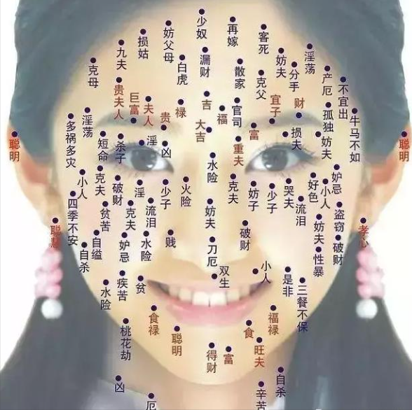
右
左

