Slide 1
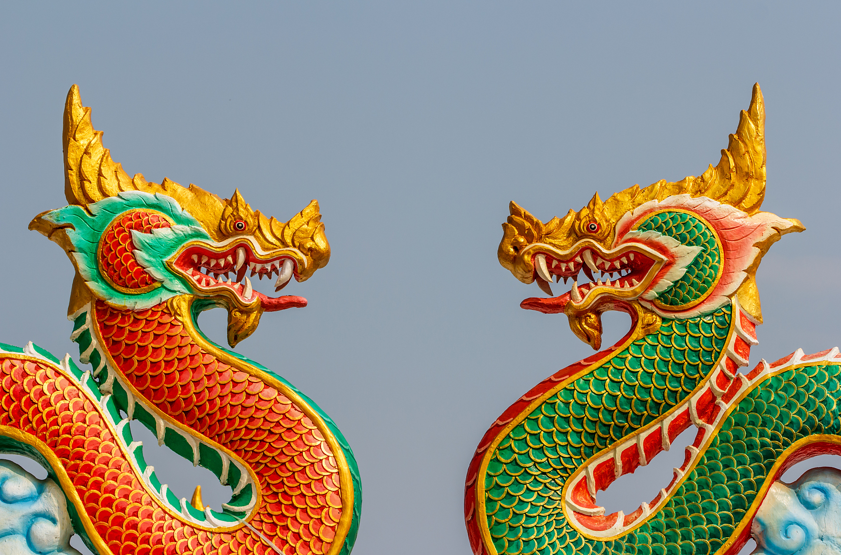
Chinese Dragon
Notes:
test

Slide 2
The History of the Chinese Dragon

Slide 3
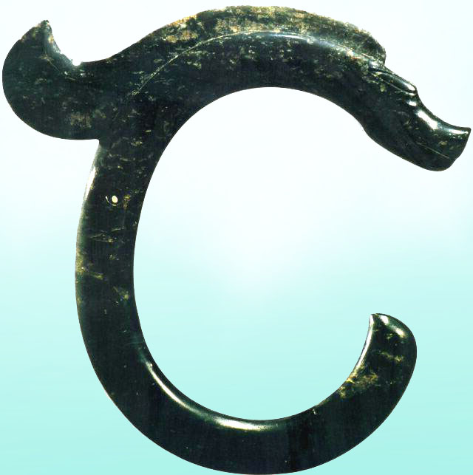
Neolithic ( about 5000 years ago )
Notes:
The C-shaped jade totem of Hongshan culture (c. 4700–2920 BC)

Slide 4
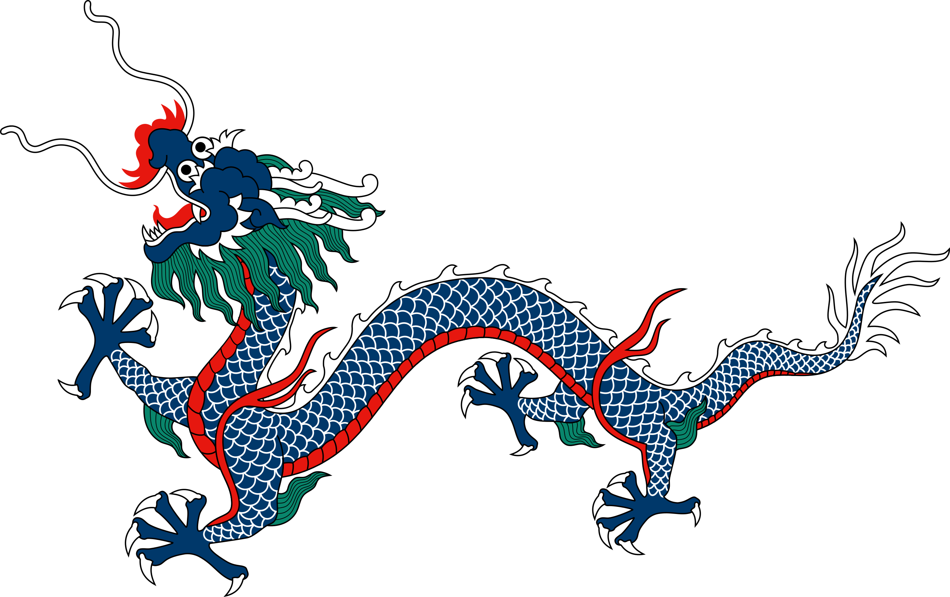
The Azure Dragon depicted on the flag of the Qing dynasty

Slide 5
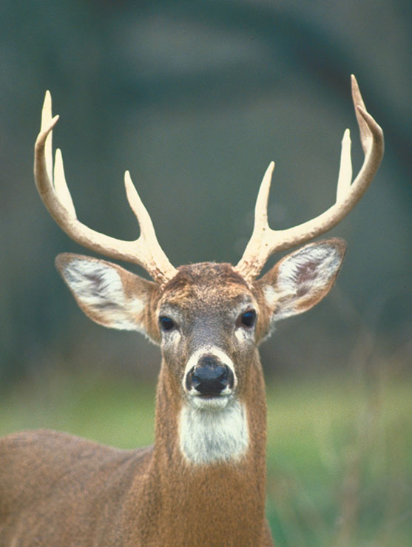


Slide 6
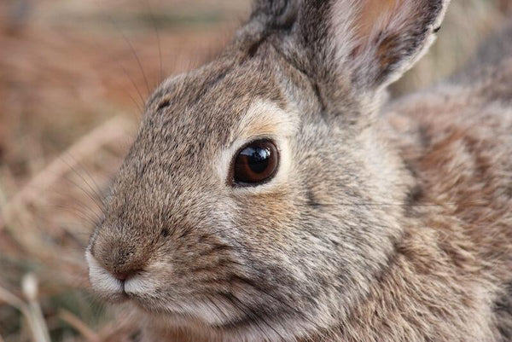
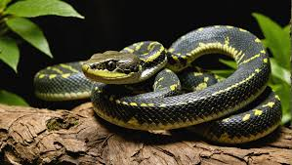

Slide 7
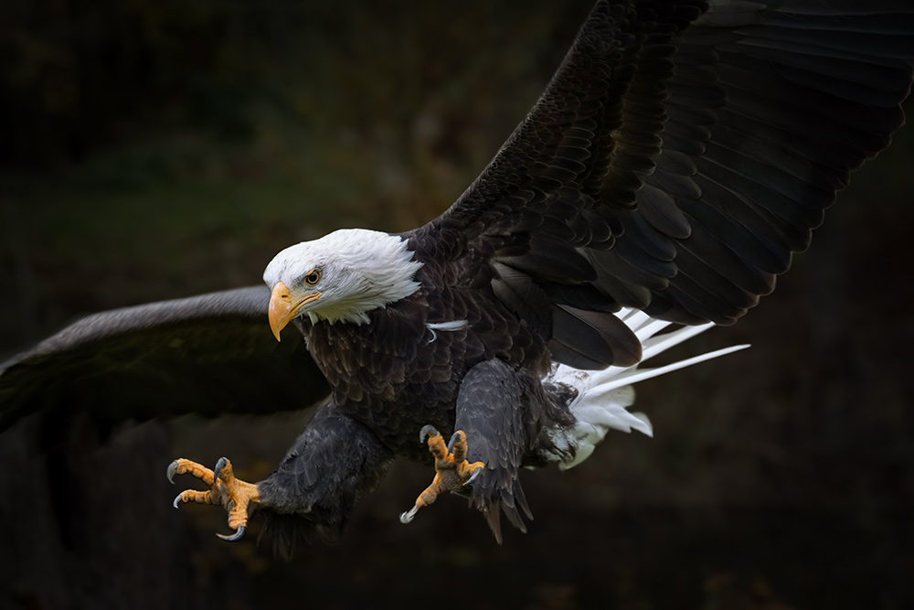
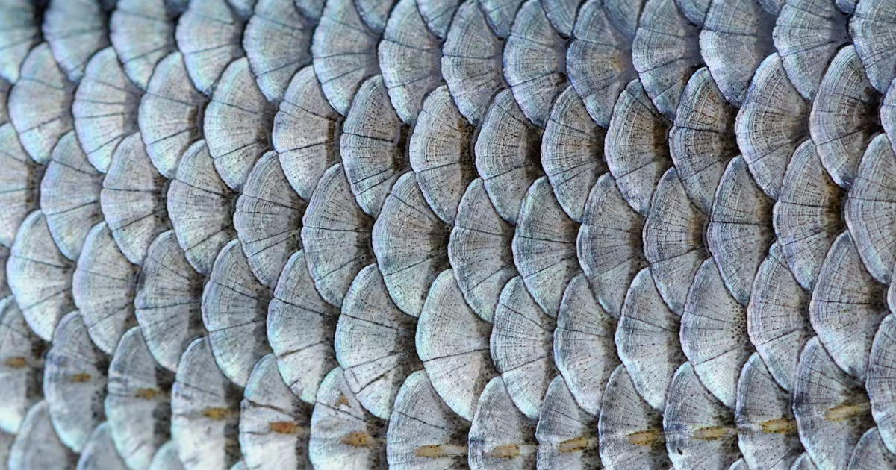

Slide 8

A tiger’s paws

Slide 9


Slide 10
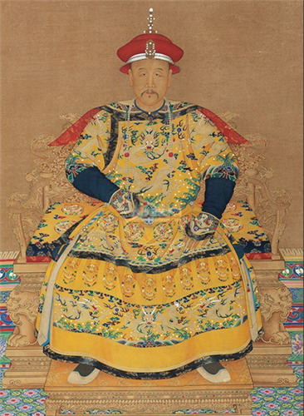
A Qing emperor's dragon robe

Slide 11
The Chinese Dragon in Global Cinema

Slide 12

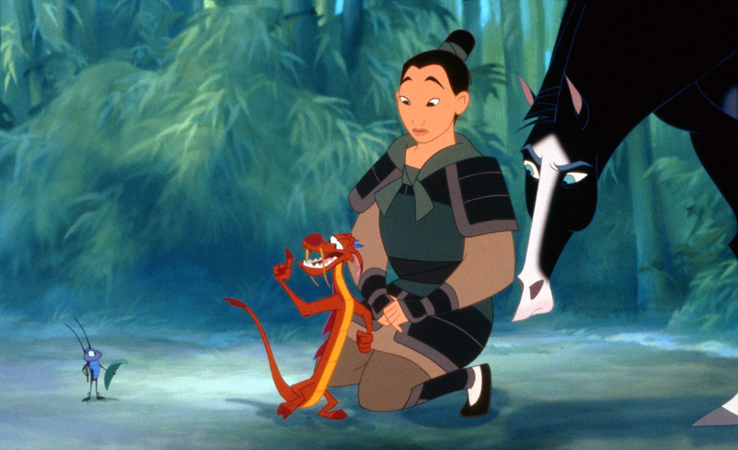
Mushu
木須

Slide 13

Kung Fu Panda

Slide 14

Crouching Tiger, Hidden Dragon (2000)

Slide 15

Long Chenchen

Slide 16


Slide 17


Slide 18
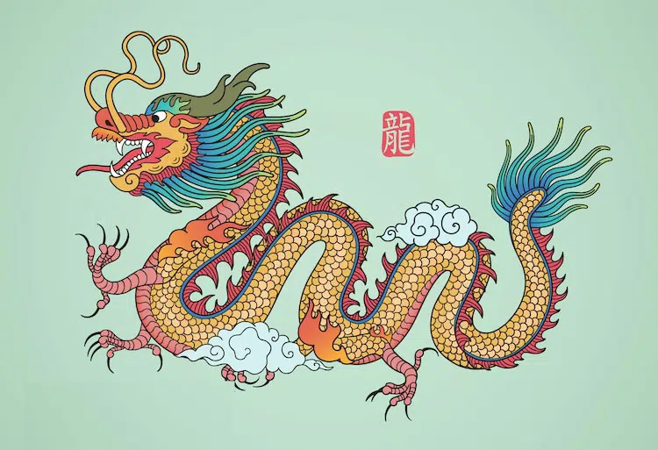
Thank you!

