Slide 1

仕进制度：中国传统选拔官员方式
The official selection system: Traditional Chinese way of selecting officials
夏蓉-Sharon
2024.12.11
Notes:
Generate By BIYOO ChatPPT.
HomePage：www.chat-ppt.com
AIGC 2024/12/11 18:15:12
[AI生成内容仅供参考，请注意甄别准确性]

Slide 2

Contents
1
历史演变 Historical Evolution
2
科举制度 Imperial Examination System
3
社会影响 Social Impacts
4
现代启示 Modern Enlightenment
Notes:
Generate By BIYOO ChatPPT.
HomePage：www.chat-ppt.com
AIGC 2024/12/11 18:15:12
[AI生成内容仅供参考，请注意甄别准确性]

Slide 3
壹
Historical Evolution
Notes:
Generate By BIYOO ChatPPT.
HomePage：www.chat-ppt.com
AIGC 2024/12/11 18:15:12
[AI生成内容仅供参考，请注意甄别准确性]

Slide 4
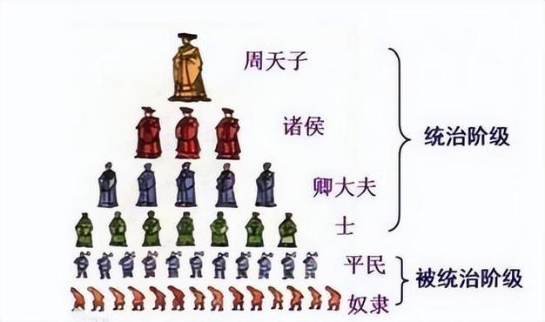
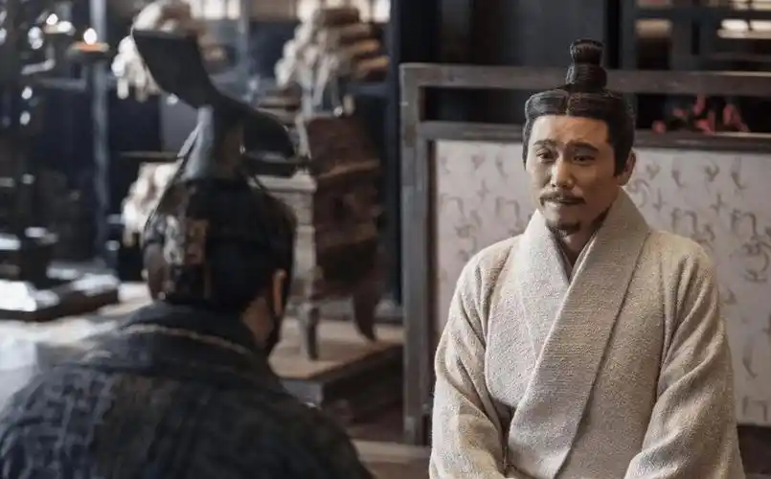
历史演变
Historical evolution
Western Zhou Dynasty
Spring and Autumn and Warring-States Periods
The earliest official selection system can be traced back to the Western Zhou Dynasty, when the selection of officials was mainly through hereditary and recommendation systems.
With the contention of the feudal states, there emerged a trend of "supporting scholars,"or “alien minister” where scholars obtained official positions by persuading the lords.
Notes:
Generate By BIYOO ChatPPT.
HomePage：www.chat-ppt.com
AIGC 2024/12/11 18:15:12
[AI生成内容仅供参考，请注意甄别准确性]

Slide 5
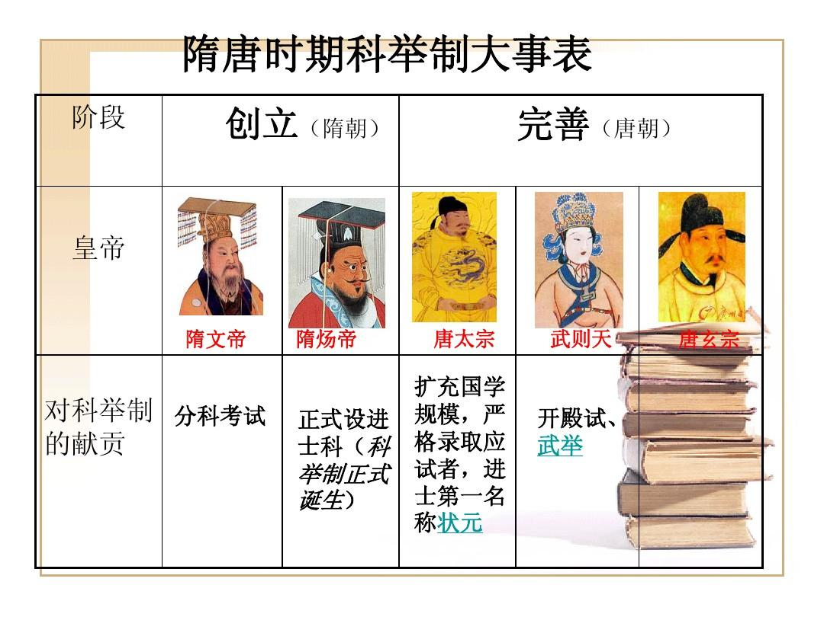
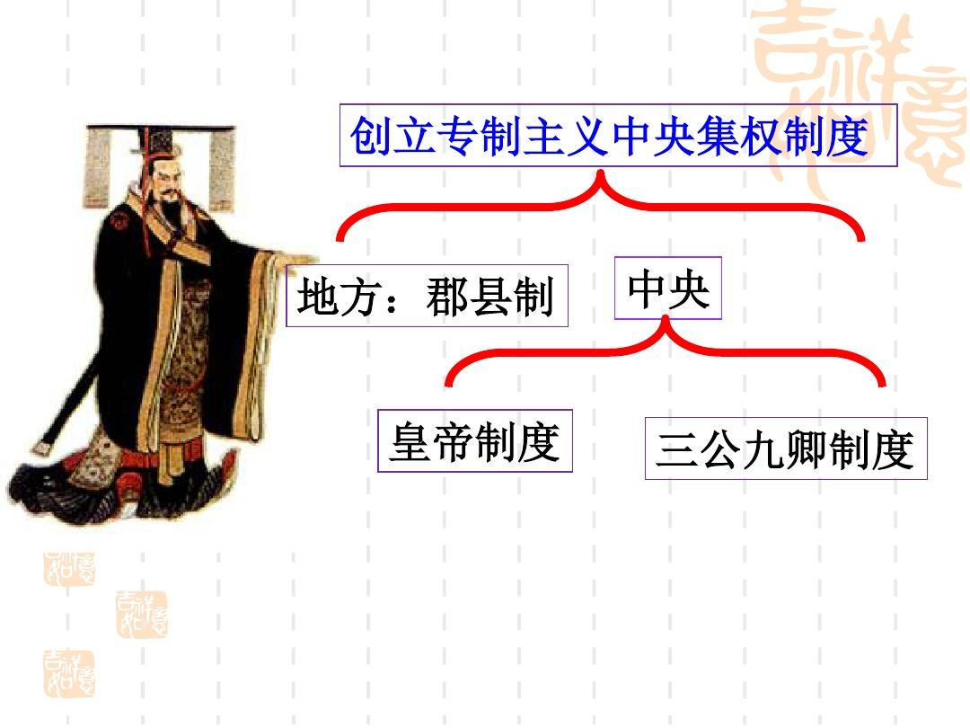
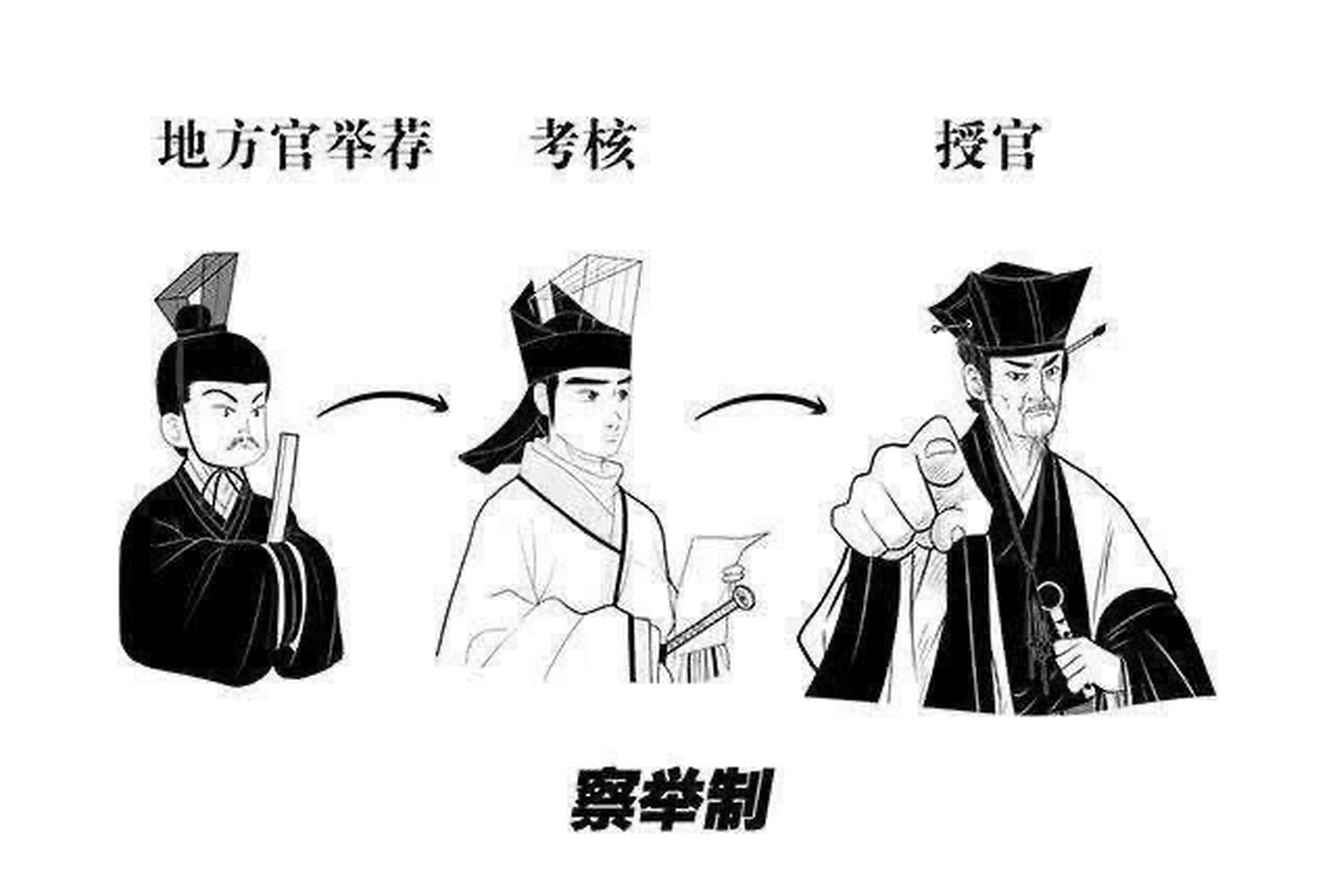
历史演变
Historical evolution
Qin and Han Dynasties
Sui and Tang Dynasties
The Qin Dynasty implemented the county system, where officials were directly appointed by the central government. The Han Dynasty developed the recommendation system, selecting talents through local recommendations and central examinations.
During the Sui and Tang Dynasties the imperial examination system was established, marking the peak of the ancient Chinese official selection system. Officials were selected through examinations, breaking the limitations of heredity and powerful clans.
Notes:
Generate By BIYOO ChatPPT.
HomePage：www.chat-ppt.com
AIGC 2024/12/11 18:15:12
[AI生成内容仅供参考，请注意甄别准确性]

Slide 6
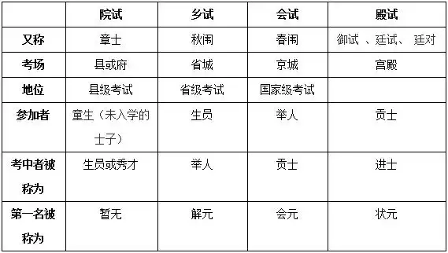
历史演变
Historical evolution
Song, Yuan, Ming, and Qing Dynasties
The imperial examination system was further developed and perfected, becoming the main pathway for selecting officials.
Notes:
Generate By BIYOO ChatPPT.
HomePage：www.chat-ppt.com
AIGC 2024/12/11 18:15:12
[AI生成内容仅供参考，请注意甄别准确性]

Slide 7
贰
Imperial Examination System
Notes:
Generate By BIYOO ChatPPT.
HomePage：www.chat-ppt.com
AIGC 2024/12/11 18:15:12
[AI生成内容仅供参考，请注意甄别准确性]

Slide 8
Imperial Examination System
01
02
three-tiered examination system
examination subjects
The traditional Chinese Imperial Examination System consisted of preliminary selection, provincial examinations (乡试), and metropolitan examinations (会试) in three distinct levels, with each level filtering candidates rigorously to ensure a strict selection process, such as the provincial examination pass rate often being below 5%.
The subjects covered classics, policy discussions, and poetry, completely assessing knowledge and abilities, with many classic subjects drawn from the Four Books and Five Classics.
selection process
Special Selections Encourage Diligence
The process of selection advanced step by step from the preliminary round to the metropolitan examinations, ultimately identifying the elite among the candidates, with only a small fraction of those who took the metropolitan exams being admitted.
Scholars from humble backgrounds could transcend social classes and achieve promotion through the imperial examination system. For instance, Zhang Juzheng of the Ming Dynasty, who originated from a poor family, eventually became a renowned minister.
03
04
Notes:
Generate By BIYOO ChatPPT.
HomePage：www.chat-ppt.com
AIGC 2024/12/11 18:15:12
[AI生成内容仅供参考，请注意甄别准确性]

Slide 9
叁
Social Impacts
Notes:
Generate By BIYOO ChatPPT.
HomePage：www.chat-ppt.com
AIGC 2024/12/11 18:15:12
[AI生成内容仅供参考，请注意甄别准确性]

Slide 10
Social Impact
Enhance Cultural Popularization：
The imperial examination system fostered a culture of reading, with the Song Dynasty seeing more than ten thousand scholars achieving the Jinshi degree, thereby promoting the widespread dissemination of cultural knowledge among the populace.
Reducing Corruption Phenomena:
The fair selection mechanism, such as the imperial examination system, effectively curbed official corruption. During the Ming and Qing dynasties, with millions of candidates taking the imperial examinations, the number of corruption cases relatively decreased.
Maintaining Social Stability:
A fair selection system leads to a high level of public trust in the government. After the implementation of the imperial examination system in the Tang Dynasty, the periods of social unrest were significantly shortened.
Inheriting Confucian Culture:
The imperial examination system focused on Confucian classics as its main content, leading to a significant increase in the number of Confucian scholars after the Song Dynasty, which allowed Confucian culture to penetrate various social strata.
Notes:
Generate By BIYOO ChatPPT.
HomePage：www.chat-ppt.com
AIGC 2024/12/11 18:15:12
[AI生成内容仅供参考，请注意甄别准确性]

Slide 11
肆
Modern Enlightenment
Notes:
Generate By BIYOO ChatPPT.
HomePage：www.chat-ppt.com
AIGC 2024/12/11 18:15:12
[AI生成内容仅供参考，请注意甄别准确性]

Slide 12
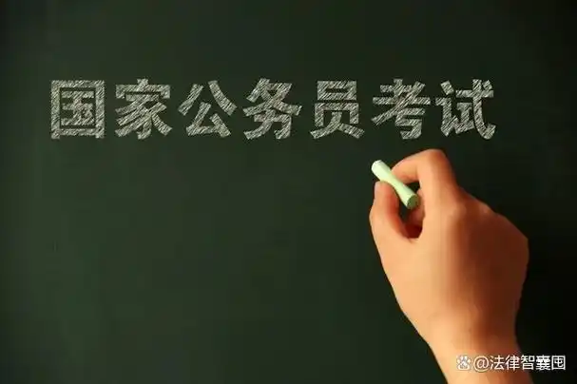
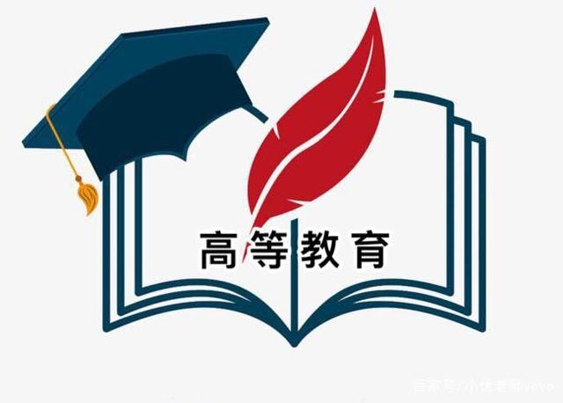
Modern Enlightenment
Fair Competition Promotes Selection Justice
Talent Cultivation Fuels Social Development
The imperial examination system selected officials through standardized examinations, ensuring fair competition. Modern selection systems have adopted this principle to enhance transparency and fairness, such as in civil service examinations.
The ancient selection system placed emphasis on nurturing talent, such as through the education in academies, providing intellectual support for modern society. For instance, the higher education system cultivates high-quality talents, propelling scientific and technological innovation.
Notes:
Generate By BIYOO ChatPPT.
HomePage：www.chat-ppt.com
AIGC 2024/12/11 18:15:12
[AI生成内容仅供参考，请注意甄别准确性]

Slide 13
谢谢观看
Thank You！
夏蓉-Sharon
2024.12.11
Notes:
Generate By BIYOO ChatPPT.
HomePage：www.chat-ppt.com
AIGC 2024/12/11 18:15:12
[AI生成内容仅供参考，请注意甄别准确性]

