Slide 1

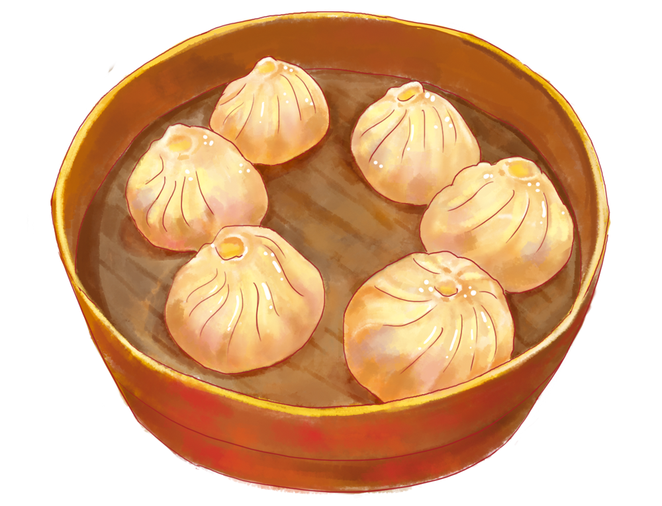
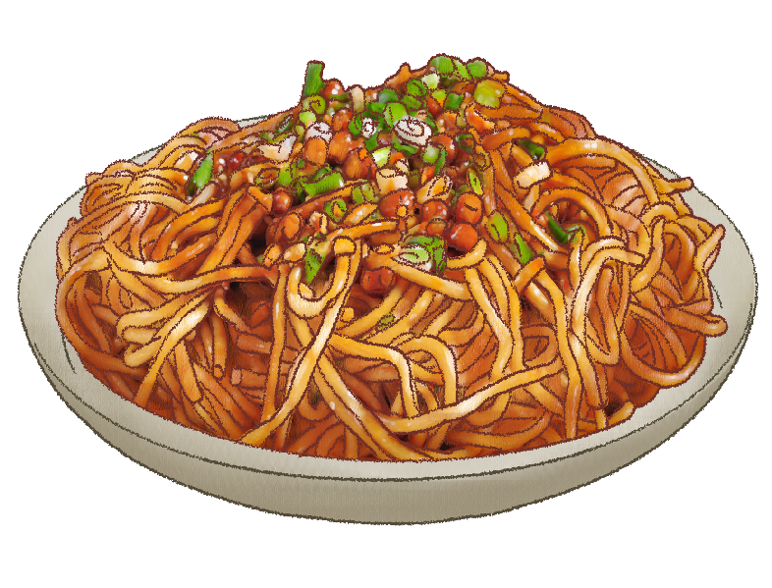
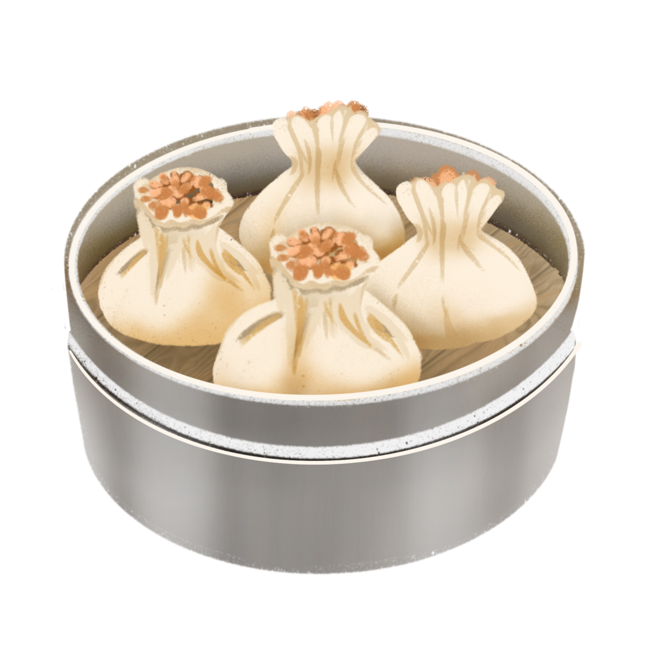
Breakfast Culture
of Wuhan
Liu Peini

Slide 2
What is "guozao" in Wuhan?
「过早」是湖北地区对吃早餐的俗称，包括武汉、荆州、黄石等地。这个词汇最早出现在《汉口竹枝词》，是清代道光年间的作品。
受历史和地理位置的影响，武汉码头文化早在明代就初具规模，到清代到达鼎盛并且延续至今，而武汉独特的「过早」文化也应运而生。这种文化源于码头工人基于自身工作特点而对早餐的一种需求，他们需要高热量的食物在短时间内补充体力，以满足早起的工作。因此，高碳水高热量的特色早点和边走边吃的饮食习惯也在武汉这座城市延续至今。

Slide 3
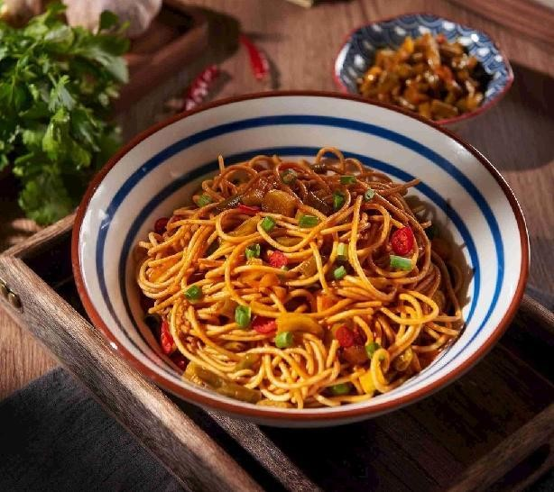
热干面 Hot Dry Noodles
The noodles are cooked in a mixture of water and sesame oil, cooled, tossed and warmed in the same mixture right before serving. The process results in a delicious serving of noodles which are coated with a strong sesame flavor. Vendors use different elements such as peanut or sesame oil, soy sauce, and chili to create their signature hot dry noodles.

Slide 4
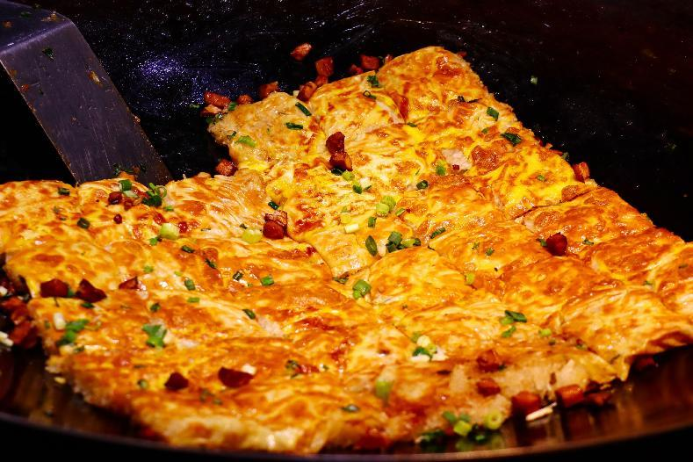
豆皮 Bean Pies
A thin, crispy wrap made from bean curd filled with sticky rice and various savory fillings like pork and mushrooms.

Slide 5
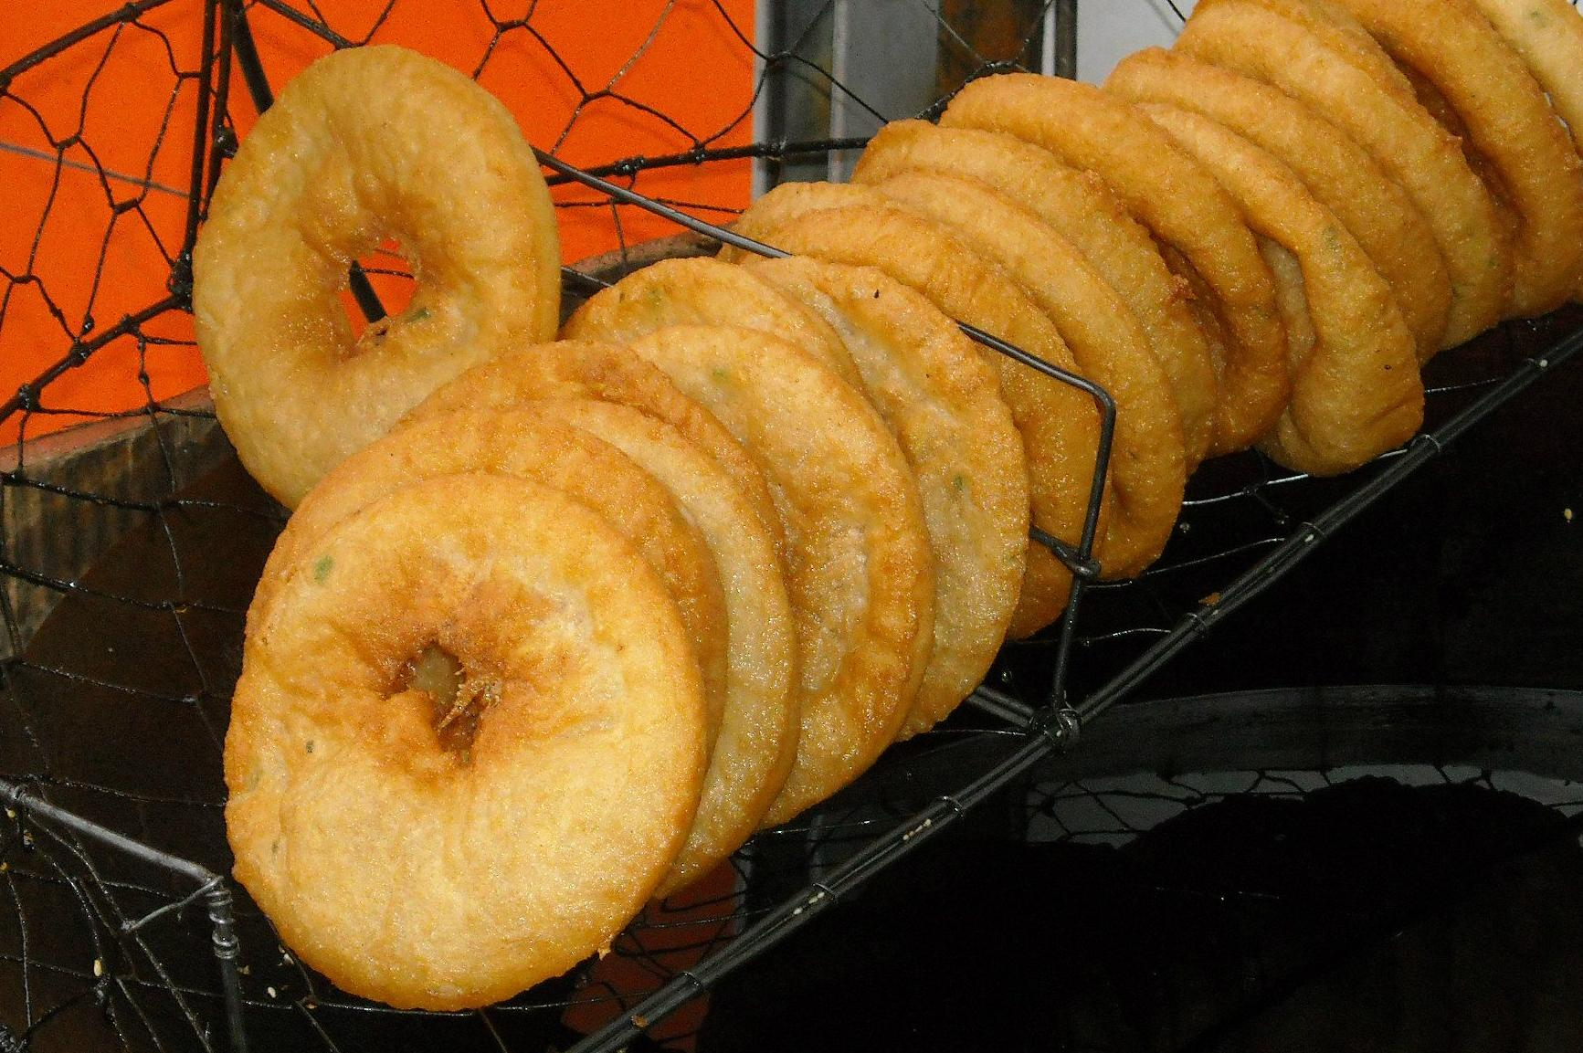
面窝 Fried Rice Buns
Made from a batter of rice and soybeans, it is deep-fried into a round, ring-shaped cake with a crispy, lacy edge and a soft, slightly chewy center.

Slide 6
Challenges in Translation
1、语言层面
Terminological Uniqueness: Many food names are dialect terms and have no direct English equivalents.
2、文化认知差异
Cultural Context Deficiency: The Western concept of "breakfast" lacks a similar level of cultural depth or profound connotations.

Slide 7
Translation Skills
[Transliteration+annotation]
热干面:
hot dry noodles → reganmian (Wuhan’s iconic sesame-paste noodles)
面窝：
fried rice buns → mianwo (fried rice buns)

Slide 8
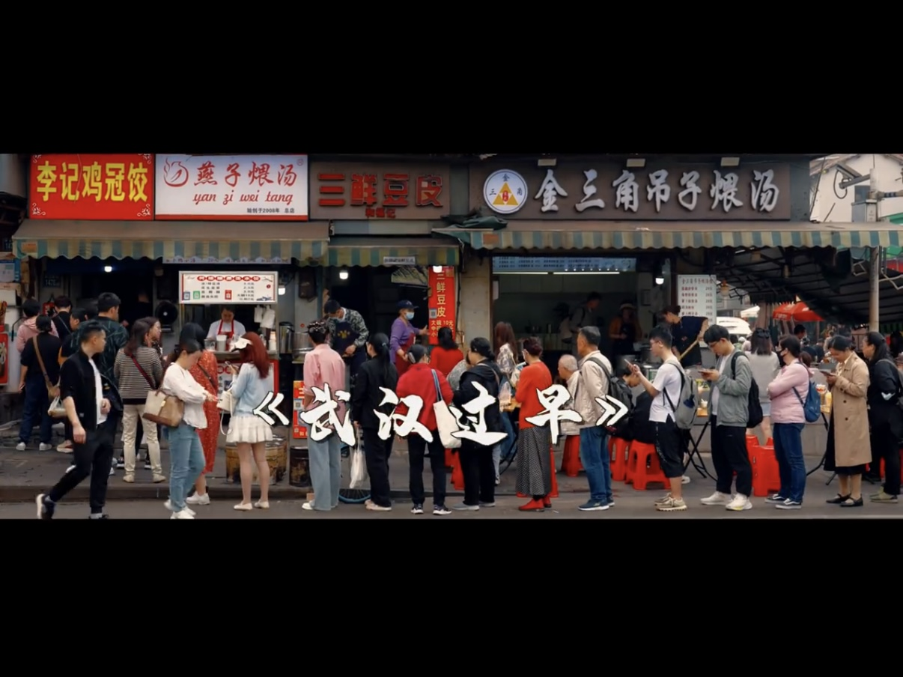
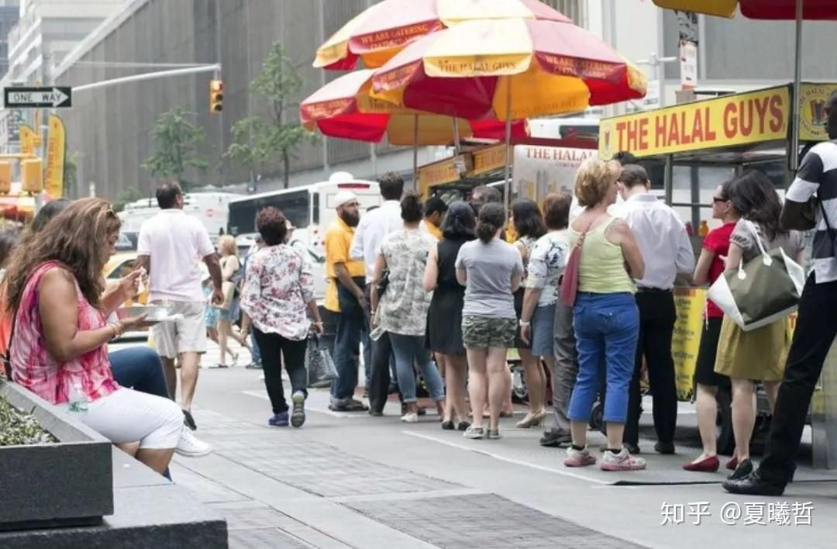
[Analogy of Culture]
"GuoZao" is a cherished tradition where locals flock to bustling streets lined with vendors serving hot, fresh breakfast dishes.
The atmosphere is lively, with people eating on the go or standing by small tables, creating a sense of community and shared culinary heritage.
New York’s “grab-and-go” food carts provide a quick, on-the-go meal option for busy urbanites. Iconic trucks serve everything from gourmet tacos and artisanal coffee. The scene is fast-paced, with people grabbing meals between work or errands, embodying the city's hustle and diversity.

Slide 9
Thank you

