Slide 1

Chinese Dialects
Long Jiayu
Tara

Slide 2


What is a dialect?
Social Phenomenon
Regional Branch
Standard Language
Unique Pronunciation, Vocabulary, Grammar

Slide 3
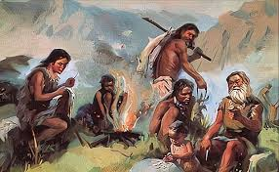
The Origin of Dialects
Different
Geographical Location
Natural Environment
Lifestyle
Productivity
&
Population
Tribes
&
Ethnic Groups
Languages
Dialects

Slide 4
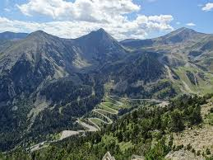
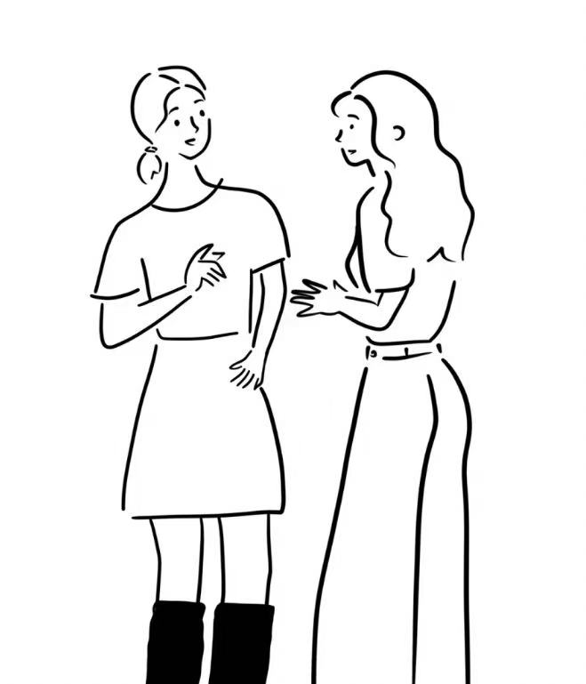
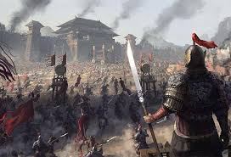
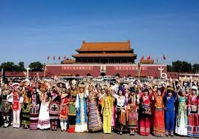
“十里不同音”
Geographical differences
Historical changes
Ethnic integration

Slide 5
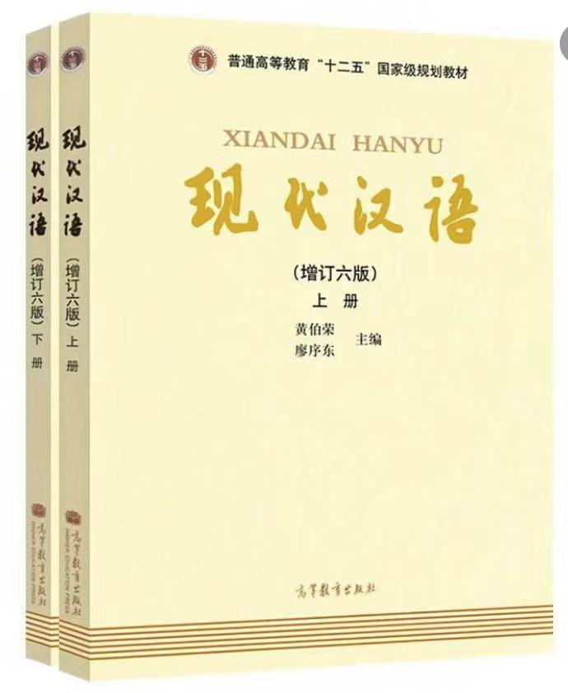
Classification of Chinese Dialects
Seven Dialect Groups:
1. Northern Chinese Dialect
2.Yue Dialect (Cantonese)
3. Min Dialect
4. Xiang Dialect
5. Hakka
6. Gan Dialect
7. Wu Dialect
266

Slide 6


Chinese Dialects Listening Test
Listen to the recording and choose the correct answer from A, B, or C.

Slide 7
Northern Chinese Dialects
1. A large number of speakers/2. Wide distribution/3. Long history
>900 million
73%

Slide 8
Northern Chinese Dialects
1. A large number of speakers/2. Wide distribution/3. Long history
Four sub-dialects
Northeastern dialects
Northwestern dialects
Southwestern dialects
Jianghuai dialects (lower reaches of the Yangtze River dialects )

Slide 9
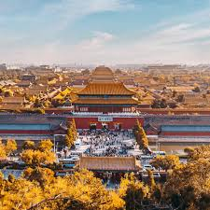
Northern Chinese Dialects
1. A large number of speakers/2. Wide distribution/3. Long history
Northern Chinese Dialect
VS.
“雅言”

Slide 10
Yue Dialect (Cantonese)
Guangdong&Guangxi
Southeast Asia such as Vietnam, Singapore, Malaysia, Indonesia
Overseas Chinese communities in Australia, New Zealand, the United States
Qin dynasty
“Yayan”
Song dynasty
Qing dynasty

Slide 11


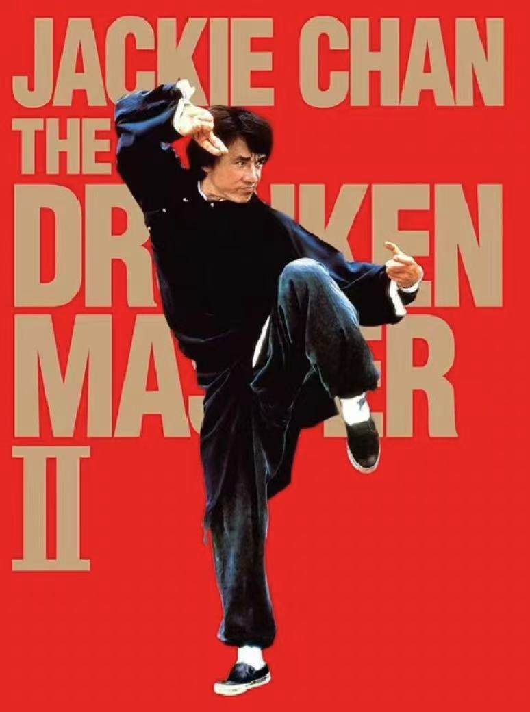
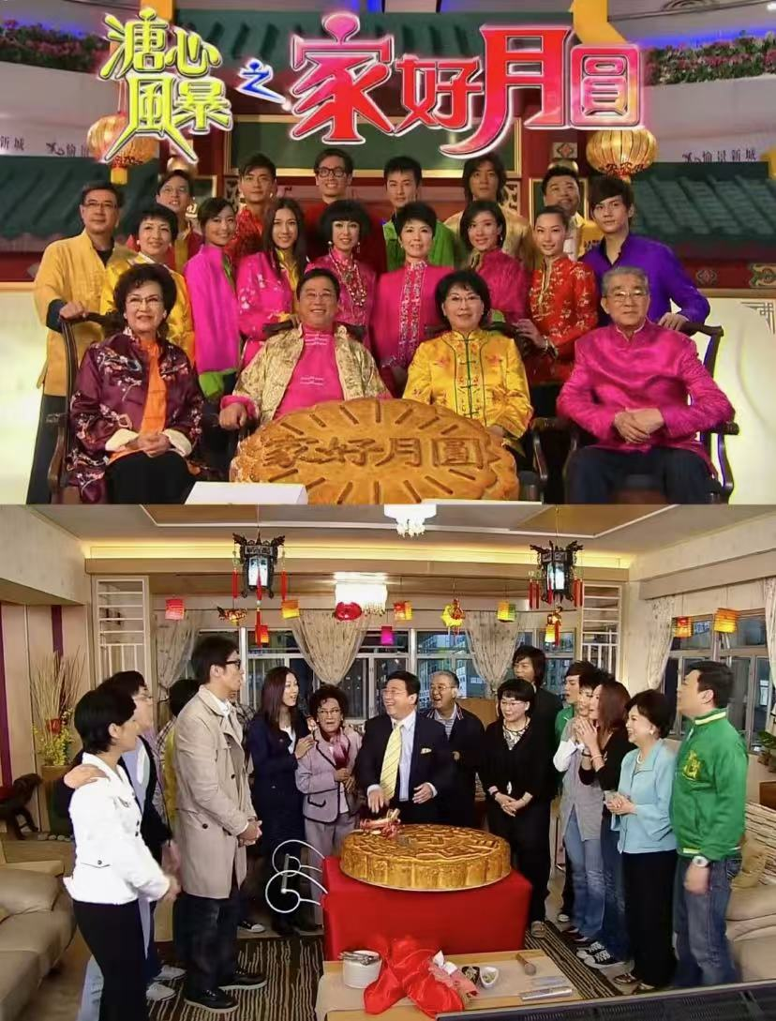
>120 million

Slide 12

Min Dialect
Guangdong&Fujian&Hainan&Zhejiang…
1. Wu dialect (Jiangsu/Zhejiang)＋ local dialects (Fujian）
Two combinations
2. Yayan (Central Plains)＋ local dialects (Fujian）

Slide 13
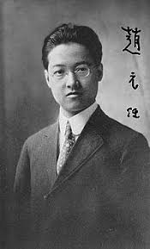
Father of Modern Chinese Linguistics
33 Chinese dialects ＋ seven languages
Mathematics as his major? Cornell ?
What is his greatest joy in life?
Visited Changsha for three times

Slide 14
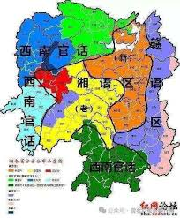
Xiang Dialect
Shuangfeng
Hengyang
Shaoyang
Loudi
The harder? The closer?

Slide 15

Preserving Dialects is Our Responsibility
1955
Jinhua city, Zhejiang province
6-14
52%
22%

Slide 16
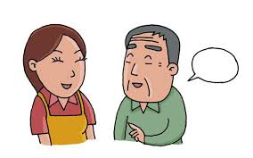

How?
Inefficient
Before
Three years
Collection of 1.5 million dialect sentences
Recognition for 23 dialects
Translation for 2 dialects
Now

Slide 17

Dialects serve as carriers of regional culture, rich in historical information.
They are not only tools for daily communication but also reflect regional characteristics.
Respect
Cherish
Say it out loud!

