Slide 1


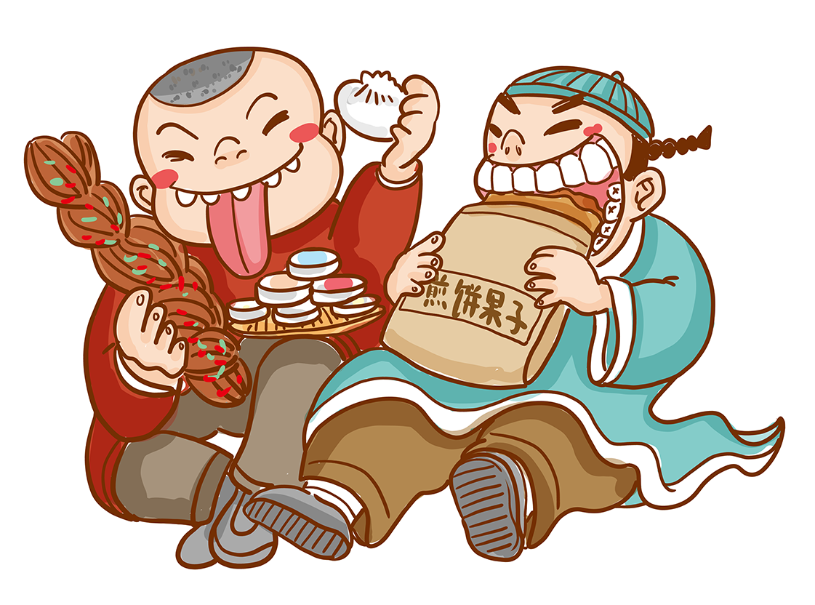
03
Latiao from Hunan

Slide 2
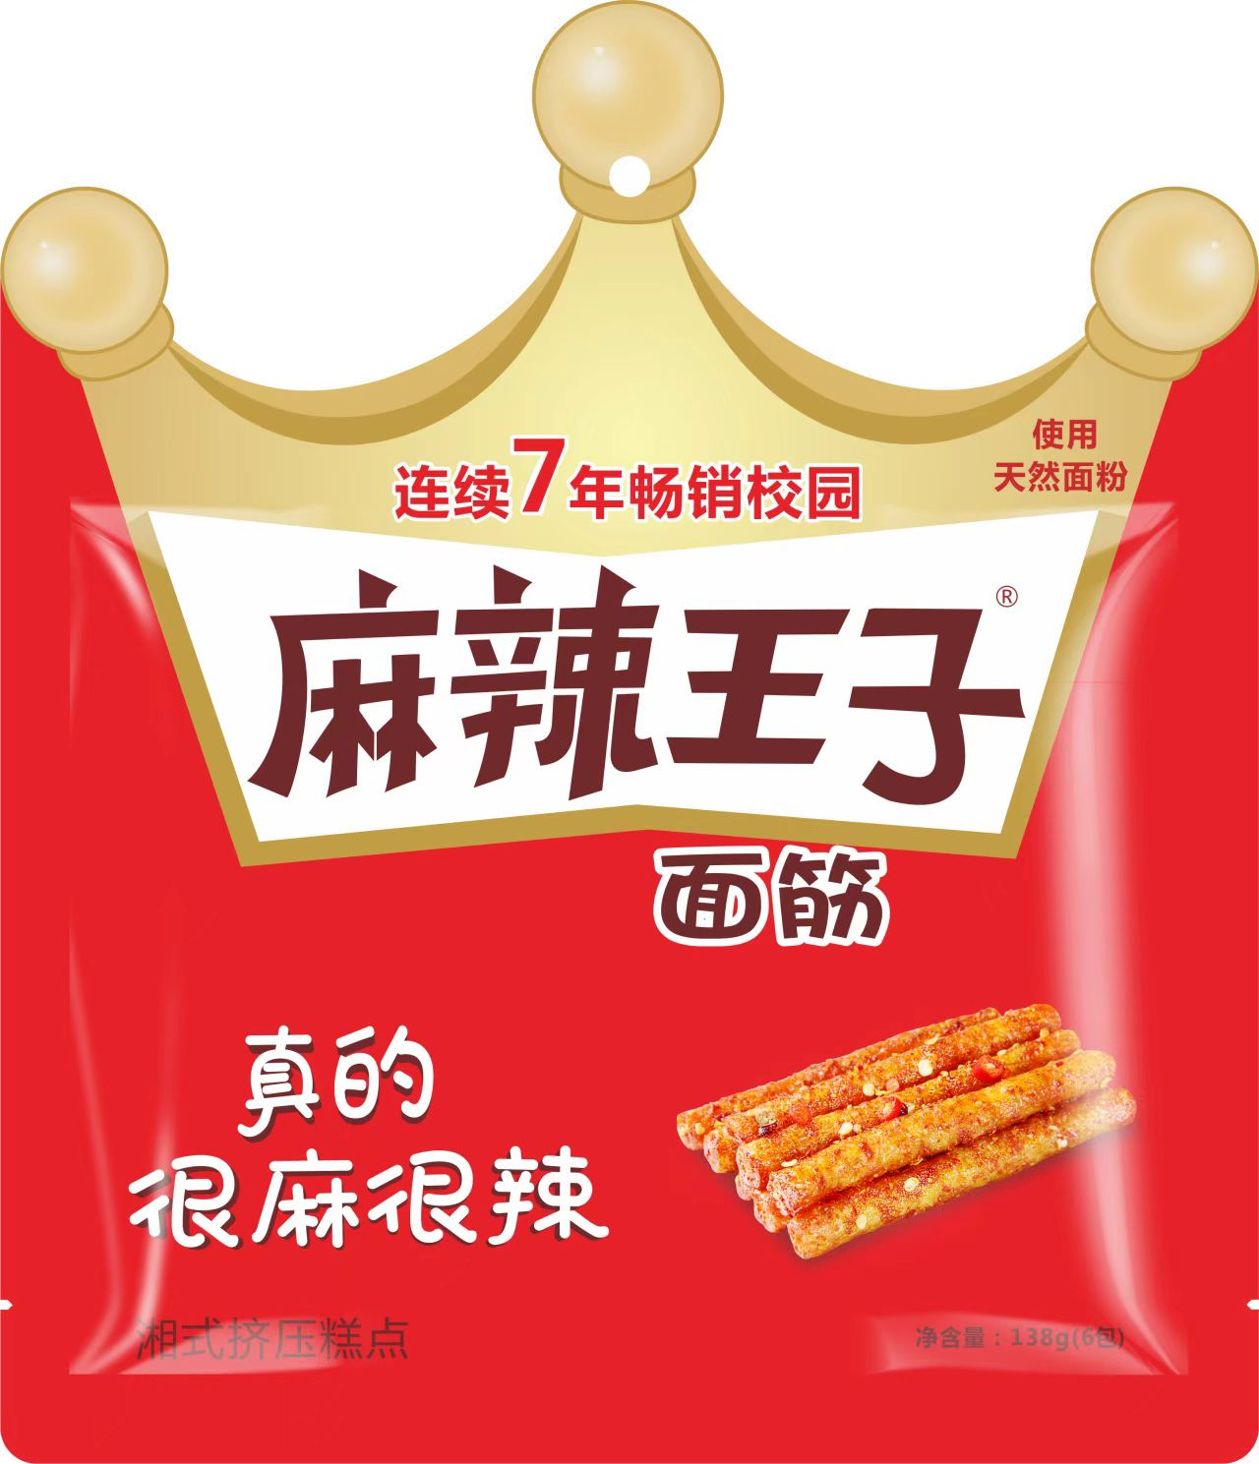
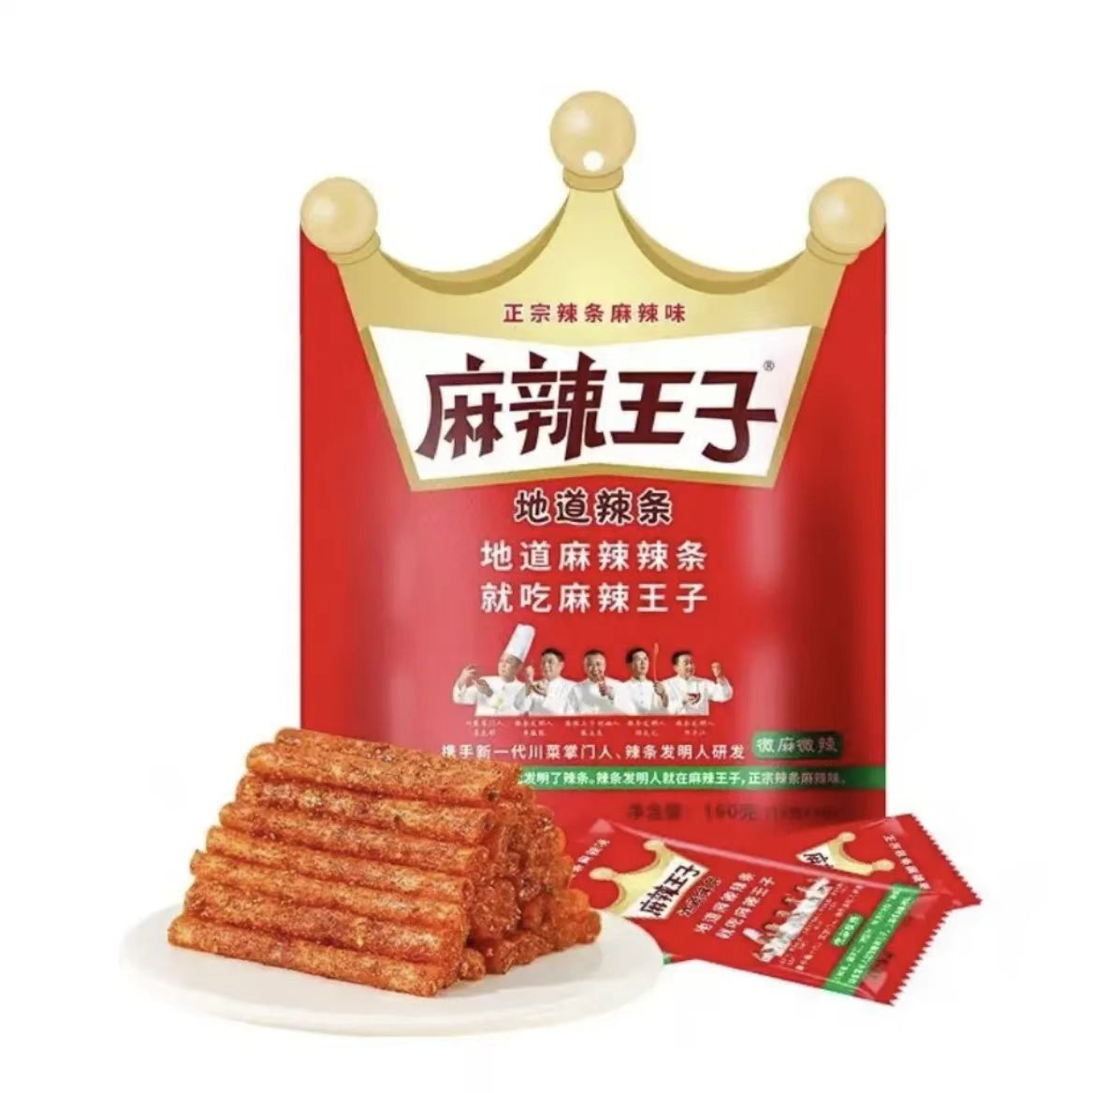
Spicy Prince
Main ingredients: wheat flour; chili; edible salt
Key steps: dough mixing, pressing, frying, seasoning and packaging
Feature: spicy flavor, a soft yet chewy texture
and vibrant color
Pingjiang

Slide 3
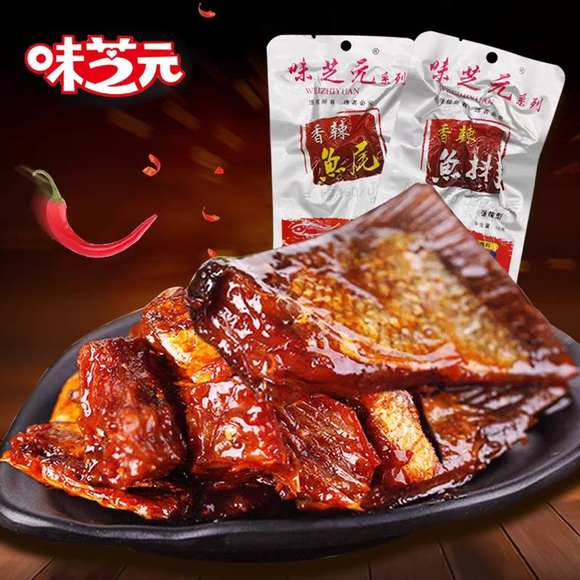
Weizhiyuan Fish Fillet
Ingredient: fresh fish from the Dongting Lake
Purpose: to ensure the quality and freshness of the fish
Key steps: smoke and marinate
Purpose: to remove the fishy taste; to make the fish fillet
tender and a unique flavor
Feature: spiciness and a distinctive smoky flavor
Yiyang

Slide 4
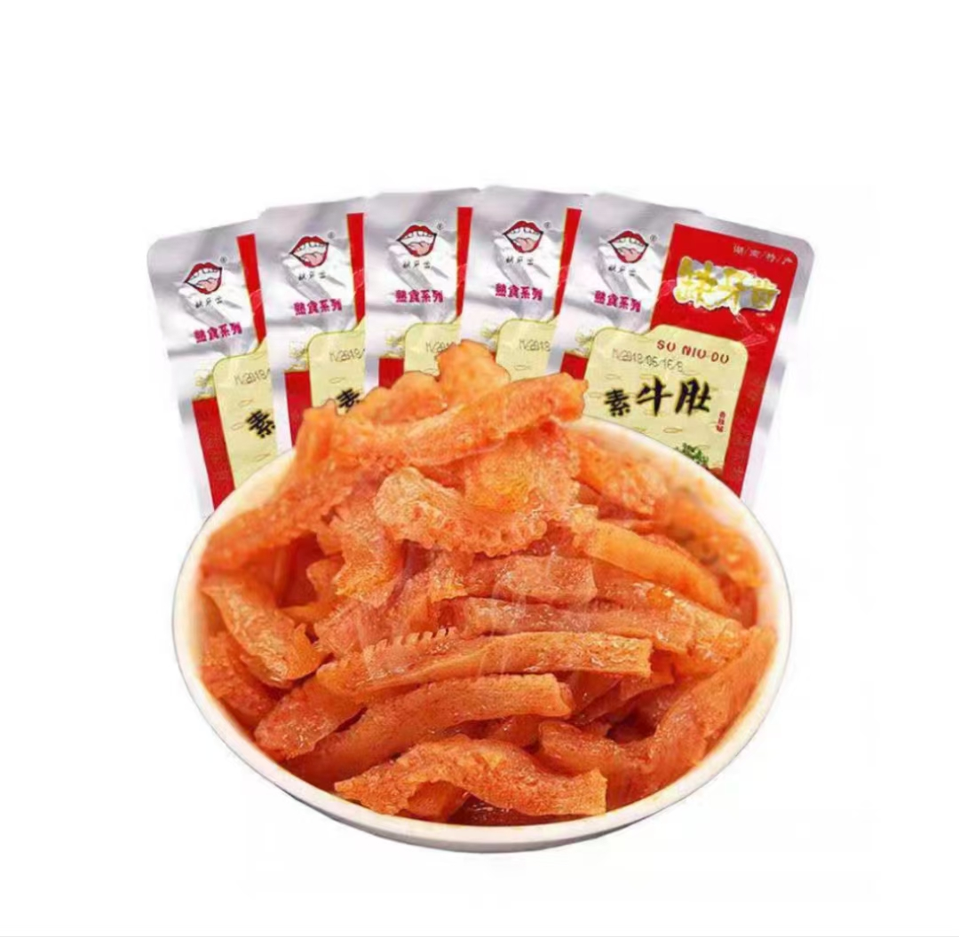
Queyachi
A konjac-based product
Main ingredients: konjac flour, soy protein and wheat protein
Feature: the texture and flavor of tripe; low-calorie and low-fat; spiciness
Yiyang

Slide 5
04
Interaction

Slide 6
Rules
Number: 3 students
Requirement: a packet of Latiao (Queyachi); within the shortest time; 不嘶哈
Prize: Spicy Prince（一大包麻辣王子）

Slide 7
Thank you
for your listening!

