Slide 1
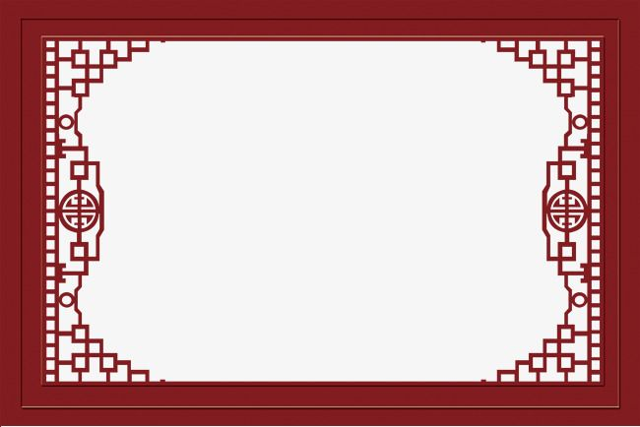
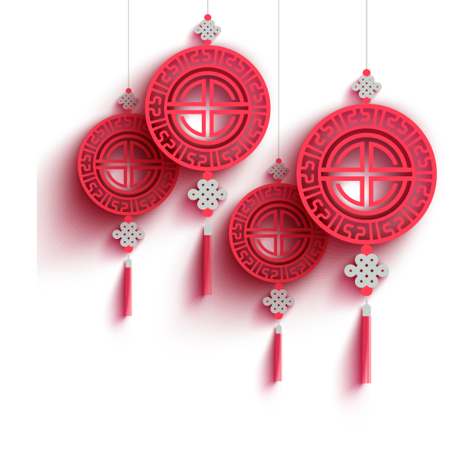
The Chinese Red Envelope and Lucky Money Tradition
汤惠 4.14

Slide 2
Introduction
In Chinese and other East and Southeast Asian societies, Red Envelopes are popular gifts.
Holidays or special occasions or festivals such as weddings, graduation, senior people's birthday parties or the birthday of a child, visit a newborn baby
The Lunar New Year Festival
"worldwide peace" “longevity and fortune”
Translation
红包：Red Envelope/Red Packet/Luckey Money/Li Shi(利是、利事)
天下太平："worldwide peace"
千秋万岁：“longevity and fortune”

Slide 3


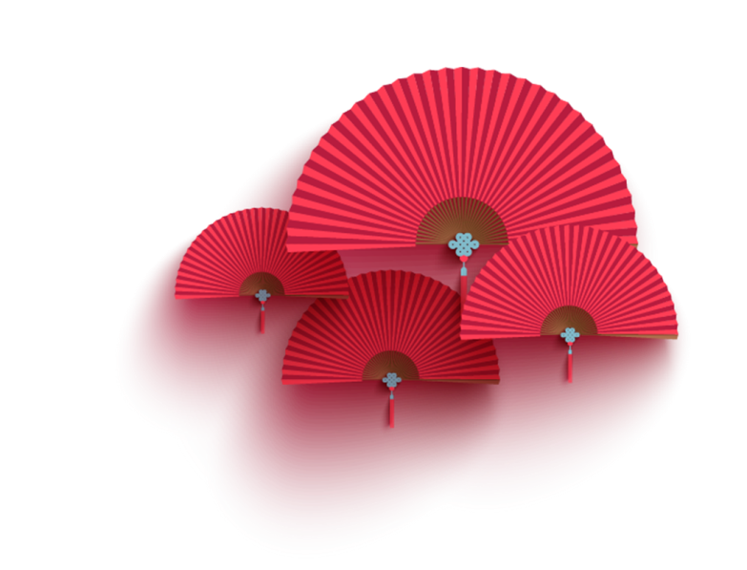
Contents
壹
壹
The Legend
壹
贰
The Tradition
壹
叁
Alipay and WeChat Red Envelope
壹
肆
Outside of China

Slide 4
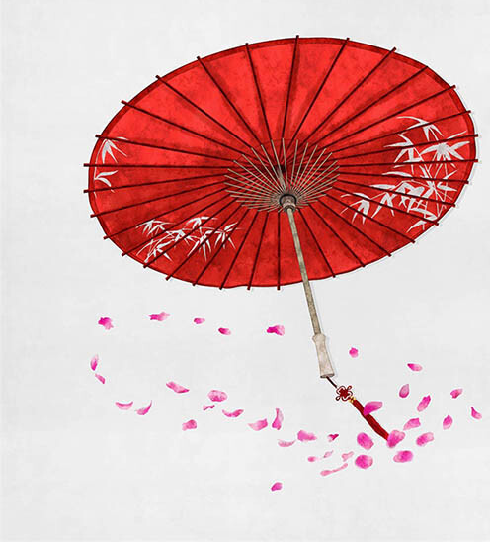
壹
壹
The Legend

Slide 5
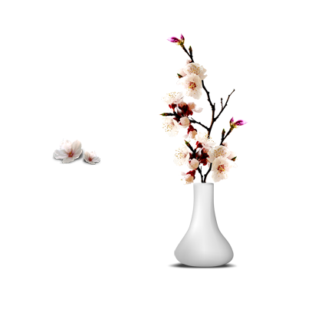
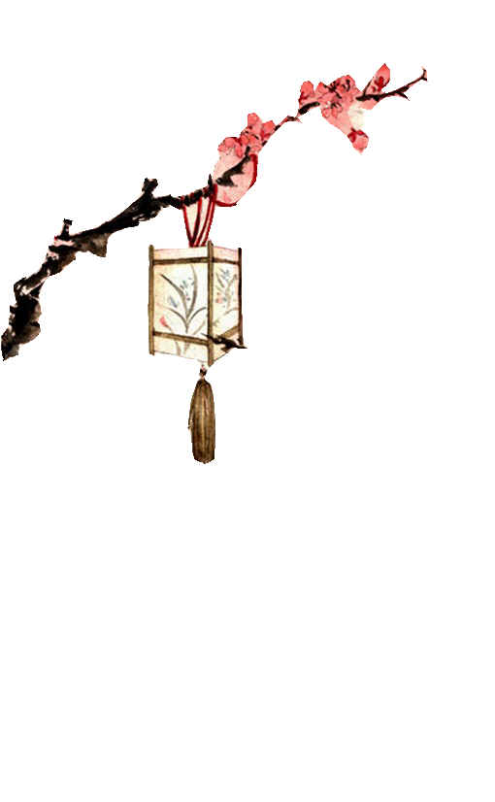
壹
Sui: There was a kind of little demon called Sui in ancient times. Once upon a time, there was a couple had just given birth to a little boy. In that Lunar New Year, 8 fairies visited their house and knew that there would be a monster coming to hurt him. To protect the baby, the 8 faires transformed into 8 coins which were then wrapped in red cloth and laid beside the boy when he was sleeping. Thanks to these coins, which were the fairies, the boy was unharmed by the monster.
壹
壹
Translation
祟：Sui/Ghost
守祟：Shou Sui/stay up all night on New Year’s Eve
贰

Slide 6
壹
贰
The Tradition

Slide 7
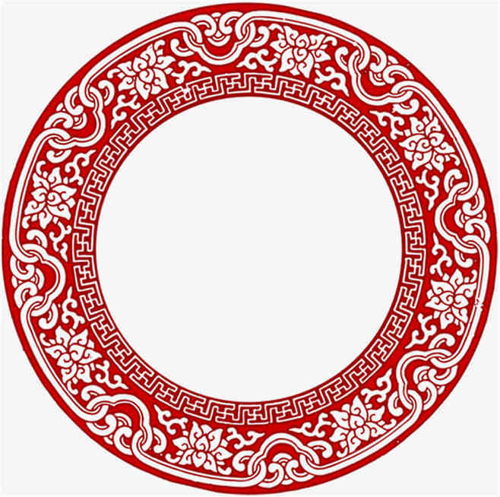
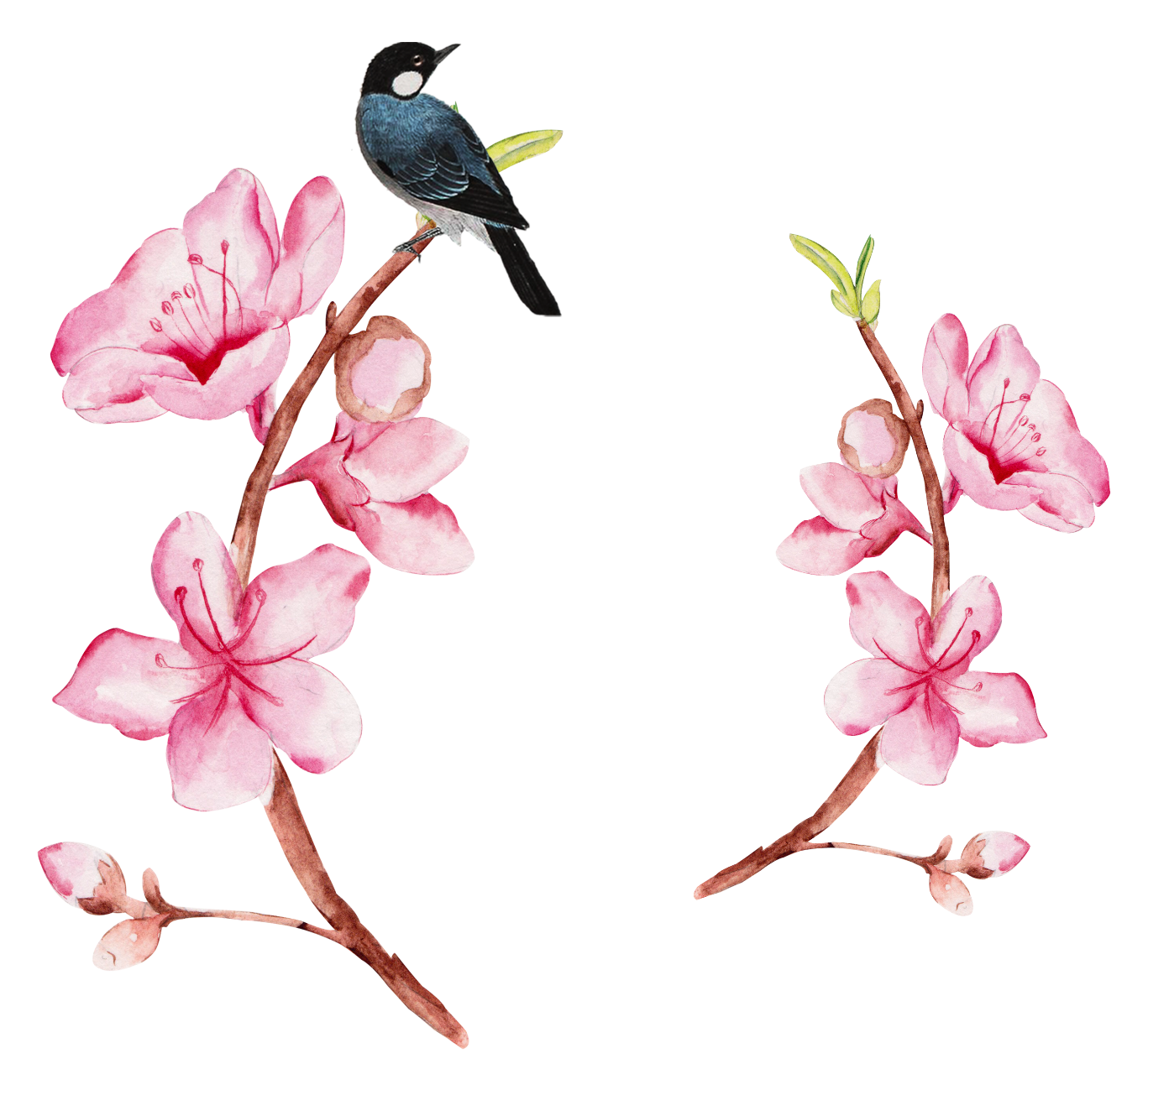
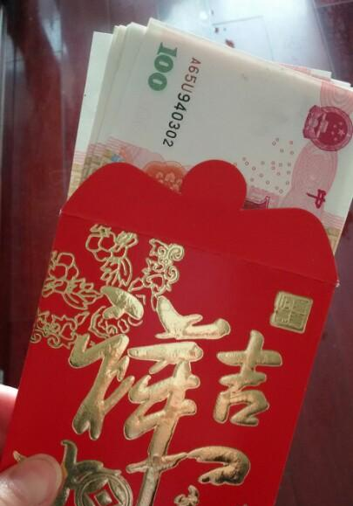
Color
Chinese people really like red, so the Lucky
Money is always red, symbolizing luck and happiness.
Number
Avoid number 4(“死”)
include number 8(“发”)
How to Receive
Kneel to receive
Never open it at once
Translation
压岁钱:
Suppressing Ghosts Money

Slide 8
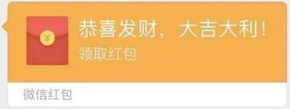
壹
Alipay and WeChat Red Envelope
叁

Slide 9
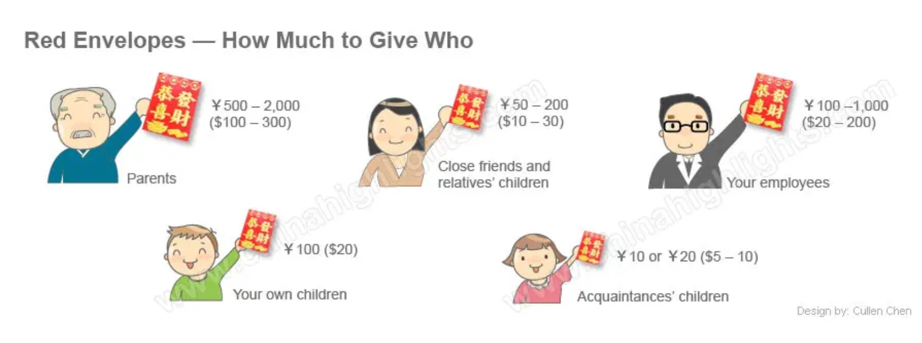
Digital Envelopes
Moving on from the traditional Red Envelope, in the 21st century, many people exchange digital Red Envelopes instead of the traditional paper ones.
01
Users can even send digital Hóngbāo to their favorite celebrities using apps such as Alipay, WeChat and the Weibo Red Envelope.
02
While the tradition centers on children, Red Envelopes are given to friends, family, colleagues and many other relatives.
03

Slide 10
壹
肆
Outside of China

Slide 11
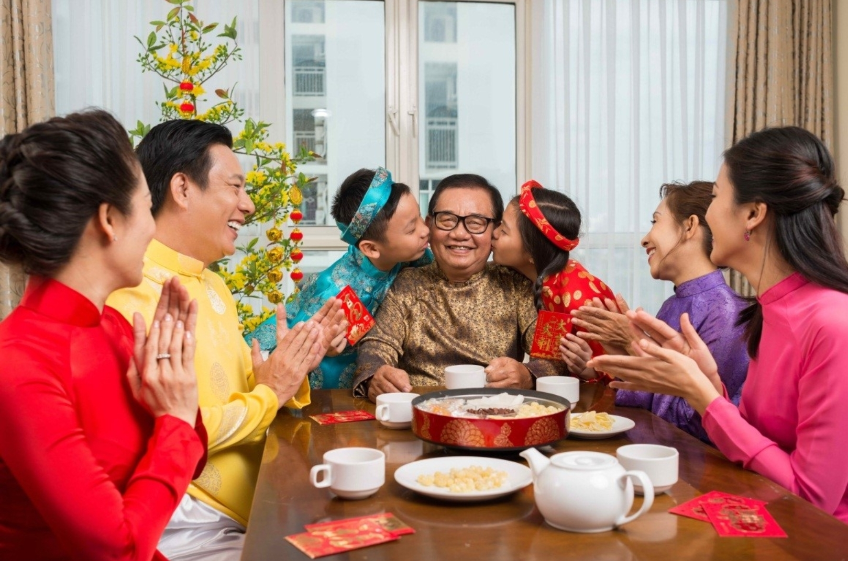
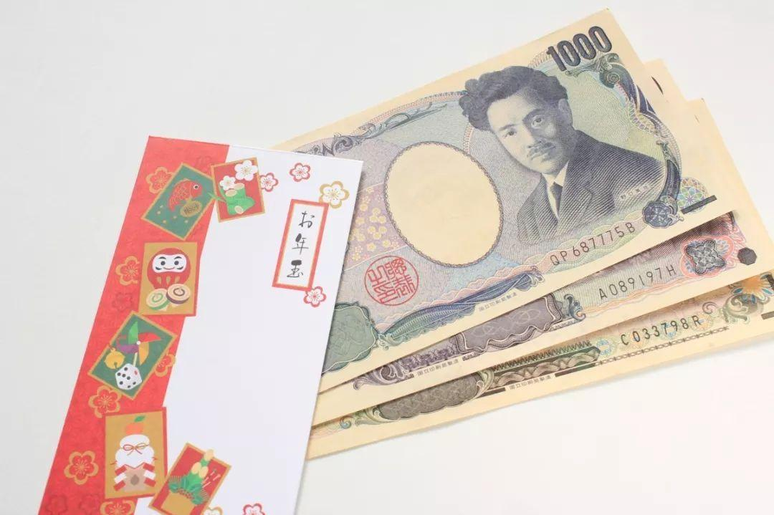
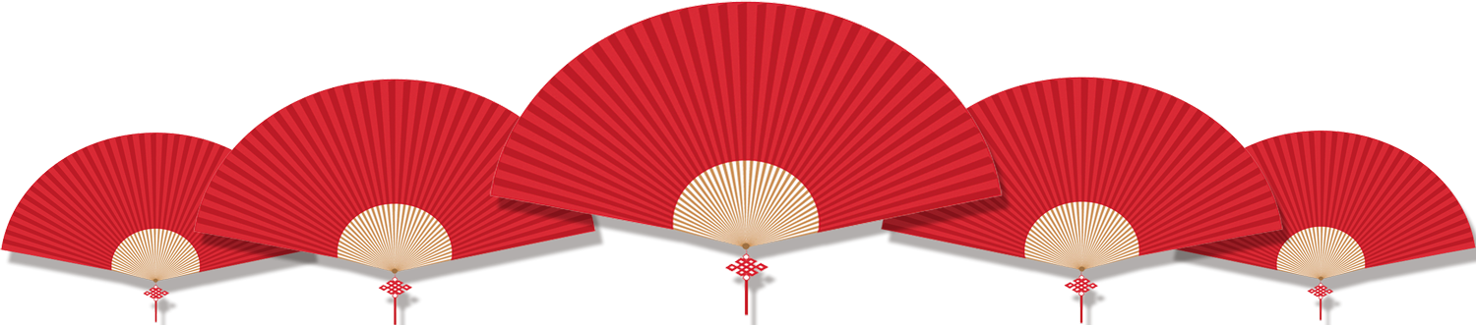
Vietnam
Japan
In Vietnam, Lucky Money is called Lì xì/Tiền mừng tuổi and very typical.
In Japan, Lucky Money is called Otoshidama(お年玉). Unlike other countries, the amount of Japanese Lucky Money depends on the child's age, the relationship of the family.

Slide 12

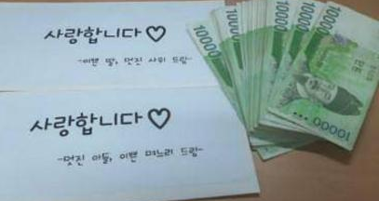
Korea
Islam
In Korea, Lucky Money is called Sabae.
Green Envelope-giving has even become a practice during the Islamic holiday of Eid al-Fitr across Southeast Asia.

Slide 13
Thanks for listening!

