Slide 1

Traditional Chinese Pigments
Cao Yuan

Slide 2

Part 1
History

Slide 3
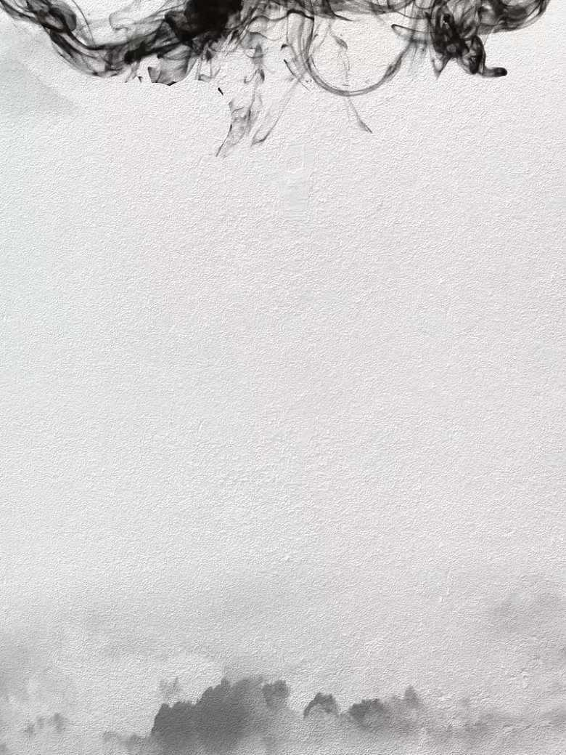
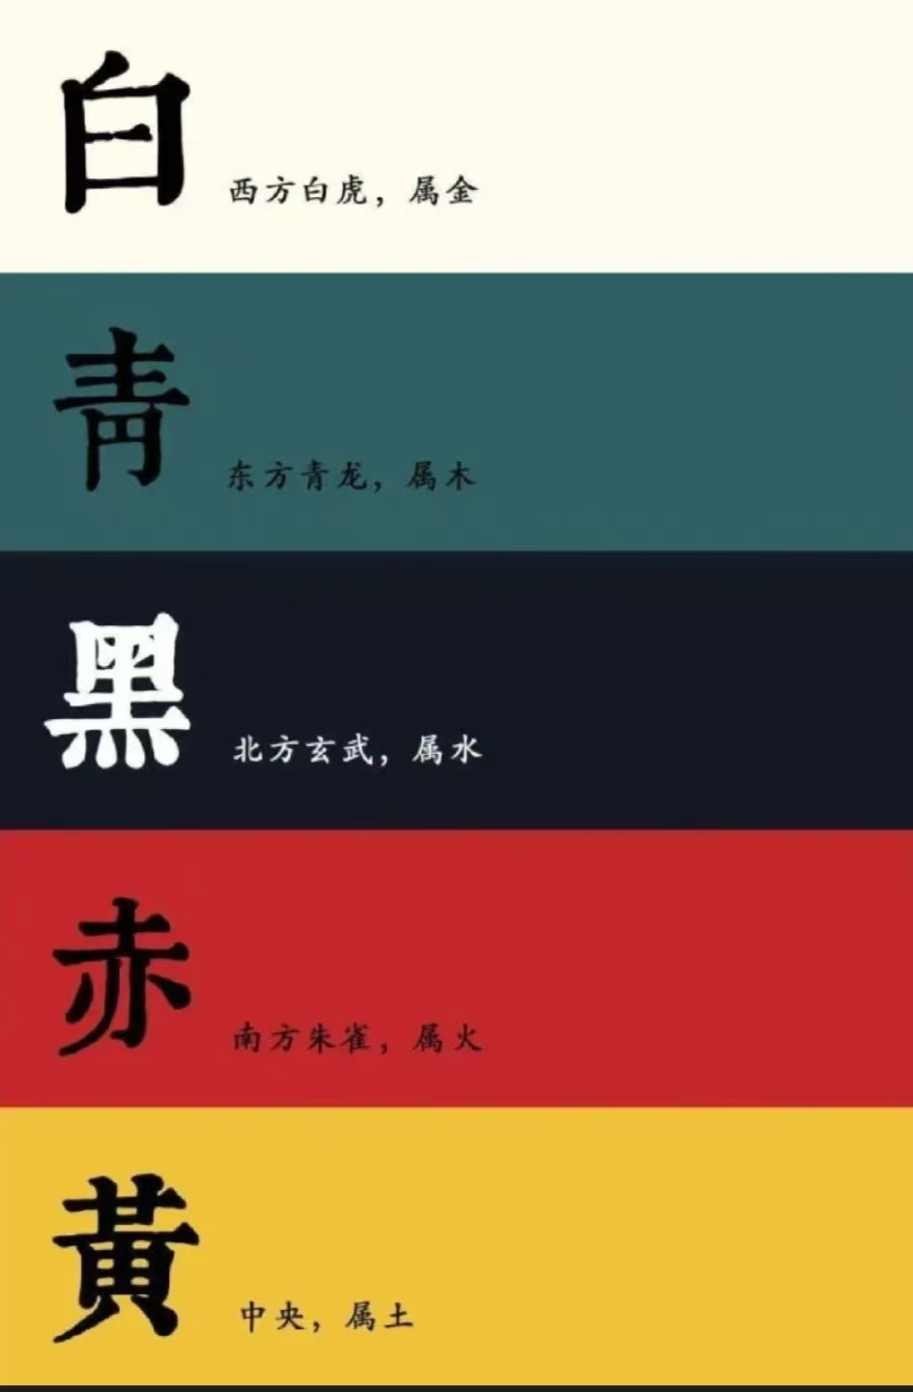
Earliest known records: Emperor Shun(22nd century BC)
White
金
Blue/Green
木
Black
水
Red
火
Yellow
土
Five -color system
based on
Five Elements Philosophy
developed during
Xia, Shang, and Zhou dynasties

Slide 4
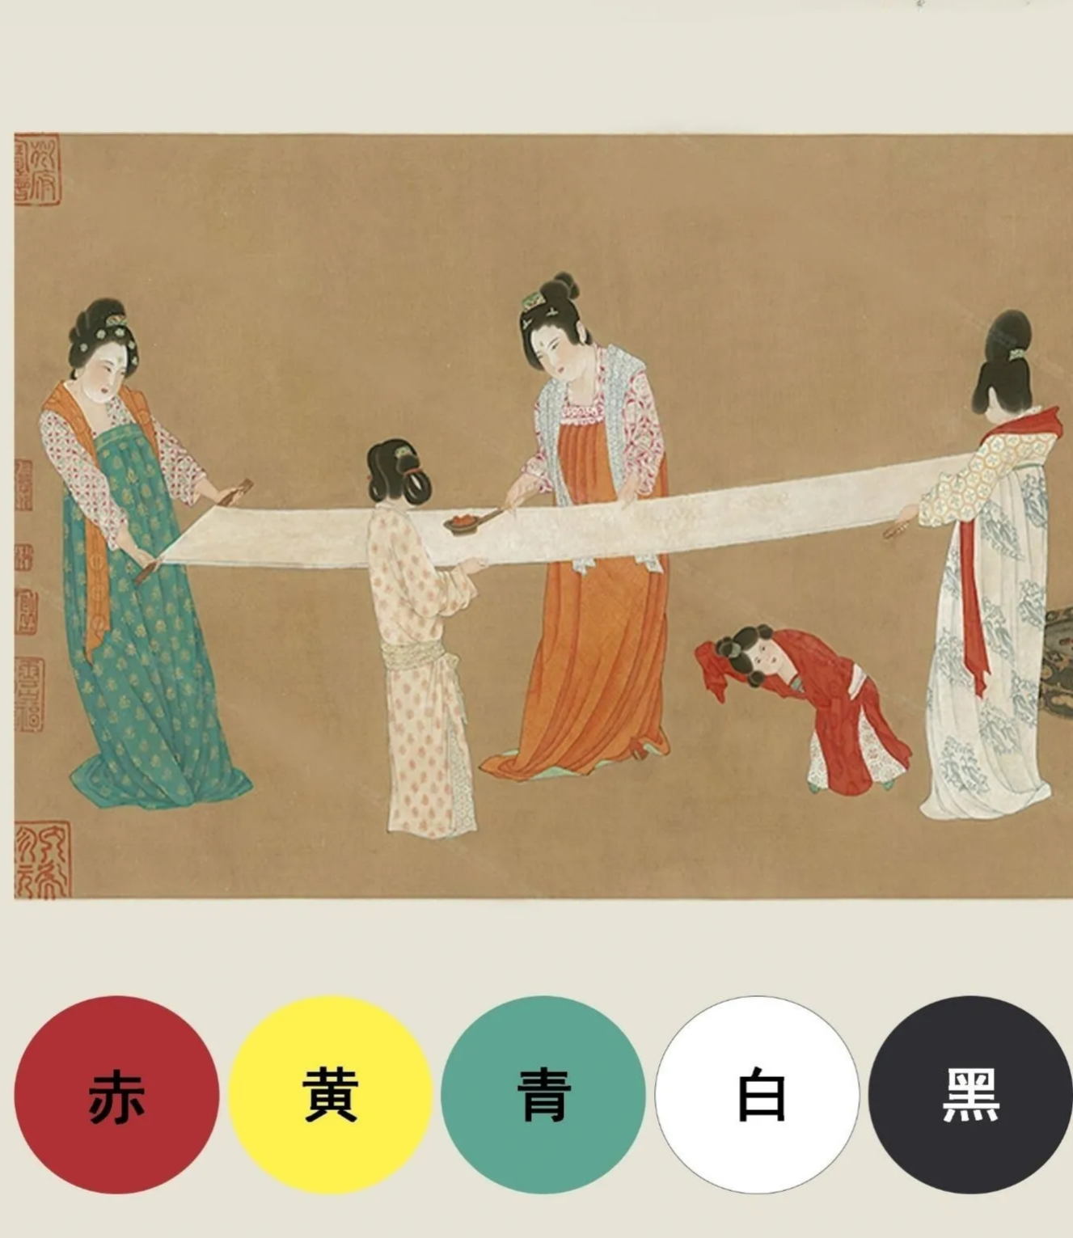
Red: red iron oxide(氧化铁红)，derived from hematite(赤铁矿) and maghemite(磁赤铁矿)，dates back to Paleolithic Age
Yellow:
appeared in Shang Dynasty;
Pre-Qin era: earth yellow; mineral yeallow and realgar(雄黄)
Earliest used yellow pigment in China: earth yellow(or yellow ocher)

Slide 5
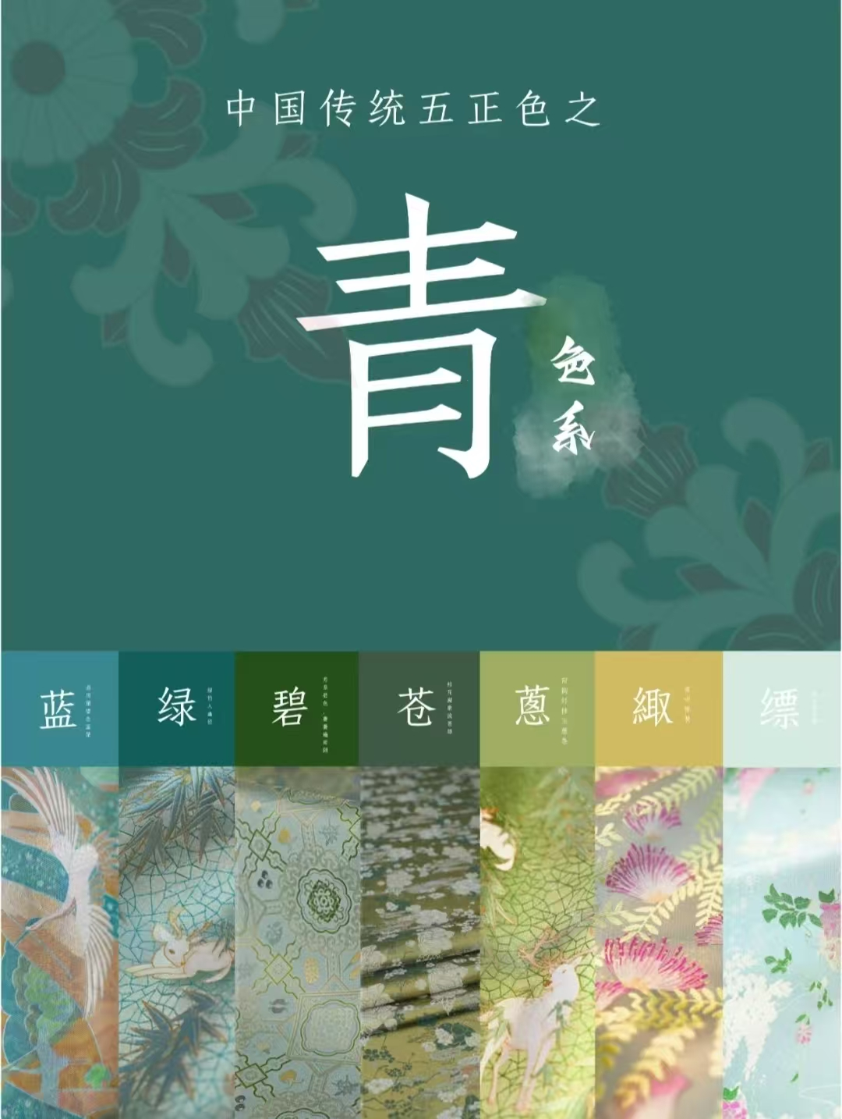
“青”Blue/Green raw material:
1. azurite蓝铜矿(for stone blue石青)
2. malachite孔雀石(for stone green石绿)
The use of the color blue/green : Neolithic Age

Slide 6
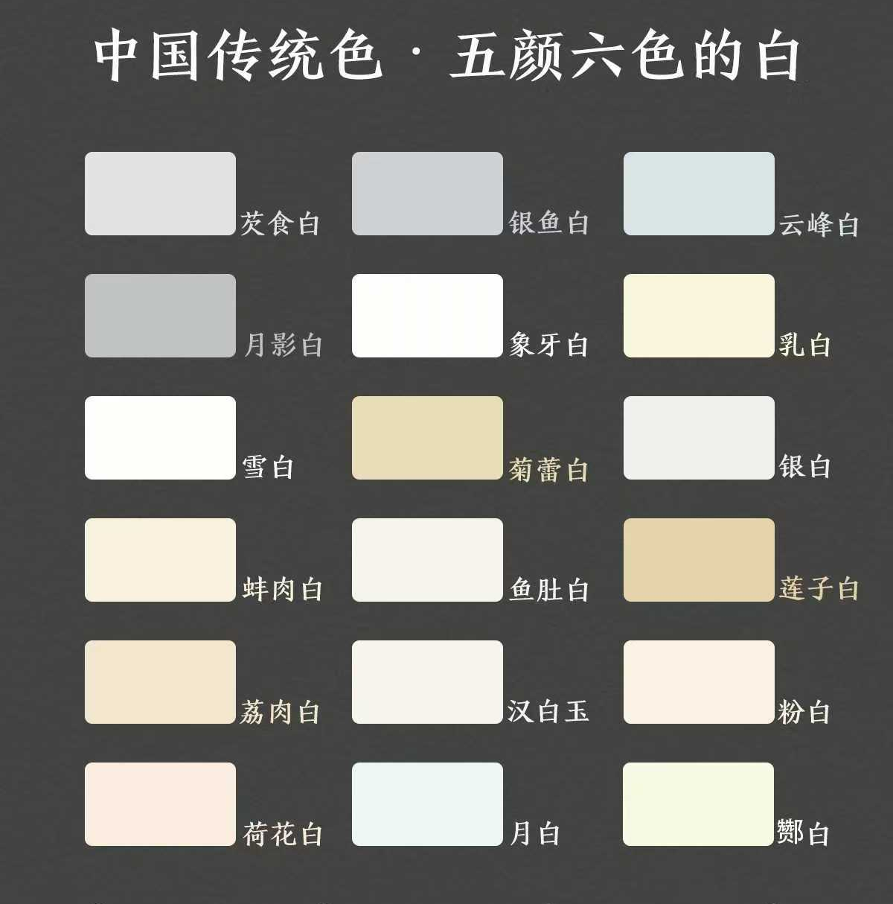
白White:
White chalk, also known as white powder, is a significant pigment in ancient Chinese painting.
1. A mixture of chalk and dolomite(白云石) appeared 5000 years ago in Yangshao Culture.
2. Clamshell white appeared during the Spring and Autumn period.

Slide 7
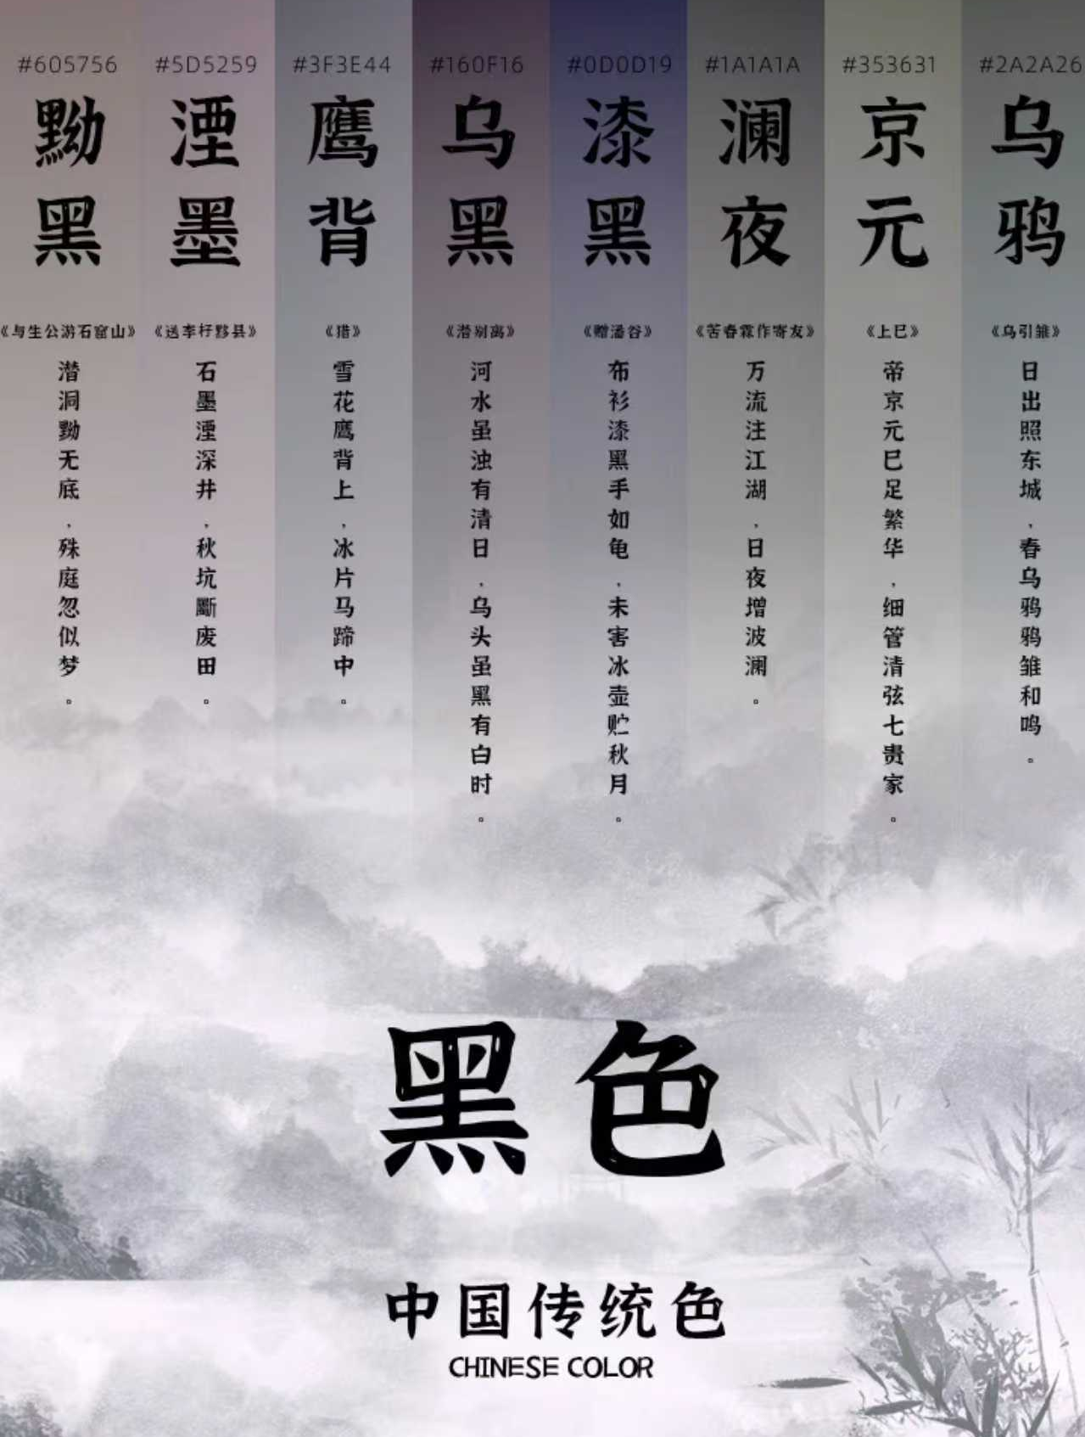
Black center；before other pigments; well developed in Qin and Han dynasties commonly used black pigments: graphite(石墨);black lacquer; plant ash(百草灰) and tetrapanax papyriferus ash
(通草灰)

Slide 8

Part 2
Classification &Features

Slide 9
Classification
Pigments
natural inorganic pigments
such as cinnabar，graphite and red iron oxide
natural organic pigments
such as indigo(槐蓝属植物；靛蓝染料)
synthetic organic pigments
raw materials
emerged alongside
natural minerals/plant juices
organic dye technology; foreigners

Slide 10
Features
1. natural pigments: (minerals/ plants)
advantage: superior in terms of resistance to light, heat, acid, alkali, and moisture
disadvantage: need to follow traditional methods and skills for extraction, production and so on; difficulty in obtaining raw materials; thus, expensive and difficult
2. synthetic pigments:
disadvantage: lack stability
advantage: easiness and lower prices

Slide 11

Part 3
Production

Slide 12
The process of making traditional mineral pigments
raw material processing
glue and alum allocation
selection
grinding and washing
selection
mixing glue, alum, and raw materials

Slide 13
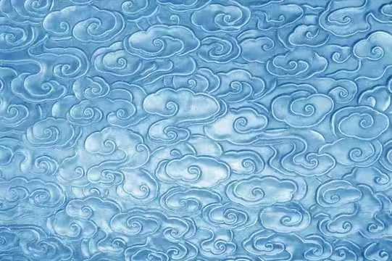
Part 4
Application

Slide 14
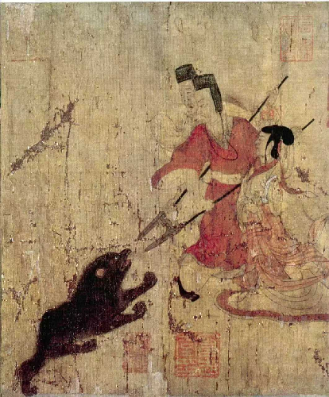
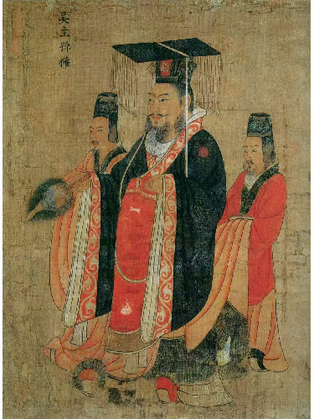
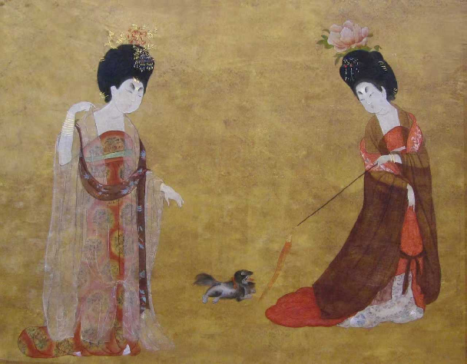
1. Traditional Chinese Painting
Traditional Chinese pigment is one of the most significant tools for 1. Take cinnabar (a kind of raw material for traditional Chinese red) as an example.
calligraphy, ink paste and painting. It can be seen in famous ancient traditional Chinese painting.
Admonitions of the Instructress to Court Ladies
Court LadiesWearing Flowered Headdresses
Portraits of Emperors of Past Dynasties

Slide 15
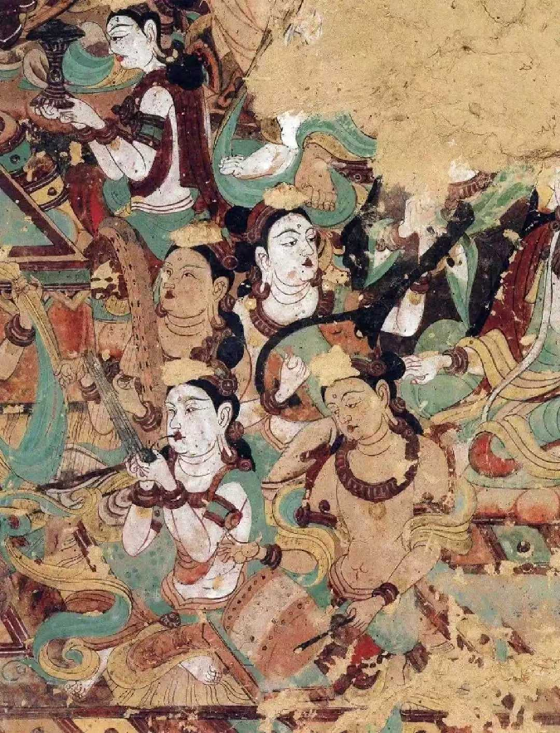
2. Dunhuang Grottoes
·known as the “Louvre of the East”
·located in Dunhuang at the weatern end of the Hexi Corridor
·renowned for their exquisite murals and statues in the world
·preserving a vast collection of pigment samples over 1000 years
a museum with rich pigment specimens

Slide 16
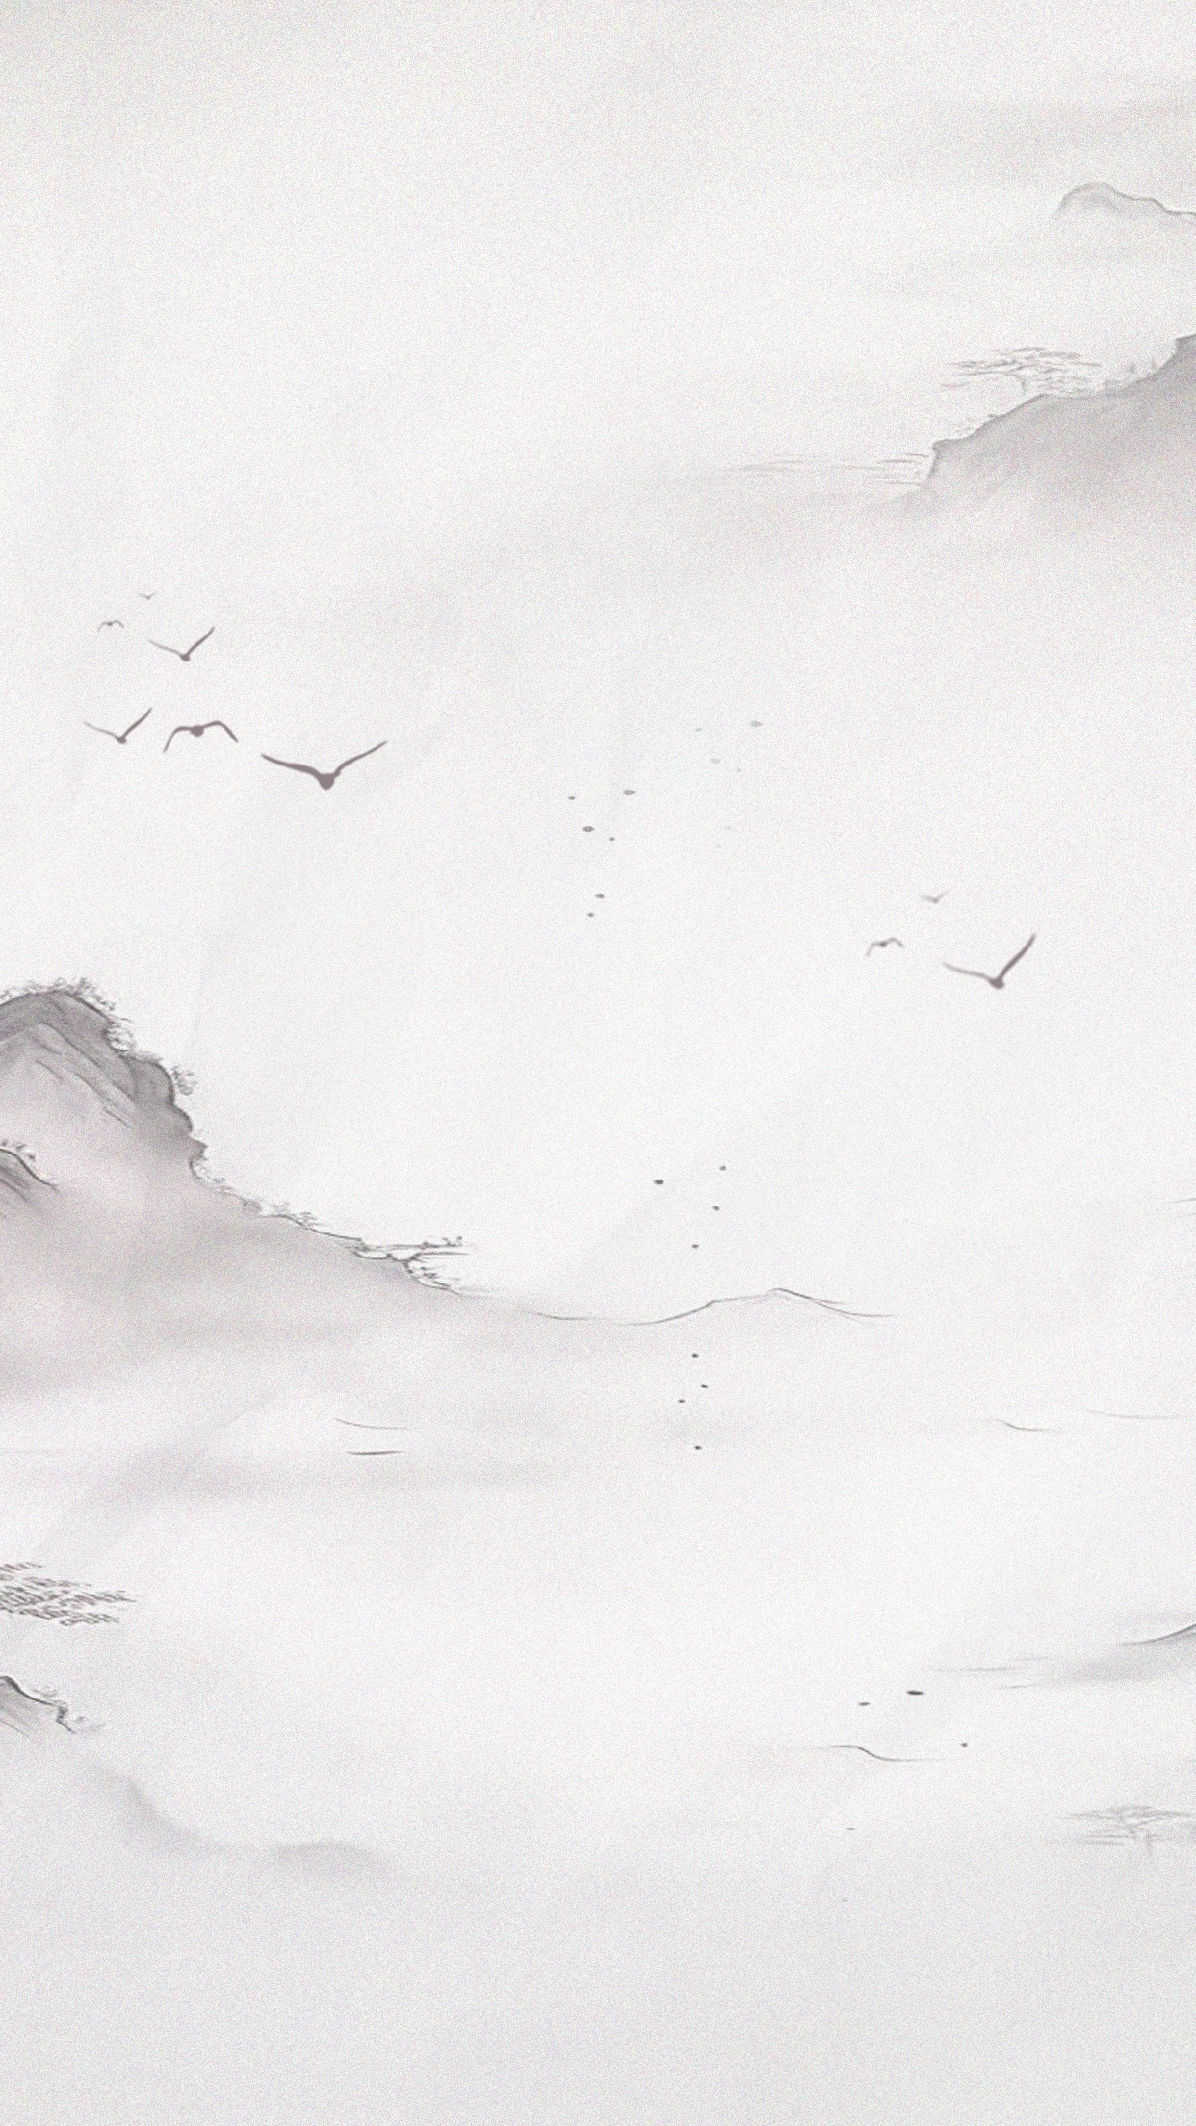
Thanks!
感谢聆听

