Slide 1
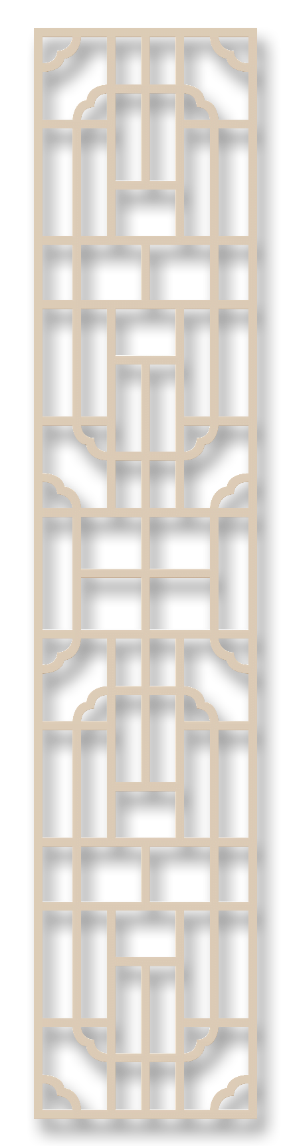
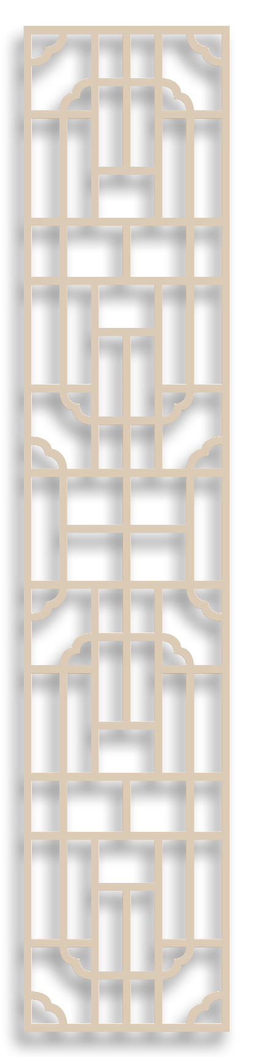



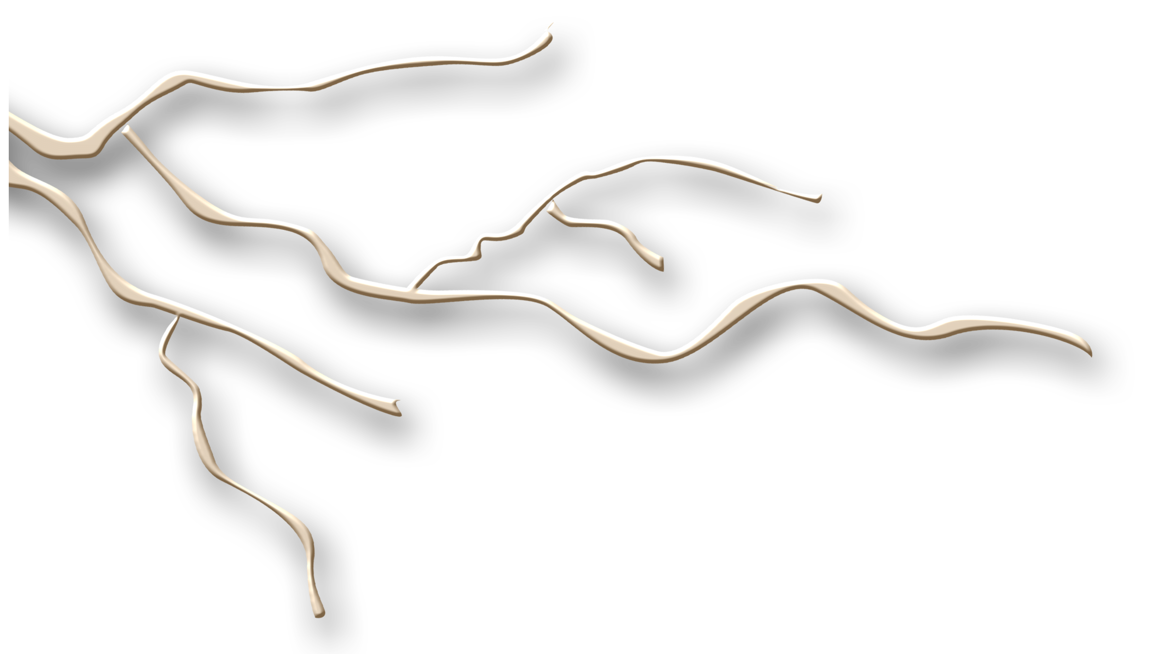

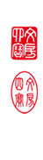
Ancient Chinese Architecture
张佩闻 张毓婕

Slide 2
Part one
Part two
The classification of ancient Chinese architecture
The translation method of Chinese architecture

Slide 3
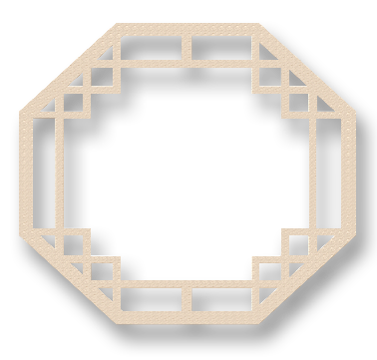
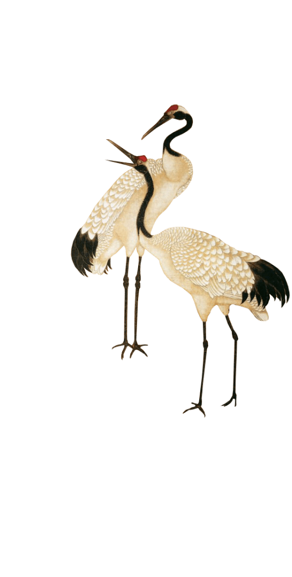

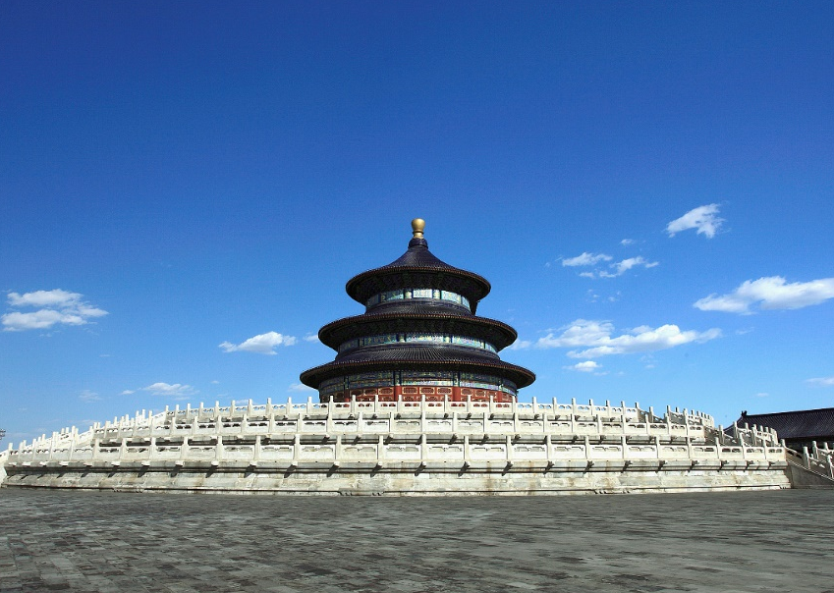
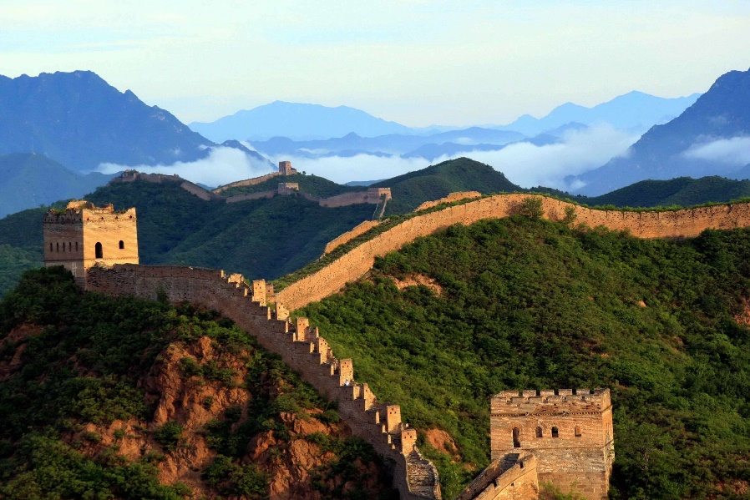
壹
贰
Defensive Building
Sacrificial Building
the Great Wall
Temple of Heaven

Slide 4
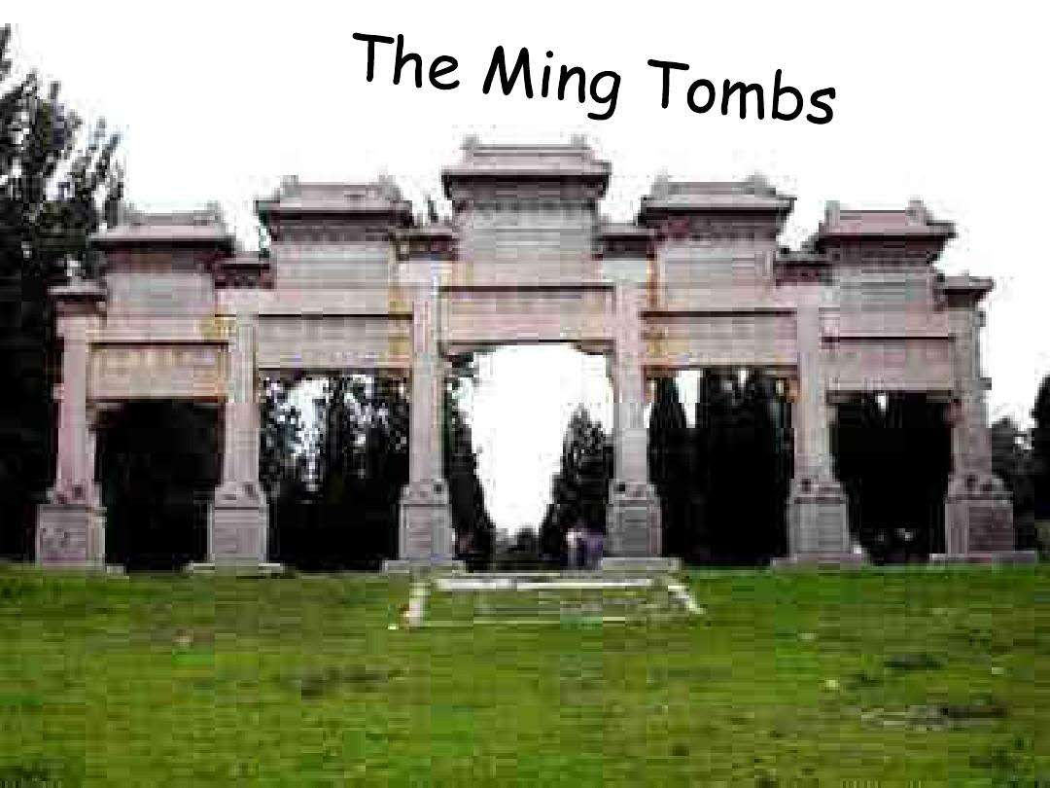
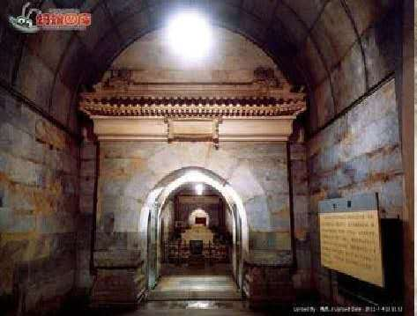
叁
Mausoleum Building
The Ming Tombs

Slide 5
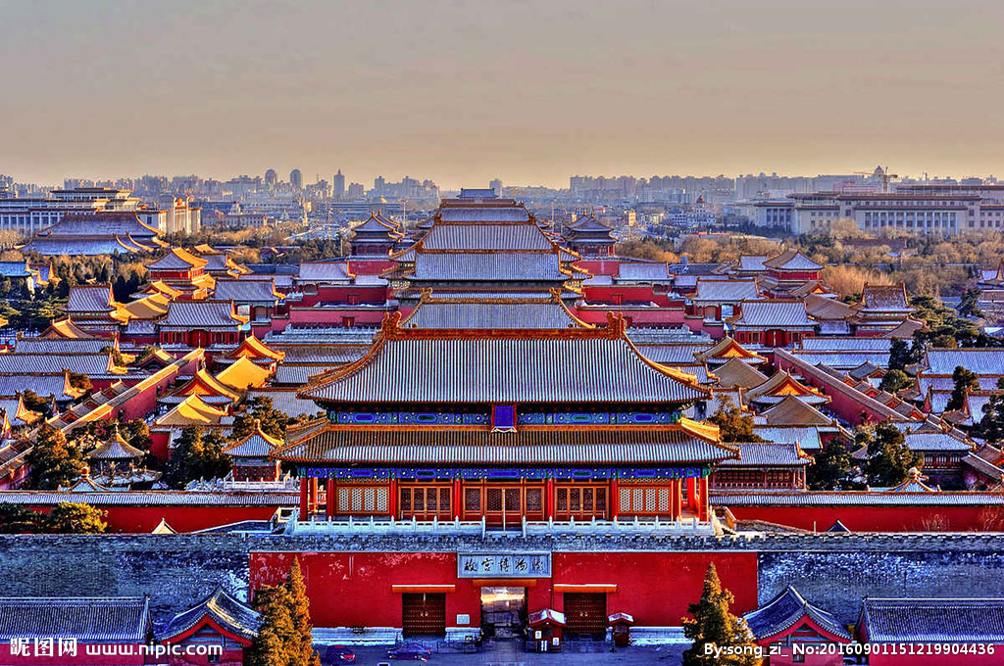
Palace Building
The Forbidden City(Zijin Cheng）

Slide 6
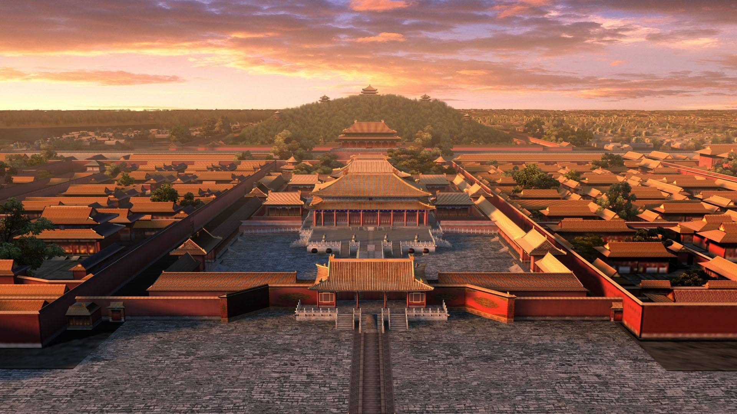
The Origin of Its Name:1. purple
2.forbidden
3.city

Slide 7
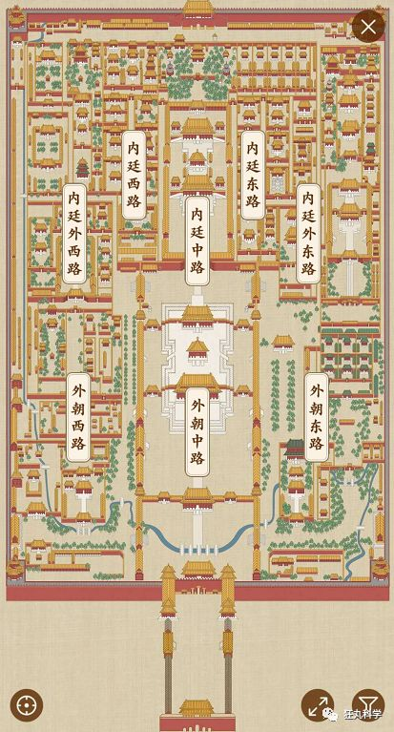
The Layout of the Forbidden City
The Inner Court
The Outer Court

Slide 8

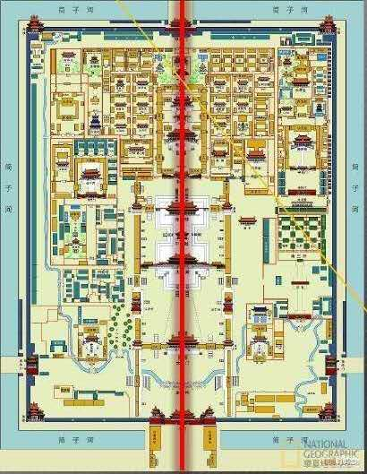
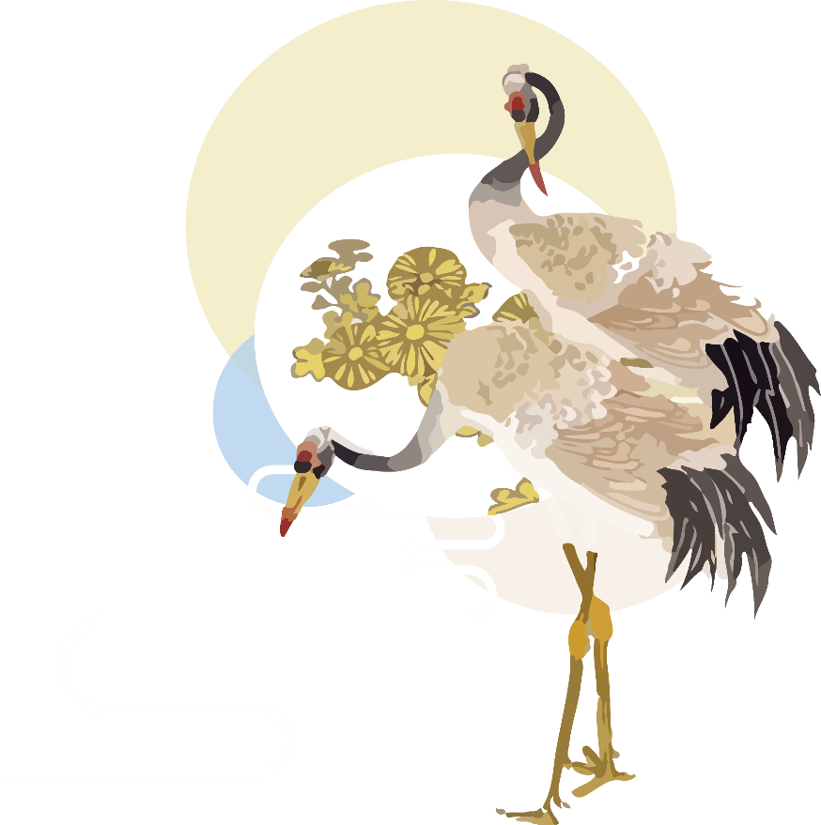
Symmetrical space
Enclosed space
Surrounded by a river

Slide 9
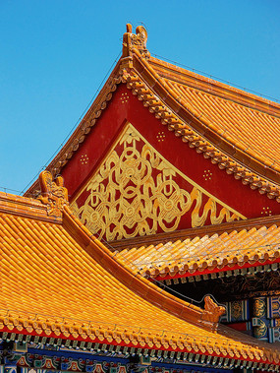
The Colors and Decorations of the Forbidden City
Yellow became an imperial color during the Tang dynasty
Red represents happiness, good fortune and wealth.

Slide 10
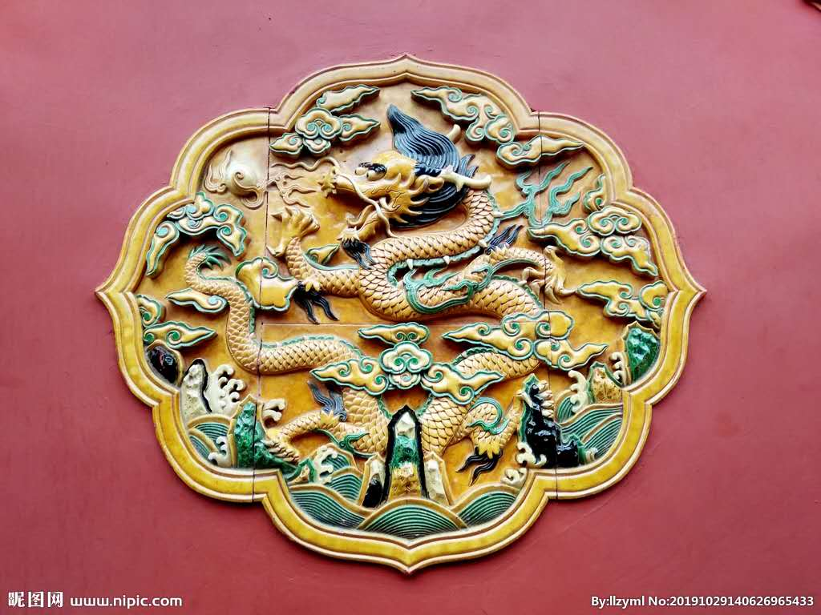
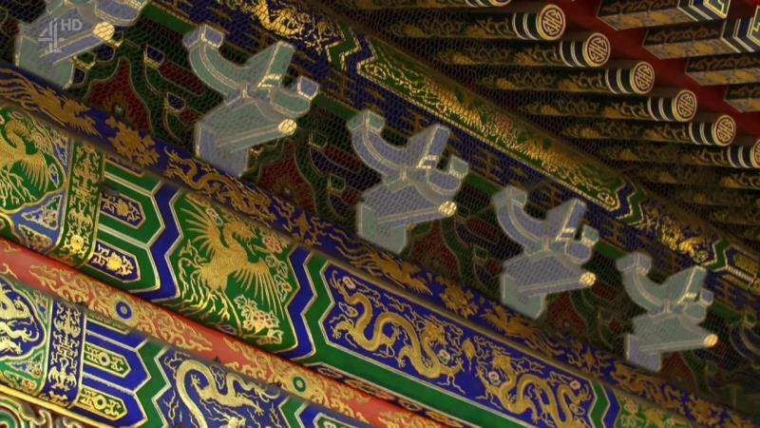
The dragon represents the Emperor while the phoenix represents the Empress.

Slide 11
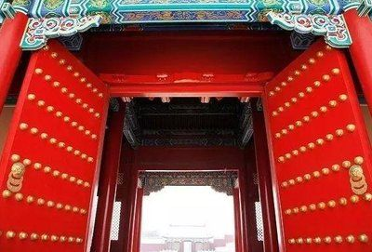
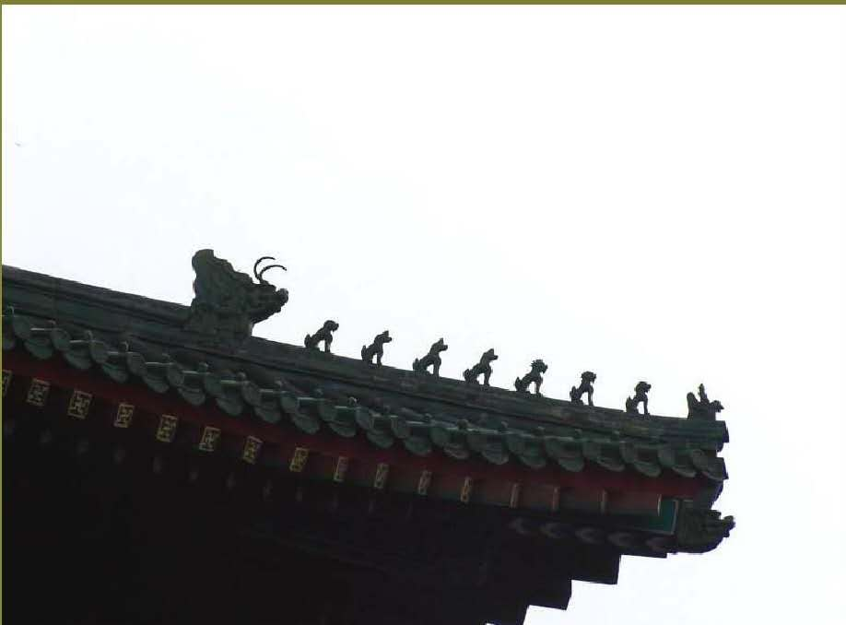
Nine is a lucky number in China

Slide 12
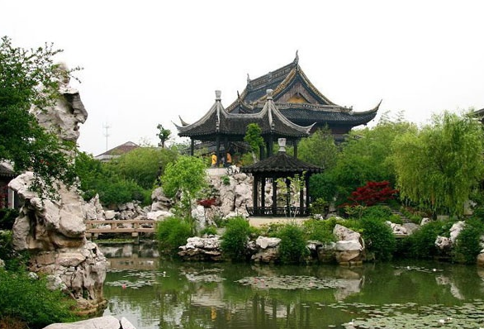

Garden Architecture

Slide 13
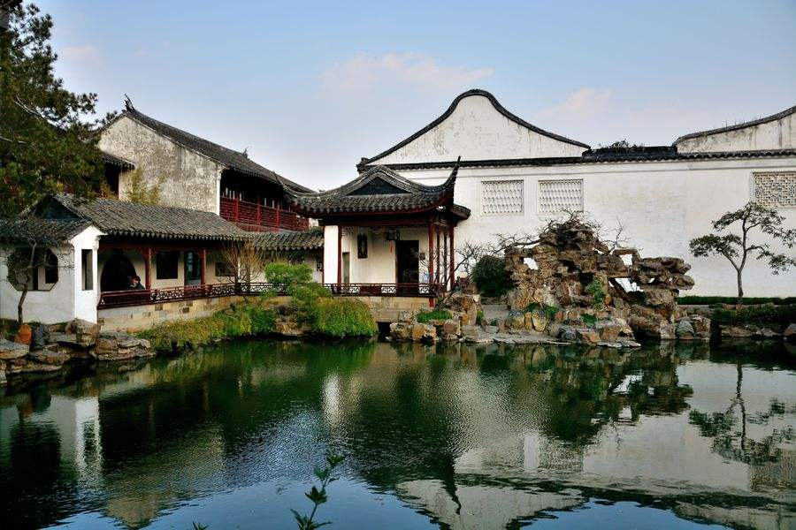
The General Characteristics of Garden Architecture:
shun symmytry along axis
adopt an irregular and complicates layout

Slide 14
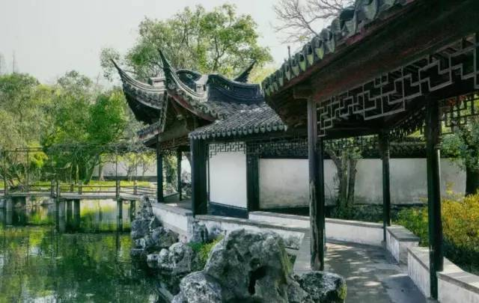
The Design of the Classical Garden
hall, pavilions, bridges, artificial mountains, rock gardens, ponds, flowers and trees
borrowed scenery
concealment and surprise

Slide 15
The Translation Method of Chinese Architecture
Transliteration
龙王庙 Long Wang Miao
邀月台 Yao Yue Tai
牡丹园 Mu Dan Yuan
大戏楼 Da Xi Lou

Slide 16

Transliteration and free Translation
仁寿殿Hall of Benevolence and Longevity(Ren Shou Dian)
大戏楼 Grand Stage(Daxi Lou)
文昌阁 Wenchang Tower (Wenchang Ge)
永寿斋 Longevity Chamber(Yong Shou Zhai)
邀月台 Moon Appreciation Terrace (Yao Yue Tai)
神马殿 Divine Horse Stable (Sheng Ma Dian)

Slide 17
Thank you!

