Slide 1
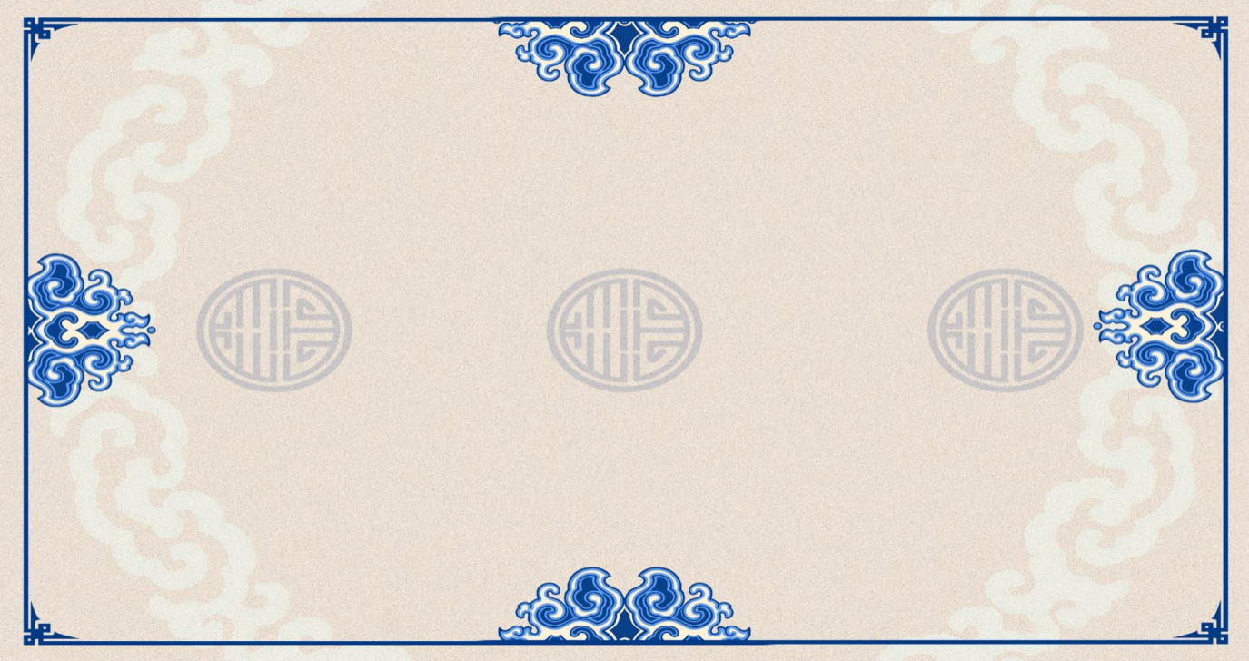
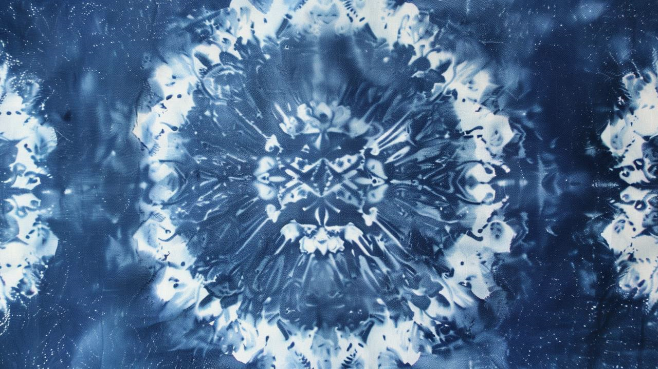

Traditional Crafts:Tie-Dye
Speaker:张琪

Slide 2
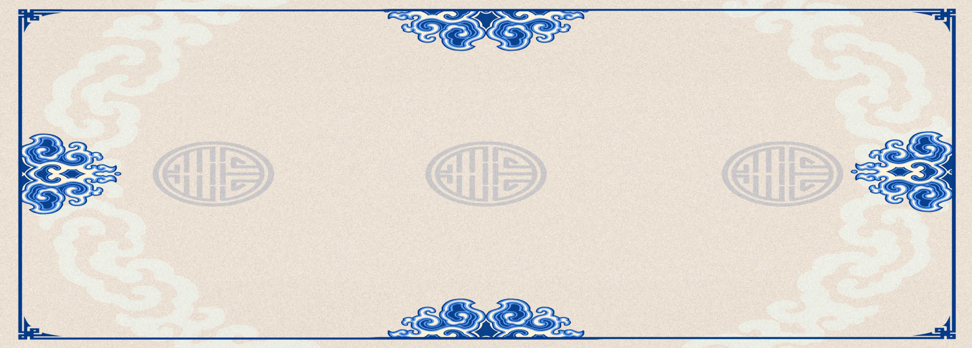


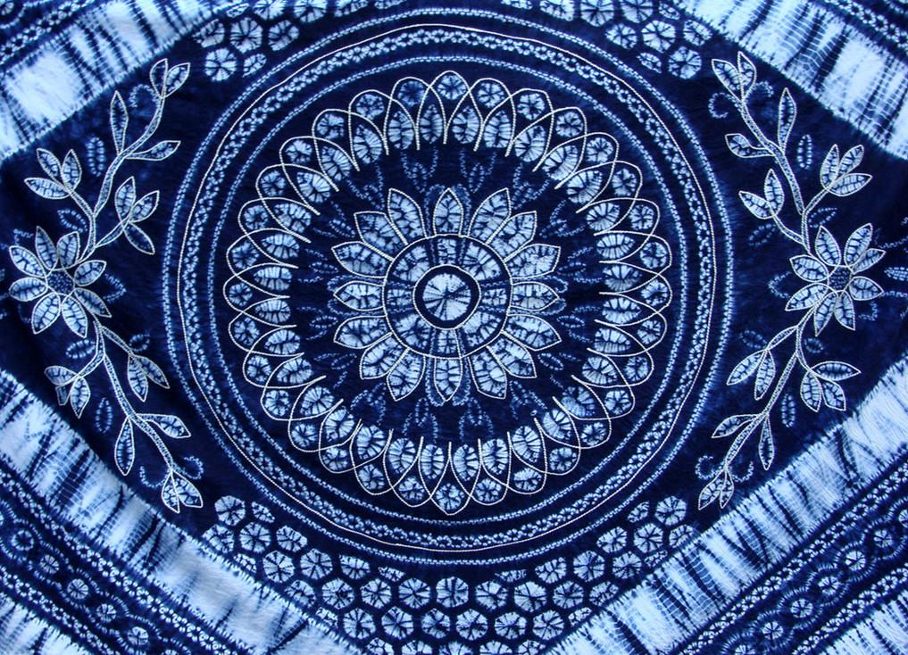
Contents
源
Historical Origin
壹
贰
Dyeing Process
Flower Pattern
Conclusion
叁
肆

Slide 3

Part I
Historical Origin
Origin:Tie-dye (known as Jiaoxie) originated during the Qin-Han period.
Maturity: the Eastern Jin Dynasty
Tang Dynasty: The Tang Dynasty marked the zenith of tie-dye.
Ming and Qing :Regions like Zhoucheng and Xizhou became hubs for Bai-style tie-dye, and it reached heights
In the 1970s:tie-dye resurged as a popular craft for fashion and decor.

Slide 4
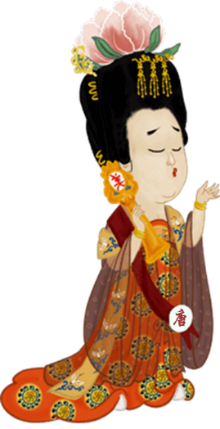
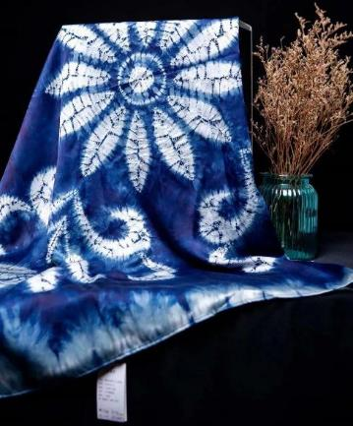

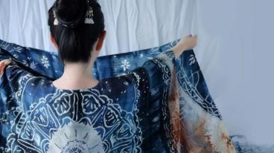
Part I
Historical Origin
Modern tie-dye: folk-art styles with over a thousand patterns
reflect: customs and aesthetic tastes
Dali（大理）: a crucial hub for tie-dye textiles in China
2006 National Intangible Cultural Heritage
杨贵妃

Slide 5
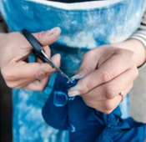
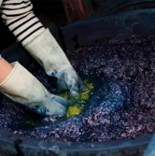
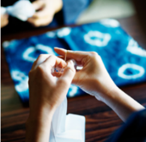
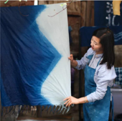
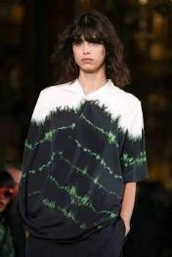
Part II
贰
Dyeing Process

Slide 6


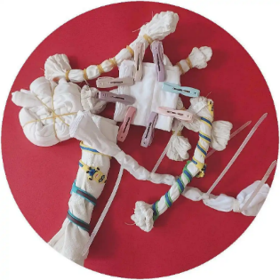

Part II
Dyeing Process
Four main stages: Pre-soaking,tying, dyeing, drying
Tools: yarn, thread, rope
The predominant blue and white color

Slide 7

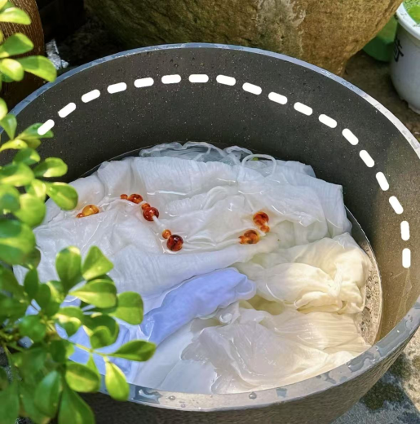
现
Part II
Dyeing Process
Pre-soaking
Submerge the fabric in clean water until fully saturated – ensuring even dye penetration.

Slide 8
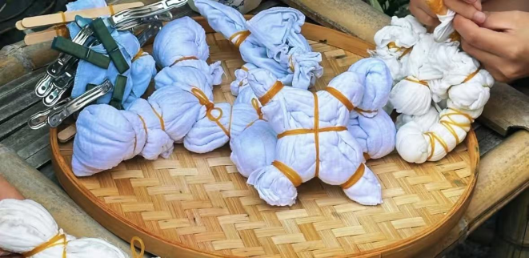
现
Part II
Dyeing Process
2.Tying:
shaping the fabric
Techniques: pleating, folding, rolling, twisting
creating clusters of “knots”

Slide 9
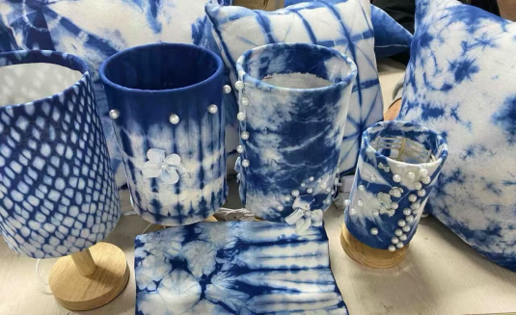
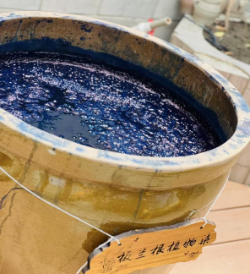

Part II
Dyeing Process
3. Dyeing:
soaking the tied fabric
immersing it in dye
4. Drying:
Untie the bindings
Rinse thoroughly with clean water
Air-dry naturally

Slide 10
叁
Part III
Flower Pattern

Slide 11
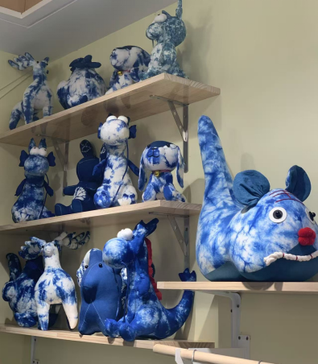
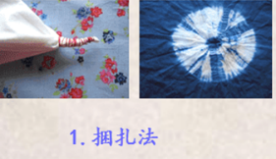
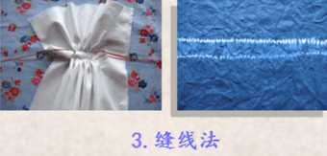
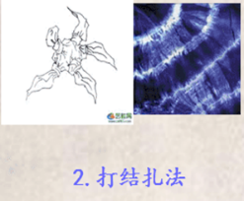


骤
Part III
Flower Pattern
1. Bundle Tying
2.Knotting Technique(pebble-like patterns)
3.Stitch Resist

Slide 12
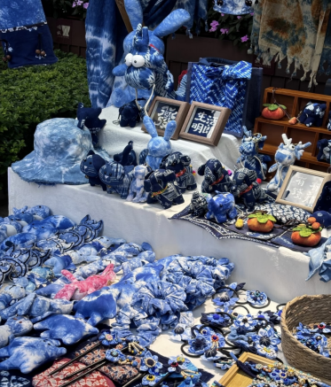
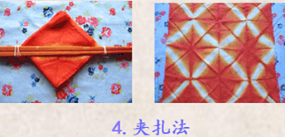
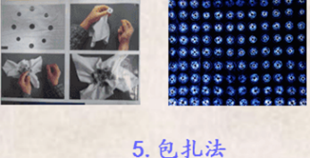
骤
Part III
Flower Pattern
4.Clamp Resist
5.Warp Binding

Slide 13
肆
Part IV
Conclusion

Slide 14
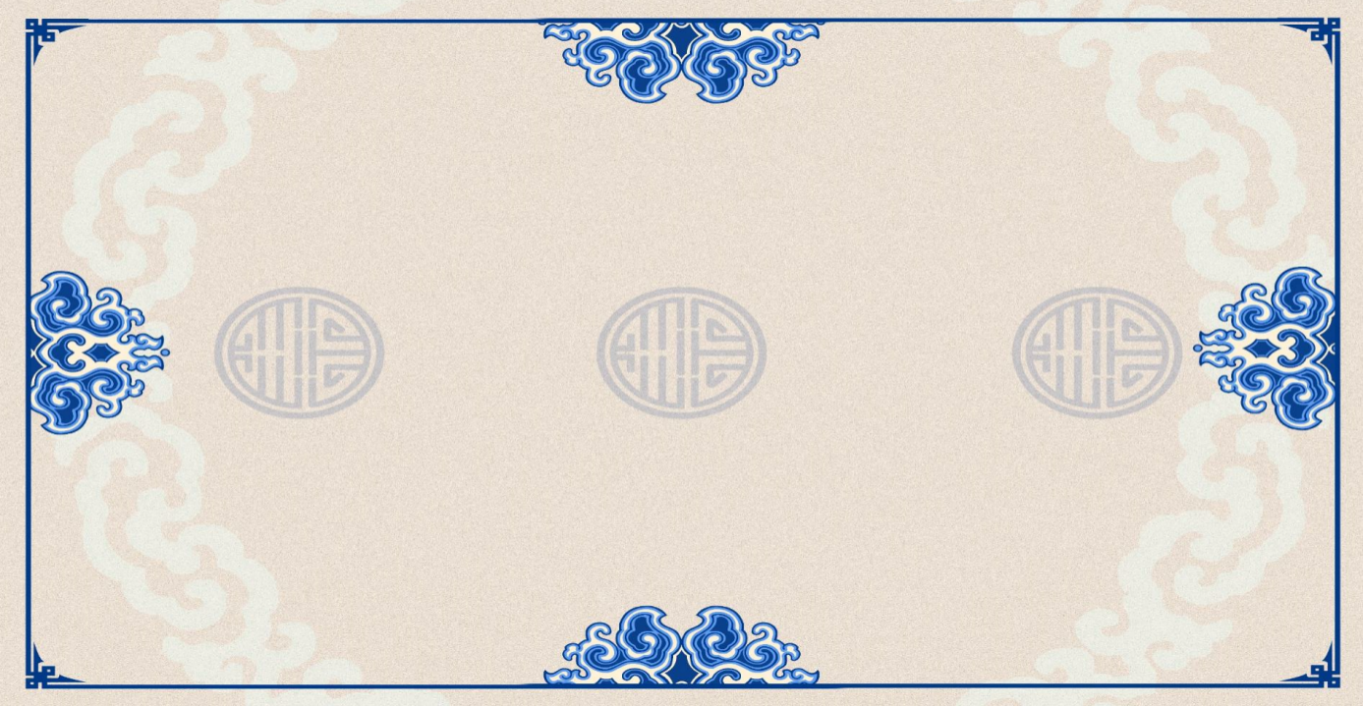
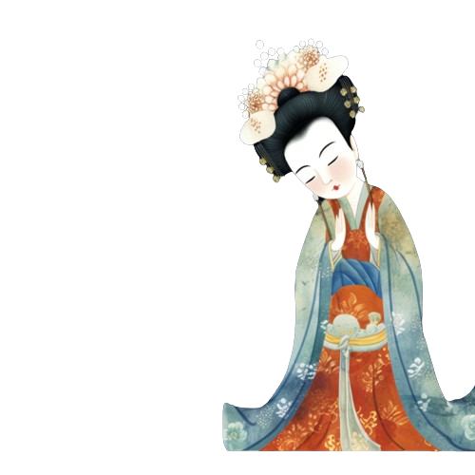

Conclusion
Tie-dye combines cultural heritage, eco-friendly practices, and artistic innovation through patterned fabric dye techniques.
护

Slide 15
Thank You

