Slide 1

Linguistic School
李丽丽 王源

Slide 2
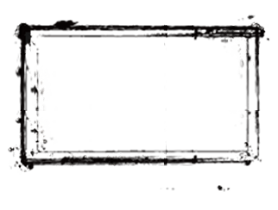
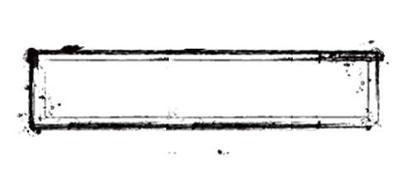
Introduction
Eugene Nida
Linguistic School
Representatives
Peter Newmark
Conclusion

Slide 3
Introduction
1.In the early 20th century, Saussure put forward the theory of general linguistics,
2.The 20th century was a period in which the linguistic school of translation studies gained tremendous development. They used modern linguistic theories such as structural theory, transformational-generative grammar, functional theory and discourse theory to conduct scientific and systematic research on translation issues, and opened up a new field of translation studies.
3.In the 1940 s and early 70 s, translation is even into the category of linguistics, and is treated as a branch of comparative linguistics, applied linguistics, and semantics.

Slide 4
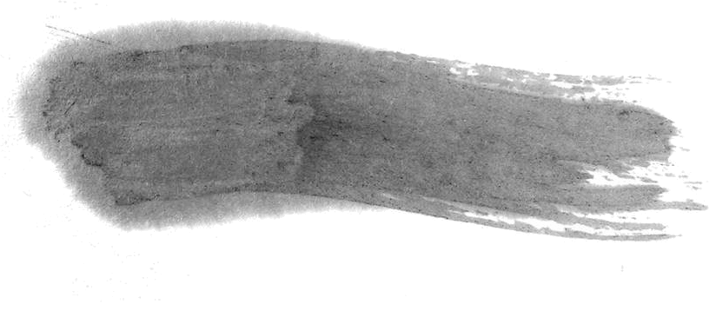
Eugene Nida
① Dynamic equivalence
② Ways to equivalence
③ The four standards of translation

Slide 5

Four aspects of equivalence
1. Lexical equivalence
2. Syntactic equivalence
3. Textual equivalence
4. Stylistic equivalence
Dynamic Equivalence

Slide 6


Ways to Equivalence
1
2
3
Make the target language conform to the source language in formal way
Give up formal equivalence and
take sense and culture into consideration
Recreate some new conceptions

Slide 7

1. 传神
2. 达意
3. 措辞通顺自然
Four
Standards
4. 读者反应相似

Slide 8
Peter Newmark
1. Communicative translation
2. Semantic translation

Slide 9
Semantic translation
Semantic translation limits the content of expression to the original culture, and does not allow to change the concept of national culture in the original text. In order to show the original author's thinking process, semantic translation tries to retain the original author's language characteristics and unique expression.

Slide 10
Communicative translation
Communicative translation attempts to make the effect of the translation as close as possible to the effect of the original reader. In order to make the translation conform to the standard of the original language, it is necessary for the translator to completely get rid of the constraints of the original form, and change all the different expressions which are not in the taste of the readers into the authentic expression of target language, without causing difficulties in understanding. The translator is based on the language and culture of the translation and the maximum acceptable range of the reader.

Slide 11
Four limitations
The translator has an imaginary reader in his mind. If he wants to conform to the readers’ expression habits, he will express getting out of the original form or meaning.
2. It is difficult to determine to what extent basic information is simplified and emphasized, because the knowledge and emotion of readers are difficult to determine.
3. It is easy to fool readers as the media.
4. It is not objective to examine only through the reader's reaction.

Slide 12
Conclusion
Nida and Newmark play an important role in translation studies. Their translation theories bypass the debate between literal translation and free translation, and propose new translation methods from a new perspective, which injects new vitality into contemporary translation research and makes outstanding contributions to translation theory.

