Slide 1
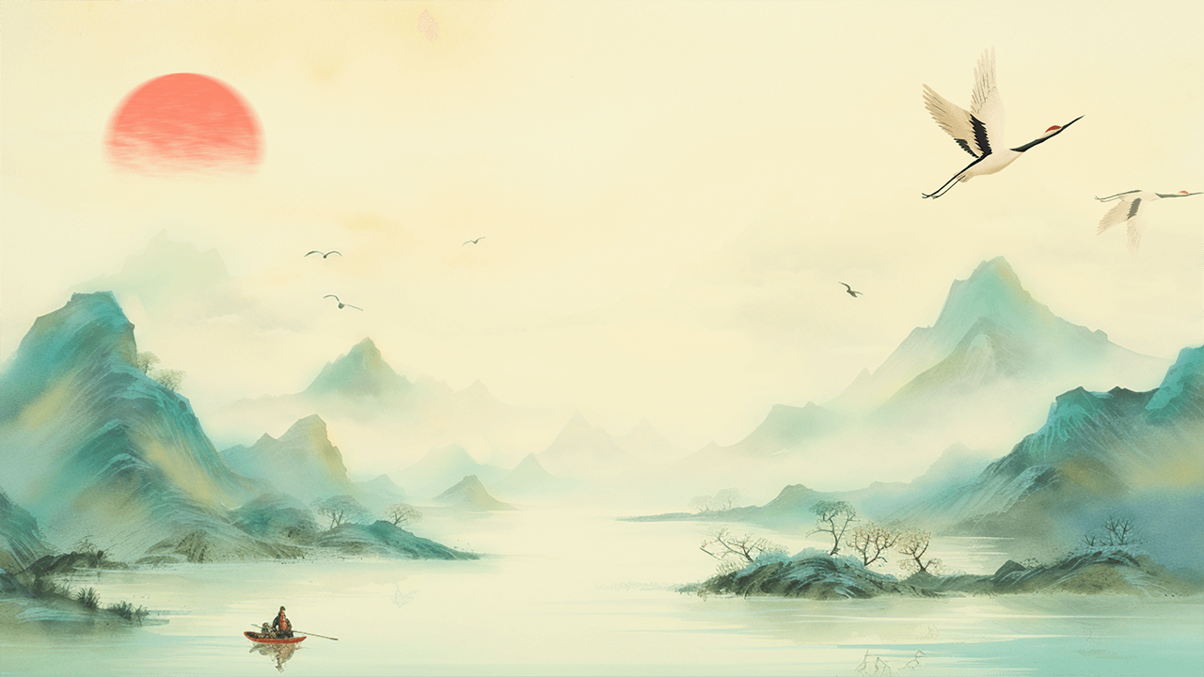
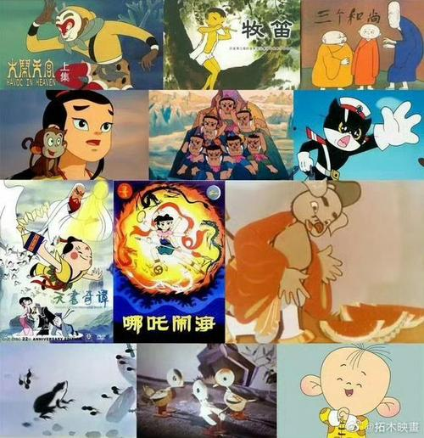
Introduction to Traditional Chinese Animation
Reporter:Pan Yilin
2024-12-05

Slide 2
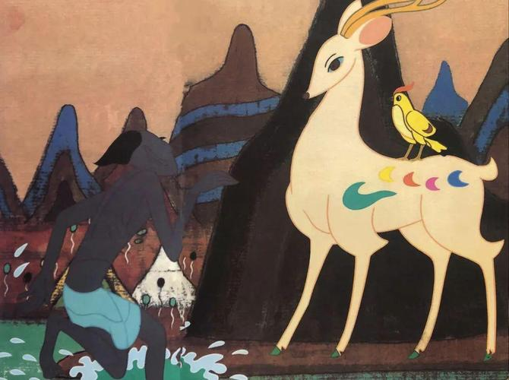

Slide 3
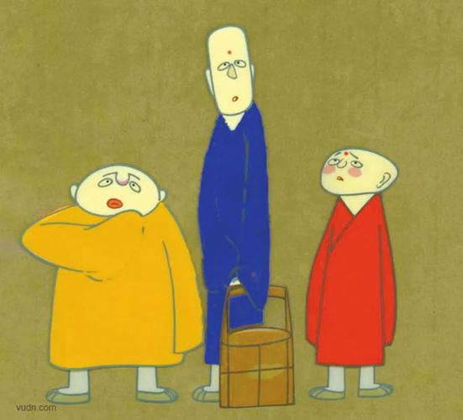

Slide 4
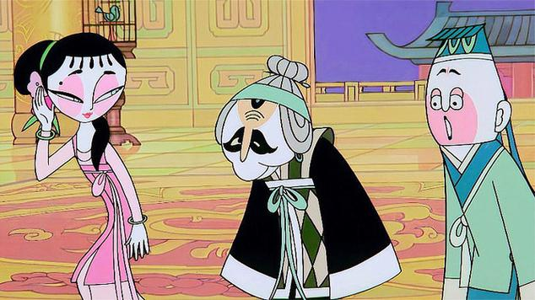

Slide 6
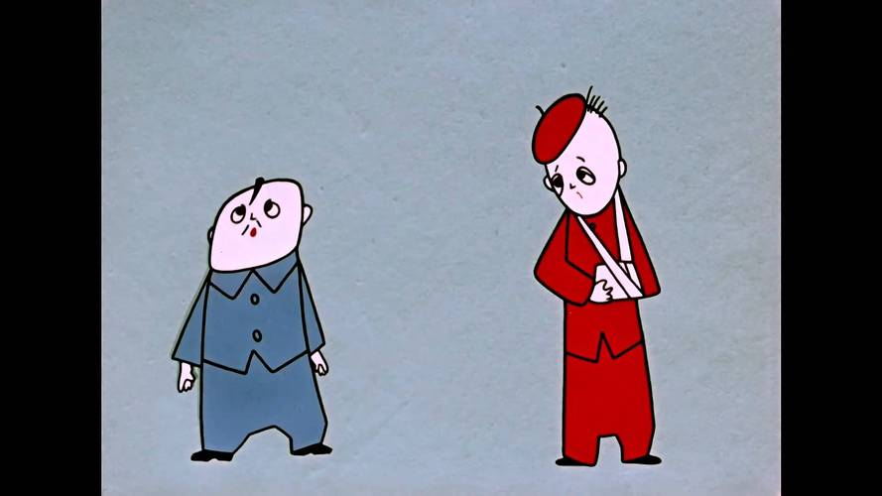

Slide 7
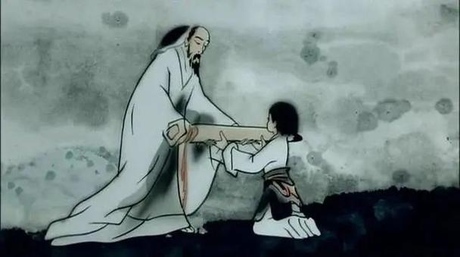

Slide 8
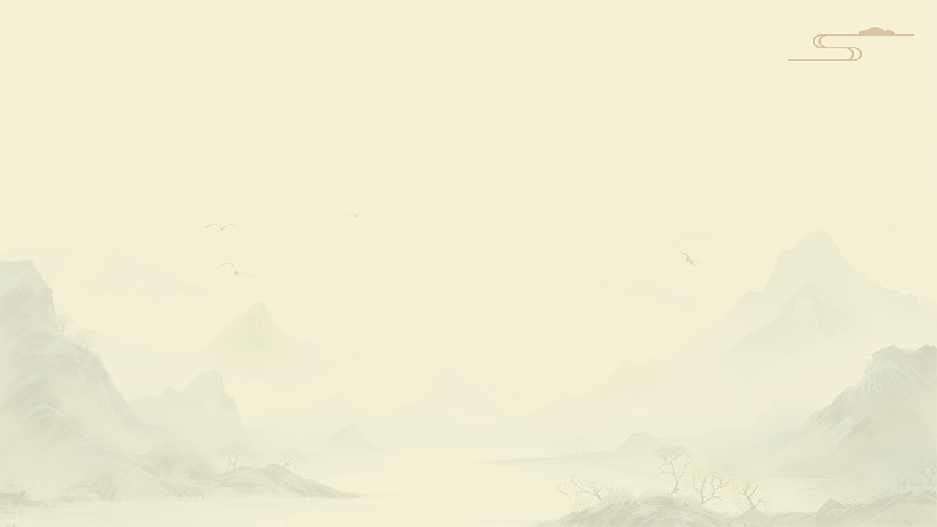
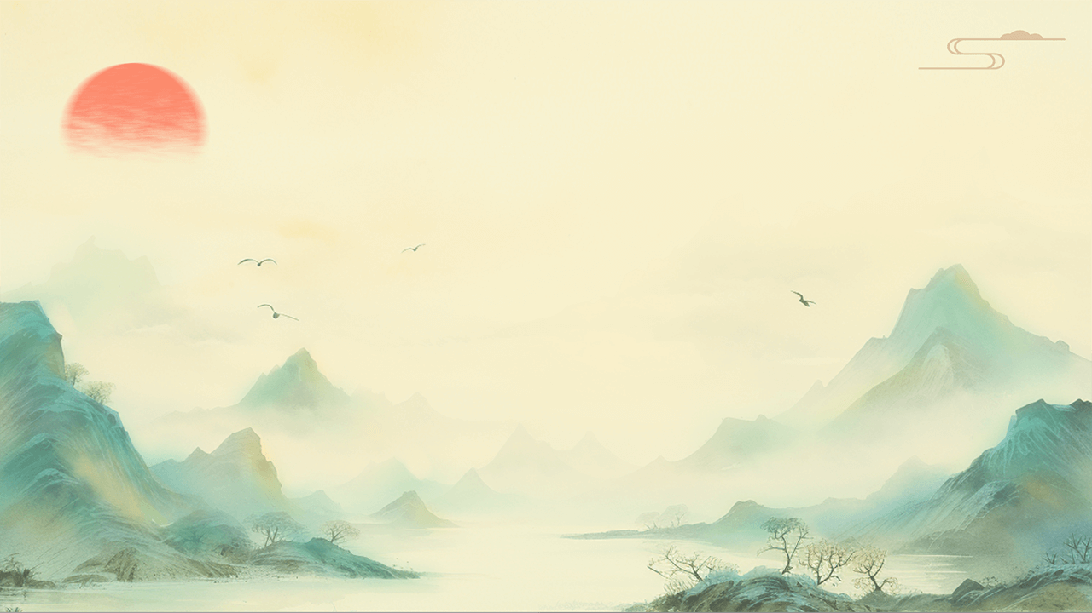
  Early Development of Chinese Animation
  Traditional Elements in Chinese Animation
  Production Techniques
  Influence of Foreign Cultures on Chinese Animation
  Specific Examples of Chinese Animation
  Conclusion
Cont.

Slide 9
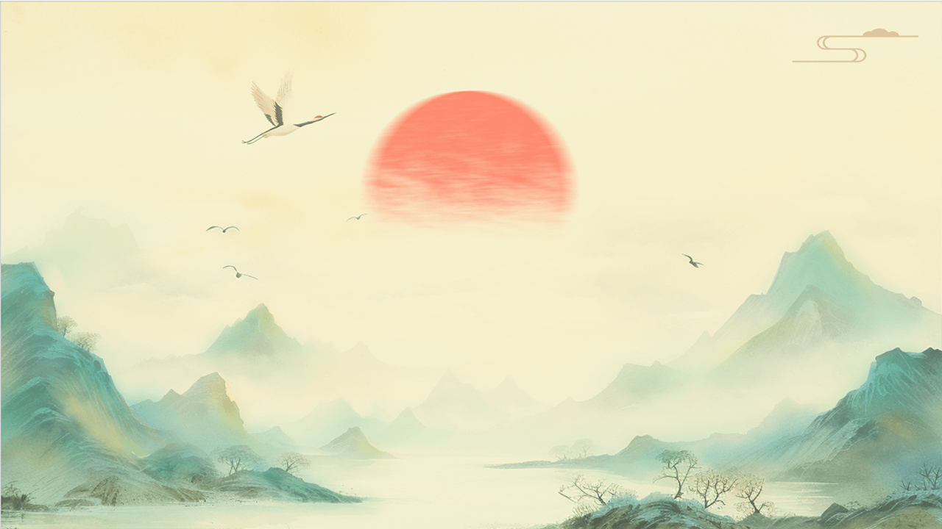
01
Early Development of Chinese Animation

Slide 10
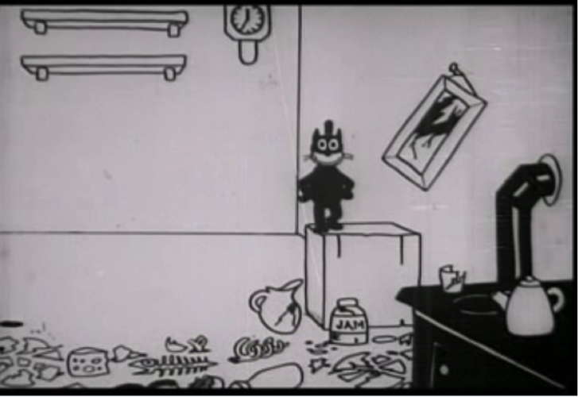
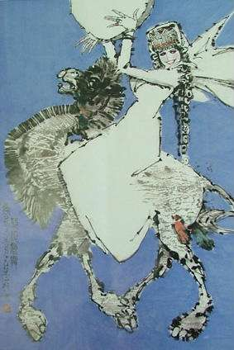
Early Development of Chinese Animation
01
Origin and early developments
Chinese animation originated in the 1920s with the Wan brothers' "Shu Zhen Dong Hua Wen Typewriter," marking the birth of Chinese animated film.
02
Sound effects and dialogue
In 1935, the Wan brothers introduced sound effects and dialogue to Chinese animation with "The Camel's Dance," ushering in the era of sound animation.
03
Milestone and international acclaim
During the 1940s, Chinese animation reached its first milestone with the production of "Princess Iron Fan," which was distributed to Southeast Asia and Japan.

Slide 11
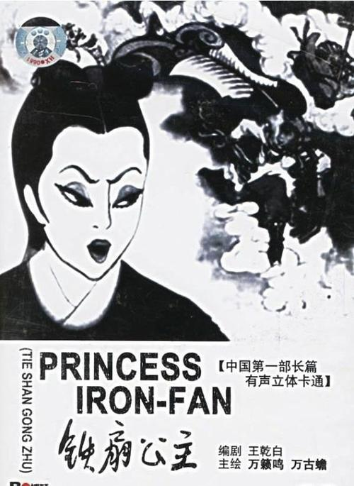
Early Development of Chinese Animation
International recognition
"Princess Iron Fan" is considered a landmark in world cinema history, following "Snow White and the Seven Dwarfs," "Gulliver's Travels," and "Pinocchio."
Influence on Japanese animation
The success of "Princess Iron Fan" inspired Osamu Tezuka, a Japanese animation giant, to pursue animation, demonstrating the film's influence on the industry.

Slide 12
02
Traditional Elements in Chinese Animation

Slide 13
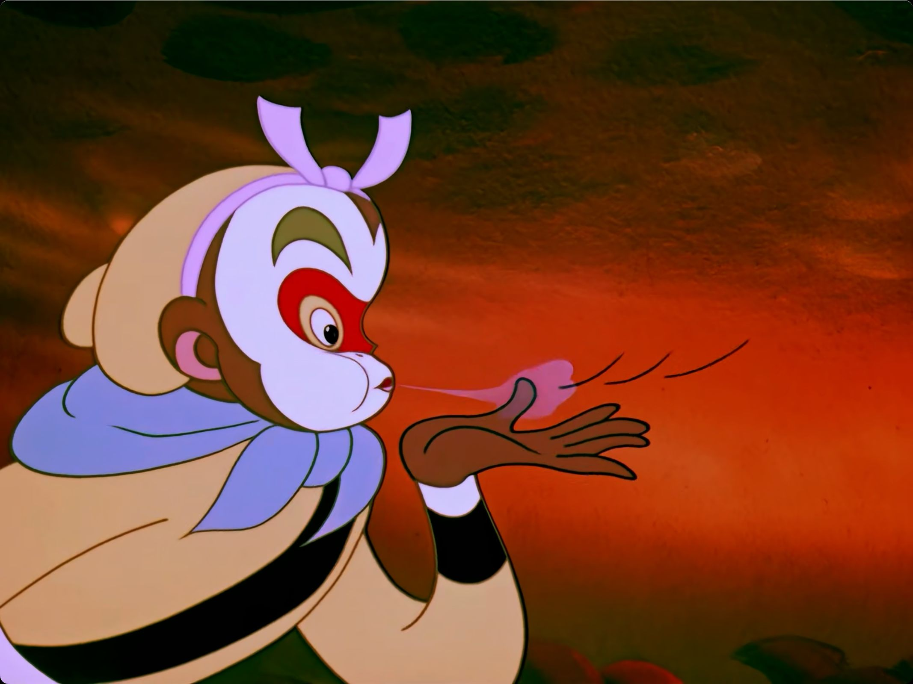
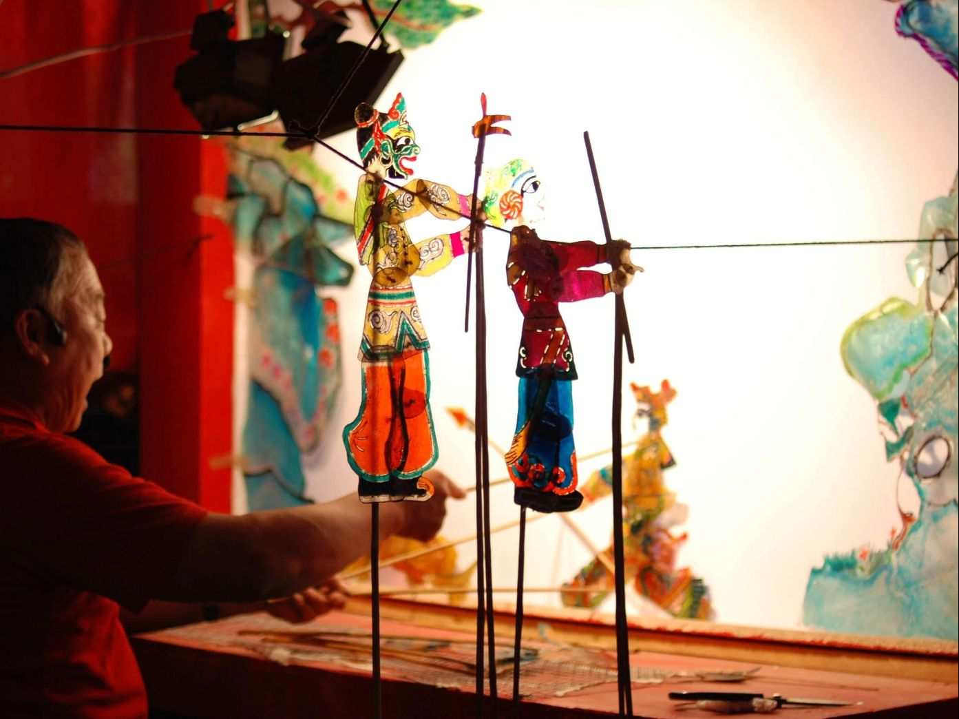
Traditional Art Forms
Historical Stories and Myths and Legends
Many animations are based on ancient Chinese myths, legends, and historical stories, such as "The Monkey King" adapted from "Journey to the West" and "Nezha Conquers the Dragon Kings" based on ancient Chinese mythology.
Traditional Art Forms
Animations draw inspiration from various traditional arts, such as ink painting, New Year paintings, shadow puppets, paper cutting, puppetry, and facial makeup.

Slide 14
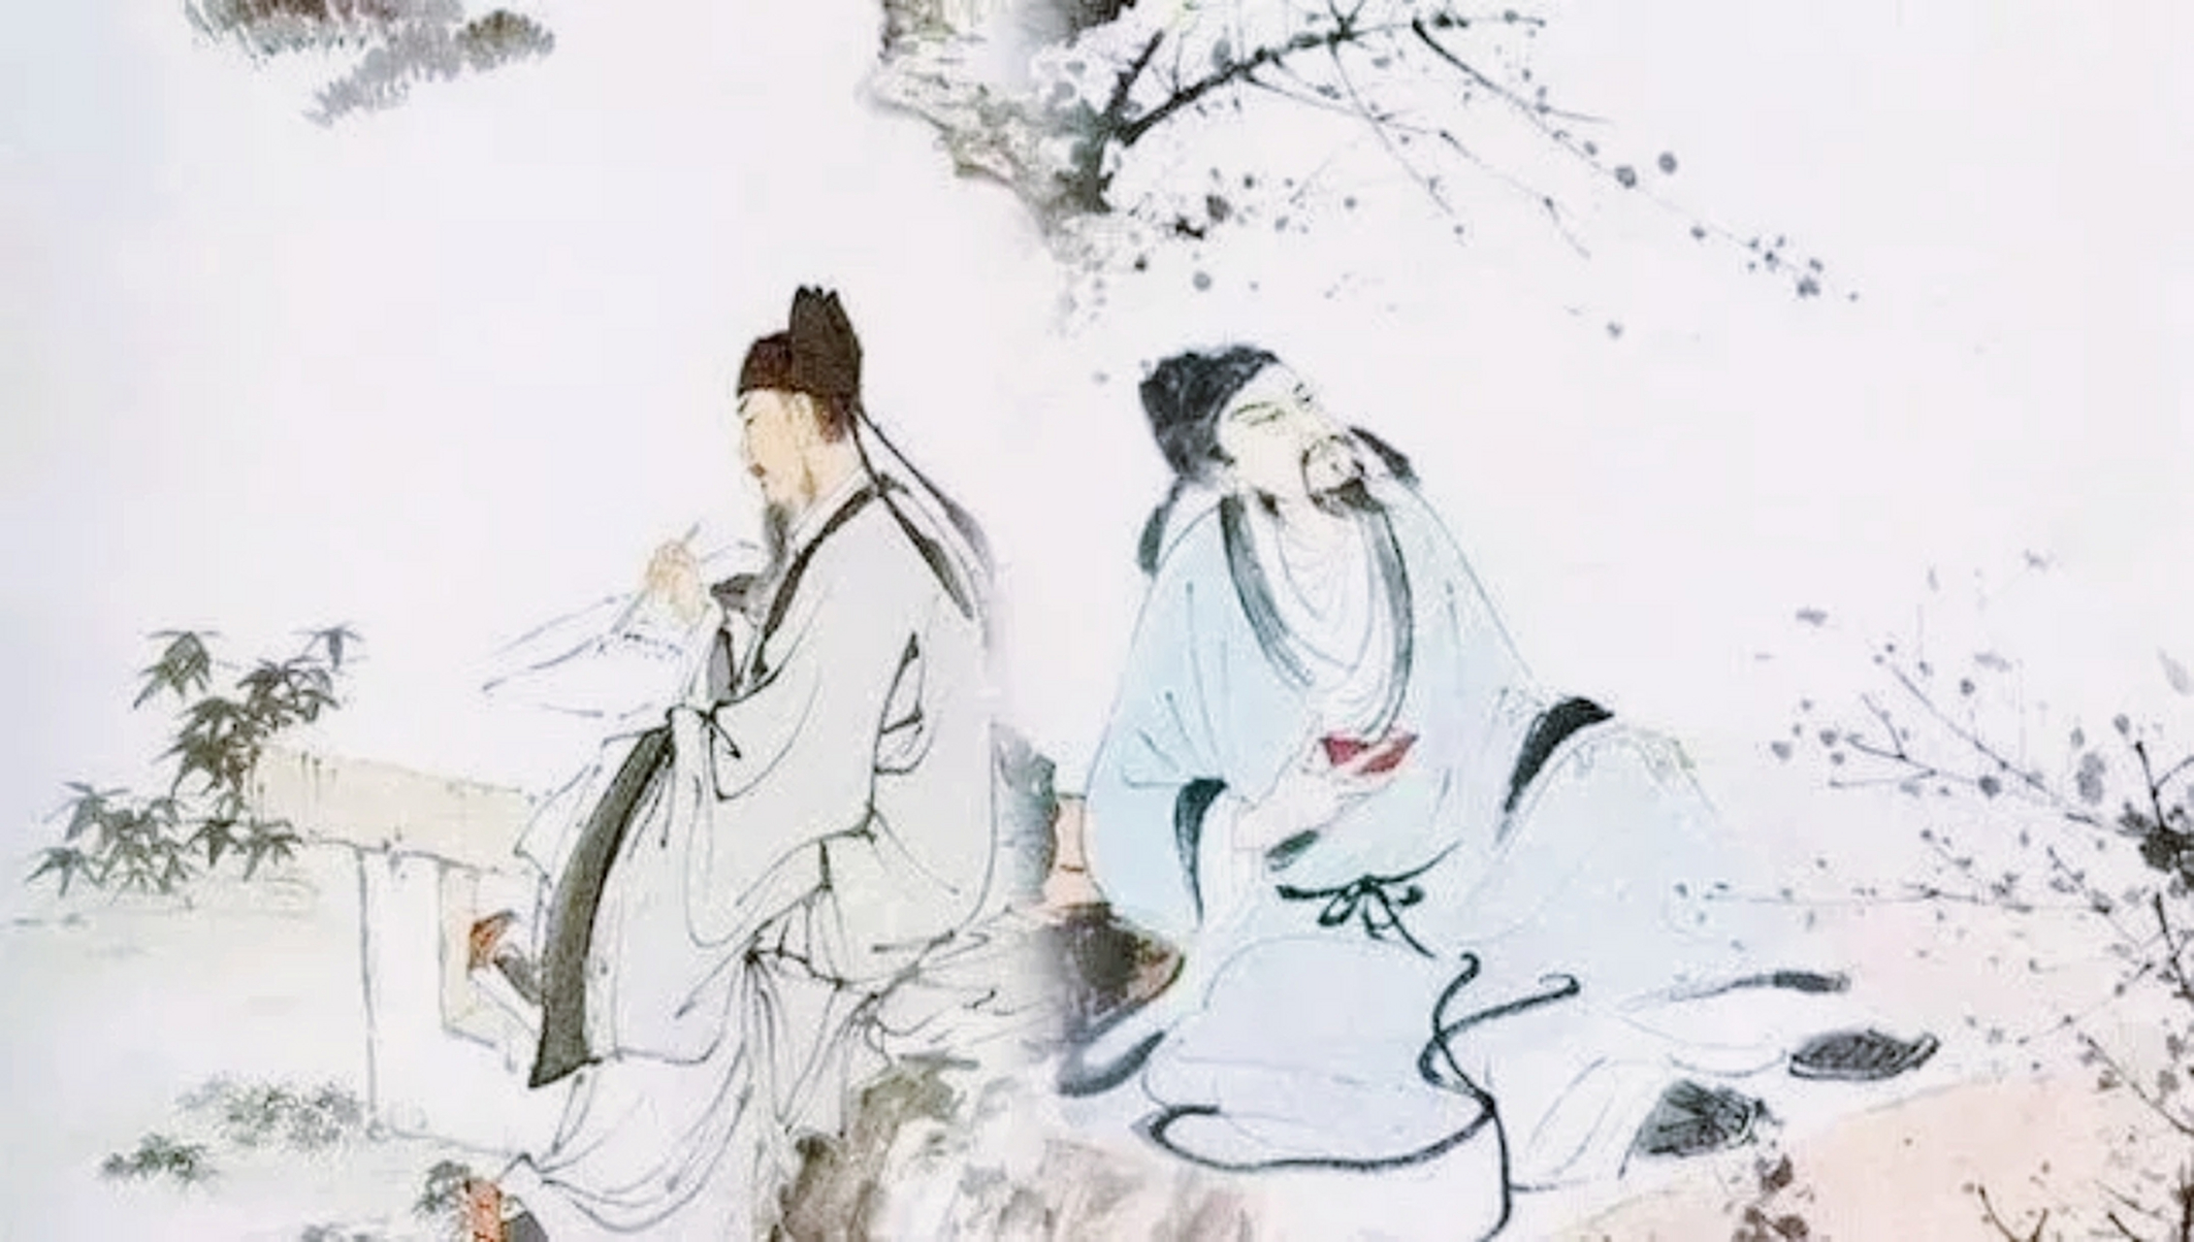
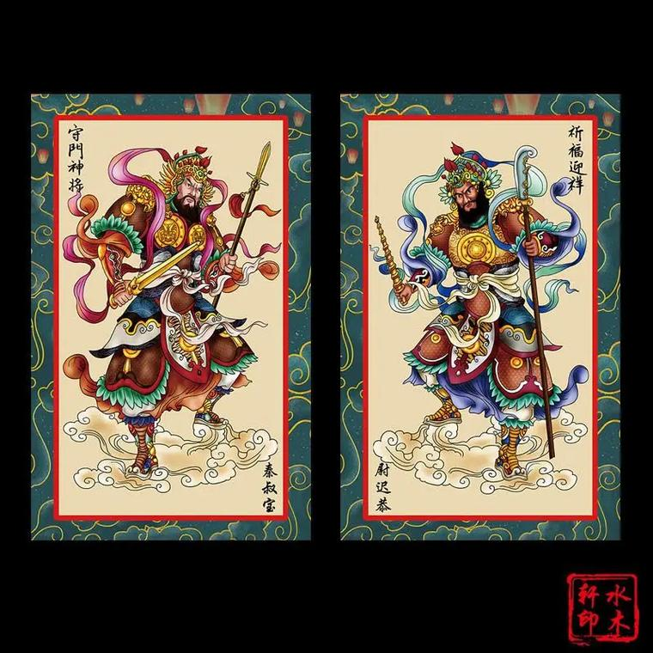
Famous Historical Figures
Historical figures in animations
Animations frequently feature famous historical figures, such as Li Bai and Du Fu, to convey cultural values and provide viewers with a deeper understanding of Chinese history.
Traditional Costumes and Folk Customs
Characters and scenes in animations often incorporate traditional costumes and folk customs, such as cheongsams, Tang suits, couplets, and door gods.

Slide 15
03
Production Techniques

Slide 16
Film Era
Hand-drawn animation
High production costs
Early Chinese animation was primarily hand-drawn, exhibiting a distinctive handmade texture.
Due to high production costs and long cycles, output was limited, making it a time-consuming and expensive process.
Due to high production costs and long cycles, output was limited, making it a time-consuming and expensive process.

Slide 17

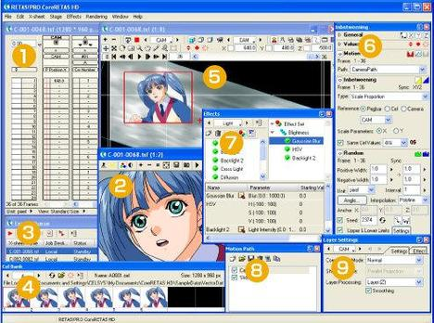
Digital Era
01
Digital animation era
Since the 1980s, with the proliferation of computers, Chinese animation entered the digital "paperless" era.
02
2D animation software
2D animation software such as Flash, RETAS, and TVPaint Animation significantly improved production efficiency.
03
3D software
The introduction of 3D software, artificial intelligence, virtual reality, and other advanced technologies further expanded animation's audiovisual expression.

Slide 18
05
Specific Examples of Japanese Anime's Influence on Chinese Animation

Slide 19
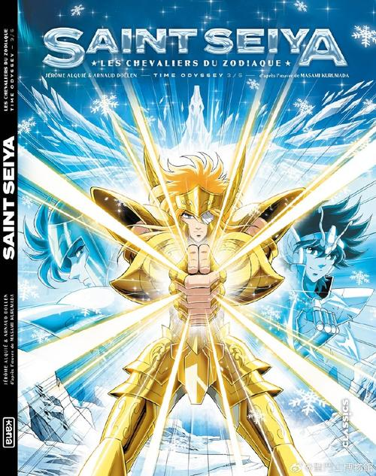
Specific Examples of Japanese Anime's Influence on Chinese Animation
"Saint Seiya"
In the early 1990s, "Saint Seiya" aired on some Chinese
television stations, quickly gaining popularity among teenagers.
Rise of Pirated Markets
The popularity of Japanese anime fueled the rise of pirated
markets, with numerous unauthorized Japanese anime books
and DVDs circulating in the Chinese market.
Pirated Products
Although these pirated products had copyright issues,
they also contributed to the dissemination and acceptance of Japanese anime in China.

Slide 20
06
Specific Examples of Chinese Animation

Slide 21
Specific Examples of Chinese Animation
The Monkey King
Mountain, Water, and Emotion
Three Monks
China's first full-length color animated film, based on "Journey to the West," uses traditional Chinese opera artistic symbols to depict the classic story of the Monkey King's rebellion against Heaven.
An ink painting animation that combines the "three distances" principle of ink painting with camera movement, creating a unique visual experience.
An animated short with minimalist styling and profound symbolism, winning awards at the Berlin International Film Festival.

Slide 22
Specific Examples of Chinese Animation
Nezha Conquers the Dragon Kings
China's first full-length color widescreen animated film in 1979, celebrating the 30th anniversary of the founding of the People's Republic of China.
Monkey King
Hero is Back: A recent critically acclaimed animated film featuring the Monkey King as the protagonist, depicting his adventures in the modern world.
Poetry in Motion
Three Thousand Miles in Chang'an: Depicting the life experiences of poet Li Bai, it incorporates rich historical and cultural elements, allowing viewers to see themselves through culture and stories.

Slide 23
07
Conclusion

Slide 24

Conclusion
Foreign Influence and Innovation
While inheriting and developing traditional culture, Chinese animation has been profoundly influenced by foreign cultures, particularly Japanese anime.
New Stages of Development
Through borrowing and innovation, Chinese animation is continuously advancing towards new stages of development.

Slide 25
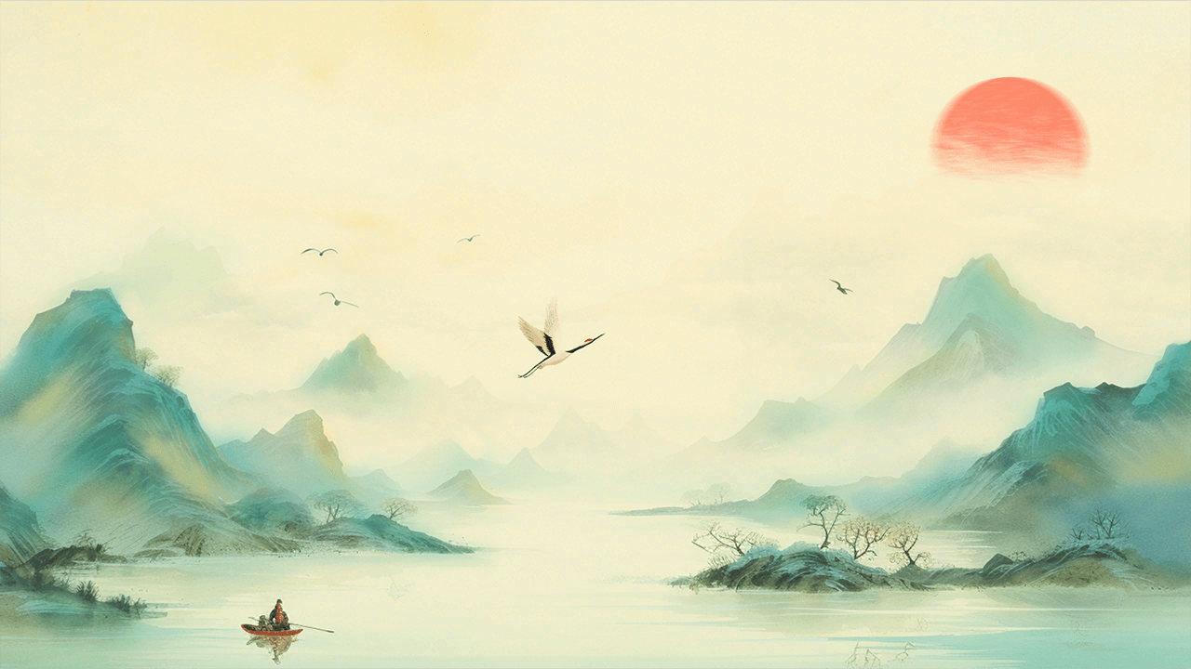
THANKS
Q&A

