Slide 1
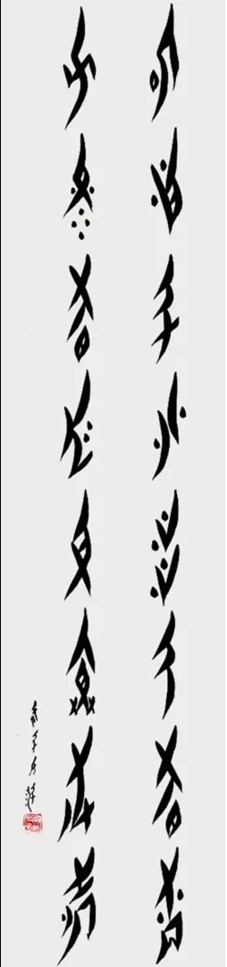
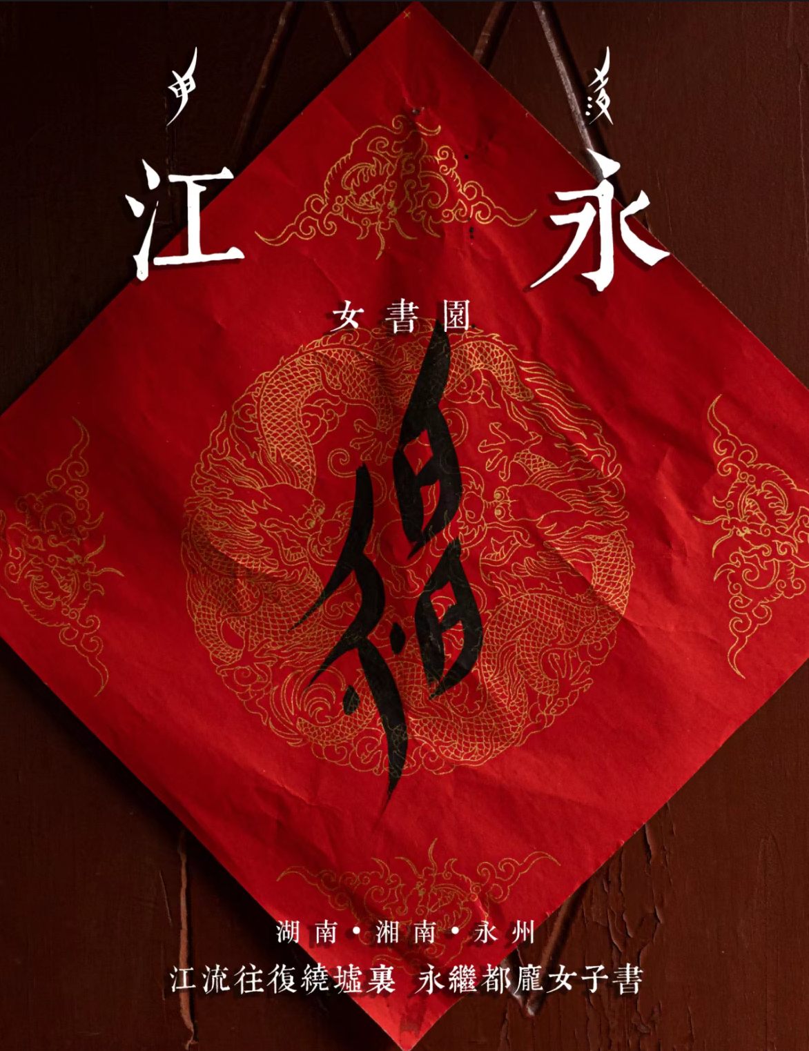
What is Women’s Script?
Nüshu, also known as Jiangyong women’s script, is a unique Chinese writing system.
Nüshu is essentially a syllabary, with one character essentially recording one syllable. The strokes Women’s Script are rounded, smooth, and predominantly small and delicate.
Its appearance is characterized by the rhomboid-shaped outline of the characters, the beautiful and delicate handwriting, and the unique shape of the characters, which is why they are also called “mosquitoes with long feet”.

Slide 2
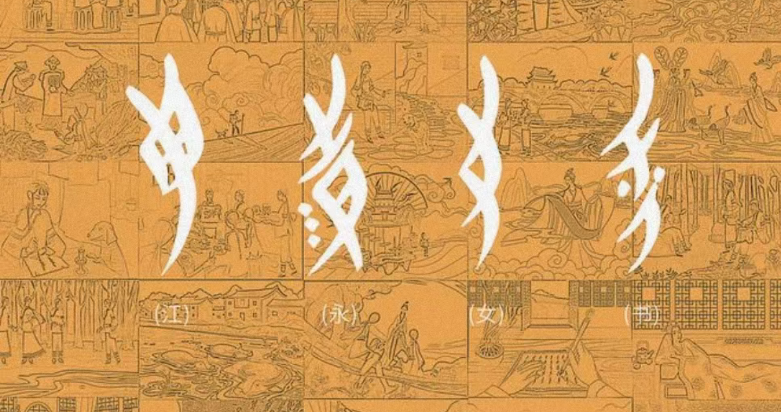
What is Women’s Script?
Narrowly speaking, it originated in Jiangyong County, Yongzhou, southern Hunan Province, China. It is a Chinese dialect syllabic script (汉语方言音节表音文字) specialized for Jiangyong Nüshu (Women’s Script) in Hunan Province. It is the only gender-based script in the world, created and used by women, and passed down among women.
Broadly speaking, Nüshu is not just a script; it includes the customs and culture of Nüshu, encompassing the human geography that gave rise to this culture, various customs and practices in the areas where Nüshu is circulated, as well as works written in the Women’s Script and objects inscribed with this script.
In 2006, the practice of Women’s Script was included in the first batch of China’s National Intangible Cultural Heritage List.

Slide 3
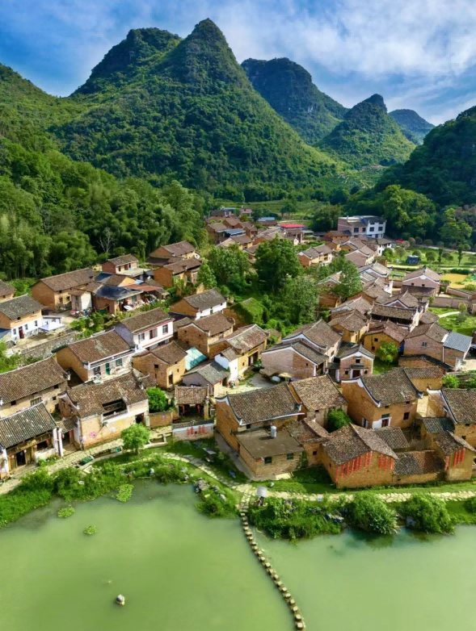
WHY & WHERE & WHEN
For a long time, Chinese women have been bound by traditional feudal moral culture, and the old mentality in China used to prevent local women from learning to read and write, which they called “men’s scripts”.
The suffering of women in Jiangyong County is even more severe.
men: dominance
women: no personal freedom
the opposition between genders : extremely sharp

Slide 4
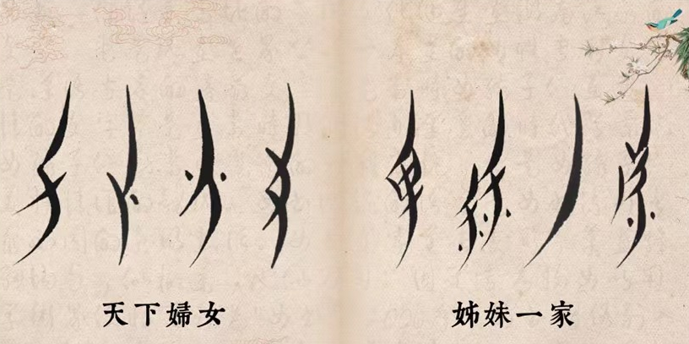
WHY & WHERE & WHEN
  Therefore, Women’s Script and its culture are the products of social deviance and norms——the result of women’s resistance.

Slide 5
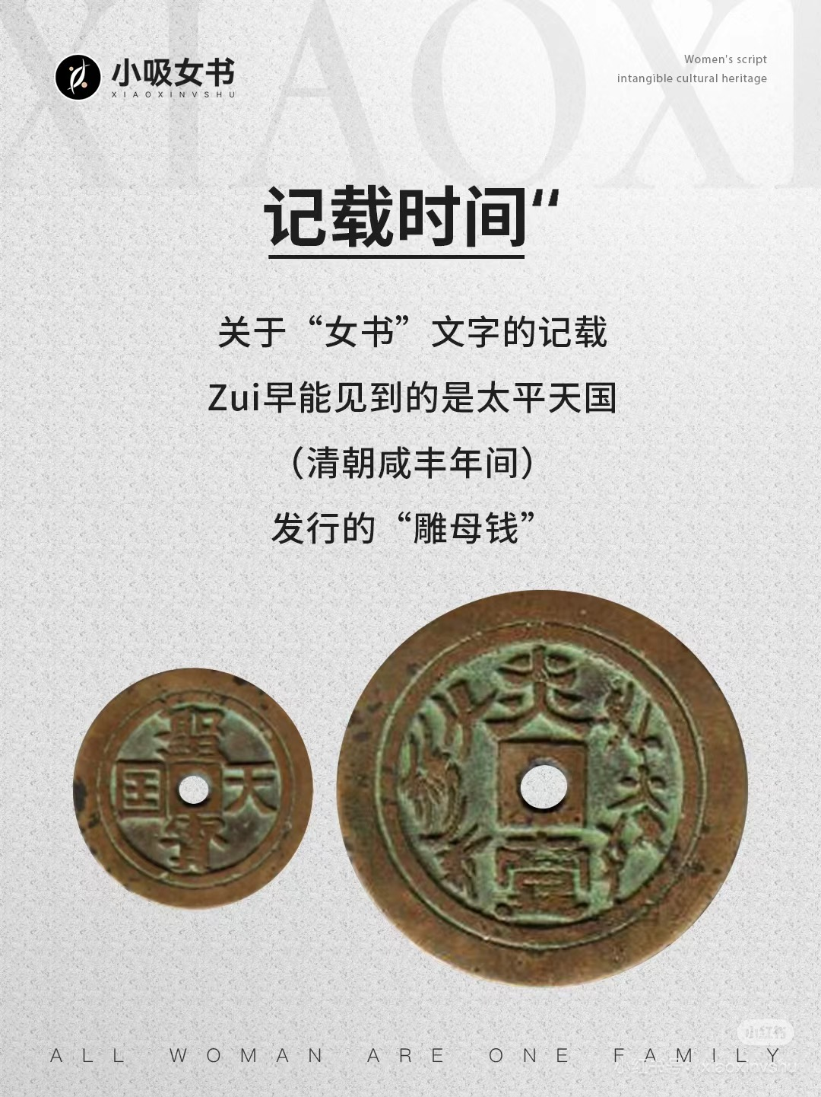
WHY & WHERE & WHEN
  雕母钱
  正面：天国圣宝
  背面中间：炎壹
  右面：天下妇女
  左面：姊妹一家

Slide 6
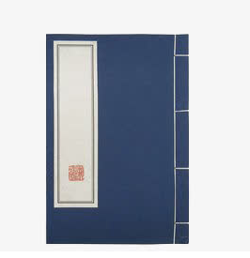
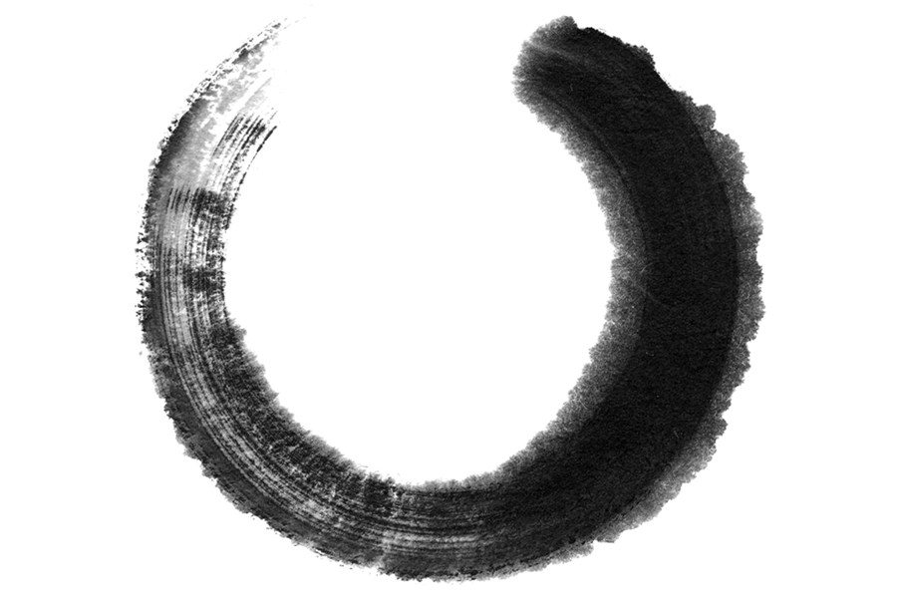




TWO
Form and Content
江永
女书

Slide 7
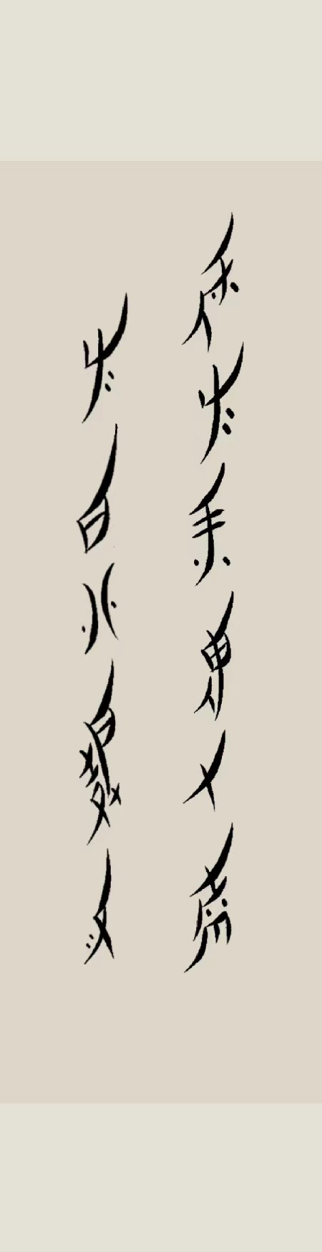
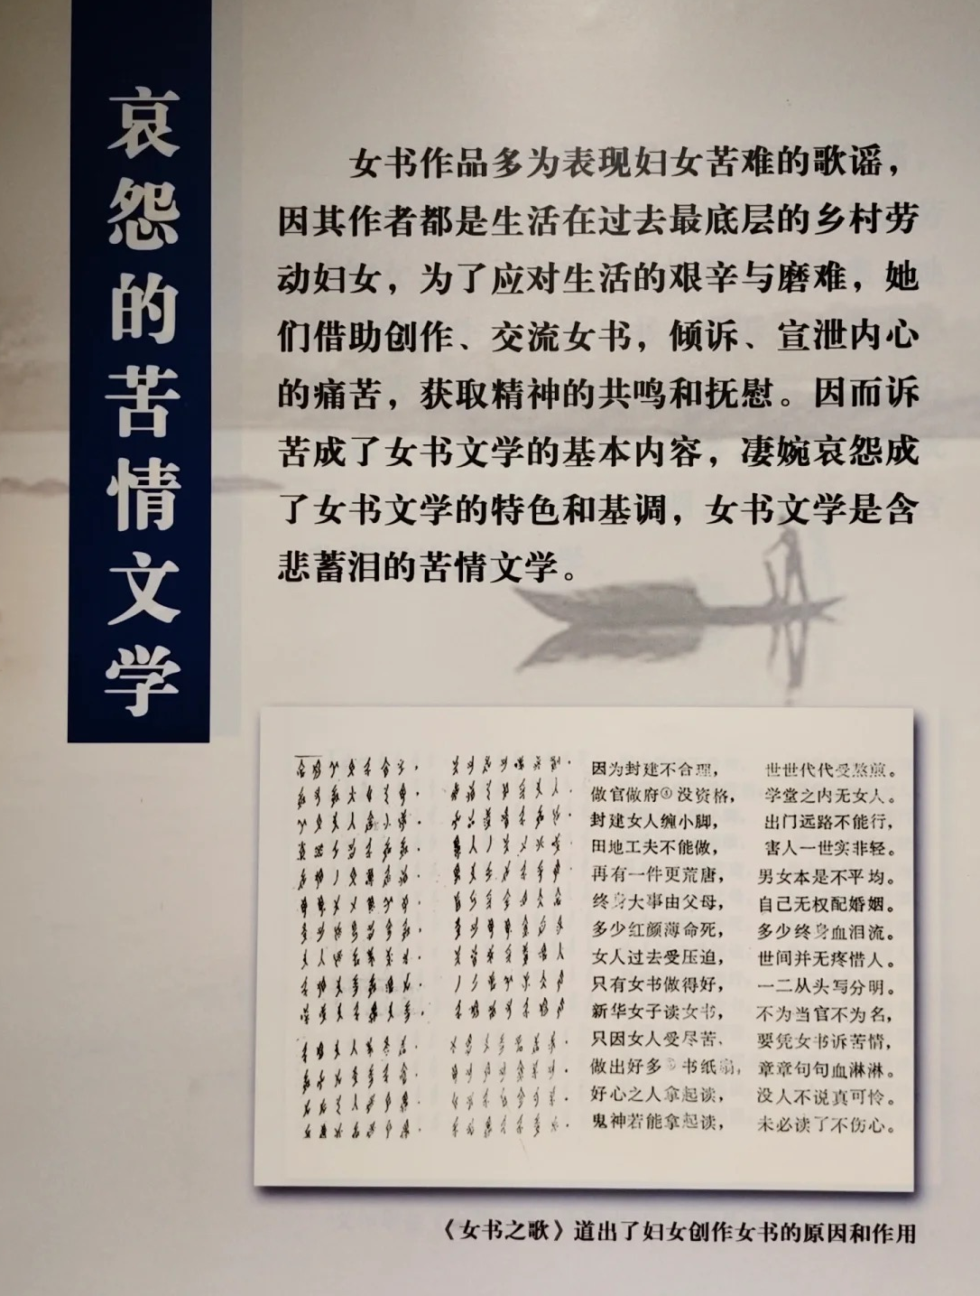
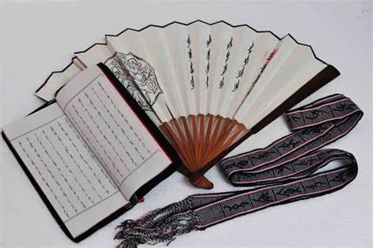
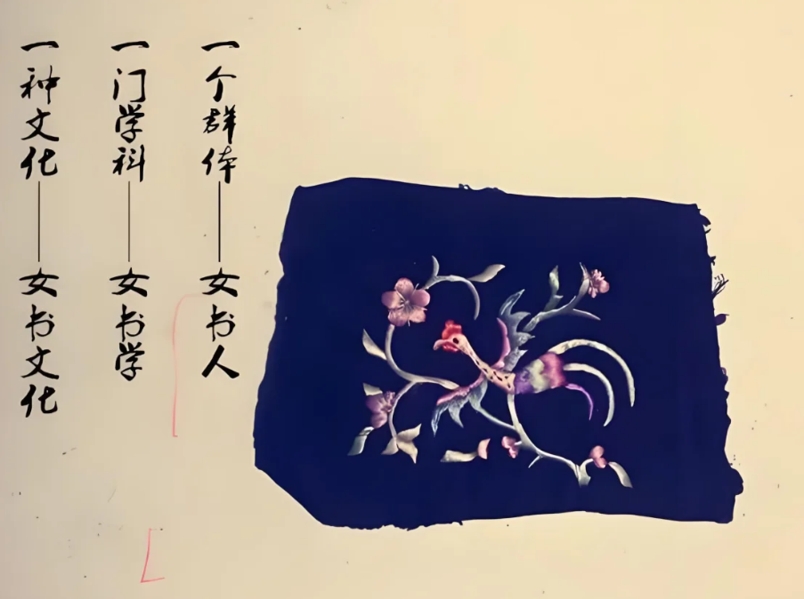
FORM & CONTENT
  Most of the works in the Women’s Script are sung in seven-character poems (七言诗体唱本), and their carriers are divided into four categories: paper, books, fans and scarves (纸、书、扇、巾). （读纸、读扇、读帕）
  Expressing grievances became the basic content of Nüshu literature, and a tone of poignant sorrow became the characteristic of Nüshu literature.

Slide 8
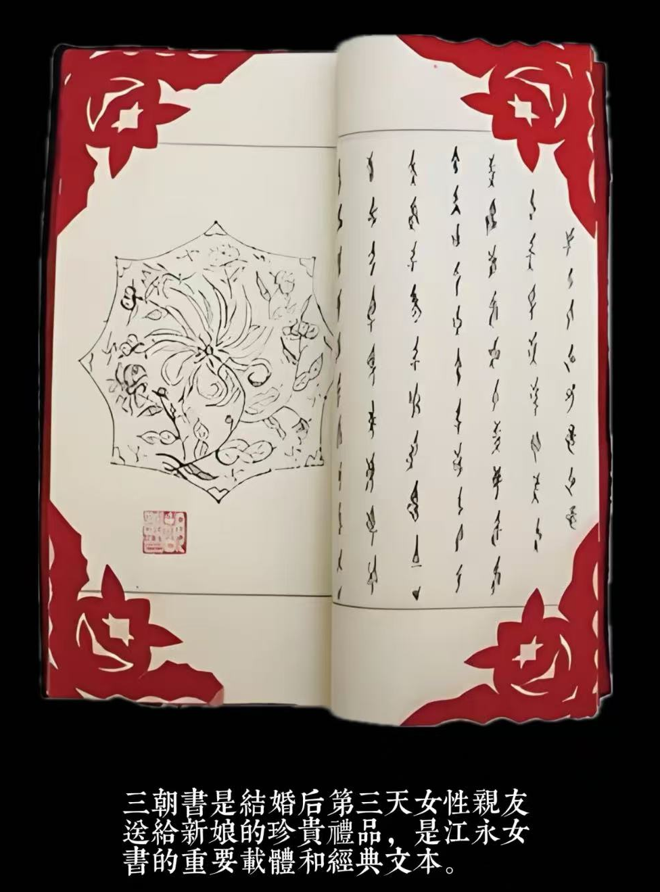
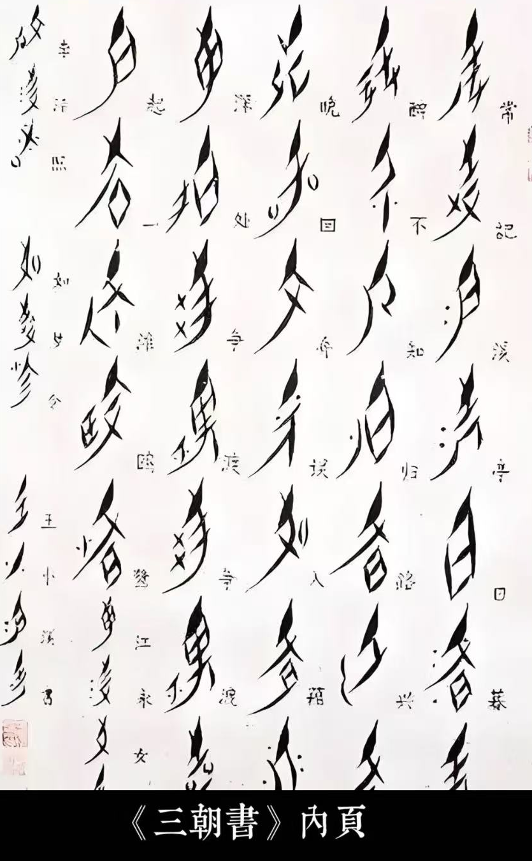
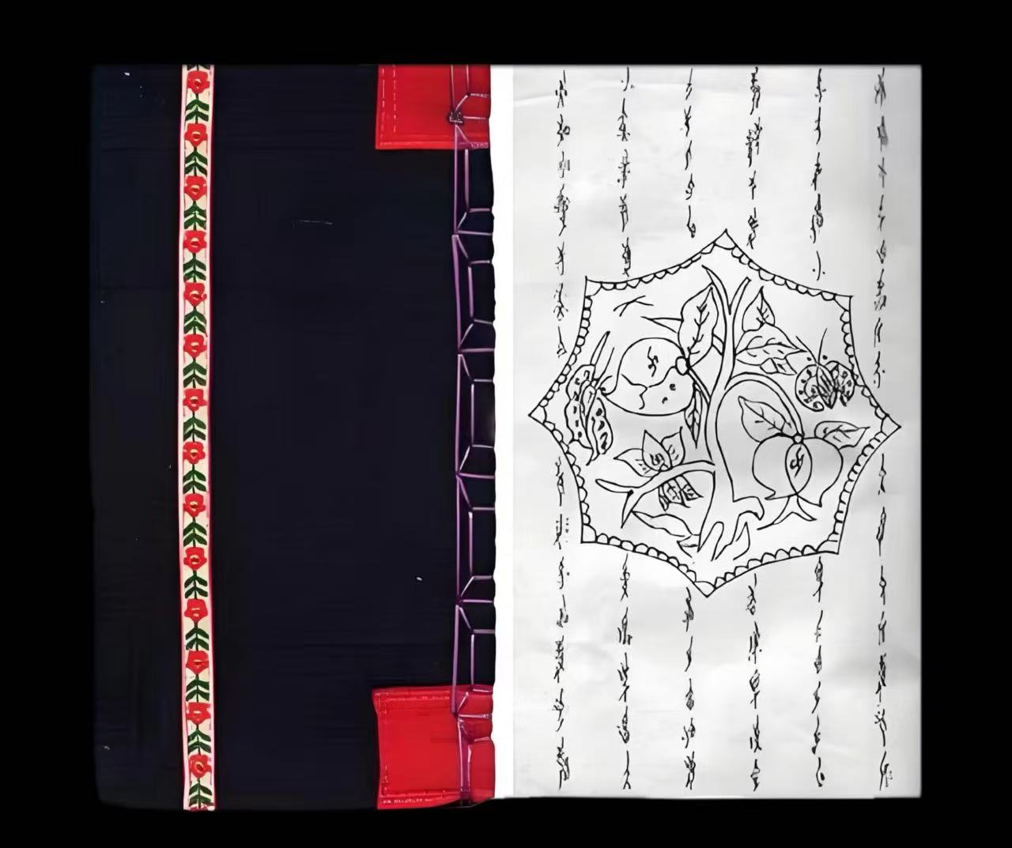
FORM & CONTENT
  1. Joyful works, such as “Sanzhaoshu” and “Kujia Song”;
  三朝书

Slide 9
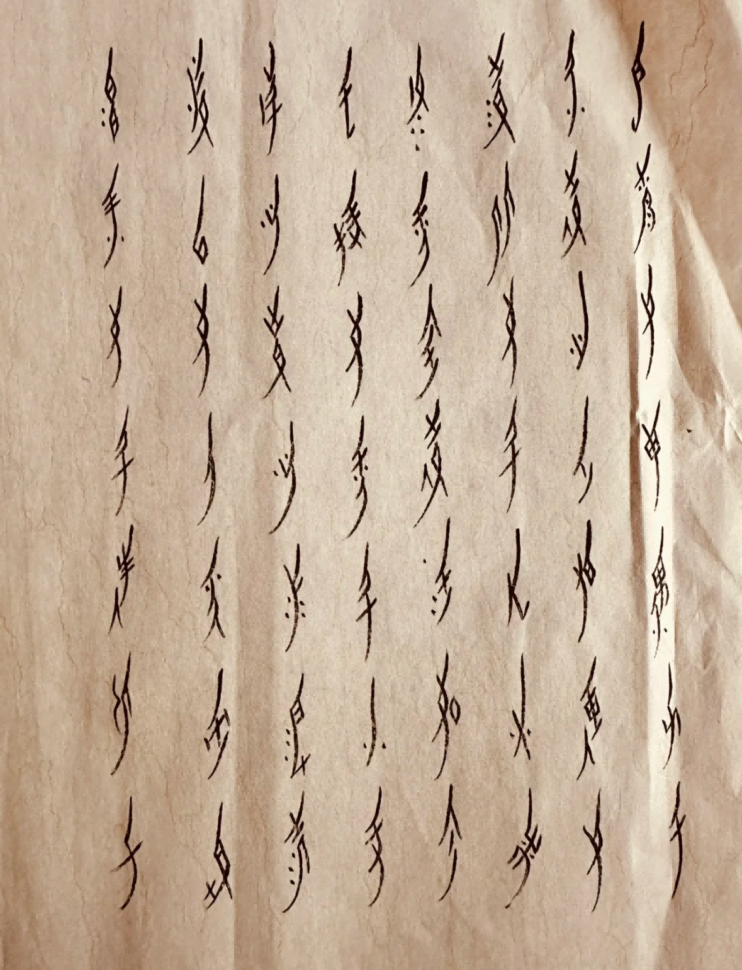
FORM & CONTENT
  2. Ritual works, including memorials to recently deceased relatives and prayers to the gods;
  3. Communicative works, involving letters of engagement, thanks, condolences, scolding, etc;
  4. Memory works, including diaries and biographies;
  5. Educational and entertainment works, including ethical works, historical stories, legends, songs and riddles, etc.;
  6. Songs, such as “Chinese Women’s Script”.
  锦绣文章达万千，不信世间有奇文。
  永明女子好才学，修书传诵到如今。
  手捧女书仔细看，字字行行写得清。
  谁说女人无用处，从来女子半边天。
  《女书之歌》

Slide 10
THREE
Women’s Script Teaching
江永
女书

Slide 11
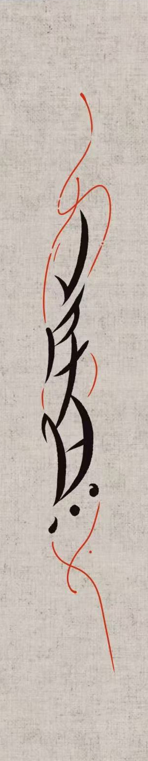
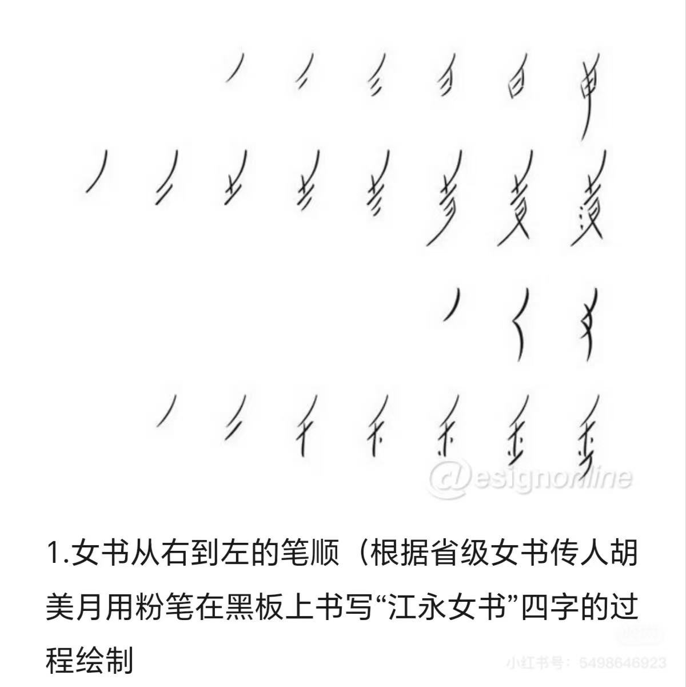
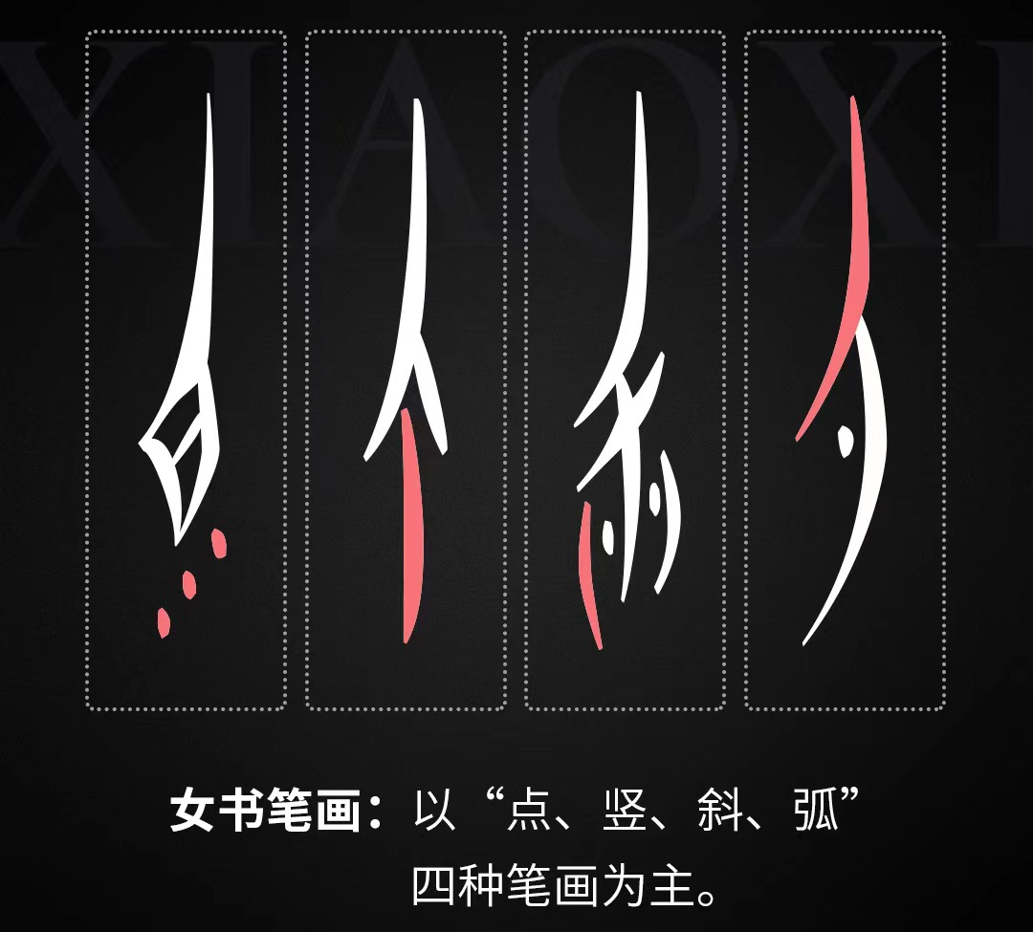
Women’s Script Teaching

Slide 12
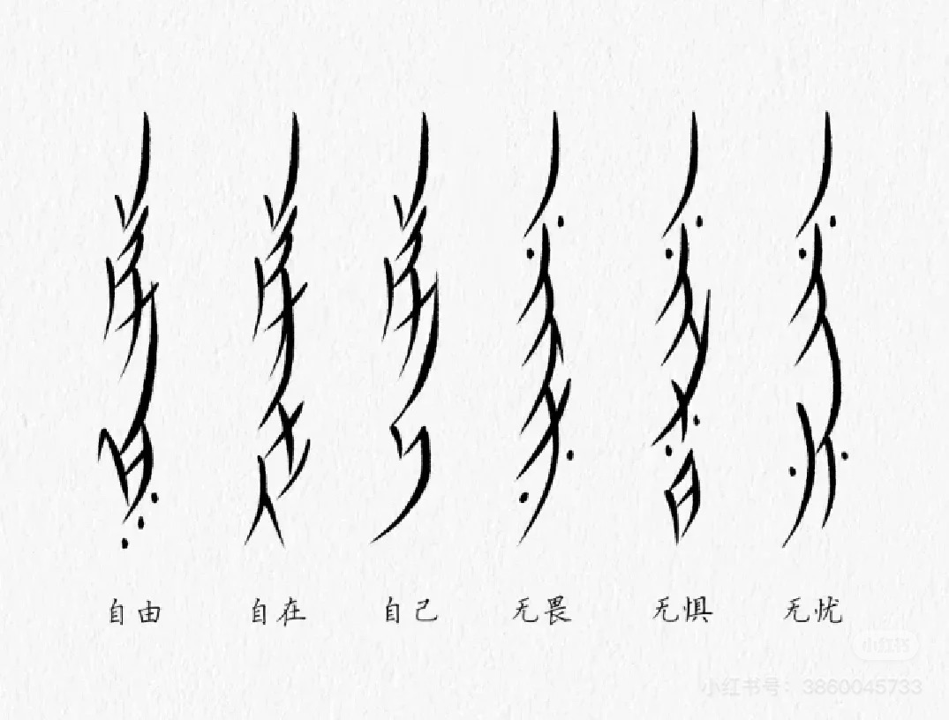
Women’s Script Teaching

