Slide 1
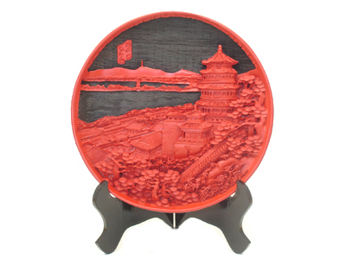
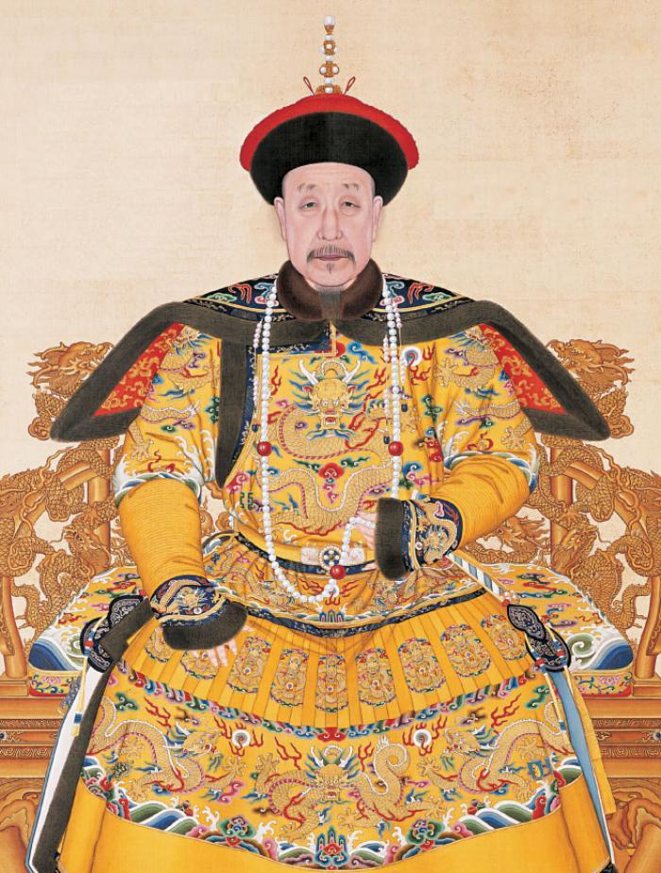
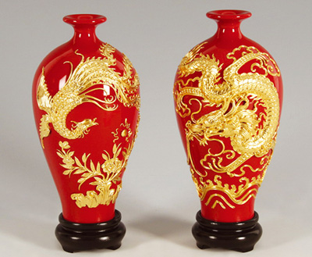
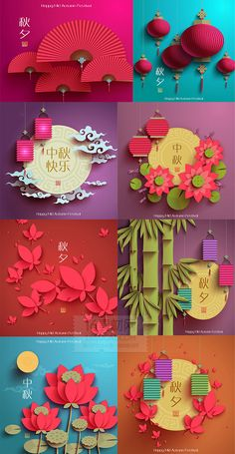
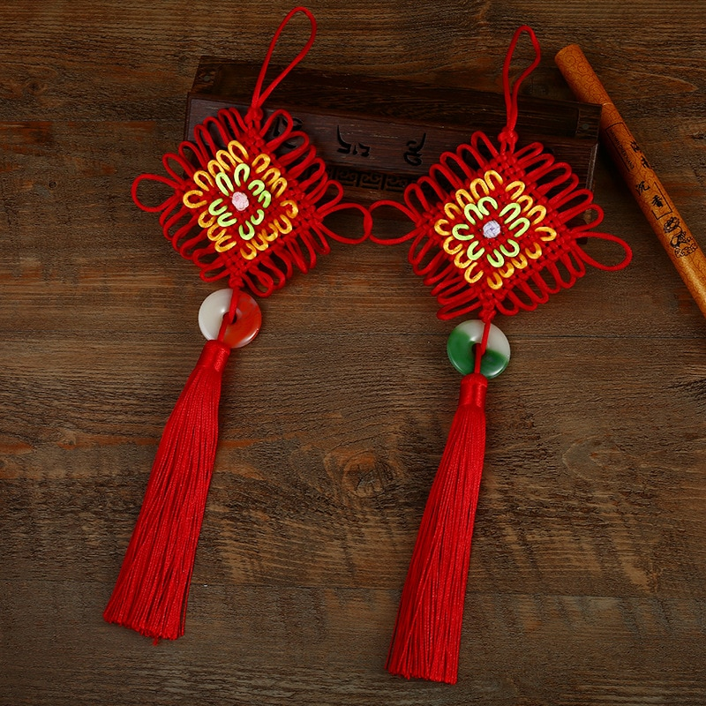
China Traditional Craft
Teacher: Martin woesler – CHINESE LANGUAGE AND CULTURE.
Student: Lo minh thao

Slide 2
Definition:
Lacquer ware are objects decoratively covered with lacquer. Lacquer ware includes small or large containers, tableware, a variety of small objects carried by people, and larger objects such as furniture and even coffins painted with lacquer. Before lacquering, the surface is sometimes painted with pictures, inlaid with shell and other materials, or carved. The lacquer can be dusted with gold or silver and given further decorative treatments.

Slide 3
Lacquerware
Part 1: History of Chinese lacquerware
Part 2: How to make a lacquer
Part 3: The development and the influence of lacquerware

Slide 4
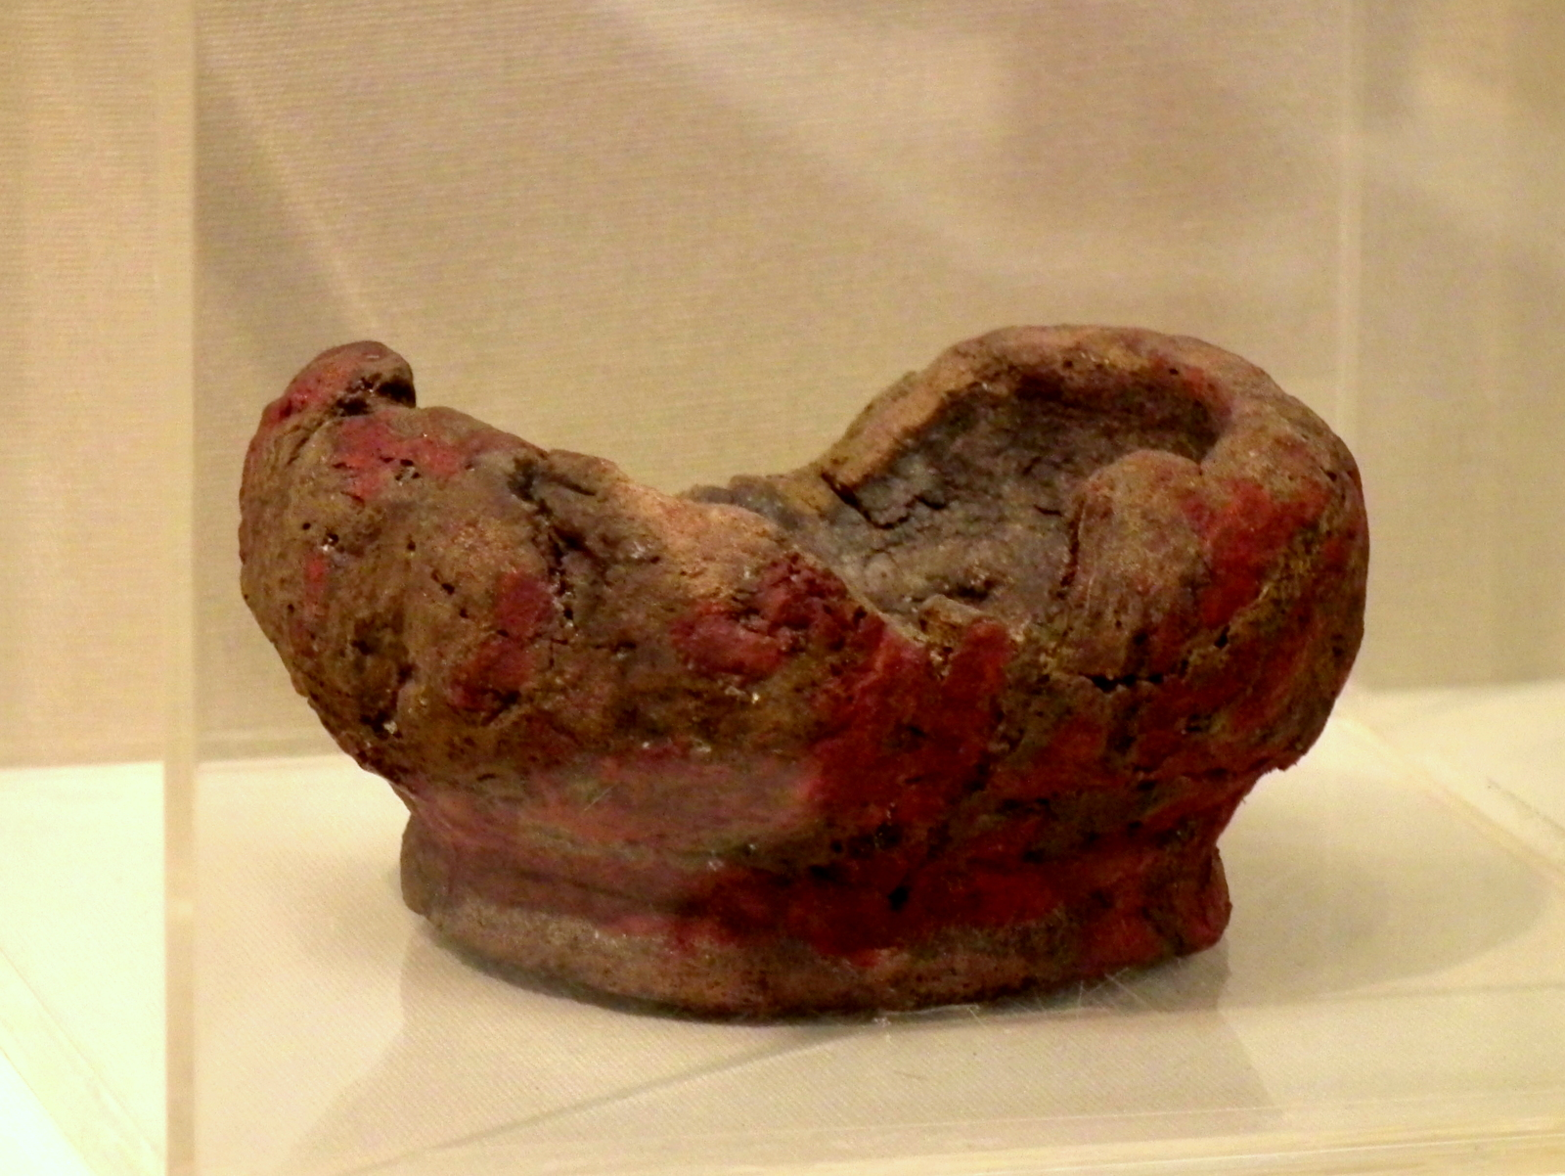
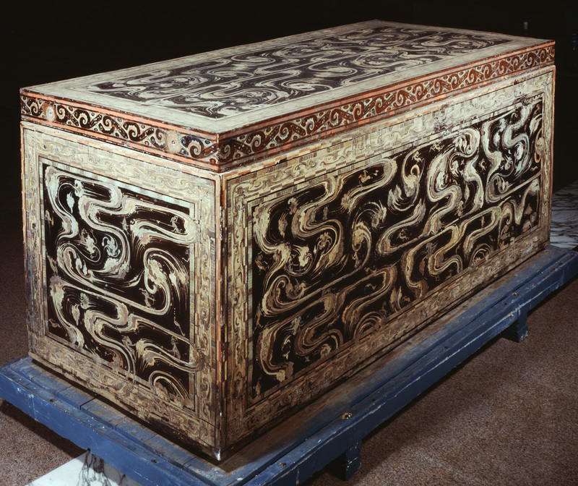
Lacquerware
Lacquer bowl in Hemude Culture(5000-4000BC)
Part 1-History:
Chinese lacquerware has a very long history. There’s a bowl proves that lacquerware had been appeared before 5,000-4000BC.
The coffins unearthed in 1972 at Mawangdui, Changsha prove that lacquerware as an art reached a new height in the Han Dynasty (206-220AD). Decorating with a lacquer picture showing people, deities, animals and clouds
Black Lacquer Coffin Mawangdui, Changsha, Hunan provice 206-220AD
(Hunan Museum)

Slide 5
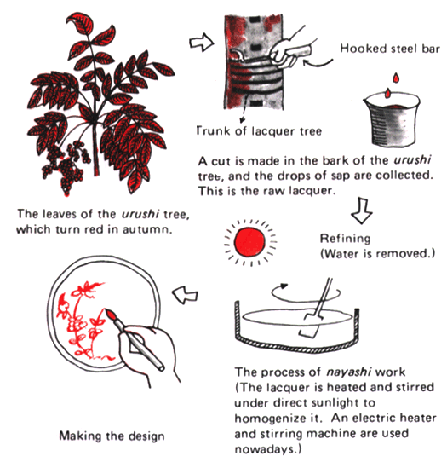
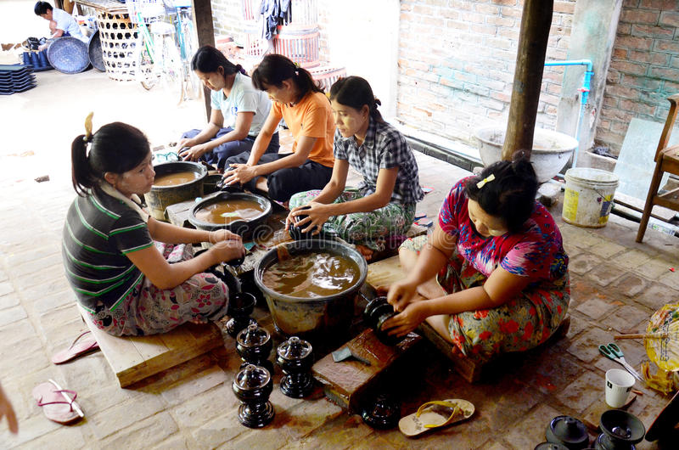
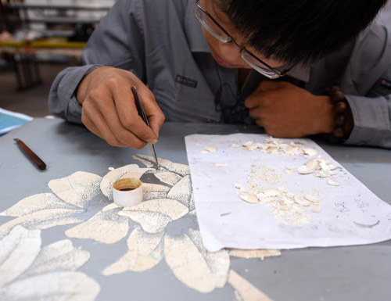
Lacquerware
Part 2: How to make a lacquer
Chinese lacquer is a natural varnish made from the sap of the lacquer tree - dries on exposure to air to a form of plastic coat ( resistant to water and acid or alkaline corrosion.)
Chinese lacquer body made from wood, bamboo, leather or metal can be applied with or without a coloring agent.
Early: restricted 2 colors black and vermilion but now it more developed with not only colorful but also inlaied with gilding, silver, jade..

Slide 6
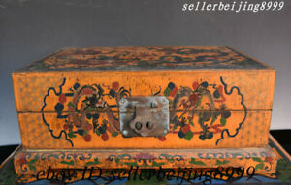
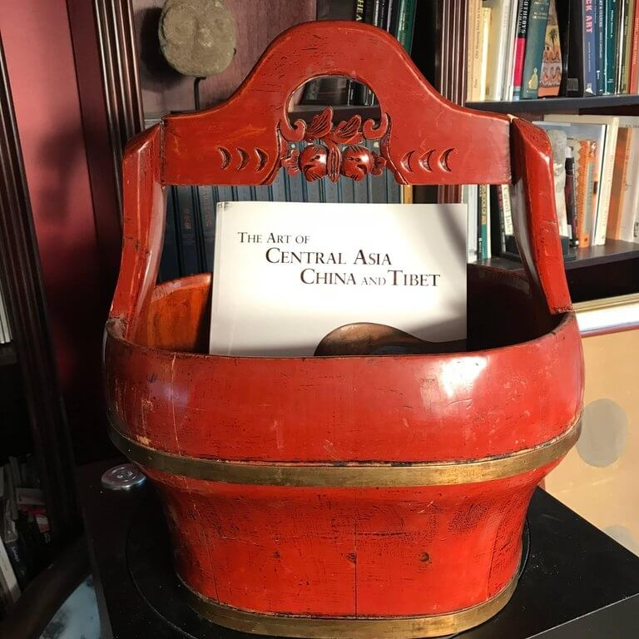
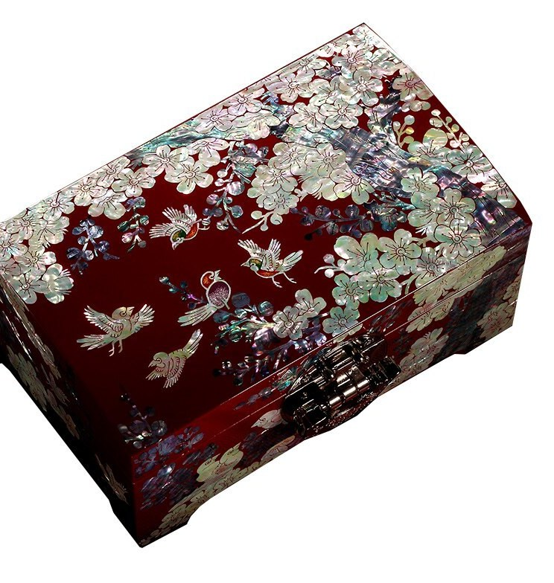
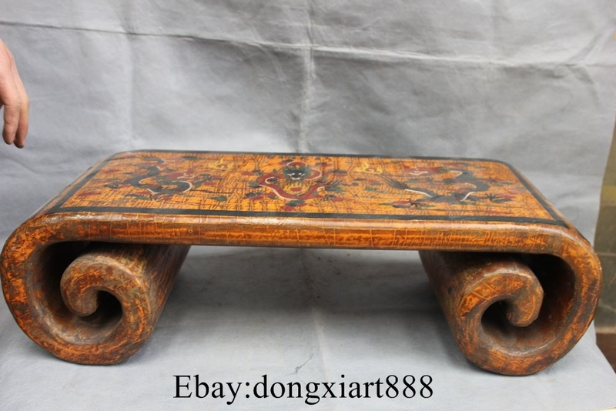
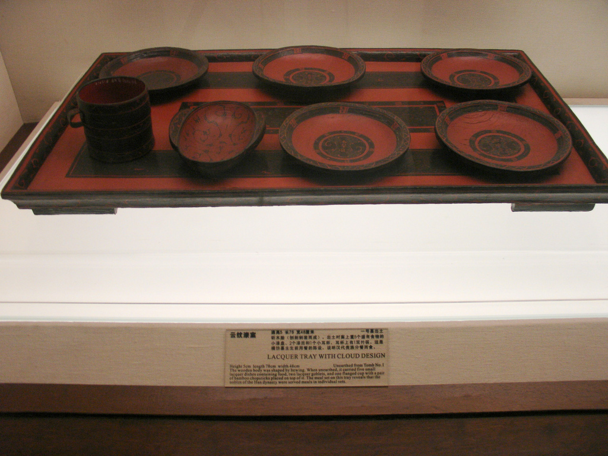
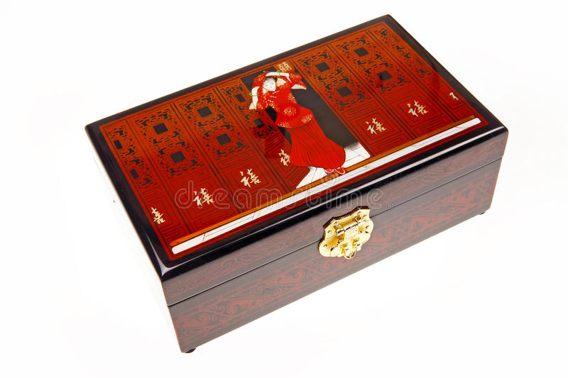
Lacquerware
Wood Lacquerware Double Dragon Storage Jewelry Case Box Statue
BIRD TREE TABLE
Part 3: The development and the influence of lacquerware
Lacquerware is produced in Bejing, Shanghai, Fuzhou, Yangzhou, Yinchuan, Chongqing, Pingyao and other places –BJ Lacquerware is developed from the techniques used in imperial workshop of Ming and Qing dynasties.
Emperor Qianlong (1711-1799) of the Qing Dynasty had a special fondess for carved lacquerware. During his reign produced lacquer thrones, screens and tables and he even buried in a carved lacquer coffin.
TRAPPING BOX
Emperor Qianlong (1711-1799)

Slide 7
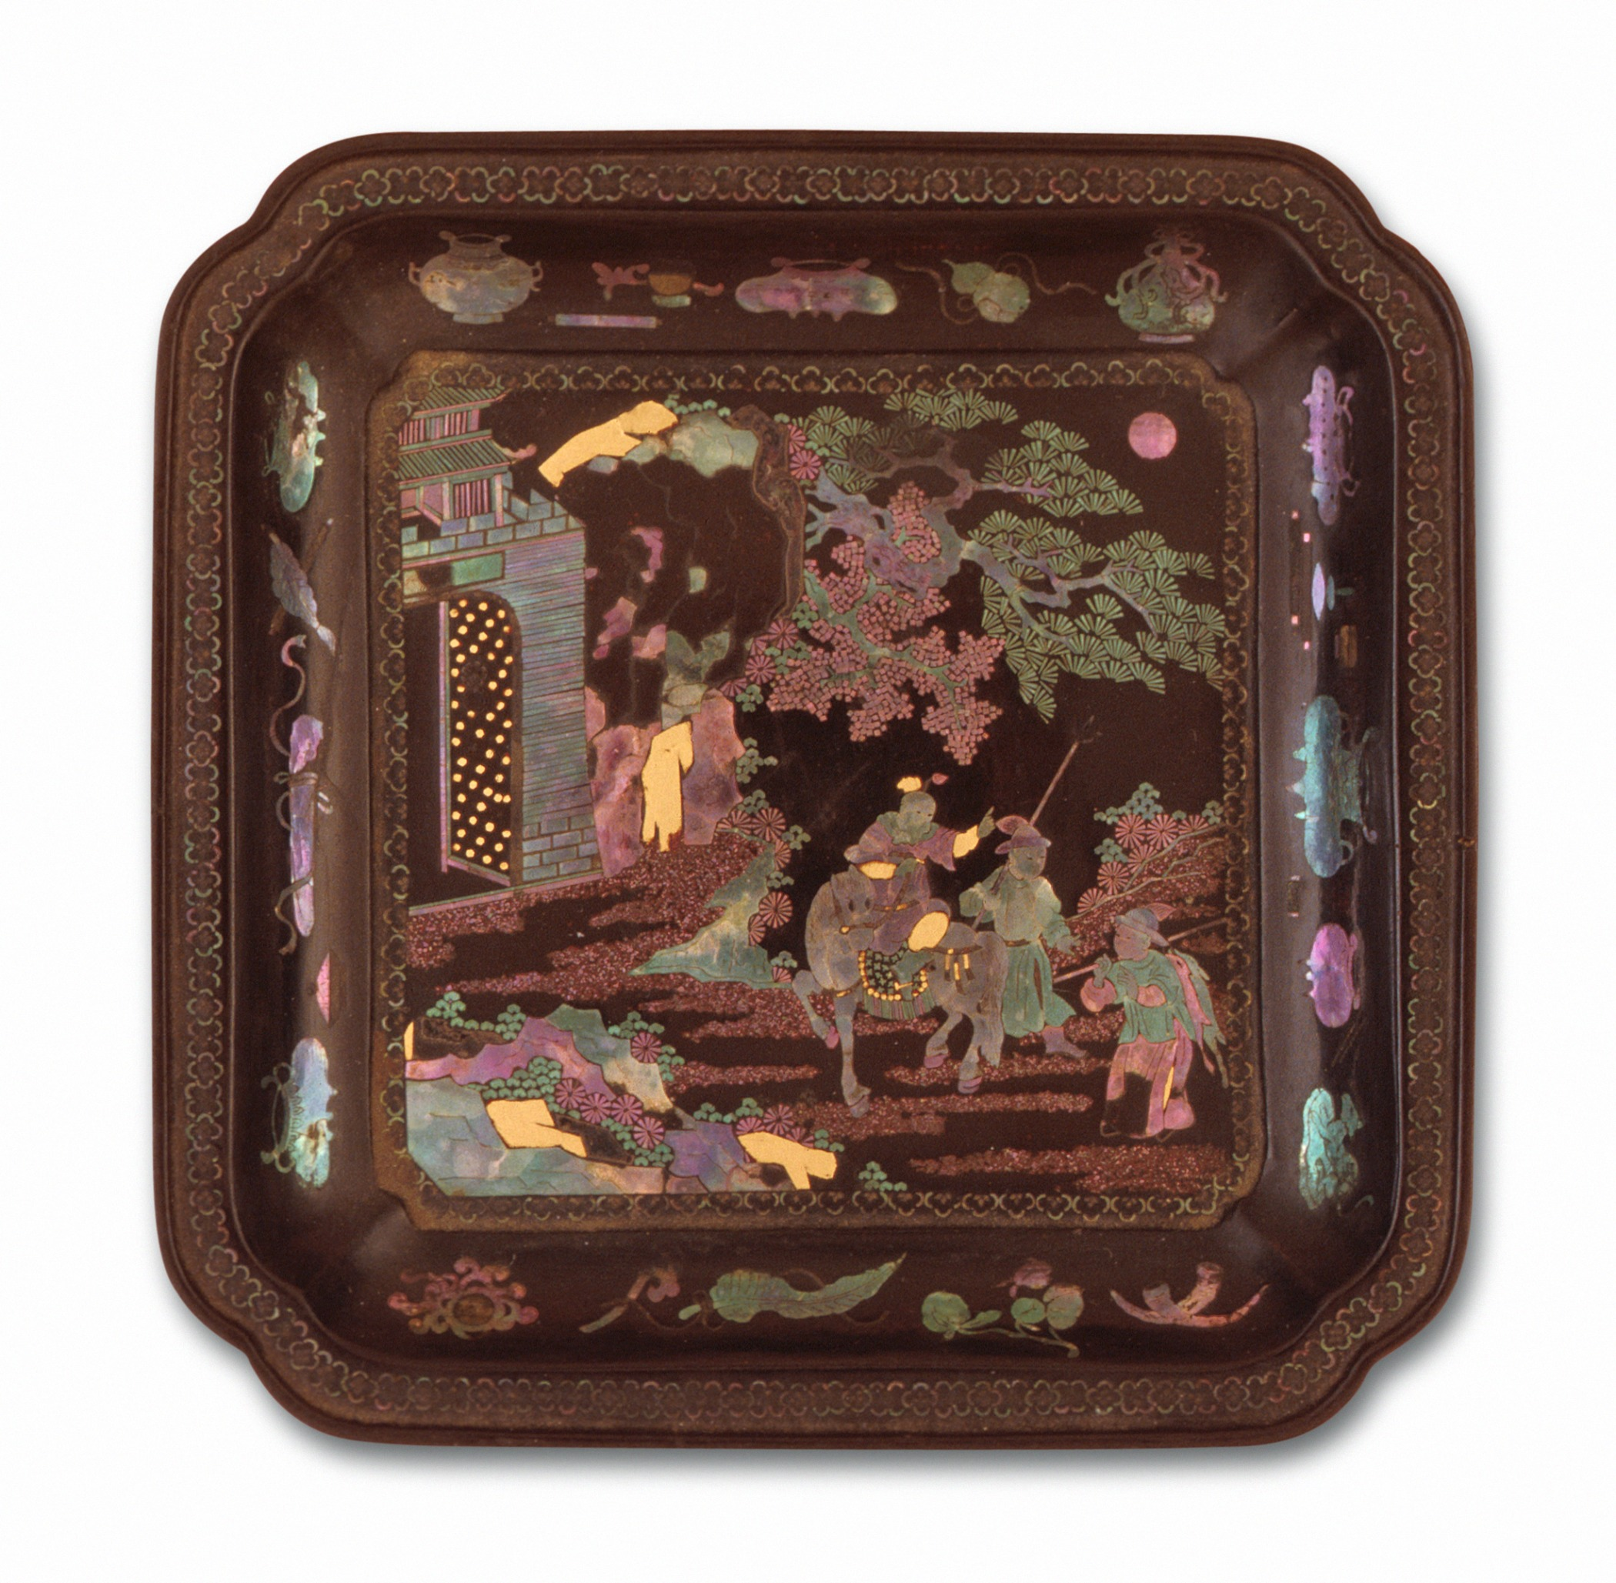
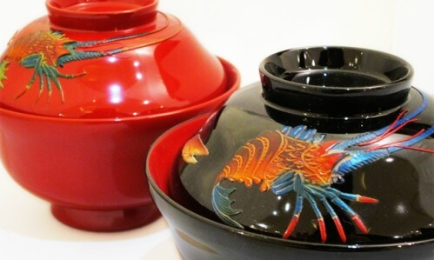
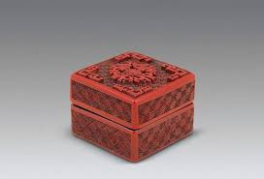
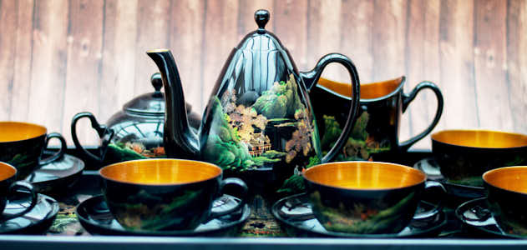
Chinese lacquerware is elaborate in workmanship, elegant in appearance and harmonious in color. Lacquer objects are works of are as well as articles for daily use, including screens, cabinets and coffee tables. They have enjoyed popularity with people at domestic and international for many centuries and are still popular today around the word.

Slide 8

China Traditional Craft Teacher: Martin Woesler – CHINESE LANGUAGE AND CULTURE. Student: Lo Minh Thao
Thank you for your listening

Slide 9


