Slide 1

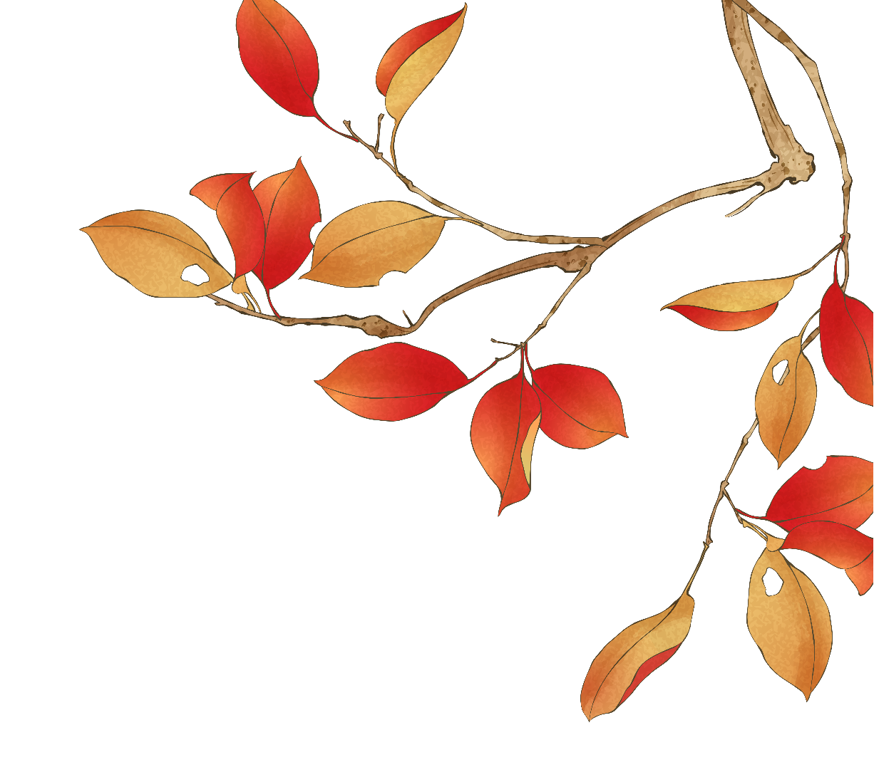
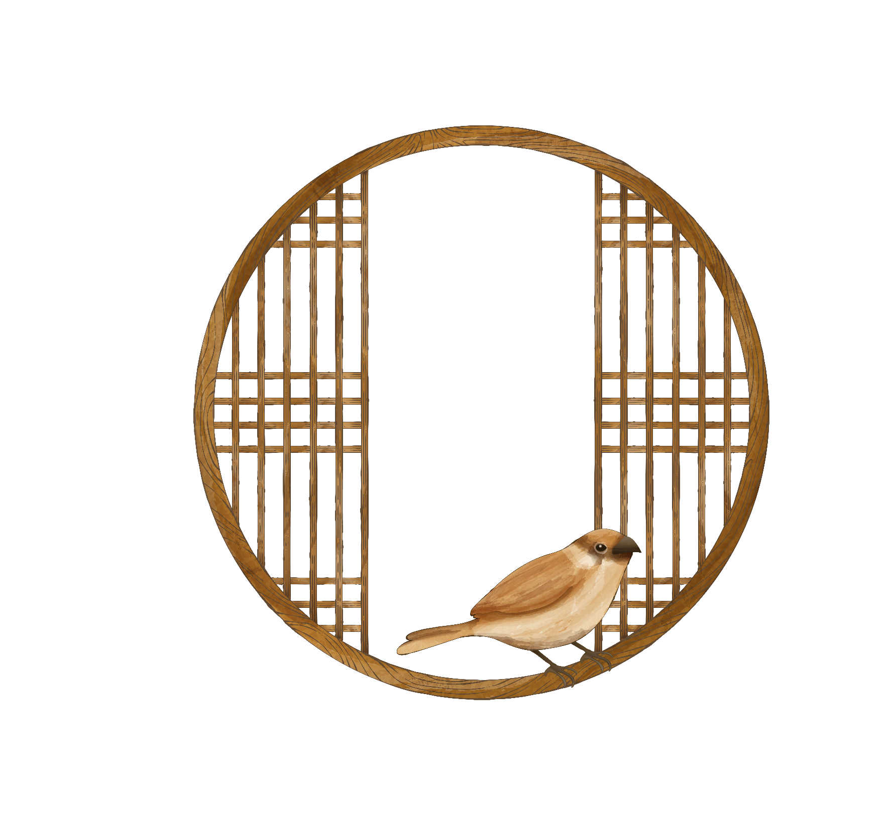
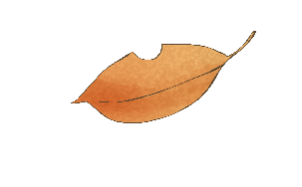
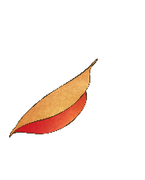
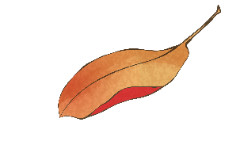
The Story of Minglan
知否知否，
应是绿肥红瘦
24英语笔译
叶思彤

Slide 2


壹
贰
目 录
Tea Culture
Marriage Customs
CONTENTS
betrothal goose
veil-lifting ceremony
叁
Polo

Slide 3
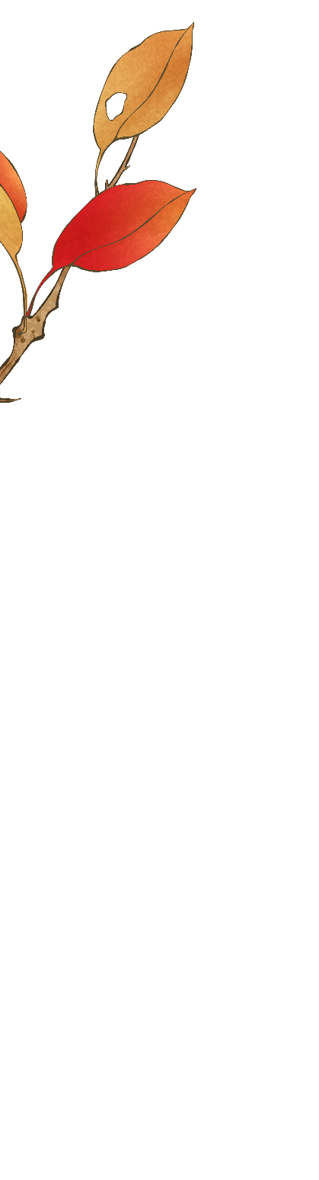
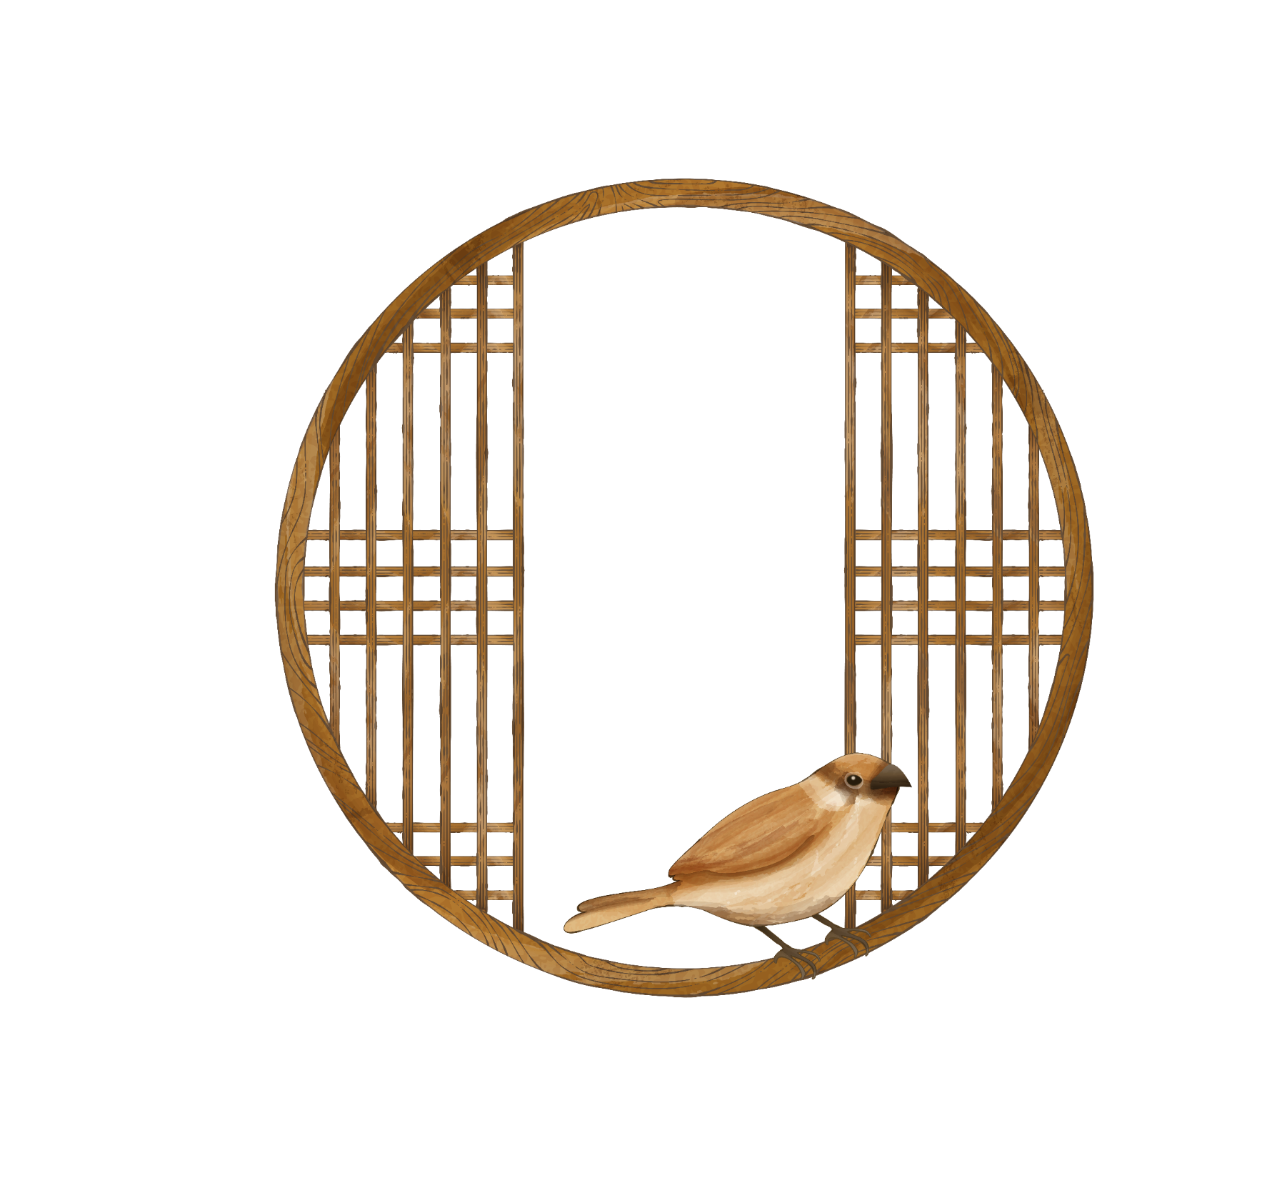

壹
Marriage Customs
PART ONE

Slide 4
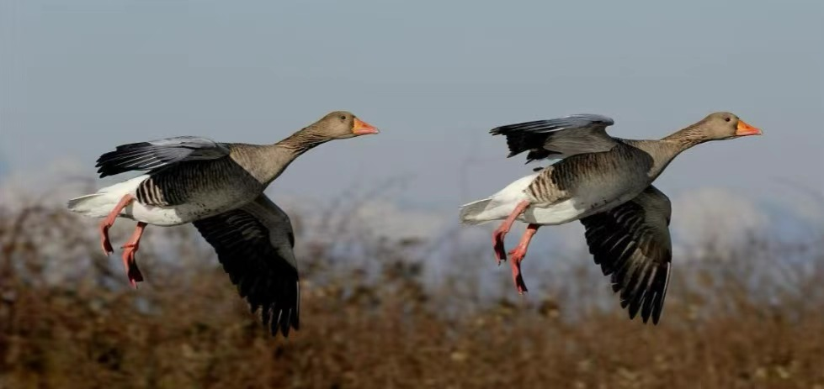
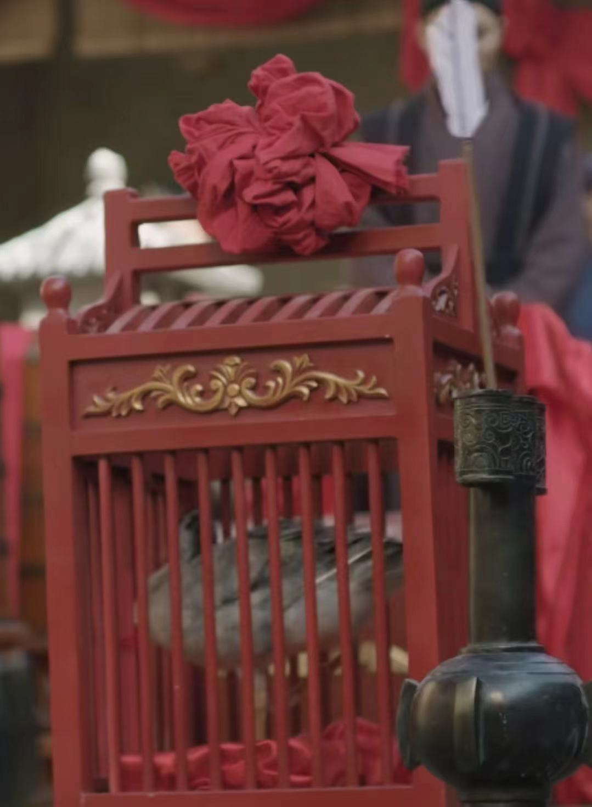

Betrothal Goose （聘雁）
“The wild goose represented chastity and auspiciousness, symbolizing a lifelong partnership.”
—— The Book of Rites – Meaning of Marriage 《礼记·昏义》

Slide 5

Six Etiquettes （六礼）
proposal（纳采）: A proposal to the girl proposed by a matchmaker on behalf of the.
inquiry（问名）: The couple exchange name and birth date.
betrothal（纳吉）: The two check if their horoscopes are compatible.
offering gifts（纳征）: The boy’s family send formal engagement gifts to the girl’s family.
setting a date（请期）: The families select an auspicious date for the wedding ceremony.
fetching the bride（亲迎）: On the wedding day, the groom goes to the bride's home to pick her up and bring her to his home.
proposal（纳采）: A proposal to the girl proposed by a matchmaker on behalf of the.
inquiry（问名）: The couple exchange name and birth date.
betrothal（纳吉）: The two check if their horoscopes are compatible.
offering gifts（纳征）: The boy’s family send formal engagement gifts to the girl’s family.
setting a date（请期）: The families select an auspicious date for the wedding ceremony.
fetching the bride（亲迎）: On the wedding day, the groom goes to the bride's home to pick her up and bring her to his home.

Slide 6
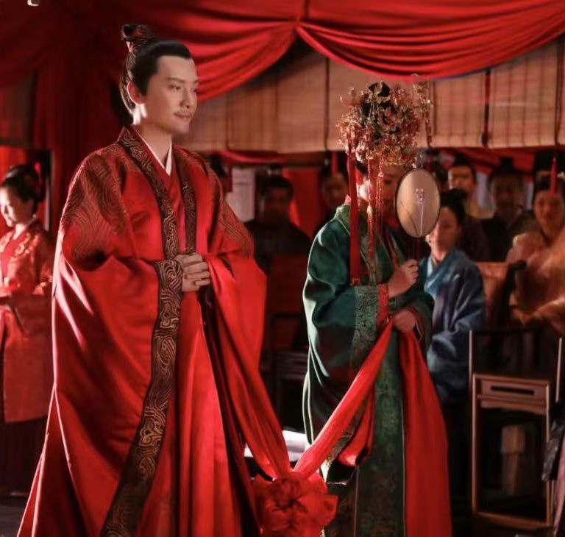
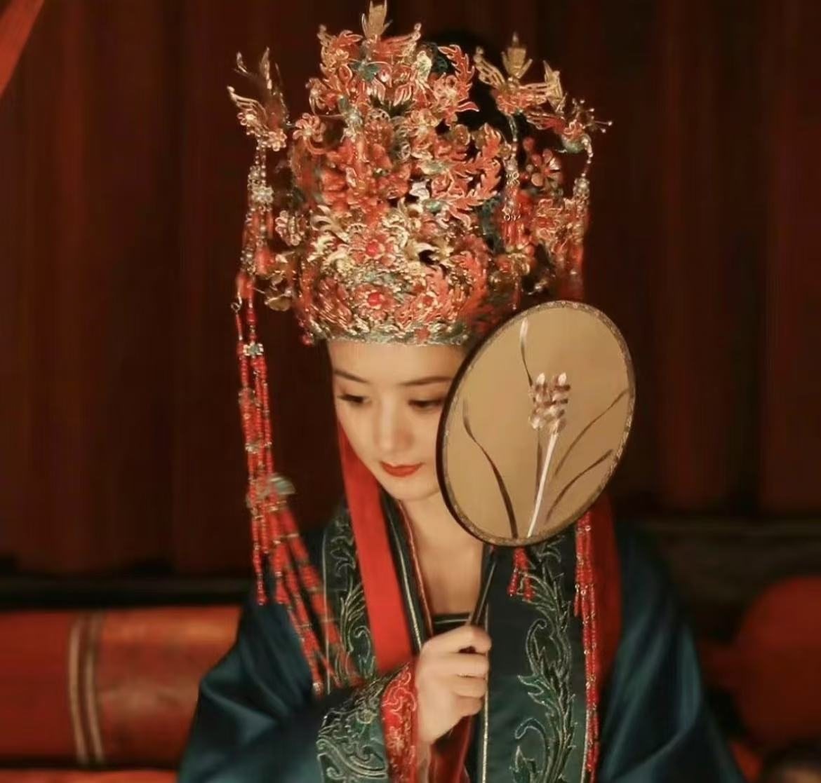
veil-lifting ceremony （却扇礼）
Origination: the Jin Dynasty
Gesture: use a fan to shield her face
Purpose: maintain modesty
Cultural significance: fan symbolizes reunion and happiness in Chinese
Resemblance: the modern custom of brides holding bouquets

Slide 7

贰
Tea
Culture
PART TWO

Slide 8
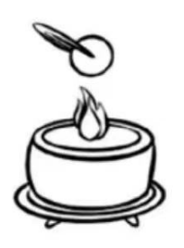
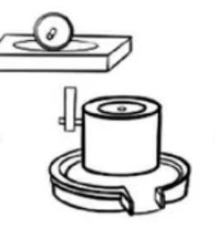
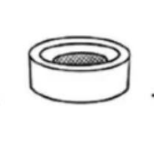
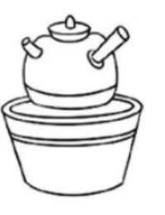
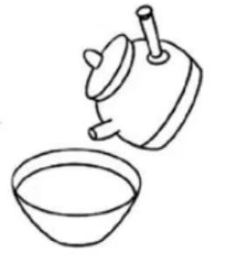
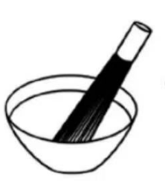
Tea Whisking / Diancha (点茶)
procedures:
step2
step4
step6
roasting 炙茶
Place the tea cake over a gentle fire and roast it to make the tea cake drier.
sieving 罗茶
Sift out the impurities in the tea powder with a tea sieve to make it finer.
warming the cup 烘盏
Warm up the tea cup with hot water to help the tea foam stay better.
grinding 碾茶
Grind the tea cake into a powdery state.
preparing the water 候汤
Boil the water.
whisking the tea 击沸
Pour the hot water into the tea cup while stirring it.
step1
step3
step5

Slide 9
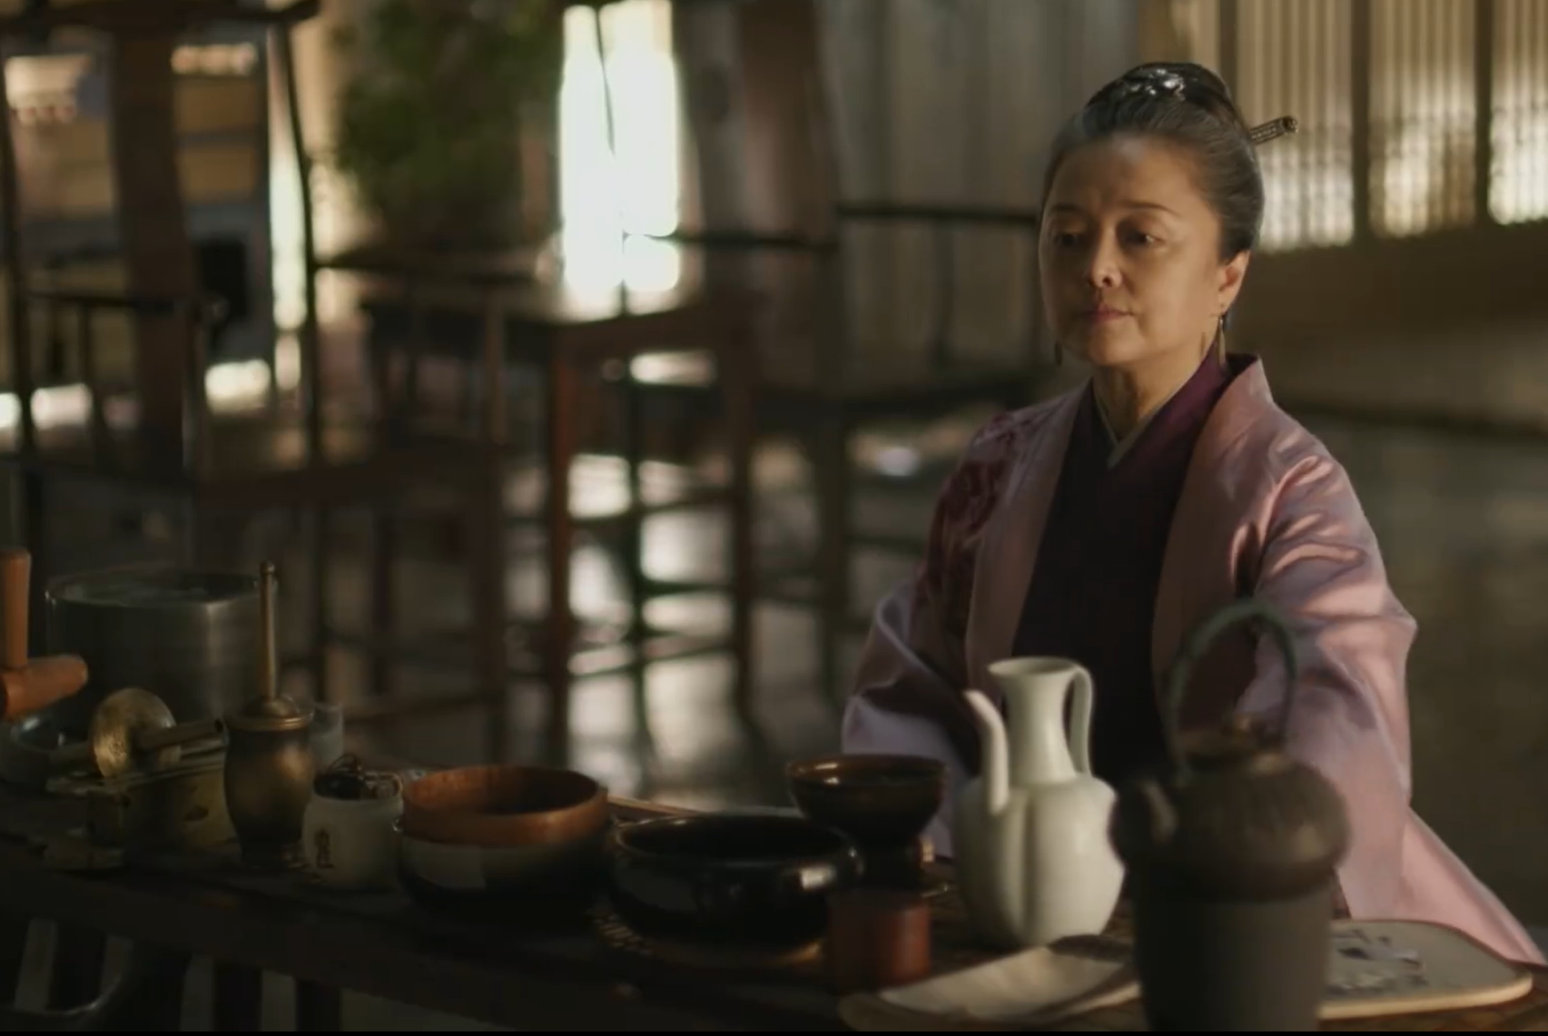
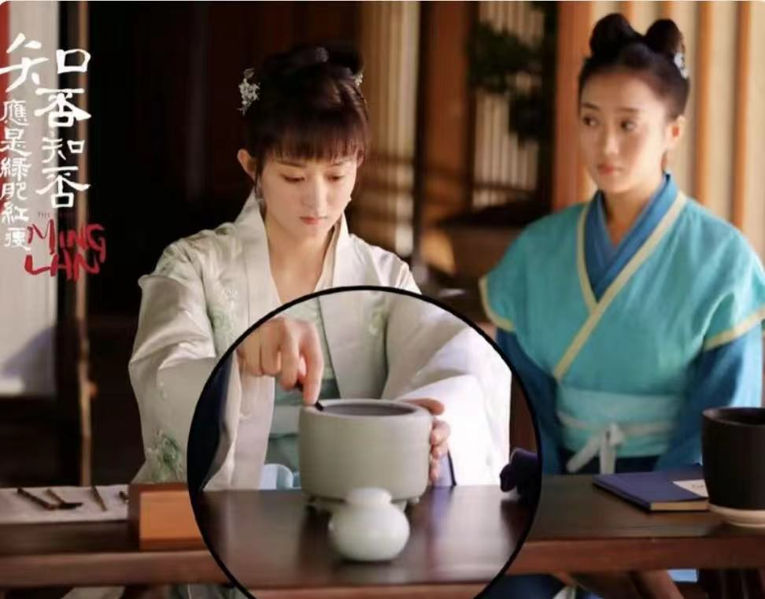
Tea Whisking
Purposes:
create a rich and fine foam on the surface of the tea.
Cultural significance:
Aesthetic Appreciation in Tea Patterns:
Skilled tea masters could create various patterns on the surface of the tea foam, such as flowers, and birds, just like painting on the tea.
A social bonding activity:
In ancient Chinese interactions, offering a tea to guests symbolized hospitality and respect.

Slide 10
叁
Polo
PART THREE

Slide 11

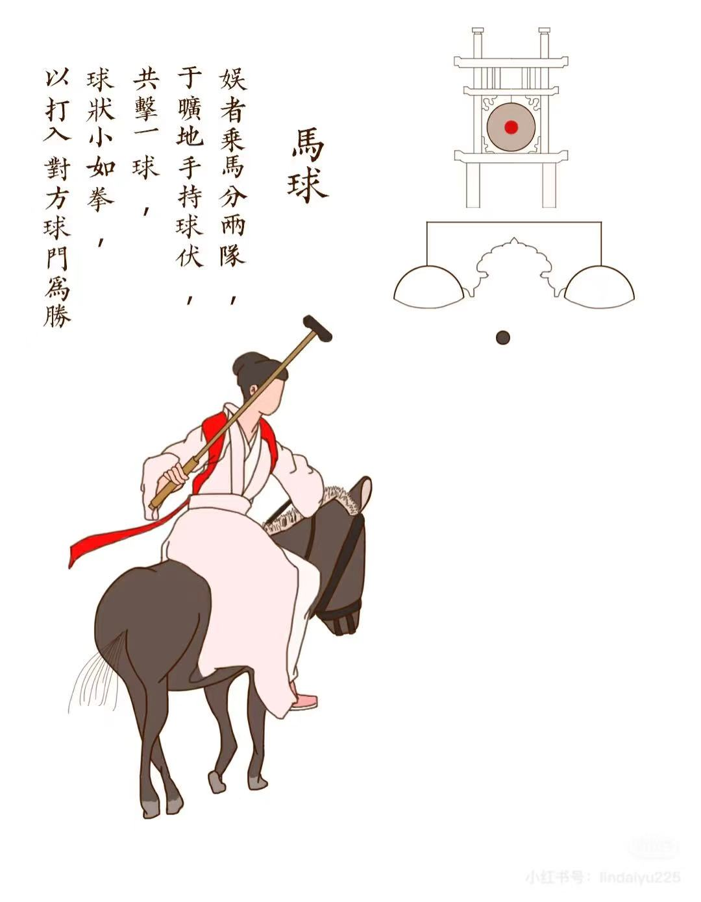
Polo (马球)
Size: about the size of an adult’s fist
Material: wood or leather
Rules:
players are divided into two teams, with no fixed number per team.
players wear different uniforms for easy identification.
a single - goal match is won by getting the ball into the net, and a double - goal match is won by scoring in the opponent’s net.

Slide 12
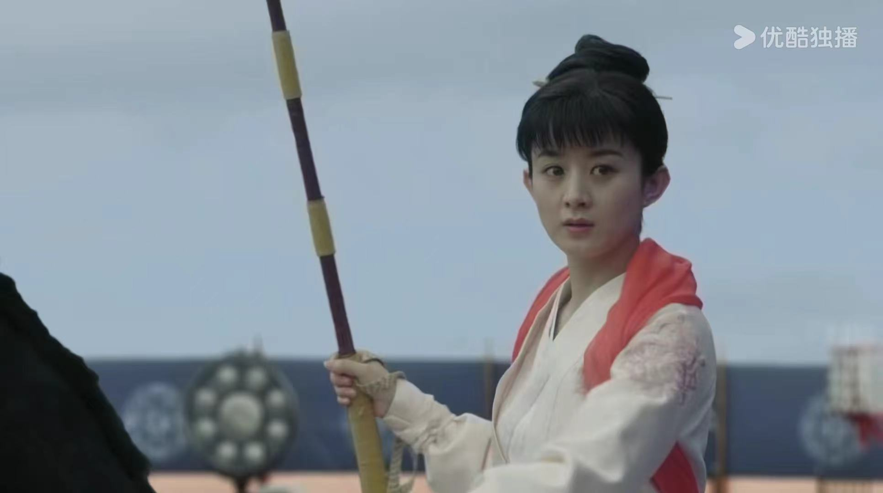
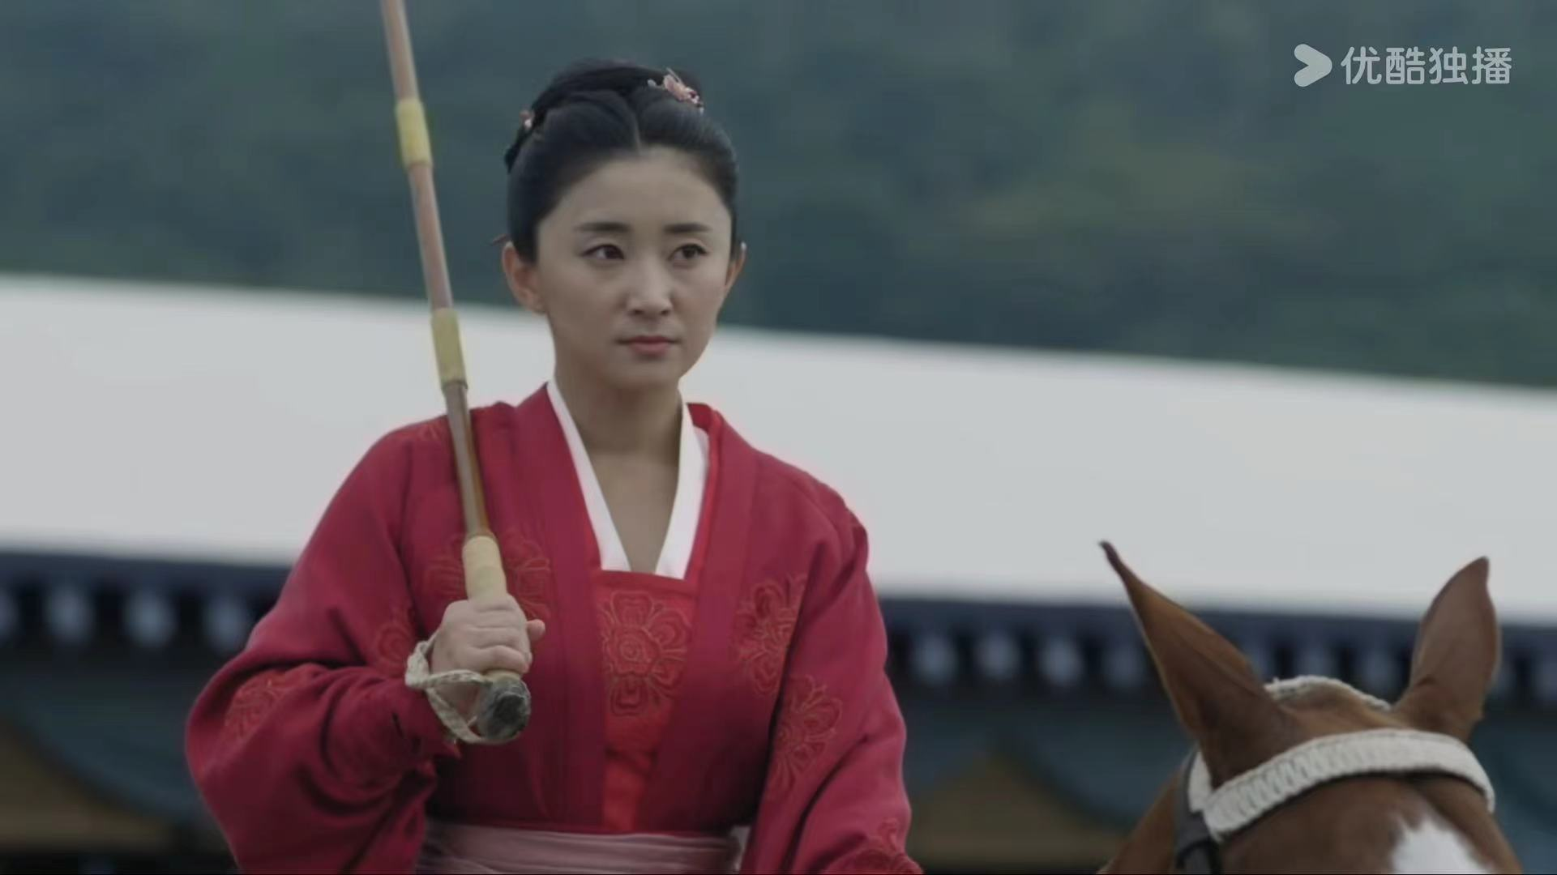
Women’s Polo
Emperor Huizong established a royal women's polo team, and they would perform for the public during festivals.
The sport later became a tradition for the royal women's polo team to hold an annual spring performance at the Jinming Pool.
The royal women's polo match was one of the most exciting events.

Slide 13
知否知否，
应是绿肥红瘦
Thanks!

