Slide 1
Chinese Philosophy, Religion and Beliefs

Slide 2
Contention of the Hundred Schools
During the Spring and Autumn Warring States Periods reforms arose and along with it, Scholars.
During the Spring and Autumn Warring States Period reforms arose, and along with it Scholars and their varying thoughts.
Many of these Scholars include: Confucius, Mencius, Laozi, Zhuangzi, Sunzi, Mozi, and Han Feizi.

Slide 3
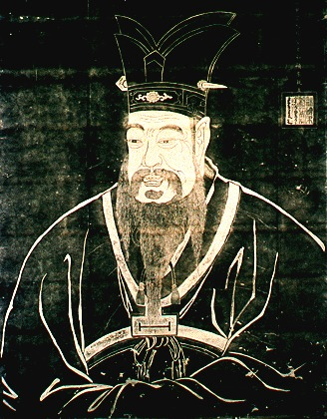
Confucianism
Although Confucius grew up in poverty he received a good education. Because of this Confucius emphasized the importance of education for all types of people from all classes. While alive, the ideas of Confucius were disregarded and not considered a religion. It is only after he died that his beliefs gained fame in China and was adopted by many people.

Slide 4
Legalism
Han Feizi grew up in the state of Han and was sent to the Qin state on a mission to advocate his philosophical beliefs. While there the Qin utilized his beliefs until Han Feizi was forced to take poison and murdered by his rival, Li Si.
Han Feizi advocated the form of power and the need for laws to exercise control. He stated ways that a political leader could maintain control of the government and in turn ultimate authority.
He advocated that punishments for disobedience must be harsh. If the punishments were not harsh then disobedience would only be encouraged.

Slide 5
Mohism was opposed to the teachings of Confucius and Taoism. Mohist beliefs were popular until the Legalist Qin Dynasty came into power. Many of the Mohist classics were ruined when Qin Shi Huang carried out the burning of books and elimination of scholars.
Mohism
Mozi was the founder of the Mohist school. He felt that war was the worst thing that only led to hurt and pain. He taught that love should be all embracing and people should love others as they love themselves.
The Mohist School was one of the main schools of thought during the Spring and Autumn Warring States Period.

Slide 6
Religions

Slide 7
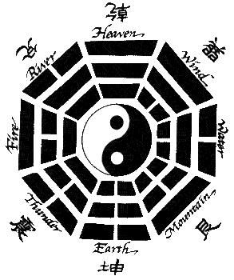
Taoism
Taoism was founded during the eastern Han period.
Tao means path or principle and Taoists believe that the only way to reach Tao is to live a life free from desires.
Laozi was the founder of Taoism. He wrote, “The Classic of the Virtue of the Tao” it is the Taoist scripture.

Slide 8
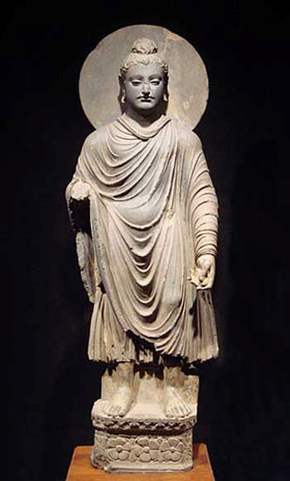
Buddhism
Buddhism was introduced into China by an Indian monk, Bodhidharma. Was Buddhism was introduced into China it began to gain Chinese elements such as Zen Buddhism.

Slide 9
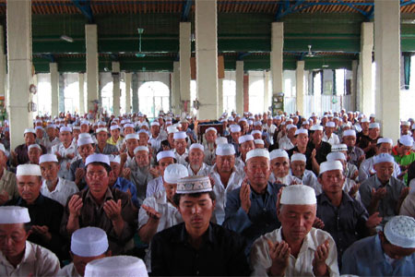
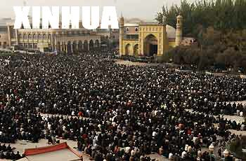
Islam
Islam was founded by Muhammad and spread to China from Arab during the Tang Dynasty.
Minority groups in China are Muslim.

Slide 10
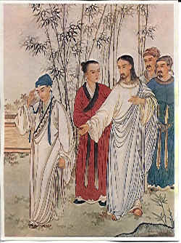
Christianity
Christianity was introduced to China during the early Tang Dynasty but did not gain influence until the Ming and Qing Dynasties when Christian missionaries from the west combined the faith with western culture and science.

Slide 11

Worships
Ancestral worship
Deity worship
The Chinese hold their ancestors in high regard. They view their ancestors that have passed away as their guardians.
The Chinese like the Greeks have their own deities that they worship for specific causes of things.
Every seventh day of the seventh lunar month the Chinese celebrate their own version of Valentines day. This story involves the seventh daughter of the Emperor of heaven and an orphaned farm boy falling in love and meeting once a year.

