Slide 1
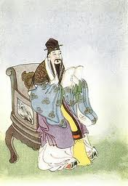
Meng Ke
Mencius
Reinventing
Confucian Tradition

Slide 2
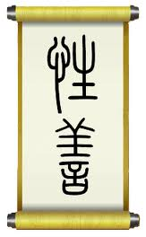
I lived in the 4th century b.c.e.
I studied with Confucius’s grandson
Warring States period was getting bad

Slide 3
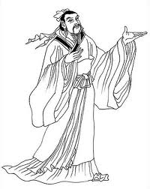
I traveled to states to talk to rulers
The Mencius is a record of my conversations with these rulers
Ren & Yi = Humaneness & rightness

Slide 4
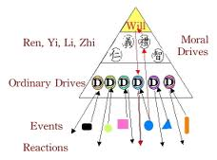

Slide 5
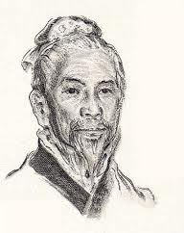
I taught that the Sage kings ruled through the Mandate of Heaven
Signaled by the willingness of the people to follow them

