Slide 1
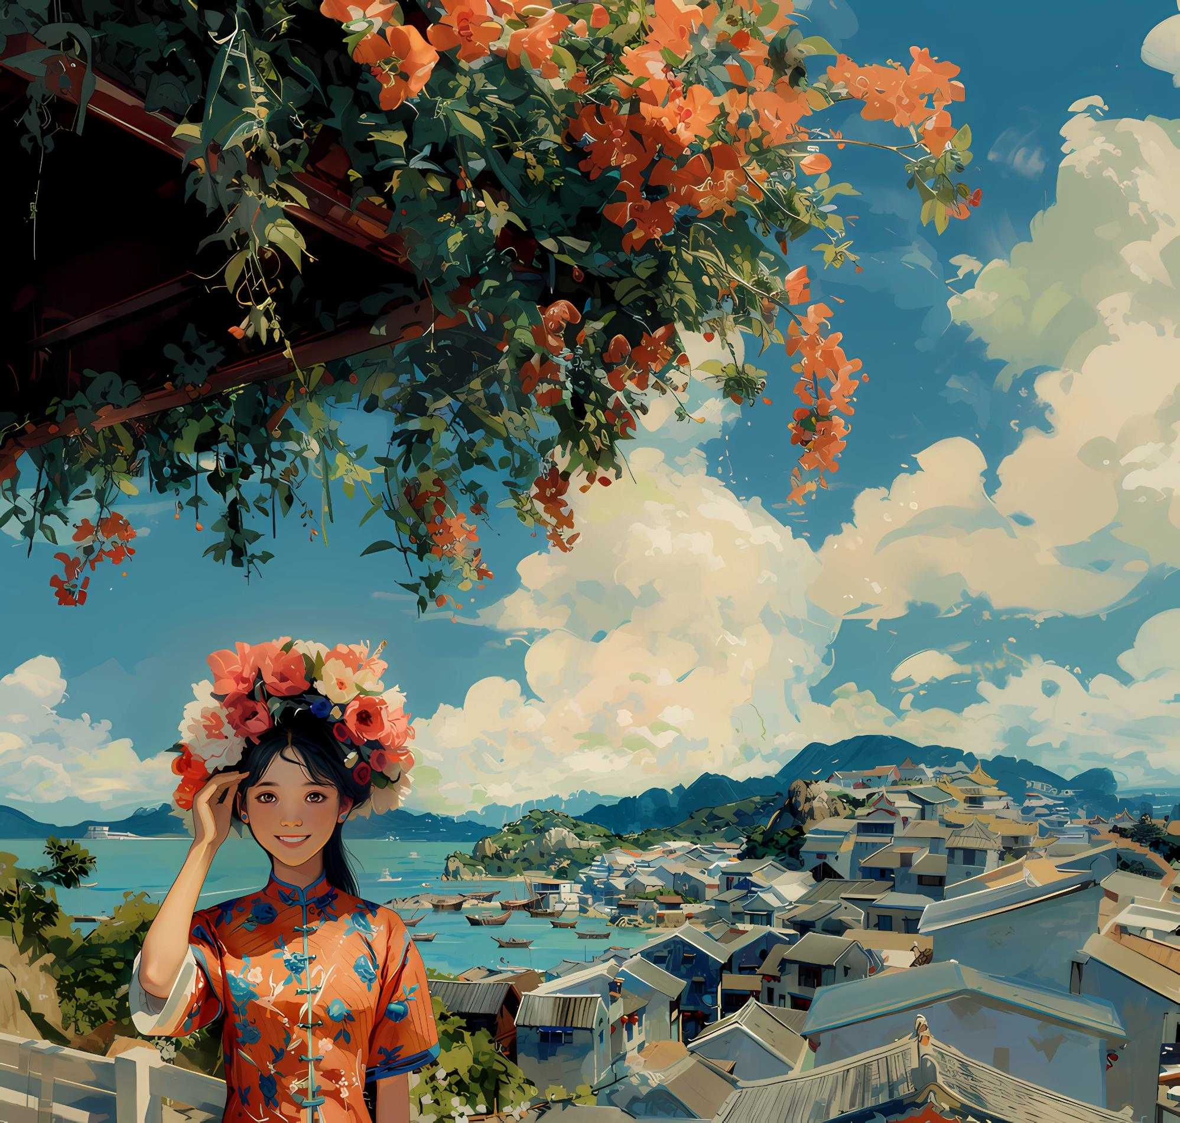

xun pu
Zan Hua Wei
蟳埔女
簪
花
围
Rediscovering Tradition
Speaker: 23英语笔译谢可

Slide 2

Table of Contents
壹
贰
叁
Introduction to Zan Hua Wei
Description and Components
Significance of Zan Hua Wei
Zan Hua Wei
肆
The Role of College Students
簪
花
围

Slide 3

Part I
Introduction to Zan Hua Wei

Slide 4
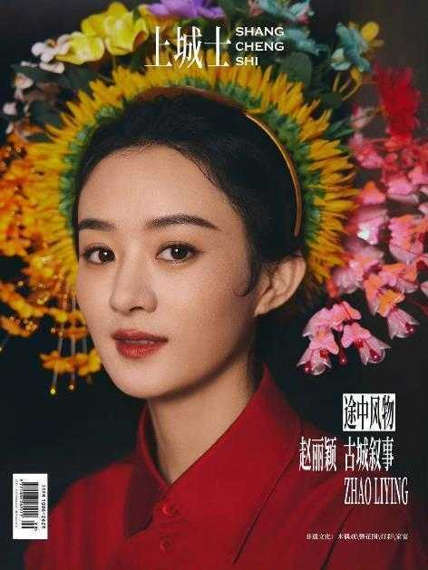

Part I
Introduction to Zan Hua Wei
origin: village of Xun Pu(Quanzhou, Fujian Province)
a fashion accessory and a cultural emblem
tradition and elegance
resurgence in popularity
influence of Zhao Liying
through magazine covers and social media
sparking renewed interest in traditional Chinese culture

Slide 5
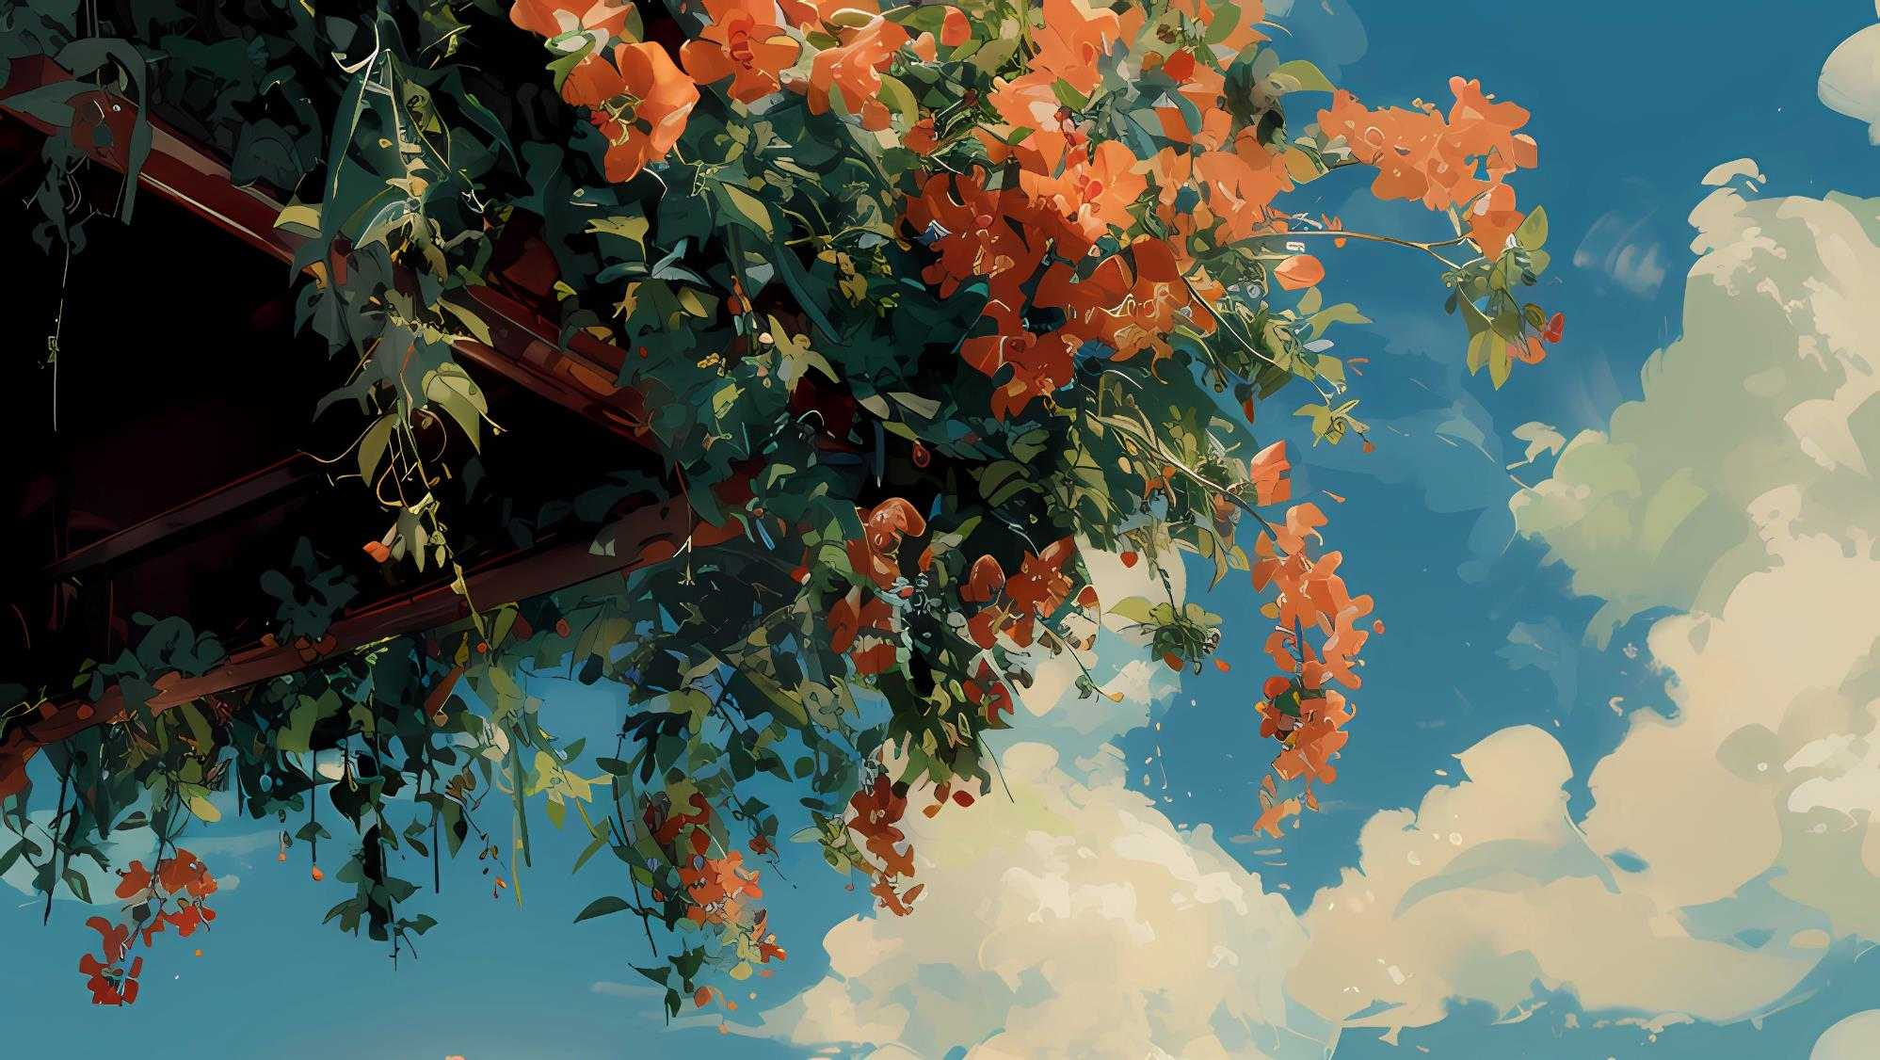
Part II
Description and Components of Zan Hua Wei

Slide 6
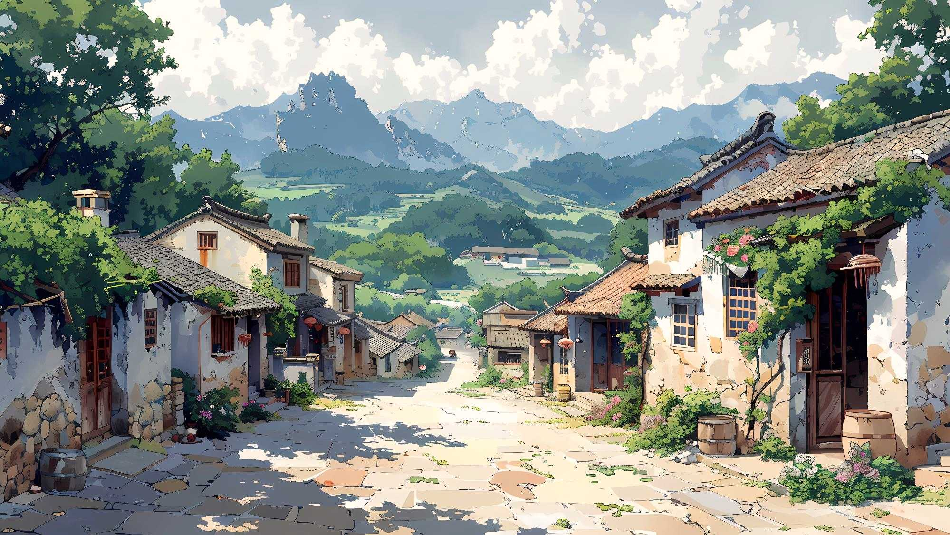
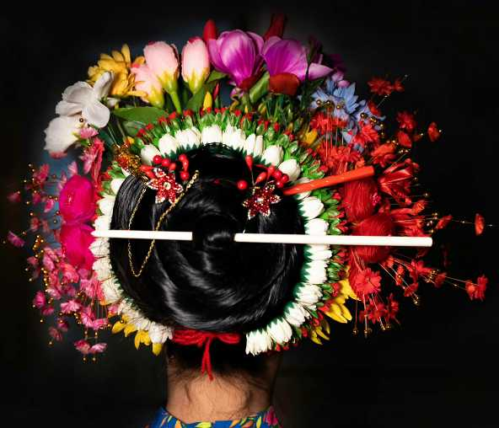
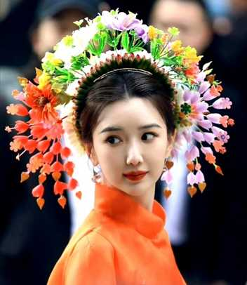
Part II
Description and Components
a floral crown
crafted hairpins(ivory or fishbones)
Flowers: prosperity, happiness, changing seasons
Hairpins: craftsmanship and spirit in traditional Chinese artistry
a visual representation of tradition, beauty, and cultural identity

Slide 7
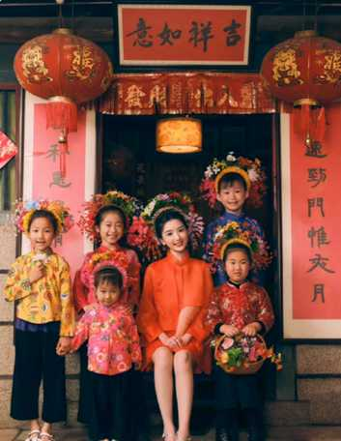

Part III
a floral crown
crafted hairpins(ivory or fishbones)
Flowers: prosperity, happiness, changing seasons
Hairpins: craftsmanship and spirit in traditional Chinese artistry
a visual representation of tradition, beauty, and cultural identity
Significance of Zan Hua Wei

Slide 8
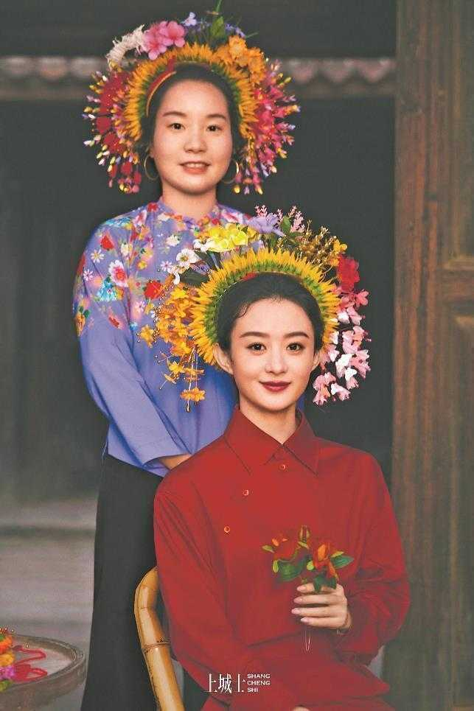
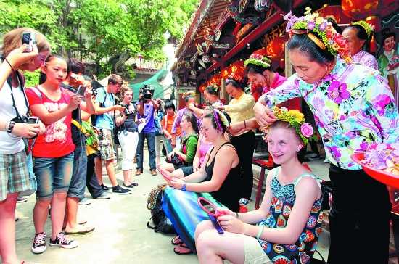
叁
Part III
Significance
Symbolism:
fashion accessory, cultural and historical importance
symbolizing beauty, tradition
the spirit of the Chinese people
Traditional Chinese attire:
signify women’s cultural heritage and social status

Slide 9
Part III
Significance
Country's rich cultural legacy:
In 2008, officially recognized as a national intangible cultural heritage of China
中国的国家级非物质文化遗产
Economy:
a positive impact on local economies(artisans craft)

Slide 10
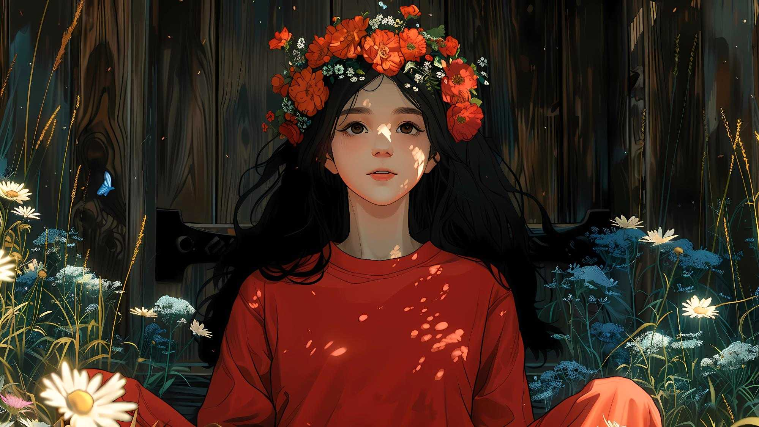
Part IV
The Role of College Students

Slide 11
We can:
Part IV
preserving and promoting traditions :
participating in cultural events and workshops
use platforms to amplify the voices of artisans and communities
honor heritage and ensure cultural treasures to thrive

Slide 12

Conclusion
Zan Hua Wei embodies the timeless elegance and rich heritage of Chinese civilization. Thus, each of us has a role to play in safeguarding our heritage for future generations.

Slide 13
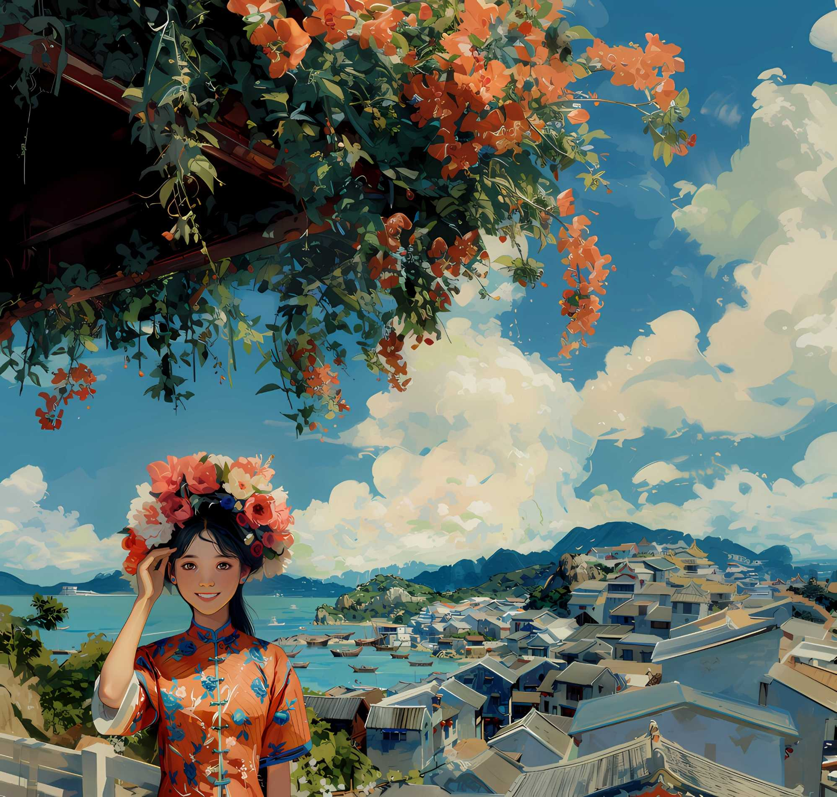
Thank You
xun pu
蟳埔女

